Slide 1

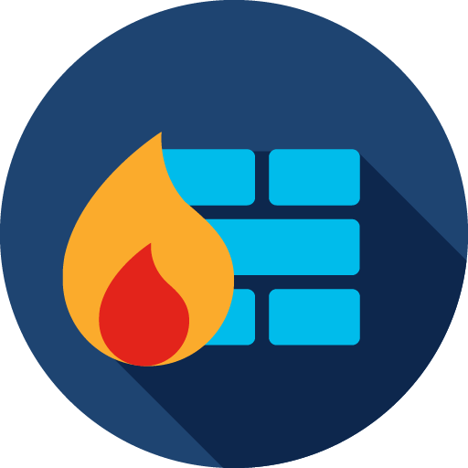


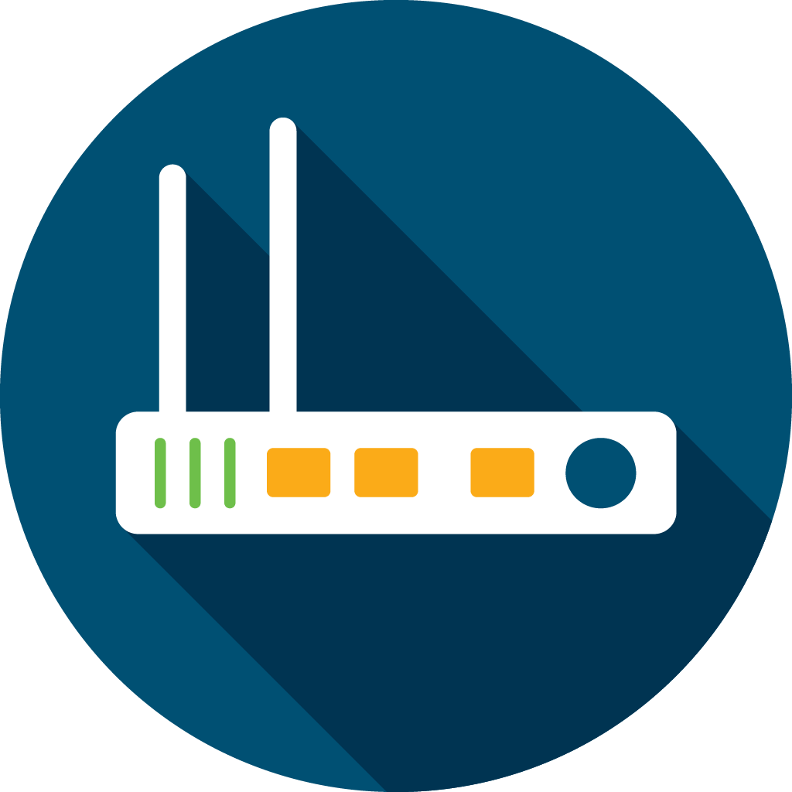
Work from Home
Customer Offers
Cisco Threat Defense Solution
Webex Work
Webex Meetings Free Trial

Slide 2
Work from Home
Solutions

Slide 3



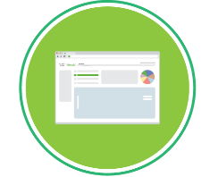

Work from Home
Webex Work
Cisco Duo
Webex Teams
Webex Calling
Cisco AnyConnect
Webex Meetings
Cisco Umbrella
Cisco AMP for Endpoints
Video
Endpoints
Home
Office
Branch/HQ
Mobile
Laptop
Shared global threat intelligence
Simple, smart collaboration from anywhere
Secure cloud-managed networking
100% cloud-delivered; no on-site IT required

Slide 4



How Hard Is It to Get Set Up?
You don’t have to be a technology expert to get set up with remote work.
Even if you don’t have a large (or any) IT team, you can do it. But you need tools that:
  Work together well
  Are easy to use and simple to maintain
  Don’t get in the way of employee productivity

Slide 5
Collaborate Easily and
Securely

Slide 6
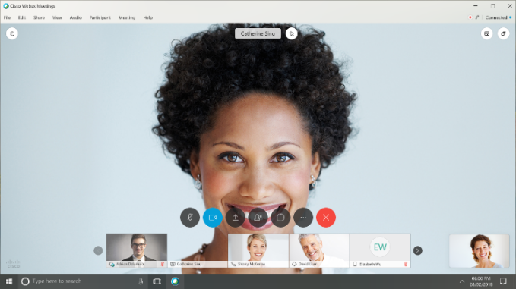
Make Sure Your Videoconferences Are Secure
Video conferencing makes communication easy, but it needs to be:
  Secure with built-in encryption to protect the privacy of both the data in use and in transit
  Easy to use with one-click sign-on, high-quality video, and simple screen sharing
  Flexible so you can participate from browsers, mobile, or video room devices—even third-party devices

Slide 7
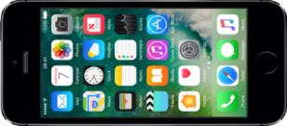
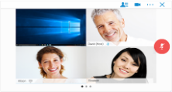
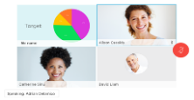
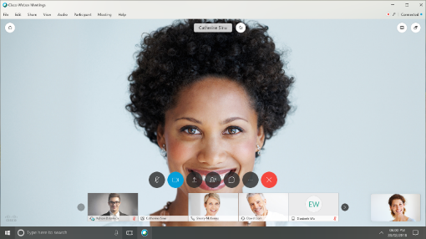
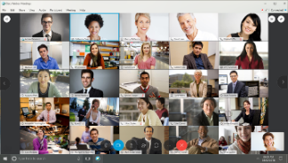
Cisco Webex Meetings
The #1 Web conferencing platform in the world
Easy to use
Strong security and privacy
Video-first experience
Anyone can join from any device
Easily share content
Record meetings
Integrates with your apps
Notes:
The Webex Meetings dashboard has been updated and modernized to provide a single view of your Webex Meeting capabilities.
Optimized join flow to start your meetings (from the desktop or browser)
A handy list for all your upcoming meetings
Ability to schedule meetings from the dashboard
Option to enter a meeting number or Personal Room id
Quick links to most recently used Personal Rooms
A recordings and playback library

Slide 8

Encourage Team Collaboration
Make it easy for team members to stay on the same page using a virtual workspace that allows users to:
Securely exchange messages and files across devices
Easily search the space to find conversations and documents
Privately message one person or create a group chat in seconds
Easily brainstorm with a digital whiteboard
Integrate with meetings to keep the collaboration going

Slide 9
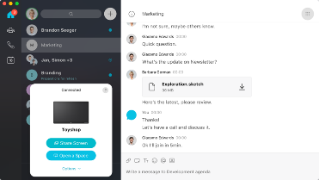
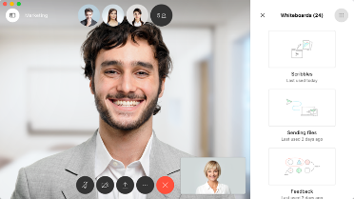
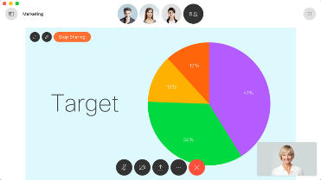
Cisco Webex Teams
Make your team more productive
Discussions and file sharing before, during, and after meetings
Team communication and collaboration: individual and team messaging, secure file sharing, video calling
  Integrated with WebEx Calling, meeting, and video services
Easy access to messages and content at any time
Democratized in-meeting content sharing and meeting control
Notes:
The next big thing is context. What we mean by that is having all your teams work available on hand in the meeting and having the ability to ‘meet’ before the meeting.
Before the meeting work can start - Webex Teams provides the space for the team to discuss things, share content - start working.
And when you get the the time of the meeting things have already started and all that discussion and work is available right there in the meeting.
You can simply share content from any device in the meeting - directly from the space, another, or from your desktop or mobile device - it really is that simple, wireless and fast! (unlike: having to go find content, find a lead to connect to the video system if in a room, or even email to all participants)
And it doesn’t stop there. The moment the meeting finishes, the work doesn’t - the team is still connected and can carry on, keep productive, check in on items discussed, provide updates and status reports - and all this is all available in the next meeting…
An added benefit of joining a meeting through Webex Teams is that during the meeting everyone is an equal participant and so can mange the meeting - mute noisy participants, record… without having to disrupt the flow of the meeting so keeping the productivity going
Slide Transition
Now let’s let’s look at the meeting experience through the lens of creativity…

Slide 10

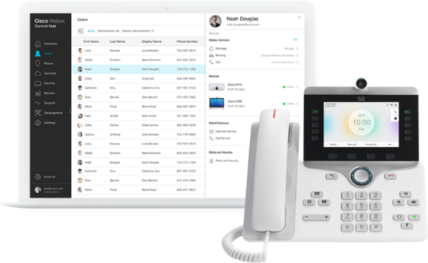
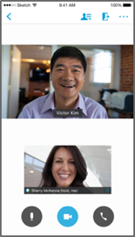
Cisco Webex Calling
Calling that works for today’s collaboration needs
  Your secure phone system in the cloud
  Full-featured Private Branch Exchange (PBX), voice messaging, and contact center
  Simple cloud management
  Strong security and encryption
  Supports Cisco phone handsets and video endpoints
  Integrates with WebEx Meetings and Teams
Notes:
The next big thing is context. What we mean by that is having all your teams work available on hand in the meeting and having the ability to ‘meet’ before the meeting.
Before the meeting work can start - Webex Teams provides the space for the team to discuss things, share content - start working.
And when you get the the time of the meeting things have already started and all that discussion and work is available right there in the meeting.
You can simply share content from any device in the meeting - directly from the space, another, or from your desktop or mobile device - it really is that simple, wireless and fast! (unlike: having to go find content, find a lead to connect to the video system if in a room, or even email to all participants)
And it doesn’t stop there. The moment the meeting finishes, the work doesn’t - the team is still connected and can carry on, keep productive, check in on items discussed, provide updates and status reports - and all this is all available in the next meeting…
An added benefit of joining a meeting through Webex Teams is that during the meeting everyone is an equal participant and so can mange the meeting - mute noisy participants, record… without having to disrupt the flow of the meeting so keeping the productivity going
Slide Transition
Now let’s let’s look at the meeting experience through the lens of creativity…

Slide 11
Don’t Skimp on
Security

Slide 12
Keep Your Workplace Safe
You can’t afford to overlook security when setting up remote workspaces. Look for security solutions that:
  Provide secure network access no matter what device people are using
  Protect your sensitive data by verifying the identity of users, devices, and applications
  Defend against threats with cloud-delivered security
  Detect and block cyberattacks
4,000
43%
62%
Daily
attacks
Target small business
Reported breaches
https://enterprise.verizon.com/resources/reports/dbir/
Notes:
The Last Two Years
4,000 attacks launched per day
43% targeted SMBs
62% of reported Breaches in SMB space
https://enterprise.verizon.com/resources/reports/dbir/

Slide 13




Secure Remote Worker Solution
Connectivity
Security
Cisco AnyConnect/VPN
Cisco Umbrella
Cisco Duo
AMP for Endpoints
Notes:
Cisco is addressing the immediate impact of increased remote workers by extending the free usage for:​
AnyConnect Mobility Client empower employees to work from anywhere, on company laptops or personal mobile devices via Virtual Private Networking (VPN).​
Duo Access provides two-factor authentication to protect your applications and data, including the VPN connection. ​
Umbrella DNS Advanced protects users working these company or personal devices whether they are on or off the VPN​
If you have other immediate needs, please work with your Cisco sales rep on what is available.

Slide 14

CISCO
Global Threat Research and Intelligence
1%
120 TB
of Data Received Daily
threats that
matter
MILLIONS
of Telemetry Agents
Automated
Analysis
Specialized Tools
BILLIONS
of Malware, Email, DNS, Web, IPS, and Flow Metadata
250+
Full Time Threat
Intel Researchers
OVER 100
Threat Intelligence Partners
Notes:
In order to reduce the threats you face, you need the best threat intelligence. Cisco Talos is the largest threat detection network in the world, monitoring 35% of global email traffic, including 600 billion email messages and 1.5 million malware samples daily.
Talos is a recognized leader in threat detection as validated by NSS Labs. With over 250 highly skilled malware reverse engineers, threat analysts, and zero-day vulnerability research engineers, Talos catches threats that traditional security infrastructure and analysis systems can’t.
Talos has unique insight into email-based threats due to SenderBase reputation filtering. Our diverse customer base allows us to address and identify threats with unparalleled speed and agility. Each day we inspect billions of emails; drawing on layered detection technologies we’re going to talk about today. Talos blocks 200 billion malicious emails a day, or 2.3 million blocks per second.
With Talos, you’re able to see more anomalies, network intrusions and threats because Cisco delivers a 24/7 view into global traffic activity and keeps you up-to-date with the latest intelligence every 3-5 minutes. No other company can offer this comprehensive intelligence.
Live map of threats today: Malware = http://beta.senderbase.org/ebc_malware/. Email Spam = http://beta.senderbase.org/ebc_spam/.
Let's have a look at how Talos protects us…
-They start by gathering and analyzing telemetry from all the vectors on the left the bad guys seek to exploit.
-This allows us to develop a more complete picture of threats looking at billions of emails every day, a million malware samples, and so on. We connect elements from one area to another to correlate threats.
-Talos then uses automated analysis like artificial intelligence and machine learning to eliminate the majority of noise and threats.
-They then bring in a second layer of specialized tools…leaving only the 1% of advanced threats that matter for Talos researchers to address.
-The last part of the funnel is Talos researchers We have over 250 threat researchers around the world with expertise in hardware, malware analysis, vulnerability research, and more.
-All of this happens before any security alert gets to that SOC analyst. When something goes red, she knows it's for a reason.

Slide 15
Cisco Umbrella
Malware
C2 Callbacks
Phishing
Umbrella
First line
Network and endpoint
NGFW
    It all starts with DNS (domain name servers)
    Precedes file execution and IP connection
    Used by all devices
    Port agnostic
Netflow
Network and endpoint
Proxy
Endpoint
Sandbox
Router/UTM
AV
AV
AV
AV
AV
HQ
BRANCH
ROAMING
Notes:
Think about where you enforce security today.
Questions to pose: What do you use to protect your network? Your endpoints?
You probably have a range of products deployed at your corporate headquarters and branch offices, or on roaming laptops.
There are many ways that malware can get in, which is why it’s important to have multiple layers of security.
Umbrella + DNS:
Umbrella can be the first layer of defense against threats by preventing devices from connecting to malicious or likely malicious sites in the first place—which significantly reduces the chance of malware getting to your network or endpoints.
Umbrella uses DNS as one of the main mechanisms to get traffic to our cloud platform, and then use it to enforce security too.
DNS is a foundational component of how the internet works and is used by every device in the network.
Way before a malware file is downloaded or before an IP connection over any port or any protocol is even established, there’s a DNS request.
Umbrella stops callbacks to command-and-control (C2) servers, malware and phishing attacks
Let’s look now at the key features for Umbrella.

Slide 16

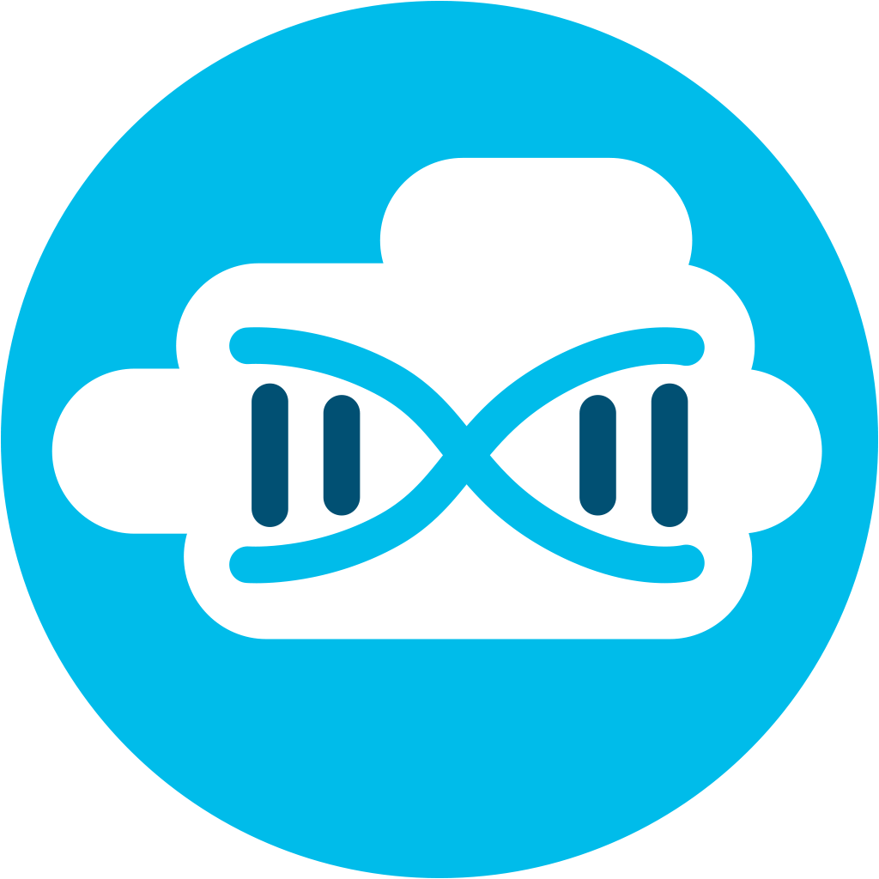
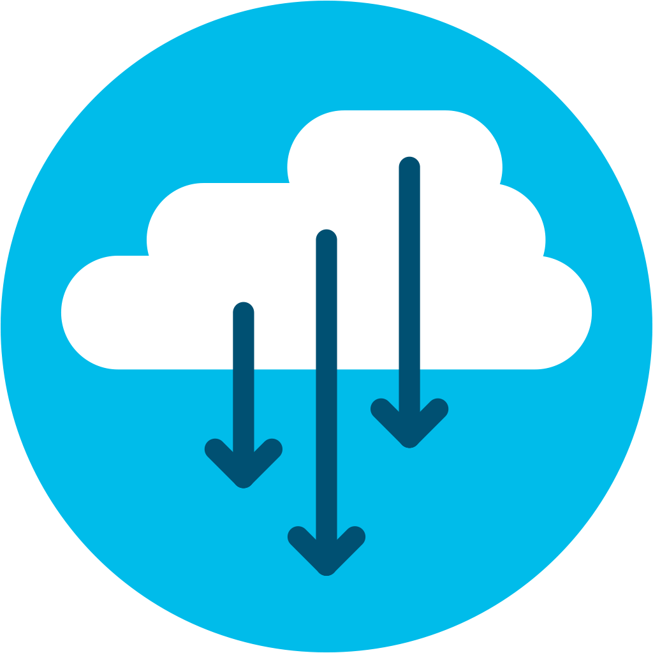

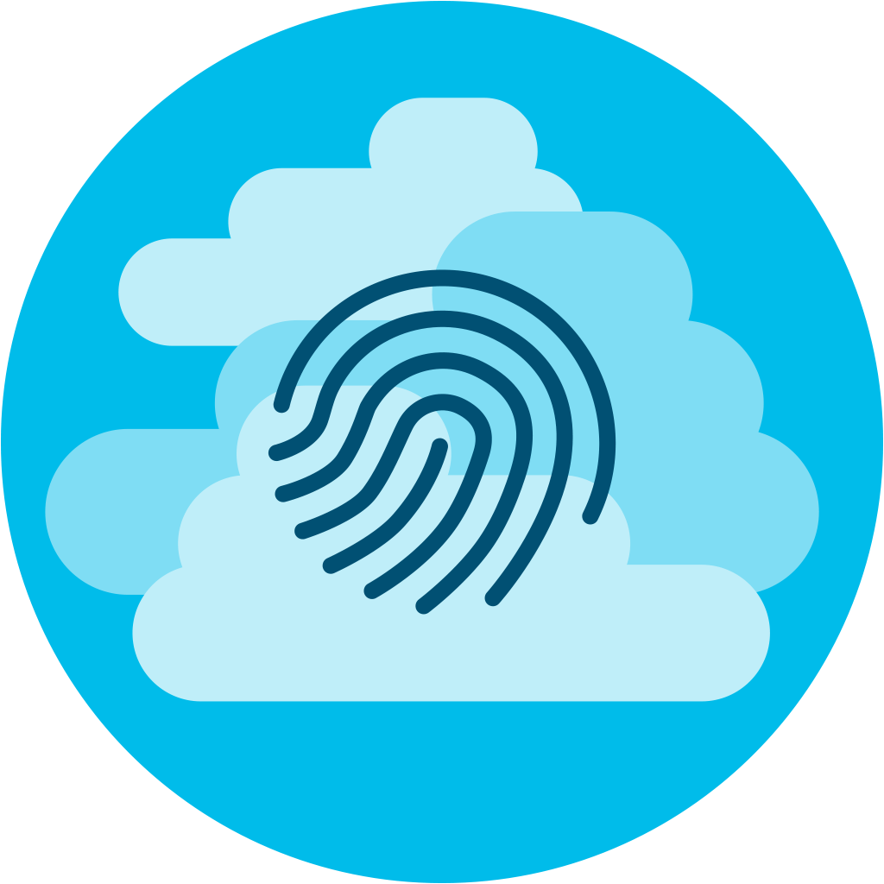
What Is Cisco AMP for Endpoints?
Next Gen endpoint firewall, Intrusion Prevention System (IPS), anti-virus and more
Cloud managed
Continuously monitors, records, analyzes all file activity
Protects Windows, Mac, Linux, and Android
Notes:
Very simply, AMP for Endpoints is a Next Gen Endpoints Security Solution that provides this visibility, context and control. It’s software as a service, cloud managed, deployed via a lightweight connector to protect endpoints running windows, mac, linux, and android

Slide 17
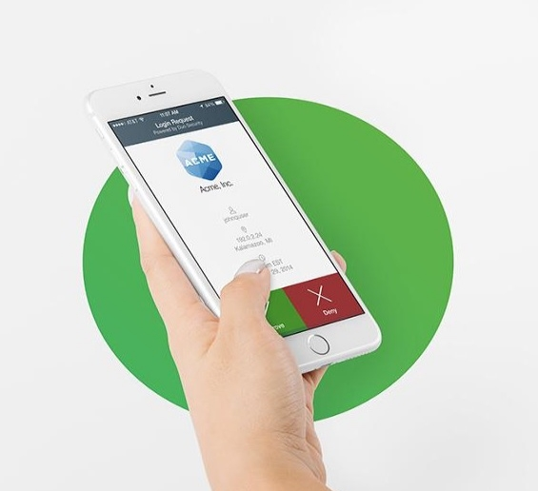
Secure Authentication
Cisco Duo
Instantly integrates with all apps
Users self-enroll in minutes
Users authenticate in seconds with no codes to enter
Notes:
Slide Objective (why to use the slide):
Duo has best-in-class MFA
Key Points:
Pioneers of Push technology for stronger security
Consistent workflow for all end-users is convenient and easy to use
Security focus - Out-of-band, context during authentication
Easy enrollment
Talking Points (how to use the slide):
Validating the user trust through an MFA solution
Duo Push is easy to use. Works on any smartphone. End-users simply tap a button to get access into applications
Duo provides a consistent workflow which is user friendly for authentication and easy to setup
End-users have a choice of authentication options when logging in
Show a simple login workflow with Duo Push - https://demo.duo.com/push
User can self-enroll their endpoints into Duo through different workflows to reduce the burden on IT admins
Most end-users enroll themselves in less than 5 minutes
Customer stories:
An IT admin called us from Stanford Health to share that he received a voicemail from a doctor, telling him that he liked using Duo (Duo Push for e-prescriptions) - this was the first time that a doctor ever thanked the IT admin for adding a new security solution.
Our customer Boston University was able to enroll 24000 students in less than 2 months

Slide 18
Connect Your Remote
Workforce

Slide 19
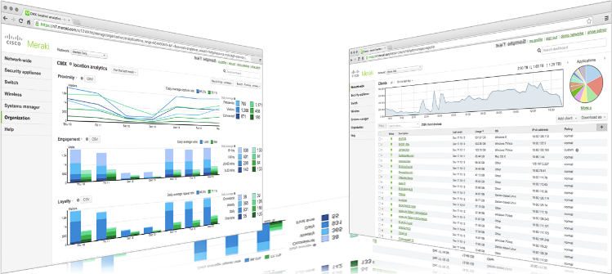
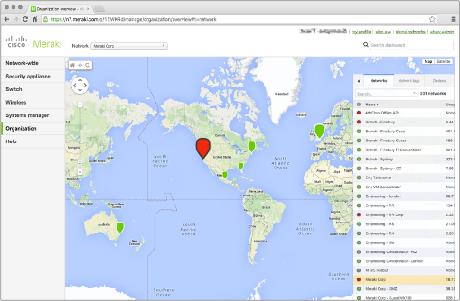
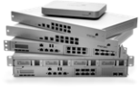




MR Wireless LAN
MS Ethernet Switches
MX Security Appliances
SM EMM
Meraki Insight
MV Video
Surveillance

Slide 20
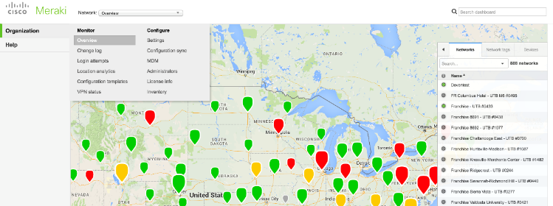
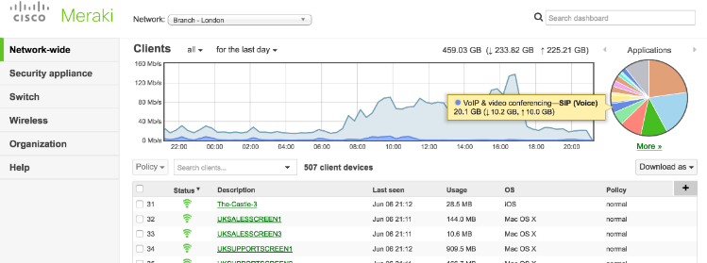
Simplifying IT with Cloud Management
A complete cloud-managed IT solution
Easy to deploy, manage, and support using the cloud
See all your employees, devices, and locations from one dashboard
Strong security with built-in unified threat management (UTM), device, network, and user security

Slide 21
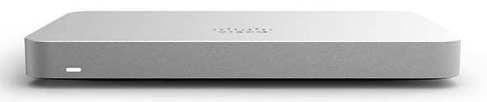

Cisco Meraki Teleworker Solution
Securely connect remote workers and devices
Remotely monitor, manage, and troubleshoot
Ensure security and productivity
Cloud Dashboard
Mobile Employees
Meraki Cloud
Management
Internet
Your Office
MR
Access Point
MX
Security VPN Appliance
Remote Worker

Slide 22
Customer Offers

Slide 23
New Office Customer Offers
Cisco Threat Defense Solution
Webex Work
Webex Meetings Free Trial
Notes:
tes

