Slide 1
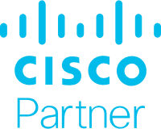
Why Your Business Deserves Cisco Security
October 6, 2020
Notes:
Why Cisco for Small Business?

Slide 2
Security designed to meet the needs of your business
End-to-end security to optimize your time and resources
Secure the network, cloud, and every endpoint
Protect customer, business, and financial data
Keep employees connected, protected, and productive
Protect users on and off the network
Security that grows with your business

Slide 3
Small businesses are hit by
62% of all cyberattacks.
Your business faces threats on many fronts, and the more users, devices, and applications you add, the more vulnerable your network becomes.
Keep your business secure by detecting threats earlier, faster and with more ease.
Your security experience simplified
Security that works as fast as you do
Security that grows with your business

Slide 4
Your security experience simplified
Is your security too complicated?
How many different security vendors are you managing today?
Cisco Security takes you from overwhelmed to empowered. Go from one or two people doing everything, to an integrated and open system that does the legwork for you:
Are any of your security products integrated?
Gain robust protection through quick and painless deployment, and use automatic, accurate alerts to save time.
You don’t have to be an expert in networking technology or advanced threat remediation. You’ll be leveraging tools that already come with advanced behavioral analytics, for total network visibility and fast breach detection.
Your employees will experience frictionless security. They will be able to access any application securely, no matter where they are, what device they’re using, or where the application is.
Can your firewall talk to the
rest of your security ecosystem?
If a cyber-attack was to occur, where would you start?

Slide 5
Security that works as fast as you do
Things happen quickly in small businesses, so Cisco designed their security to match. Cisco Security comes with an entrepreneurial mindset, just like you. Our powerful tools keep you safe as your business pursues what’s next. It’s Security that works as fast as you do.
Receive protection for previously unknown threats in under 10 minutes — the fastest time to remediation in the industry
Leverage the unrivaled intelligence from Cisco Talos
Separate critical incidents from the noise, so you can act on what’s important
Update policies and implement new capabilities with just a few clicks

Slide 6
Security that grows with your business
As your business grows and takes on new challenges, you won’t have to keep changing your security strategy every six months. Take full advantage of the resources and expertise that Cisco includes in their products, to take your business to new heights.
Manage risk more efficiently as you grow
Stay one step ahead with Talos threat intelligence that anticipates what’s next
Cisco regularly adds new capabilities and seamless integrations across their entire security portfolio
Invest with confidence in a platform designed for the long haul

Slide 7
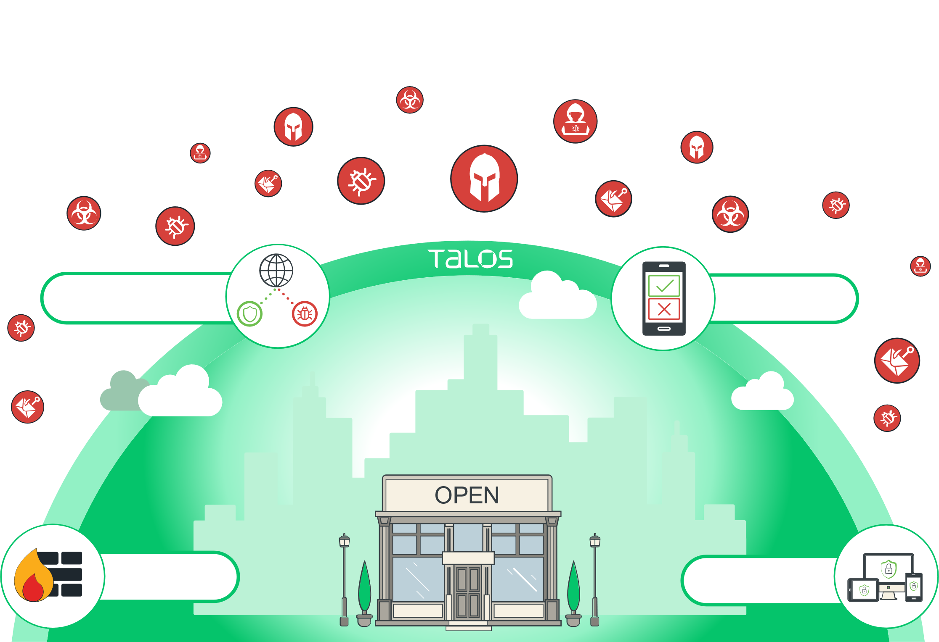
Security for your users wherever they are
Protect your passwords
Securing your network
Protecting your employees’ devices
Protect your business with the
strongest security team on the planet.

Slide 8
The Power of Simplicity
Reducing complexity can make all the difference when it comes to security. So Cisco’s goal is to simplify everything for you, leaving you free to embrace your innovation and accelerate your success. We know that things happen quickly in your world, that’s why we want to introduce you to security solutions that have a similar entrepreneurial and flexible mindset.
Cisco’s security solutions also act as a team. They learn from each other. They listen and respond as a coordinated unit. When that happens, security becomes more effective. Cisco’s combination of next gen firewalls, endpoint security, cloud security, and user authentication creates the foundation for a powerful, yet simple, security approach.
Network Security
Endpoint Security
Cloud Security
Multi-Factor Authentication
VPN
Meraki MX
Cisco Firepower 1000 Series
Cisco AMP for Endpoints
Cisco Umbrella
Cisco AnyConnect
Cisco Duo
Cisco Talos threat intelligence is embedded across the entire Cisco security portfolio.
The Talos Group is an elite team of security experts focused on providing superior cyber threat intelligence.

Slide 9
Securing your network
Why do you need a firewall?
Firewalls put up a barrier between your trusted internal network and untrusted outside networks, such as the Internet.
Cisco Meraki MX
If you prefer a completely cloud managed solution, Meraki MX can be remotely deployed in minutes and gives you complete control over the users, content, and applications on your network. Security settings are simple to synchronize, using templates.
Firewalls control access to your company's resources.
Cisco Firepower 1000 Series
Firewalls help prevent the loss of company data.
The 1000 series is a SMB focused Next Generation firewall. It provides enterprise-grade protection for small to medium sized offices and is flexible enough to protect your business while you grow. With Firepower 1000 you can get application visibility and control, a next-generation intrusion prevention system, advanced malware protection, and URL filtering. It’s easy to use and is designed not to impact network performance (unlike other firewalls which can slow your business down).
The best firewalls prevent disruption of business-critical applications and services due to security breaches.

Slide 10
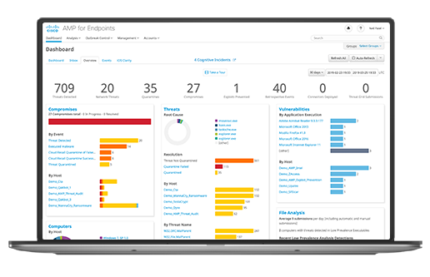
Protecting your employees’ devices
Why do you need endpoint security?
Cisco AMP for Endpoints
Laptops and mobiles are the most vulnerable endpoints for small businesses.
Cisco Advanced Malware Protection (AMP) for Endpoints prevents threats at the point of entry and then continuously tracks every file it allows onto your endpoints, such as mobile devices, laptops, desktop PCs, and more. This enables you to uncover the most advanced threats—including fileless malware and ransomware.
As malware becomes more evasive, traditional antivirus falls short in protecting your endpoints.
Prevent: Block known malware automatically leveraging the best global threat intelligence and enforce Zero Trust by blocking risky endpoints from gaining access to applications.
Detect: Run complex queries and advanced investigations across all endpoints, and continuously monitor all file activity to detect stealthy malware.
Respond: Rapidly contain the attack by isolating an infected endpoint and remediating malware across PCs, Macs, Linux, servers, and mobile devices (Android and iOS).
Endpoint security helps you to find the threat fast and see what it has affected.
Quickly stop threats from spreading and fast-track remediation.

Slide 11
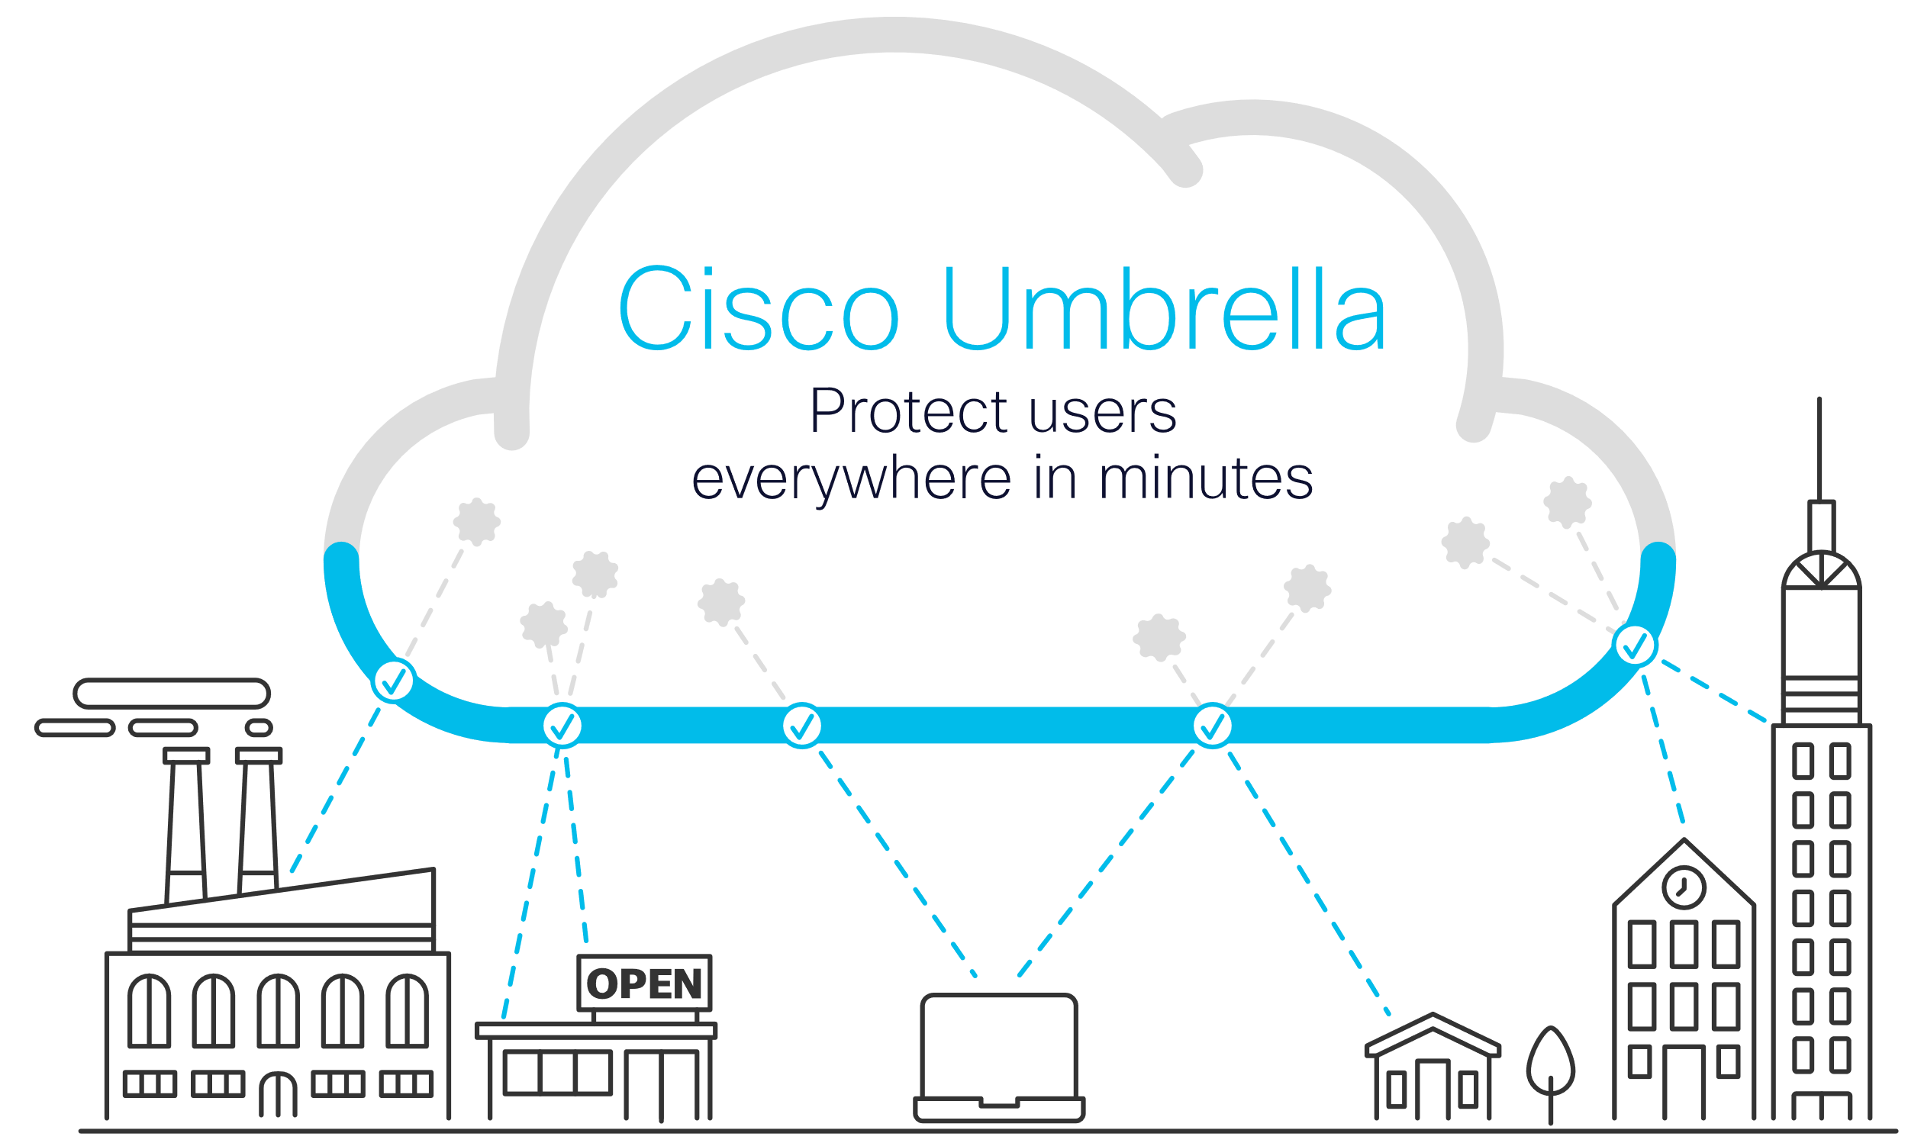
Security for your users wherever they are
Why do you need DNS-layer security?
Cisco Umbrella
By enforcing security at the DNS and IP layers, Umbrella blocks requests to malware, ransomware, phishing, and botnets before a connection is even established.
Your users work from many locations and devices. They no longer need the VPN to get work done — they use cloud applications, many of which have not been vetted by IT. What if you had a fast, easy way to protect users and enforce acceptable use policies?
Cisco Umbrella helps protect your users both on and off the network by blocking malicious Internet destinations before a connection is ever established.
And because Umbrella is delivered from the cloud, it is the easiest way to protect your users everywhere in minutes.
Monitoring DNS requests can be an easy way to reduce blind spots and provide better accuracy and detection of compromised systems, improving network protection.

Slide 12
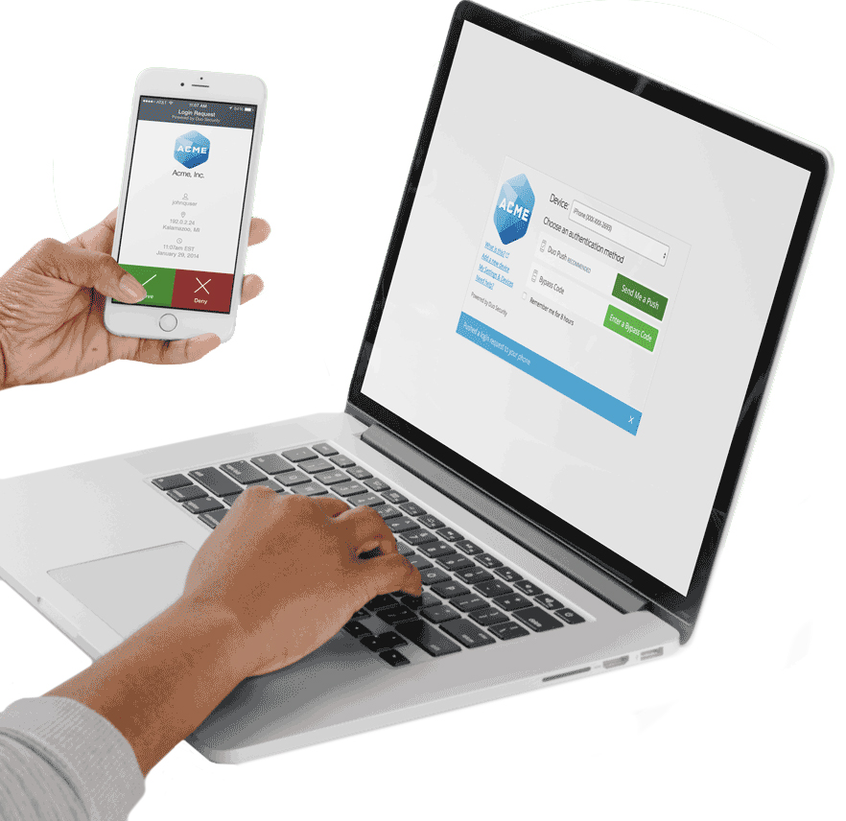
Get user & device trust
Why do you need Multi-Factor Authentication?
Cisco Duo
Cisco Duo verifies the identity of all users with strong two-factor authentication before granting access to your applications.
After verifying user identities, Duo checks that their devices meet your security standards - safeguarding against vulnerable or compromised endpoints.
Duo is engineered to provide a simple, streamlined login experience for every user and any application, and as a cloud-based solution, it integrates easily with your existing technology.
80% of security breaches involve compromised passwords.¹
Verify user identities in seconds.
Protect any application on any device.
Enforce secure access to your applications and data.
^{1.} 2019 Data Breach Investigations Report, Verizon - via DBIR Interactive

Slide 13
Simplify secure endpoint access
Why do you need a VPN?
Cisco AnyConnect
Enable remote workers to access your corporate network securely
Ensure that sensitive data is transmitted across your network securely
Defend against threats, no matter where they are and make your security investments work harder for you by integrating your VPN solution with multi-factor authentication, DNS-layer security, and endpoint security
Empower your employees to work from anywhere, on company laptops or personal mobile devices, at any time.
AnyConnect simplifies secure endpoint access and provides the security necessary to help keep your organization safe and protected as you enable more remote workers.
AnyConnect can be deployed with a range of features and flexible licensing options to meet your needs.
Learn more about AnyConnect, how it can easily integrate with Duo, and other tools you can use to secure your remote workforce.

Slide 14
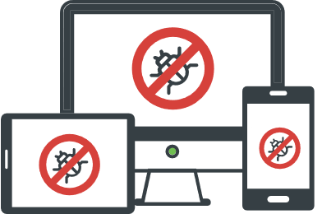
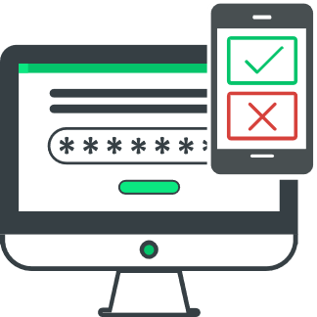
Harness the power of Talos threat intelligence
Talos threat intelligence
Talos tracks threats across end points, networks, cloud environments, web, and email providing a comprehensive understanding of cyber threats and solid, actionable intelligence.
Talos security intelligence is the industry’s most powerful cyber threat protection.
19.7B threats blocked per day
600B emails inspected per day
1.5M malware samples per day
When you own a Cisco security product, you’re automatically harnessing the power of Talos threat intelligence, which Cisco integrates into every solution.

Slide 15
Let’s get started!
Let us show you how easy it can be to protect your entire organization so you can run your business fearlessly.
Network security health check
You build your business,
we’ll secure it.
Solution demos
Free trials

