Slide 1

Cisco Webex Work Bundle
April 2020

Slide 2
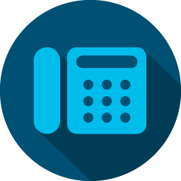

Webex Work Bundle
✔️Orderable April 29th!
Webex Calling
Webex Meetings
MC1000
Webex Teams
IP Audio / CCASP / TNU
Unlimited storage
Pro-pack
‘Flex Up and Flex Down’ – Customer or Partner can add new users w/out a CCW transaction (self-service)
Committed Users paid with standard subscription terms; added users are billed in arrears
Cisco Suggested Price*
to customer
$19.95 / user / month
+ PSTN Access
Partner Price:
$14.95 / user / month
Add-ons
Common area phone licenses
Webex Event Center (EC1000) a-la-carte
Webex Audio: BCCB, Int, Committed, Toll Free
Additional Webex Teams Message users
Cloud registration for video endpoints
Price shown is 1 year commitment. Uncommitted is 10% more.
* CSP is Cisco Suggested Price to End Customer.
Reseller’s actual price may vary. Price shown is with partner hunting differentiation

Slide 3

Why
Driving our single platform advantage
Call, message and meet on a single platform for an affordable price
Bundled offer simplicity makes purchasing speedy, easy and flexible
Providing customers with immediate access to the value of Webex through a flexible consumption (utility) model
Sharing the value of a full cloud suite with small and mid-size customers
Enable customers we have not previously targeted with an offer that is easy for them to buy and use

Slide 4
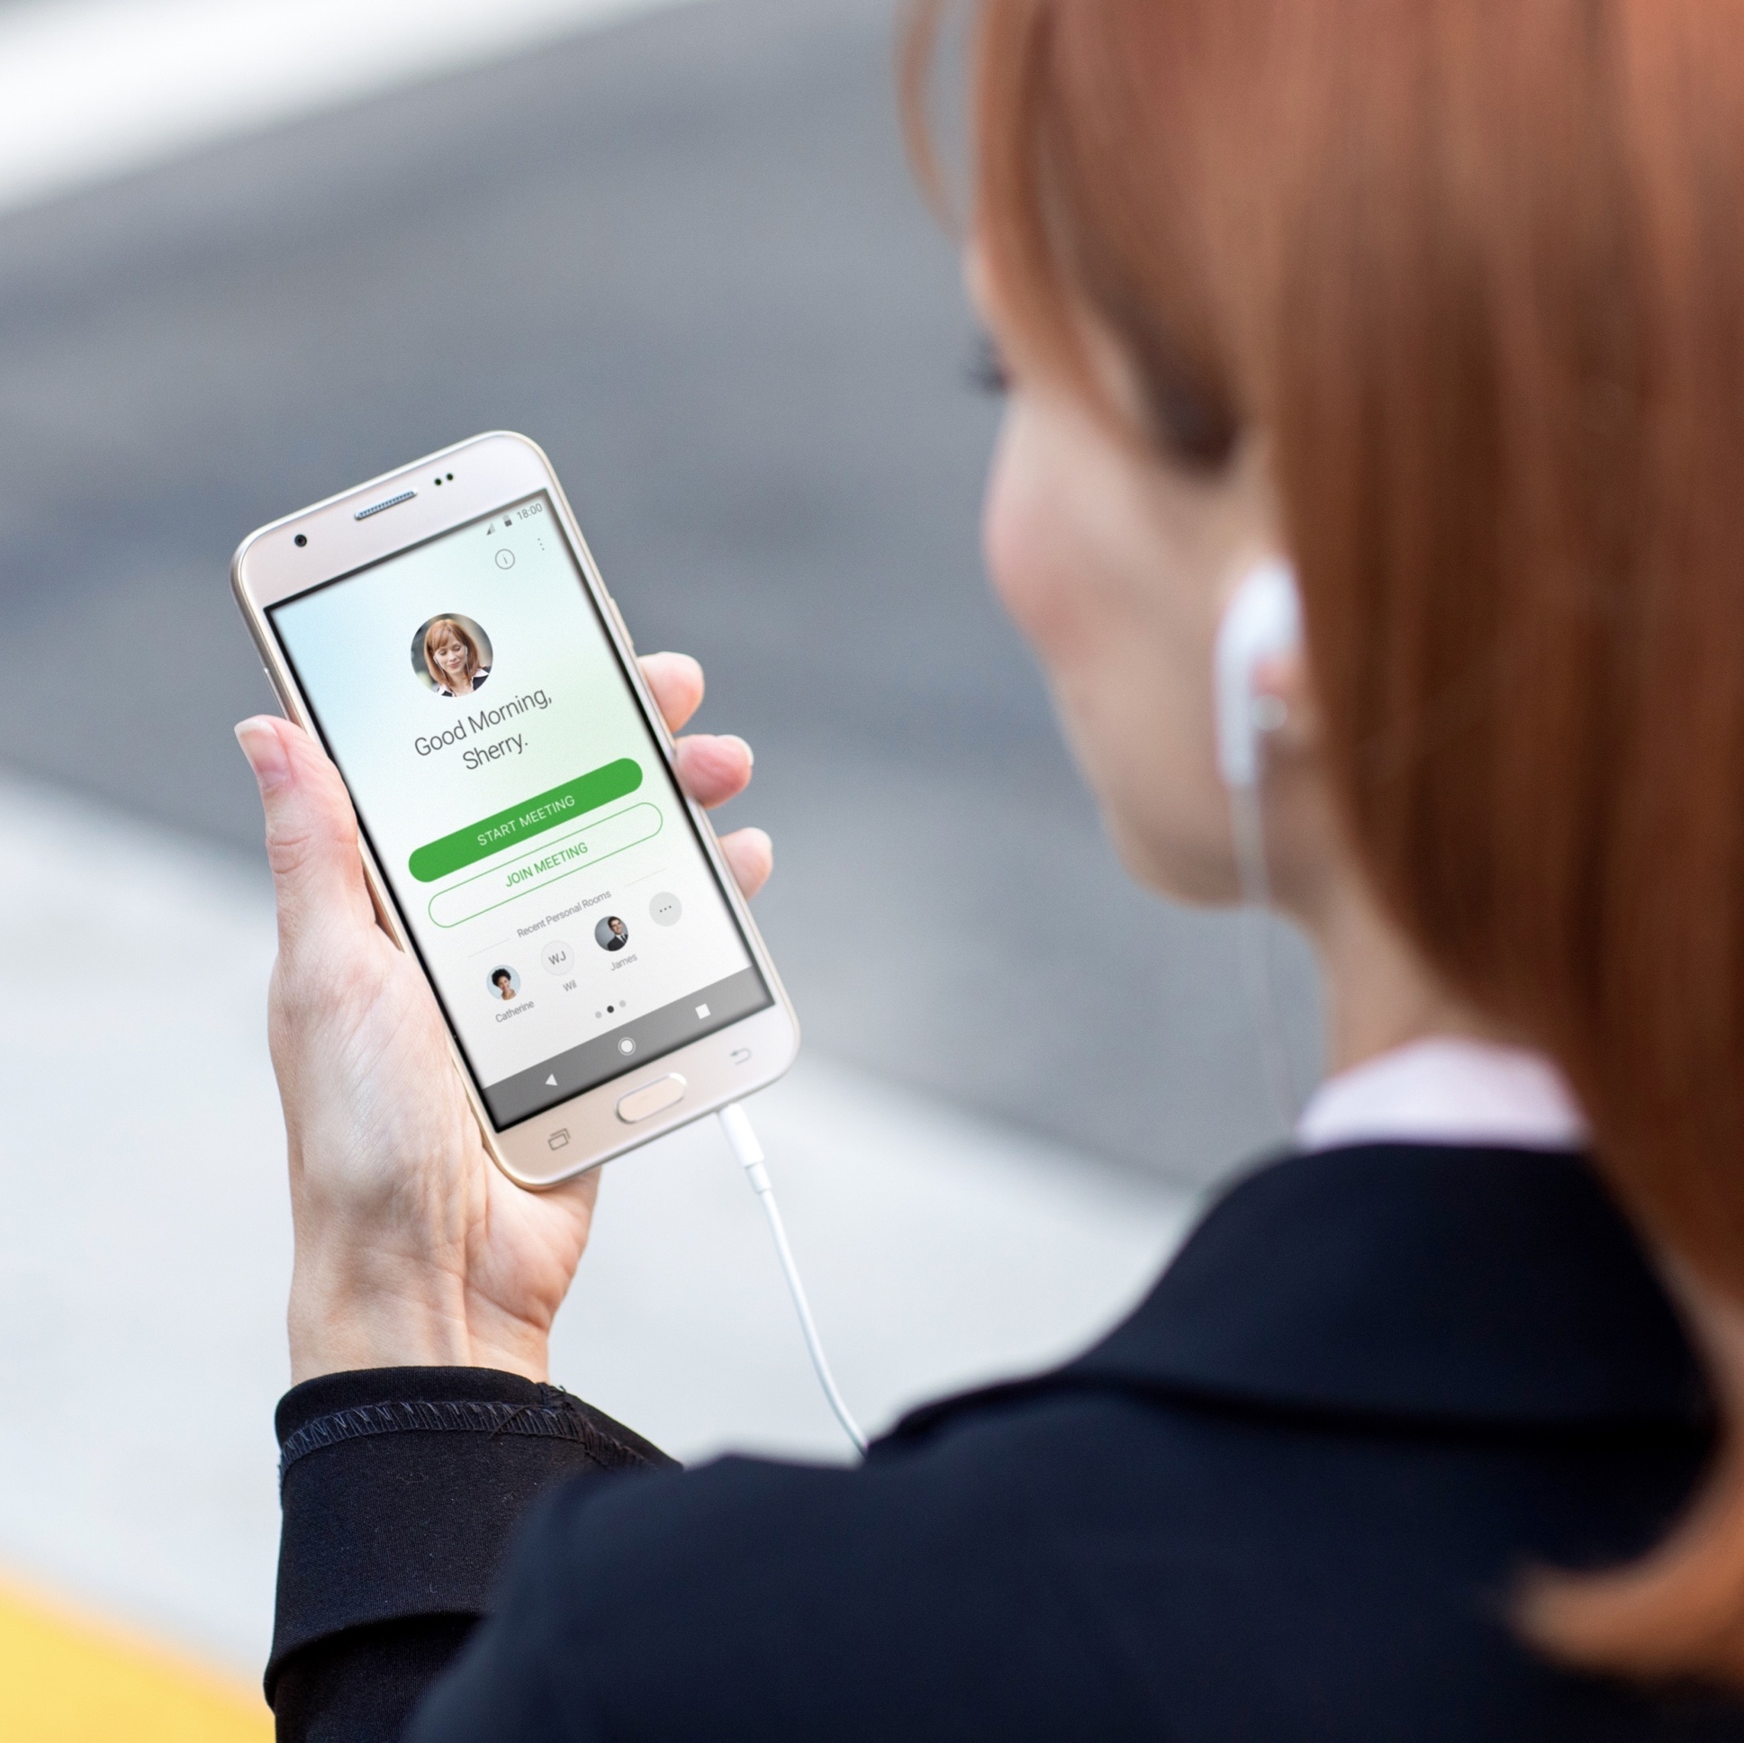
Target Market
1000 and under - above 1000 by approval
Greenfield accounts
Available in US first; roll-out soon to where Webex Calling is available
FedRamp targeted for later this year
(price not yet determined)

Slide 5


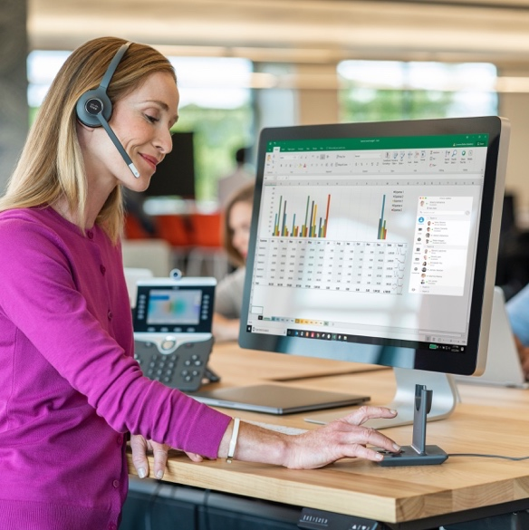
Webex Work Bundle: Customer Scenarios
New
Meetings Customers
New
Calling Customers
Existing
On-Prem Calling
Webex Trials
Bridge free Customers to paid recurring offer with a compelling bundle including Webex Calling, Meeting and Messaging
Introduce simplicity with Webex single platform for Webex Meeting, Calling and Messaging
Bring additional value to Calling customers with a single platform solution
Move on-premises customers to the cloud with the benefit of Meeting and Messaging
All at a low Monthly Cost

Slide 6
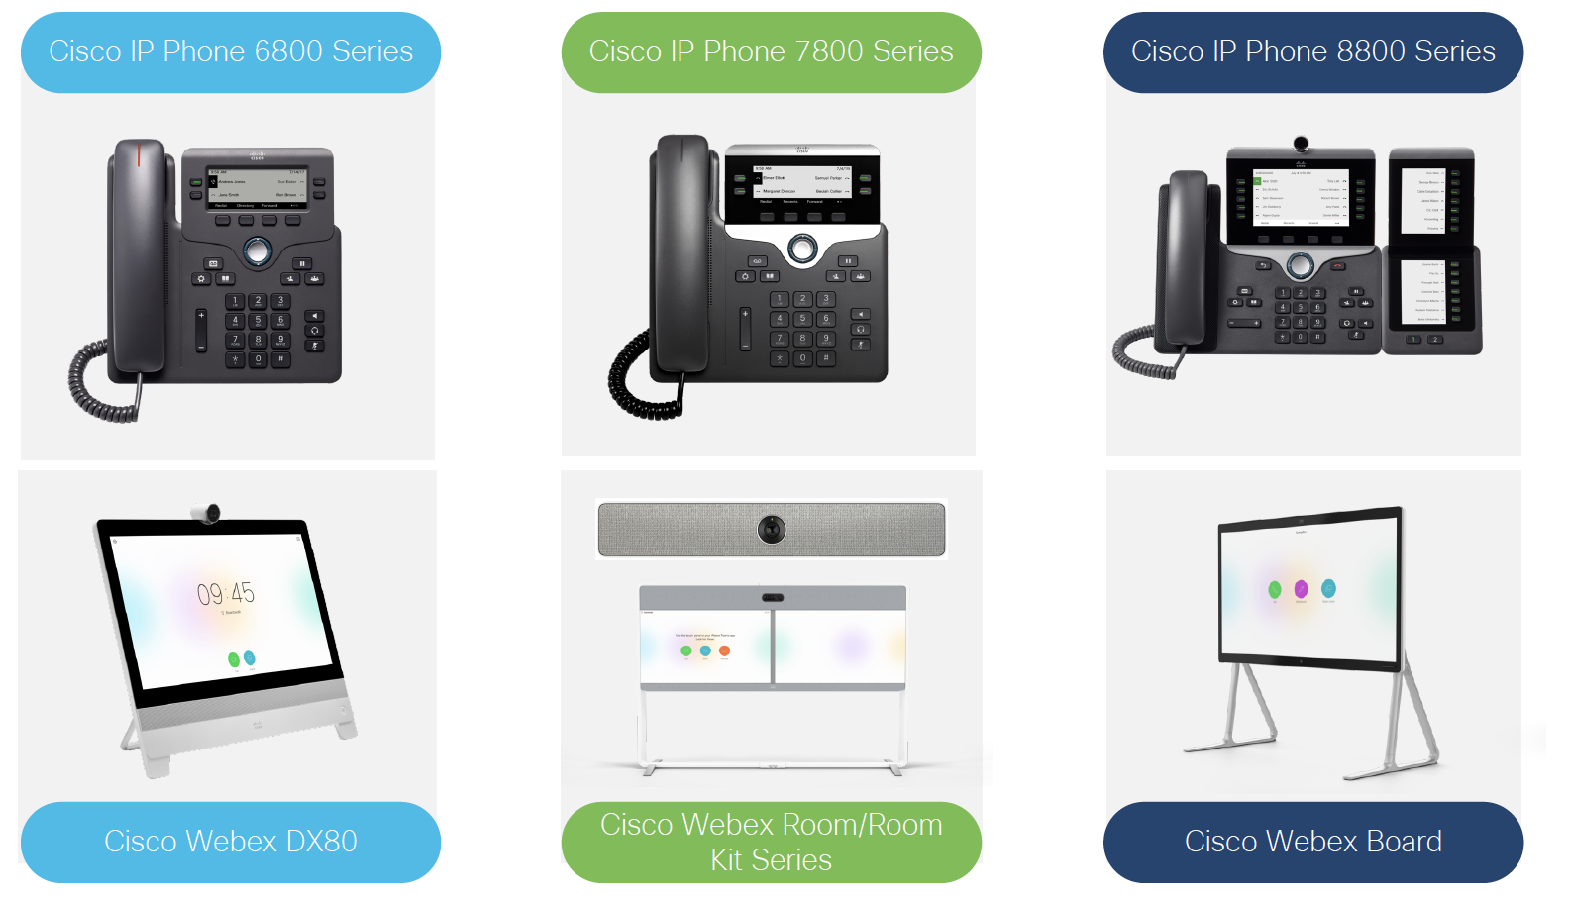

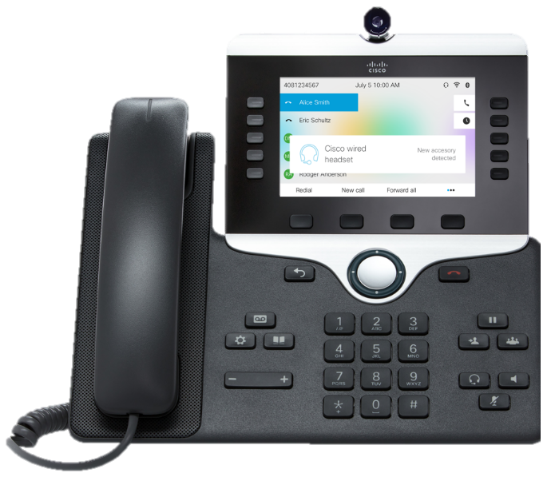
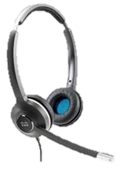

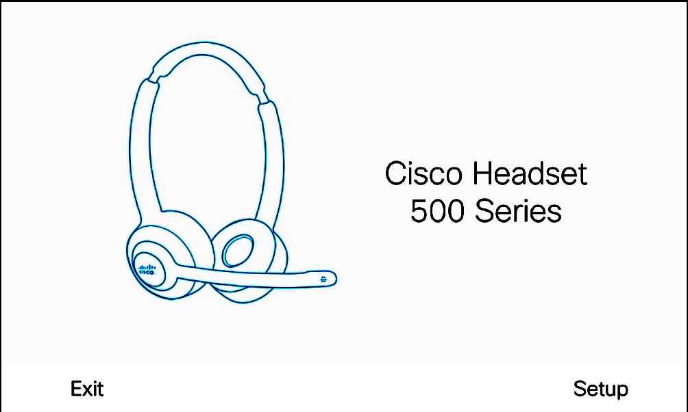
Webex Work Bundle: Expand the Opportunity !
HaaS- Hardware as a Subscription Offer
Webex Room Devices
Headsets &
UC Endpoints
Additional value-added offers
More affordable payment plan enables pervasive adoption.
Better user experience with complete Webex solution
3 year initial term. Pay monthly or annually.
Automatic 1 year extension
Helps Customers to keep up with technology innovations.
Enable people and teams with latest collaboration capabilities
Upgrade your customer experience to First Class Meetings with Webex Room devices
Create Customer stickiness and position adoption services opportunities
  Leverage Room analytics for Workplace real estate optimization and cost effectiveness
  Add Device registration licence and bridge Customers to Cloud
Extend the collaboration experience by attaching phones and headsets.
Increase productivity in open work spaces, small offices and remote offices to allow users to interact freely
Headsets are optimized for Cisco IP phones providing the best experience.
Webex Event Center 1000
Extended Security (Duo/Umbrella)- Coming Soon
Webex Contact Center – Coming Soon

Slide 7



Webex Work Bundle
Offer Details
Separate Product Family for simplicity (A-WORK)
Named user, cloud offer only
Target market <1,000 users, greenfield accounts. Exception process for larger customers
US orderability launch (April 29) with additional geographies where Webex Calling is available to follow
Aggressive competitive pricing for Webex Calling and Webex Meetings bundle
Drive our single platform advantage
Bundled offer simplicity enables transactional velocity with simple quoting and ordering
Best price for partners up-front; no trade-in (purchase adjustment); not included in VIP.
Partner differentiated pricing for hunting (fast turnaround, no AM approval required)
Launching an adoption incentive plan through Lifecycle Advisor (validated by Webex Health score)
“Flex Up and Flex Down” - Flexible Consumption (utility) and Self-Service model:
Choose to pay for committed value subscription prepaid, annually or monthly
New users can be provisioned by partner/customer and billed automatically; ’uncommitted’ users billed in arrears.
Add-ons
Phase 2
Common area licenses
Webex Event Center (EC1000) a-la-carte
Webex Audio: BCCB, Int, Committed, Toll Free
Additional Webex Teams Message users
Device Registration
Webex Contact Center
Extended Security (Duo and Umbrella)
Additional geographies where Webex Calling is available
Public Sector version of bundle (under evaluation)

Slide 8
Webex Work Bundle Discount Structure

Slide 9
Webex Work Bundle – US Discount Structure
Work Bundle
Work Bundle with OIP
Partner Price (With OIP):
$14.95 / user / month
Up to 30%**
Hunting/Teaming
Up to 20%
Cisco Suggested Price*
Starting at $19.95 user / month
+ PSTN Access
Partner Standard Discount
Partner Standard Discount
*** US Discounts shown.
*Final price may vary. Final price set by Cisco Partner
End Customer Prices shown is with partner hunting differentiation

Slide 10
Webex Work Pricing & Discounts
Partner Hunting
Market Category Discount – 20% on List Price; additional 10% for Partner Hunting
 | Utility | List Price | 20% discount | 30% discount
A-WORK Bundle | Committed | $21.35 | $17.10 | $14.95
 | Uncommitted | $23.50 | $18.80 | $16.45
Webex Teams – Messaging only (incremental users) | Committed | $3.55 | $2.85 | $2.50
 | Uncommitted | $3.55 | $2.85 | $2.50
Event Center (EC 1000) | Committed | $428.20 | $342.55 | $299.75
 | Uncommitted | $471.05 | $376.85 | $329.75
Video Device Registration | Committed | $21.35 | $17.10 | $14.95
 | Uncommitted | $23.50 | $18.80 | $16.45
Common Area Calling | Committed | $3.55 | $2.85 | $2.50
 | Uncommitted | $3.95 | $3.15 | $2.75
BCCB |  | $4.00
BCCB-TF |  | $5.00
GCCB |  | $30.00
Core Offers
Add-ons
Audio

Slide 11
✔
✔
✔
✔
✔
✔
¹ Uncommitted priced at ~10% premium to Committed
² Using Small Deal Accelerator discount
³ Using Named User Meetings push promotion

Slide 12




Webex Work Bundle Competition
Webex Work – Enterprise features at a market-leading price
Webex Work
Premium
Enterprise + Calling
Premier
End-customer Price (PUPM) | $19.95 | $34.99 | $26.67 | $26.59 | $19.95
Max Meetings Participants | 1,000 | 100 | 500 | 12 | 250
Cloud Calling | ✔ | ✔ | ✔ | ✔ | ✔
Team Collaboration | ✔ | ✔ | Limited | Limited | Limited
Contact Center included | ✔* | X | X | X | ✔
Adv. Security, Compliance & Analytics | ✔ | X | Limited | X | X
Unlimited Cloud Storage | ✔** | X | ✔ | X | X
PSTN | X | ✔ | X | ✔ | ✔
* Webex Contact Center will be added to Webex Work bundle in Q3 CY2020
**Unlimited Cloud Storage for a year
Notes:
https://www.goto.com/pricing/connect
https://www.goto.com/connect/international-calling

Slide 13
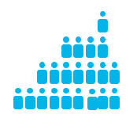
Introducing Utility Billing for Webex Work Bundle
Uncommitted
Provisioned in control hub, and will be billed on usage in arrears. Uncommitted are allowed to change “Flex up and Flex down” and will incur an additional 10% cost. ​
Committed
The number of licenses that will stay constant throughout the term, unless a commerce transaction is made to increase the quantity.
Committed billed -monthly, annual or prepaid
Uncommitted will be billed monthly.
.
Only add
Flex UP
And
Flex down
Committed users - billed for the whole term of your agreement
Uncommitted users (+10%*)
- billed monthly in arrears
Uncommitted is 10% more.

Slide 14
Partner Selling Requirements and Incentive Program

Slide 15
How to start down a path to more profitability
Add Cloud Collaboration solutions to your portfolio and start selling Webex Work Bundle
1
Get Collaboration SaaS Authorized.
Train sales teams to lead with SaaS recurring offers
remember: cloud first, not cloud only.
Adopt value-based selling to improve
long-term profitability.
Invest in delivering business outcomes through Cisco
solutions and your partner services and consulting
across the customer lifecycle.
Change seller mindset.
Reward and compensate sellers
for driving recurring revenue deals.
Notes:
15

Slide 16
How to start down a path to more profitability
2
Start selling Webex Work Bundle and earn rewards
throughout the lifecycle today
Get Customer Experience Specialized
Get Specialized and open new opportunities to interact
with customers, create value, and impact customer
business outcomes.
Apply for the Lifecycle Incentive Program
The new Lifecycle Incentives program combines
incentives and rewards for driving software use,
adoption, and expansion.
Earn Rewards for selling the Webex Work
Bundle and other Collaboration Offers
Sell Webex Work Bundle and earn Lifecycle Adopt
and Expand incentives.
Notes:
16

Slide 17

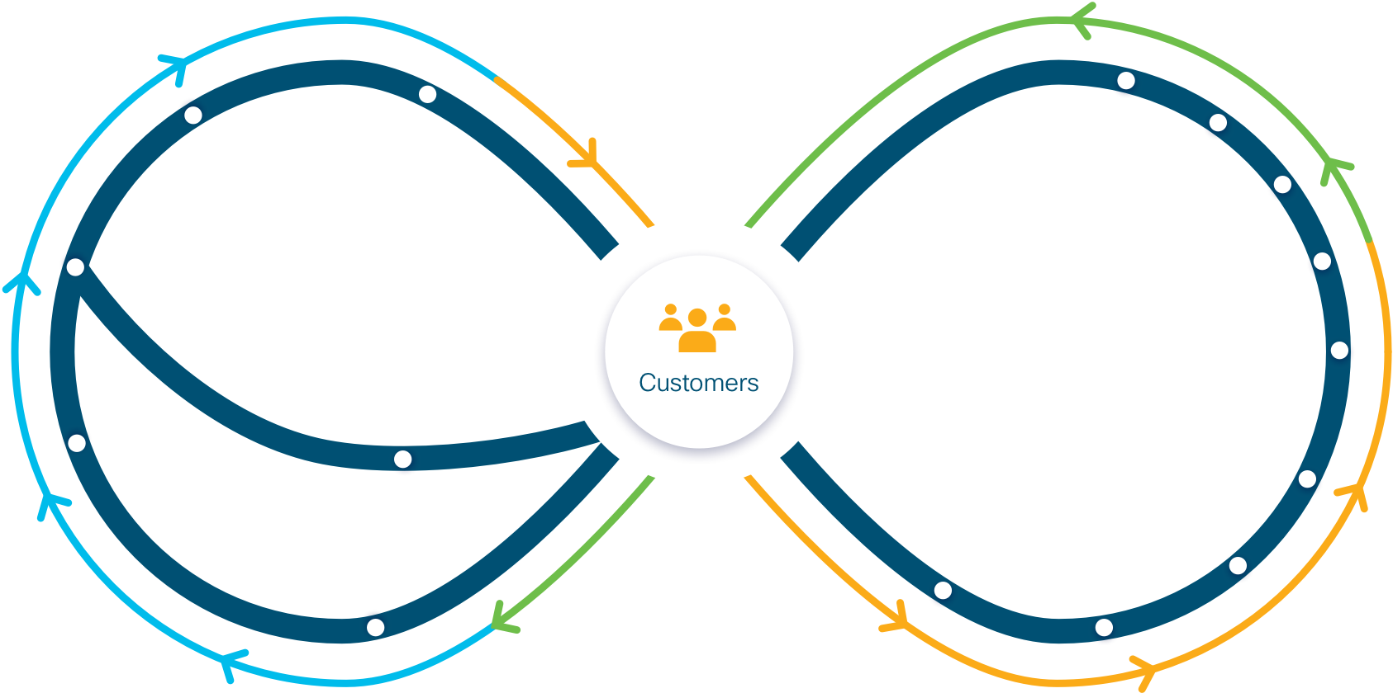

Why a Lifecycle-First Approach?
Customer experience
52%
2.5x
3x
profitability comes after initial sale (post-land)
will become
top brand differentiator
software growth when partners
have customer success practice
renewal rates
for partners with adoption services
(Global Touch)
(Walker Information)
(Cisco)
(Cisco)
Notes:
Global Touch Partner Profitability survey
Customers 2020: A Progress Report | Walker Information, 2017 | https://www.walkerinfo.com/knowledge-center/featured-research-reports/customers2020-1)
3. Cisco (based on FY19 bookings and renewal data for Lifecycle Advisor partners vs. all others)
SW growth is based on LCA certified partner SW bookings for FY19 vs all others
Renewal Rate is based on the CSPP renewal rate metrics for FY19 of LCA certified partners vs all others

Slide 18




Lifecycle Incentive Program
Adopt Incentive
Architecture
Collaboration
Data Center
Enterprise
Agreement
Enterprise
Networking
Security
Eligibility
Behavior and Reward
Terms
Partner Eligibility
  Customer Experience Specialized or Advanced Customer Experience Specialized*
  Advanced product architecture specializations
Offer Eligibility
  Minimum
  bookings size
Rewards for driving adopt continuum and deal/customer size
Adoption Window
  Submit Customer Success Plan within 90 days of booking
  Submit Successful Business Outcomes within 9 months of Customer Success Plan
  EA can extend to up to end of EA terms with exception approval
  Quarterly payout
  Removed cap for Advanced Customer Experience
  Specialized partners*
New!
 | Non EA |  | Enterprise Agreements
Cisco Net Book Value (software) | Customer Success Plan | Successful Business Outcome | Customer Success Plan | Successful Business Outcome
Small ($50K – 499K) | $5K | $15K | Required | $25K
Medium ($500K – 1.999K) | $5K | $25K | Required | $50K
Large ($2M) | $5K | $45K | Required | $100K
New!
New!
Webex Work bundle
Note: Partner can submit one time per customer
*Distribution partners please see Appendix for details
More Information: cisco.com/go/customerexperiencespecialization & cisco.com/go/lifecycleincentives

Slide 19
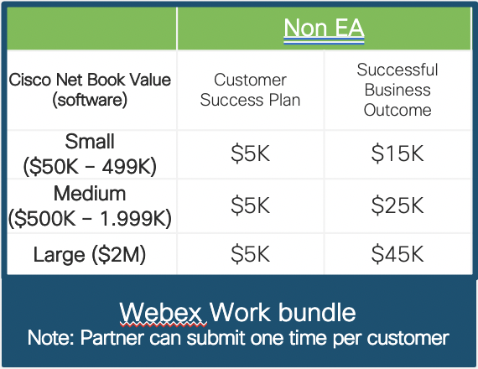
Earn Adoption Incentive with Webex Work
Eligibility
Customer Experience Specialized
Potential Reward
Partner Eligibility
  Customer Experience Specialized or Advanced Customer Experience Specialized*
  Advanced product architecture specializations
Offer Eligibility
  Minimum
  bookings size
Up to 3 deals per quarter
New!
Advanced Customer Experience Specialized
Unlimited deals per quarter
**Earn up to $90k per quarter for 3 medium size deals

Slide 20

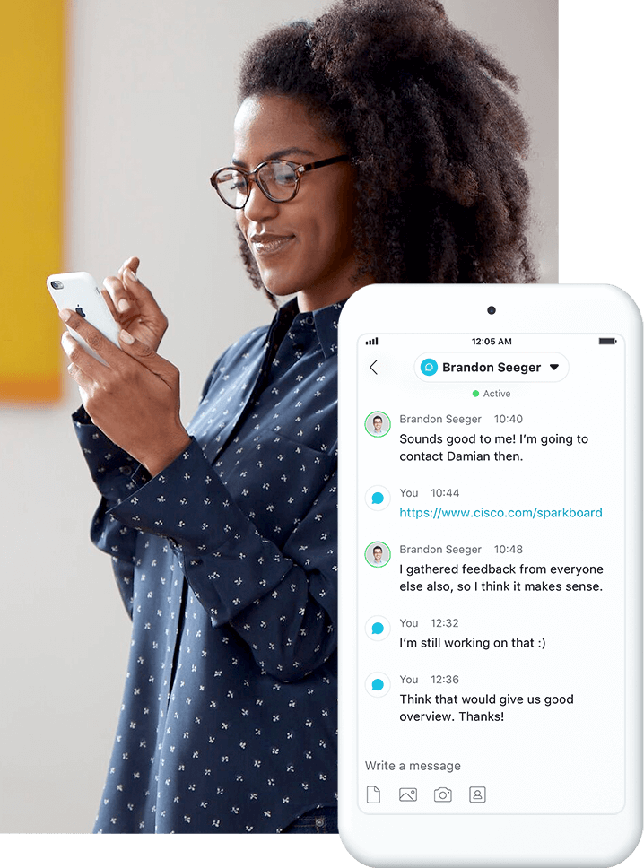


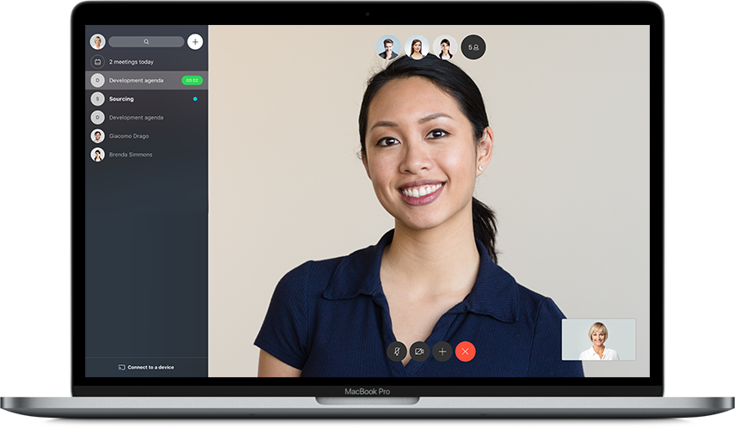
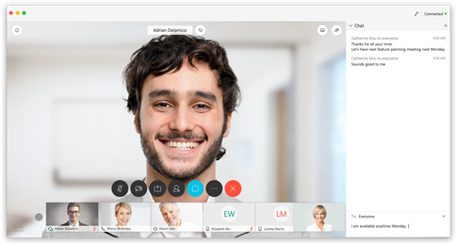
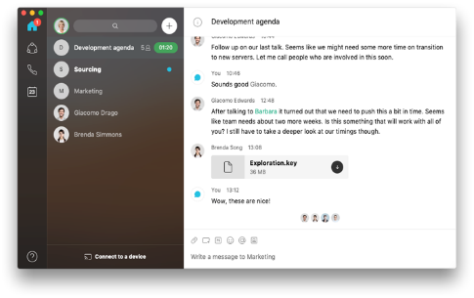
Webex Adoption Resources
Webex Work Sales Connect Hub
User Adoption Resources
Webex Adoption Toolkits
Configure Control Hub
Live and Recorded Online Classes
Technical Adoption Resources
Adoption Master Classes
Online Learning Paths
Adoption Learnings Paths

