Slide 1
Experience
Webex
April 2020

Slide 2
This is not WebEx

Slide 3
This is Webex

Slide 4
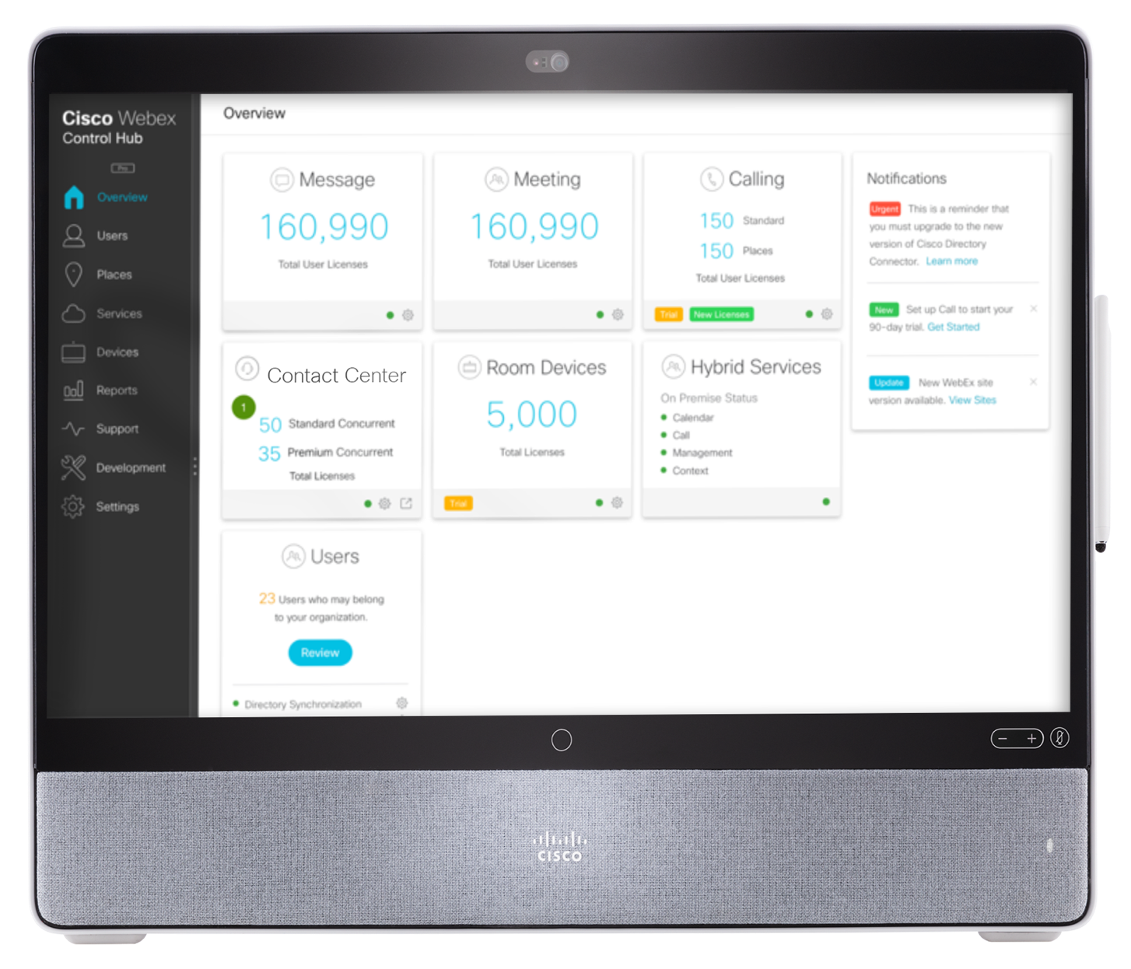
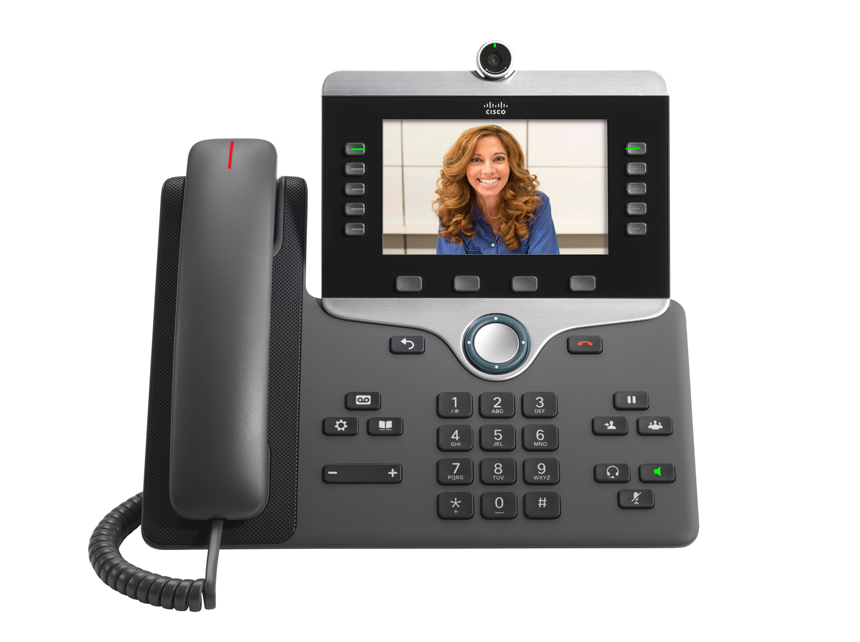
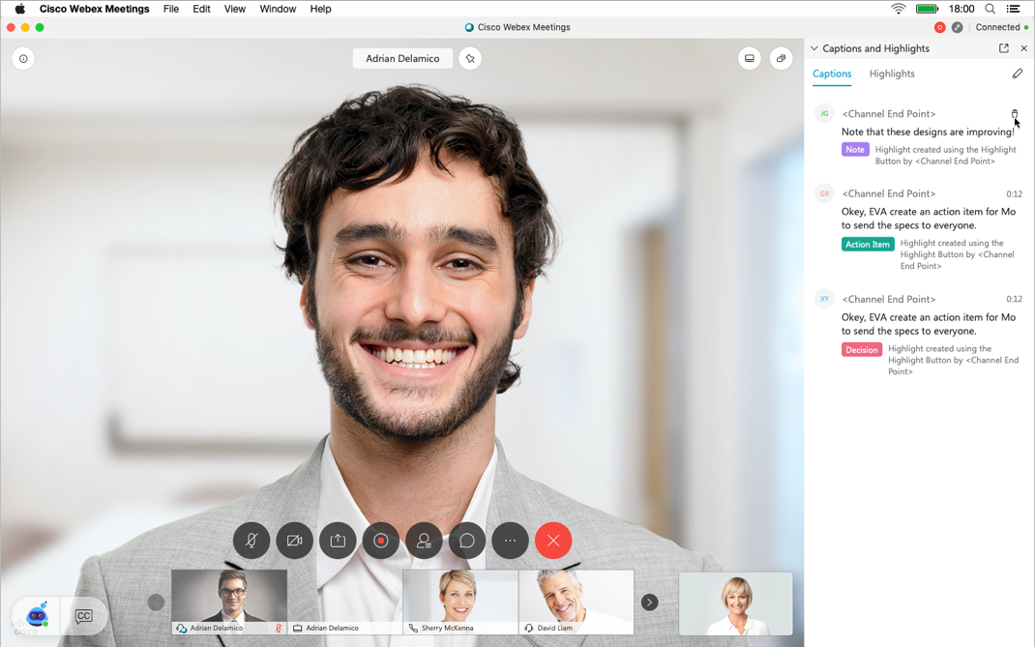
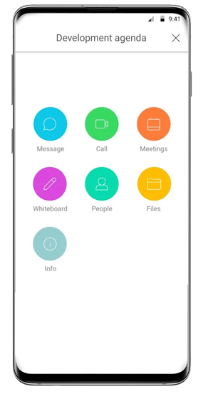
…this is also Webex

Slide 5

Webex is here when the world needs to connect, communicate, and collaborate
Webex is the World’s #1 collaboration platform that powers the present and future of work.
Webex is a business brand. The world runs on Webex.
Webex is the most secure, most reliable, most scalable platform in the world.
Webex is where governments serve, doctors save, military and police protect, media reports and employees produce.

Slide 6




The New Standard
Easy to Use
Easy to Manage
Platform Advantage
Secure, reliable and scalable
A modern interface and experience designed to integrate calling, messaging, and meeting with the apps you use every day.
A unified experience manageable through a single pane of glass, with real-time actionable insights to scale up or down whenever you need it.
AI-enabled software and devices to assist calling, messaging and meeting from a single platform.
The most secure, most reliable and most scalable collaboration solution on the planet.
Notes:
The Voicea acquisition reflects Cisco’s vison of Cognitive Collaboration, interoperability, and workplace transformation through combining the power of AI, ML, software, hardware, and the network to remove friction and get work done faster and smarter.
Voicea is an open platform, like Webex. Its service allows users to leverage voice commands within a meeting and update popular systems of record
Language processing and speech recognition further automates key productivity and workflow integrations
Examples include:
booking followup meetings into calendaring applications
Creating followup item/reminder in task management platform
Updating CRM with notes or follow up from call
This acquisition reflects Cisco’s vison of Cognitive Collaboration, interoperability, and workplace transformation through combining the power of AI, ML, software, hardware, and the network to remove friction and get work done faster and smarter.
These advanced capabilities include meeting transcription, voice search, meeting highlights, and automatically capturing and initiating action items. All of this while preserving the highest data privacy and security standards. Now teams can have efficient meetings by turning talk into action.
This AI/Cognitive Collaboration solution will unlock the power of data within business conversations across Cisco’s voice assets. This will allow businesses to discover information from past conversations, create more actionable meetings, improve productivity, and enhance the team experience all in a highly-secure Cisco certified environment that adds data privacy for management of sensitive meeting/company information.

Slide 7
Easy to use
Easy scheduling
Simple to join and share
Video-first, mobile-centric
Intuitive workflow integrations
Notes:
We are committed to continuous enhancements to user experiences across our portfolio.
Agile development cycle means we’re introducing many features on a monthly and quarterly basis.
If you joined us for the CTG roadmap review several weeks ago you got a peek into our roadmap of features,
We wanted to call out a few here to illustrate our commitment to winning the hearts and minds of our customers…minimizing with Fast AND effective user experiences

Slide 8
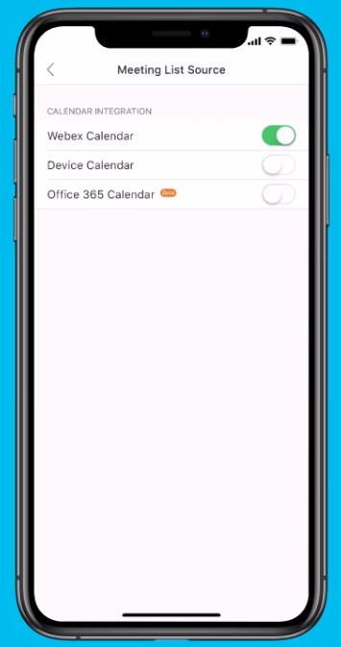
Easy to Schedule
Google
Outlook
iCloud
Notes:
https://help.webex.com/en-us/nwtulzs/Schedule-a-Cisco-Webex-Meeting-from-Your-Calendar

Slide 9

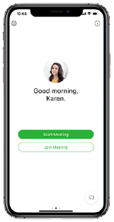
Easy to Join
In the office
At Home
On the go
Intuitive experience from anywhere. No downloads or plug-ins required.

Slide 10
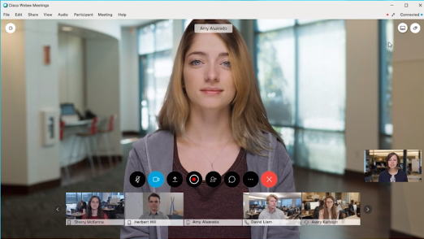
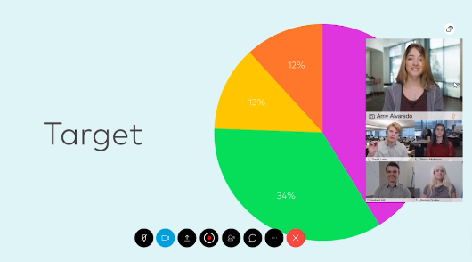
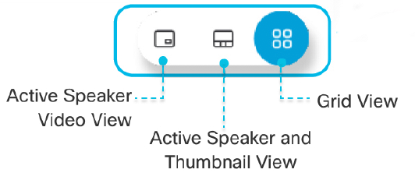
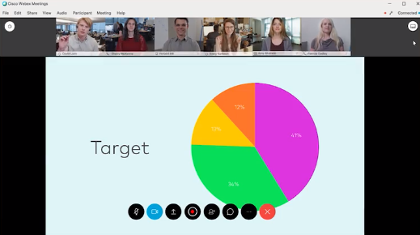
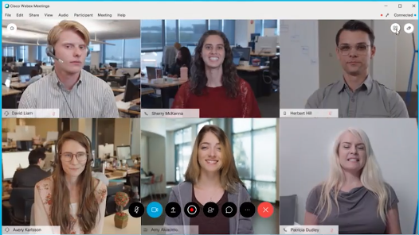
Flexible Video Conferencing Layouts
Notes:
https://help.webex.com/en-us/5hbazy/Switch-Between-Video-Layouts-in-Cisco-Webex-Meetings-and-Cisco-Webex-Events

Slide 11

Meet face to face, wherever you are
☆☆☆☆
Top Ratings
MILLIONS
of downloads
Notes:
https://apps.apple.com/us/app/cisco-webex-meetings/id298844386
https://play.google.com/store/apps/details?id=com.cisco.webex.meetings&hl=en_US

Slide 12



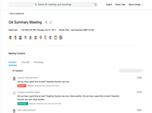

Accelerated workflow with AI-enabled meetings
Consistent
visual
experience
Accelerate
follow-up,
productivity
Support
deeper
engagement
& focus
Great ideas,
action items
not lost
Multiply the
value of every
interaction
Before the meeting
During the meeting
After the meeting
Notes:
Cognitive collaboration is modernizing meeting experiences before during and after – using our powerful voice intelligence engine across the Webex platform.
Users gain a consistent visual experience – you’ll note the Webex Assistant character is visible on Webex Room Devices and in Webex Meetings. Common wake word - Hey Webex, Ok Webex… ( Understands commands in context – ie commands before or after meeting in the conference room, commands in-the Webex Meetings to take notes, action items, highlights.. –user experience is one assistant, not two )
With integrated advanced voice intelligence users can be more focused and engaged in the discussion – not the technology or in taking notes. Great ideas, action items are not lost or delayed – in fact this helps to accelerate follow-up as well as increase productivity
And it helps organizations multiple the value of ever interaction – with post meeting features …
Transition.. But there is more to this story than just meetings. We are helping organizations unlock the power of collaboration across meetings and even calls for Contact Center operations staff…

Slide 13
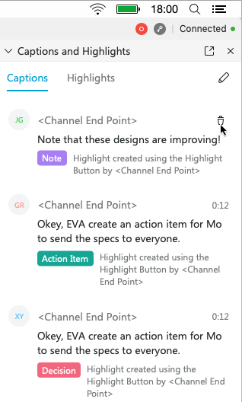
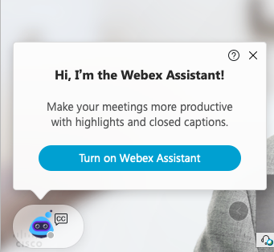

Real-time transcription and action items via In-Meeting Assistant

Slide 14





Interoperates with the tools you love
From your calendar
From messaging apps
From where you learn
From your car
Webex Meetings is designed to work with your daily workflow
Notes:
Any third-party, standards-based device that can dial a SIP address, can certainly call into Webex Meetings. Webex cultivated interoperability and openness. H.323/SIP/WebRTC -- we are proud sponsors and advocates of many interoperability standards – we build it into our products and don’t charge extra for standards-based connectivity. Furthermore, Webex has carefully cultivated partners that integrate their apps that work consistently and reliably.

Slide 15
Easy to Manage
A unified experience manageable through a single pane of glass, with real-time actionable insights to scale up or down whenever you need it.

Slide 16
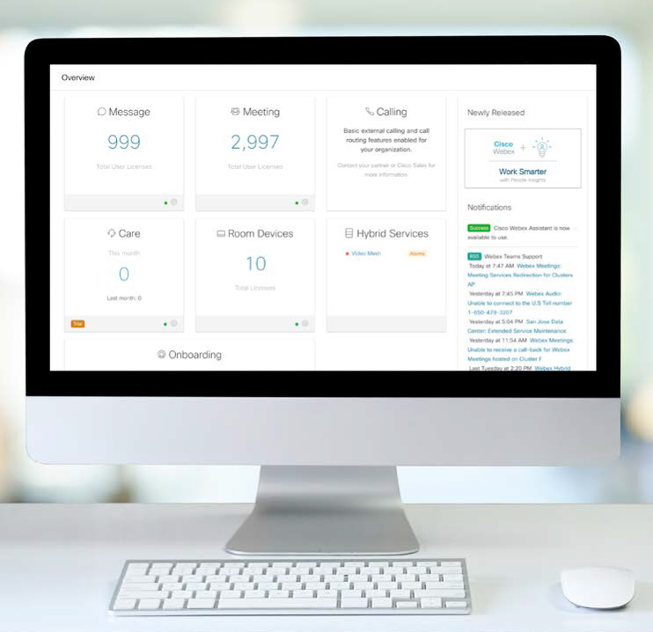
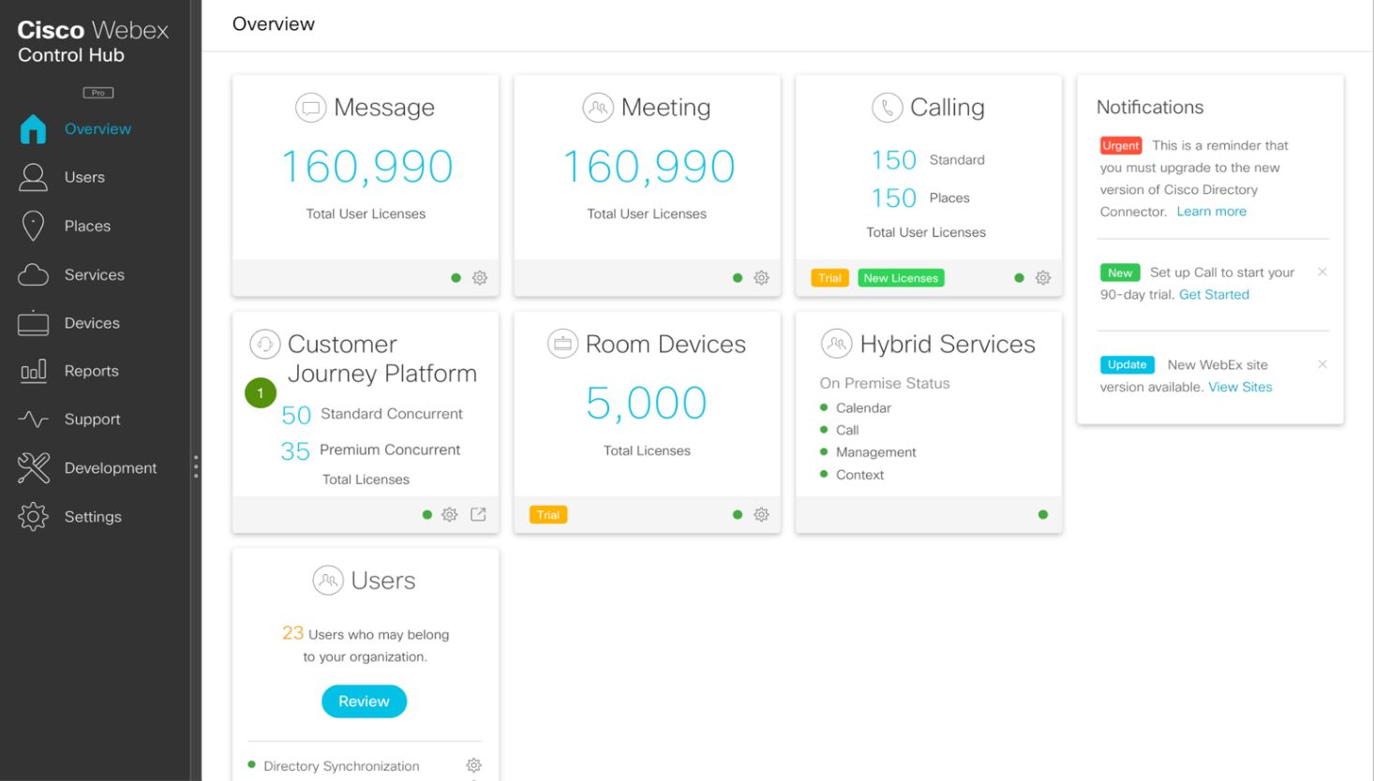
One management tool for a seamless workflow
Contact Center
In the cloud? On-premises? Both? No problem.
Ready to provision a new device or remotely wipe one that’s been compromised? You got it.
Need to deploy signage across hundreds of devices? Absolutely.
Want to monitor workload and productivity analytics in real time? Say no more.

Slide 17


Actionable Insights from Webex Control Hub
Troubleshooting
Analytics for business insight
Manage everything
Identify issues before they have an impact
Identify recurring anomalies within historical trends
Easily see and drill down into
problem areas
Search meetings in real time
Explore detailed quality data
(at the meeting and user level)
Understand usage and adoption, and optimize resource usage
See who joins each meeting
Drill down into details of each meeting
View historical metrics – when meetings are taking place
Understand which meeting features are being used
Control and provision user
and device information
quickly and at scale
See usage information by device type
Understand how people join
each meeting
Correlate resource utilization and system usage for capacity planning
Monitor usage across cloud
and premises

Slide 18
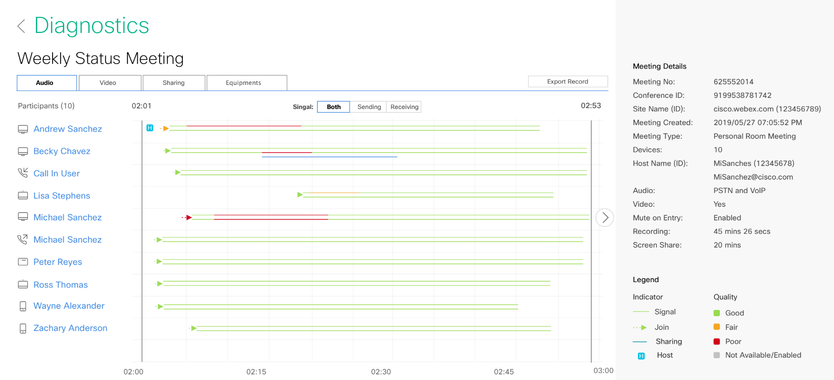
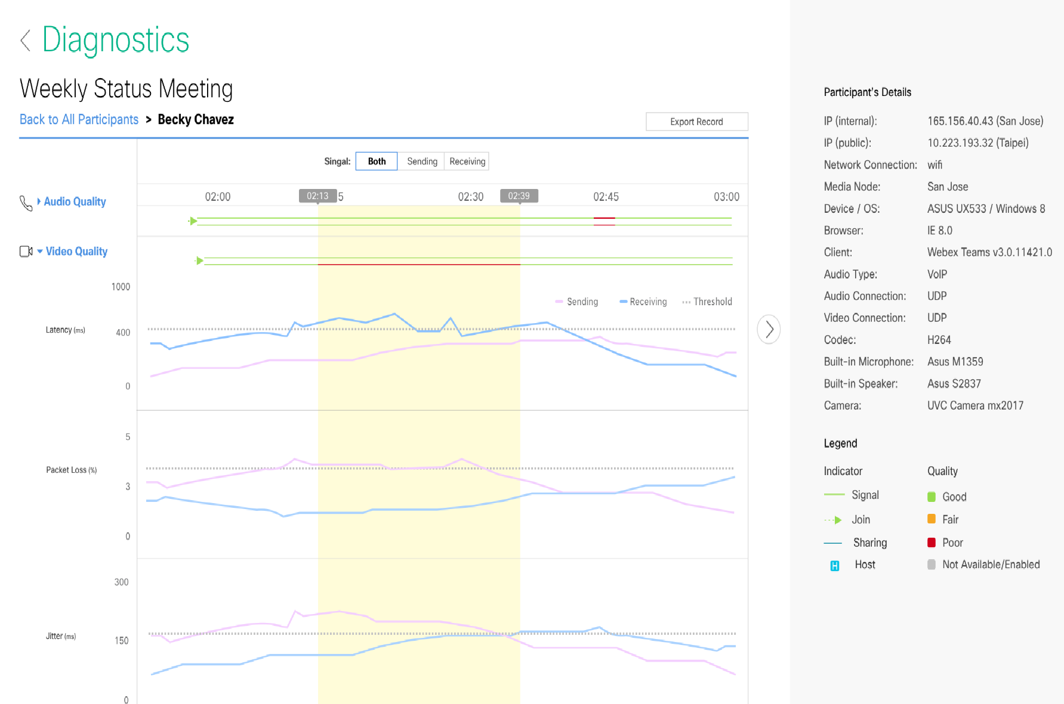
Advanced Diagnostics
Detailed information for each meeting participant for faster diagnostics
Participant Drill Down
Richer insight at a meeting participant level for IT admin to self-diagnose and fix quality of service issues before calling Cisco or partner-led support.
Notes:
Goal: Provide richer insight to IT Admins to help them diagnose and prevent Webex quality of service issues without calling TAC
Advanced Diagnostics, provides 20+ new data points for IT Admins to help diagnose quality of experience issues with Webex meetings. The trending data is updated near real time (1 min updates):
Participant insight: Laptop, speaker, microphone & camera information, client type and version, CPU utilization over time
Join information: DC node, Connection type, Data transport type
Quality metric trending over time: Packet Loss, Latency, Jitter, Resolution, Bitrate, Framerate

Slide 19
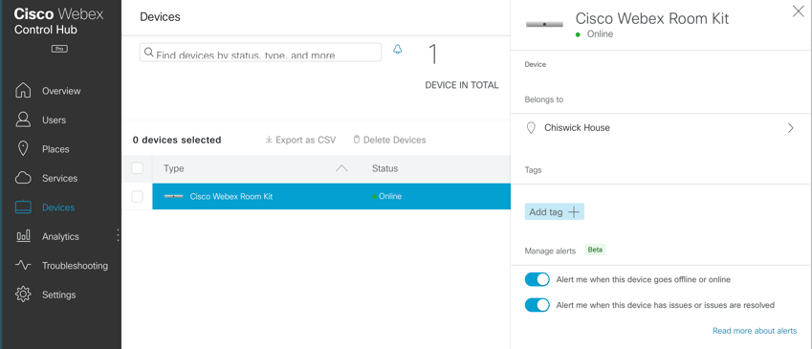
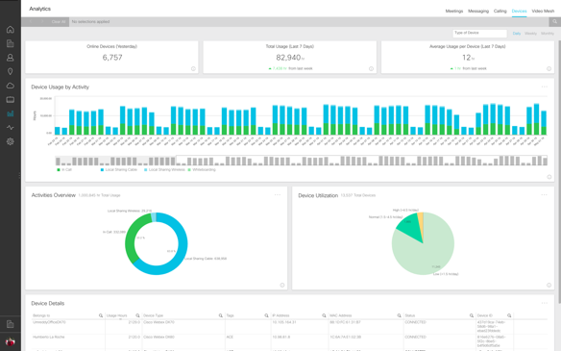
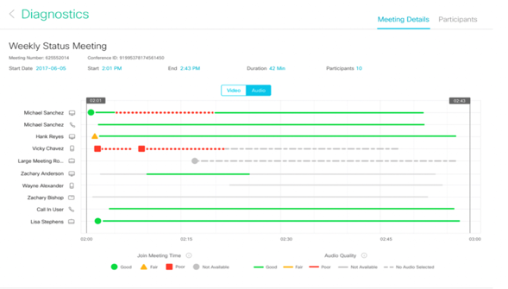
Central Management for Webex Rooms
View and manage device settings
Receive device alerts from Control Hub
Monitor meeting real-time quality for Webex Rooms and other participants
View device utilization history
All from a single, easy to use control hub web interface

Slide 20
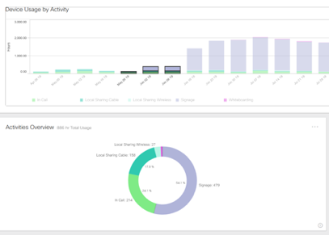


Webex Edge for devices
A first taste of cloud to our On-Prem Customers
Premise Video
Cloud Link
Control Hub
Super simple setup - one button to Cloud Link
Scalable management and analytics
Keep media local
Access cloud services & innovations
Insights through Control Hub
Troubleshoot devices in Webex Meetings
On-premises Media & Signaling
Included
for Flex Customers
+ Webex Assistant

Slide 21
Webex Edge for Meetings
Cisco Webex Edge
Audio, video & content
Seamlessly connect UCM, PBXs, and on-prem devices
End-to-end Webex global backbone experience
On-premises video quality with cloud simplicity & scale
Amazing and Cost effective
meetings every time
Eliminate PSTN costs
Enhanced
security experience
Bridge from
on-prem to cloud
Webex Edge Audio
Webex Edge Connect
Webex Edge Video Mesh
Notes:
Webex Edge allows users to have the most optimal meeting experience (Audio, Video and Content) over VoIP consistently at all times while saving significantly on PSTN Costs. With Webex Edge, users do not have to change their behavior and IT doesn’t need to train people on adopting a different way to connect to meetings.
It also allows customers to directly connect to Cisco Webex globally distributed network that is designed for real-time media and your meetings traffic only so you are guaranteed to receive the best meeting experience at at all and your meetings with never interfere with your mission critical applications.

Slide 22
Cisco Webex Hybrid Solutions
Cloud first, but not cloud only
Webex Edge
Reshapes and e-architects the edge to maximize the power of Webex cloud
Webex Control Hub
Unlock the power of the Platform for easy to use experiences for IT
Webex Hybrid Services
Integrate your existing infrastructure
with the Cisco Webex cloud

Slide 23
Platform Advantage
AI-enabled software and devices to assist calling, messaging and meeting from a single platform
Notes:
We are committed to continuous enhancements to user experiences across our portfolio.
Agile development cycle means we’re introducing many features on a monthly and quarterly basis.
If you joined us for the CTG roadmap review several weeks ago you got a peek into our roadmap of features,
We wanted to call out a few here to illustrate our commitment to winning the hearts and minds of our customers…minimizing with Fast AND effective user experiences

Slide 24

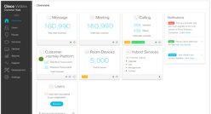
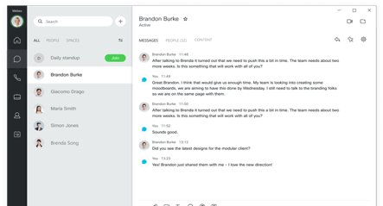
One
unified
modern experience
CONTROL HUB
UNIFIED APP
Call Meet Message Devices Contact Center
Single Platform
Single, modern unified experience: call, message, meet
Modular and personalized
Adds value to current collaboration investment
Integrates apps with devices
Enterprise-grade security
Cognitive collaboration
Analytics
Edge and Hybrid Services
Global Backbone
PSTN
Third-party
PBX
Cisco
UCM
Cloud
Calling
Contact Center
Room
Device
Messaging
Notes:
To deliver on unified modern experience – on top of existing investments
As part of our single platform approach – we leverage a unified app framework to integrate calling, meetings, messaging and device controls to unify and simplify experiences for end-users
And one that is designed to be modular and configured to the needs of every workstyle – as well as to the deployment mode. Giving IT the flexibility to extend common experiences for users while connecting to call control on prem to provide flexibility to optimizing existing investment while extending modern experiences to users.
And our Edge services enable hybrid deployments – allowing customers to link with what they currently have and enabling flexible transition to the cloud – connecting on-prem investment …and enabling advanced capabilities across any deployment model – adding value to their current collaboration investments
Our single platform enables customers to deliver the very best experience with integration across software and hardware to enable collaboration experiences across devices and in shared spaces
And that experience is Integrated with cognitive intelligence to enable smarter experiences– bringing context and intelligence to every collaboration interaction and across all workloads. Meetings and messaging are integrated with People Insights to provide more context about the people you work with and have just met to create more engaging interactions, more productivity meetings.
And a modern unified experience delivered from a single platform , a single app framework creates creates opportunities to address key concerns for the business starting with … How to drive better employee engagement and productivity
Transition… and we’re excited to be introducing new capabilities in Nov that will help organizations accelerate their workplace transform even further.

Slide 25
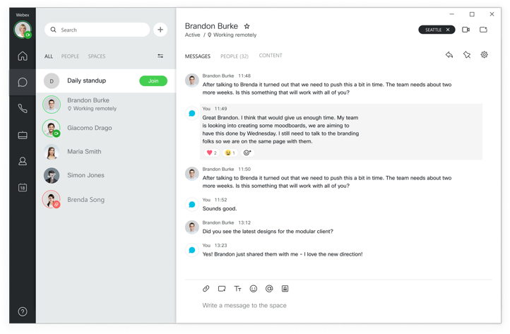
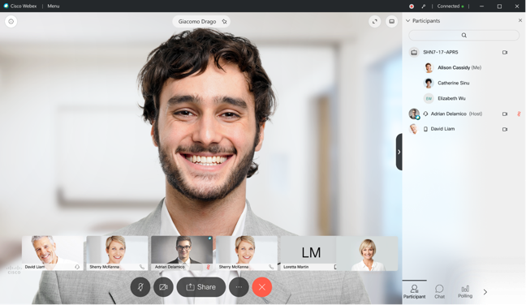
Collaborate Your Way
All the Collaboration workloads to meet the workforce productivity needs with ONE APP
Meetings
Wireless Pair and Share
Full-feature Webex Meetings UX
Pair/share wirelessly with your Cisco video deviceS to join your meetings or share content on screen and in-meeting
Calling
Integrations
New calling capabilities such as hold / retrieve, 2nd line, IP Phone control. Supports CUCM or Webex cloud calling
Simplify and accelerate workflows by Integrating business applications directly into the Unified app
Messaging
Centralized Management
Persistent chat with new capabilities such as reactions, threading, ECM integration
Control Hub: single pane of glass to deploy, manage and support the Unified app
Enterprise-grade Security and Compliance
Integration with DLP; Cisco CloudLock-ready or 3rd-party CASB integration
Notes:
Changing the game with the Unified app. ONE APP to meet all of your Collaboration workloads needs

Slide 26
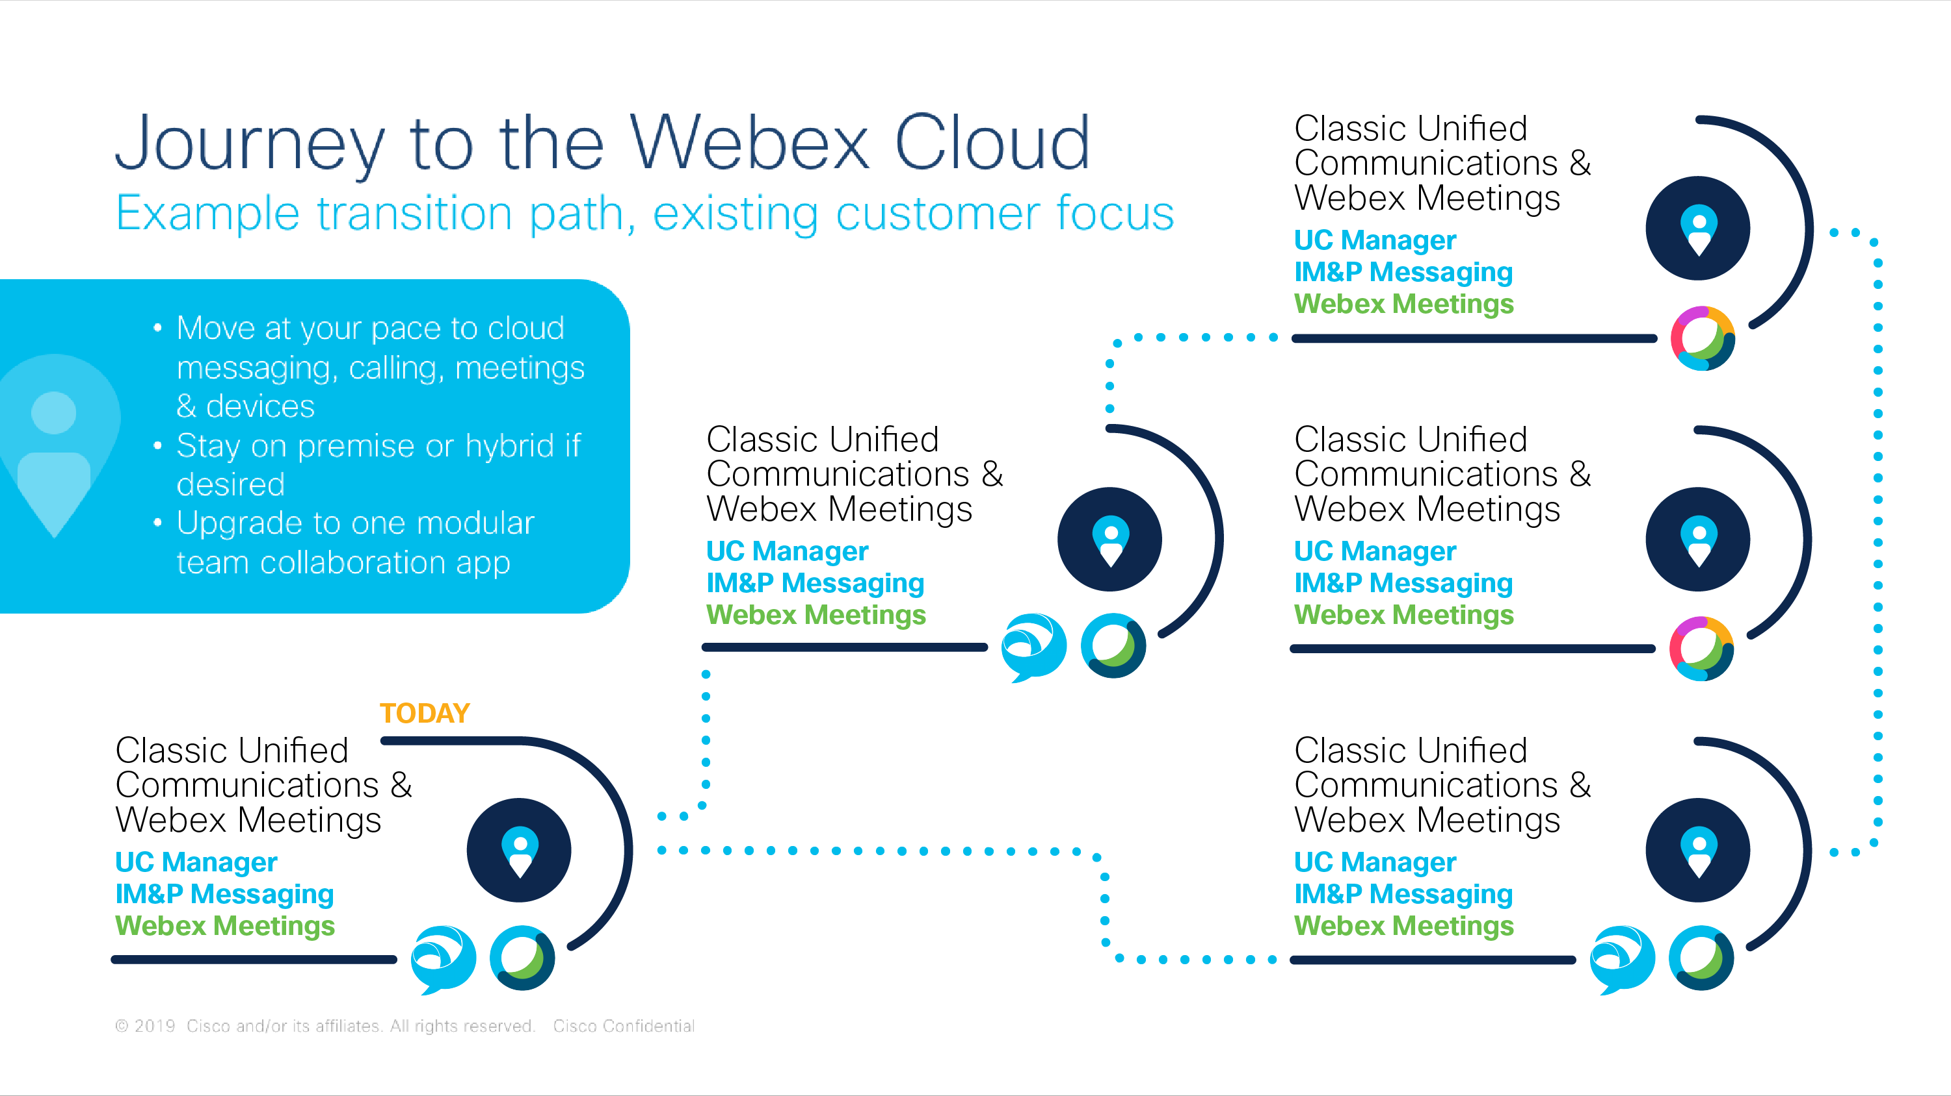

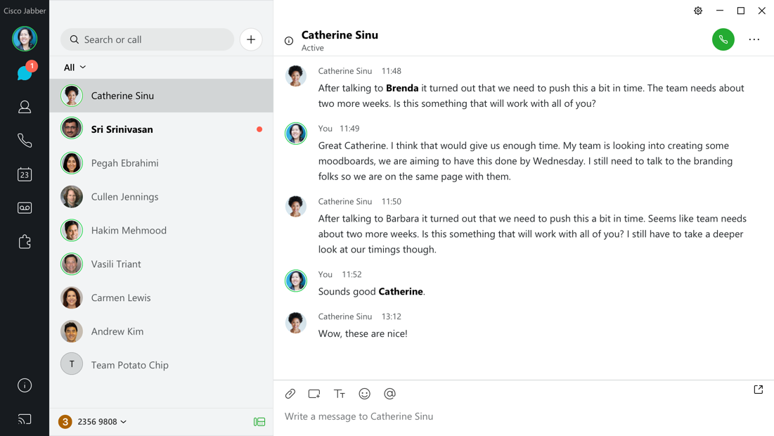
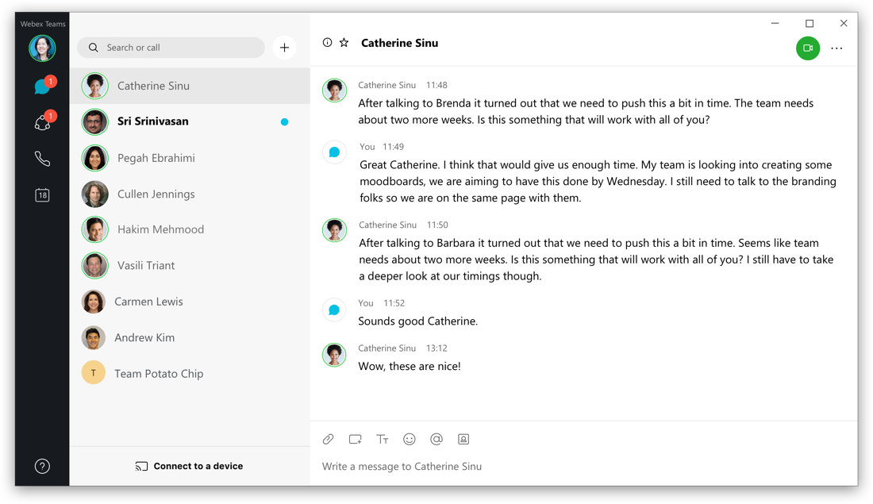
Unified app experience vision
Whether cloud, on-premises or hybrid deployment
Unified message store: Jabber Team Messaging Mode or Webex Teams
Hybrid deployments connect diverse workstyles, interop enabled
Faster innovation from Cisco – consolidated software development train
Unified user experience
Webex Teams App
Cisco Jabber App
Notes:
The good news is, we have some steps that we're announcing in June that will get us very close to this vision.
Let's talk about a little bit of where the vision is and if you're a cloud or an on-premises customer,
because today you can have, unified messaging through Jabber with teams messaging mode or WebEx teams and Jabber team interoperability as a stepping stone to transition.
If I've got an on premise deployment, I can do messaging in the cloud. So that's already starting to get that hybrid and bringing in the team's messaging to the Jabber platform. Hybrid deployment helps you can connect different work styles.
And have interop, also by starting to move towards this unified app experience,
We can focus our innovation at Cisco to provide the best experience in that app.
And for the user. But what we don't yet offer completely is that unified user experience.
And this is what it's going look to,
like,whether you're in WebEx teams,
which is cloud or Cisco Jabber app,
which is on from very hard to tell right.
I'm gonna have to look at the screen up in the lefthand corner is really where you can tell this is where we're headed.
We have the WebEx teams app here, but we do not yet have the Cisco Jabber up, looking like that.
But what we will have in June is a major leap forward and so there you have WebEx teams on the left, and there's Jabber on the.
Right so, in August, the look and feel will be very, very similar to the WebEx team experience.
And then we'll take that next step to make it look much more cohesive.

Slide 27
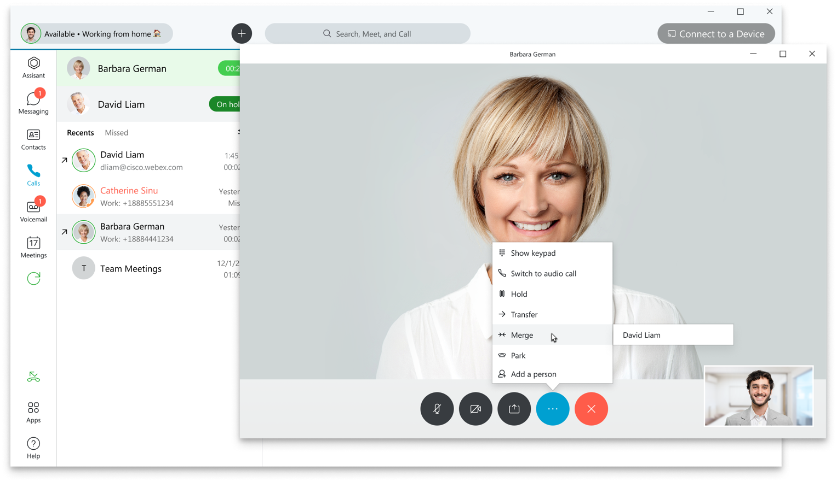


Calling
High-quality, enterprise-rich calling features with integrated devices, headsets, meeting and cognitive collaboration
Proven enterprise-ready cloud PBX
Carrier-class availability, globally delivered over the Webex backbone
Powerful quality and performance analytics at a user/device level
Integrates with your existing on-premises calling solutions
Bring-your-own carrier flexibility with a global network of partners
Unified, global, administration via Control Hub

Slide 28
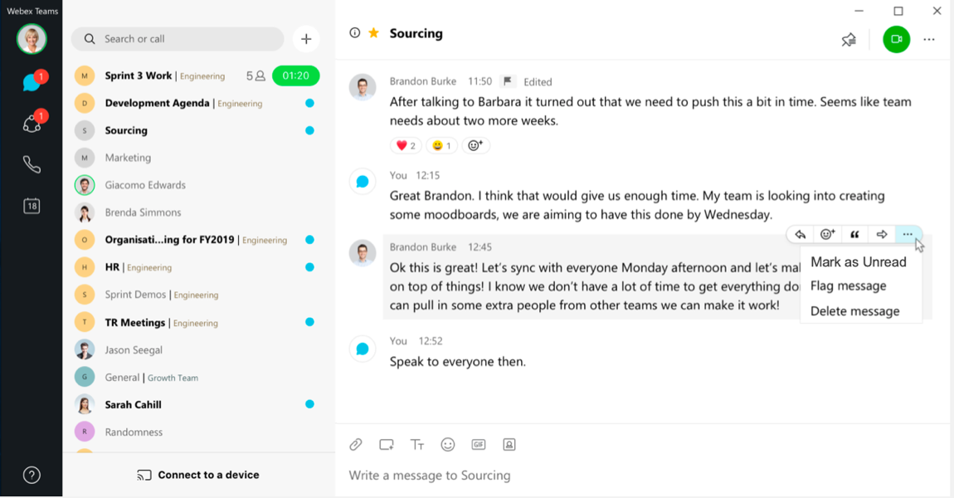
Messaging
Slick & easy to use messaging at your fingertips
New fluid design built to enhance workflows with less clicks
Organize your spaces and content for better manageability and to suit your workstyle
Customizable status to provide your colleagues more info on what you are doing and your availability
XMPP Federation enables users to message with everyone on other XMPP-based Messaging clients
Demonstrate your personality with reactions and GIFs 😂

Slide 29
Seamlessly connecting customers and agents
On-Premises
Cisco Cloud
Contact Center
Webex Contact Center
Available on-premises or partner-hosted
All business sizes
Express: SMB-Midsize up to 400 agents
Enterprise: Large Enterprise up to 24,000 agents
HCS: Partner Hosted up to 24,000
Cisco-hosted
All business sizes
Webex Contact Center: up to 1,000 agents
Webex Contact Center Enterprise: up to 24,000 agents
Single Webex Platform for Contact Center

Slide 30

Webex Rooms powered by RoomOS for the ultimate meeting experience

Slide 31

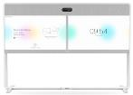
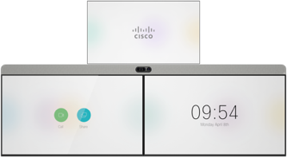



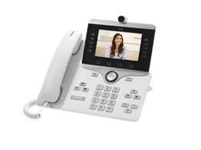
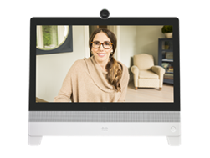
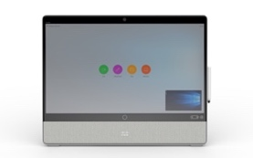

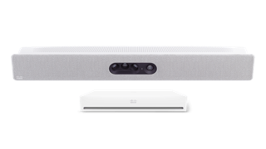



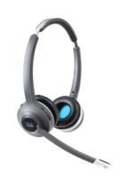

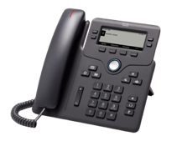
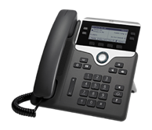
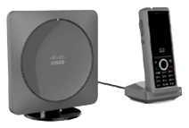
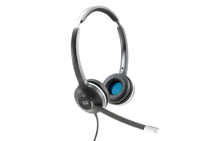
Add integrated devices to transform your workplaces
Pair your app with the right device for the task at hand to experience seamless collaboration
Collaboration Room Video
Co-Creation
Webex
Room 55
Webex
Room 55D
Webex
Room 70S G2
Webex
Room 70D G2
Webex
Room Panorama
Webex Board 55S
Webex Board 70S
Webex Board 85S
In-Room Sharing
Collaboration Desktop Video
Collaboration Room Kits
Webex
Share
Cisco IP Phone
8845 and 8865
Webex Room Kit Mini
Webex Room USB
Webex
DX80
Webex
Desk Pro
Webex Room Kit
Webex Room Kit Plus
Webex Room Kit Pro
Headsets
Desktop Voice
Wireless Voice
Conference Audio
Cisco Headset
500 Series
Cisco Headset
700 Series
Cisco IP Phone
6800, 7800, and 8800 Series
Cisco IP Phone
6825 DECT
Cisco IP Conference Phones
7832, 8832
Notes:
Our portfolio of collaboration devices includes everything from voice to collaboration room devices for the small business to the very large enterprise. Cisco offers you the most complete range of solutions in the industry, so you can build the voice and video collaboration network that meets your needs.
The majority of the portfolio has been redesigned to make collaboration more affordable, accessible, and easy to use. Many of them of received the Red Dot award for excellence in design. The Cisco Webex Board and IX5000 received the Best of the Best award in 2017 and 2015, respectively.
Here a few highlights:
Our room-based devices have been completely refreshed with a new award-winning industrial design; richer functionality; easier installation, deployment, and use; and a great, consistent experience across the board.
Now with the addition of Cisco Webex Board, we’re expanding the collaboration rooms with new ways to create and collaborate and engage teams. With Cisco Webex Board, you can wirelessly present, white board, and video or audio conference – everything you need for team collaboration, all at the touch of a finger.
More intelligent audio, video, and usability, with new ways to bring your own personal devices, such as a smartphone or tablet, into a phone or video meeting to further enhance your collaboration experience.
The new Webex Share device allows easy, one-click wireless screen sharing from the Webex Teams software client to any external display with an HDMI port.
Collaboration desktop video devices offer users a range of options from entry level HD video up to the lifelike DX video collaboration devices.
Our IP Phone portfolio delivers superior voice communications, with select endpoints supporting HD video and a range of options that offer you a choice regardless of the size of your business, your feature needs, or your budget. Our complete portfolio also supports specialty use cases, such as in-campus wireless with WLAN handsets and an audio conferencing endpoint for conference rooms small to large conference rooms. The focus of our IP Phone portfolio is simple: Deliver the highest-quality audio communications with affordable, scalable options for desktop video that are easy to use and administer so you can collaborate effectively and achieve your desired business results.
The Cisco® Headset 500 Series delivers surprisingly vibrant sound for open workspaces. Now users can stay focused in noisy environments with rich sound, exceptional comfort, and proven reliability. The headsets offers a lightweight form factor designed for workers who spend a lot of time collaborating in contact centers and open workspaces. With the USB headset adapter, the 500 Series delivers an enhanced experience, including automatic software upgrades, in-call presence indicator, and audio customizations that allow you to adjust how you hear the far end and how they hear you.

Slide 32
Secure, reliable and scalable
The most secure, most reliable and most scalable collaboration solution on the planet.
Notes:
We are committed to continuous enhancements to user experiences across our portfolio.
Agile development cycle means we’re introducing many features on a monthly and quarterly basis.
If you joined us for the CTG roadmap review several weeks ago you got a peek into our roadmap of features,
We wanted to call out a few here to illustrate our commitment to winning the hearts and minds of our customers…minimizing with Fast AND effective user experiences

Slide 33

“Privacy is a fundamental human right, and we need security and transparency to protect it.”
Chuck Robbins
Chairman and CEO, Cisco
February 7, 2019
Three Security Principles:
Privacy, Security and Transparency
Committed to the privacy of your data
Secure by design and by default
Transparent about security

Slide 34










Single Platform Advantage: Security and Compliance
Protect against malware
Global DDoS with Active Scrubbing
Encryption of Data at Rest
General Data
Protection
Regulation
Encrypted Media Streams
eDiscovery and Legal Hold
Powerful Host Controls
Secure user identity and access
Secure Search
Notes:
Cisco Webex collaboration security and compliance is built from the ground up into the platform – including true end-to-end encryption, and compliance visibility and control. Our 360 degree approach enables secure collaboration – whether inside your own organization, or even when you’re collaborating across company lines – with vendors, partners and customers.
With Cisco, you get a hardened collaboration platform to keep your sensitive data secure – while delivering a seamless, integrated and easy-to-use experience for your users. No need to compromise user experience for security.
Transition… enterprise secure and designed to support a smarter way to work for everyone.

Slide 35






Webex security included with license
Webex Control Hub
Full lifecycle management and security (Existing)
Strong encryption | Fast, simple secure search | User Identity and access
Device and Browser Protection | Flexible Retention and Archiving | eDiscovery
Provisioning
Administration
Management
Compliance
Analytics
Security
Notes:
Only Cisco gives you one single Control Hub for all of your cloud collaboration tools, including :
Unfied Contact Center
Mobile Device Management
Jabber
Webex Meetings
Webex Teams
Webex Teams Control Hub:
The Webex Teams Control Hub is included with any paid subscription for Webex Teams. The visibility, control and extraction of data from Webex Teams is all administered from the Webex Teams Control Hub.
For overall management we’ve built Webex Teams to be cloud-simple and intuitive with a single pane of glass to do everything that Webex Teams offers (Meetings, Messaging, and Calling). The Webex Teams Control Hub provides a single pane of glass for provisioning, administration, management, and reporting, enabling administrators to manage the entire Webex Teams experience effectively and easily. It all starts with very easy user onboarding, through administration of users and devices, and to usage analytics.
Additionally, you get the following capabilities included with the base license:
End-to-end encryption
All information is encrypted while in use and before it leaves your device, not just in transit and at rest.
Fast, simple, secure search
When users search, matches are retrieved and sent to the user's device before they are decrypted.
User identity and access
Provision users manually or automatically. Only authenticated users can view messages and files in Webex Teams spaces.
Device and browser protection
Customize security controls, including idle timeout, device PIN enforcement, and remote wipe of Webex Teams content.
Flexible retention and archiving
Store content indefinitely, until a user deletes it, or per your policy. Use the API to poll for events to archive application content.
eDiscovery
Administrators can search and extract any content, including data such as timestamps, space IDs, and participant IDs.

