Slide 1
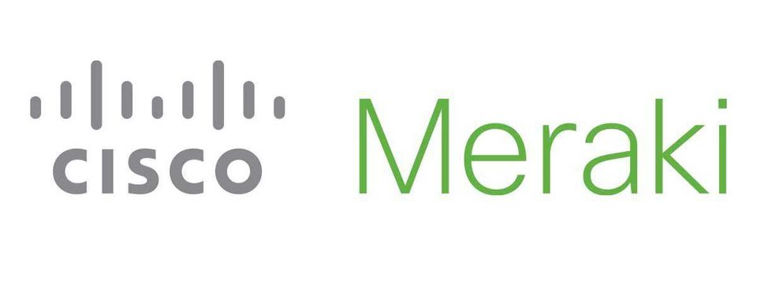
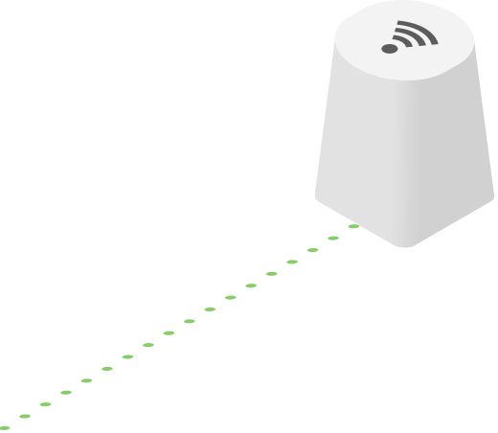
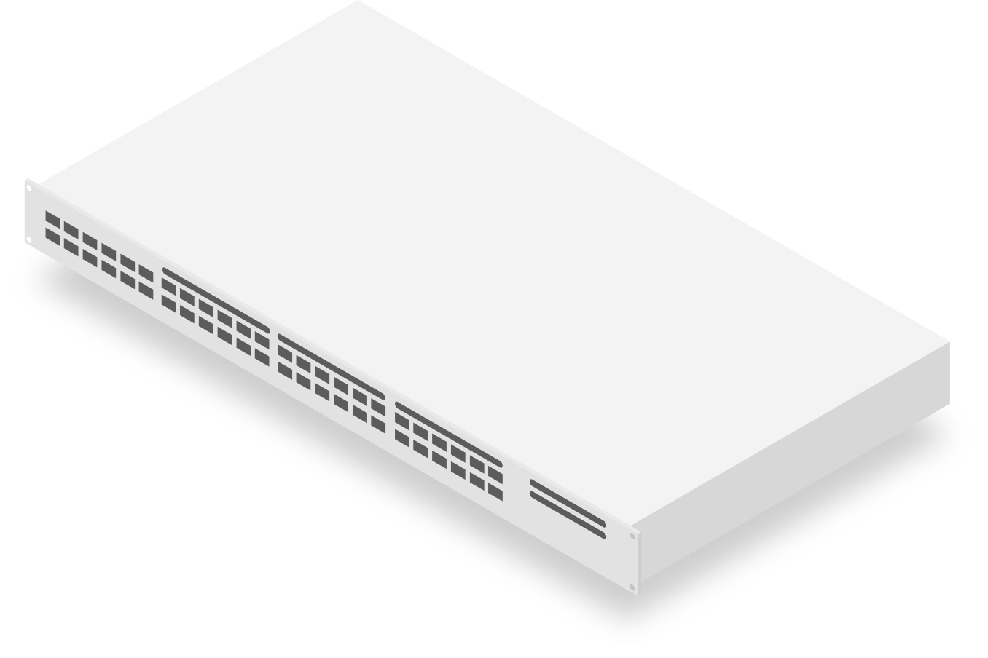
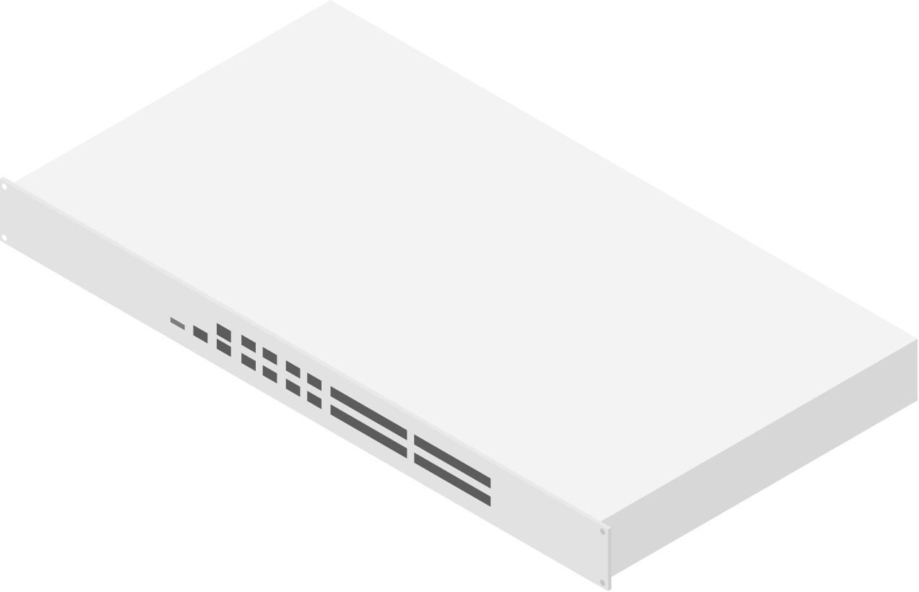
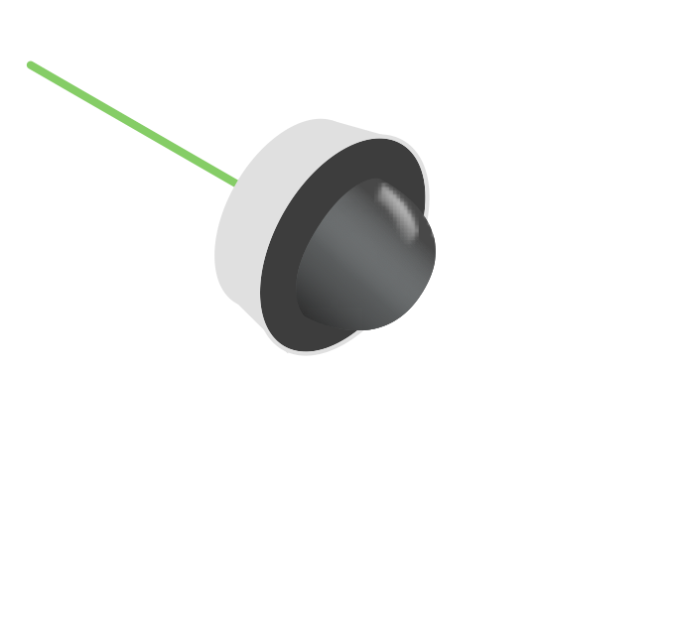
Security Made Simple
With Cisco Meraki

Slide 2
Simplifying powerful technology to free passionate people to focus on their mission.

Slide 3
Security is a journey not a destination
Notes:
Cisco Meraki is already the most secure full-stack networking solution

Slide 4
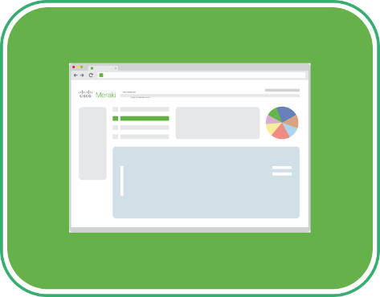
A Comprehensive Cloud Platform
OUT-OF-THE-BOX
MANAGEMENT & ANALYTICS
INTEGRATIONS & SOLUTIONS
POWERED BY MERAKI
{ APIs }
Automation of repetitive tasks
“1 click vs 1,328 clicks”
Platform Integrations
“Meraki plus ______”
Tailored solutions
“Seamless device onboarding”
Notes:
Meraki is already the most secure, most complete full network solution on the market

Slide 5
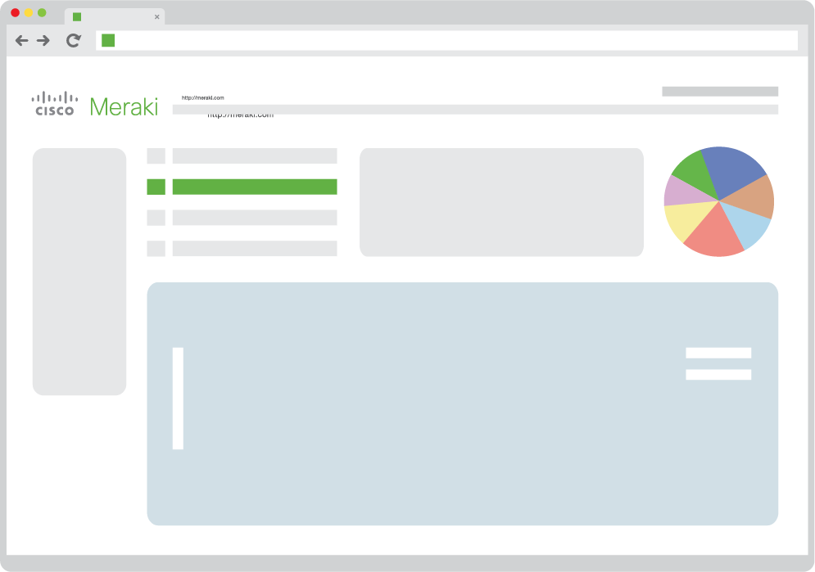
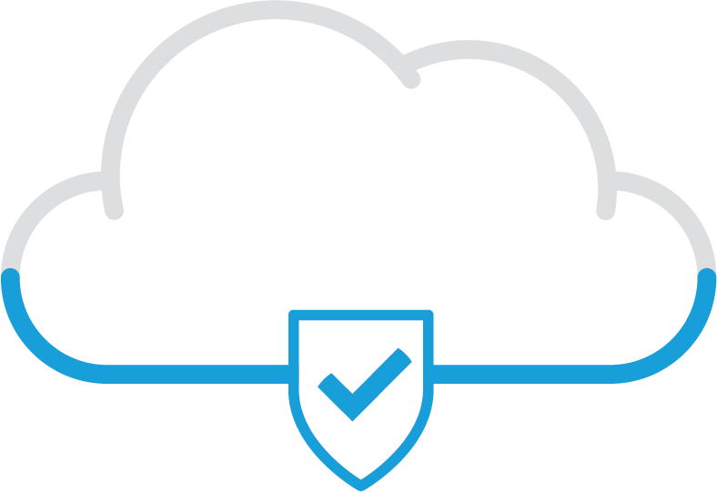
A Head Start in Cloud Managed Security
MR
Intrusion Detection
MX
Umbrella
MS
Open & Extensible APIs
AMP
MI
ISE
SM
MV
Talos
Notes:
Dashboard on top left, all Meraki devices are down below
On the right side Talos should be in the foreground and others smaller circles to include, AMP, Threatgrid, ISE, Umbrella. CDO should be shown as a dashboard.

Slide 6
Trustworthy Solutions
Security features that ensure that the Meraki platform is tamper proof
TRUST ANCHOR
IMAGE SIGNING
A tamper-resistant chip in Cisco products that provides secure storage and crypto services.
Creates a unique digital signature and encryption for code using a Cisco private key.
SECURE BOOT
RUNTIME DEFENSES
Ensures code in hardware is authentic while protecting Cisco devices from non-compliant software
Makes it impossible for attackers to exploit running software by targeting malicious code running in software.

Slide 7
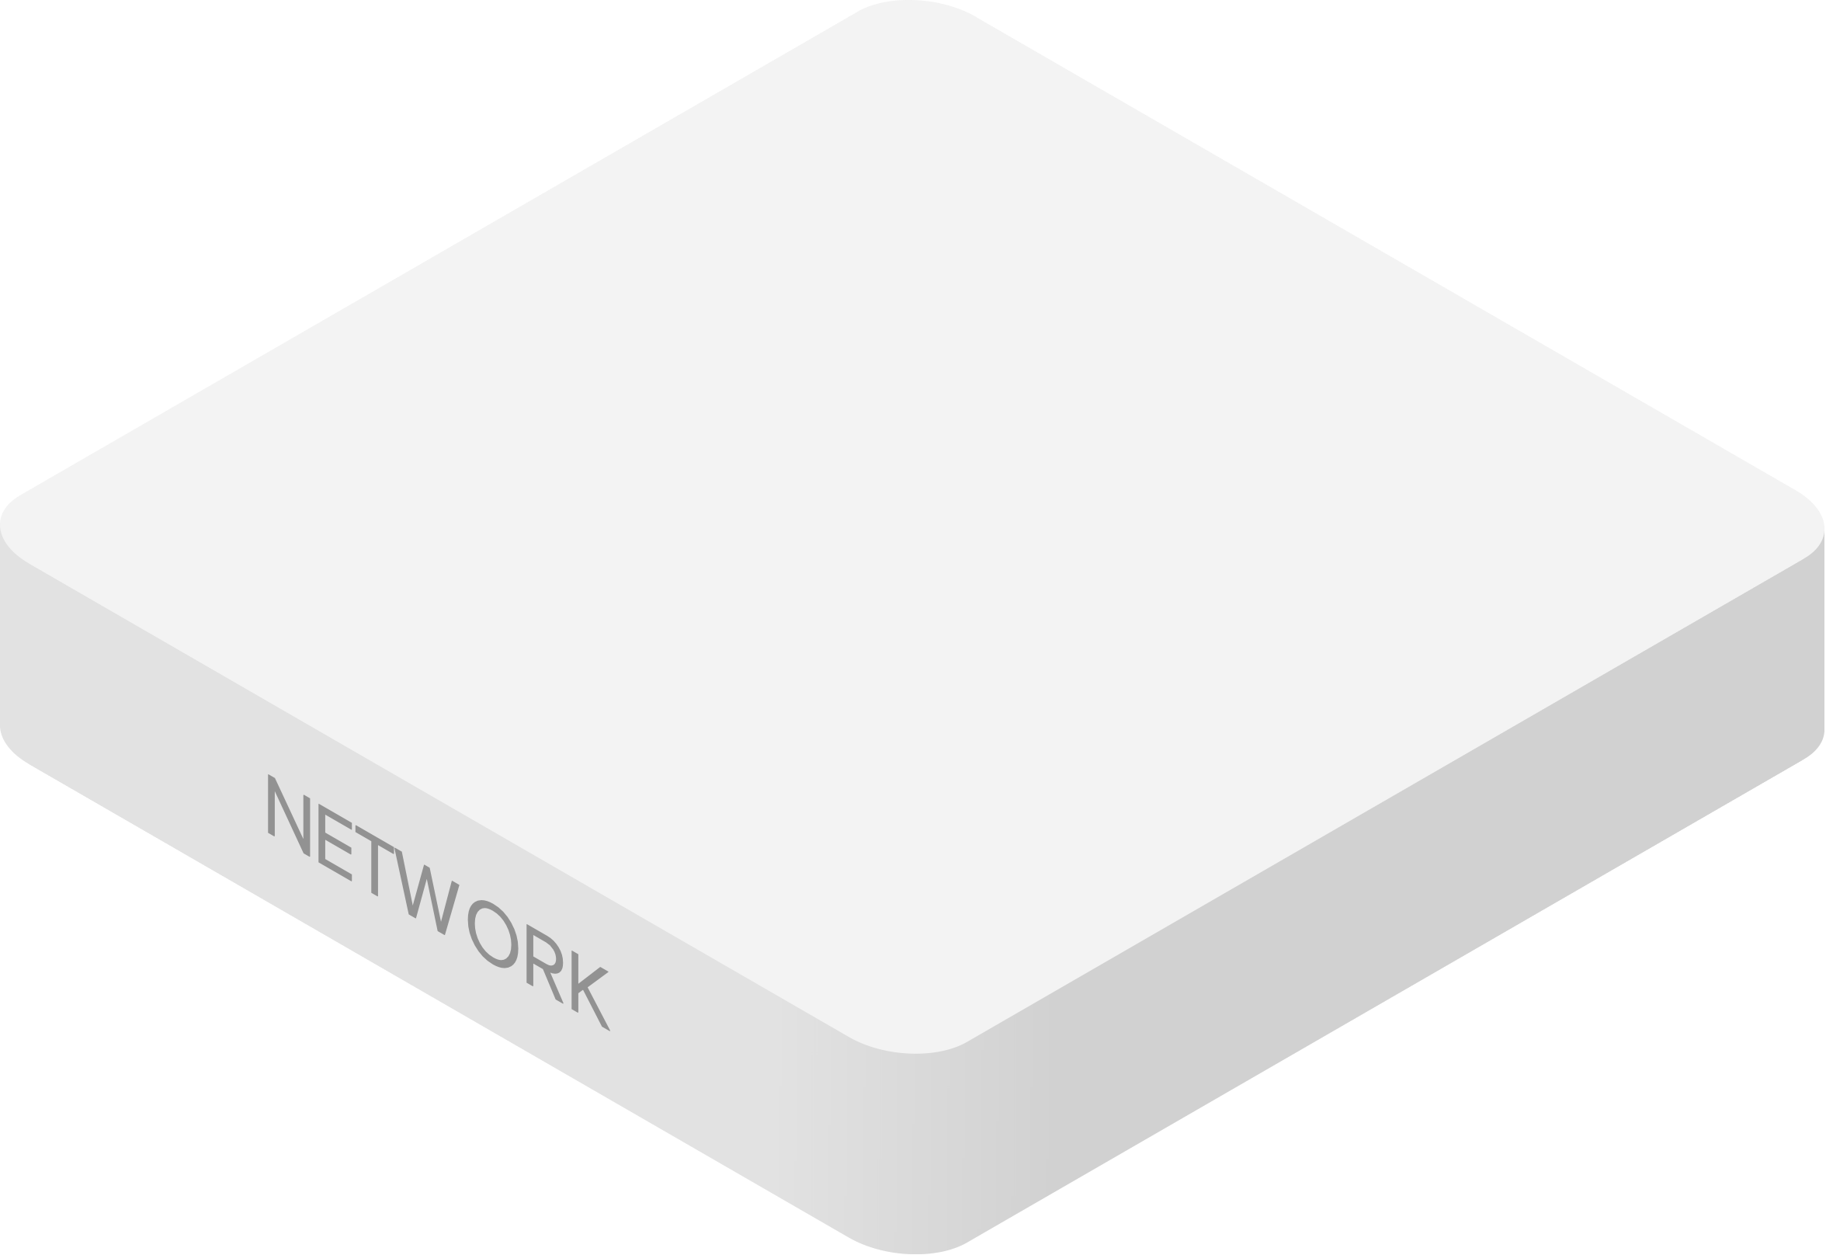
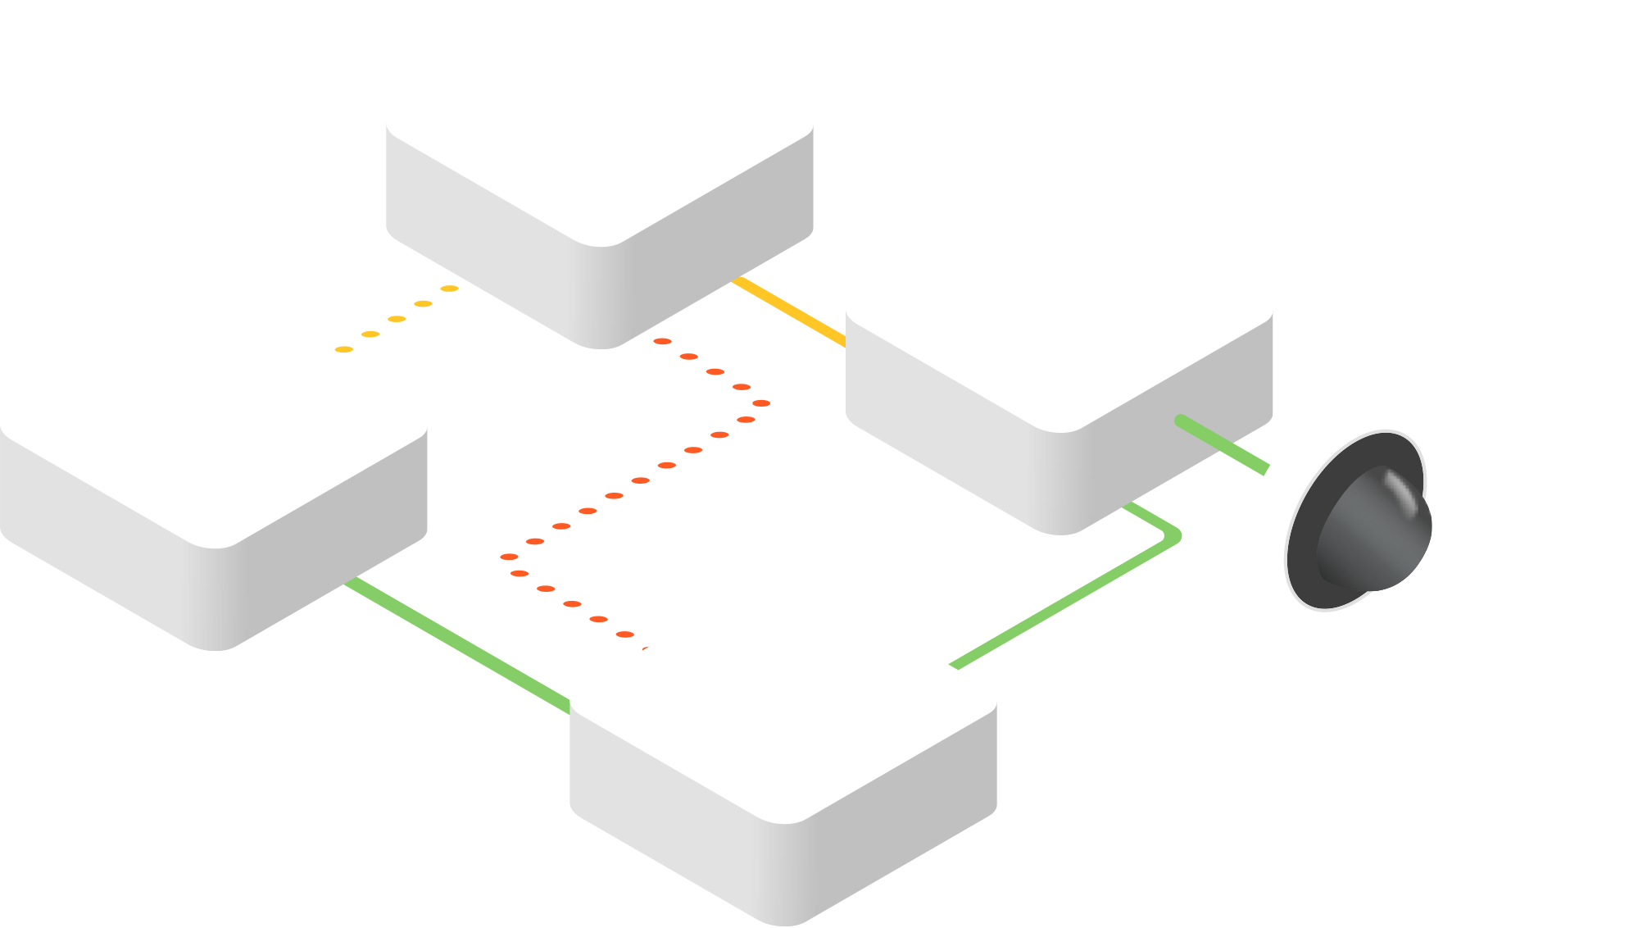
Securing the Network can be Hard
Securing various network devices is manual and difficult
Notes:
Get data for this…

Slide 8
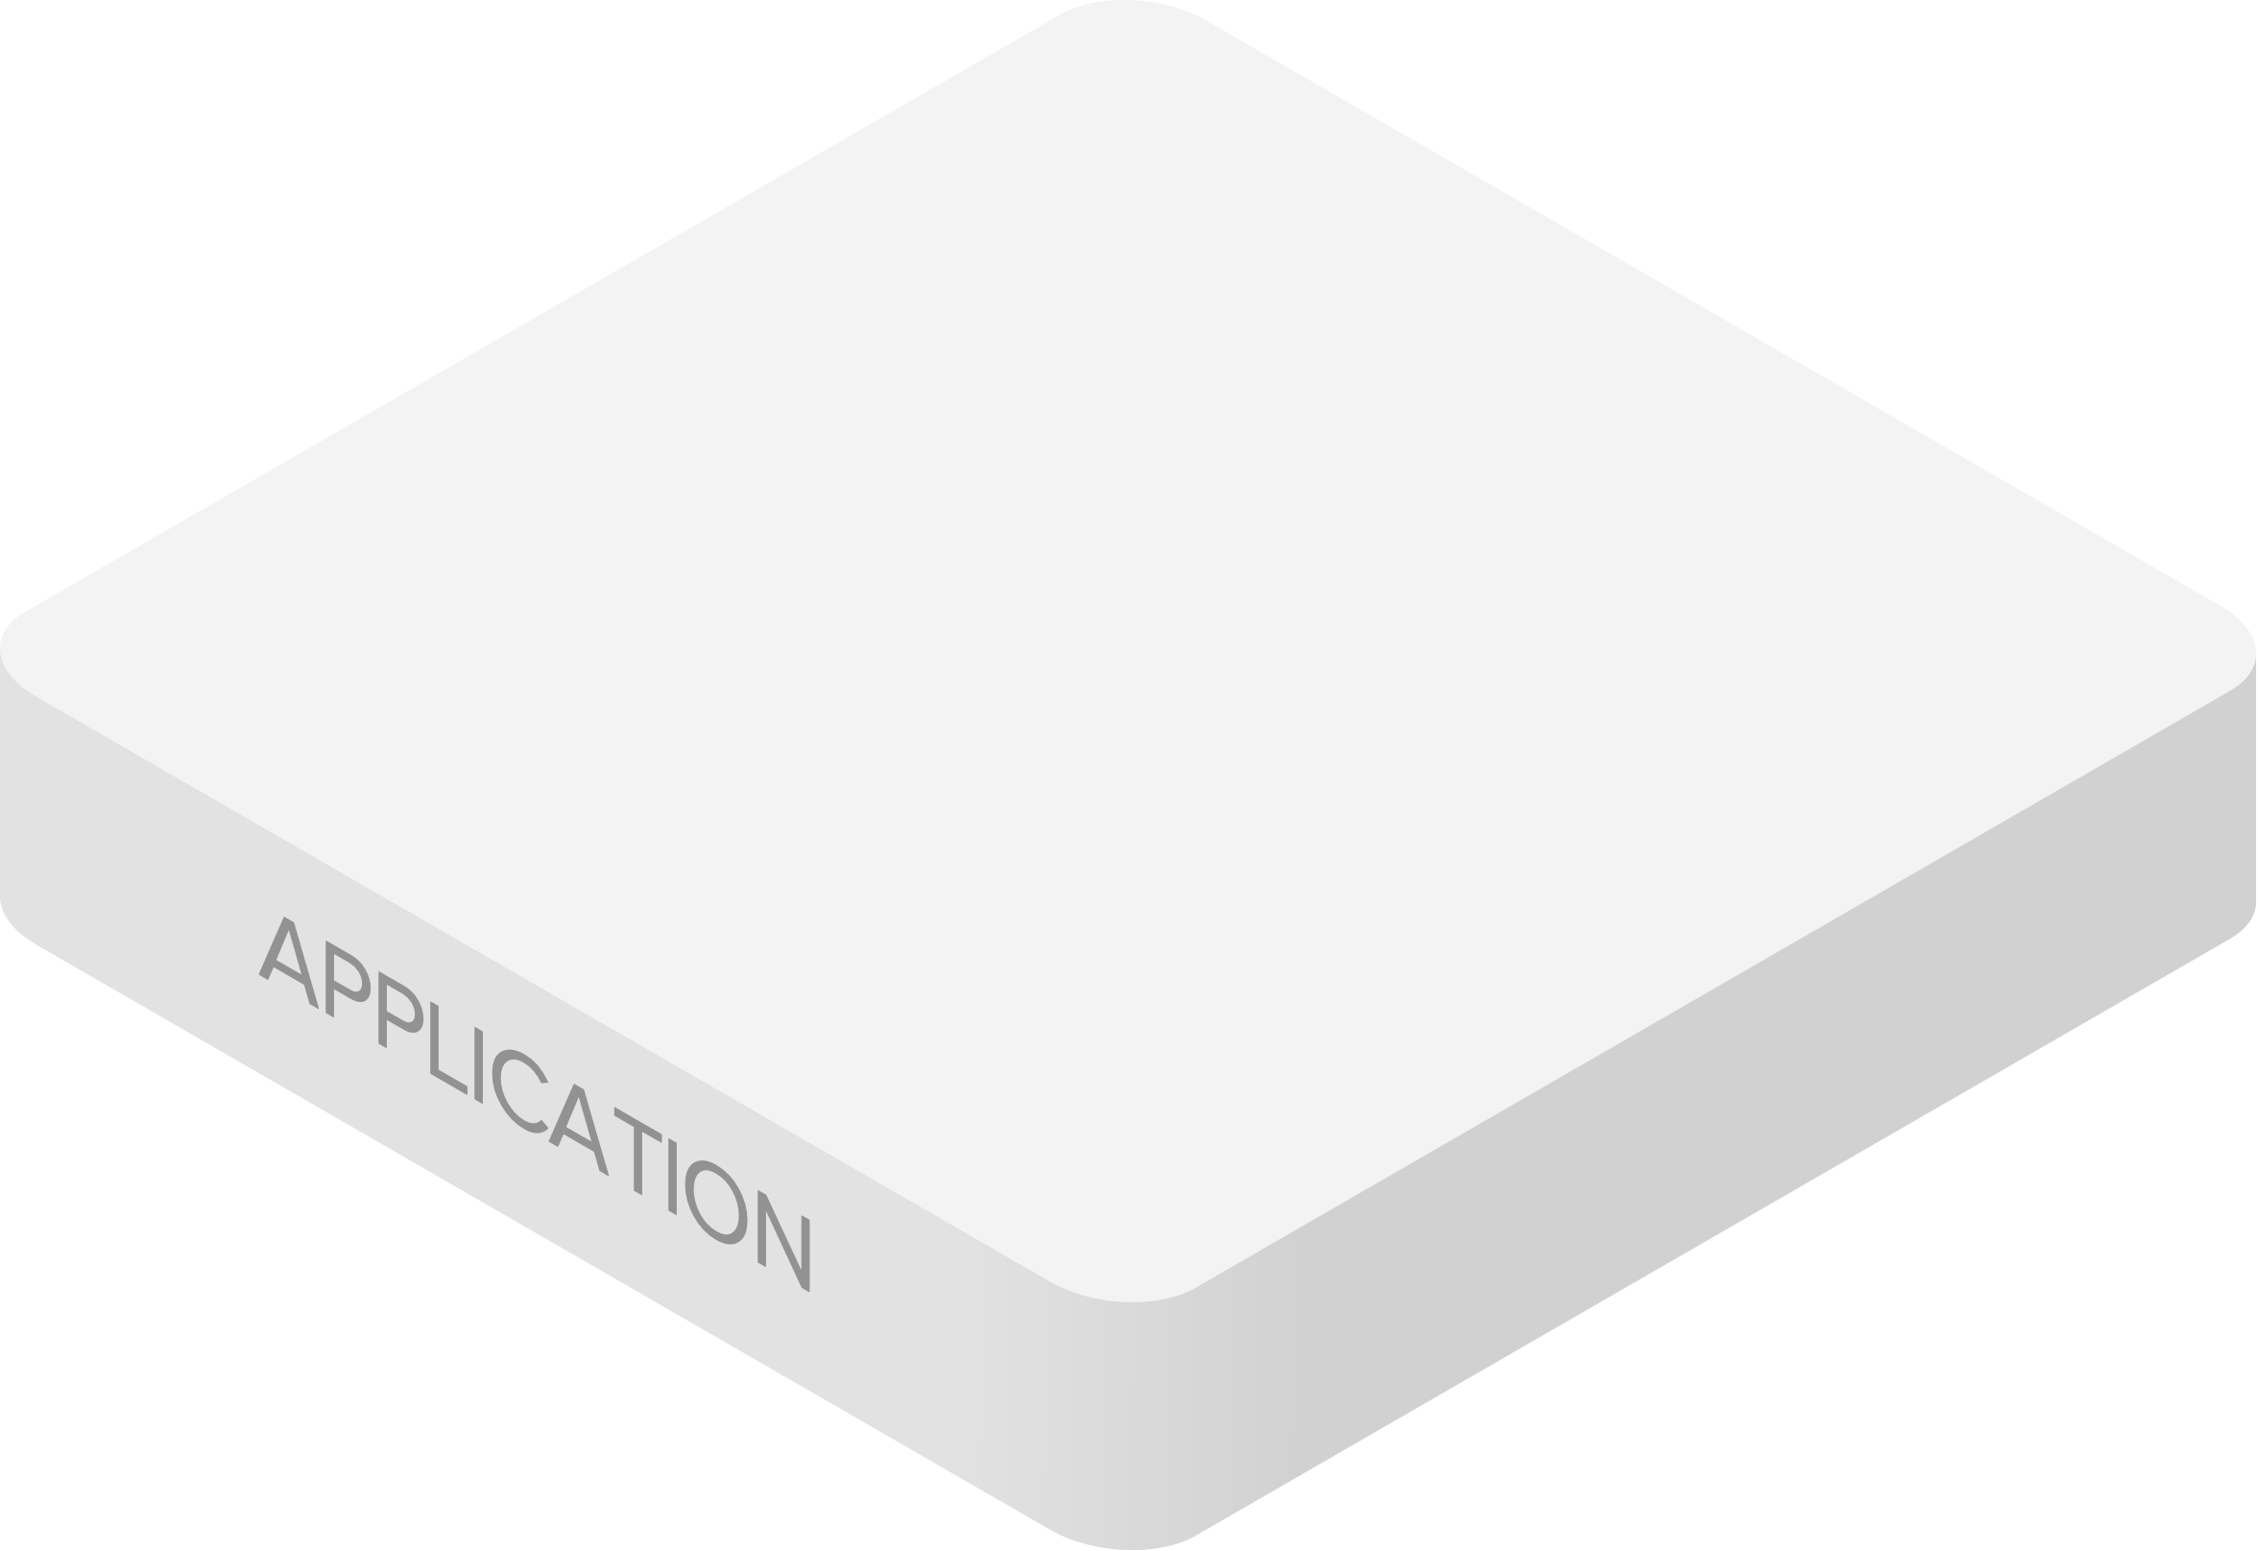
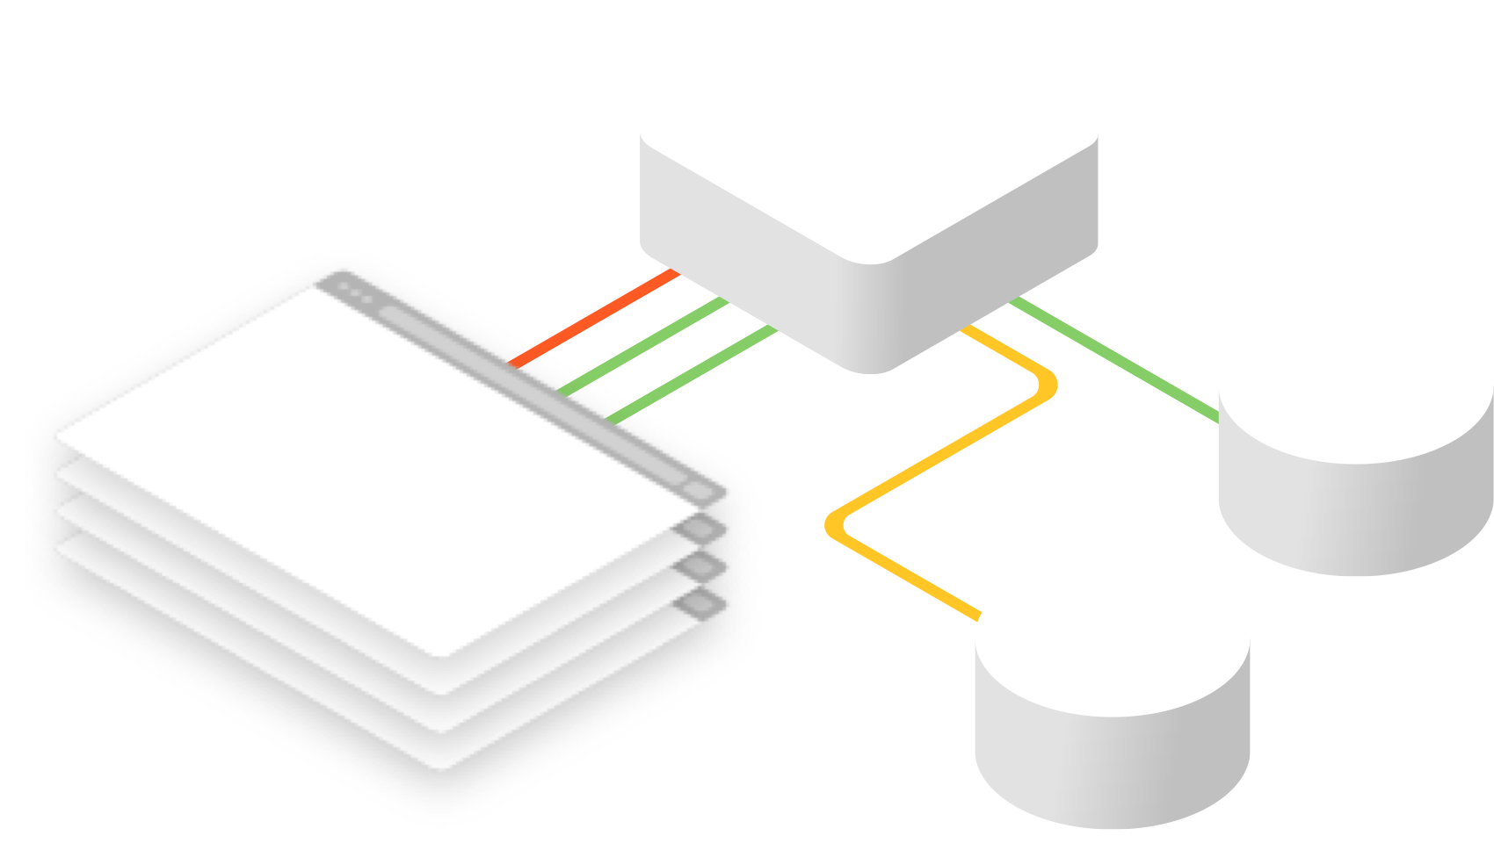
Securing the
Application Layer
can be Complicated
Malicious cyber-attacks are evolving
Notes:
Get data for this…

Slide 9
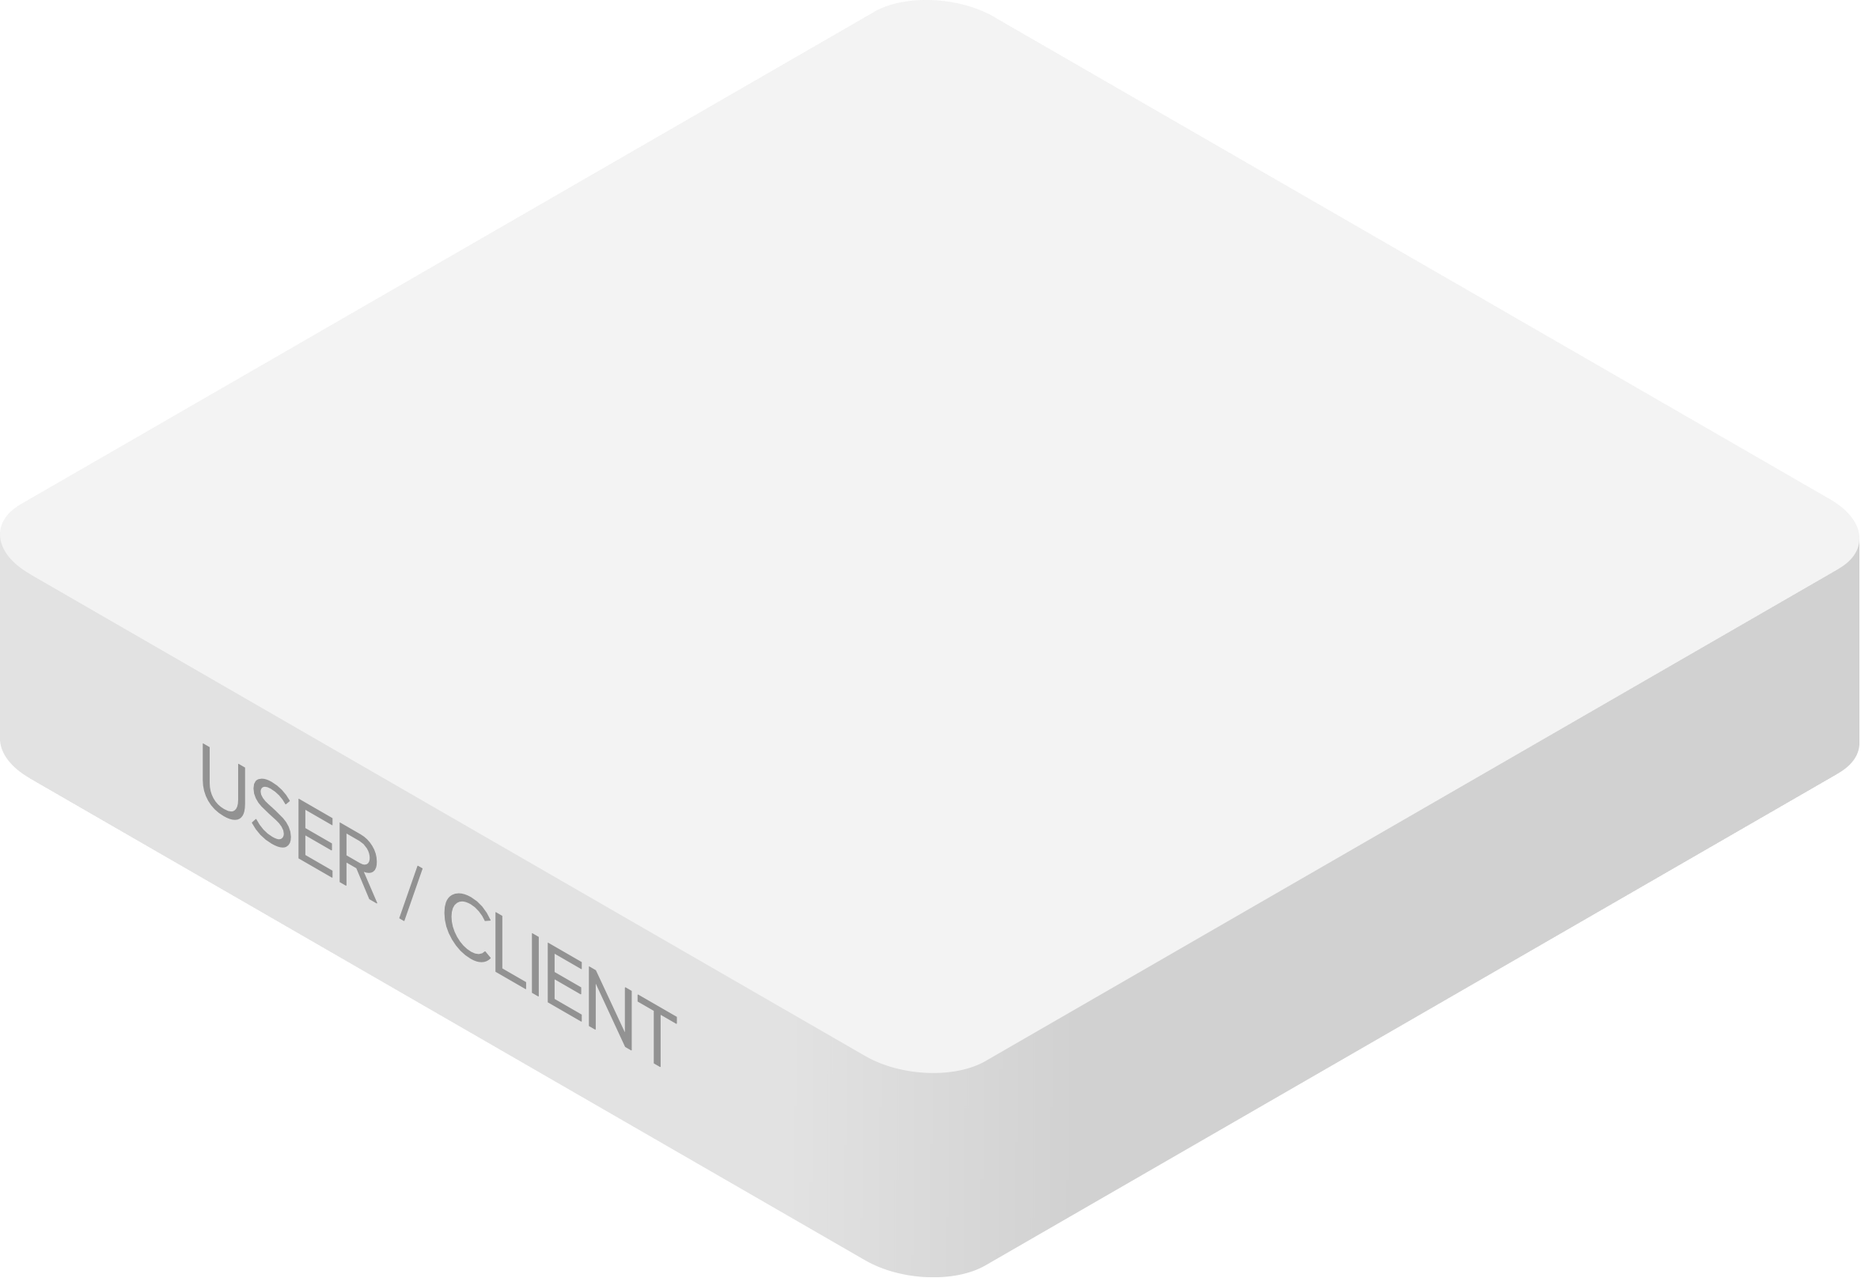
Securing the devices and users adds to the complexity
IOT devices don't support 802.1x and BYOD policies stress security postures
Notes:
Get data for this…

Slide 10
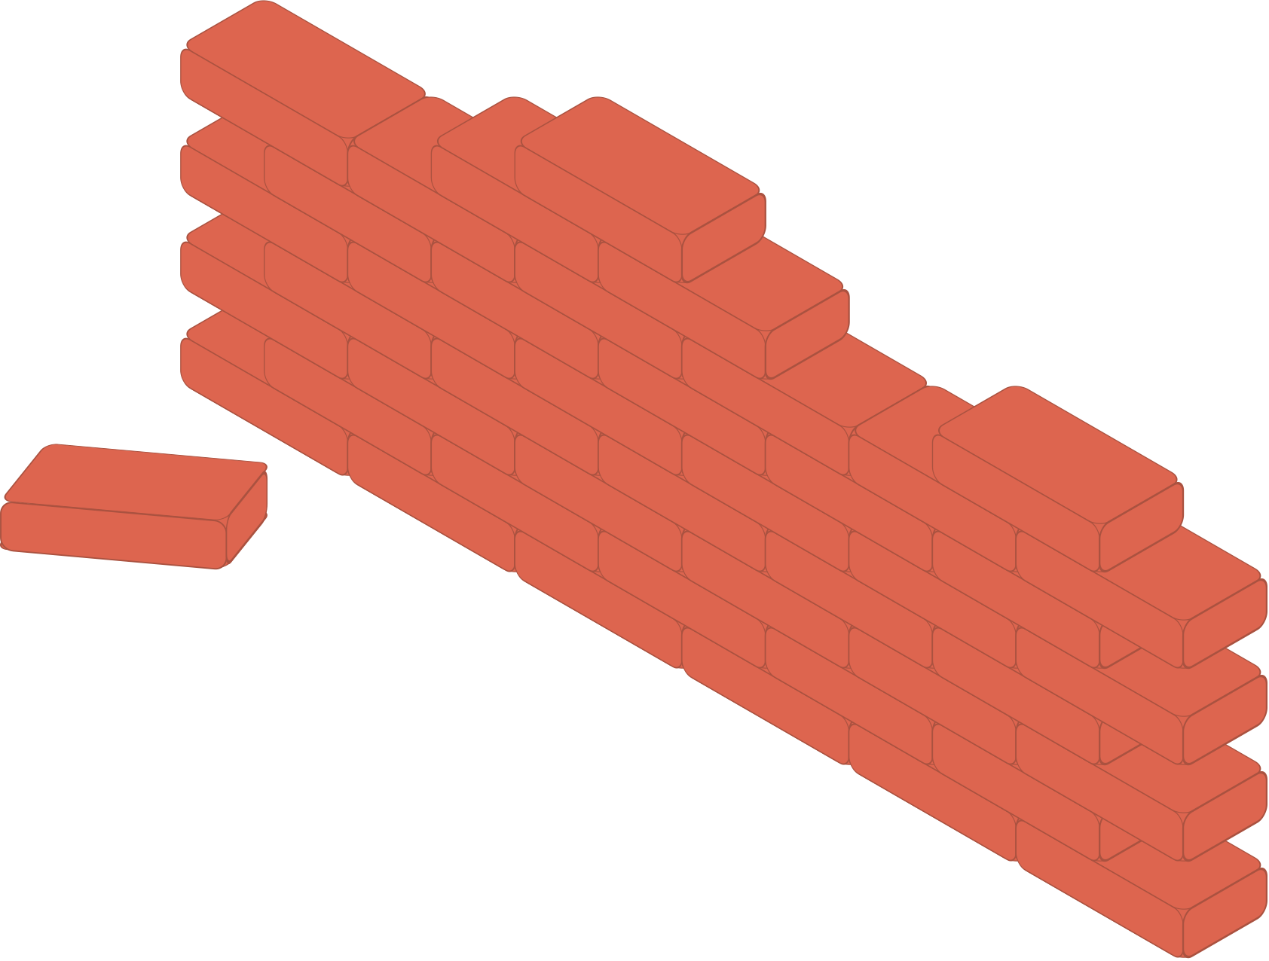
Too Many Obstacles for Comprehensive Security
Everything is manual and done through
multiple dashboards
Security rules are not scalable
“Just slap in a firewall”
Notes:
Bu it doesn’t have to be this way

Slide 11
The Perimeter is evolving into micro-perimeters
Customers need a security posture and a framework that works across the whole network

Slide 12
Let's talk about our new features that address this...

Slide 13
Meraki Trusted Access
INTRODUCING
Enables personal devices to access critical resources without requiring installation of an MDM
Enabled with MR +
Notes:
Being certain about who is trying to get connected, with what device type, and when is obsolete and far from the IT admin’s reality. Meraki Trusted Access provides visibility into users and devices and enables secure network access seamlessly.

Slide 14
Identity PSK
IoT Group 1
Radius
Server
INTRODUCING
Unique policies per group of IoT devices on a single SSID
Enabled with MR Devices
IoT Group 3
IoT Group 2

Slide 15
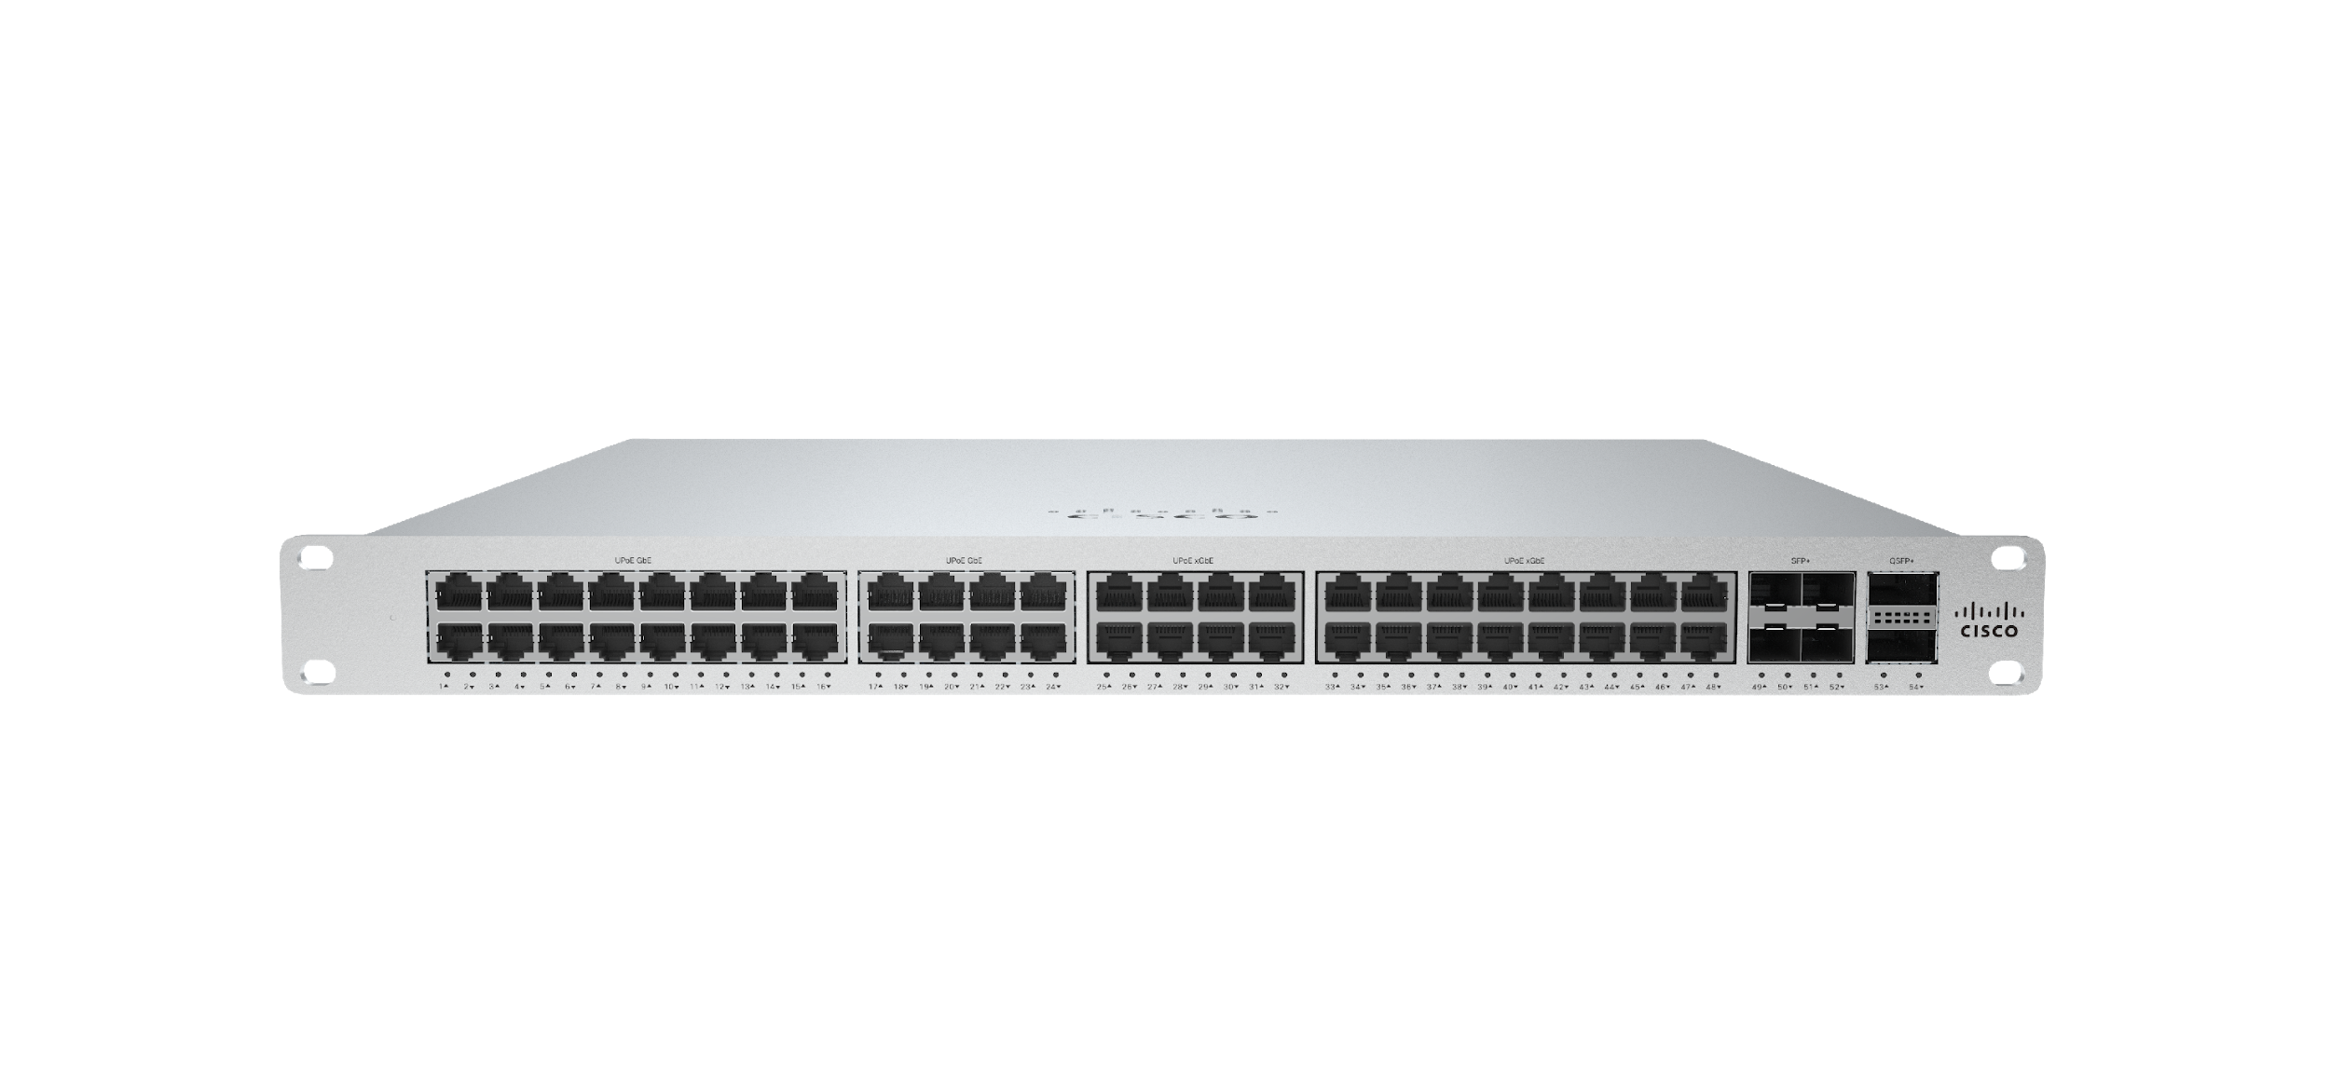
SecureConnect
INTRODUCING
Automated switch port-detection between MR and MS
with MS210 and above models
on Wi-Fi 5/6
MR
Notes:
Of course, beautiful hardware needs to be paired with incredibly simple software and Meraki is going to change the industry with an extraordinary feature called Secure Connect
Imagine, taking your Meraki AP and plugging it into your Meraki switch and having Dashboard securely, cryptographically allowing the two devices to authenticate and communicate and automatically configuring your APs to your desired settings
Other solutions on the market today simply leverage CDP and LLDP to detect the device type and then give access from there, which is ripe with security vulnerabilities. That's only the beginning for us, since we're building this solution on top of Cisco's world-class private key infrastructure paired with the power of Dashboard to completely automate the infrastructure required to do this via standards-based certificate authentication."
We are building this solution on top of Cisco's world-class private key infrastructure paired with the power of Dashboard

Slide 16
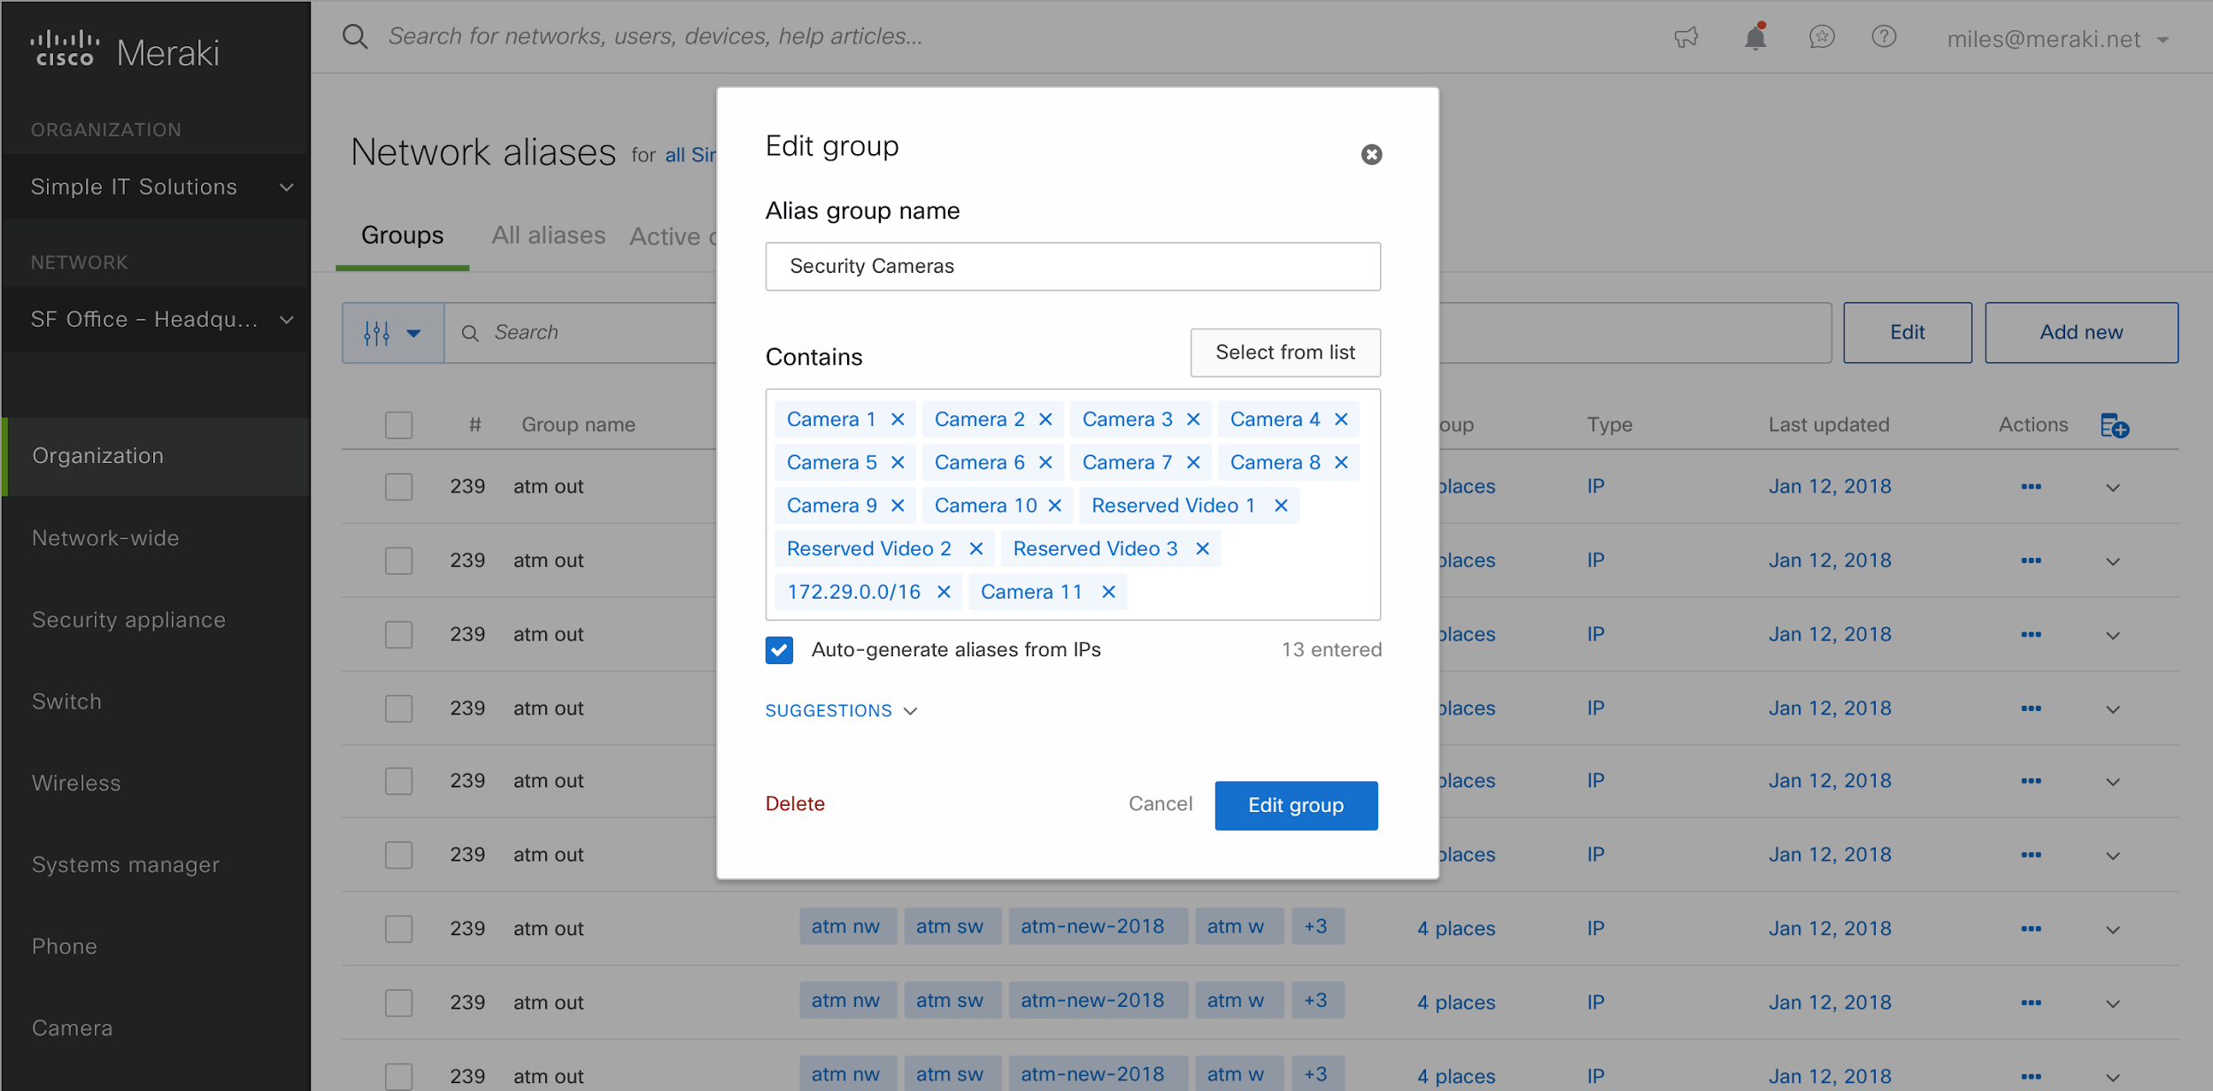
Enhanced Firewall Rules on MX
INTRODUCING
Consolidate firewall rules using logical groups and aliases

Slide 17
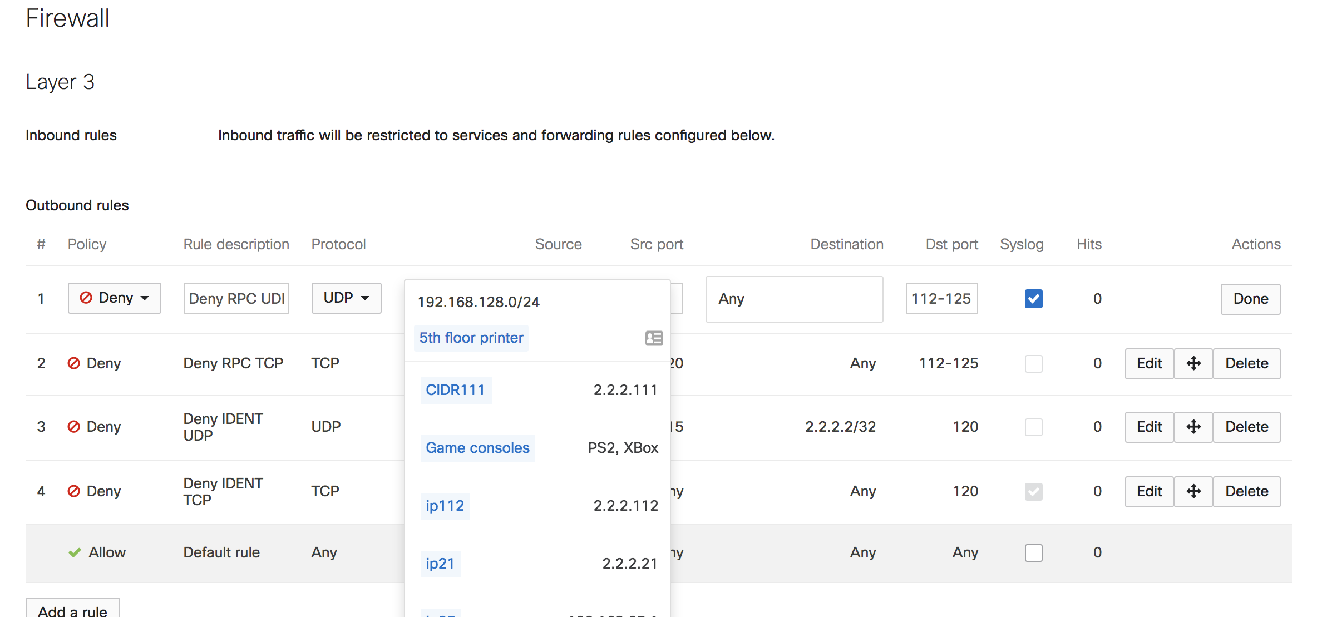
Enhanced Firewall Rules on MX
Consolidate firewall rules using logical groups and aliases

Slide 18
MR + Cisco Umbrella Integration
INTRODUCING
One license, two solutions. Zero touch DNS traffic protection and content filtering.

Slide 19
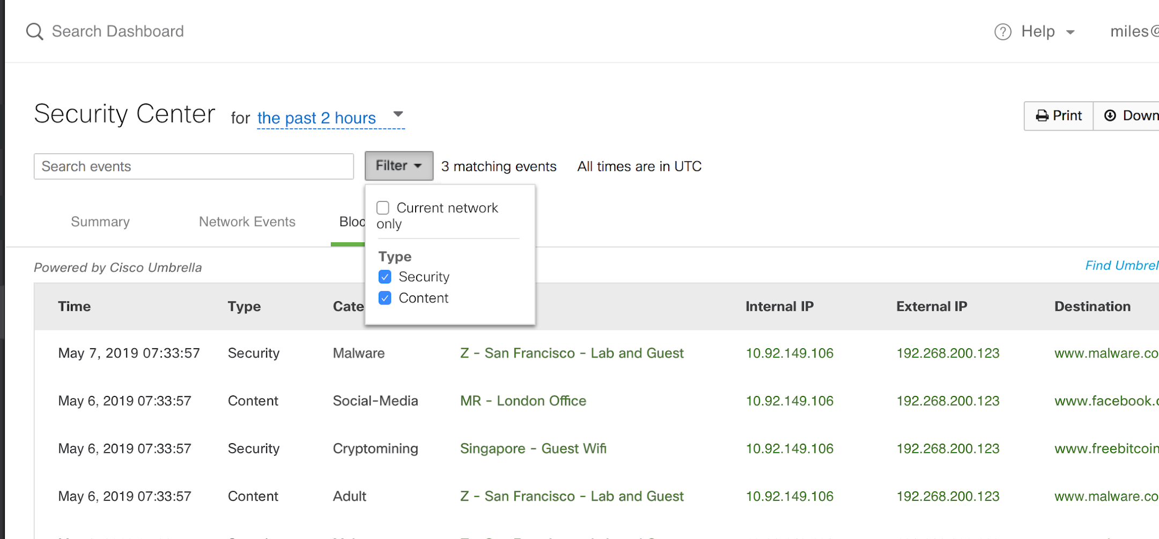
Umbrella Events now in the Meraki Dashboard
Notes:
If you want to build custom policies, please use the power of the Umbrella dashboard

Slide 20
Now the big thing…

Slide 21
INTRODUCING
The next generation of access switching
MS390
Notes:
From our entire portfolio, if you have to remember one switch, it is the MS390 and Why ?
What makes it….

Slide 22
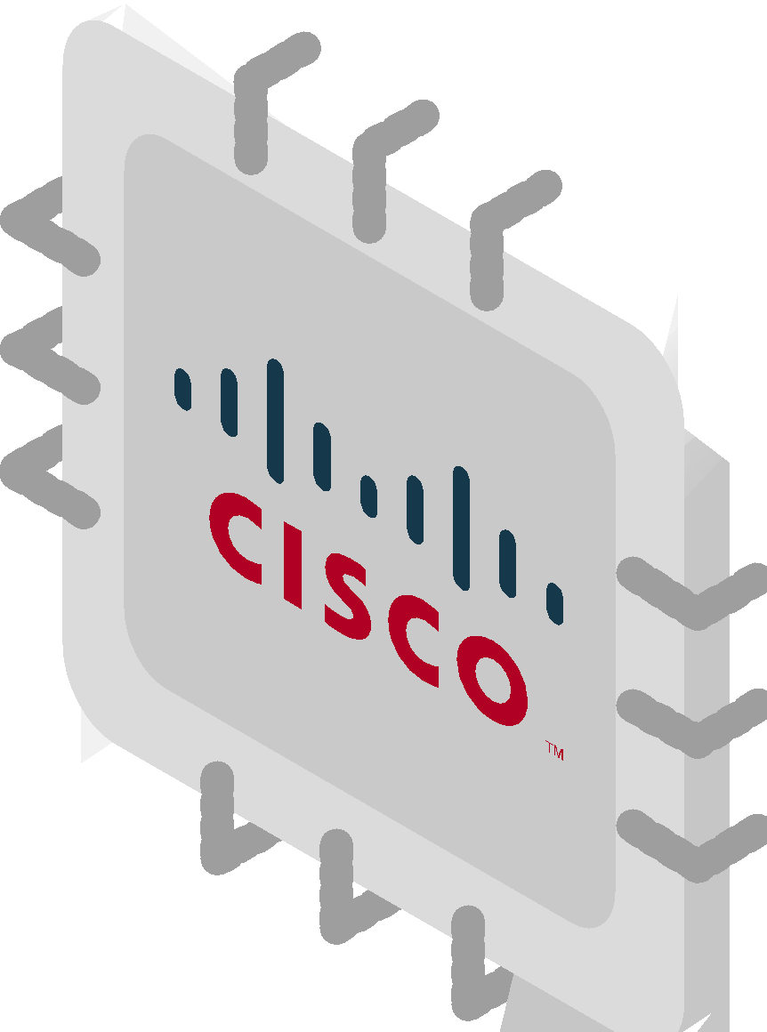
What Makes the MS390 Special?
Dashboard Simplicity
The first Meraki device with Adaptive Policy
Cisco Power
Notes:
Get data for this…

Slide 23
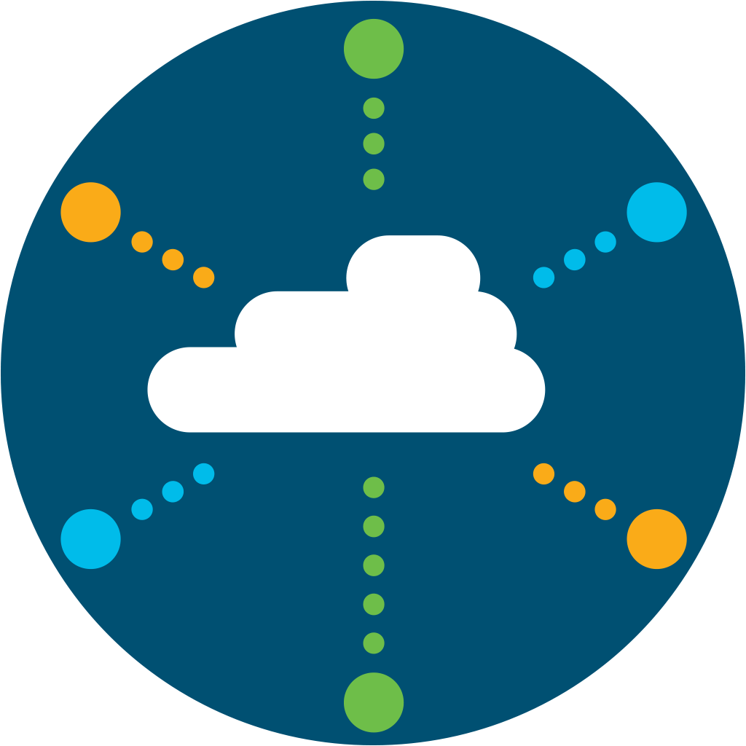
Multi Domain
Users
DC
SD-WAN
Public
(IaaS)
Things
Public
(SaaS)
SD-Access
Cloud
Edge
Internet
Devices
Notes:
With Cisco

Slide 24
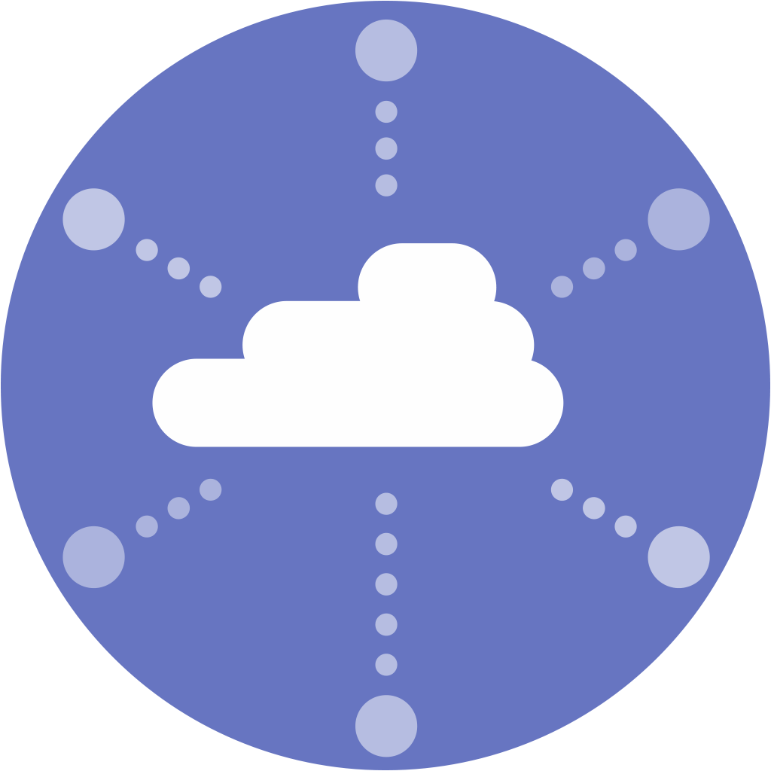
Multi
Domain
Users
SD-Access
DC
SD-WAN
Things
Cloud
Edge
Public
(IaaS)
Devices
Users
Public
(SaaS)
SD-WAN
Things
Adaptive
Policy
Cloud
Edge
Internet
Devices
Notes:
With Adaptive Policy, this is how Meraki compares to Cisco’s network architecture

Slide 25
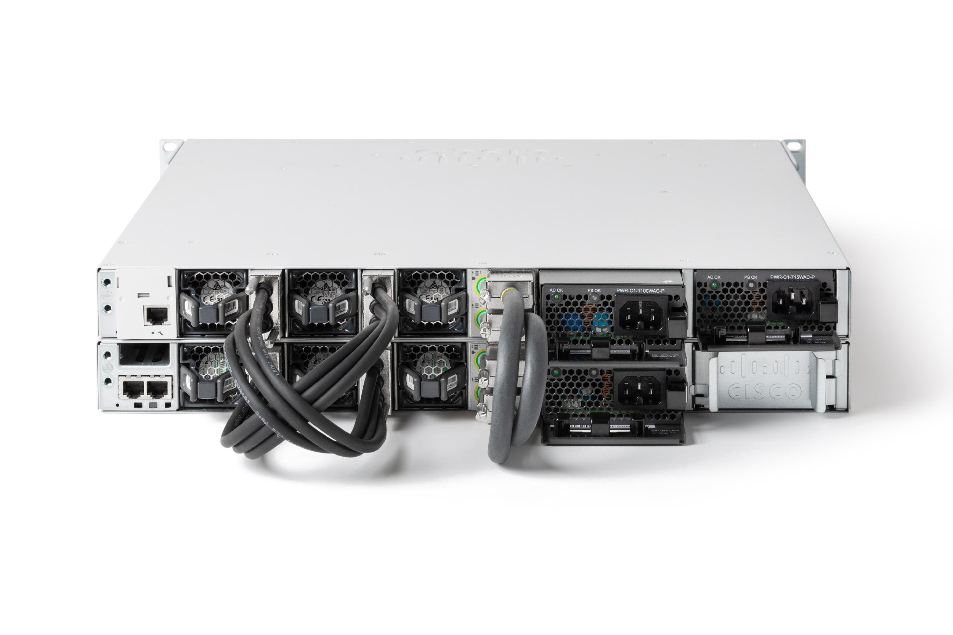
Advantages of the MS390
48-port PoE & mGig
Adaptive Policy
480 Gbps Stacking
Modular Uplinks
StackPower
Physical Stacking

Slide 26
INTRODUCING
License Tiers
Enterprise
Advanced
MS350 Feature Parity
OSPF (Max 1,000 routes)
MS350 Feature Parity
Full Routing + Adaptive Policy
Notes:
+ Flexible Netflow**
ETA**
Macsec-256**
*Naming and license content NOT finalized - subject to change
**Future (NOT committed) examples

Slide 27
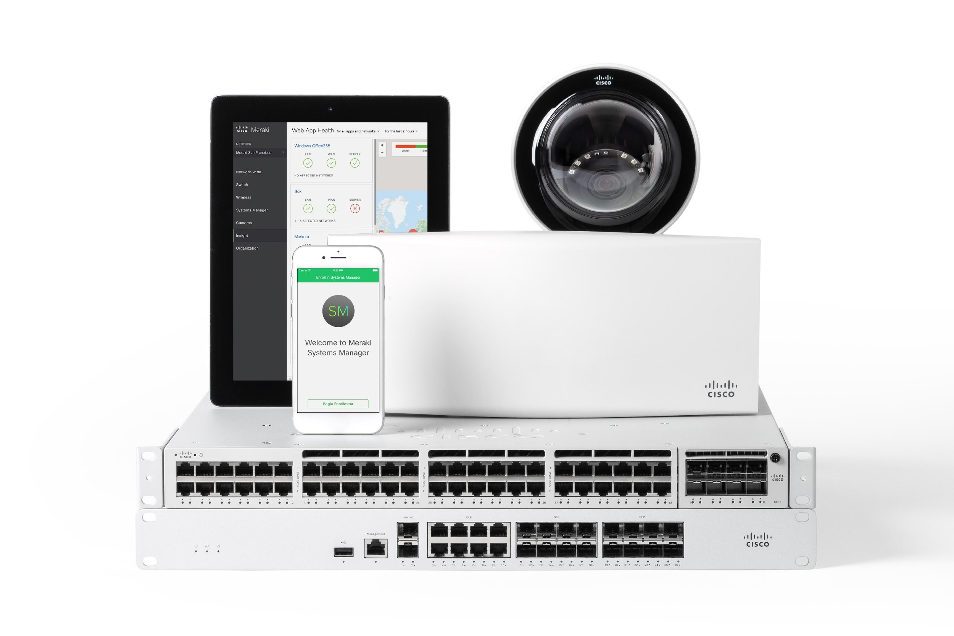
A secure platform
Notes:
We are the only one that encrypts the PPSK
Is there a checklist of features for security ?
Ensure that we are able to show ONLY Meraki can do this
So what ? Before and after….. time and security.. stats on open ports..
Zeus, Brandon ?
Elevate the story with security/CIO is good
how the custom silicon allows us to do things better than before
Difference between Catalyst and Meraki portfolio
New plays with Luxtera, web scale applications more.. Hardware matters story.. Tie into this..
References
Positioning: Lean IT and Traditional IT… Easier to manage features across Catalyst Campus and Meraki Branch

Slide 28
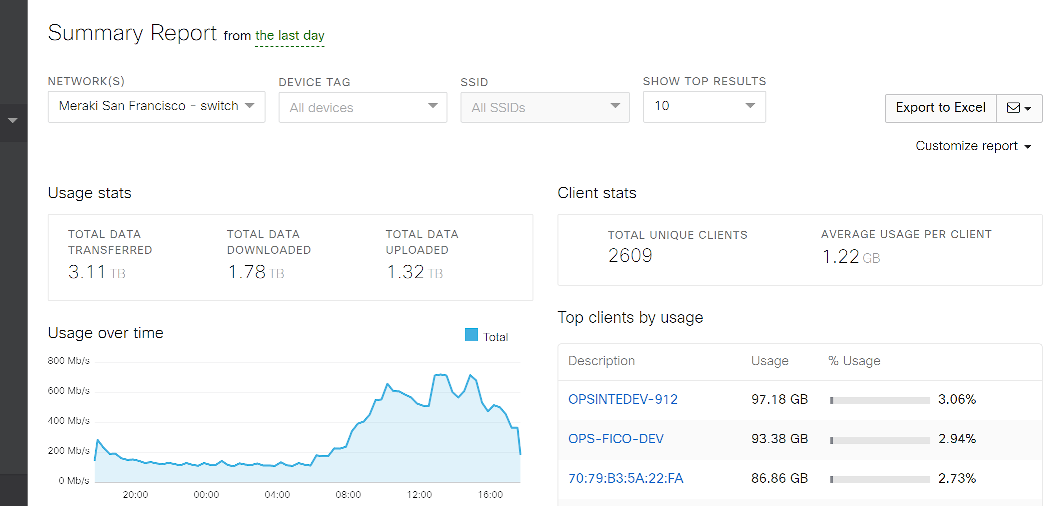
In One Intuitive Dashboard

Slide 29
Security Made Simple
Only Cisco Meraki can deliver on this promise for a digital workplace
SIMPLE
SECURE
DIGITAL WORKPLACE
Increased Productivity & Error Reduction
Efficient & Reliable Visibility of Policy
Dynamic & Scalable Automation of Policies

Slide 30
Oh! One more thing…

Slide 31
Meraki MG21/21E
INTRODUCING
Cloud-managed Cellular Gateway
Features
Cat 6 LTE Up to 300 Mbps | Multi-surface mounting bracket
2 X 1000 BaseT | Integrated high performance antenna (non E model)
Nano SIM slot | External antenna capable model
DC / PoE powered | Dipole included Patch antenna available

Slide 32
Simplifying powerful technology to free passionate people to focus on their mission.
TECHNOLOGY THAT SIMPLY WORKS

Slide 33
Thank you

