Slide 1
Security Evolved
More Effective Security with Cisco NGFW + Cisco’s Integrated Architecture
© 2019 Cisco and/or its affiliates. All rights reserved.

Slide 2

Advanced threats have evolved

Slide 3
They can evade even the best preventative security measures and get inside

Slide 4
Yet most organizations still focus 100% on prevention, with limited ability to deal with threats once they’re inside

Slide 5
In hopes of improving security posture, a multitude of disparate point-products are thrown at the problem
Vendor A
Vendor B
Vendor C
Vendor D
Vendor E
Vendor F
Vendor G
Vendor H
Notes:
In hopes of improving their security, they throw a multitude of disparate point-products at the problem. So now they are managing multiple products with multiple interfaces, and these products don’t necessarily share information, communicate with one another, or automate security operations.

Slide 6
But when you have a mixed bag of point-products that don’t communicate with one another, it increases complexity and can make you less secure
55% Of customers rely on more than 5 vendors to secure their network¹
Security Gap
54% Of legitimate security alerts are not remediated due to lack of integrated defense systems²
Complexity
100 days Industry average to detect common threats³
Capabilities
¹ Cisco 2017 Annual Cybersecurity Report
² Cisco 2017 Annual Cybersecurity Report
³ Cisco 2016 Mid-Year Cybersecurity Report
Notes:
To create an advanced defense against security threats, a multitude of new point solutions will be added. In fact, the average customer relies on more than 5 vendors to secure their network.
These solutions may work for a while but adding solutions that don’t seamlessly integrate with your existing setup can add unnecessary complexity to your environment and actually make you less secure.
The more point solutions, the more difficult it is to correlate information between them to gain a clear picture of what is going on in your business. Every new solution comes with another management interface, and each one demands human resources and management hours to set up, set policy, and respond to alerts. You’ve now added complexity without much overall incremental effectiveness since your security solutions don’t work together or share information with each other.
This complexity can also hinder your threat defense. A lack of integrated defense systems can lead to up to 54% of legitimate security threats not being remediated. These threats continue to sit in your environment for far longer than they should, pushing the industry’s average of time to detect threats up to 100 days.
T: Often times, implementing these point security solutions means sacrificing the efficiency and effectiveness of your overall security posture. It’s time for a different approach.
<Click>

Slide 7

Security needs to evolve. What’s needed is an integrated system of security tools that work together to combat threats
ISE
Stealthwatch
Cloudlock
Network
ISR/ASR
Umbrella
Meraki
Advanced
Malware
Threat Grid
Email
Web
WWW
NGFW/ NGIPS

Slide 8
Cisco’s Integrated Security Portfolio works in concert to prevent breaches, automate response, and detect and stop threats fast
ISE
Event
Threat Intel
Policy
Context
ISE
Stealthwatch
Stealthwatch
Cloudlock
Cloudlock
Network
ISR/ASR
Network
ISR/ASR
Umbrella
Umbrella
Meraki
Meraki
Advanced
Malware
Advanced
Malware
Threat Grid
Threat Grid
Email
Email
Web
Web
WWW
WWW
NGFW/ NGIPS
NGFW/ NGIPS

Slide 9
At the heart of that integrated ecosystem should be a next-generation firewall that provides capabilities beyond just prevention
NGFW/ NGIPS
Cloud Access Security (Cloudlock)
UTM
Email Security
Secure Internet Gateway (Umbrella)
Advanced Malware Protection
Network Policy and Access
Network Analytics
Web
WWW

Slide 10
Cisco’s next-generation firewall provides built-in IPS and advanced malware capabilities to find and uncover threats fast
NGFW/ NGIPS
Cloud Access Security (Cloudlock)
UTM
Email Security
Secure Internet Gateway (Umbrella)
Advanced Malware Protection
Network Policy and Access
Advanced Malware Protection
NGIPS
AVC and URL Control
Network Analytics
Web
WWW

Slide 11



What differentiates Cisco Next-Generation Firewalls?
Stop Threats
Network Visibility and Analysis
Performance and Hardware Design
Cisco Talos Threat Intelligence
Integrated Security Architecture
Notes:
To address these challenges, Cisco NGFW brings the following capabilities:

Slide 12
Cisco NGFW blocks more threats, prevents breaches
Includes top-rated NGIPS: real-time contextual awareness and network mapping
Advanced malware protection (AMP) comes built-in to continuously analyze files, regardless of disposition, to uncover stealthy threats
Security automation and adaptive threat management
Built-in sandboxing: detect evasive and sandbox-aware malware
Behavior-based: considers file behavior and site reputation using over 1000 indicators
Proven leadership: NSS Labs ranks Cisco as leader in breach detection and security effectiveness
Stop Threats
Blocks more threats and prevents breaches
Notes:
Full list of bullets:
Impact assessment and contextual awareness helps to correlate intrusion events, and tells administrators what needs immediate attention
Includes top-rated next-gen IPS, with real-time contextual awareness and network mapping.
- Competitor IPS is signature based
Security automation and adaptive threat management
Built-in sandboxing capabilities (ThreatGrid) detect evasive and sandbox-aware malware
Considers file behavior and site reputation using over 1000 behavioral indicators
NSS labs ranks Cisco as leader in breach detection and security effectiveness

Slide 13
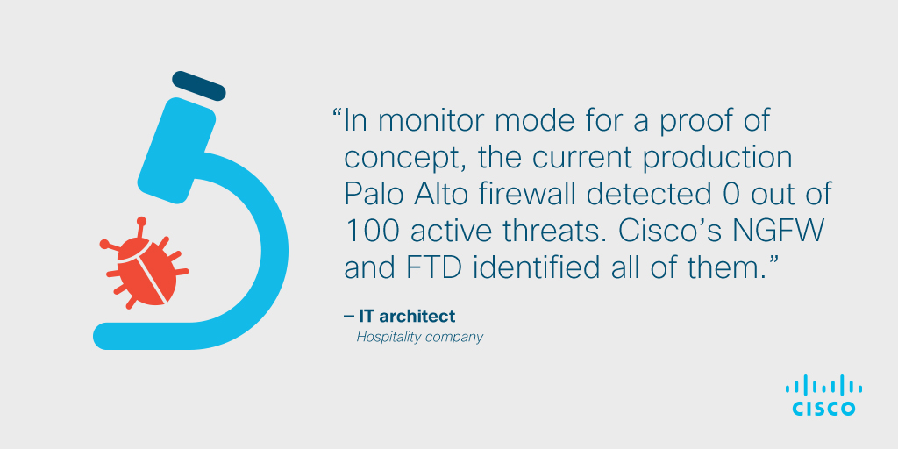
Cisco NGFW blocks more threats, prevents breaches

Slide 14
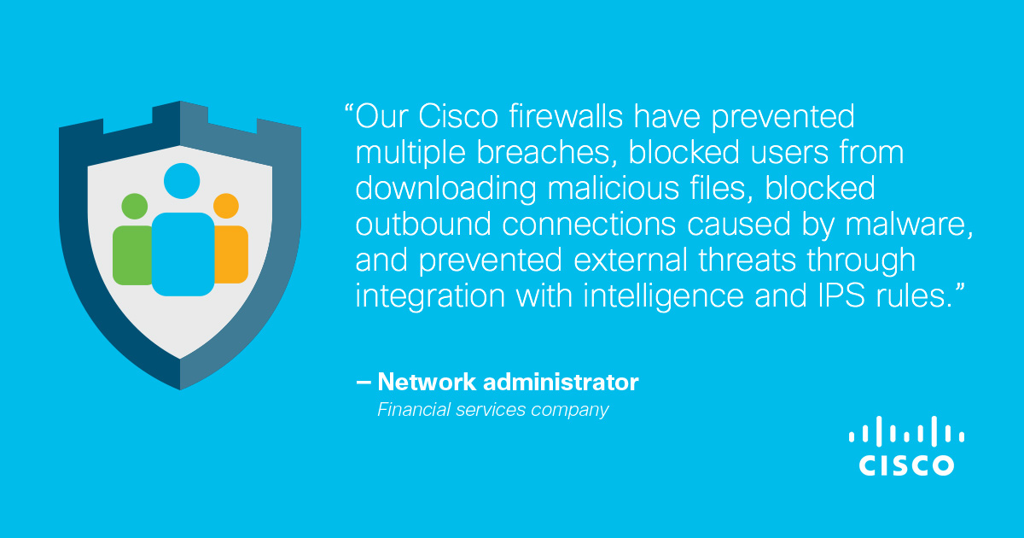
Cisco NGFW blocks more threats, prevents breaches

Slide 15
More visibility equals faster time to detection
Visibility into threat activity across users, hosts, networks, and infrastructure
Network file trajectory maps how hosts transfer files, including malware files, across your network to scope, set outbreak controls, and identify patient zero
Centralized management provides contextual threat analysis, with consolidated visibility into security and network operations
  Single or HA pair of consoles provides all updates, patching, reporting, and threat information
Network Visibility and Analysis
See more and detect threats faster
Notes:
You can’t protect against what you can’t see
Get visibility into threat activity across users, hosts, networks, and infrastructure
Centralized management provides contextual threat analysis, with visibility into users and user history on every machine, mobile device, client-side application, operating system, virtual machine-to-machine communications, vulnerabilities, threats, and URLs.
Network file trajectory maps how hosts transfer files, including malware files, across your network to see if it was blocked or quarantined. This enables you to scope, set outbreak controls, and identify patient zero.
Operations and management combined security and network operations (one console or HA pair of consoles provides all updates, patching, reporting, and threat information)

Slide 16
Gain more insight with increased visibility
“You can’t protect what you can’t see”
Client applications
Operating systems
Command and control servers
File transfers
Mobile devices
Threats
Routers and switches
Users
Application
protocols
Typical IPS
Web applications
Printers
Malware
Typical NGFW
Network servers
VoIP phones
Cisco Firepower™ NGFW

Slide 17
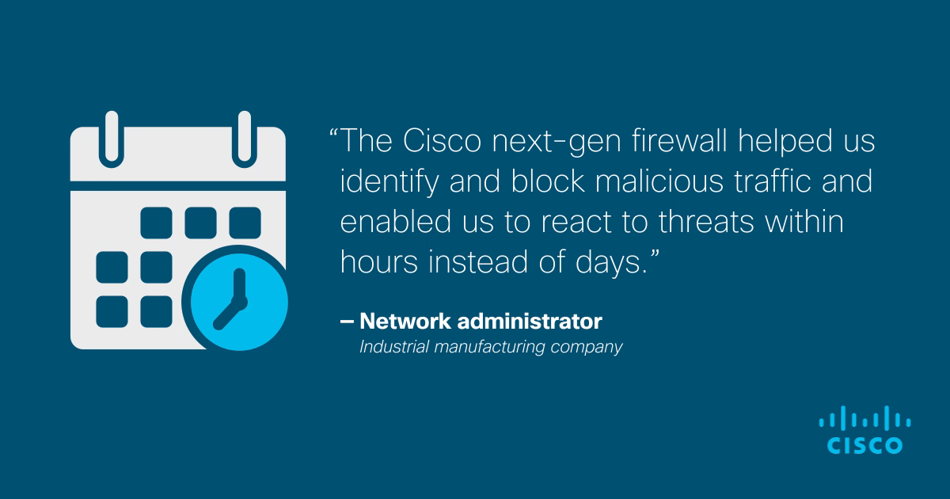
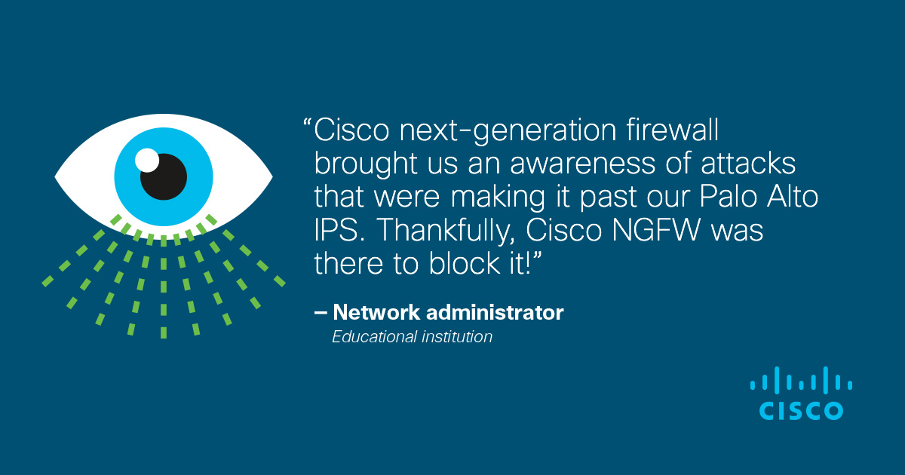
More visibility equals faster time to detection

Slide 18
Designed and optimized for better security
Sustained throughput performance when IPS threat inspection is enabled (FP2100) due to dual multi-core CPU architecture (vs. 40-60% competitive degrade)
throughput speeds from 2 Gbps to 8.5 Gbps
support for sixteen (16) 1 GE ports on the low-end and up to twenty-four (24) 1 GE ports or up to twelve (12) 10 GE ports on high end—all in a 1RU form factor
Dual multi-core CPUs
6.2.3 release in March delivered quality and performance upgrades
Performance and Hardware Design
Reliable hardware delivers exceptional security inspection performance
Notes:
Firepower 2100’s dual multi-core CPU architecture delivers
Sustained throughput performance when NGIPS inspection is enabled
Competing NGFWs degrade 40-60%, and if inspection is disabled, security is compromised
Cisco NGFW design advantages:
Flexibility and future-proofing versus ASIC-based designs that inhibit the ability to add new defenses and functions
Fast path accelerates flows not requiring threat inspection, to further enhance performance
Modbus, DNP3, and BACnet. SCADA protocols
Scanning architecture: OptiFlow vs. Single Pass, ASIC, or Multipass for competitor firewalls
Software-defined segmentation (Cisco TrustSec and ACI)

Slide 19
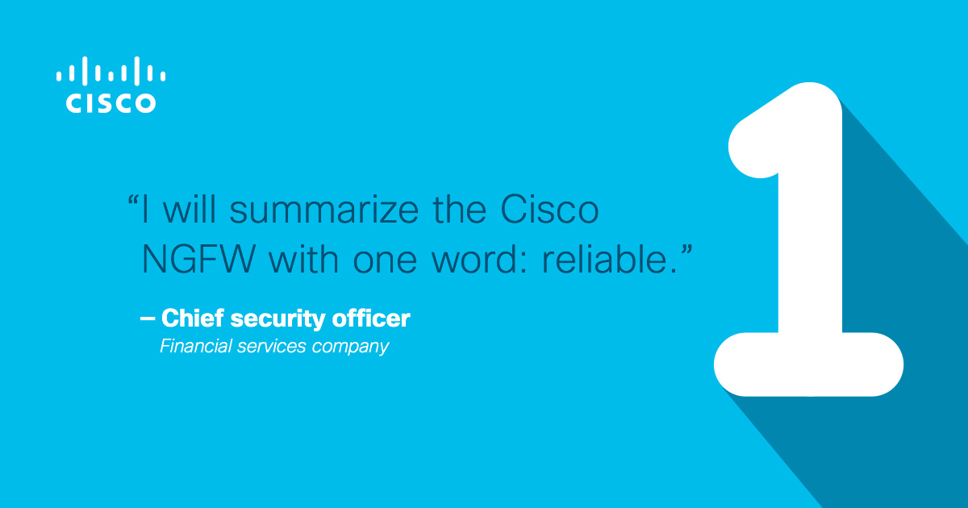
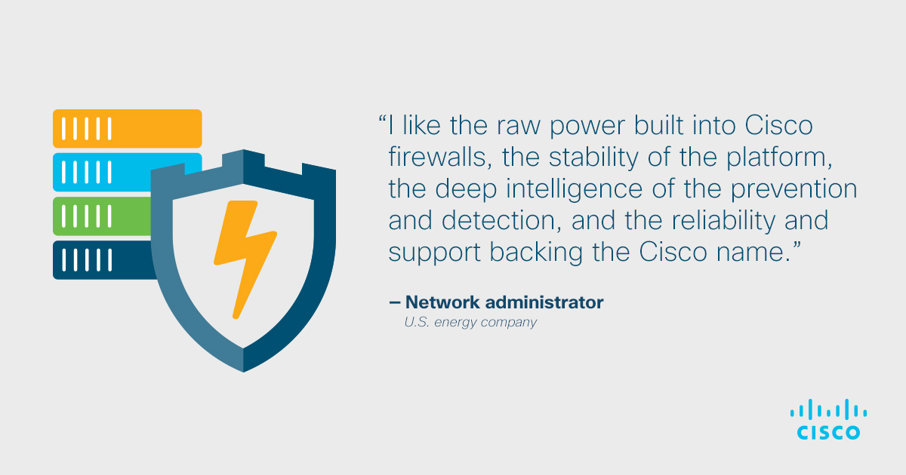
Designed and optimized for better security

Slide 20
Backed by Talos - the best security intelligence
Talos has 250+ threat researchers and analysts on the front lines of cybersecurity:
  See 1.5 million unique malware samples per day vs. 10s of thousands each for competitors
  Block 19.7 billion threats per day
  Scan 600 billion email messages per day
  Monitor 16 billion web requests per day
Automated security intelligence feeds update Cisco NGFW every 2 hours, adjustable to 5-minute interval
Cisco Talos Threat Intelligence
Unmatched, timely threat intelligence blocks zero-day threats first
Notes:
Automated security intelligence feeds update Cisco NGFW every 2 hours, adjustable to 5-minute interval
Talos provides ~250 SCADA rules based on Snort. That are geared toward ICS industry. Customers can build rules and import third party rules as well
Talos 250+ threat researchers and analysts on the front lines of cybersecurity:
See 1.5 unique malware samples per day vs. 10s of thousands each for competitors
Block 19.7 billion threats per day
Scan 600 billion email messages per day, more than 85% are spam
Monitor 16 billion web requests per day

Slide 21
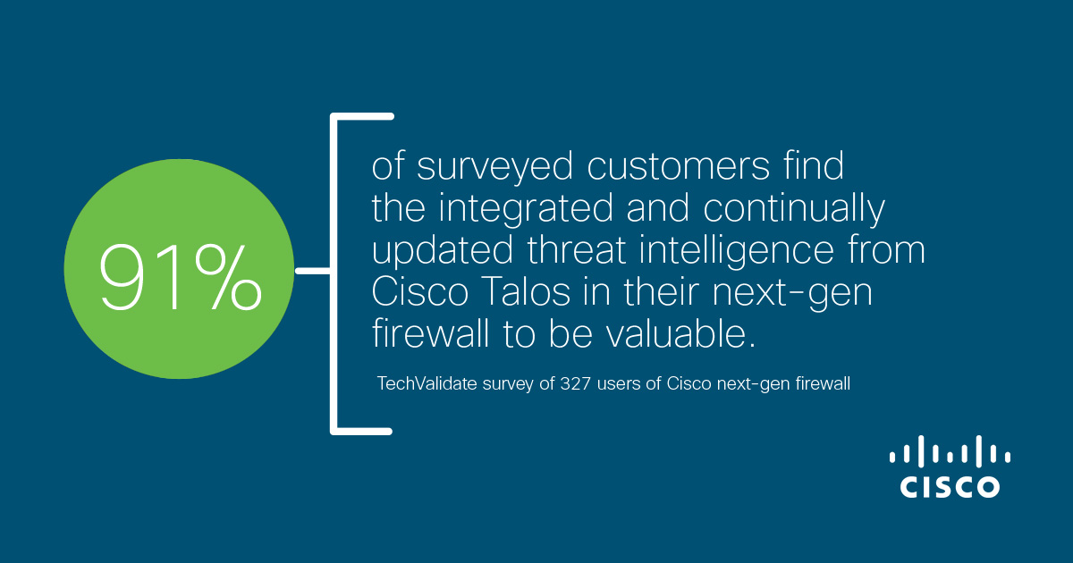
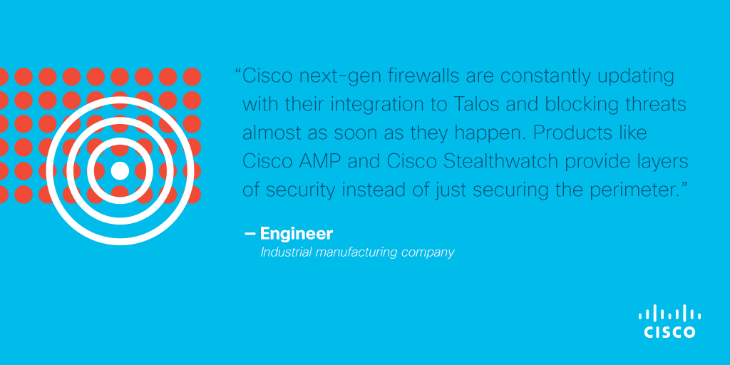
Backed by Talos - the best security intelligence

Slide 22
Beyond firewall – an integrated security architecture
Cisco NGFW is the foundation of Cisco’s integrated security architecture that shares actionable intelligence across the extended network – competitors are following our lead
We give customers visibility in more places so they can see threats once and stop them everywhere
Fastest Time to Detection of a Successful Breach: Cisco Security at 4.6 hours vs. 100 day industry average
Integrated Security Architecture
Integrating security across the extended network to contain threats faster
See how it works
Notes:
Cisco NGFW is not a siloed point-product. It’s the foundation of Cisco’s integrated security architecture that shares actionable intelligence across the extended network. Cisco is the only vendor that can offer this today
We give customers visibility in more places so they can see threats once and stop them everywhere
Data and threat information is easily shared and correlated among different points of presence in the extended network, from endpoint to edge.
Industry average time to detection is 100 days. Cisco integrated security architecture reduces time to detection to 3.5 hours.
Cisco’s integrated security architecture is very powerful against threats like ransomware

Slide 23
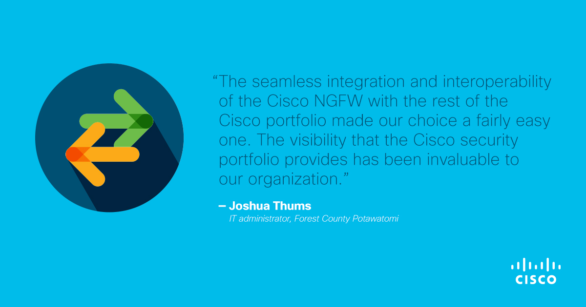
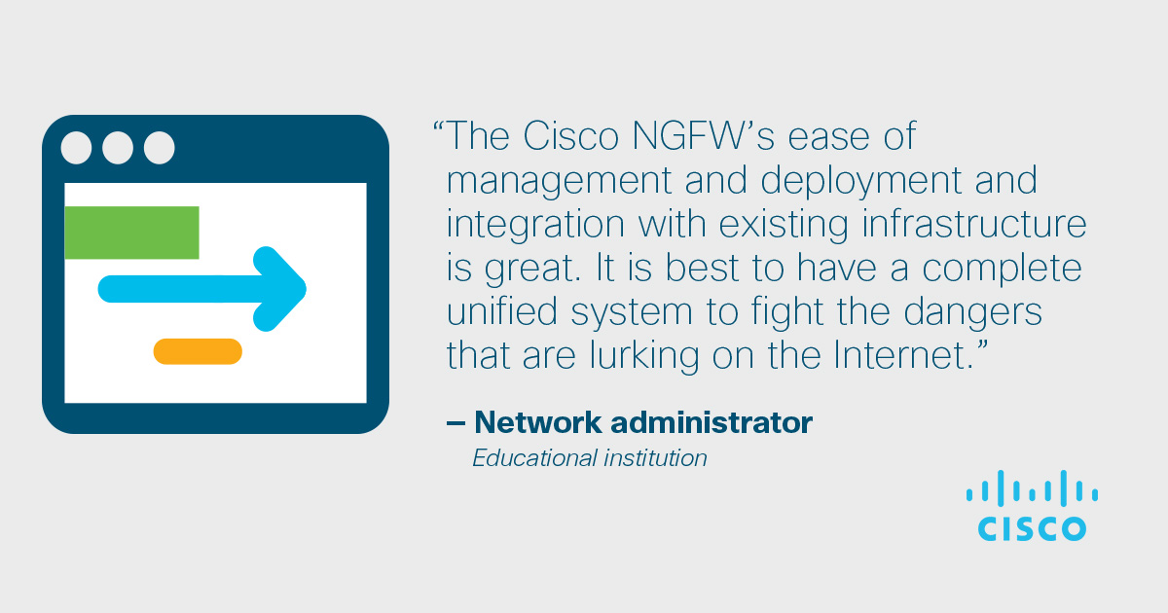
Beyond firewall – an integrated security architecture

Slide 24
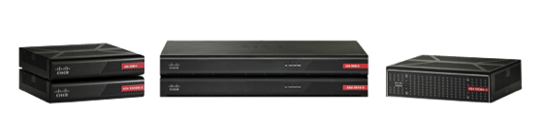
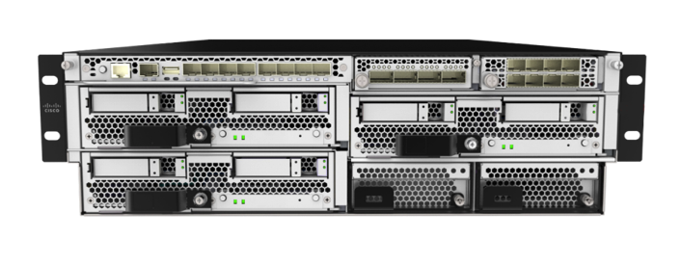
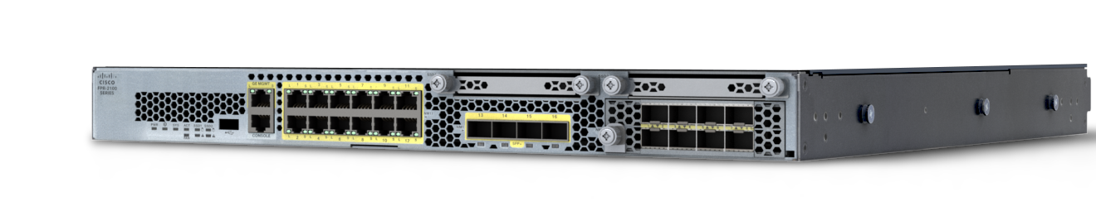
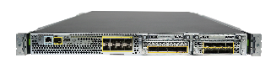
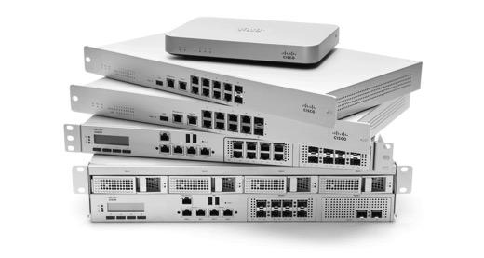



All of the pictured appliances above can run ASA or Firepower Threat Defense base software
Cisco NGFWs and UTMs, for every organization
Small and Midsized Business
Enterprise / Midrange
Large Enterprise/ Campus / DC / SP
Firepower 2100 Series
5525-X/ 5545-X/ 5555-X
Firepower 4100 Series
Firepower 9300
5506-X/5506W-X/5506H-X/5508-X/5516-X
Virtual and Public Cloud:
Firepower NGFWv & ASAv
Meraki MX UTM: Cloud Managed for Lean IT
On-box
Centralized
Learn more
Watch a demo
Management
Firepower Device
Manager
Firepower Management Center
Notes:
We offer Cisco NGFWs for every use case

Slide 25
Simply ask yourself these questions
Can your firewall talk to the rest of your security ecosystem to improve visibility, increase speed to detection and response, and automate tasks?
How do you protect yourself from traffic the firewall doesn’t see?
How do you protect devices when they are off the corporate network?
Are you prepared for Ransomware infections?
What if you ARE breached…What do you do next?
If your security tools can’t answer these questions, you need to upgrade to a Cisco next-generation firewall and Cisco’s integrated architecture

Slide 26
Next Steps
Upgrade your security today!
Compare us with the competition
See what an upgrade can mean for you
Attend a webinar to learn more
Sign up for a free NGFW trial
See what the Cisco Integrated Architecture can bring to your organization

