Slide 1





Simple, mobile, and secure networking solution purpose-built for small businesses

Slide 2
What will we cover?
Why Meraki Go
Transform SMB IT
Products & Demo
Customers

Slide 3


Why Meraki Go

Slide 4

43%
Small Businesses Need Simplicity
Use home WiFi for business
Generic “home” WiFi or all in one boxes are not sufficient or secure
Complex network equipment requires IT staff
51.2%
Business critical non-IT staff spending time on IT
60%
Concerned about Security of network devices

Slide 5
Meraki Go - Simple. Secure. App Managed.
83%
Business owners want or need secure WiFi for their business
27%
SBO’s are confident in their existing network being secure
“It took me 6 minutes to add my Meraki Go AP and set up WiFi networks for the first time”
-Danny, Business Owner
Hair It Is Barbershop
53%
SBO’s believe security of network devices is a top priority
100%
Business owners who want a solution that simply works

Slide 6

Transform SMB IT

Slide 7


Our Mission
Giving business owners the easiest way to manage the network-connected devices and cloud-managed services on which their businesses rely.

Slide 8

New Products

Slide 9

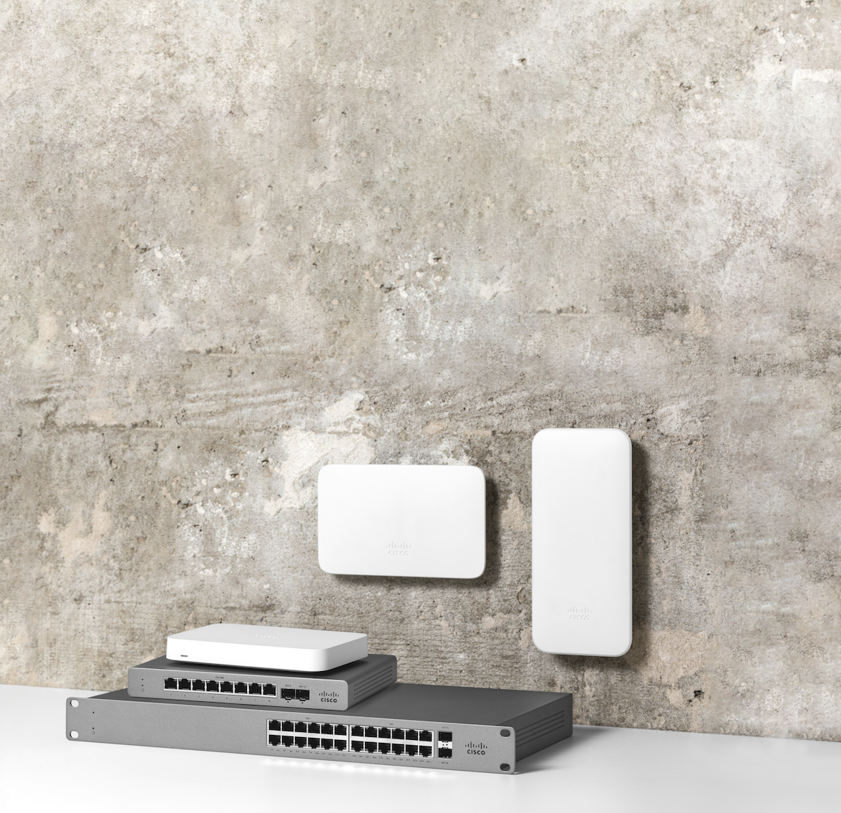
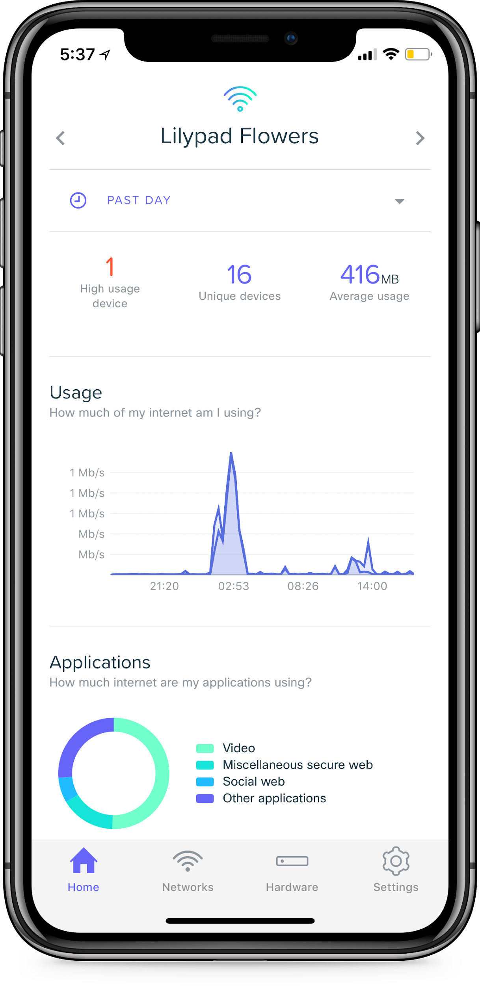
Meraki Go Family
Mobile App Managed:
Indoor Access Point
Outdoor Access Point
Security Gateway
Network Switches
NO license or subscription is required!

Slide 10
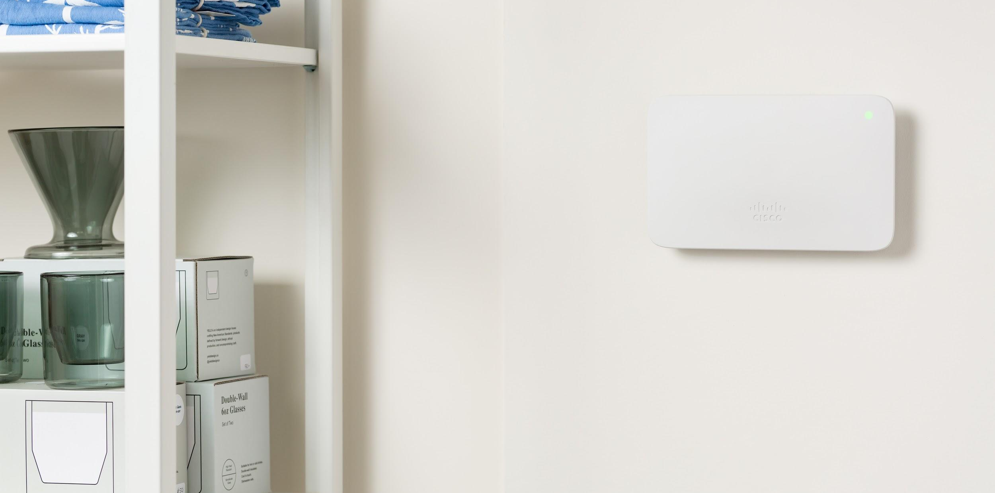


Meraki Go Access Points
Meraki Go
Security Gateway
Meraki Go
Network Switches
Pricing: $149 / $199
Pricing: $149
Pricing: $229 - $899
Secure guest WiFi with a single click
Add APs as your business grows
Outdoor APs, IP67-rated for tough environments
Keep business free from dead zones
Analytics to help make business decisions
Built-in security to prevent cyber threats
Intuitive website blocking to ensure appropriate network use
Remotely enable/disable ports at any time
Set usage limits for fair bandwidth sharing
View alerts to fix any bad cables or misconfigurations
See status of devices plugged into switch
View alerting ports and enable/disable them remotely, ensuring network security
Apply bulk settings to your ports
No added cost or trouble installing electrical outlets, wires, or clunky power brick with PoE
View power and current consumption
Add on:
Meraki Go Security Subscription for increased protection (optional)

Slide 11

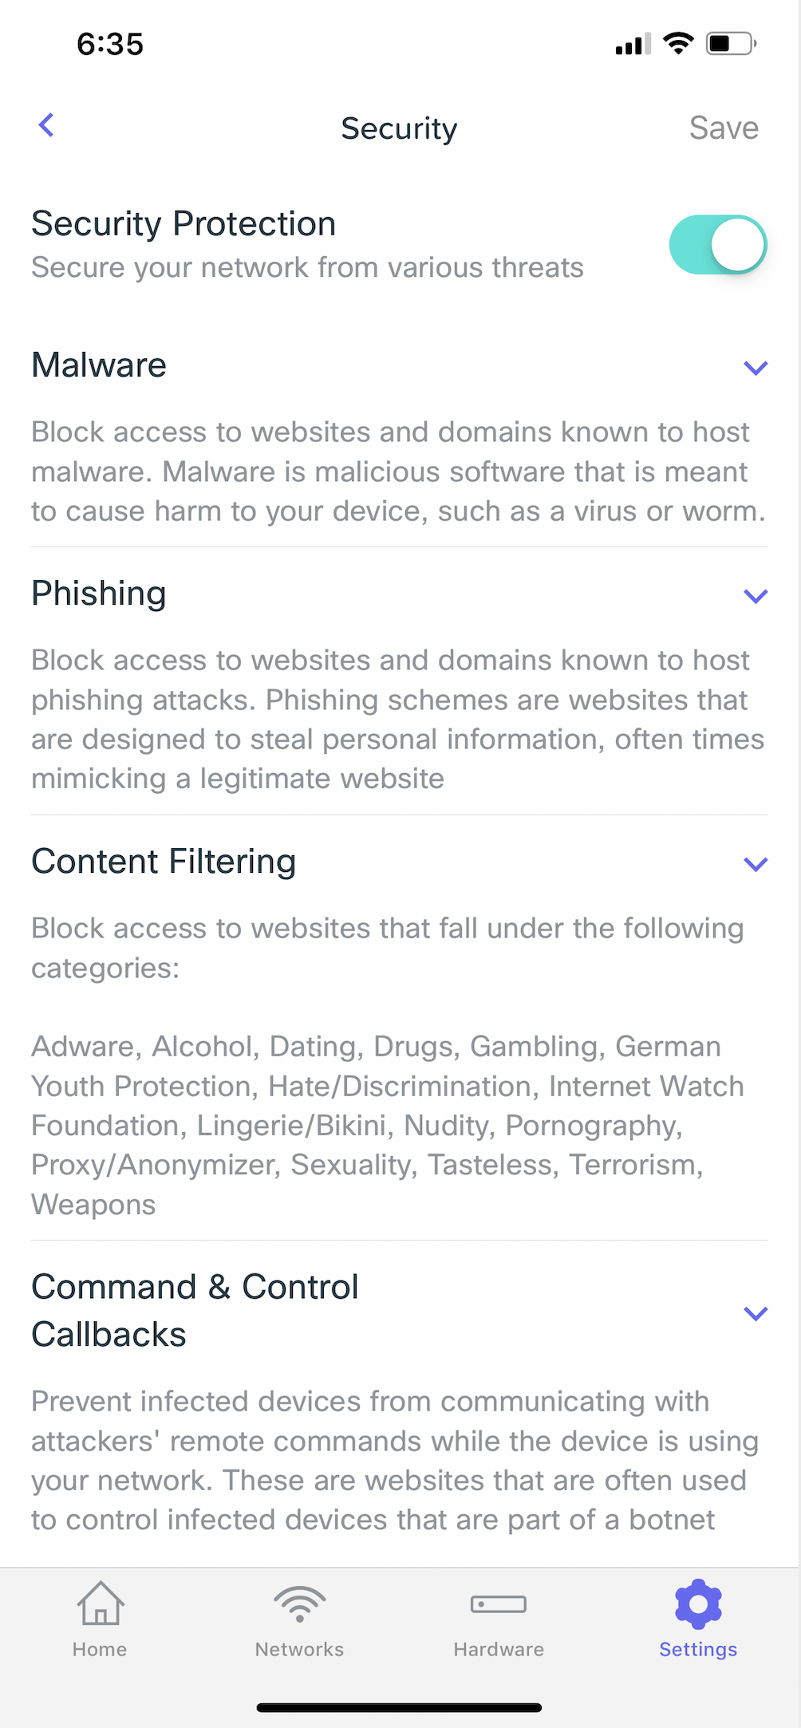
Meraki Go Security Subscription
Pricing: $120/year
Automatically reviews and blocks malicious sites
Protects against attempts which could allow your network to be hacked
Anti-phishing
Anti-malware
Prevents C2 callbacks
Single-tap Security Configuration
53 % SBOs believe security is a top priority for network devices and they look for secure services that protect devices from cyber attacks

Slide 12

App Demo

Slide 13
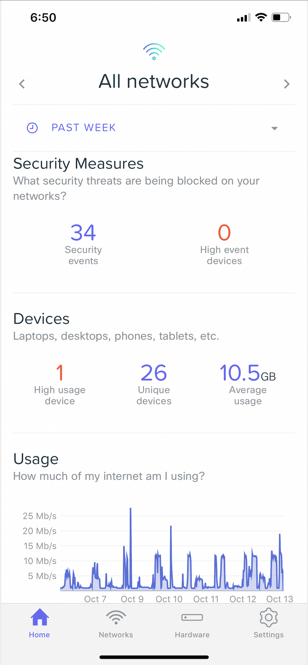






The Meraki Go Mobile App
Easy, Intuitive and Proactive Networking
Quick Network Settings
Fast Onboarding
Network Health View
Adjust settings on the fly – web blocking, usage limits, and guest WiFi
For wired and wireless clients on stationary and mobile devices
Monitor from anywhere and take actions when needed
Up-to-date and secure
Rich Guest Insights
Brand Awareness
Automatic feature, software, firmware, and security updates
Higher customer engagement and loyalty using the analytics
Drive customers to web or social channels with custom splash pages

Slide 14
Meraki Go Customers

Slide 15


Customer Stories
Shotwell’s Bar
Hair It Is Barbershop
Dr. DeLong's Family Dentistry
“It’s a really quick snapshot of what’s happening on our network, Meraki Go gives you a lot of information that just didn’t exist before.”
Tom, co-owner
“Setting up Meraki Go was very easy... It tells me who’s on the network, what devices they’re using, & the things they’re looking at.”
Danny, owner
“Since we've had Meraki it's been very seamless and it's amazing. Patients absolutely love it.”
Dr. David, owner

Slide 16


Increased business productivity and security
Increased customer engagement and loyalty

