Slide 1
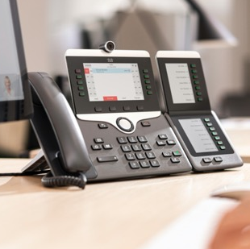
Cisco Multiplatform Phones
The future is calling

Slide 2
Agenda
Modern communications
Introduction to Cisco multiplatform phones
Why Cisco
The Cisco lineup of MPP phones

Slide 3
As businesses digitize, workstyles change
Traditional
Mobile
Agile
Executing tasks
Integrating processes
Innovating, adapting
Mobile platform phones enable a more intuitive way to work.
Notes:
The way that people and teams are working is changing.
Traditional model
• We worked in offices, with large, hierarchical organizational units of people around us who had similar skills and knowledge.
• We formed large, long-lasting project teams to solve problems, often focusing on how to better execute on the tasks and processes that underpin our business operations, and do it better, time and time again.
Changing demands
• As organizations grew, as workforces became more mobile, we needed tools to enable us to be productive outside the office.
• Workers demanded tools that would help them engage with colleagues and get things done, whenever and whenever they were located.
• They needed to ensure key processes didn’t break down, and to remain responsive to their customers’ needs.
• Often, we focused on integrating processes as we were driving towards increased personal productivity.
Our new way of communicating
• Today, organizations are adopting a more agile approach.
• As organizations digitize, they’re looking for new ways to solve traditional problems, create new customer experiences, and develop new business models.
• This requires people with different skill sets, in different parts of the organization (and even outside it) to come together, to innovate, and to find new solutions.
• Cross-functional tiger teams form to solve particular challenges, iterate fast, learning as they go.
• These teams need another set of tools to allow information and the exchange of ideas to flow freely and efficiently across the project team members.
Paving the way
• The reality is, most organizations are at different stages of their journey, with some parts of their organization more focused on one or more of these priorities.
• At Cisco, we’re providing comprehensive collaboration tools that enable new ways of working.
• We’re developing call, meeting, and team collaboration tools that produce magical and consistent experiences.
• We’re enabling high-definition audio and video, messaging, chat, and intuitive meetings experiences with content sharing and white boarding.
• One thing is certain, though – business calling remains a critical part of that solution for all organizations.

Slide 4
Voice calling is as essential as ever
71%
65%
91%
of knowledge workers frequently make and take phone calls
prefer to conduct business calls
on a desk phone
agree that phone calls remain a vital form
of communication
Sources: National Statistics Council, Ovum, Interaction Associates
Notes:
Voice is still king
Indeed, voice is the essential tool. Voice, in fact, is the largest network on the planet.
But why is that? It’s because you simply can’t convey the full power of your message in text. Or in email.
We still need that human touch and tone of voice to provide context to our communication.
The numbers speak loudly
71% of knowledge workers are frequently on voice calls.
65% prefer to have one-to-one business calls with voice.
9 out of 10 workers say voice calls are essential.

Slide 5
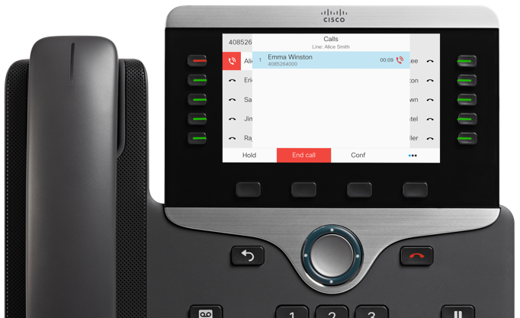
Meet the Cisco multiplatform environment
Cisco BroadWorks
Cisco Webex Calling
Cisco BroadCloud
Metaswitch
Centile
Asterisk
Cisco Cloud Calling
Notes:
Cisco IP phone users can enjoy the superior phone design, quality, and features, while communicating across an approved third-party (or supported SIP) cloud hosted platform.

Slide 6
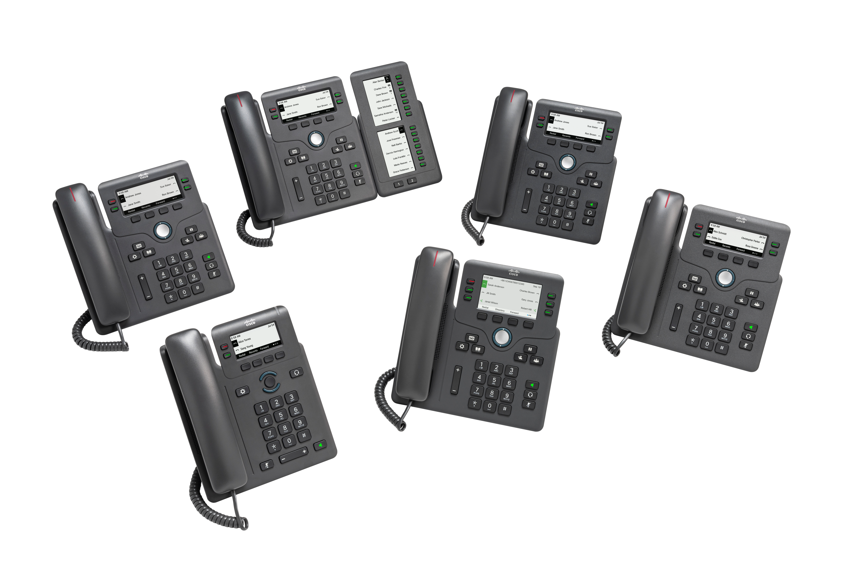
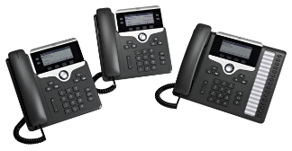
Cisco IP phone portfolio Enabling tens of millions of devices to transition with the flex plan
Value
Basic
Enhanced
6800
Low-cost phones
Optional KEM support
7800
Ideal for light to highly active voice users
Backlit greyscale displays
8800
Color displays
Bluetooth, USB, integrated Wi-Fi
Optional KEM support
Cloud IP phone firmware
On-premises IP phone firmware

Slide 7
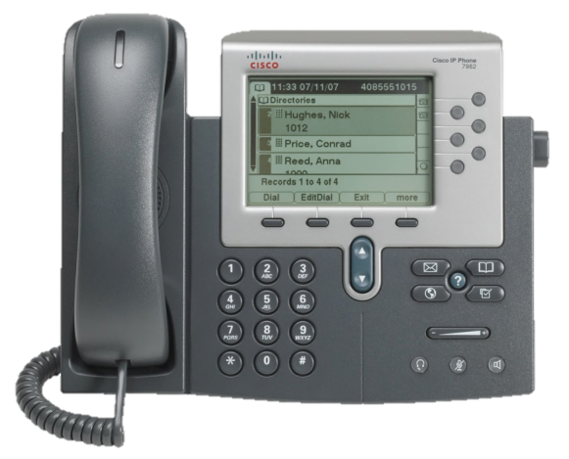
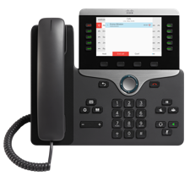
Deliver a better calling experiences
Security/Regulatory Compliance (PCI, HIPAA, GDPR, etc.)
Gigabit Ethernet (for ever more web-/cloud-based apps)
Cloud-ready
Simplified Teleworker support (VPN-less)
Enhanced Cisco Headset support (USB, centralized management)
Smartphone integration
Ask your preferred Cisco partner about our trade-in programs
Notes:
We started our journey to reinvent business calling a few years back, with the end user firmly in mind, when we completely redesigned our entire range of IP phones.
Along the way, we added new capabilities that meet the needs of the IT department – enhanced security, including the latest TLS version support for PCI DSS compliance; better support for firmware, including options to configure our phones to register to our cloud calling services’ Gigabit and Wi-Fi connection options, etc,
But we made significant enhancements to improve the end-user experience with USB headset configuration options, support for VPN-less remote and mobile access for teleworkers, smartphone integration options, HD video model options, and accessibility features such as those described earlier in our work with the American Council for the blind.
More details (optional):
PCI DDS compliance
Supported firmware
Longer-term Cisco UCM support
Cloud-ready
Gigabit and Wi-Fi options
Enhanced Cisco headset support (USB)
Mobile remote access
Proximity (mobile phone pairing)
HD video option
Accessibility features

Slide 8
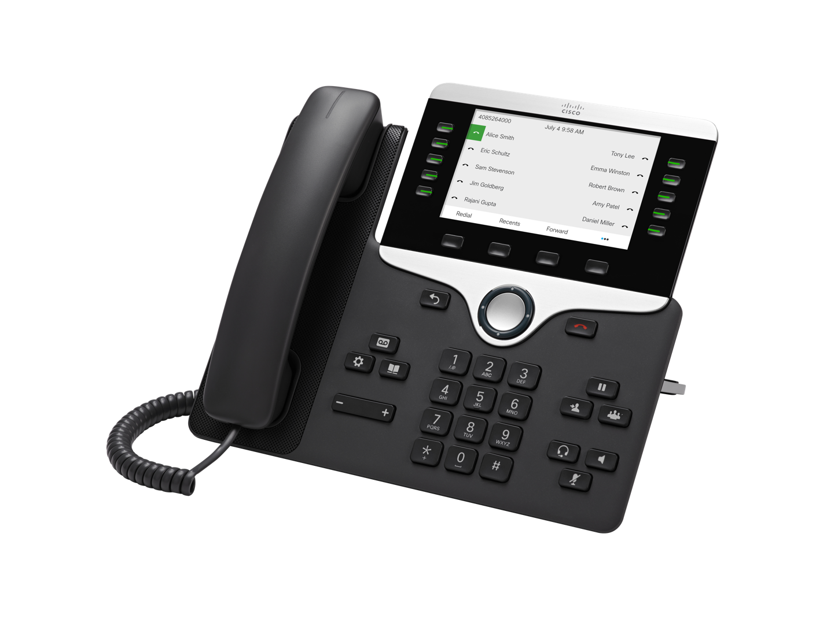
The evolution of a proven design

Slide 9
Why choose Cisco?
Years of VoIP/ UC Innovation
Enterprise Voice Market Share
Enterprise Voice Market Share
20+
#1
>45%
Unique solutions for on-premises and hybrid scenarios
Meet customer needs across enterprise, midmarket, SMB, and public sector
Deliver via any deployment model through Cisco global partner network
Collaboration Partners WW
Calling Customers
Fortune 500
Utilize Cisco Calling Solutions
95%
2,000+
230K+
IP Phones shipped
Calling clients
Leader In Gartner
Magic Quadrant
93M+
11x
45M+
Notes:
We have been the leaders in UC market with on-prem and hybrid scenarios to meet enterprise, midmarket, SMB and public sector customers across any deployment model
On prem : Unified Communications Manager, Meeting Server, IP Phones
#1 Market Share of Enterprise Voice: Q1 CY'2019 Enterprise Voice Market Share Results
Source: Synergy Research, June 2019
Cisco Share: Excluding key telephony systems (KTS), Cisco’s worldwide revenue share was 46.3%, up +4.6 pts y/y and down -1.5 pts q/q. If including KTS, Cisco’s share was 41.9%, up +4.4 pts y/y. Regarding geographies excluding KTS, Americas share was 56.9% (+4.0 pts y/y), EMEAR was 37.2% (+5.3 pts y/y), and APAC was 31.2% (+3.5 pts y/y).
Source: Synergy Research, December 2018
350,000 + organizations world wide; 95% of Fortune 500
20+ years of experience and innovation in UC platforms for calling, meeting, contact center ((Cisco launched voice GW on Cisco routers 1995, acquired Celscius 1998) 120M + phones (inc. 35Million active users Jabber soft phone licenses)
Hybrid solution enable evolution to cloud as well as provide unique value from the cloud to connect the prem and cloud intelligence…
_____________________________________________________________________________________________________
Approx. 200,000 Cisco calling customers worldwide • inc150,000+ Unified Communications Manager customers • 95% of fortune 500 companies • 85M+ Cisco IP Phones shipped • 35M Jabber UC users • 42.6% share (#1) of worldwide revenue for Enterprise Voice (Synergy Research - Sept 2018) • Over 2,000 Cisco Collaboration partners WW • Over 20 years experience in IP telephony and unified communications (Cisco launched voice GW on Cisco routers 1995, acquired Celsius 1998) • July 2018 - Cisco named a leader in Gartner Magic Quadrant for Unified Communications - for 11th straight year

Slide 10
Why choose Cisco multiplatform phones?
The Cisco brand is widely preferred
Cisco is the market leader in IP handsets (over 100m sold)
Cisco quality ensures the phones last the full duration of your contract
Your investment risk is minimal given Cisco’s stability
Advanced user experience such as Wi-Fi and Bluetooth
Intelligent proximity lets you pair with smartphones and move calls between devices
Notes:
Cisco multiplatform phones meet the needs of a diverse range of professionals and their organizations.
Whether your business needs affordable, entry-level phones for knowledge workers, administrative staff, and managers with moderate to active call activity, or advanced phones for intensive call volumes and collaboration, Cisco has just the right MPP solution for you.

Slide 11
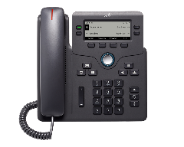
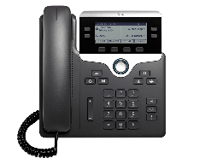
The Cisco lineup of multiplatform IP desk phones
Cisco 6800 Series
Cisco 7800 Series
Cisco 8800 Series
New family of low-end, low-cost phones
The only IP phones exclusive to multiplatform
Enterprise-grade quality with a user experience similar to the 7800/8800 Series
Ideal for lightly-to highly-active voice users
High-quality wideband audio*
Easy-to-use
Backlit grey scale displays*
Speakerphone on all models
Ideal for knowledge and administrative workers, managers, and executives
Color display and Bluetooth
Cisco Intelligent Proximity for smartphone integration
Optional key expansion modules
Notes:
The Cisco MPP lineup comprises the 6800 Series, the 7800 Series, and the 8800Series.
The 6800 Series are entry-level phones designed for light to moderate use.
The 8800 Series offers advanced features for high-volume activity.
And the 7800 Series falls somewhere in between.

Slide 12
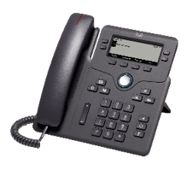
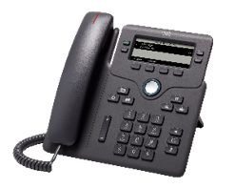
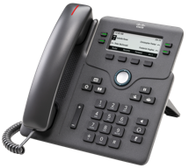
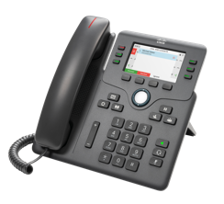
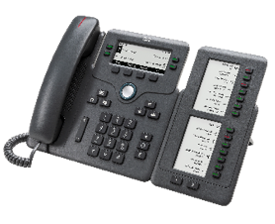
The 6800 Series
Cisco IP Phone 6841
Cisco IP Phone 6851
Cisco IP Phone 6861
Cisco IP Phone 6871
Cisco 6851 KEM (key expansion module)
New family of low-end, low-cost phones
Only IP phones with exclusive to multiplatform (will not work on CUCM)
Enterprise-grade quality and similar user experience to Cisco 7800/8800 Series phones
Works with flexible deployment models for small or home offices
Key expansion module provides extra flexible keys for heavy phone use
Notes:
The 6800 Series is a cost-effective, high-fidelity voice communications portfolio designed to improve your organization’s people-centric communications while reducing your operating costs in third-party hosted call control deployments.
This series combines an attractive new ergonomic design with “always-on” reliability and secure encrypted communications. The phones deliver advanced IP telephony features and wideband audio capabilities with an easy-to-use, full-featured voice communications experience on third-party hosted call control.
The 6800 Series provides:
Line keys on each model that are fully programmable.
Tricolor LEDs on the line keys that make the phone simpler to use.
A full-duplex speakerphone that lets you set up clear multiparty conferences for flexible, productive collaboration.
Other features include:
The ability to set up keys to support either lines (such as directory numbers) or call features (such as speed dialing).
A multiple-calls-per-line appearance feature that boosts productivity by enabling users to handle multiple calls for each directory number.
Fixed-function keys on all models for one-touch access to service, messaging, directory, hold/resume, transfer, and conference features.
6800 Key Expansion Model
Provides extra flexible keys for heavy-use phone operators such as reception or assistant roles.
Features 2 pages of 14 keys.

Slide 13
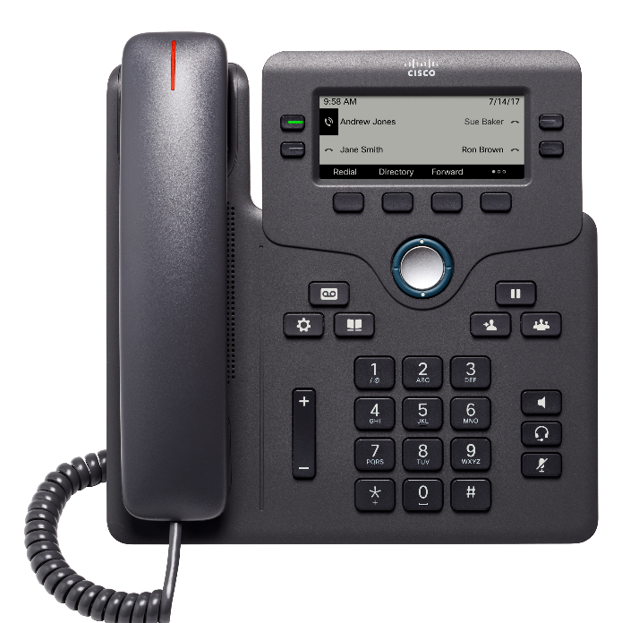
6800 Series highlight: 6851
Visual ring indicator
3.5-inch display (grayscale or color options) (396x162 resolution)
Wideband audio handset
4 programmable line keys
Wideband audio speakerphone
Soft keys
2-way navigation and select key
Messaging, service, and directory
Hold/resume, transfer, and conference
Keypad
Volume
Audio path control
10/100/100 Ethernet
Wall mountable

Slide 14
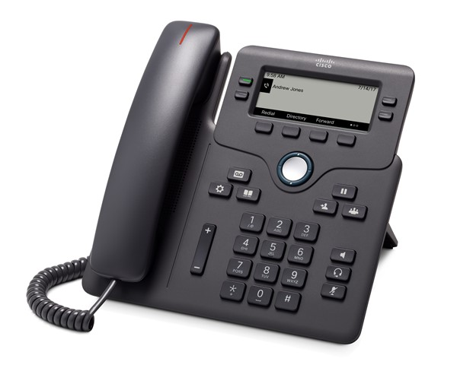
The 6800 Series key features
 | 6821 | 6841 | 6851 | 6861 | 6871 |  | 6800 KEM
Screen | 240x120 (2.5”) backlit grayscale | 396x162 (3.5”) backlit grayscale | 396x162 (3.5”) backlit grayscale | 320x120 (3.2”) backlit grayscale | 480x272 (3.5”) color | Screen | 3.3” Backlit mono
Ethernet switch | 10/100 | 10/100/1000 | 10/100/1000 |  | 10/100/1000 | Number of keys | 14 (28)
Programmable line keys | 2 | 4 | 4 | 4 | 6 | Page selector | Two pages
Programmable soft keys | 4 | 4 | 4 | 4 | 4 | Aux (In)
Headset port |  |  |  |  |  | Wall mount | n/a
EHS support (AUX)
Full duplex speakerphone
Wideband audio | NB Handset
POE class | 1 |  | 2 |  | 3
USB Port
KEM |  |  | 1
Wall mount | Keyholes, no kit
Gigabit enabled
Orderability | Now | Now | Now | Now | Now

Slide 15
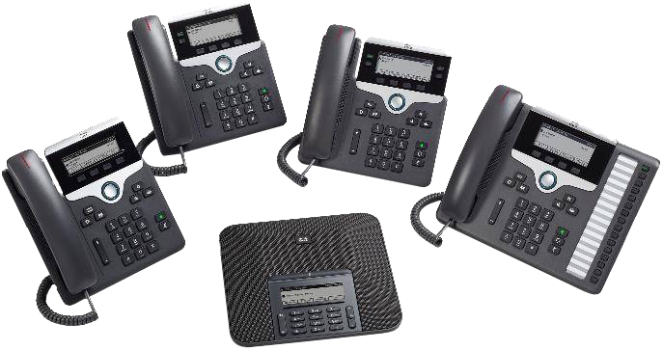
The Cisco 7800 Series
Ideal for lightly- to highly-active voice users
Affordable, high-quality voice communications
High-quality wideband audio
Easy-to-use
Backlit grey scale displays
Speakerphone on all models
Comprehensive telephony
Energy efficient due to low power consumption
IEEE Class 1 endpoints
Electronic hook-switch support
7832 Conference Phone facilitates group discussion
Cisco IP Phone 7821 (2-line)
Cisco IP Phone 7841 (4-line)
Cisco IP Phone 7811 (1-line)
Cisco IP Phone 7861 (16-line)
Cisco IP Conference Phone 7832
Notes:
The 7800 Series is a high-fidelity voice communications portfolio designed for people-centric voice collaboration.
The series introduces four endpoints and a new ergonomic design to support the needs of light to highly active voice communications users.
These phones are ideal for midsize to large enterprise customers seeking to upgrade or expand their voice communications presence with Cisco Unified Communications.
The 7800 Series provides:
Wideband* audio support (G.722) for superior audio clarity.
Backlit* graphical grayscale displays ease navigation.
Always-available, full-featured IP telephony to increase personal productivity.
Other features include:
Encrypted communications for greater security.
An earth-friendly design and Cisco EnergyWise™ technology for low power consumption.
Electronic Hookswitch* support (from third party headsets that support these features) for greater freedom at the desk.
- Users can initiate calls, terminate calls, adjust volume and hear calling line ID without being tethered to their desk.
- Consult third party headset vendor of choice for models they support with this feature on the IP Phone 7800 Series.
*Note to speaker:
The 7811 handset is a narrow-band phone with a grayscale display (not backlit). Also, the electronic hook-switch is not available on the 7811 model.

Slide 16
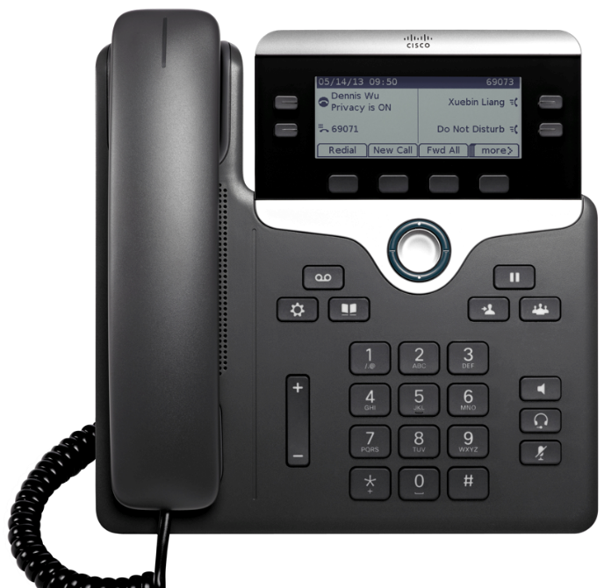
7800 Series highlight: 7841
Visual ring indicator
3.5-inch grayscale display (396x162 resolution)
Wideband audio handset
4 programmable line keys
Replaceable bezel
Wideband audio speakerphone
Soft keys
2-way navigation and select key
Messaging, service, and directory
Hold/resume, transfer, and conference
Keypad
Volume
Audio path control
10/100/100 Ethernet
Adjustable viewing angle
Wall mountable

Slide 17
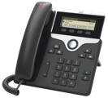
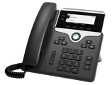
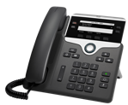
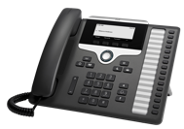
The 7800 Series key features
 | 7811 | 7821 | 7841 | 7861
Replaceable bezel
Screen | 384 x 106 (3.28”) grayscale | 396x162 (3.5”) backlit grayscale | 396x162 (3.5”) backlit grayscale | 396x162 (3.5”) backlit grayscale
Ethernet switch | 10/100 | 10/100 | 10/100/1000 | 10/100
Programmable line keys | 0 | 2 | 4 | 16
Programmable soft keys | 4 | 4 | 4 | 4
Headset port
EHH support (AUX)
Full-duplex speakerphone
Wideband audio | With additional WB Handset
POE class | 1 | 1 | 1 | 1
Protocols | SIP | SIP | SIP | SIP
Notes:
The 7800 Series key features
• Line keys
- Programmable with all models.
- This enables them to be programmed as lines or features (such as speed dial for single button access to a user’s most frequent contacts).
• Full Wideband
- G.722 support.
- Delivered on headset, handset, and speaker.
- Superior audio performance without compromise.
• IEEE Integrated switches
- Reduces OPEX with ability to consolidate cabling infrastructure at the desk (one drop supports both PC and Phone traffic) and IT administration.
- 7841 is Gigabit Ethernet; 7821 and 7861 are 10/100.
- Note: Use cases determined that 7821 and 7861 deployments are most often 10/100 deployments and imposing Gigabit Ethernet would only increase customer cost to account for the small percentage of occurrences who want Gigabit Ethernet switching with these particular models.
• PoE Class 1 devices
- The 7800 Series (all models) are the lowest power class endpoints available from Cisco (Class 1 devices).
- EnergyWise offers added support, taking advantage of power save plus mode during off-business hours.
- That can help increase power savings by up to 60% (and thus help with OPEX costs).
• Displays
- 3.5” (89mm), 396x162 pixel, white backlight.
- Grayscale, pixel-based, and graphical with a white backlight to help viewing under a variety of lighting conditions.
- The 7800 Series also comes with four context-sensitive soft label keys to make them easier to use by only presenting relevant options to the user.
• Electronic hookswitch
- Switch enables customers to untether their users by taking advantage of third-party headsets that support Electronic Hookswitch control.
- This is offered by the auxiliary port of the 7800 Series.
• Bluetooth communications
- The 7800 Series does not integrate Bluetooth communications.
- Selected models of 8900 and 9900 Series and the DX650 serve users who seek added freedom from the desk with Bluetooth radio integration.
• Security
- Security comes standard with Authenticated Encryption Standard (128-bit) for enterprise grade security.
• Silent monitoring and recording
- Key capabilities supported for customer care environments.
• IPv6
- Future safe with support at FCS.

Slide 18
The Cisco 8800 Series
Cost-effective, high-quality endpoints
Easy-to-use, intuitive experiences
State-of-the-art, audio performance speakerphone on all models
Optional key expansion modules available
Cost-effective entry to HD video on 8845 and 8865 models
8832 conference phone provides 360∘ coverage for midsize-large rooms and executive offices
Ideal for knowledge and administrative workers, managers, executives, and conference rooms
Advanced features such as WiFi, Bluetooth
Intelligent Proximity enables smartphone pairing, contact sharing, moving calls between devices
Cisco IP Phone 8860 and KEM (key expansion module)
Cisco IP Phone 8861
Cisco IP Phone 8841
Cisco IP Phone 8865
Cisco IP Phone 8811
Cisco IP Phone 8821 (not available in MPP)
Cisco IP Conference Phone 8832
Cisco IP Phone 8865
and KEM (key expansion module)
Notes:
The 8800 Series delivers superior voice communications.
The different models provide options for knowledge professionals, administrative staff, managers, executives, and for workers in various sizes of conference rooms.
All models have been acoustically enhanced in hardware to deliver the best voice communications experience Cisco has delivered to-date in its IP Phones.
This includes enhancements for canceling out echo (very important for a dispersed workforce) and vibration isolation mechanisms for even clearer lows and highs.
The 8800 Series provides:
Speakerphones are standard on all models.
IP phone software designed for end-use ease of use.
Intuitive menus and backlit displays with higher resolution.
Wallpapers that can be customized for with company logos or graphics.
Other features include:
Support for Cisco Intelligent Proximity for Mobile Voice (in select models).
BYOD Telephony feature integration with personal mobile devices for convenience, flexibility, and an enhanced user experience.
Contacts and call history import between mobile devices and 8800 Series phones.
Transferring audio calls—via Bluetooth—to smartphones to take advantage of the superior acoustics.
Ability to charge mobile devices via a USB port.
Optional Key Expansion Module
The 8800 Series extends your return on investment with the optional Key Expansion Module on select models.
These modules are designed to increase responsiveness with added shared lines
They also simplify the user experience with one-button speed dialing.
Video Calling
The latest additions to the 8800 Series are the 88545 and 8865 models.
These models offer an affordable entry point for organizations looking to provide high-definition video calling from the desktop.

Slide 19
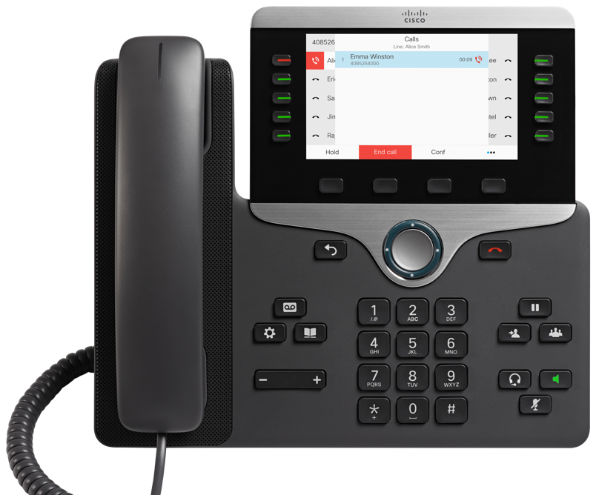
8800 Series highlight: 8841
5-inch WVGA (800x 480 resolution)
Visual ring indicator
5 programmable line keys
Adjustable viewing angle
Wideband audio handset
Replaceable bezel
Soft keys
Wideband audio speakerphone
2-way navigation and select key
Messaging, service, and directory
Hold/resume, transfer, and conference
Keypad
Volume
Audio path control
10/100/100 Ethernet
Wall mountable

Slide 20
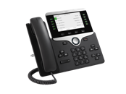
The 8800 Series key features
 | 8811 | 8841 | 8845 | 8851 | 8861 | 8865
HD video (720p) | - | - |  | - | -
Integral switch | Gigabit | Gigabit | Gigabit | Gigabit | Gigabit | Gigabit
Programmable (line) keys | 10 | 10 | 10 | 10 | 10 | 10
Bluetooth/DECT | - | - | Bluetooth | Bluetooth | Bluetooth | Bluetooth
Cisco Intelligent Proximity | - | -
USB (physical ports) | - | - | - | 1 | 2 | 2
KEM | - | - | - | 2 | 3 | 3
Wi-Fi (802.11n) | - | - | - | -
Wall-mountable
Notes:
Speaker notes TBD…

Slide 21
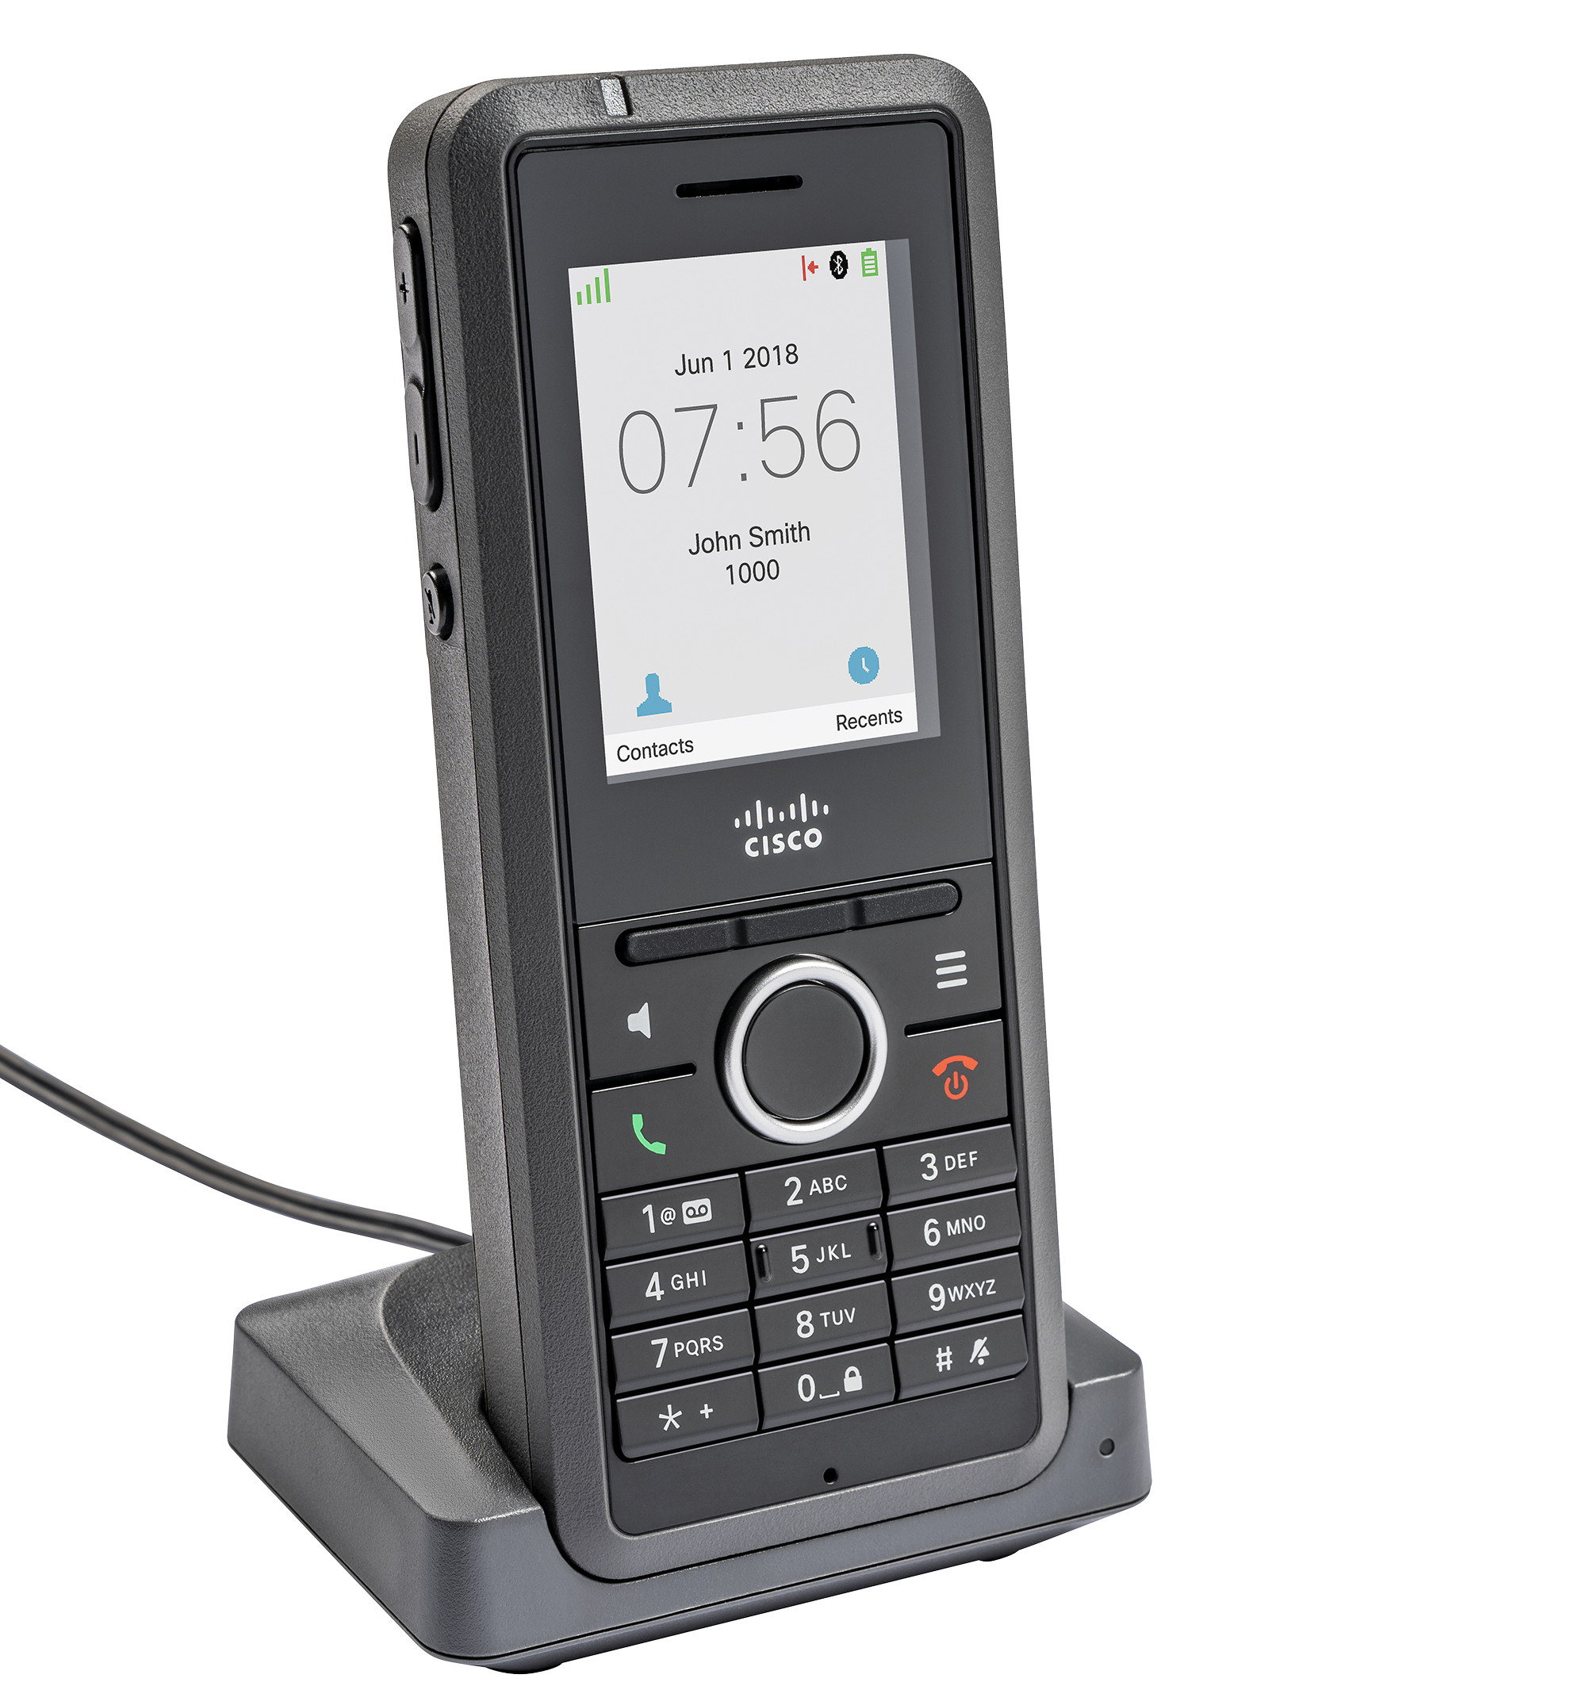
The IP DECT 6800 Series
Cisco IP Phone 6825 Handset
Cisco DBS-210 Multi-Cell Base Station
Excellent indoor and outdoor range
Extended roaming and mobility
Secure radio communications
No on-site expertise required - minimize installation costs, reduce time to dial tone
Ideal for older buildings with physical barriers, including offices and factories
Fully expandable for future growth and investment protection
Extend range and capacity with minimal incremental investment

Slide 22
Purchasing option

Slide 23
Cisco Webex Hardware as a Service
Transformative collaboration hardware as a service
A simple, scalable and flexible way to pay
Designed for Cisco Webex
Enable your people and teams with the tools they need to get things done and better service your customers
Affordable and predictable payment plans that you can scale from a single device to thousands of devices, and add devices at any time
Industry first, comprehensive program for IP phones, Webex desktop and room video systems, and interactive whiteboards
*Currently available in the US only

Slide 24
How Webex HaaS works
3 Year minimum term
1 Year extension
1 Year extension
1 Year extension
Auto-renewal
Default, continue with current devices
3 Year minimum term
Subscription starts
Device title passes to customer
Device refresh
New 3-year term, Current devices become obsolete, New devices issued
Subscription not renewed
Current devices become obsolete
Devices cannot place or receive calls, unless they have an active HaaS subscription
*Currently available in the US only

Slide 25
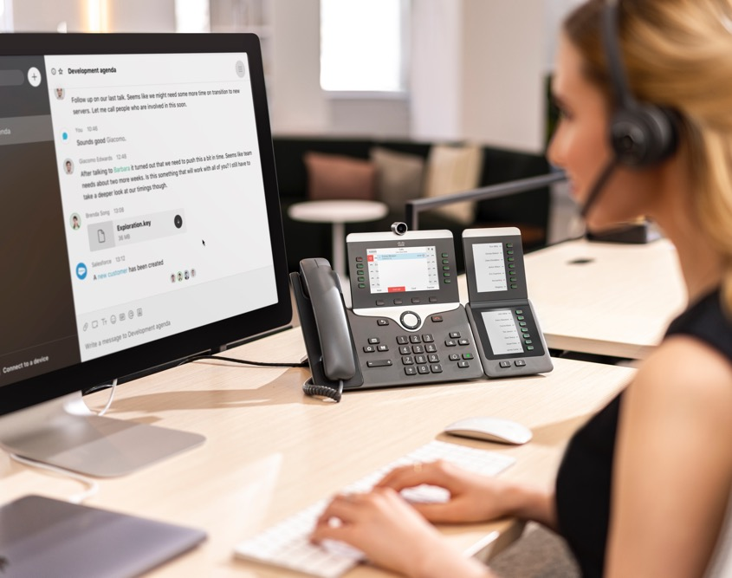
Next steps
Find out which multiplatform phones are the perfect fit for your business
cisco.com/go/mpp

