Slide 1
IBN Offers COVID-19
Enabling Remote Network Access
Help where we can with what you have
Global Solution Specialists, Customer solutions Marketing, EN Business unit
April 2020

Slide 2
As we navigate through this unprecedented COVID-19 situation, Cisco is aligning in solidarity with our customers.
Our priority is to help our customers & communities and enable business continuity during this period of disruption, focusing on key use cases we see our customers being challenged with, and leveraging where possible, existing customer investments.
In this resource we will highlight the networking aspects of the key customer use case for which we can help provide a solution for.
Our mission

Slide 3
Helping maintain business operations
Secure Remote Work
Supporting Temporary Healthcare
Remote Network Access
Healthcare Ad-hoc Connectivity
Collaboration Solutions
Location Services
Secure Remote Access
Mobile Field Hospital
VDI Performance enhancements
Essential Business
Click to view Cisco’s COVID-19 pandemic page

Slide 4

Enabling Remote Network Access use cases
Notes:
Photo by Agnieszka Boeske on Unsplash

Slide 5
Enabling Secure Remote Work
The following solutions and offers are focused on customers in any market segment and any industry, who wish to enable their employees to work remotely in work from home or micro office environments.
Remote network access using Wi-Fi
Remote network access using WAN
Cisco access points in OfficeExtend mode
Cisco Virtual Office
Cisco Meraki MR wireless access points
Cisco microbranch routers
Cisco Meraki Zero Touch Teleworker

Slide 6






Remote network access using Wi-Fi
Cisco access points in OfficeExtend mode
COVID-19 expands around the globe, almost every country is impacted
IT need to provide convenient connectivity from home or a temporary office for employees / management
IT configure AP’s centrally as ”Office extend AP’s” and ship them to employees
Local authorities encouraging/enforcing companies to initiate work from home policy or work from small temporary offices to meet social distance requirements
IT leverage available and older generation Access points
Employees receive AP’s, connect them to their network and in minutes are able to log on to the corporate Wi-Fi network for an enhanced secure experience, with no need to manually log in through VPN every time
Use case premise:
Any Cisco Aironet or Catalyst Access Point can function as an ‘Office Extend AP’ (OEAP) – this means if there is inventory of any Aironet AP’s they can be leveraged to provide secure teleworker solution for employees.
Any controller (virtual or physical) can be used for creating the secure tunnel or a dedicated controller can be set up in DMZ.
With OEAP, an employee at home or in a temporary micro office will have ac
Note: If customer doesn’t have AP’s in stock, or is not a cisco Wi-Fi customer, Cisco can still help get this use case executed for them.

Slide 7

3 Pieces of the Puzzle – What is needed?
Cisco access points in OfficeExtend mode
Office Environment
Home Environment
1-Any WLC - Physical or Virtual:
(w. sufficient AP licenses)
2-Internet Connection
3-Any Aironet or Catalyst AP:
Any Cisco Catalyst or Aironet AP going 3 generations back can be used:
11ax: 91xx
11ac W2: 18xx/28xx/38xx/48xx
11ac W1: 17xx/27xx/37xx
11n: 16xx/26xx/36xx
Purpose built 1815T teleworker AP AireOS 8.5 and Later,
also IOS XE; Recommended 8.5.161.0/8.10.112.0, 17.2
Any Aironet 11n - AP16xx/26xx/36xx; AireOS 7.4 to AireOS 8.5 not on IOS XE
11ac Wave 1 - AP17xx/27xx/37xx AireOS 8.3 and later,
also IOS XE; Recommended 8.5.161.0/8.10.112.0, 17.2
11ac Wave 2 AP’s- AP18xx/28xx/38xx) AireOS 8.3 and later also IOS XE; Recommended 8.5.161.0/8.10.112.0, 17.2
11ax AP’s – C9115, C9117, C9120, C9130 AireOS 8.10 also IOS XE 17.2; Recommended 8.5.161.0/8.10.112.0, 17.2
Virtual: Catalyst 9800-CL (free download)
Cisco IOS XE: Catalyst 9800-L, 9800-40, 9800-80
AireOS: 2504/3504/55xx/85xx
* Can be any AireOS Controller WLC 3504/5520/8540 or even older 5508/8510 running AireOS 8.5 or later
Catalyst 9800 appliance or Catalyst 9800-CL in private cloud (OEAP mode supported)
note: AireOS vWLC does not support OEAP
Office Internet Connection (where WLC is deployed)
Home
Internet Connection

Slide 8
Getting Started with OEAP Configuration
Cisco access points in OfficeExtend mode
WLC requires a public routable IP address so remote APs can reach WLC from their home network ( can be in DMZ)
That public IP can be added as a NAT IP on WLC management interface
Some ports like CAPWAP, radius etc. needs to be open on Firewall as the OEAP controllers located in the DMZ need to communicate using a number of services such as RADIUS, TACACS+,NTP,FTP and CAPWAP
For non OEAP models AP ( for e.g. 1600/2600/3600/2700/3700/3800/4800 etc. - admin needs to change the AP mode to FlexConnect and then enable OEAP option.
Pre-configure the OEAPs to join the WLC i.e. configure OEAP with WLC management public IP address
Reference OEAP CVD Link
Notes:
Reference OEAP CVD Link - https://www.cisco.com/c/dam/en/us/td/docs/solutions/CVD/Aug2014/CVD-CiscoOfficeExtendDesignGuide-AUG14.pdf

Slide 9
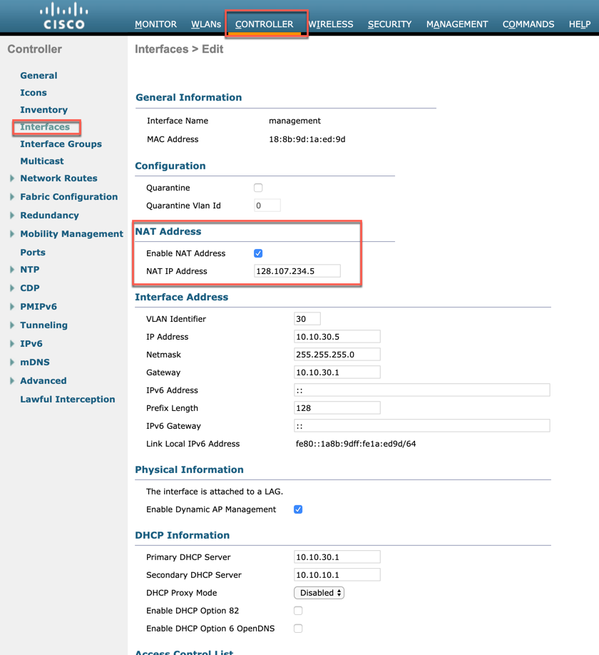

Cisco access points in OfficeExtend mode
Configure AireOS WLC
Step 1: Set up either physical or virtual controller to be used in DMZ
Step 2: Configure Management
In Controller > Interfaces, click the management interface
Step3: Select Enable NAT Address.
Step4: In the NAT IP Address box, enter the publicly reachable IP address, and then click Apply. (Example: 128.107.234.5)
Watch a WLC Guided Configuration Walk-through

Slide 10
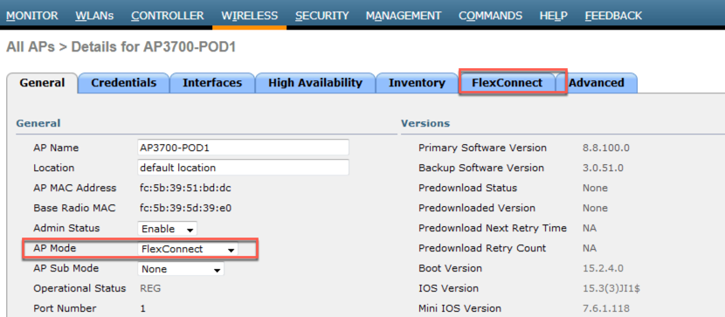
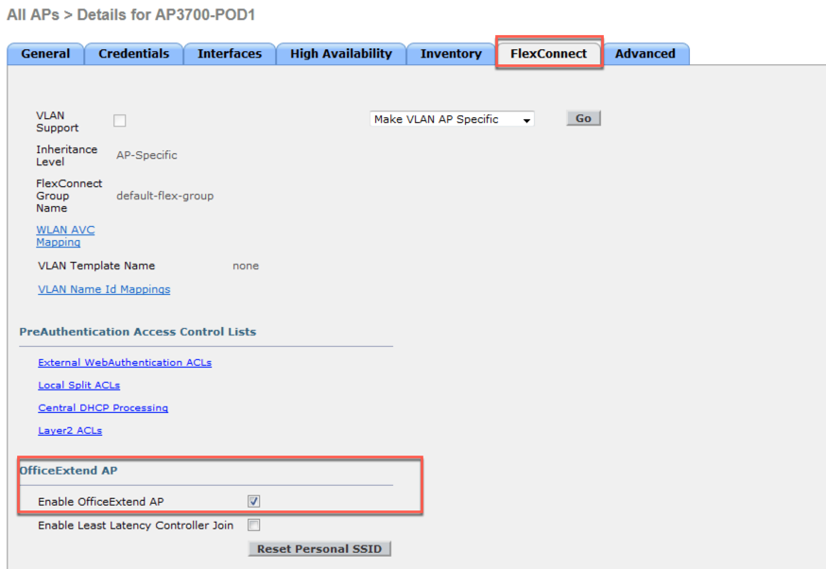
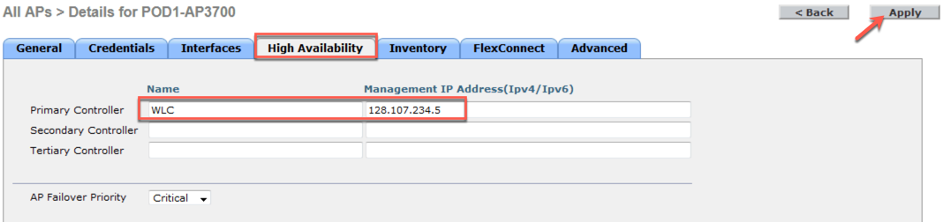
Cisco access points in OfficeExtend mode
Prime AP: Configuring AP mode to OEAP
Step 1: Have all AP’s join a WLC to start so that it’s connected and has the latest code
Step 2: From WIRELESS >All APs Select the AP which needs to be converted to OEAP
Step 3: From General tab change the AP mode to FlexConnect
Step 4: Then go to FlexConnect>OfficeExtend AP enable OfficeExtend AP by checking the box
Step 5: Also, configure the high Availability by providing the WLC name and IP address in Primary Controller option and click Apply.
Now admin can take out the AP and give it to the remote worker where he connects it to the home router
Note: verify which AP’s are being sent to the employees. Most AP’s use an AC adapter, some AP’s might require a power injector or POE to power up the APs
Watch a Prime AP Guided Configuration Walk-through

Slide 11
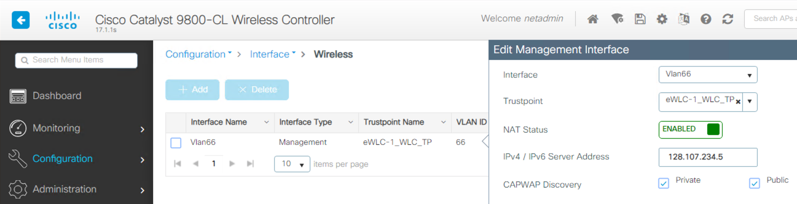
Cisco access points in OfficeExtend mode
Configure 9800 WLC
Step 1: Set up the virtual controller** to be used in DMZ
Step 2: If a publicly reachable IP address is not assigned directly to the controller, enter the NAT IP address by going to Configuration → Interface → Wireless (GUI option on 17.1.1) or via the CLI under the wireless management interface configuration.
Step 3: Configure the WLAN and Policy for the wireless network that would be extended to the remote user. (Example based 802.1X)
Step 4: Navigate to Configuration → Tags & Profiles → Flex and modify the default-flex-profile (or create a new one) to enable Office Extend AP
Step 5: Go to Configuration → Tags & Profiles → AP Join to edit the default-ap-profile (or create a new one) an under the CAPWAP Advanced parameters make sure that Enable Data Encryption is enable to secure the traffic traversing the internet.
Step 6: Go to Configuration → Tags & Profiles → Tags to edit the default-site-tag (or create a new one) that is mapped to the Flex Profile from the previous step. Make sure that Enable Local Site is unchecked.
Watch a 9800 WLC Guided configuration Walk-through
** same steps for appliance as well

Slide 12
Cisco access points in OfficeExtend mode
Offers
AireOS and IOS-XE WLCs
Leverage WLC evaluation license
Supports maximum WLC platform AP Limit
Duration: 90 Days for either AireOS or IOS-XE based controllers
  No AP Count license required for Mobility Express or Autonomous Mode APs
Setup evaluation license in AireOS or IOS-XE
Free 9800-CL WLC
With a 90-day evaluation license
Supports maximum WLC platform AP Limit
No AP Count license required for Mobility Express or Autonomous Mode Aps
Download WLC controller for cloud .ova file here
Setup evaluation license in IOS-XE

Slide 13
Cisco access points in OfficeExtend mode
Additional resources
OEAP Configuration Guide (AireOS 8.5): Link
OEAP Configuration Guide (AireOS 8.8): Link
OEAP WLC guided configuration video
OEAP Cisco Validated Design: Link
1815t Deployment Guide: Link
Cisco Wireless Solutions Software Compatibility Matrix: Link
AP at teleworker site
Wireless OEAP TDM presentation: Link
Wireless OEAP Cheatsheet: Link
AP Models | OEAP | RLAN/Aux port | 9800 | AireOs
91xx | Supported | N/A (AP does not have Aux Ports) | 17.2 | 8.5.161.0/8.10.112.0
Wave 2 Aps (including 4800) | Supported | 28xx/38xx/1850/1815t/1815w supports RLAN | 17.2 | 8.5.161.0/8.10.112.0
Wave 1 | Supported | N/A (AP does not have Aux Ports) | 17.2 | 8.5.161.0/8.10.112.0
Notes:
Customers can leverage the buy one access point, get one free offer: https://www.cisco.com/c/dam/en/us/solutions/collateral/enterprise-networks/promotions-free-trials/buy-one-access-point-get-one-free.pdf
OEAP Configuration Guide (AireOS 8.5): https://www.cisco.com/c/en/us/td/docs/wireless/controller/8-5/config-guide/b_cg85/configuring_officeextend_access_points
OEAP Configuration Guide (AireOS 8.8): https://www.cisco.com/c/en/us/td/docs/wireless/controller/8-5/config-guide/b_cg85/configuring_officeextend_access_points
OEAP WLC guided configuration video: https://www.youtube.com/watch?v=OWJwPbXREPQ
OEAP CVD: https://www.cisco.com/c/dam/en/us/td/docs/solutions/CVD/Aug2014/CVD-CiscoOfficeExtendDesignGuide-AUG14.pdf
1815t Deployment Guide: https://www.cisco.com/c/dam/m/zh_cn/solutions/enterprise-networks/mobility-express/office-extend/office-extend-deployment-guide.pdf
Compatibility Matrix: https://www.cisco.com/c/en/us/td/docs/wireless/compatibility/matrix/compatibility-matrix.html

Slide 14
Remote network access using WAN
Cisco Virtual Office / Cisco microbranch routers
COVID-19 expands around the globe, almost every country is impacted
IT want to enable virtual office experiences for employees / management for both home office or micro office use cases, and do it simply.
IT ship configured routers to employees / micro office locations
Local authorities encouraging/enforcing companies to initiate work from home policy or work from small temporary offices to meet social distance requirements
IT use a secure zero touch model to deploy Integrated services routers with 4G/5G capability, enabling voice video data and security needs.
Employees receive device, connect to their network and benefit from a secure, consistent office experience for all their data and collaboration needs, in their home / micro office
Use case premise:
Set up home, remote, and small branch offices without onsite provisioning using Cisco ISR 1K along with CVO licenses enabled.
Go beyond zero-touch provisioning, firewall and multi-layered VPN support with Cisco SD-WAN – With centralized management, content filtering, IPS you can securely deploy routers at scale with little or no configuring
For micro-branch environments, Cisco ISR1K routers offer both embedded Wi-Fi and pluggable giga-bit class advanced LTE/cellular options for expanded WAN coverage, backhaul over cellular, backup/fail-over connectivity and active-active configurations

Slide 15

3 Pieces of the Puzzle – What is needed?
Cisco microbranch routers
Headend
ISR 1000
Headend Failover
Data center
Micro Office Environment
1- Support for full IP phone, wireless, data, and video services over an encrypted VPN
  Headend : ASR1K Series
2-Internet Connection
3-Cisco Remote Office Router:
  Remote Router with integrated Wireless:
    SD-WAN ready Cisco ISR1K : C1121-8PLTEPW$*, C1111-4PW, C1111-8PW, C1117-4PW
  Cellular options for fail-over, backhaul
  Modules : P-LTEAP18-GL, P-LTEA-EA, P-LTE
See bundle options in following slides
Headend Internet Connection
Home
Internet Connection
* SKU based on Wi-Fi domain

Slide 16
3 Pieces of the Puzzle – What is needed?
Cisco Virtual Office
CVO
Controller
Headend
Virtual Office Router
Data center
Virtual Office Environment
1- Support for full IP phone, wireless, data, and video services over an encrypted VPN
  CVO Controllers with Zero-Touch deployment and management
    Licenses : CVO-1100-4P-CFG, CVO-1100-8P-CFG
  VPN Headend : ISR4K for Secure device provisioning, ASR1K Series
2-Internet Connection
3-Cisco Virtual Office Router:
  Remote Router with Wireless:
    SD-WAN ready Cisco ISR1K : C1121-8PLTEPW$*, C1111-4PW, C1111-8PW, C1117-4PW
    SEC license needed for CVO deployment to enable zone-based firewall, easyVPN, DMVPN capabilities
  See bundle options in following slides
Headend Internet Connection
Home
Internet Connection
* SKU based on Wi-Fi domain
Suitable for midsize and large organizations looking to provide teleworkers, small offices, and mobile users with office-like experiences combining voice, video, wireless, and real-time data applications in a secure environment

Slide 17
Benefits: Solutions with SD-WAN ready ISR 1000
Increased workforce productivity
Greater collaboration with seamless voice and video
Optimal user experience
Reliable connectivity and performance
  4/8 GE LAN with PoE/PoE+
  Integrated Wi-Fi: 802.11ac with Mobility Express
  Next-gen LTE (CAT18/6/4) with integrated LTE and pluggable options
  DSL option (EMEA/Canada)
  Optional extended temperature support for extreme environments
Easy deployment and management
Cisco SD-WAN ready with central management and policy control
Zero-touch deployment (Plug-n-Play)
Branch multi-cloud access
Investment protection and future-proof (5G Ready)
Multi-layered, proactive security
  Firewall
  Content filtering
  Intrusion prevention system
  Multilayered VPN technologies

Slide 18
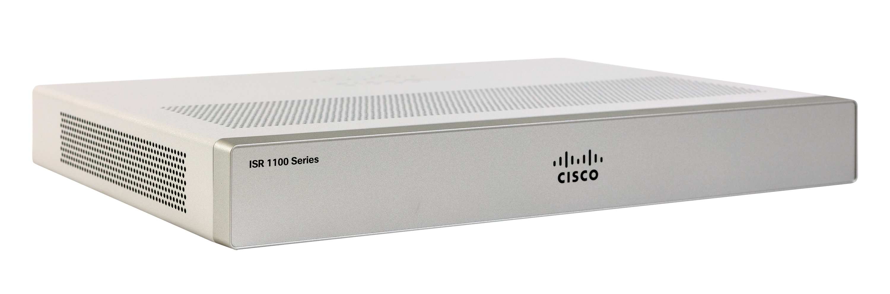
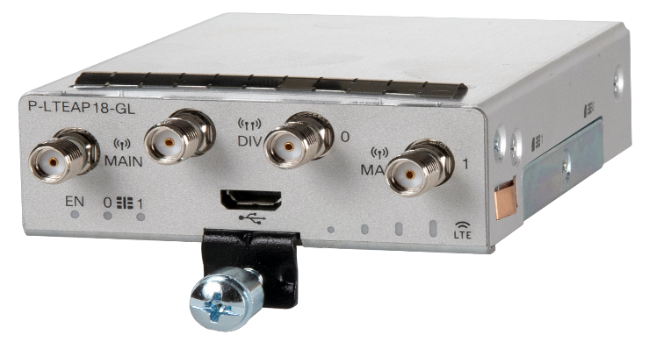
Gigabit-Plus LTE Connectivity to On-Demand Locations
ISR 1121 + 4G/LTE (5Ge) Advanced Pro Module
Microbranch Solution
Routing, switching,
and wireless
SD-WAN Ready
C1121X-8PLTEPWY*
Router
Integrated security
Security
Speed and performance
Switch Ports
P-LTEAP18-GL**
Integrated
management tools
Wireless
(Wi-Fi)
Cellular
(1.2 Gbps LTE Advanced Pro)
Multi-connectivity
PID | LTE Bands
P-LTEAP18-GL | 1, 2, 3, 4, 5, 7, 8, 12, 13, 14, 17, 18, 19, 20, 25, 26, 28, 29, 30, 32, 38, 39, 40, 41, 42, 43, 46, 48, 66, 71
** P-LTEAP18-GL available Europe & US only. For global CAT6 LTE options please visit ISR1K Datasheet
C1121X-8PLTEPWY*
* Wi-Fi domain WY; Y = A, E, B, Z

Slide 19
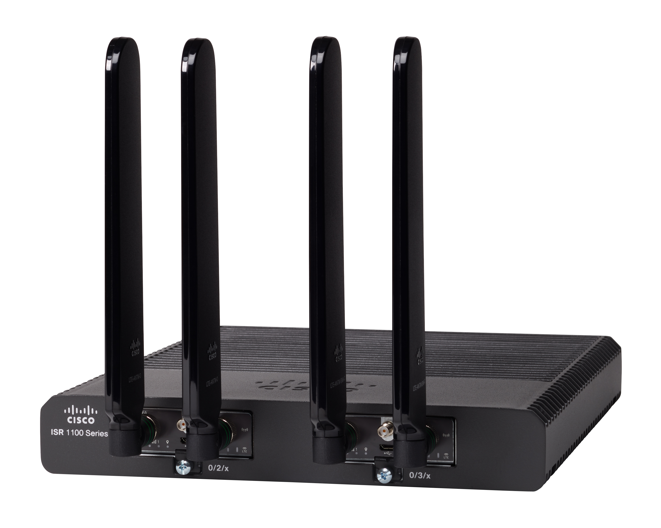
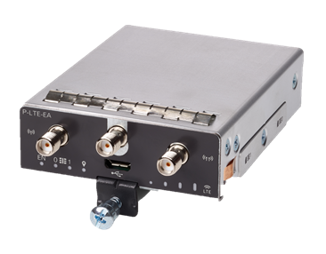
Active/Active LTE Advanced Connectivity to On-Demand Locations
ISR 1109 with Dual-Pluggables
Microbranch Solution
C1109-4PLTE2PW*
Routing, switching,
& Wireless
SD-WAN Ready
Router
Integrated security
Security
Extended temperature for extreme env.
Switch Ports
2x P-LTEA
Integrated
management tools
Wireless
(Wi-Fi)
Cellular
(300 Mbps LTE Advanced Pro x2)
Multi-connectivity
PID | LTE Bands
P-LTEA-EA | 1-5, 7, 12, 13, 20, 25, 26, 29, 30, and 41
P-LTEA-LA | 1, 3, 5, 7, 8, 18, 19, 21, 28, 38, 39, 40, and 41
C1109-4PLTE2PW*
* Wi-Fi domain W* =A, B, D, E, Q, R, Z

Slide 20
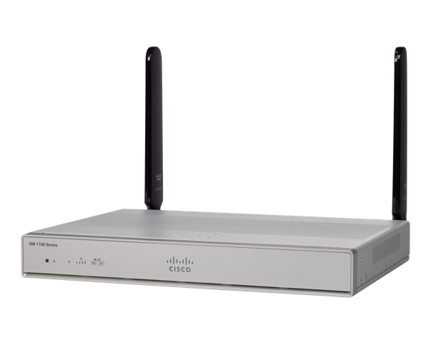
Secure Connectivity to Remote Teleworkers
ISR 1111 with Integrated 4G LTE Advanced
Teleworker Solution
SD-WAN Ready
Routing, switching,
and wireless
C1117-4PW
C1111-4PW / C1111-8PW
Router
Integrated security
Security
Speed and performance
Switch Ports
Integrated
management tools
Wireless
(Wi-Fi)
Cellular
(300 Mbps LTE Advanced)
Multi-connectivity
PID | LTE Bands
C1111-xPLTEEA | 1-5, 7, 12, 13, 20, 25, 26, 29, 30, and 41
C1111-xPLTELA | 1, 3, 5, 7, 8, 18, 19, 21, 28, 38, 39, 40, and 41
C1111-xPLTExAW*
* Wi-Fi domain W* = A, B, D, E, F, H, N, Q, S, Z

Slide 21
Targeted offers to support the solutions
Teleworker Bundles
ISR1000-4P-TWPM20
ISR1000-8P-TWPM20
(14% Off* on HW)
Use cases : Home Office
SD-WAN Ready ISR1K
  SKU Options : C1121-8PLTEPW$*, C1111-4PW, C1111-8PW, C1117-4PW
  Wi-Fi domain: W$; $ = A, E, B, Z
Free Virtual Office License
  SKU : CVO-1100-4P-CFG, CVO-1100-8P-CFG
Cellular Modules
  SKU Options : P-LTEAP18-GL, P-LTEA-EA, P-LTE
Add-on SD-WAN subscriptions (L-LIC-DNA-ADD)
Microbranch Bundle
ISR1000-4P-MBPM20
ISR1000-8P-MBPM20
(14% Off on HW)
Use cases : Health Camps / Relief Camps / Support center/ Urgent Care
SD-WAN Ready ISR1K
  SKU Options : C1121X-8PLTEPW$*, C1109-4PLTE2PWB, C1111-xPLTExAW*
  Wi-Fi domain: W$; $ = A, E, B, Z
Cellular Modules
  SKU Options : P-LTEAP18-GL, P-LTEA-EA, P-LTE
SD-WAN subscriptions (Optional – As part of bundle)

Slide 22
Useful Links
ISR1K Datasheet: https://www.cisco.com/c/en/us/products/collateral/routers/1000-series-integrated-services-routers-isr/datasheet-c78-739512.html
Cellular WAN Datasheet: https://www.cisco.com/c/en/us/solutions/collateral/enterprise-networks/4g-lte-solutions/datasheet-c78-743503.html
ISR1K Configuration Guides: https://www.cisco.com/c/en/us/support/routers/1000-series-integrated-services-routers-isr/products-installation-and-configuration-guides-list.html
SD-WAN Ordering Guide: https://www.cisco.com/c/dam/en/us/products/collateral/software/one-wan-subscription/guide-c07-740642.pdf
Cisco CVO page : https://www.cisco.com/c/en/us/solutions/enterprise-networks/virtual-office/index.html
Step-by-step guide to setting up Popup ISR1K Single Box LTE/WiFi Hotspot Solution - XE SD-WAN: https://community.cisco.com/t5/networking-documents/popup-isr1k-single-box-lte-wifi-hotspot-solution-xe-sd-wan/ta-p/4049385
Step-by-step guide to setting up Popup ISR1K Single Box LTE/WiFi Hotspot Solution – IOS-XE: https://community.cisco.com/t5/networking-documents/popup-isr1k-single-box-lte-wifi-hotspot-solution-ios-xe/ta-p/4046810

Slide 23

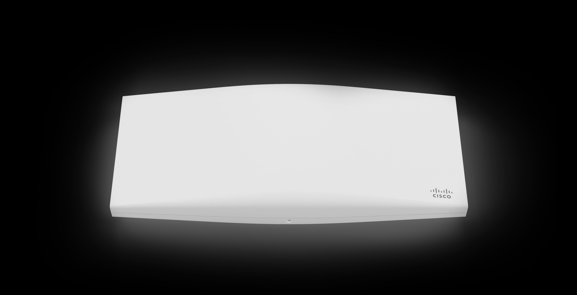
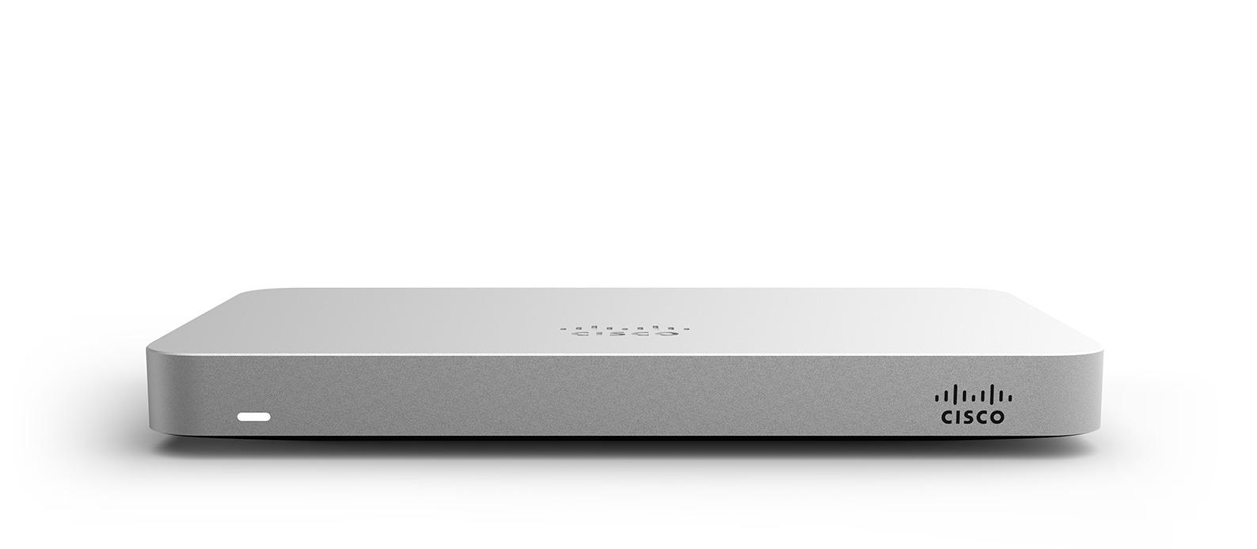


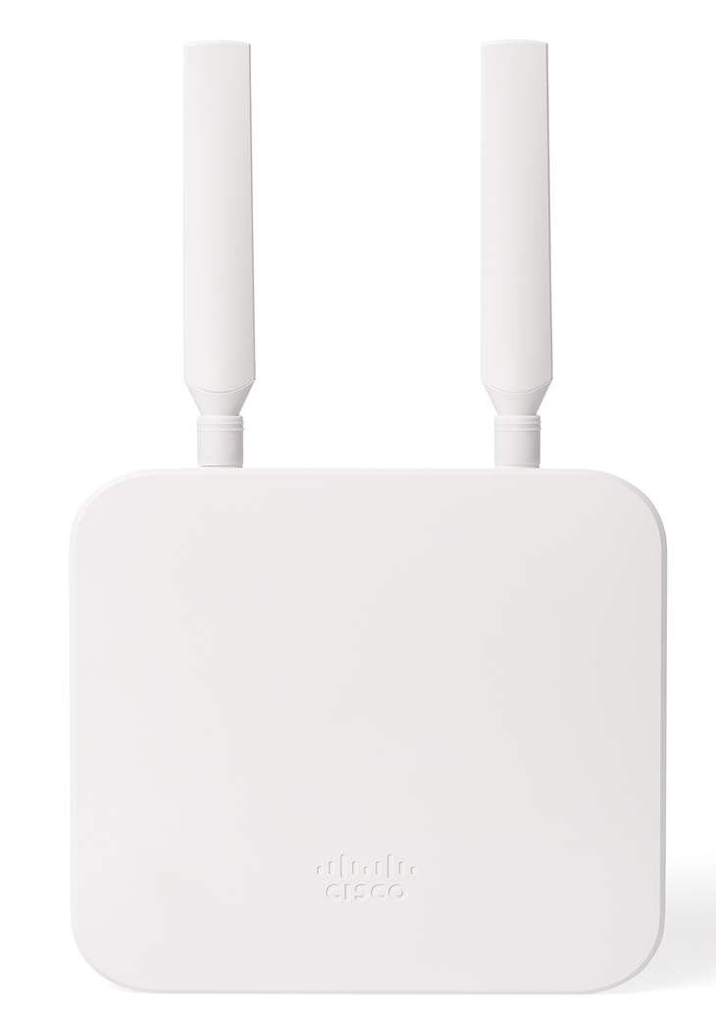
Cisco Meraki Zero Touch Teleworker
Needs updating by meraki
Meraki had made solutions and offers available for customers looking for remote work offers:
All Meraki Security & SD-WAN, Teleworker Appliances (MX, Z) and Access Points (MR) have the capability to securely extend a corporate network into the home.
Meraki Insight (MI) gives IT admins a view into the remote performance of cloud-based applications (WebEx, O365, G-Suite, etc.)
Meraki Systems Manager (SM) keeps school/government/enterprise issued devices secure when off net and assists in the rapid deployment of security offerings (Duo, Umbrella, Clarity, etc.)
Teleworker Device
Wireless
Remote Work
Client VPN
AutoVPN
Cellular Connection
Meraki offers
Notes:
Customer offers: https://meraki.cisco.com/

Slide 24
Additional resources for customers
3
Online resources:
IBN COVID-19 offers Cisco.com page
Supporting business continuity during the COVID-19 pandemic page on cisco.com
Three Network Challenges IT Can Solve to Drive Business Continuity blog: link
Cisco Offers No-Cost Wireless Networking Equipment for Healthcare’s Pandemic Response blog: link
Americas Pandemic Brokerage Program: program overview, equipment donation form, healthcare equipment request form
Remote network access promo page
Rapid response network bundle promo page
Webinars
Americas Teleworker virtual series webinars: Register here
Americas Healthcare pop-up wireless strategies webinar Register here
Notes:
Supporting business continuity during the COVID-19 pandemic page on cisco.com: https://www.cisco.com/c/m/en_us/covid19.html#%7Efor-partners
Americas Teleworker virtual series webinars: https://web.cvent.com/event/01c4f384-c702-4bc2-a646-1b00f3000479/summary
Americas Healthcare pop-up wireless strategies webinar Register here
https://web.cvent.com/event/b6d5933e-03f4-4185-8781-bebeac829938/summary

