Slide 1
Cisco HyperFlex Anywhere
Modernize the present, simplify the future

Slide 2
What does the future
look like?
Traditional Infra
#1 Initiative Is to Reduce Operations and Capital in the Core
“Over the Last Two Years, IT Organizations Spent 70% on “Run the Business” IT Spending, up from 67% in 2013 to 2014, and 65% in 2012”
Private Cloud
Scale-Out Infra
Core
Mgmt. and Ops
04/18 Gartner,
2018 Strategic roadmap for compute infrastructure, Chirag Dekate, Daniel Bowers, et al., 10 April 2018.
Notes:
According to IDC FutureScape: Worldwide IT Industry 2018 Predictions by 2020 – “60% of all enterprises will have fully articulated an organization wide digital transformation platform strategy and will be in the process of implementing that strategy as the new IT core for competing in the digital economy”.
This planning however is a stark contrast to current budget spending, which Gartner highlights in their 2018 Strategic Roadmap for Compute Infrastructure by highlighting “Over the last two years, IT organizations spent 70% on "run the business“ IT spending, up from 67% in 2013 to 2014, and 65% in 2012. This trend has infrastructure and operations moving in a direction diametrically opposed to the requirements of digital business”.
Making strategy a reality means that reducing operations and capital expenses related to the core the #1 initiative according to Gartner.

Slide 3

Core-Cloud Apps and
Data Flows
What does the future
look like?
Traditional Infra
IaaS/PaaS/SaaS
By 2020, Over 90% of Enterprises Will Use Multiple Cloud Services and Platforms
Private Cloud
Public Cloud 1
Scale-Out Infra
Core
Cloud
Public Cloud 2
2018 IDC,
IDC FutureScape:
Worldwide IT Industry 2018 Predictions
Mgmt. and Ops
Public Cloud 3
Notes:
The future for most organizations will include a blend of core on-prem workloads as well as leveraging public clouds and Software as a Service (SaaS) offerings. IDC predicts that by the same year, over 90% of enterprises will use multiple cloud services and platforms.

Slide 4

Core-Cloud Apps and
Data Flows
What does the future
look like?
Traditional Infra
IaaS/PaaS/SaaS
“By 2022, more than 50% of enterprise-generated data will be created and processed outside [of] the core data center or cloud”
Private Cloud
Public Cloud 1
Scale-Out Infra
Core
Cloud
Public Cloud 2
Mgmt. and Ops
Public Cloud 3
Edge-Core Apps and
Data Flows
Edge
Edge-Cloud Apps and
Data Flows
12/18 Gartner,
Gartner IT Infrastructure, Operations & Cloud Strategies Conference Event Presentation, The Future of IT Infrastructures: Always On, Always Available, Everywhere, David J. Cappuccio, Bob Gill, et al., 3-6 December 2018
IoT
Branch/
Remote
Real Time Analytics and Inference
Notes:
In addition to core and cloud, Gartner predicts that by 2022, 50% of enterprise-generated data will be created and processed outside of the core data center or cloud. These off-prem edge workloads will be used to enhance branch or remote office capabilities as well as utilizing AI analytics and inferencing to support IoT and mobile workloads.

Slide 5







The Future is the
Distributed Datacenter
Core
Cloud
Edge
Notes:
The future is the distributed datacenter that will blend core datacenters, cloud services, and edge workloads in a seamless ecosystem.

Slide 6

Are you ready for the future today?
…or just keeping the lights on?

Slide 7



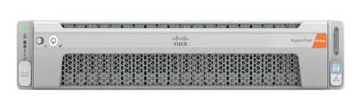
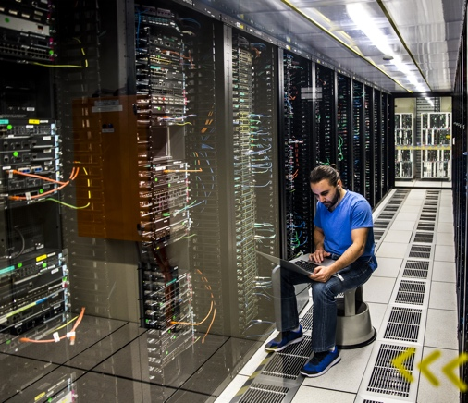





Datacenter Modernization
Your bridge to the Future
Traditional Infrastructure
Highly Manual Core Operations
Limited Time and Budget
for Future Initiatives
Modernized Hyperconverged Infrastructure
Streamlined and Modernized Core
Optimized for the Distributed Datacenter
63% of Organizations Currently Describe Their Current Workload at “Highly Manual”
Core
Cloud
Edge
75%
Management
Time Savings³
451 RESEARCH,
VOICE OF THE ENTERPRISE
90%
Downtime Reduction⁷
80%
Savings vs. 3-tier Infrastructure¹
Notes:
Traditional infrastructure can be complex with multiple silos to manage through what was described by 63% of the organizations in a recent 451 Research Voice of the Enterprise poll as “highly manual”. This maintenance focused operations model leaves IT departments with limited time and budget to allocate for future initiatives that you know you need to address.
With IT budgets expected to remain flat, and IT staff time being limited to the fixed time in the day, how do you get from just keeping the lights on today, to being future ready for the distributed datacenter? By modernizing your current infrastructure.
Hyperconverged Infrastructure (HCI) has proven to yield impressive results with customers reporting 75% time savings in managing their infrastructure, 90% reduction in downtime, and 80% savings over traditional 3-tier infrastructure. By combining virtualized computing, software defined storage and networking into a single pooled cluster, it’s simplicity allows HCI platforms to be implemented and managed by generalist IT staff, who do not need the expertise of storage and network specialists. This enables you to spend less time managing your core infrastructure, and utilize your specialized staff to address strategic projects to advance the business.
Given that cloud and edge will figure largely in future IT environments, modernized on-premises core infrastructures utilizing HCI not only provide cloud-like in their delivery of IT resources, they are software based technologies, that easily integrate well with public cloud service providers as the foundation for hybrid infrastructures. Additionally, and their modular architecture is easily adaptable to edge environments in the distributed datacenter.

Slide 8

Cisco HyperFlex Anywhere
Your Platform to
Modernize The Present
Simplify Your Future

Slide 9
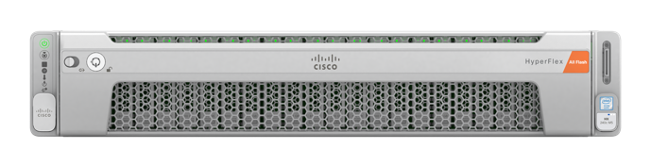
What is HyperFlex?
Engineered and Optimized HCI
Performance and Scalability to Power
Any App, Any Cloud, Anywhere
HX Data Platform
Cloud Platform
UCS Foundations
Purpose Built for HCI
Fast and Flexible
Enterprise Grade Storage
Cisco Intersight
Cisco CloudCenter
Cisco Workload Optimization Mgr.
Software Defined Compute
Fabric Centric
Intent-Based
Notes:
So what is Cisco HyperFlex? Fully engineered and optimized HCI.
When Cisco decided it was time to get into the HCI market, we observed the shortcomings of the HCI solutions available at the time, and set out to introduce a product that would redefine the space by addressing the shortcuts in networking integration and scalable performance that first-generation HCI vendors made then and continue to carry over now.
We engineered HyperFlex to provide a seamless experience by deeply engineering hardware and software together in order to deliver the performance and scalability to power any app, in any cloud, anywhere. Each node ships from the factory with fully integrated hardware, software, and networking, making HyperFlex solutions ready to be deploy in minutes
UCS Foundation - Cisco UCS, the foundation for Cisco HyperFlex Systems, is built with a single point of management and connectivity for the entire system. Cisco UCS provides a single point of connectivity and hardware management that integrates Cisco HyperFlex nodes into a single unified cluster. The system is built to be self-aware and self-integrating so that when the system’s fabric interconnects notice a new component attached, that component is automatically incorporated into the cluster.
Fabric Centric - High performance fully integrated unified fabric that integrates smoothly with the Cisco Application Centric Infrastructure (Cisco ACI™) solution
Software Defined Compute - Abstracts hardware from the operational plane to easily adapt to multiple workloads
Intent-Based - Automate configurations and tasks to business objectives and application experiences
HX Data Platform - The Cisco HyperFlex HX Data Platform combines the cluster’s storage devices into a single distributed, multitier, object-based data store.
Purpose Built for HCI - High performance, log-structured, scale-out file system that is designed for hyperconverged environments
Fast and Flexible - Supports multiple hypervisors and containerized applications
Enterprise Grade Storage - A full set of enterprise-class data management features are built in: for example, snapshots, thin provisioning, replication for disaster recovery and backup, data encryption, integration with third-party backup tools, and instant and space-efficient cloning.
Cloud Innovations - The Cisco HyperFlex multicloud platform is an adaptive system engineered for speed and simplicity. Capable of powering more workloads with deployment on premises or in the cloud.
Cisco Intersight - Cloud based management and AI driven analytics
Cisco CloudCenter - Hybrid/Multicloud
Cisco Workload Optimization Mgr. - Intelligent workload placement across cloud and on-prem environments to optimize cost

Slide 10

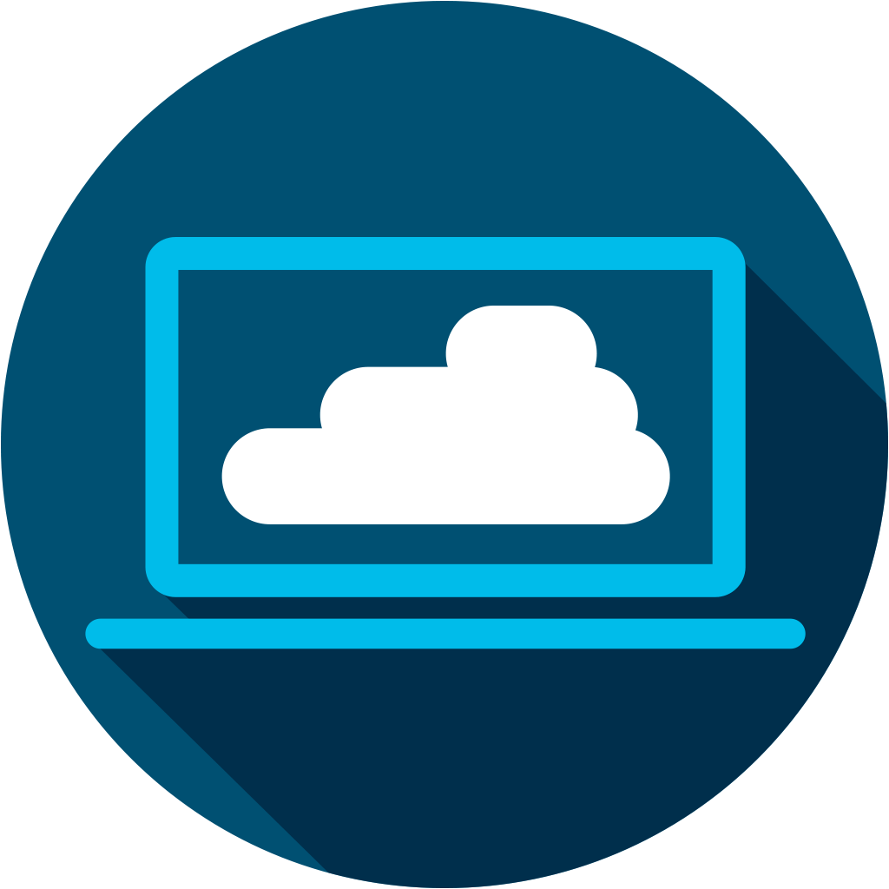
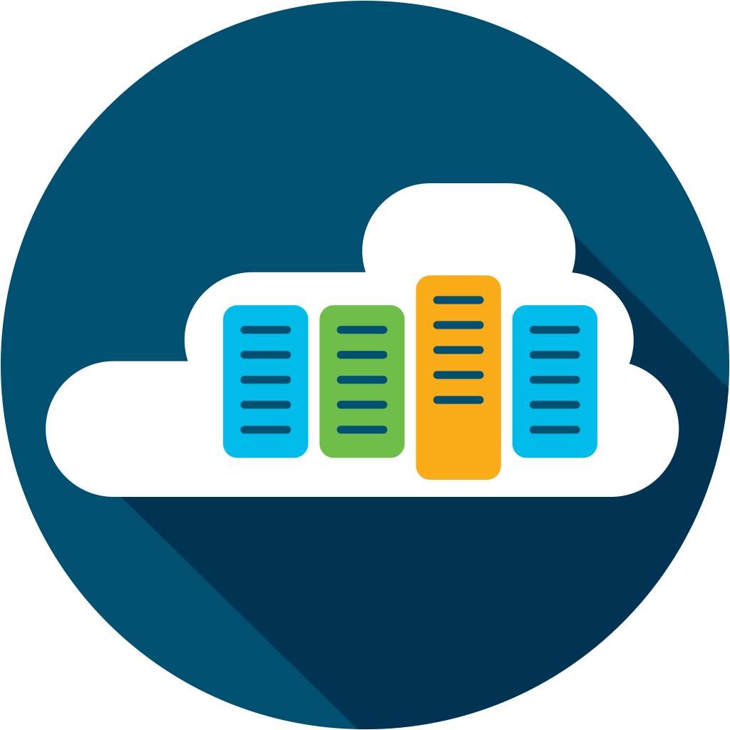
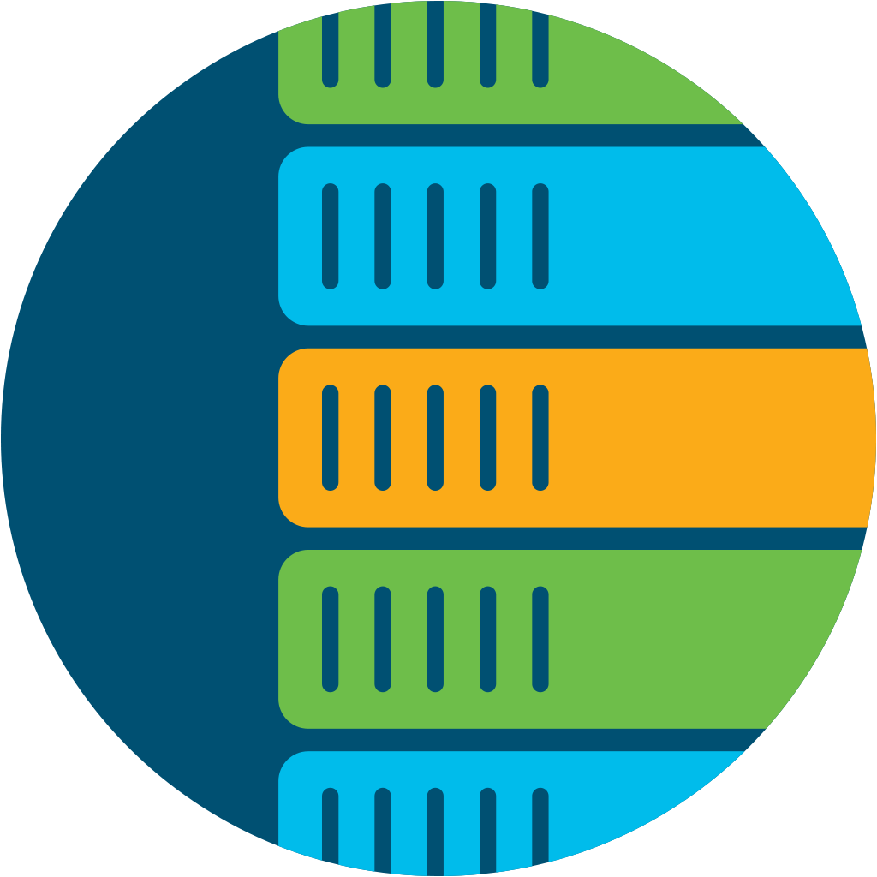
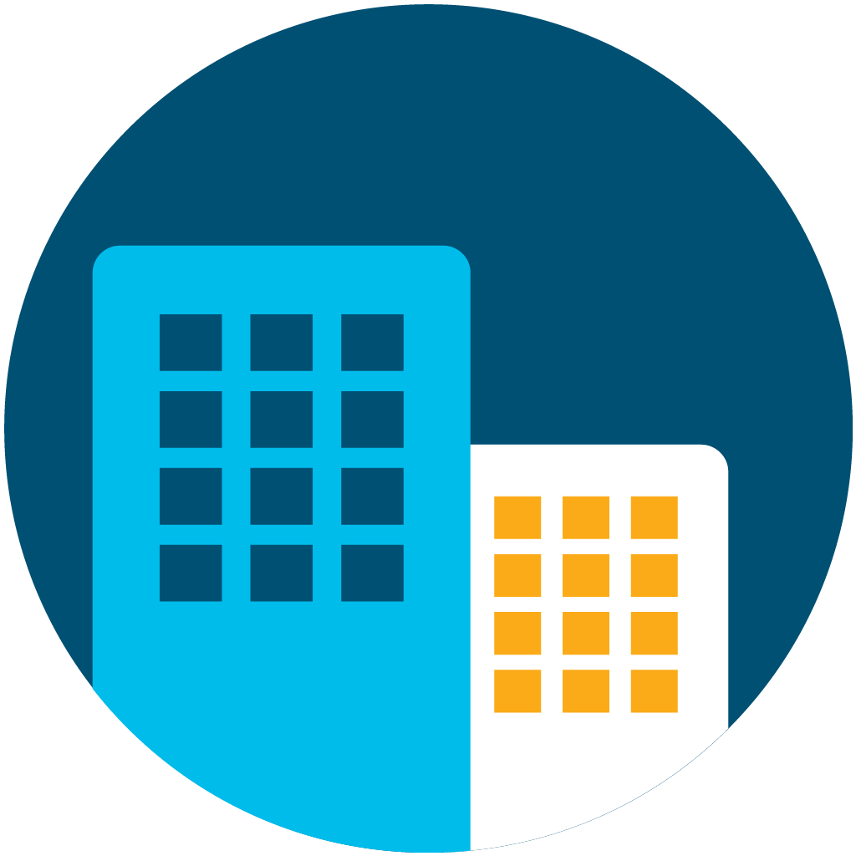

End-to-End Modernization Today
Game Changing Results
Test and
Development
Virtual Desktop Infrastructure
Server Virtualization
Databases
& ERP
ROBO &
Edge
3000+
Customers Are Saying:
2x
Virtual desktop speed⁴
50%
Improvement in ERP Response Time⁶
30%
More Performance for Mission Critical Apps⁵
90%
Downtime Reduction⁷
80%
Savings vs. 3-tier Infrastructure¹
75%
Management
time savings³
51%
Savings vs. Public Cloud Over 3 years²
Notes:
Hyperconverged Infrastructure has gained popularity based on it’s simplicity which drives business outcomes to its users. However, since coming to market, HCI has seen a growing trend of disaggregation between it’s hardware and software layers as vendors move in a direction to make their HCI software available on multiple hardware platforms. This trend adds complexity and hinders the performance that an HCI solution can deliver, which in turn, limits the use cases and business outcomes that can be delivered to it’s users.
As we discussed earlier, HyperFlex is fully engineered and optimized HCI solution that ships from the factory ready to deploy with fully integrated hardware, software and networking. This fully engineered approach means that you can expect game changing results through a seamless user experience along with industry leading HCI performance to power end-to-end modernization across all of your applications.
Lets take a look at a few examples of what modernizing on HyperFlex can for you.
Based on feedback received from some of the 3000+ customers using HyperFlex, here’s some key examples of real-world game changing results our customers have experienced.
Improvements in application performance and availability
Increased virtual desktop performance by 2X
Improved ERP response time by 50%
30% performance improvement for mission critical applications
Downtime becoming a thing of the past with a 90% reduction in reported downtime
Staff time and economic benefits
Savings of 80% vs 3 tier infrastructure, to enable budget reinvestment in strategic initiatives
Transforming the way IT spends their time through cloud like deliver of IT resources that requires 75% less time to manage infrastructure
A cloud like experience on-prem that provides a 51% savings vs full public cloud migration when measured over a 3yr period
These application performance benefits means that you can migrate over to a new modernized infrastructure platform, and not only increase the performance in which you deliver applications to your end users, but also transform your operating model to one that results in staff time and economic benefits that free up time and budget to enable your future.
Customer Citations located on slide 24

Slide 11
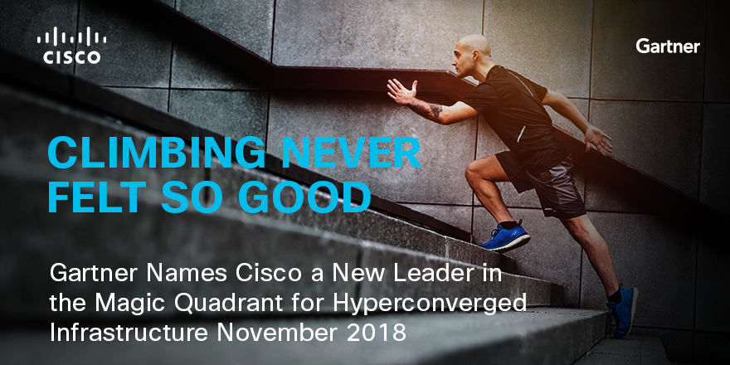
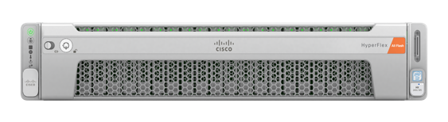
Cisco HyperFlex Rapid Pace in Leadership
From Launch to an
HCI Magic Quadrant Leader in
2.5 years
Gartner, Magic Quadrant for Hyperconverged Infrastructure, 27 November 2018. Gartner does not endorse any vendor, product or service depicted in its research publications, and does not advise technology users to select only those vendors with the highest ratings or other designation. Gartner research publications consist of the opinions of Gartner’s research organization and should not be construed as statements of fact. Gartner disclaims all warranties, expressed or implied, with respect to this research, including any warranties of merchantability or fitness for a particular purpose. GARTNER is a registered trademark and service mark of Gartner, Inc. and/or its affiliates in the U.S. and internationally, and is used herein with permission. All rights reserved.

Slide 12
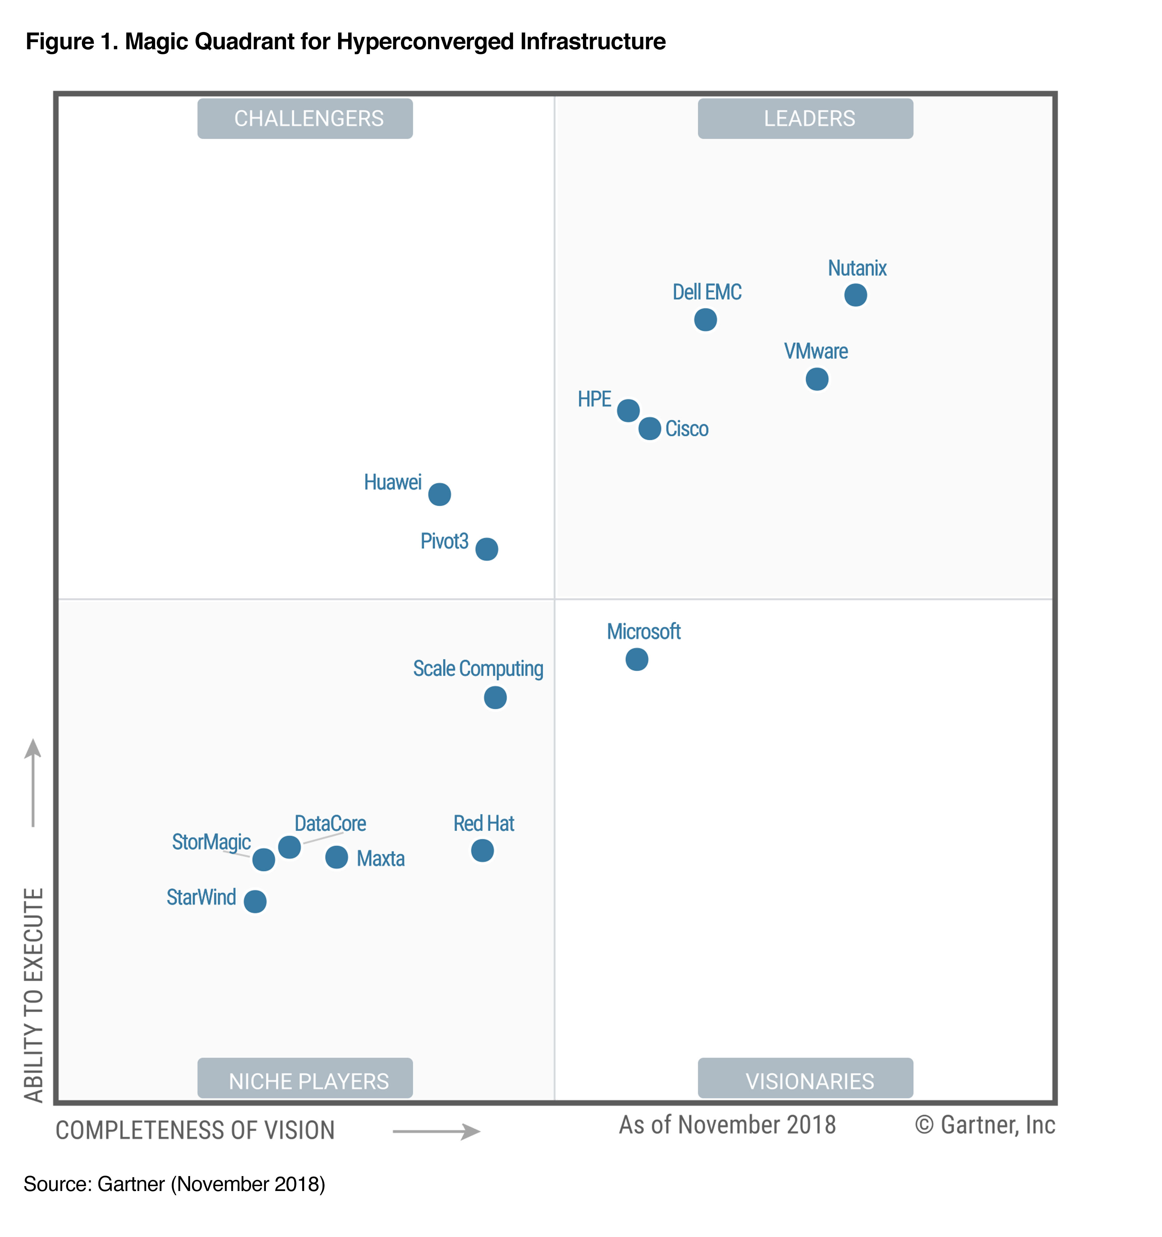
Cisco HyperFlex Rapid Pace in Leadership
From Launch to an
HCI Magic Quadrant Leader in
2.5 years
Gartner, Magic Quadrant for Hyperconverged Infrastructure, 27 November 2018. This graphic was published by Gartner, Inc. as part of a larger research document and should be evaluated in the context of the entire document. The Gartner document is available upon request from Cisco. Gartner does not endorse any vendor, product or service depicted in its research publications, and does not advise technology users to select only those vendors with the highest ratings or other designation. Gartner research publications consist of the opinions of Gartner’s research organization and should not be construed as statements of fact. Gartner disclaims all warranties, expressed or implied, with respect to this research, including any warranties of merchantability or fitness for a particular purpose.

Slide 13
Modernize on a Platform That Will Simplify the Future

Slide 14

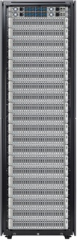
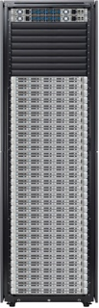


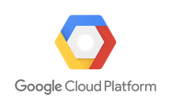

Cisco HyperFlex Anywhere
HyperFlex
Any App, Any Scale
Hybrid Cloud Stacks
Consistent On-prem + Cloud Environment
Core
Cloud
Edge
HyperFlex Edge
Ultra-Light
Cloud Managed
Notes:
While hyperconverged infrastructure is commonly associated with just the core datacenter, Cisco HyperFlex enables you to extend HyperFlex Anywhere your data is with a simplified computing platform engineered for the core, hybrid cloud, and expanding edge operations. With HyperFlex you can simplify operations for mission critical applications in core data centers, power new distributed cloud-native containerized applications across clouds, and enable the new IoT and inferencing applications emerging across a growing distributed Edge.

Slide 15


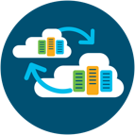

HyperFlex Anywhere
Platform to Simplify
Your Future
Cloud Based Mgmt. Automation
AI Driven IT Mgmt. (AI Ops)
Application Performance Monitoring
Intelligent Workload Placement
Simplified Multicloud Operations
Multicloud Platform
Integrated Kubernetes
HCI Workload Protection and Analytics
(Tetration)
Distributed Edge Application Support
AI Driven Apps and Inferencing
IoT
Remote Office/Branch Office (ROBO)
Notes:
While modernizing your current infrastructure can deliver performance and cost benefits today, embracing emerging technologies can further those benefits to make IT a strategic enabler in gaining a competitive edge in your industry.
However, things will be coming at you at a scale beyond what is cost effective to manage from a human capacity, so you need a platform designed around simplifying your adoption of these technologies in order to enable you to effectively manage the distributed datacenter. Cisco has engineered HyperFlex as a single, integrated platform to simplify your future through seamless integration of powerful management automation tools, muticloud capabilities, and the ability to adapt to the evolving application ecosystem.
As you plan ahead in your future goals, there are three main areas which need to be addressed by your modernized infrastructure in order to simplify your path.
These include:
Cloud Based Management Automation: The distributed datacenter can be a complex ecosystem to manage. Core workloads will no longer be static to your datacenter, cloud services will come from multiple sources, and the growth of edge computing driven by IoT and mobile workloads is driving management complexity beyond what is possible from current IT staffs. AI driven operations (AIOp’s) is coming, and Cisco Intersight as an integrated component of HyperFlex will serve at the foundation to AI driven IT end-to-end mgmt. Additionally, application performance monitoring, as well as intelligent workload placement means you can spend less time managing your infrastructure and realize cost benefits from running your applications in their ideal location, be it on-prem or in the cloud.
Simplified Multicloud Operations: We live in a multicloud world. Over the next 2 years, research indicates that 90% of organizations will utilize multiple clouds as well as SaaS offerings, and managing this can prove to be a daunting task without a true multicloud platform designed to around providing you workload protection and a secure connection to applications hosted off-prem.
Distributed Edge Application Support: Ecosystem: HyperFlex Edge and Cisco Intersight enables an enterprise-class edge platform for simplifying the deployment of branch, edge applications and enabling new IoT and intelligence services in the edge

Slide 16

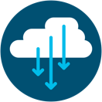

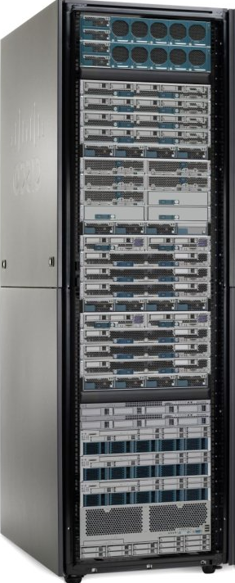
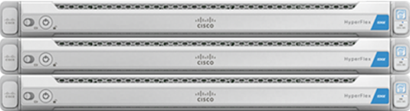
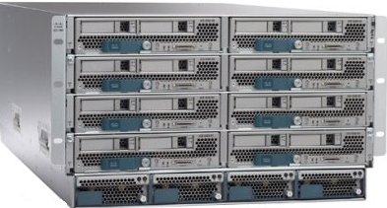




Managing your Future Datacenter
Harness the power of cloud-based management
Proactive Guidance
Connected Support
Remote Deployment
Storage Analytics
Data Center 1
Remote Office/
Branch Office
Edge Computing
Data Center 2
Cisco HyperFlex
Cisco HyperFlex
Cisco HyperFlex Edge
2-Node ROBO
Cisco HyperFlex Edge
Cisco UCS
Cisco UCS
Actionable Intelligence
Increased Agility
Reduced Operational Costs
Notes:
As we have discussed, the role of the datacenter needs to expand to embrace extensibility into the cloud, and Edge deployments with the overall idea to bring the datacenter infrastructure (computing, networking, security, analytics, etc.) closer to where the data is gathered, wherever that may be. This creates three major trends that will impact your future operations.
Application Evolution - Modern apps are fundamentally becoming less monolithic and datacenter-dependent, becoming more mobile-enabled and hyperscale in architecture through the use of modular and highly distributed microservices. This is creating an explosion of new end points that IT has to account for in terms of management and security.
Application Location - Whereas traditional IT could support and manage all users and applications safely behind the confines of the on premise datacenter, modern IT organizations have to now deal with users and application and workloads that operate in public, managed, and private cloud environments as well. The big challenge for IT is that this is a “and” problem. While monolithic apps like Microsoft, SAP, Oracle are not going anywhere, you have to prepare for the onslaught of modern, next-gen apps delivered over containers. IT has to support all on premise datacenters “and” leveraging the agility and simplicity of private cloud and public cloud options for those next-gen apps.
Infrastructure Management - Organizations are implementing distributed applications and distributed infrastructure to support new business services, such as IoT and mobility. The speed and complexity of this rapid change is becoming overwhelming for existing staff to support operations and ensure the performance, reliability and security of the applications and infrastructure. Existing on premise management tools from other systems vendors are inadequate and just add to the complexity.
Our customers love Cisco Meraki, because it is cloud-based networking management. Meraki frees them from the hassle of managing their networks, and because it is cloud-based, we can deliver many additional benefits to our customers. Cisco Intersight is cloud-based systems management – It’s Meraki for computing. Cisco Intersight cloud-based management platform for HyperFlex allows you to treat infrastructure as code, and adds analytics and machine learning that enable the systems to learn and adapt. It gives you instant access to all of your clusters—including installation capabilities— regardless of where they are located. This means that you can ship your nodes to the facility of your choosing and install them remotely.
The benefit?
You will be able to bring data together from all connected sources, for real-time analysis, and receive actionable intelligence
You will be able to meet your user needs with the speed and agility of public cloud providers
You will reduce manual involvement to deliver projects to meet business needs with full security and governance, easing the burden on IT teams that slow the growth rate needed to accelerate your business – resulting in reduced operational cost

Slide 17
Simplified Multicloud Operations
Simplified public cloud consumption
SaaS
Cisco CloudCenter
AppDynamics
Cisco Workload Optimization Manager
Cisco Cloud Container Platform
Platform for Multicloud
ACI / Nexus Tetration Analytics
Cisco Intersight
Cloud like experience on-prem
Notes:
Public cloud services have reset expectations for the speed and simplicity that IT resources can be delivered, but in a mutlicloud world, there is a growing mix of applications, across multiple environments that need to be managed efficiently in order to deliver the promised benefits of the cloud. Without a multicloud platform engineered to effectively manage a full hybrid service portfolio, complexity can undermine the value of cloud computing.
Why?
Clouds are all different – have different APIs.
Business units want multiple clouds, for multiple reasons
Evolving application architectures and technologies - Core workloads will no longer be static to your datacenter, new SaaS versions of apps, adoption of containerized workloads
The Cisco HyperFlex Platform for Multicloud simplifies multicloud operations to give you everything you need to securely deploy your applications anywhere with a cloud agnostic platform that translates the application profile into a deployable blueprint for each cloud API.
Cisco CloudCenter - simplifies self-service deployment. It helps define how an application is to be structured and then deploys it in a Cisco HyperFlex cluster, a public cloud, or a multicloud environment. CloudCenter eliminates the complexity of having to adapt to different public cloud models, making it easy to deploy and move applications based on changing business, workload, or economic factors.
Cisco AppDynamics® - gives you complete multicloud lifecycle management. It combines the decision engine of Cisco Workload Optimization Manager with the deployment engine of Cisco CloudCenter. The AppDynamics platform adds instrumentation and performance monitoring to help continuously evaluate your deployment decisions for excellent application performance.
Cisco Workload Optimization Manager - helps you optimize where your workloads run so that they get the resources they need for best performance. It continuously analyzes workload consumption, cost, and compliance constraints to give you the best possible intelligence on where to deploy your workloads initially and where to move them should conditions change.
Cisco Intersight platform - gives you instant access to all of your clusters regardless of where they are located.
End-to-end security - In addition to the built-in security of our platform are the security tools that you expect from Cisco.
Cisco Application Centric Infrastructure (Cisco ACI™) with Tetration secures the multiple layers of infrastructure with contracts that allow only specified traffic between application layers.
Cisco Adaptive Security Appliances (Cisco ASA) protect your network perimeter by blocking known threats and command-and-control callbacks while providing dynamic analysis for unknown malware and threats.
Cisco Stealthwatch Enterprise helps to outsmart emerging threats in your digital business with industry-leading machine learning and behavioral modeling.

Slide 18

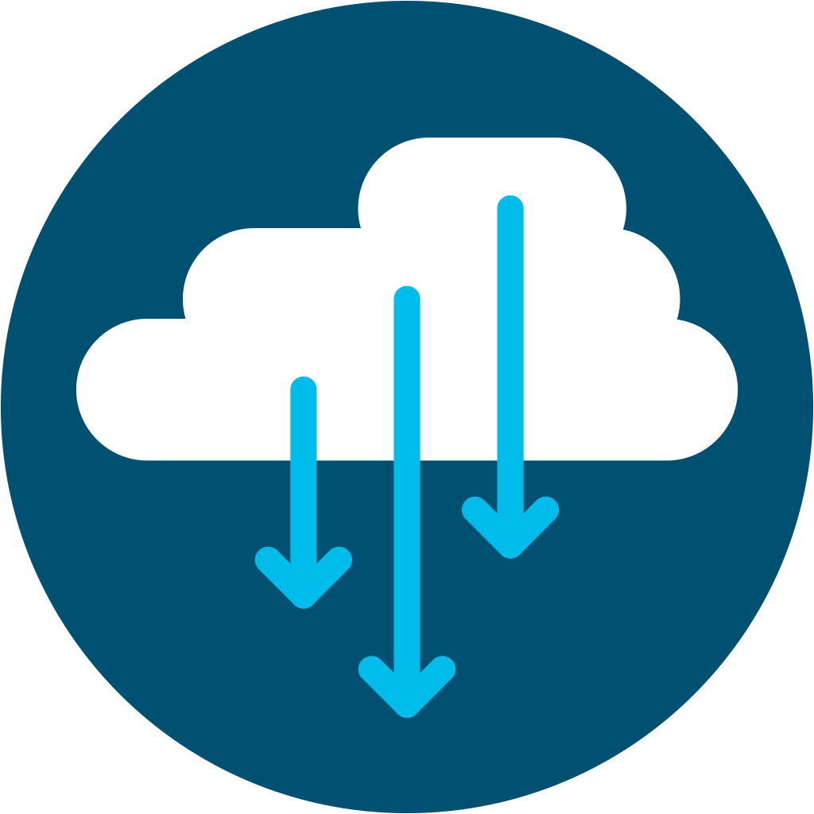

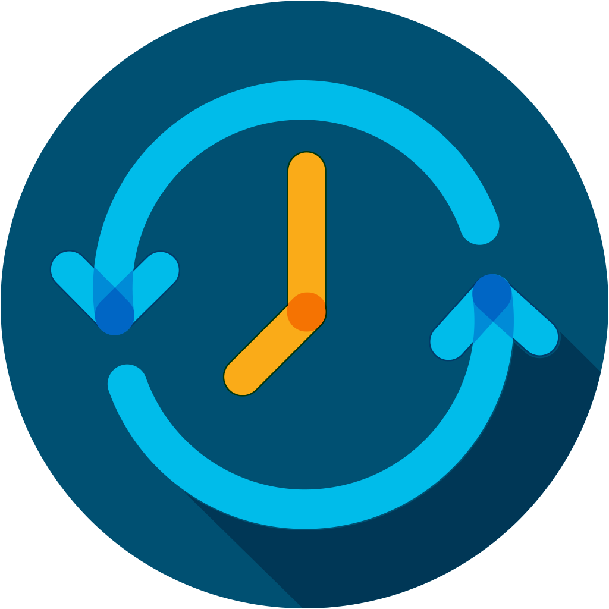



The New
HyperFlex Edge
The Power of Cloud-Managed Computing
Ultra-light 2-node HyperFlex Edge
Lights out, multi-site parallel deployment
Rapid cluster profile creation and full stack upgrades
Customer Leveraging
Existing Branch Network
Flexible scalability and investment protection
WAN
Cloud Witness Service
Connected TAC Support
Three-node cluster quorum
without physical 3rd node!
Notes:
New HyperFlex Edge solutions bring the full power of your datacenter to the edge. HyperFlex and Intersight allow you to extend the simplicity and efficiency of HCI from your core data center to the edges of your operations with consistent policy enforcement and cloud-powered systems management. HyperFlex delivers an enterprise-class edge platform to power the growing requirements in branch offices and remote sites and enable new IoT and intelligent services at the edge.
Cisco Intersight lets you automate deployment and ongoing operation of HyperFlex systems across hundreds or thousands of remote locations from a single point of management with consistent policy and security
Customers experience up to a 35% TCO reduction and lower their deployment times by as much as 75% when they deploy HyperFlex Anywhere across hundreds or thousands of Edge and ROBO sites.
New HyperFlex Edge solutions are fully configurable and available in 2 to 4 node clusters, engineered to meet the unique requirements of deploying HCI for multi-site, distributed computing at global scale
Meet aggressive cost envelopes for computing at branch locations in retail and other consumer industries.
New ultra-light 2 node cluster configurations - While most 2 node cluster configurations require a 3rd node remotely deployed as a witness to maintain quorum, HyperFlex Edge clusters utilize Cisco Intersight to provide an Invisible Cloud-based Witness to simplify 2 node deployments and completely eliminate the need to host and manage a witness node.
Option to leverage existing network fabric – HyperFlex Edge solutions offer you a choice in networking with capabilities to leverage existing 1Gbe or 10Gbe switches to save cost. If you choose to use 1Gbe switches, HyperFlex Edge nodes include the capability to directly connect to each other via a 10Gbe LOM to include performance
• Support IoT, AI driven applications and inferencing at the edge with an enterprise grade solution. HyperFlex Edge solutions can scale to 4 nodes, and now include GPU support to power demanding edge applications

Slide 19














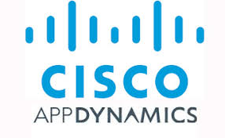









Supporting your Ecosystem Anywhere
Enterprise Apps
Hybrid/Multicloud
Containers / Cloud Native Apps
Intelligent Management (AI Ops)
Core
Cloud
AI/ML Apps
Cisco Cloud Center
Cisco Container Platform
Edge
Cisco Workload Optimization Manger
Notes:
Your essential application ecosystem is evolving quickly, and HyperFlex delivers the power and scalability to support all of your ecosystem essentials now and in the future.

Slide 20
HyperFlex Anywhere
Modernize the Present, Simplify your Future
Core
Cloud
Edge

Slide 21


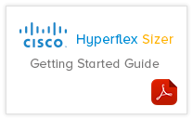
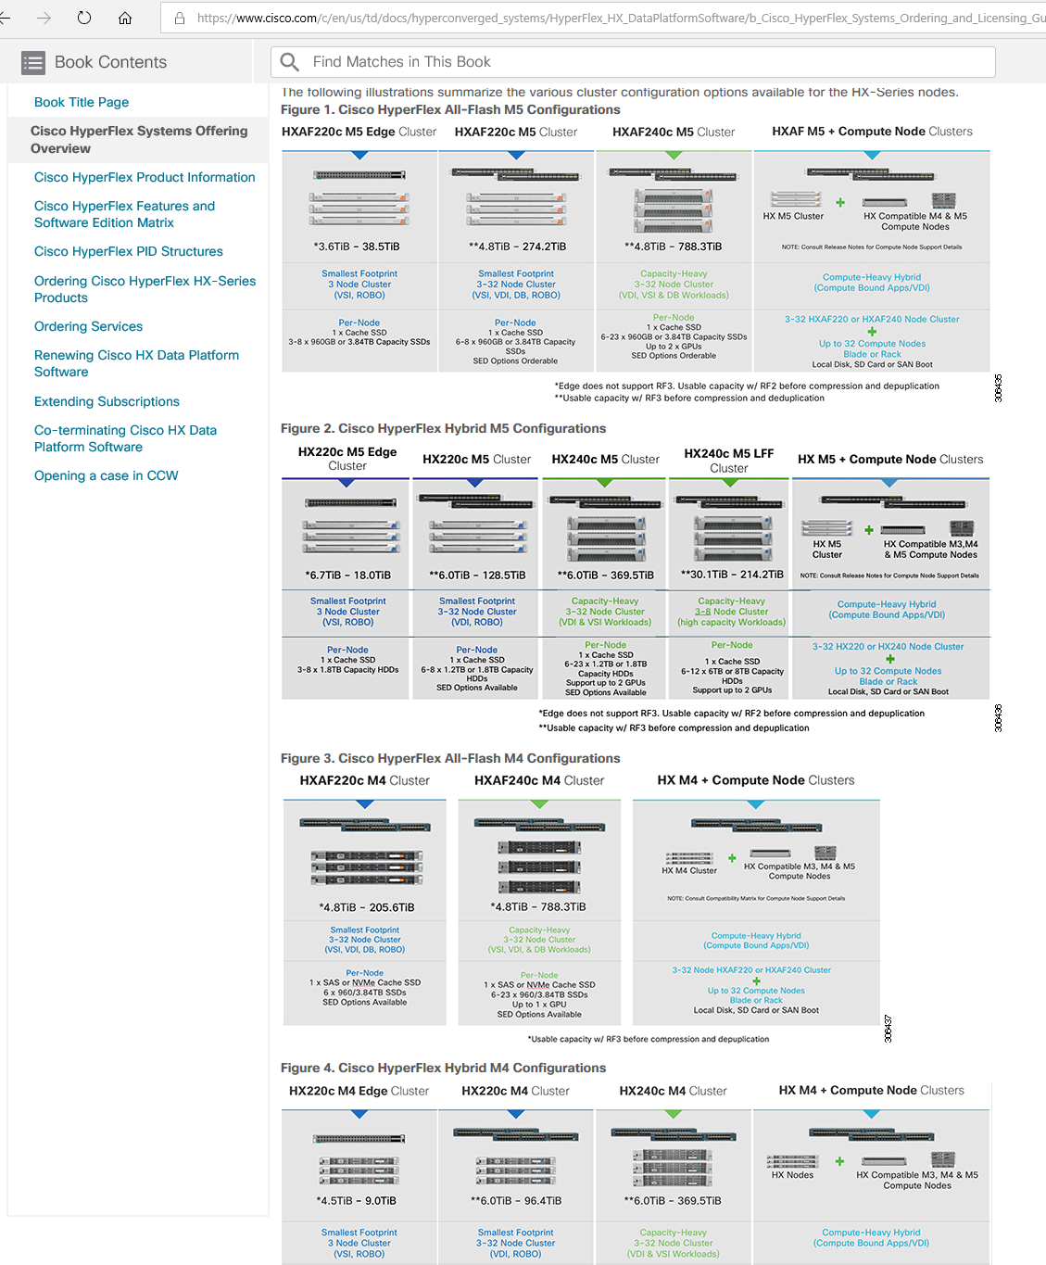
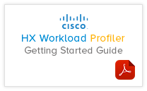
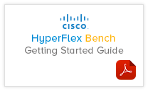

Get Started Today
3.
2.
Consult
Proof of Concept
1.
Research
Your Cisco Account team will size the perfect HyperFlex Solution
HyperFlex Systems &
Cluster Configurations
What to expect
Increased Application Performance
Spend Less Time Managing your Infrastructure
https://www.cisco.com/c/en/us/td/docs/hyperconverged_systems/HyperFlex_HX_DataPlatformSoftware/b_Cisco_HyperFlex_Systems_Ordering_and_Licensing_Guide/b_Cisco_HyperFlex_Systems_Ordering_Guide_chapter_00.html
Lower TCO
Notes:
Cisco has made getting started with HyperFlex easy.
We have online HyperFlex systems and cluster configurations posted to research options.
Cisco HyperFlex sales specialists utilize a variety of tools to size your HyperFlex cluster, profile your workloads, as well as benchmark HyperFlex cluster performance to meet your specific needs
Once you have sized your HyperFlex cluster, your Cisco account team can assist in getting your cluster onsite for a proof of concept where you can experience increased application performance, a streamlined management experience, and see first hand in your environment how HyperFlex can lower your infrastructure TCO.

Slide 23
HyperFlex Customer Case Studies
Referenced on Slide 15
Superscript | Customer Name | Results | Link to Case Study
1 | Digby Brown Solicitors | 80% Savings vs. 3-tier Infrastructure | https://www.cisco.com/c/dam/global/en_uk/products/hyperconverged-infrastructure/pdf/Cisco_HyperFlex_case_study_Digby_Brown_Solicitors_FY18Q3.pdf
2 | IDC ExpertROI® SPOTLIGHT ForePaaS | 51% HyperFlex Savings vs. Public Cloud Lower Cost Over 3 years | https://www.cisco.com/c/dam/en/us/products/collateral/hyperconverged-infrastructure/hyperflex-hx-series/idc-expert-spotlight-hyper.pdf
3 | Meander Medisch Centrum | 75% Management time savings | https://www.cisco.com/c/dam/en/us/products/collateral/hyperconverged-infrastructure/hyperflex-hx-series/cisco-meander-case-study-08262016.pdf
4 | Bellevue Group | 2X Virtual desktop speed | https://www.cisco.com/c/en/us/about/case-studies-customer-success-stories/bellevue-group.html
5 | Dhanuka Agritech Limited | 30% More Performance for Mission Critical Apps | https://www.cisco.com/c/en_in/about/case-study/dhanuka.html
6 | Spark Minda | 50% Improvement in ERP Response Time | https://www.cisco.com/c/en_in/about/case-study/spark-minda.html
7 | EagleBurgmann | 90% Downtime Reduction | https://www.cisco.com/c/dam/en_us/about/case-studies-customer-success-stories/eagle-burgmann-case-study.pdf
Additional HyperFlex Customer Case Studies: https://www.cisco.com/c/en/us/products/hyperconverged-infrastructure/hyperflex-hx-series/case-study-listing.html

Slide 24


Digby Brown Solicitors
Driving Growth and Innovation with Cisco HyperFlex
Business Objectives
Digby Brown Solicitors sees IT as pivotal to its ability to grow and to be agile in the on-going development and continuous improvement of client services.
Simplify and modernize the infrastructure and applications base with private cloud infrastructure hosted offsite by a managed servers provider in two data centers
Adopt flexible and scalable infrastructure to keep pace with the business.
Solution
Hyperconverged infrastructure in the form of Cisco HyperFlex has been deployed in two data centers to support a new case management application.
Business Outcomes
Cisco HyperFlex delivers up to a 90% reduction in operational expenditure.
Enterprise storage features and data protection can deliver savings of up to 80% by removing the need for complex SAN technology
“Choosing Cisco HyperFlex and implementing it as a private cloud solution will improve the agility and efficiency of IT across the firm. This in turn will provide benefits around technology simplification and scale.”
- Graeme Agnew, Director of IT, Digby Brown Solicitors
Notes:
APROVED FOR PUBLIC PRESENTATION USE
i.e. WEBCASTS, LARGE CUSTOMERS ETC.

Slide 25

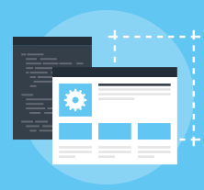
Fast-growing software startup ForePaaS
Builds a robust test/dev environment with Cisco HyperFlex systems.
Information Technology: Software development
Business Objectives
Needed a robust test/dev environment to test innovations to its PaaS offering.
Wanted a reliable system with strong performance.
Wanted easy scalability to enable more industry-specific application templates to be tested and produced.
Wanted easy manageability & more operational efficiency, automation, & orchestration.
Solution lion
Cisco HyperFlex Data Platform: A high-performance, distributed file system that tightly integrates compute, storage, networking and virtualization resources into in an easy-to-deploy-and-manage hyperconverged system with independently scalable resources.
Business Outcomes
51% lower cost over three years compared with public cloud
68% lower bandwidth costs
51% lower monthly cost for compute than public cloud
Increase IT staff productivity due to ease of manageability & more operational efficiency.
Fast-growing software developer, ForePaaS needed a robust test/dev environment to test innovations to its PaaS offering.
They chose Cisco HyperFlex systems to quickly increase business growth and market share, reduce TCO, increase revenues, and increase IT staff productivity.
Notes:
CUSTOMER OVERVIEW:
ForePaaS is a French company that offers a simple cloud-based platform for big data management and analysis: a Platform as a Service (PaaS) to create data analytics application on-demand and online. “ForePaas is an environment that gives IT professionals and developers the tools to quickly and easily create solutions for dashboard reporting, data visualization, data mining and custom software.”
==============================================================================================

Slide 26


Meander Medical Center
Delivers innovative patient care across The Netherlands with Cisco hyperconverged infrastructure.
Healthcare - Hospitals
Business Objectives
Support innovation and improve patient care.
Deliver flexible infrastructure to support business agility; offer new & expanded services to patients.
Provide faster access to patient records & critical applications.
Support VDI & handheld device access to hospital-wide MCS Easycare electronic medical records application.
Increase ease of IT resources deployment & manageability.
Reduce IT costs, increase ROI on IT.
Solution
Cisco HyperFlex Data Platform: A high-performance, distributed file system that tightly integrates compute, storage, networking and virtualization resources into in an easy-to-deploy-and-manage hyperconverged system with independently scalable resources.
Business Outcomes
Accelerated deployment of new services by 400%.
Reduced IT management time by up to 75 percent.
Reduced data center space, power & cooling requirements by 40%.
Increased server utilization by 40%; increasing ROI.
Can easily identify & remove any future performance bottlenecks—without downtime or expensive, time-consuming migrations.
“With Cisco HyperFlex Systems, we can respond much faster to business and application needs because CPU, storage, and network resources are independently scalable. It’s easy to adjust the underlying infrastructure as workloads change.”
-Paul Bauwens, IT Architect, Meander Medisch Centrum
Notes:
APROVED FOR PUBLIC PRESENTATION USE
i.e. WEBCASTS, LARGE CUSTOMERS ETC.

