Slide 1
From our Cybersecurity Report Series, the Simplify to Secure report:
Explores the growing complexity of security ecosystems
Provides insights into how an integrated platform approach can improve many aspects of security
Notes:
The Cisco Cybersecurity Series is our preeminent collection of thought leadership reports. This report explores the growing complexity of security ecosystems, based on industry research, interviews (both internal Advisory CISOs and Cisco customers) and data from our 2020 CISO Benchmark Survey of 2,800 global IT and security professionals. The report offers insights on breach impacts along with trends showing the integration of security technologies and vendor consolidation to reduce complexity. Several best practices and expert advice for pathways to simplify security while improving effectiveness are provided.

Slide 2
Report Summary
Insight: Data-driven insights from Cisco’s 2020 CISO Benchmark survey
Expertise: Advice from our own Advisory CISOs and security industry experts
Beyond Security: Recommendations to enable innovation, growth, and profitability
cisco.com/go/simplifytosecure

Slide 3
Journey from Complexity to Simplicity
An overly-matrixed vendor landscape complicates security efficiency and efficacy
The lack of integration multiplies security gaps and doesn’t optimize resources
A path to an integrated security ecosystem can:
Reduce security risk
Improve operational efficiency
Drive innovation
Boost ROI
cisco.com/go/simplifytosecure
Notes:
In Simplify to Secure, we examine the implications of the persistent treadmill of integrating a multitude of point solutions from an overly saturated cybersecurity industry. We explore and question the approach of solving every new problem with a new technology and usher in a paradigm shift by outlining the advantages and efficiencies that can be gained through a platform approach to security.
Key Takeaway: Enable the organization to accelerate adoption of a platform approach to security.

Slide 4
Increasing Demands on Security Teams
Business evolution
Security pressures
Pervasive devices
Transition to the cloud
Too little visibility
Too few experts
Distributed workforces
Digital transformation
Too little integration
Too much exposure
cisco.com/go/simplifytosecure
Notes:
Positive shifts like moving to the cloud and other elements of digital transformation are a double-edged sword. Although they drive your business forward, they put additional pressure on your security teams.
Already entrenched in the process of keeping your business secure, your security professionals are now asking themselves questions like:
How can I maintain visibility across my infrastructure?
How do I find security professionals to integrate all these tools that don’t work with one another?
How can I maintain security as my perimeter evolves?
At times, it might feel like you can’t secure every new business endeavor.

Slide 5
Don’t Multiply… Simplify
Adding new security technologies can compound challenges
Threat intelligence and visibility become more siloed
Need to constantly pivot between interfaces
Spending too much time on integration
Workflows become disconnected and hard to follow
Notes:
Adding new security technology can create challenges: Every new solution that does not natively integrate with your existing technology contributes to siloed visibility and creates complexity by multiplying security gaps. With the lack of built-in interoperability, security teams are left with the task of stitching them together.

Slide 6
Key Findings: More Strategic Focus, Less Noise
Challenging to orchestrate alerts from multiple security vendors’ products
Impacts alert management and prioritization
Reduces productivity
Increases integration headaches
Limits response efficacy
Notes:
The multi-vendor approach results in an overwhelming number of alerts and limits alert prioritization. Our 2020 CISO Benchmark data shows that alert fatigue sufferers find a multi-vendor environment challenging.
In 2020 CISO Benchmark Survey, CISOs reported that they’re only able to investigate 51% of their security alerts. Of those investigated alerts, 50% of the legitimate alerts are not remediated.

Slide 7
How challenging is it to orchestrate alerts from multiple security vendors’ products?
28%
53%
17%
1%
Very challenging
Somewhat challenging
Not challenging at all
N/A We don’t use products from multiple vendors
Source: Cisco 2020 CISO Benchmark Study. All percentages rounded.
cisco.com/go/simplifytosecure

Slide 8
“Positive shifts in digital transformation have made it evident that security technologies in silos contribute to more complexity. Our teams are losing precious time connecting the dots and integrating all these tools that don’t work with one another.”
Michael Degroote, Infrastructure Consultant, Mohawk Industries
cisco.com/go/simplifytosecure

Slide 9
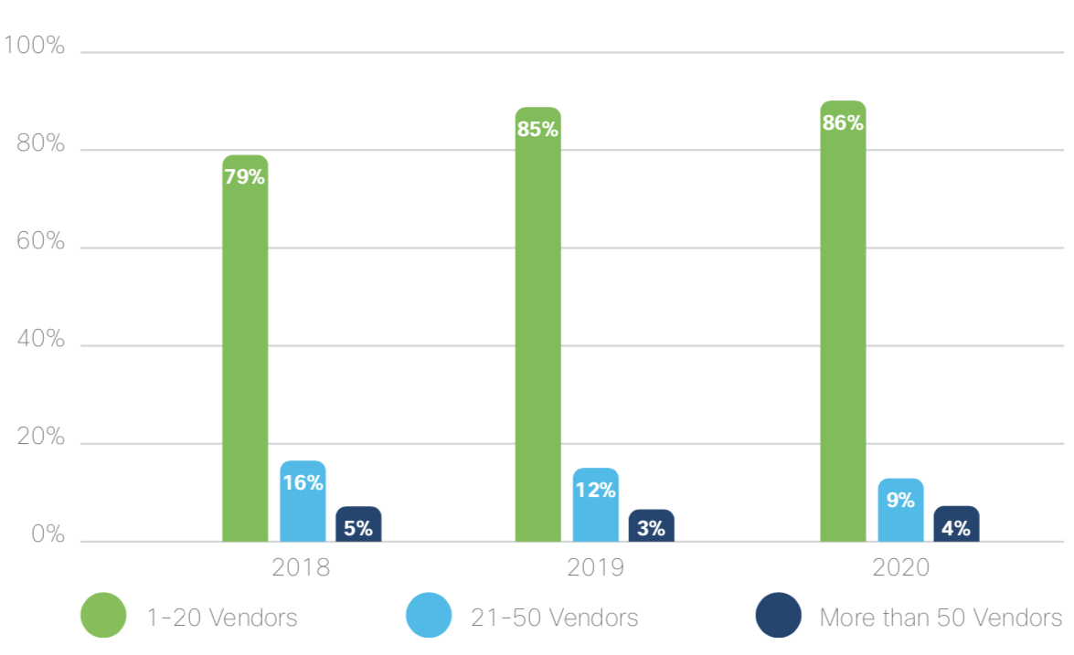
The trend is to reduce the number of vendors in security environments Simplify!
Source: Cisco 2020 CISO Benchmark Study. All percentages rounded.
cisco.com/go/simplifytosecure
Notes:
The increasing demands are likely why we continue to see a trend towards vendor consolidation in security.
In 2018, 21% of respondents relied on more than 20 vendors, whereas in 2020 only 13% of respondents relied on a such a large number. Those with only 1-20 vendors rose from 79% to 86% in two years, while those with more than 50 vendors dropped.

Slide 10
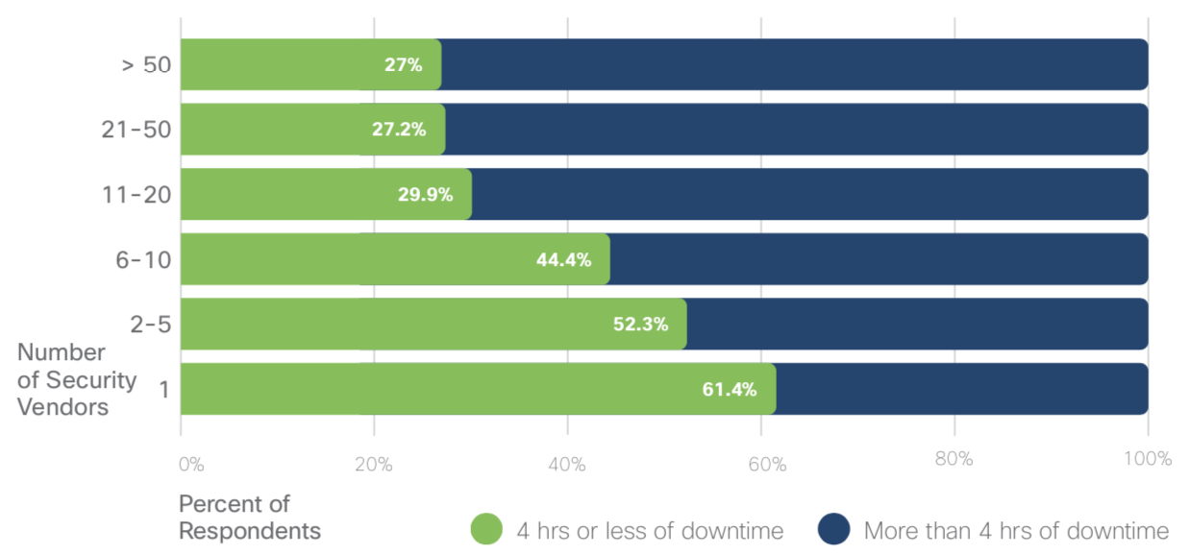
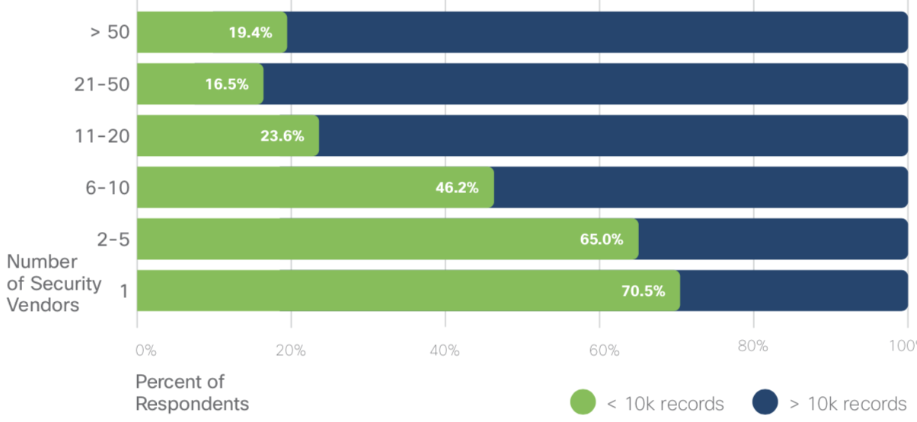
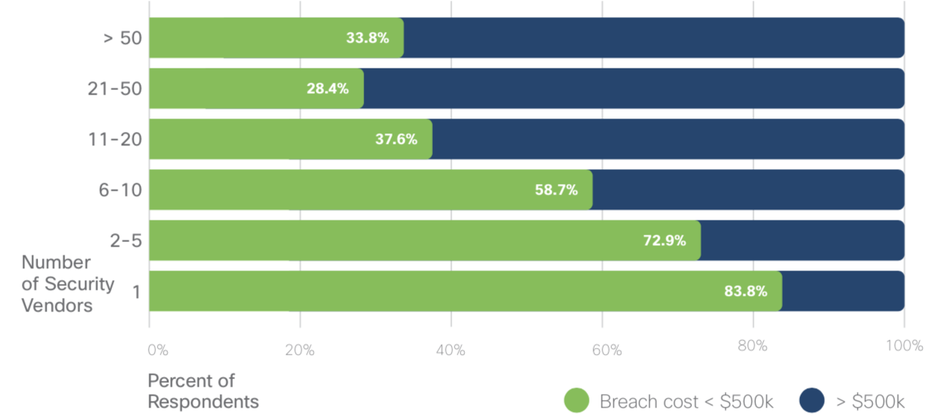
Using fewer vendors shows during an attack:
Fewer hours of system downtime
Fewer records impacted
Lower financial impact
Source: Cisco 2020 CISO Benchmark Study. All percentages rounded.
cisco.com/go/simplifytosecure
Notes:
Vendor/solution complexity can significantly degrade breach readiness and impact. We saw a negative correlation between the number of vendors in an environment, and the resulting impact on downtime.

Slide 11
“Digital organizations seeking to reduce complexity and manage risk more efficiently will leverage an integrated security platform for unified visibility and intelligence, operational efficiency and simplified security.”
A Platform Approach Can Tame the Beast
Brad Arkin, Senior Vice-President and Chief Security and Trust Officer, Cisco
Organizations need foundational, portfolio-wide capabilities at the platform level in order to experience the full potential of all security products.
cisco.com/go/simplifytosecure
Notes:
A platform approach is the pathway to effective security
Organizations need foundational, portfolio-wide capabilities at the platform level in order to experience the full potential of their products.
Backend integration across the security ecosystem can enable a streamlined frontend experience — one that can unify visibility, enable automations, and strengthen security.

Slide 12
From Complexity
To Simplicity
Identity
An integrated environment with back-end integrations translate into better front-end experiences.
Continuous Trust Verification
Endpoint
Response
Analytics Management
Network
Cloud
Constant Threat Intelligence
Application
Risk
Security Platform
Notes:
In our 2020 CISO Benchmark Study data, we saw a trend to reduce complexity through vendor consolidation over the last few years. Those with 1-20 vendors rose from 79% to 86% in two years, while those with more than 50 vendors dropped.

Slide 13
Foundational strategies from our Advisory CISOs
Drive technology choices based on integrations
Enable collaboration
Adopt a security maturity model
Unify visibility
Leverage automation
cisco.com/go/simplifytosecure
Notes:
Security teams are seeing a host of outcomes and they’re realizing these benefits faster than ever before. Here are some foundational strategies from our advisory CISOs:
Consider integration to be a key part of the buying decision .
– Drive technology choices based on how they natively integrates the backend solutions with built-in interoperability for a unified frontend experience.
Bring NetOps, ITOps, and SecOps into alignment .
-Employees shouldn’t have to struggle to collaborate. Make security an enabler so that they have shared context needed to deliver strong outcomes.
Guide your decision making with a security maturity model .
-Pick a security maturity model and be proactive about your trajectory . Choose a platform that help you simplify your security ecosystem, not complicate it.
Give your people one view to focus on, not twenty .
-Get rid of the swivel chair problem with unified visibility and ability to streamline workflows. Save time and enhance productivity with a simpler, more consistent experience .
Use automation wherever you can to make your teams more efficient .
-Simplify workflows that inefficiently stretched across multiple interfaces with the strengthen of automation.team should have shared context, enabling them to collaborate better than ever before.
When you can get more productivity out of your people, your security strengthens.

Slide 14
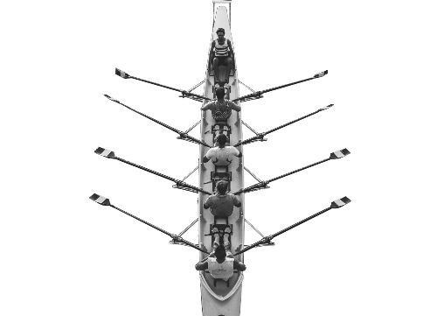
Create quantifiable improvements and better outcomes
Build operational efficiencies with complete and actionable insights
Empower resources with the strength of automation
Drive innovation and growth with an open ecosystem
Rationalize ROI by improving security efficacy
cisco.com/go/simplifytosecure
Notes:
Organization can realize desired outcomes informed by measurable outcomes, meaningful metrics and analytics.

Slide 15
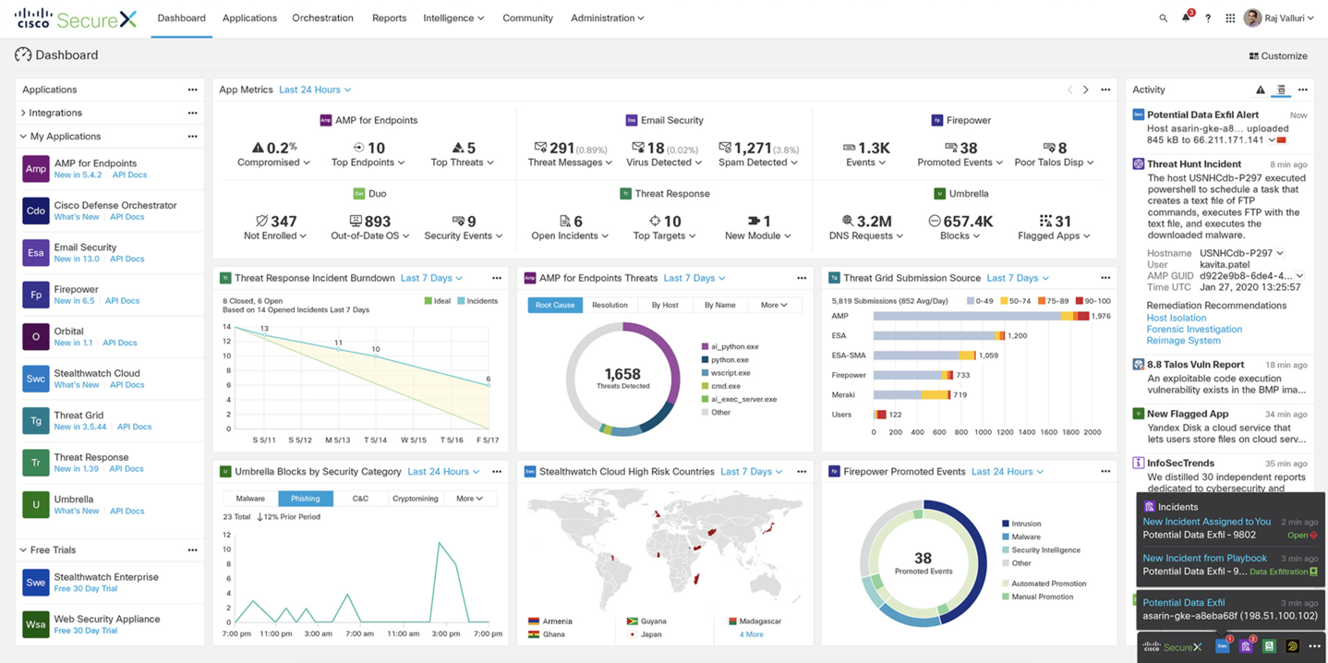
Cisco SecureX connects with your entire security ecosystem
Cisco SecureX connects with your entire security ecosystem
Cisco Security
Network
Endpoint
Cloud
Applications
SecOps
ITOps
NetOps
Your teams
Integrate everything in your environment to unify visibility, enable automation, and strengthen security
3rd Party/ITSM
Intelligence
Identity
SIEM/SOAR
Your infrastructure
Notes:
SecureX doesn’t just connect to Cisco products, it transforms Our customers infrastructure from a series of disjointed solutions into a fully integrated environment.
We know that Cisco is not the only vendor Our customers use. Because SecureX offers out-of-the-box interoperability, Our customers can instantly connect every tool—Cisco or otherwise—on a single platform. So if they have identity solutions from Palo Alto or MFA from another provider – great! Bring them to our platform so everything you have can work better, together.
Unlock the full potential of every one of your existing security investments by unifying visibility, enabling automation, and strengthening security.

Slide 16
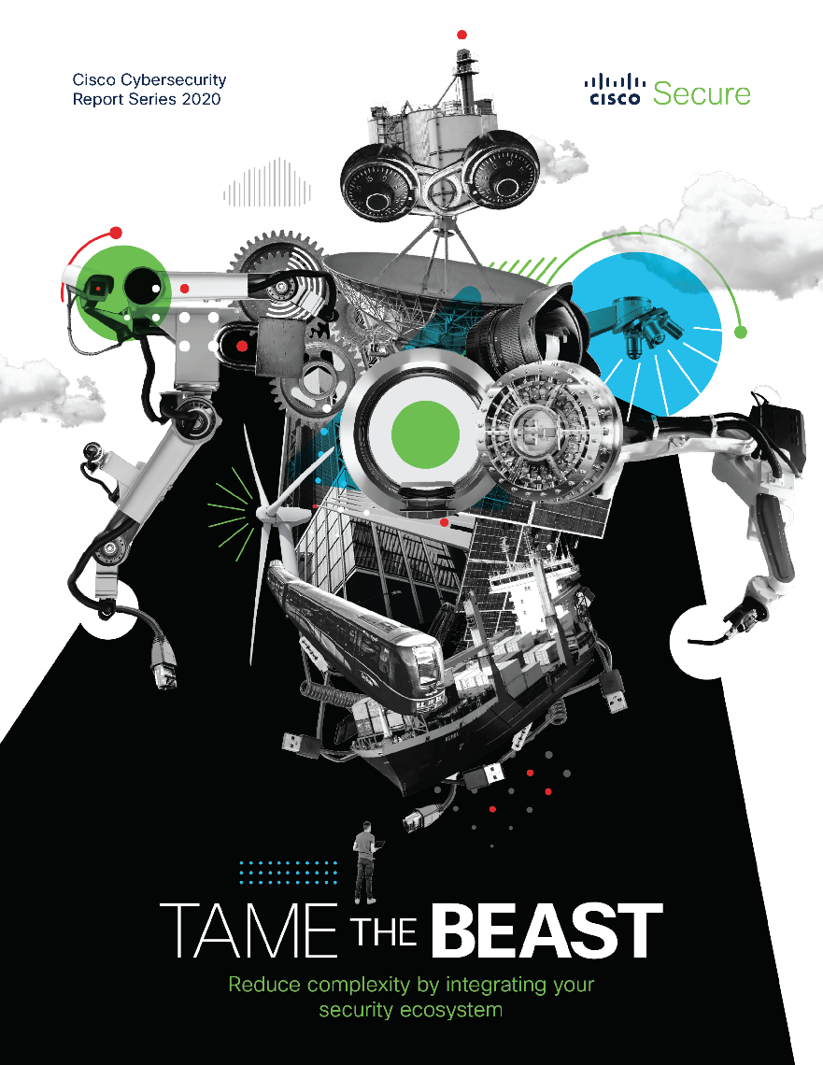
Download the report
cisco.com/go/simplifytosecure

Slide 17
Cybersecurity Report Series
More reports available at cisco.com/go/securityreports

