Slide 1
Why migrate to Cisco?

Slide 2
Cisco delivers superior protection and visibility to specialized threats
Reduce threats exposure
Support cloud transition
Achieve granular controls
with advanced protection
with availability and assurance
through operational efficiency
Notes:
With Cisco email security, you can reduce exposure with advanced threat protection, support growth with availability and assurance, and achieve agility through operational efficiency.
<Click>

Slide 3
Enterprise Network Firewall Magic Quadrant 2018 Leader
Secure Web Gateway Magic Quadrant 2018
Challenger
Zero Trust
Forrester Wave
2018
Strong Performer
Built by a recognized leader
Email Security Forrester Wave
2019
Leader
AV-Comparatives
APPROVED
Business Security
2019
Notes:
Independent cybersecurity experts are recognizing Cisco Security as an industry leader. A platform starts with a range of high-quality products. And that’s what we have.
Sources:
https://blogs.cisco.com/security/cisco-named-a-leader-in-the-2018-gartner-magic-quadrant-for-enterprise-network-firewalls
https://www.binat.net.il/wp-content/uploads/2018/11/Gartner-2018-Magic-Quadrant-for-Secure-Web-Gateways.pdf
https://www.forrester.com/report/The+Forrester+Wave+Zero+Trust+eXtended+ZTX+Ecosystem+Providers+Q4+2018/-/E-RES141666
https://www.forrester.com/report/The+Forrester+Wave+Enterprise+Email+Security+Q2+2019/-/E-RES144398
https://www.forrester.com/report/The+Forrester+Wave+Endpoint+Security+Suites+Q2+2018/-/E-RES137973

Slide 4
Why migrate to Cisco Email Security?

Slide 5
Top 10 reasons why you should migrate
Cisco leads the market in Email Security
Effective & complete management console
Email efficacy un-matched; BEC fraud detection
External
integrations
In-depth
reporting
Enterprise class policy engine
Simple to use and configure security controls
Minimize confusion with Cisco’s attachment & embedded URL handling
Integrations into on-prem and cloud-based directories
Effective connection policies spam and unwanted emails
Notes:
Cisco lead the market in Email security and are committed to ongoing investment and innovation
Cisco provides administrators an extremely effective and complete management console, proven by the number of referral sales
Cisco’s spam and unwanted email efficacy is un-matched due to the number of technology layers and continual intelligence updates provided by Talos, BEC fraud detection is a substantial area of difference with many customers moving to Cisco because of this
External integrations: Not only between all the other Cisco security solutions and proven with the free Cisco Threat Response tool, but also with external SIEM/Reporting solutions and others via API
Cisco provide far more depth in reporting with over 124 standard reports available, all customizable & schedulable
Enterprise class policy engine: email policy just continues to get more complex with all the new and emerging regulatory compliance requirements, Cisco’s policy engine is un-paralleled in features and flexibility
Simple to use and configure security controls: Cisco has your back, ensuring security controls are defined easier and providing maximum protection via Talos threat intelligence updates
Cisco’s attachment and embedded URL handling provides the right mix between maximizing efficacy and minimizing end-user confusion
Being an enterprise class email security solution, Cisco provides native integration into on-premise and cloud-based directories for policy definition
Cisco invented connection policies with SenderBase and since then has continually innovated to ensure maximum efficacy for spam and unwanted email without relaying heavily on language controls

Slide 6
Email Security
Your layered threat defense against the #1 attack vector
Network Security
Endpoint Security
Email
Security
CISO
“Automatically protects us against phishing and fraudulent senders trying to compromise our business”
“Blocks known and zero-day threats with advanced sandbox analysis of file-based email threats, keeping our users safe”
“Maximizes our blocking malicious emails and attachments without increasing our false positive rate”

Slide 7
Why migrate to Cisco AMP for Endpoint?

Slide 8
The Cisco AMP for endpoint advantage
5,500+ Endpoint Customers
AV-Comparatives
2019 Business Security Test Series
Protection, Detection and Response in Single Agent
14.7M+ Endpoints
Apple Partnership
MSS Ready
AMP Everywhere
90,000+ customers
NSS Labs “Recommended”
Architecture:
Network, Endpoint, Cloud
Global Customer
Success
Cisco Partner Ecosystem
Broad OS,
Platform Support
Notes:
This slide is like your cheat-sheet for selling AMP4E
5.5k AMP4E customers – compare with competition Crowdstrike had 2.5k customers when they went public (we’re more than double) and Carbon Black was about 5.6k (so we’re neck-to-neck)
Translates to 14.7M endpoints under management
Core AMP capabilities attached to various SBG offerings leading to 90k customers – talks not just about the scale of AMP but also the amount of intelligence we collect that in turn helps protect each and every customer
Solid results in 3rd party testing like AV-Comparatives.
Important – single agent offering Protection, Detection and Response – helps consolidate agents on the endpoint.
Special Apple partnership helped offer Cisco Clarity – helps offer unprecedented visibility and control on iOS devices
MSSP ready
Broad platform support
Talos – ofcourse – powering the intelligence of the product

Slide 9
AMP for Endpoints
Your last line of defense protecting laptops, desktops, servers, and mobile
Network Security
Endpoint Security
CISO
“Replaces antivirus to automatically block advanced exploit-based and in-memory attacks before they are launched against us”
“Continuously analyzes our 30-day history of endpoint behavior to expose and block any attempts to compromise our devices”
“Gives us environment-wide answers and action at our fingertips to reduce our response time from hours to seconds”

Slide 10
Cisco AMP for Endpoints is full AV replacement
EPP
EDR
Machine learning
Behavioral analysis engine
File-less malware prevention
Cloud based file reputation engine
Antivirus engine
Network traffic protection
Continuous activity monitoring
Advanced endpoint search
Sandboxing
Cloud Indicators of Compromise
Proactive threat hunting
Custom block/allow lists for files and network traffic
Vulnerable and low prevalence software identification
Unmanaged endpoint discovery
Endpoint isolation
Better protection
Cloud form factor
Easier to integrate

Slide 11
See once, block everywhere
AMP+Email
If malware gets in
Removed automatically from endpoints
Blocked across network, endpoints, email and cloud
Immediate
Detection
Get the comprehensive protection today’s threats demand
by making the switch to Email or Endpoint Security from Cisco
Act now to take advantage of the Email or Endpoint Security Replacement Promotion for Symantec customers
Notes:
As mentioned, we design our products to integrate
by doing this, we can automate things like threat detection across the portfolio.
We block more threats outright than anyone – but it would be foolish to think that malware can never get in.
If it does, we detect it immediately because we never lose sight of what a file does or where it goes.
The moment it exhibits malicious behavior we know exactly what endpoints it is on to automatically remediate.
As we do this, we automatically update protections to block the file everywhere - on endpoints, the network, email or web gateways…so it is never a problem again for any Cisco customer.

Slide 12
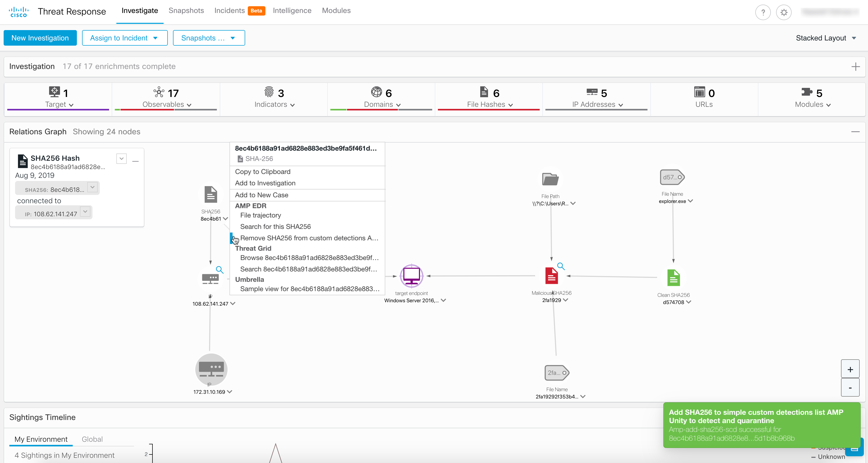
“We are secure”
INCLUDED
Cisco
Threat
Response
Integrated threat hunting delivers answers and action in seconds
Cisco Threat Response provides a far-reaching look into threat history and trajectory across a wide array of other Cisco Security products. Feeds come from Talos and inputs of IoC from Email Security, NGFW, AMP and Umbrella. Cisco Threat Response automates integrations across a growing number of Cisco Security products and accelerates key security operations functions: detection, investigation, and remediation. It is a key pillar of Cisco’s integrated security architecture.

Slide 13
What’s the offer?

Slide 14
Replacement Promotion: Offering Incredible Savings
Email Security Bundles
Email security + AMP + Threat Grid bundles
Email Security Appliances
Advanced Malware Protection (AMP) for Endpoints
Free Policy Migration
Offer available to current Symantec customers who are new to Cisco Email Security. Limitations apply.
For more information contact your Cisco Account Manager or Partner today!
The Offer

Slide 15
Applicable SKUs

Slide 16
Applicable SKUs: Base CES, ESA and Hardware
Subscription SKU | Description
L-CES-ESI-LIC= | Cloud Subscription SKU that combines Email Inbound bundle (Anti-spam, AV, Outbreak Filters, custom filters)
L-CES-ESP-LIC= | Cloud Subscription SKU that combines Email Premium bundle (Anti-spam, AV, Outbreak Filters, custom filters, DLP, Encryption)
L-CES-SUB | Flexible Billing Option using the Subscription Billing Platform (SBP)
ESA-ESI-LIC= | On-prem SKU that combines Email Inbound bundle (Anti-spam, AV, Outbreak Filters, custom filters)
ESA-ESP-LIC= | On-prem SKU that combines Email Premium bundle (Anti-spam, AV, Outbreak Filters, custom filters, DLP, Encryption)
ESA-C195-PR-K9 | C195 ESA Appliance
ESA-C395-PR-K9 | C395 ESA Appliance
ESA-C695-PR-K9 | C695 ESA Appliance
ESA-C695F-PR-K9 | C695F ESA Appliance
SMA-M195-PR-K9 | M195 Management Appliance
SMA-M395-PR-K9 | M395 Management Appliance
SMA-M695-PR-K9 | M695 Management Appliance
SMA-M695F-PR-K9 | M695F Management Appliance
Cloud
On-prem
Hardware
Promotional Offers
Up to 30% off

Slide 17
Applicable SKUs: CES with AMP and Threat Grid
Subscription SKU | Description
L-CESI-AT200-K9= (For seat bands S1-S8 : 100-9999 users) | Cloud Subscription SKU that combines Email Inbound bundle (Anti-spam, AV, Outbreak Filters, custom filters) with AMP and TG subscription – with 200 file uploads per day
L-CESI-AT2K-K9= (For seat bands S9-S10 : 10K-49999 users) | Cloud Subscription SKU that combines Email Inbound bundle (Anti-spam, AV, Outbreak Filters, custom filters) with AMP and TG subscription – with 2K file uploads per day
L-CESI-AT6K-K9= (For seat bands S9-S10 : 50K+ users) | Cloud Subscription SKU that combines Email Inbound bundle (Anti-spam, AV, Outbreak Filters, custom filters) with AMP and TG subscription – with 6K file uploads per day
L-CESP-AT200-K9= (For seat bands S1-S8 : 100-9999 users) | Cloud Subscription SKU that combines Email Premium bundle (Anti-spam, AV, Outbreak Filters, custom filters, DLP, Encryption) with AMP and TG subscription – with 200 file uploads per day
L-CESP-AT2K-K9= (For seat bands S9-S10 : 10K-49999 users) | Cloud Subscription SKU that combines Email Premium bundle (Anti-spam, AV, Outbreak Filters, custom filters, DLP, Encryption) with AMP and TG subscription – with 2K file uploads per day
L-CESP-AT6K-K9= (For seat bands S9-S10 : 50K+ users) | Cloud Subscription SKU that combines Email Premium bundle (Anti-spam, AV, Outbreak Filters, custom filters, DLP, Encryption) with AMP and TG subscription – with 6K file uploads per day
Inbound Plus
Premium Plus

Slide 18
Applicable SKUs: ESA with AMP and Threat Grid
Subscription SKU | Description
L-ESAI-AT200-K9= (For seat bands S1-S8 : 100-9999 users) | On-prem SKU that combines Email Inbound bundle (Anti-spam, AV, Outbreak Filters, custom filters) with AMP and TG subscription – with 200 file uploads per day
L-ESAI-AT2K-K9= (For seat bands S9-S10 : 10K-49999 users) | On-prem SKU that combines Email Inbound bundle (Anti-spam, AV, Outbreak Filters, custom filters) with AMP and TG subscription – with 2K file uploads per day
L-ESAI-AT6K-K9= (For seat bands S9-S10 : 50K+ users) | On-prem SKU that combines Email Inbound bundle (Anti-spam, AV, Outbreak Filters, custom filters) with AMP and TG subscription – with 6K file uploads per day
L-ESAP-AT200-K9= (For seat bands S1-S8 : 100-9999 users) | On-prem SKU that combines Email Premium bundle (Anti-spam, AV, Outbreak Filters, custom filters, DLP, Encryption) with AMP and TG subscription – with 200 file uploads per day
L-ESAP-AT2K-K9= (For seat bands S9-S10 : 10K-49999 users) | On-prem SKU that combines Email Premium bundle (Anti-spam, AV, Outbreak Filters, custom filters, DLP, Encryption) with AMP and TG subscription – with 2K file uploads per day
L-ESAP-AT6K-K9= (For seat bands S9-S10 : 50K+ users) | On-prem SKU that combines Email Premium bundle (Anti-spam, AV, Outbreak Filters, custom filters, DLP, Encryption) with AMP and TG subscription – with 6K file uploads per day
Inbound Plus
Premium Plus

Slide 19
Applicable SKUs: Hybrid (CES and ESA)
Subscription SKU | Description
HYB-EMAIL-ESI-BUN | Cisco Email Security Inbound Hybrid – Includes license for ESA, ESAv & CES Anti-spam + Anti-virus + Forged Email Detection + Outbreak Filters
HYB-EMAIL-ESP-BUN | Cisco Email Security Premium Hybrid – Includes license for ESA, ESAv & CES Anti-spam + Anti-virus + Forged Email Detection + Outbreak Filters + DLP + Encryption
HYB-ESAI-AT-BUN | These are multi-line bundles with mix of cloud and on-prem SKUs that combine Email Inbound bundle (Anti-spam, AV, Outbreak Filters, custom filters) with AMP and TG subscription – with 2K file uploads per day
HYB-ESAP-AT-BUN | These are multi-line bundles with mix of cloud and on-prem SKUs that combine Email Premium bundle (Anti-spam, AV, Outbreak Filters, custom filters, DLP, Encryption) with AMP and TG subscription – with 2K file uploads per day
NOTE:
Hybrid makes life simple while migrating from on-premise to cloud: Take the redistribution form and fill in the requested information.
When ordering hybrid bundles please ensure:
The term for each of the underlying PIDs are equal
The start and end date for each of the underlying PIDs are the same

Slide 20
Applicable SKUs: AMP for Endpoints
Subscription SKU | Description
AMP4E-CL-SUB | AMP for Endpoints Essentials package
FP-AMP-LIC= | AMP for Endpoints Essentials package
AMP4E-ADV-CL-SUB | AMP for Endpoints Advantage package
FP-AMP-ADV-LIC= | AMP for Endpoints Advantage package

Slide 21
Resources

Slide 22
Symantec Background for Email Security
Symantec has two separate email security solutions, on-premise based appliances/virtual appliances and a Cloud based platform, email security. Cloud that it acquired as part of MessageLabs
The two platforms are not comparable in terms of features
The analyst reports are based very much around the feature rich on-premise solution, but the bulk of the customer base is on the much cheaper cloud platform with less capability, so the solution regarded by Analysts is not necessarily the one the customer is running
Symantec Email Security.cloud has historically been priced lower than Cisco (less capable product) and recently Symantec has been discounting even more to try and close renewals
Note: Normally Proofpoint & Mimecast cloud offerings are priced ~25% higher than Cisco’s CES

Slide 23
Symantec Background Email Security (continued)
Among the changes Broadcom outlined when announcing its purchase of Symantec, the networking chipmaker said it will:
Focus on data loss prevention (DLP), endpoint, and web security and scale back investments with lower returns—no mention of what it plans for email security
Slash more than $1 billion in spending across R&D (a 40% cut) and sales (an 82% cut)
Focus on Global 1000 customers, a move that leaves its commitment to smaller customers in doubt
Business Email Compromise (BEC) has hit Symantec customers particularly hard. BEC fraud are the low volume emails that impersonate senior execs, no attachment, no embedded URL. Cisco has added some capability to its base product and we also have the Advanced Phishing Protection module to address these attacks, we have spoken to many Symantec customers that have been financially impacted by BEC attacks.
The other big impact has been the increasing email policy requirements from new regulatory compliance regulation, whether GDPR in Europe, mandatory data disclosure in Australia, lots of examples of this and the issue affecting Symantec Email Security.cloud (MessageLabs) customers in particular is the limitations of the policy engine, its just not flexible enough and does not have enough depth.

Slide 24
Updated Competitive Content
Top 10 Reasons for customers to migrate from Symantec to Cisco
Updated Symantec battlecard on the campaign site
https://www.cisco.com/c/dam/en/us/products/se/2019/11/Collateral/battlecard-symantec-email-pte.pdf

Slide 25
Symantec: Background for AMP
Strategic Recommendations Position AMP for Endpoints as a full AV replacement with strong advanced Endpoint Detect and Remediation (EDR) capabilities including Advanced Search for complex investigations and threat hunting, and access to Threat Grid Cloud which allows security teams to perform in-depth static and advanced dynamic file analysis in order to identify malware quickly in a safe and secure environment.
For organizations that are looking to augment their EPP deployment with EDR capabilities without the installation and management overhead of adding new agents to their environment -position AMP4E as a single product that delivers strong EPP and EDR solution against the riskiest threats.
AMP for Endpoints is a powerful standalone endpoint security solution, but the competitive differentiators is the Cisco Security Platform that is powered by an integrated security architecture – fit for customers who are prefer a platform approach to their security. Use Cisco Threat Response to demonstrate the value of our integrations.
Positioning/Messaging Highlights
Highlight our three value pillars:
Block threats. Before they target you.
Leverages multiple protection engines fueled by Cisco Talos threat intelligence to block threats before they target you.
Know everything. About every endpoint.
Provides advanced EDR capabilities make threat hunting and security investigations easy
Respond completely. With security that works together.
Integrates seamlessly with other security technologies so you can respond to threats completely with security that works together.
Drive prospects to “Join our Threat Hunting Workshops”, “Request a Demo” and “Sign up for our Free Trial’. Designate ‘demo experts’ for this purpose.
Solution Recommendations
Add an EDR capability as part of the overall solution in the security platform
Perform further analysis to evaluate pricing competitiveness considering potentially less expensive marketplace solutions
Review Threat Hunting to understand compatibility with other solutions and false positive reduction.
Incorporate/position AMP4E to support our zero trust architecture-Integrates with other zero trust technologies such as Cisco DUO multi-factor authentication, Cisco AnyConnect VPN, and Cisco Umbrella secure internet gateway
Notes:
https://www.gartner.com/reviews/market/endpoint-protection-platforms/compare/cisco-vs-symantec-corporation

Slide 26
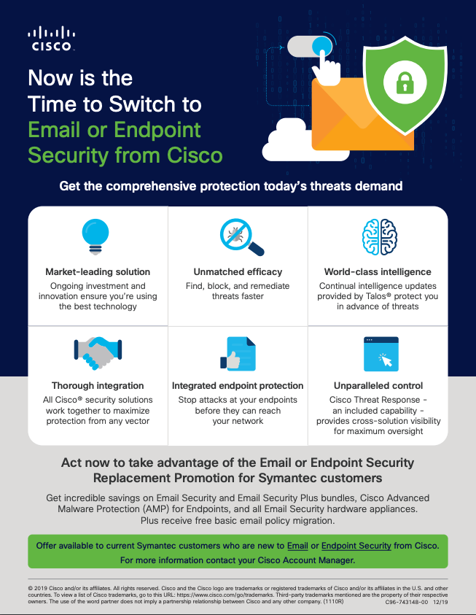
Customer Flyer
https://salesconnect.cisco.com/open.html?c=6b788704-872a-40d2-8524-822ab554ed8b

Slide 27
AMP for Email Security Infographic
https://www.cisco.com/c/dam/en/us/products/collateral/security/cloud-email-security/amp-email-sec-info.pdf

Slide 28
AMP for endpoint Resources
Cisco AMP for Endpoints At a glance
5 Reasons To Sell Cisco AMP for Endpoints (AMP4E) for Cisco Partner
AMP Attach Sales Playbook How to sell AMP for Endpoints (includes a section for Partners and links to additional resources.)
Visit the AMP for Endpoints, AMP Everywhere, Integrated Security Architecture, and Cisco Threat Response pages on SalesConnect for the latest collateral, videos, and sales tools:
Security Sales Plays: https://salesconnect.cisco.com/#/program/PAGE-11166
AMP for Endpoints: https://salesconnect.cisco.com/#/program/PAGE-2254
Cisco Threat Response: https://salesconnect.cisco.com/#/program/PAGE-13369
Breach Readiness and Response: https://salesconnect.cisco.com/#/program/PAGE-11728
Battlecards: https://salesconnect.cisco.com/#/search/endpoint%2520battlecards/content
AV-Comparatives: Business Main-Test Series 2019
Cisco Advanced Malware Protection for Endpoints Data Sheet

