Slide 1
Cisco Threat Response
Security that works together

Slide 2
Threat Investigations are complex
Notes:
Threat investigations are complex thanks to an ever-evolving threat landscape, making it challenging for your SOC to stay ahead of the next emerging and known threats out there.

Slide 3
Security Operations challenges
SOCs are understaffed
Overwhelmed with alerts from disparate security products
Unable to keep pace
with current threats
2 million cybersecurity positions are projected to go unfilled by 2019*
*according to Cybersecurity Ventures,
Notes:
In addition to that, there are other challenges that security operations teams face that make threat investigations challenging.
Cybersecurity organizations as a whole have been facing a massive skills gap that is only widening – as 2 million cybersecurity positions are projected to go unfilled by 2019. [Cybersecurity Ventures, 2017].
1) Given this paradigm, we know how hard it can be to find skilled resources to staff your team.
2) What’s more, the multi-console approach with your security solutions isn’t doing you any favors, as these products can overwhelm and burden your team with frequent and often redundant alerts. This leads to more manual effort for an already understaffed team, making it harder to keep pace with threats and issues that are constantly evolving.
3) Studies show that most SOCs are only able to handle 7-8 investigations per day
Together, these factors contribute to gaps in security, higher operational costs, and a less efficient team.
Transition: But it doesn’t have to be this way.
<Click>
[Source link: https://cybersecurityventures.com/jobs/ ]

Slide 4
















And time is a critical factor
Risk of a major breach in the next 24 months
Late detection
High impact
Early detection
Low impact
Time
Industry average detection time for a breach
Industry average time to contain
a breach
Average cost of a data breach
Source: Ponemon 2018 Cost of a Data Breach Study
Notes:
The expanding enterprise attack surface due to increased network complexity and the evolution of attacks has led to an erosion of the network perimeter. The traditional, perimeter-based defenses are just not enough to protect the digital business.
Therefore today, businesses are prone to a breach more than ever. Nearly half of the alerts an organization receives daily go uninvestigated.
Minimizing the impact of a breach is largely a function of reducing time to detection. And without visibility, breaches can go undetected for months, until the organization’s critical data are likely compromised.
<Click>
Scaling alerts – 51% of security alerts are not investigated and 43% of legitimate alerts are not remediated - Source: Cisco 2019 Security Capabilities Benchmark Study

Slide 5
We believe security systems should empower your people to investigate and respond to threats faster
Automation should
reduce the burden
on the SOC
Security products and threat intel should all
work together
Make it easier and faster
to investigate threats
Notes:
We believe your tools and technology should be working for you, not the other way around.
Your tools and technology should be automated as much as possible to free up your resources’ valuable time.
Alerts should be smart and prescriptive to empower your team to take decisive action against bad actors – rather than generating noise for your team to sift through.
And above all, we believe security products should talk to each other, consolidating processes, eliminating redundancies and allowing for more comprehensive protection while saving your team time.
Ultimately, we think security technology should empower and free up your resources to focus on what matters most for your company, allowing you to do more with the team you have.
Transition: But realizing this vision requires a partner who can make it a reality.
<Click>

Slide 6

CISOs want to efficiently manage cybersecurity risks
SOC Managers want to demonstrate their team’s effectiveness
Would you like
to improve your
cybersecurity posture...
while efficiently and
effectively managing risks?
Would you like
to manage fewer
security vendors...
while dramatically improving your cybersecurity capabilities?
Would you like to
shorten time-consuming investigations...
while focusing your staff on higher-value activities?

Slide 7
Integrated security that WORKS.

Slide 8







Security must work together
But too often it doesn’t...
Security Operations
Technologies and Intelligence
Threat Intel
Endpoint Security
SIEM
Next-Gen IPS
Malware
Detection
Secure Internet Gateway
Email Security
Web Security
Is this thing bad?
Has it affected us?
Why?
How?
Third party
Sources
Network
Analytics
Next-Gen Firewall
Identity
Management
Notes:
When things don’t work together, skilled people and solid processes must make up the gap. This has been the situation in cybersecurity for far too long. Even today, Security Operations teams have many questions every day, but those answers are locked up in various threat intelligence sources and technologies. If answers are available, they almost always take too long to answer and require highly skilled people to find them. Time is more critical than ever. That’s why security must work together, but too often it doesn’t. The ‘game of the consoles’ cripples your organization’s response capabilities by leaving holes in your security platform. This lack of integration poses a massive security risk to any organization.
Juggling multiple consoles just makes the already-complex security challenges even harder. At Cisco, we’re changing all of that – so you can maximize your protection with an integrated platform approach.

Slide 9
Cisco security platform
Open APIs · Developer Environment · Services
Management · Response
Deploy
Policy
Detect
Investigate
Remediate
Technology Partners and other 3rd party threat feeds
Continuous Trust Verification
Users, devices, applications, and more
Enforcement Everywhere
Network
Endpoint
Cloud
Application
3rd Parties
Comprehensive Threat Intelligence
Known Threats
Unknown/Zero-day
Notes:
At the heart of our platform approach is a simple idea: security solutions should be designed to act as a team. They should learn from each other. They should listen and respond as a coordinated unit. When that happens, security becomes systematic and more effective.
Our goal is not to be your wall-to-wall security vendor—it’s for you to be secure and compliant with less effort. We believe that is only possible with a platform approach. As the biggest security company in the world, we have the knowledge and breadth to solve platform-level challenges that span the data center, network, cloud, internet, email, endpoints, and everywhere in between. As the global leader in networking, we’re uniquely positioned to embed security into your network and architecture at scale. And in keeping with our track record of trusted partnership, we’ll continue to drive industry standards and integrations that support the outcomes you need.
We start with best of breed products, protecting the network, endpoint, applications and cloud.
We use trust verification as a foundational piece to ensure only the right people gain access
Each product is backed with industry-leading Talos threat intelligence to block more threats to keep organizations safer.
We provide automated responses to advanced threats and streamline operations with integrated threat and security management throughout our portfolio.
Lastly we build our products to work with the other technologies you have in place for integrated security responses – even outside of Cisco.

Slide 10

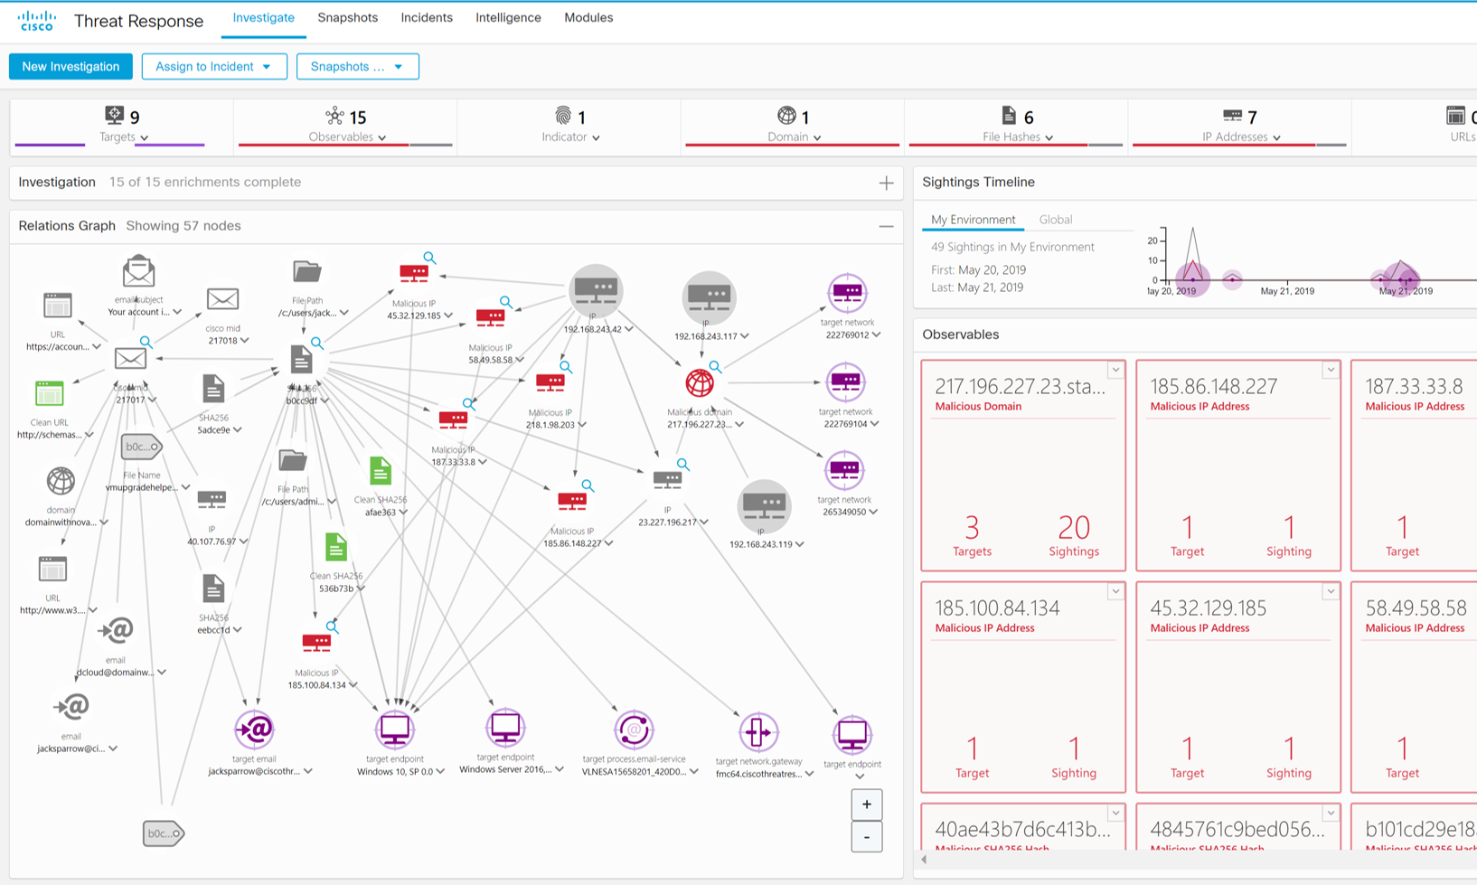
Cisco Threat Response
The unifying force powering Cisco’s integrated security architecture
Simple
Detect, investigate, and remediate across multiple integrated security technologies
Fast
Reduce time spent on security operations functions up to 85%*
Effective
Aggregate threat intelligence
into immediate action
…and it’s FREE with existing Cisco Security licenses
*based on internal simulations
Notes:
We just discussed how Cisco Threat Response is the key pillar of our integrated security architecture, designed to get you more from your Cisco Security investments. It unleashes the full power of our portfolio by automating integrations directly out of the box (and that’s a cliché, as Cisco Threat Response is completely cloud-based so there’s nothing to install). It’s designed to dramatically cut the time and effort needed to detect, investigate, and remediate – thereby making your SOC operations more efficient and effective. It’s about making sure your organization has the best possible security posture. Another great part? Cisco Threat Response is included as part of the Cisco Security product licenses... There’s nothing more to buy.

Slide 11





Threat Response integrates across Cisco’s security platform
Included FREE with the following licenses
Cisco AMP for Endpoints
Cisco
Umbrella
Cisco Email Security
Cisco Threat Grid
Cisco Firepower
…and more integrations to come!

Slide 12






Backed by the industry’s best threat intelligence
Web/URL
Network Analysis
Email
Malware/Endpoint
DNS/IP
Network Intrusions
Threat intelligence researchers
III00II 0II00II I0I0II0II0 I0 I0 I00 00I0 I000 0II0 00
Accurately identify
and block known threats
III00II 0II00II I0I000 0II0 00I0I00 I0 I000I0I 0II 0I0
Analyze network telemetry
00I00 I00I0I II0I0I 0II0I I0I00I0I0 0II0I0II 0I00I0I I0
Quickly analyze
suspicious payloads
II0III0I 0II0II0I II00I0I0 0I00I0I00 I0I0 I0I0 I00I0I00
Threat processing centers
II0II0I0I0I I0I0I0I 0I0I0I0I 0I0I00I0 I0I0I0I 0II0I0I0I
Detect and block threats
in email messages
III00II I000I0I I000I0I I000I0I II 0I00 I0I000 0II0
Threat intelligence partners
00I I0I0I0 I0I0III000 I0I00I0I 0II0I0 I00I0I0I0I 00
Block access to known or suspected malicious web sites
0II00 I00I0I0 0I00I0I I00I0I0 I0I0I0I 0I0I0I 0I0I0
Notes:
What makes Cisco Security so effective is our industry-leading threat intelligence team, Cisco Talos, the largest non-governmental threat intelligence group on the planet. With close to 300 researchers, Talos is the single best source of threat intelligence. Cisco customers gain a unique benefit with Cisco Security solutions. These solutions directly contribute to Talos’ telemetry, which in turn is utilized to provide protection to all types of assets. The reason Talos’ intelligence is the best is because the team gathers intelligence across all vectors. To analyze billions of samples, Talos uses automated analysis - artificial intelligence and machine learning - to detect anomalies.
Talos protections are included in all of our products already – no additional licenses – just use our products.

Slide 13





How Threat Response works
Intelligence, context, and response
Intelligence
Local security context
Response actions
Cisco AMP | Threat Grid | Umbrella Investigate
AMP for
Endpoints
Umbrella
Block domains
Block files
Virus Total and other 3rd parties (via APIs)
Email Security
NGFW/
NGIPS*
Isolate hosts
Are these observables suspicious or malicious?
Have we seen these observables? Where?
Which endpoints connected
to the domain/URL?
Observables:
File hash
IP address
Domain
URL
Email addresses
Etc.
Notes:
How does Cisco Threat Response work? This slide looks a bit complicated, but it’s actually pretty simple.
Threat Response aggregates intelligence from both Cisco Security product data sources and third party sources via APIs, to identify whether observables such as file hashes, IP addresses, domains, email addresses are suspicious. The top left-hand corner shows the intelligence sources that are used to generate verdicts on the IOCs
Many customers begin with a threat intelligence source like a cyber advisory or intelligence blog and have questions like, “Did this affect us and how?” Most times those intelligence sources also provide Indicators of Compromise (IOCs) also known as Observables – things like file hashes, IP addresses, domain names, and URLs that are associated with the potential threat. Before Cisco Threat Response, each had to be investigated against threat intel sources and security products individually and manually, which takes even seasoned experts a long time to do. With Threat Response, they simply paste all of those observables into Cisco Threat Response’s “Investigate” user interface, and it does the work form them. It adds context from integrated Cisco Security products automatically so you know instantly which of your systems was targeted and how. It brings all of that knowledge back from intel sources and security products, displaying results in seconds. From there, SOC teams can take action immediately or continue their investigation with the tools provided.
Cisco Security products know a lot about what’s happening on your network, and they’re designed to alert when they see something suspicious or malicious. We’re making those alerts more meaningful – high-fidelity – and delivering them directly to Cisco Threat Response through a new feature called the Incident Manager. As its name implies, it helps you manage and close cyber incidents quickly and easily. The very first integration that uses the Incident Manager is Cisco NGFW/NGIPS which, though Firepower Management Center (FMC) delivers these events securely to Threat Response in the cloud.
Finally, you take corrective action directly from its interface. Block suspicious files, domains, isolate hosts and more--without having to log in to another product first.

Slide 14

Complement your existing investments
Enhance your SIEM and SOAR tools to support your IR team
Cisco Threat Response
Cisco Security Products
and Threat Intel Context
Existing
SIEM
Provide enrichment and response
Consume curated incidents from IM
Detect
Other Existing 3rd Party products
and Threat Intel Context
Investigate
Auto enrichment
Existing SOAR
Remediate
Use CTR API to coordinate responses across multiple products
Notes:
Threat Response is not meant to replace your existing security investments. Rather, you can enhance your existing SIEM and SOAR tools with Threat Response:
Cisco Threat Response works alongside your SIEM to provide real-time access to your security devices interpreted through the lens of real-time threat intelligence
Cisco Threat Response provides answers – not just a match for where the threat was found in your environment, but can give you peace of mind to know the activity was not malicious
Cisco Threat Response integrates with your Cisco security products directly and right out of the box, along with Talos threat intel.
Gartner estimates that by 2020, 15% of security organizations with five or more security professionals will adopt Security Orchestration and Automation (SOAR) – a big increase from the current adoption rate of less than 1%. This means that more and more organizations see the value in security integration to support SOC operations. That’s why Cisco Threat Response exists – not only to integrate and automate your Cisco Security products (and associated intelligence and context), but also to work with your existing SIEM or SOAR investments.

Slide 15
Cisco Threat Response capabilities
Single console for
rapid triage and response
Simplify threat investigations using an intuitive and interactive user interface
Relations graphs
Immediately see a fuller picture of the threat and the organizational impact
Case documentation
Document all the analysis in a cloud casebook *and snapshots* from all integrated or web accessible tools at any time.
Incident Manager
Triage, prioritize, track, and respond to high-urgency incidents.
APIs
Open, available, well-
documented APIs allow for custom integrations into existing SOC tools and workflows

Slide 16
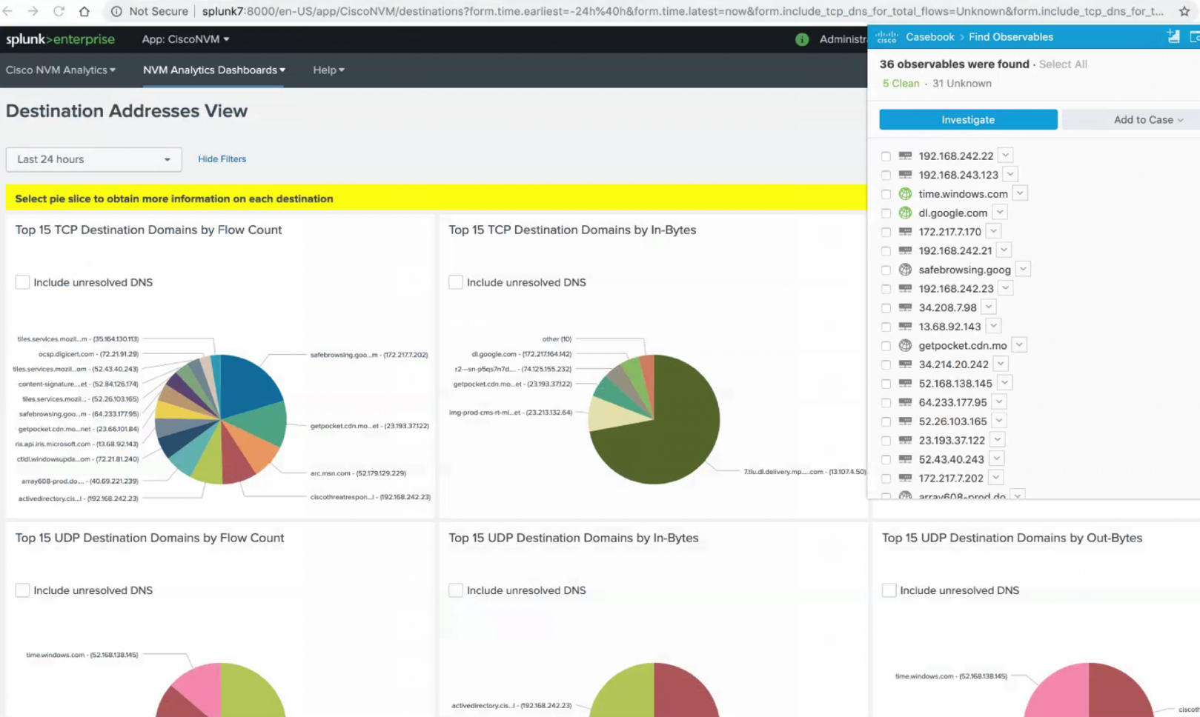
Use Cisco Threat Response everywhere
Kick off an investigation from any browser-based console
Casebook browser
plug-ins
Chrome and Firefox
  cs.co/CTR4Chrome
  cs.co/CTR4Firefox
Notes:
The Casebook browser plug in allows you to quickly and easily pull in indicators of compromise from any webpage or browser-based console…Cisco or otherwise
If Threat Response isn’t yet integrated with products that you have? Leverage the Casebook browser plugin.
For example, you can use it to pull IP addresses or domains from Stealthwatch or from FMC….anywhere there’s an observable, Casebook will pull in directly so you can kick off an investigation fast
And as the screenshot suggests, it works with non-Cisco products as well…just like this Splunk example…helping you demonstrate how Threat Response can work along side their SIEM.

Slide 17
Threat Response use cases
Threat hunting
Ransomware
Phishing attacks
File-less malware
Server-based attacks
Cryptomining

Slide 18
Your SecOps with and without Threat Response
Without Threat Response
IOC / Alert
Investigate incidents in multiple consoles
Action/Remediate
  Product
  dashboard 1
  Product
  dashboard 2
  Product
  dashboard 3
  Product
  dashboard 4
  Product
  dashboard 1
  Product
  dashboard 2
  Product
  dashboard 3
  Product
  dashboard 4
32 minutes
With Threat Response
IOC / Alert / Browser Plugin
Investigate and remediate incidents from multiple security tools in a single console
5 minutes
Notes:
How do you operationalize your cybersecurity program?
Let’s take a moment to imagine SOC analysts at work on a typical day WITHOUT Threat Response. They review increasing numbers of alerts from different solutions. They correlate the information from various sources to build a complete picture of each potential threat. They triage and assign priorities. They perform all these complex tasks with a tremendous sense of urgency. Their goal is to quickly formulate an adequate response strategy based on situational awareness and threat impact, potential scope of compromise, and the criticality of damage that can ensue. This laborious process is often error-prone and time-consuming, requiring a SOC analyst to manually swivel through multiple consoles quickly. We’ve run internal simulations, and all of this can take around 32 minutes.
With all the SOC analyst’s multi-tasking to size up alerts from numerous point solutions, there’s a good chance for high severity threats to be overlooked. More and more organizations are prioritizing the need for effective integration between security technologies to simplify their security architecture for just this reason. The ‘game of the consoles’ cripples your organization’s response capabilities by leaving holes in your security architecture. This lack of integration poses a massive security risk to any organization.
But WITH Threat Response, you’re able to see an aggregated set of alerts and intelligence whether using the browser plugin on any webpage or by pasting observables into Threat Response’s interface. Then Threat Response does all the work, bringing all the knowledge back from intel sources and security products in seconds. So you can then investigate and take action – all within a single console. Our internal simulations has this taking around 5 minutes, which is 85% faster than if you didn’t use Threat Response.

Slide 19
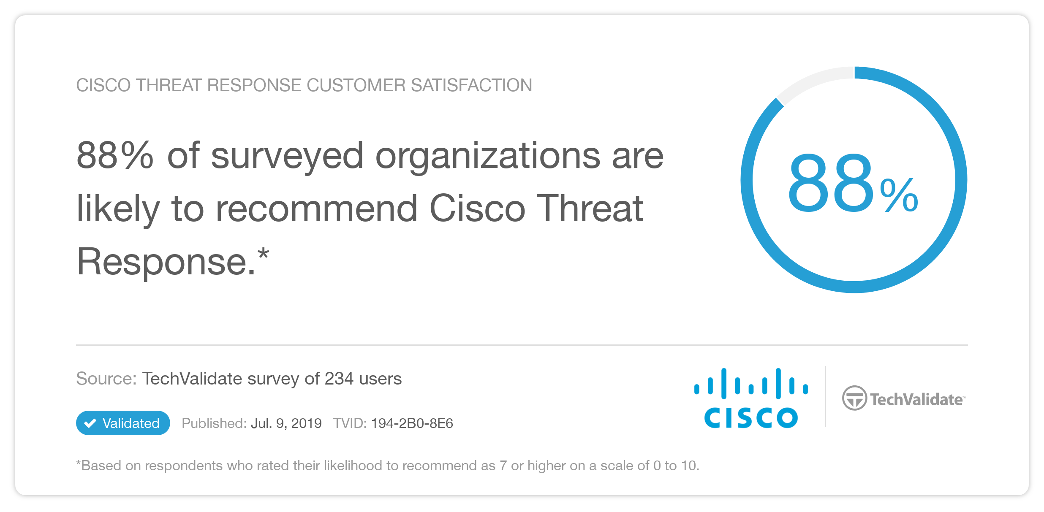

Slide 20
A Call for Unification
Cross-platform visibility and response to detect and stop threats faster!

Slide 21





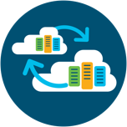
How Cisco integrates security
Cloud Access Security
Threat Intel/Enforcement
Increased Threat Prevention
Email
Security
Enterprise Mobility Management
Secure Internet Gateway
Secure
AS-WAN/ Routers
Event Visibility
Decreased Time to Detect
Advanced Threat
Identity and Network Access Control
Context Awareness
Decreased Time to Investigate
Web
Security
Switches and Access Points
Automated Policy
Decreased Time to Remediate
Next-Gen
FW/IPS
Cloud Workload Protection
Network Traffic Security Analytics
Notes:
Of course, before we talk about integration, the underlying security controls must do their jobs well. Cisco has invested over $7 billion in a comprehensive, industry-leading portfolio of advanced security controls across the network, user/endpoint, and the cloud. It’s backed by Cisco Talos, our threat intelligence and research group. And we will continue to invest in our security portfolio to ensure that each and every individual product solves the cybersecurity challenge that it’s designed to solve – both today and in the future.

Slide 22

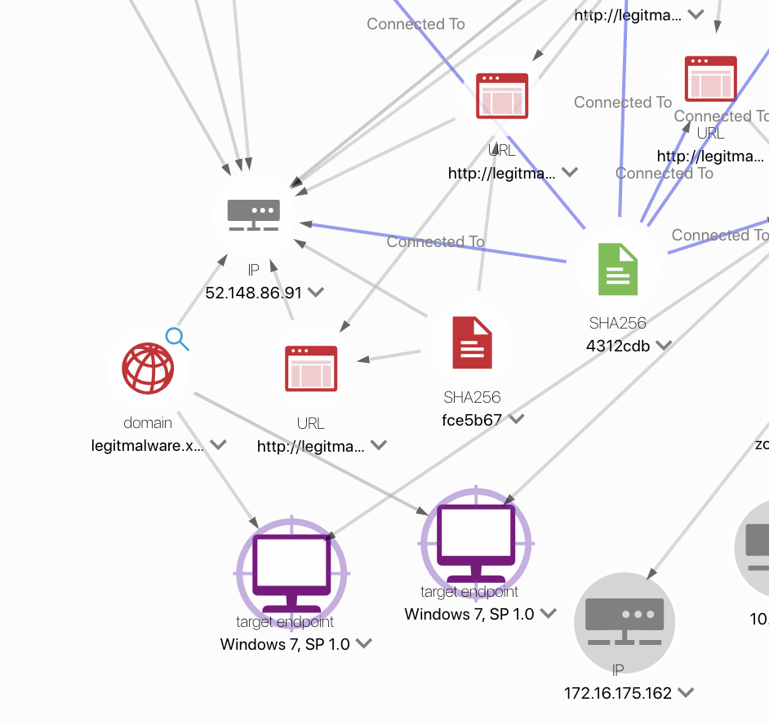


One integrated security platform
across network, endpoints, and cloud
  Automate integrations
  Uncover threats by simultaneously investigating multiple observables across multiple data sets and products
Aggregate intelligence for context
Correlate threat intelligence to enrich investigations and get verdicts quickly
Reduce time with two-click response
Take immediate actions across multiple Cisco products

Slide 23
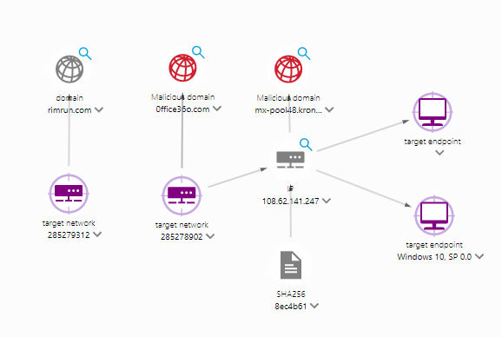

Cisco Threat Response + Umbrella
Umbrella Integration
  Enrichment based on history of DNS request and global domain reputation to get verdicts quickly
Pivot point to detailed domain,
IP, and file history
Take action with two-click response to quickly block domain that is command and control resource for malware.
.
Notes:
Umbrella automatically uncovers attacker infrastructure staged for current and emerging threats, and proactively blocks malicious requests before they reach a customer’s network or endpoints. With Cisco Umbrella enrichment for Threat Response, customers can stop phishing and malware infections earlier, identify already infected devices faster, and prevent data exfiltration. Because Umbrella is built into the foundation of the internet and delivered from the cloud, it provides complete visibility into internet activity across all locations and users. Plus it’s one of the simplest security products to deploy and manage.

Slide 24
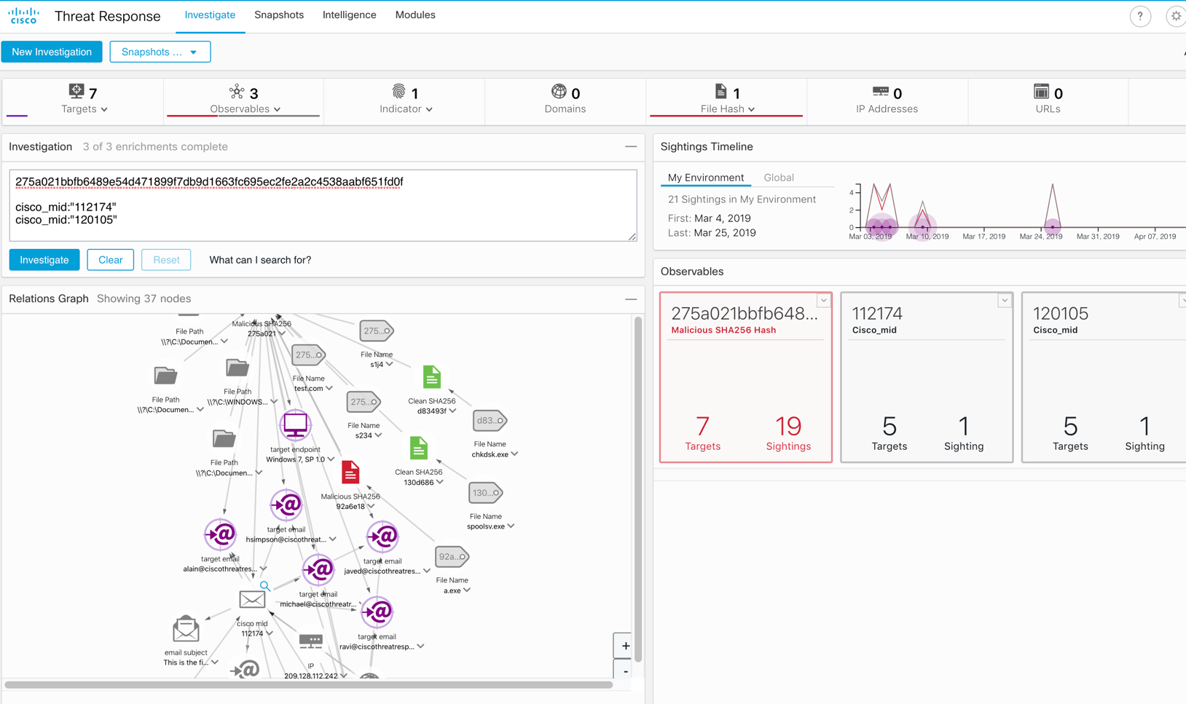
Cisco Threat Response + Email Security
Email Security integration
  Understand email as a threat vector by visualizing message, sender, and target relationships in the context of a threat.
Search for multiple email addresses, subject lines, attachments at once to understand how a threat has spread.
Expand visibility for your SOC into email and other threat artifacts
Notes:
Email continues to be the way most breaches start - about 95% of breaches start with email, according to Verizon’s Data Breach Investigations Report. Also, our Cisco 2019 Annual Cybersecurity Report also found that attackers turn to email as the primary vector for spreading ransomware and malware. With Cisco Threat response you can now correlate threats across the endpoint, network and cloud email to block threats faster and more efficiently all through a single unified console.
Coming soon: Drop emails with risky links automatically or block access to newly infected sites with real-time URL analysis to protect against phishing.

Slide 25

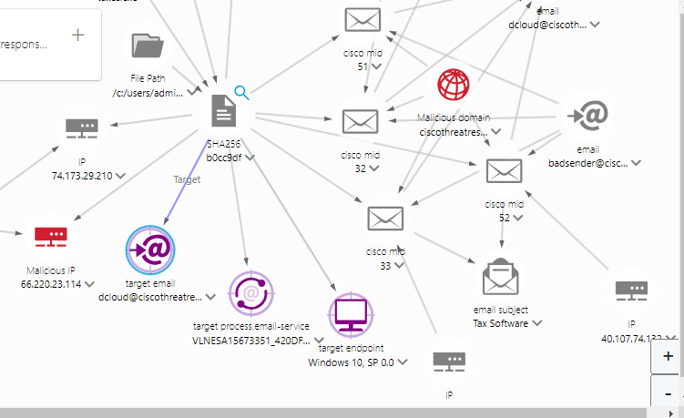
Cisco Threat Response + Email Security
What happened?
Where did the malware come from?
What is in the email attachment?”
How bad is it?
How far has it spread?

Slide 26
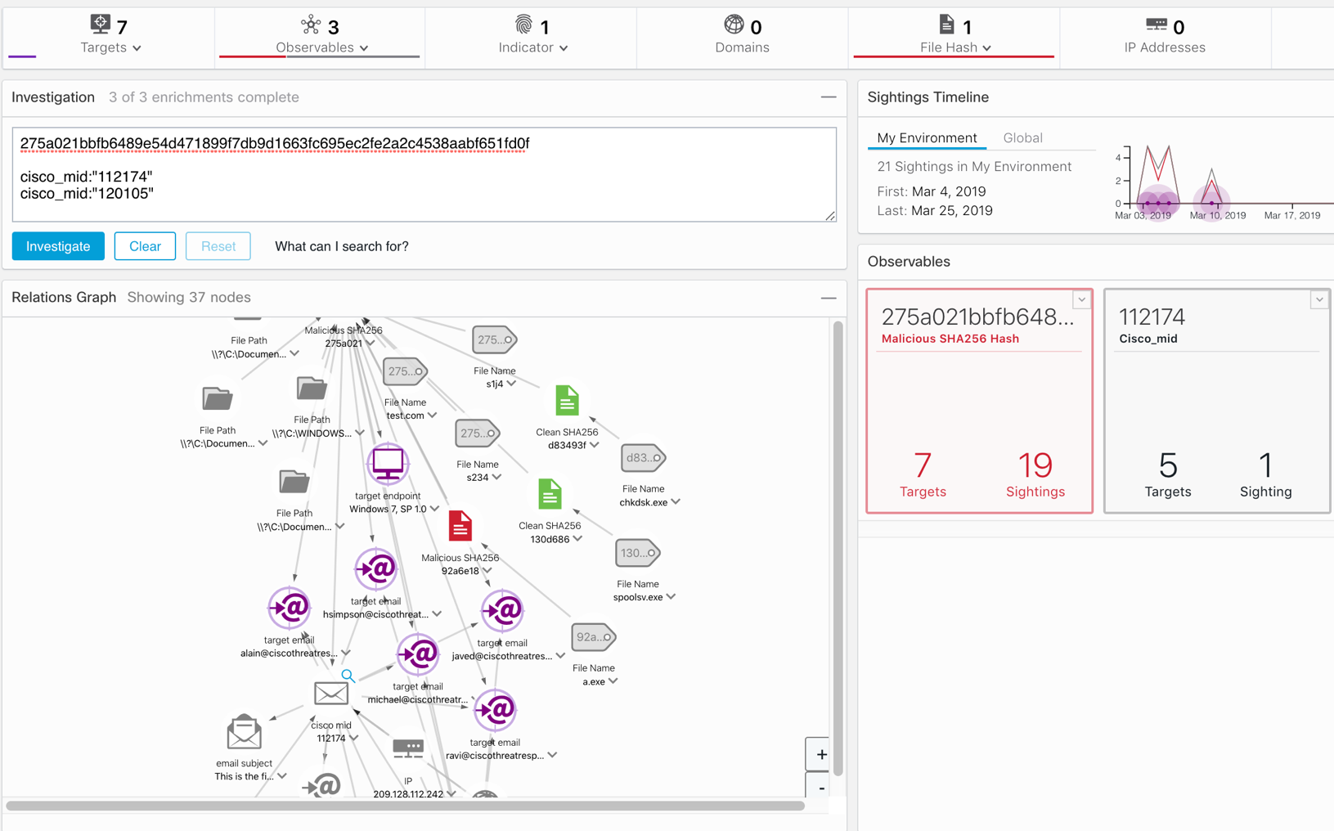
Cisco Threat Response + Firepower NGFW/NGIPS
New! Firepower integration
  Investigate, identify and enrich Firepower intrusion events with context from integrations across security products
Enrich all investigations with network context from Firepower devices
Automated triage and prioritization of intrusion events through the
built-in Incident Manager
Notes:
Cisco Firepower NGFW prevents breaches and can quickly detect and mitigate stealthy attacks using deep visibility and the most advanced security capabilities of any firewall available today – all while maintaining optimal network performance and uptime. You can now take full advantage of your Next Generation Firewall investment is by using Cisco Threat Response, which dramatically cuts the time and manual effort required to investigate and remediate cybersecurity incidents - thereby making your SOC operations more efficient and effective.

Slide 27


Cisco Threat Response + AMP for Endpoints
AMP for Endpoint integration
  Investigate and identify multiple files with context from integrations across security products
Detailed information on affected endpoints and devices including IP addresses, OS, AMP GUID
Block files at endpoints and AMP-capable edge devices, and immediately quarantine affected endpoints with AMP Host Isolation response feature
.
Notes:
Even when you have visibility into your environment, removing a threat and remediating a compromised endpoint takes time. The longer it takes you to detect and eliminate the threat, the more likelihood of the attack becoming widespread. This can lead to a long, costly remediation cycle that affects both your end users’ workflows and your security team’s resources. With our new host isolation capability, AMP for Endpoints rapidly contains the attack by isolating an infected endpoint, so you can stop the threat from spreading. By drastically reducing the footprint of the attack and accelerating remediation, your team can instead focus on more strategic defenses.

Slide 28
AMP for Endpoint customers use Threat Response to unify
87%
87% of surveyed Educational Institution and Fortune 500 organizations with Cisco AMP for Endpoints found Cisco Threat Response an effective way to integrate their security technologies.*
*TechValidate, Cisco Threat Response 2019 survey
Notes:
(https://www.techvalidate.com/tvid/BC4-B56-2C8)

Slide 29
Third-party integrations
Complement your existing security ecosystem with Cisco Threat Response
Enhance investigations and remediations by integrating Threat Response with
your Cisco and 3rd-party security products via
open APIs
How
Access to a private data storage facility for your security telemetry and threat intelligence
Directly import, aggregate, and correlate threat intelligence and security context data
Take response actions in 3rd party products
Benefits
In a single console:
Greater enrichment and fuller context
Faster queries
Automate response process
DevNet
Get hands-on with Threat Response APIs at Cisco DevNet https://developer.cisco.com/threat-response/

Slide 30
Cisco Threat Response for everyone
Commercial Organizations
and State and Local Governments
... and integrations with Cisco security products and threat intelligence
Large Enterprises
and Large Government Agencies
Managed Security
Service Providers
Scales with the changing needs of your organization
Small security team
Limited or no SIEM deployment
Leverage full stack with API
Security Operations Center
Extensive SIEM deployment
APIs across the stack is key
Security Operations Center
Multi-tenant SIEM deployment
APIs across the stack is key
Notes:
Cisco Threat Response is designed for organizations of all sizes. From smaller commercial organizations to large MSSPs, we’ve designed to make Threat Response scale with your changing needs to make your cyber programs more efficient and effective.

Slide 31
Cisco Threat Response in the real world
Join Cisco Security customers who are gaining value from it now
6100+
  “Cisco Threat Response might change the way security incidents are being handled in my company…”
Organizations are using it today
  “You cannot hit a target you cannot see. Cisco Threat Response really simplifies security analysis...”
Notes:
While Cisco Threat Response is our newest innovation, it’s already proven to be effective with our customers today. At time of writing (Nov 2018), more than 2500 different organizations have already gained value from it. You can see some of their quotes here.

Slide 32


Cisco Incident Response Services
Because cybersecurity is not just about technology
Retainer
Offer may include:
Emergency Response
Proactive Threat Hunting
IR Readiness Assessments
Table Top Exercises
Access to included tools:
AMP for Endpoints
Umbrella
Cisco Threat Response
Stealthwatch
Threat Grid
Annual Subscription
Dedicated, Seasoned Consultants
Proactive
Emergency
Proactive Threat Hunting
Emergency Incident Response
IR Readiness Assessment
Table Top Exercises
IR Plans & Playbooks
Notes:
Cisco Threat Response is a technology solution, of course, but we all know that cybersecurity is also about policy, people, and process as well. For many of our customers, cyber incident readiness and response capabilities could benefit from professional services – retainer, proactive, and emergency response services. If you feel as though your team can too, then please learn more about Cisco Incident Response Services. Below is more information from the Cisco Services team.
---
When we talk about IR services we are essentially talking about putting our crack team of security experts at the end of a phone, so that when you suffer a breach they spring into action, literally jumping on a plane to your site and helping you scope, close and recover from a breach much more quickly, drawing on all of our security products and threat insights to help them.
We sometimes compare IR to a breakdown service for your car, or the fire service, or if we wanted to get a bit Tom Clancy, like Special Forces.
But it’s important not to focus just on the emergency response aspect of the service, and instead to look at it as a yearly subscription that you get value from all year round. A bit like if the breakdown service also maintained your car and taught you how to do preventative maintenance. Or if the Special Forces taught you self-defence.
That’s because as part of an IR retainer you take out with us you also get access to our experts to plan and improve your readiness. We’ll get to know your network, proactively hunt for threats that may be lurking in your network, assess your breach readiness, help you build and document your incident response plan, test it with you during tabletop exercises, and so on.
-------------------------
alternatively
So why would you you choose a retainer vs just engaging when in an emergency
We can get to know your infrastructure first so we’re not going in cold
We can help you build your incident response plan
We can help you test your incident preparedness before hackers do
You want to know you have a team of IR experts standing by in case of an emergency, and in the meantime, are helping you prepare for the inevitable
We work with you to understand how best you’d like to use your retainer. If you need an IR plan, we’ll work with you to develop one.
If you already have one, we can use it for other engagements for example:
See what threats are in your network with Proactive Threat Hunting
Check your ability to respond effectively and efficiently with an IR Readiness Assessment
Engage in Table Top Exercises to see how your team responds in simulated breach situations
Document and update your IR Plans and Playbooks
And of course, when you do suffer a breach. We’re there for you
You spot a breach, or realise that you can’t close it yourself.
Call us — we have one global number dedicated to this.
We’ll diagnose/interrogate remotely and be on-site in 24 hours from our bases in EMEAR. We literally jump on a plane.
We’ll diagnose, contain and remediate to get you back on your feet.
You’ll have access to Cisco security products like AMP for Endpoints and Umbrella.
And of course we provide regular checkins.

