Slide 1


Cisco Secure Email
Layered Defenses For Comprehensive Protection
Fall 2020

Slide 2


Email was not built with security and is easy to exploit
An estimated $1.77 billion in internet and cybercrime losses came from reports of BEC (Business Email Compromise).²
Attacks on emails remain
the easiest way for attackers
to breach an organization.
Malware and malicious spam are the top two causes of downtime. They’re followed by phishing, spyware and ransomware.³
Email delivery is involved in 94% of malware detection.¹
1. 2020 Verizon DBIR
2. FBI’s IC3 Annual Report (2019)
3. Cisco Cybersecurity Report Series 2020 CISO Benchmark Study
Notes:
Statement:
Email is still the number one attack vector and the primary method of communication for most organizations.
Moving to cloud-based email further exposes potential risk.
With more customers going to a common cloud platform (Microsoft 365), attackers find more opportunity to create breaches.

Slide 3





Attackers use multiple ways to get in
Business Email Compromise (BEC)
Estimated exposed losses due to BEC between 2016 and 2019 totaled $26 billion.¹
Ransomware
Predicted to hit $20 billion in 2021²
Domain
Compromise
54% of legitimate
domains used in
phishing campaigns³
Malware
10.52 billion malware attacks in 2018⁴
Phishing
27% of data breaches in 2019 involved the theft of credentials such as logins or encryption keys⁵
1. Business email Compromise The $26 Billion Scam, Public Service announcement, FBI, September 10, 2019
2. 2019 Cybersecurity Almanac
3. Cisco 2018 Annual Cybersecurity Report
4. 2019 SonicWall Cyber Threat Report
5. “Forrester ® Best Practices for Phishing Prevention, September 30, 2019
Notes:
Attackers will not go away or give up. They continue to exploit the ever-changing threat landscape.
They often use social engineering to carry out technical attacks such as credentials spoofing and delivering malicious links. And, these attacks are very costly in a number of different ways; financially and from a downtime perspective.

Slide 4

Cisco Secure Email: a layered approach
Cisco Secure Email, a proven industry leader, keeps on premise or cloud-based email safe and productive by stopping phishing, spoofing, business email compromise and other cyber threats. Comprehensive threat detection ensures the security of inbound and outbound messages.
Duo multi-factor authentication
Protect credentials
Talos real-time intelligence
Secure Malware Defense Detect malicious files and sandboxing
Domain Protection
Protect your brand
Phishing Defense
Prevent phishing attacks
Secure Awareness Training
Enforce security policies with employee behavior change
Notes:
Note: Don’t go into deep detail on these. They will be covered in depth in the following slides.
Describe these in this order:
CES/ESA, Talos/SecureX, Duo, Malware Defense, Domain Protection, Phishing Defense, Security awareness.
Cisco provides Email Security in a consumption model of your choosing (CMD, CES, ESA(v) and ESA) and the consumption model that meets your needs.
Talos provides real-time intelligence and platform integrations. Talos is the backend threat intelligence and SecureX is our integrated reporting/threat hunting platform for the portfolio. Cisco provides integration of both the back-end data analytics and now with SecureX, at the management/orchestration/interrogation level.
Duo MFA – either on premise, private or public cloud, Stolen credentials should be of the utmost concern. As our users today are usually not within the “four walls” of a corporation, their access over the internet must be protected.
Malware Defense – Get global threat intelligence, advanced sandboxing, and real-time malware blocking to prevent breaches with Cisco Advanced Malware Protection (AMP). But because you can’t rely on prevention alone, AMP also continuously analyzes file activity across your extended network, so you can quickly detect, contain, and remove advanced malware. The AMP Everywhere Architecture is a unique offering in the industry covering network, endpoint, Web and Email.
Domain Protection – It’s important to protect your company’s reputation and brand. With DP, Cisco automatically identifies, monitors and manages emails sent on your behalf across the internet. This provides an easy way to identify and eliminate illegitimate email messages and block malicious ones to prevent phishing attacks impersonating your company’s domain. Domain Protection even detects the use of look-alike domains so the malicious URLs can be quickly taken down.
Phishing Defense - Advanced Phishing Protection provides sender authentication and BEC detection capabilities. It uses advance machine learning techniques, real time behavior analytics, relationship modeling and telemetry to protect against identity deception–based threats. This intelligence continuously adapts to drive a real-time understanding of senders, prevent breaches and provide enhanced protection.
Finally, its been proven that the better educated and armed your end users are, the more effective any security solution is. This is true for any technology directly touching the end user. Cisco Security Awareness provides flexibility and support to effectively deploy your phishing simulations, awareness training — or both — and measure and report results. Empower your security operations team with the ability to focus on real time threats and not end user mitigation. Our product provides the education that helps employees to work smarter and safer.

Slide 5




Superior threat intelligence from Cisco Talos
Visibility across all vectors from a best in class portfolio
Telemetry
Domain
IP
Automated Analysis
Network
File
Specialized Tools
URL
Flow
Notes:
What makes up an attack? How much raw data is there out there? Mr/Mrs customer, do you have a large enough and trained enough staff that can keep a constant lookout for threats impacting your company? If you said yes (I am impressed), expand that out to the internet. Who has the global footprint, data points and intelligence? Cisco has the largest non-military data store and analytics in the world.
How can we help our customers pivot from only reacting to threats your company sees to being proactive on threats yet to come!
Attackers have unlimited attempts and resources to be effective, so defenders have to win every time. This requires immense visibility, rapid intelligence, and the ability to respond in-kind and at-scale. Cisco Talos is one of the largest and most trusted providers of cutting-edge security research globally. We provide the data Cisco Security products and services use to take action. The key differentiator of Talos is our process — seeing what is happening broadly across the threat landscape, acting on that data rapidly and meaningfully, and driving protection. Integral to that process is that Talos has more visibility than any other security vendor in the world and unique capabilities and scale in intelligence. The core mission at Talos is to provide verifiable and customizable defensive technologies and techniques
Talos – Trying to make the internet a safer place – go there yourself at https://talosintelligence.com/
Automated Analysis
Specialized Tools
Highly trained security engineers constantly looking for the next exposure.
What do we look at?
Domain
Network
URL
IP
File
Flow
Cisco connects the dots before it detonates or stop a threat in its tracks before it impacts your business.

Slide 6







Improvements to Talos capabilities
Cisco Secure Email relies on constant and incremental improvement
Scale
Speed
Agility
Cloud
processing
Notes:
Talos builds the foundation of Email Security (as well as the rest of Cisco’s security portfolio). It takes the initiative by providing the most comprehensive security and threat intelligence solutions in the industry. Talos processes, correlates and delivers more actionable data than most intel groups. Our global footprint and depth of our investment provides intel at the scale of the internet.
Talos provides defensive weaponized intelligence and detection technologies to quickly inform and defend our customers. Our engineers and analysts are working around the world to keep every Cisco Security customer and the security community informed of the current threat environment.
The Cisco Security ecosystem covers email, networks, cloud, web, endpoints and everything in between. Cisco Talos has more visibility than any other security vendor in the world, with the sheer size and breadth of Cisco Security’s portfolio and the incoming telemetry from Cisco’s customers and products. This unique visibility delivers us greater context from many data points during an incident or campaign. This, along with other resources such as open-source communities and internal vulnerability discovery, enables Talos to move faster and create more comprehensive assessments of ongoing threats.

Slide 7





Secure Email platform options
Cloud
Hybrid
On-premises
Multi-tenant for Service Providers
Virtual

Slide 8






Duo: the world’s easiest and most secure MFA
Cisco Secure Endpoint and Secure Email
Filter and
block spam
Detect and block malicious email
Data loss
prevention
Block phishing attempts
Secure Access by Duo
Easy Integration and Secure access to Microsoft 365 using Duo Unified Access Security
Multi-Factor Authentication
Single Sign-on
Adaptive Authentication
Device Visibility & Controls
Identify and control personal vs. corporate management devices
Notes:
As more and more of users leave the protected environment of the corporate walls (or VPNs), it’s important to be able to control, secure, and reporte on who accessed which devices and from where. As more and more users access and leverage cloud-based technologies such as Microsoft 365, that access must be protected past user id/passwords. Mu,itfactor authentication has been around for awhile, but it has never been this easy to deploy, manage and support. Duo is relatively simple to deploy and the end user experience is amazing. So what does this integration do?
Provides an easy to understand and utilize interface for the end user
Tight integration to cloud-based services that is extensible (past just the email security we are discussing here)
Adapts with an open API architecture that can integrate with customer’s data store allowing an easy to deploy SSO architecture
Provides deep visibility and control of who logged

Slide 9

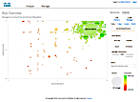
Secure Email Phishing Defense
Protect against fraudulent senders
Advanced Intelligence
Learns and authenticates identities and behavioral relationships for enhanced protection
Reduces Business Email Compromise
Better understand which emails carry targeted phishing attacks so only legitimate emails are in inboxes
Notes:
How can you help users determine if an email is legitimate? And, how do you decide when to block those that aren’t?
Phishing Defense:
Determines which identities the recipient perceives is sending the message
Analyzes the expected sending behavior for anomalies relative to that identity
Measures relationships to determine expected sending behavior; highly engaged relationships (such as between coworkers) have tighter behavioral anomaly thresholds since they have higher overall risk if spoofed
Uncovers even the most creative “look alike” domains
The screen shot here shows how easy it is to understand what is going on – RED YELLOW GREEN .. Those are obvious. The size of the circle is the volume. This detailed analysis and easy to understand visibility gives our email security analysts the confidence to block those questionable emails that try sneaking in.

Slide 10



Secure Email Domain Protection
Block attackers from using your domain
Protect Your Brand
Easily analyze, update and take action against those misusing your domain to send malicious email
Validate those who use your domain appropriately
DMARC Authentication
Compliant with new US Department of Homeland Security Regulations
Drive to DMARC Enforcement with proven tools and services
Notes:
There have been standards around for many years that address the task of monitoring your domain; making sure only those with permission are using it and watching for those that try to use it with malicious intent. Domain Protection helps protect your brand with ease.
Know with confidence who is sending email on your behalf and who is not approved to do so. Domain Protection gives you the information you need to determine that.
Domain Protection automates the DMARC email authentication process and gives you visibility into your own and third-party email senders using your domain. It automatically correlates information into an easy-to-read report that lists who is sending email on your behalf and whether they are DMARC compliant. For those senders who are not DMARC compliant, Domain Protection provides the tools to help you achieve compliance. Domain Protection also provides guidance on how to block unauthorized senders.

Slide 11




Secure Email Malware Defense
Combat targeted malware with a powerful ecosystem
Find out if a file contains a threat
Analyze new files in a secure environment
Get alerted when malware emerges in your network
Automate removal from Microsoft 365 and Exchange inboxes
Correlate threats across the endpoint, network and cloud email to block threats faster
and more efficiently with Secure Endpoint Unity
Notes:
Use this slide should be a discussion around Malware Defense in general. Talk thru Malware Defense Everywhere first and how we can tie together and understand how a threat got into the environment (North South), where it has gone (East West), and was it stopped. Cisco takes another step by pulling the file in question from the inboxes of the targets (Microsoft 365 and Exchange).

Slide 12




Secure Awareness Training
A comprehensive approach to combat phishing
Cisco Secure Email
Block malicious emails with threat intelligence from Cisco Talos
Domain Protection
Prevent attackers from using your domain in phishing campaigns
Secure Awareness Training
Focus on user behavior training to help employees work smarter and safer
Phishing Defense
Protect against advanced phishing with local intelligence from identify mapping and behavioral analytics
Duo multi-factor authentication
Protect user credentials with multi factor authentication
Notes:
People influence security more than technology or policy and cybercriminals know how to exploit human behaviors.
No security system can be 100% effective in detecting all incoming threats. Increasing security awareness plays a critical role in an organization’s overall security and risk posture.
Security and risk management leaders should invest in tools that increase awareness and influence behavior that supports security business objectives through computer-based training.
Cisco technology combined with Secure Awareness Training provides a comprehensive approach to combat phishing across your organization.

Slide 13
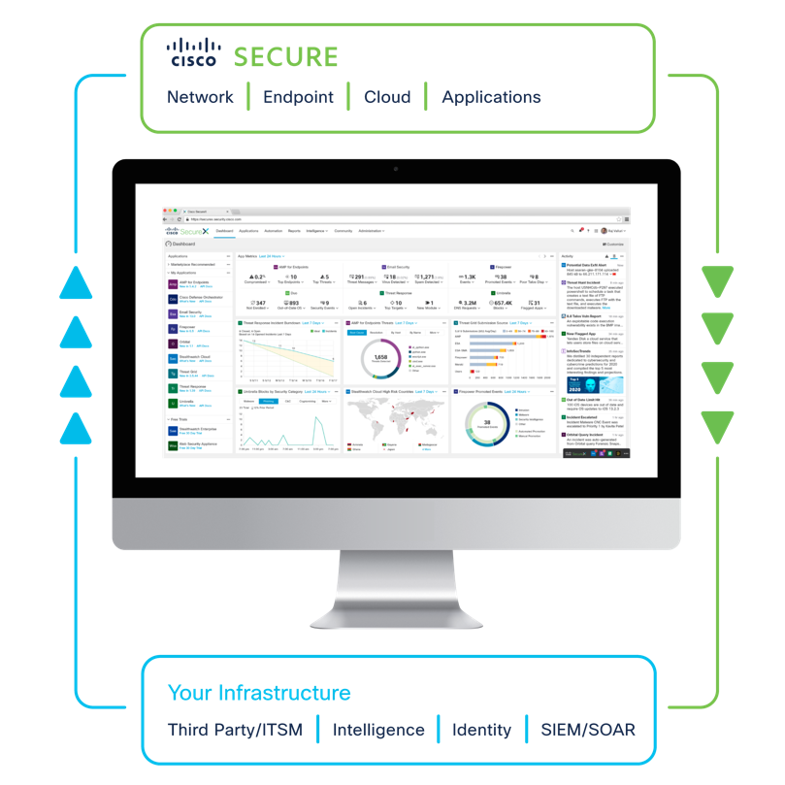
SecureX connects Cisco Secure Email with your entire security infrastructure
Integrate everything in your environment to unify visibility, enable automation, and strengthen security
Reduces complexity involved with the planning and administration of email security.
Improve compliance monitoring.
Automate investigative and response actions using Threat Response feature of SecureX.
​Harmonize email policy management and enhances threat protection.
Unify advanced sandboxing with threat intelligence to strengthen malware defense.
Augment data loss prevention and content encryption capabilities to safeguard sensitive information.
*Available August 2020 with Release 13.8
Notes:
The Cisco SecureX platform is a built-in experience embedded within our solutions, meaning you see immediate benefits from the Cisco security products you already have.
We built SecureX to eliminate the complexity we saw across the security vendor market and make security simpler. SecureX expands platform benefits across every network, endpoint, cloud, and application.
SecureX isn’t another technology layer—rather it maximizes the potential of your existing security solutions.

Slide 14
“I am able to visualize threats within my environment and take action in half the time it used to take me.”
Security Engineer, Large Enterprise Banking Company

Slide 15

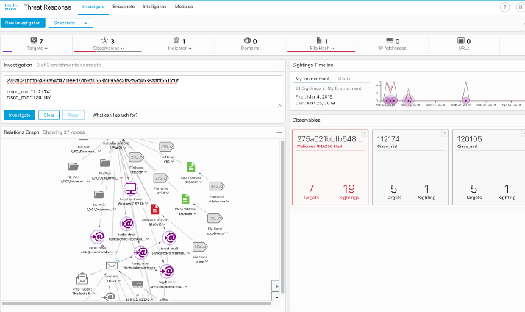


SecureX threat response and Secure Email
Secure Email integration
  Understand email as a threat vector by visualizing message, sender, and target relationships in the context of a threat
Search for multiple email addresses, subject lines, attachments at once to understand how a threat has spread
Expand visibility for your SOC into email and other threat artifacts
Notes:
SecureX doesn’t just connect to Cisco products, it transforms your infrastructure from a series of disjointed solutions into a fully integrated environment.
We know that Cisco is not the only vendor you use. Because SecureX offers out-of-the-box interoperability, you can instantly connect every tool—Cisco or otherwise—on a single platform. So if you have identity solutions from Palo Alto or MFA from another provider – great! Bring them to our platform so everything you have can work better, together.
Unlock the full potential of every one of your existing security investments by unifying visibility, enabling automation, and strengthening security.

Slide 16








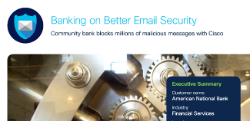
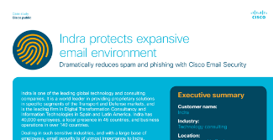
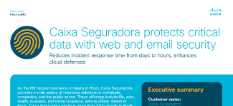
Case Studies
Sheppard Robson Video Customer Testimonial
NHS Video Customer Testimonial
United Solutions Video Customer Testimonial
First Milk Video Customer Testimonial
Ping Networks Video Customer Testimonial
Royal Freemasons Video Customer Testimonial
Delta Plastics Video Customer Testimonial
American National Bank Case Study
Indra Case Study
Caixa Seguradora
Case Study

Slide 17
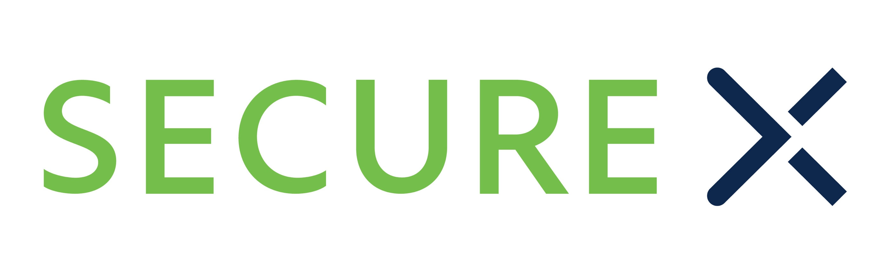




Cisco Secure portfolio: simpler to buy and use
Security Choice
Enterprise Agreement
Talos
threat intel
Great discounts on 2+ security products with support included
Buy what you need now and
add more in the future
Single coterminous agreement managed in one portal
Built-in 20% growth allowance with true forward terms
Pay annually with 0% financing
Cloud-native, built-in platform experience including XDR capabilities and beyond
Integrated and open for
simplicity with true turnkey
interoperability
Unified in one location for
visibility that accelerates your time to detect and investigate
Maximize operational
efficiency that accelerates
your time to remediate
Network
Security
Cloud
Edge
User & Endpoint
Protection
Application
Security
Zero
Trust

Slide 18

Next steps
Schedule a PoV
Use Threat Analyzer tool
Sign up for a free trial
click here

Slide 20
Appendix

Slide 21
Release 13.0

Slide 22
AsyncOS 13.0 Refresher: Feature List
Mailbox Auto Remediation (MAR) support for MS Exchange 2016 & 2013
Enhances Secure Endpoint integration on Email security for On-Prem exchange customers. This capability automates the remediation of mailboxes on retrospective verdict from Secure Endpoint
Mailbox Auto Remediation (MAR) support for Exchange hybrid deployment and Microsoft 365 multitenant deployment
Extending the existing MAR capability to support Exchange hybrid deployment (is an important use case for customers who are in the middle of transitioning from On-prem exchange to Microsoft 365) and Microsoft 365 Exchange online multi-tenant deployment
Content Disarm and Reconstruction
(aka SafePrint)
With this feature, customers can configure Secure Email to regenerate suspicious attachments in email as a PDF file with images. This will ensure that the recipients still receive the content without the risk of being exposed to any zero day threat
SecureX threat response Integration with Pivot menu and Casebook support
SecureX threat response integration is extended with support for Casebook and Pivot menu widgets which will help customer’s SOC team in their incident investigation and pivoting from SMA to SecureX threat response as well as other security products. With this release, EMEAR DC support for SecureX threat response is also made available
SSO support via SAML
Release 13.0 supports SSO via SAML authentication for Administrator access. Email Security and SMA are pre-qualified with multiple Identify providers including Secure Access by Duo Access Gateway
Logging Enhancements
A new consolidated log in CEF format summarizing each email event in a single log line is available for simplifying integration with SIEM applications. Release 13.0 also supports integration with Amazon S3 bucket, this will help customers who have Amazon S3 subscription to store the Email security logs and access them securely
NG UI on ESA
To improve customer’s operability experience, the NextGen UI which is already available on SMA/SMAv is now made available with this release for ESA/ESAv
Aggressive Spam scanning config
Release 13.0 exposes a new “Aggressive Spam scanning Profile” for customers. If any customer wants to block higher percentage of Spam, even with a risk of slightly higher False Positives, now they can take advantage of this new option

Slide 23
Release 13.5

Slide 24
AsyncOS 13.0 Refresher: Feature List
Cloud URL Analysis provides decreased time to detect and a quicker ability to act that protects against URL based email attacks.
Significant phishing capability improvements via Talos, our team of global threat intelligence professionals.
New scalable Security Management Appliance (SMA) allows for easy handling of more gateways, Cisco Domain Protection reporting integration makes for ease-of-read for DMP reporting.
On demand mailbox remediation provides an effective method to search for and remediate malicious messages that may already have reached their endpoint.

