Slide 1


Cisco SD-WAN
P O W ER ED B Y MER A K I SD-WAN and MX
Simple, Secure, Intelligently Optimized

Slide 2


About Meraki

Slide 3
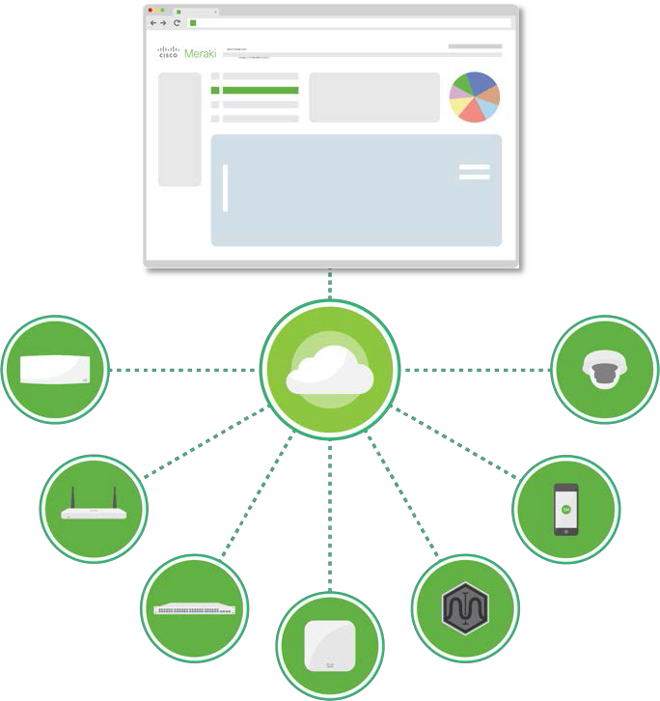
We Create Technology That Simply Works
Among Cisco’s fastest growing portfolios
Provide a complete cloud-managed IT solution with integrated hardware, software, and cloud services
WIRELESS
SECURITY & SD- WAN
SWITCHING
WIRELESS WAN
APP / WAN ASSURANCE
ENDPOINT
MANAGEMENT
SMART CAMERAS

Slide 4
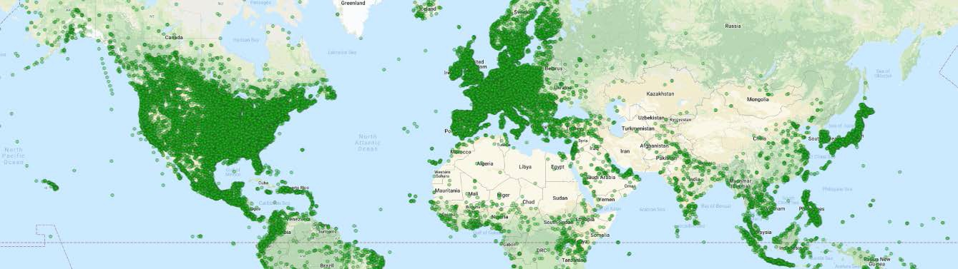




Built on the Industry’s Most Trusted Cloud Infrastructure
10+ years experience scaling cloud infrastructure
Served 500,000+ customers globally
Proven in 20,000+ location deployments

Slide 5
WAN Challenges

Slide 6






Increasing Bandwidth Demands
SaaS Applications
Video / VoIP

Slide 7



Legacy and Emerging WAN Links
Premium
Maturing
CU RRE N T
M P L S
H Q / DC
B RAN C H
B R O A D B A N D
F I B E R
F UT UR E
M P L S
H Q / DC
B RAN C H
W I R E L E S S W A N
business critical
non-critical

Slide 8
WAN Options
M PLS O N LY
1
M P L S
Increase the capacity of an existing MPLS network
H Q / DC
A U G M E N T E D M P L S
M P L S
2
B RAN C H
REDUCING COST
Supplement an existing MPLS network with broadband for increased bandwidth
Offload traffic from MPLS to broadband with policy based routing dynamic path selection
Dual high speed broadband connections
Load balance business critical traffic based on policy or link performance
B R O A D B A N D
H Q / DC
B ROADBA N D - B ROADBA N D
B R O A D B A N D
3
B R O A D B A N D
H Q / DC
B RAN C H
B RAN C H
SD-WAN
business critical
non-critical

Slide 9

Progression of SD-WAN Beyond MPLS Conversion
SaaS
M P L S
Reduce reliance on MPLS
Reduce reliance on MPLS links by utilizing increasingly mature uplinks such as broadband and fiber to satisfy increased demand for bandwidth
Reduce total WAN costs across all locations
SaaS App Quality of Experience
As more and more business critical traffic moves to become cloud-centric, it’s become imperative to
Monitor critical SaaS applications end-to- end
Implement a strategy to maximize the performance of SaaS applications

Slide 10
Cisco SD-WAN

Slide 11
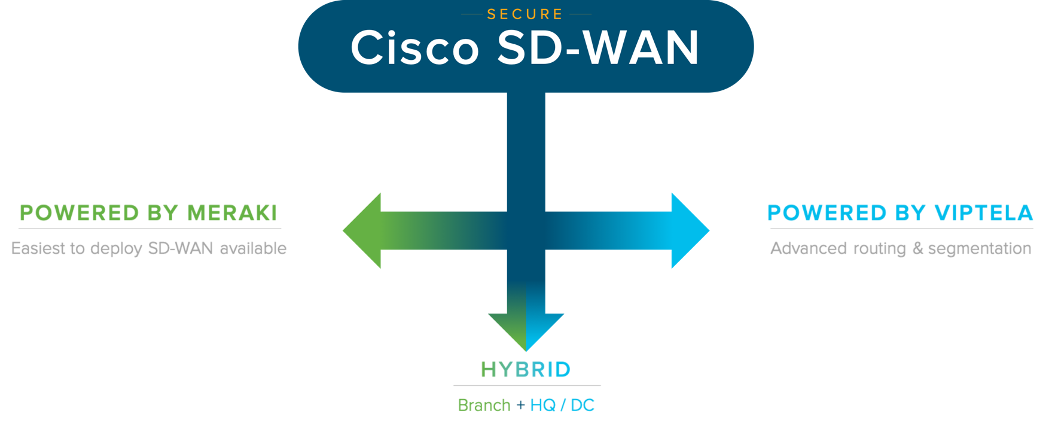
A Complete Market Leading Solution

Slide 12
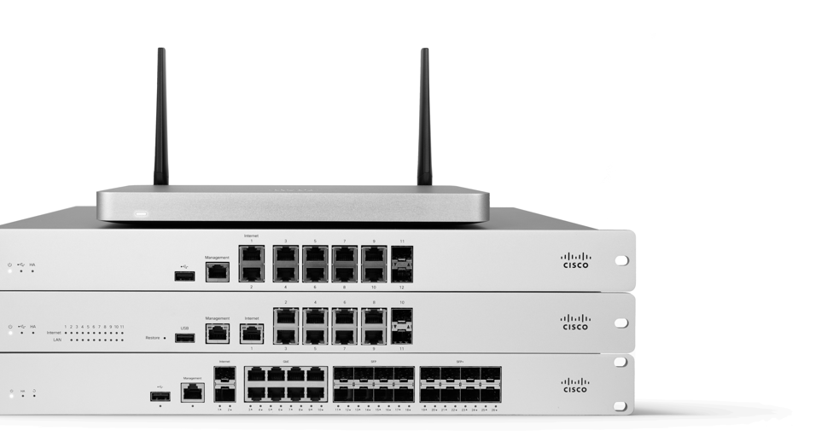




Cisco SD-WAN Powered by Meraki
Hardware highlights across all MX models
×2 WAN ports
3G / 4G / LTE USB as single-WAN or failover Models with embedded LTE modem
High availability mode and automatic WAN failover Additional Ethernet ports with PoE/PoE+ options
Delivered by Meraki MX Security & SD-WAN Appliances

Slide 13
Secure SD-WAN Plus
POWERED BY MERAKI

Slide 14
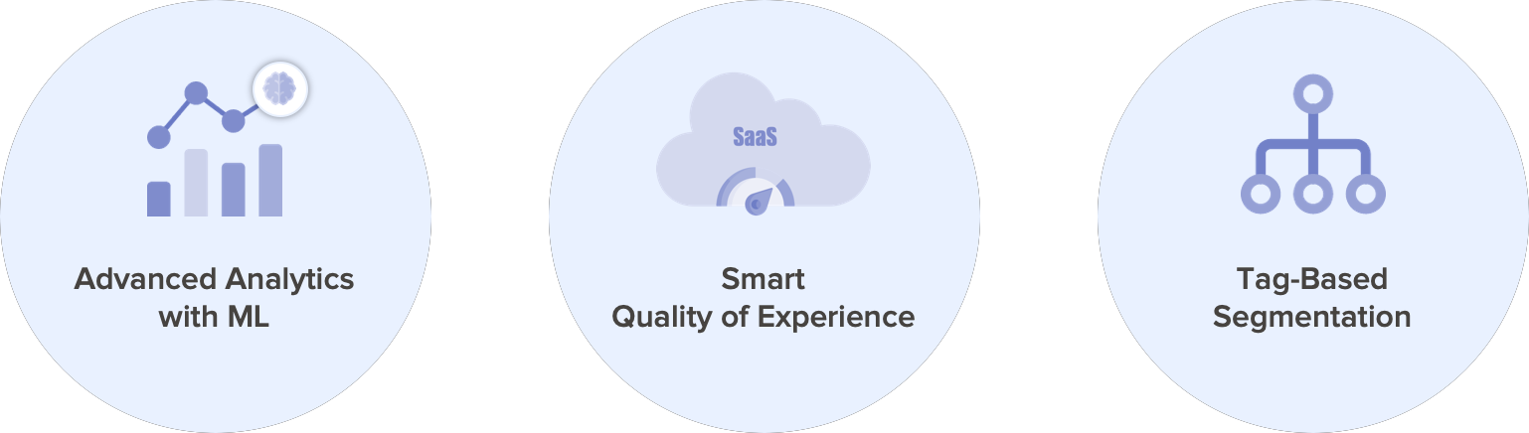
Market Leading Innovations for New Use Cases

Slide 15





Advanced Analytics with ML
Vision
Supreme Visibility
Are my critical functions performing as expected? If not, what’s the root cause of the issue.
Super-Charged with ML
How should my critical functions be performing?
Predictive Foresight
When could my critical functions be impacted?
All relevant info including internet intelligence at-a-glance
Smart Thresholds
Aggregated Meraki platform analysis with ML
No need to set any threshold
Thresholds autonomously adjust based on past behavioral patterns of the specific network
Web app health
WAN health
VoIP health
- Forewarning of when critical functions could experience performance impact
E.g.
“Gmail users in your Oregon networks could experience outages within the next 12hrs”
Increasingly powerful and autonomous troubleshooting

Slide 16

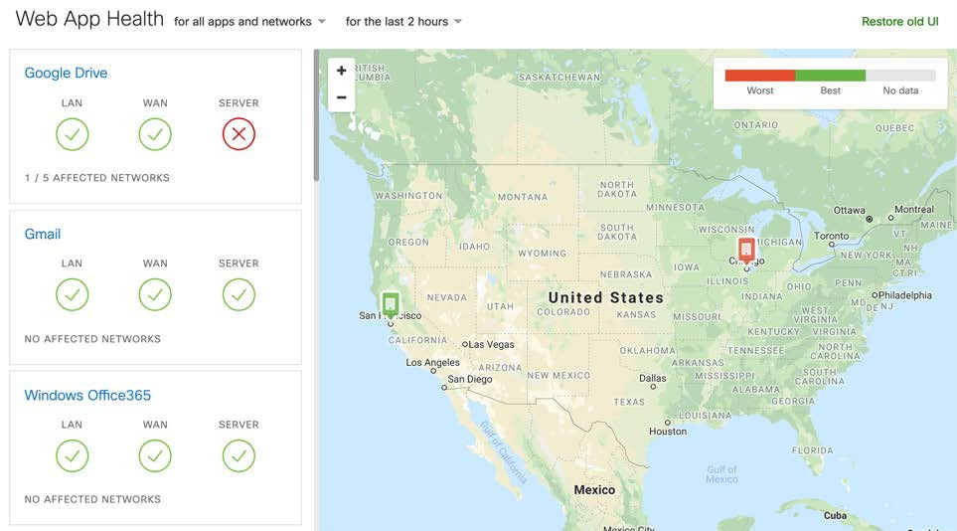
Web Application Experience
Monitor performance for apps travelling via VPN or public Internet
End-to-end visibility for SaaS application experience
Network performance analytics and troubleshooting, including the LAN, WAN, servers and domains
Accelerate IT and reduce time-to-resolution End-to-end network intelligence at work
Ease migration to SaaS with simplified troubleshooting

Slide 17

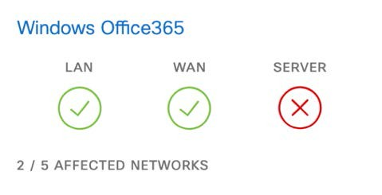

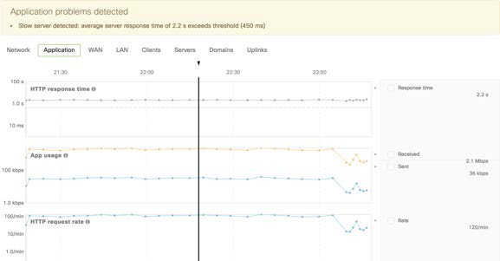
Pinpoint App Performance Issues in Minutes
Where’s the issue and so who should be contacted?
An IT admin can immediately tell which point in the network is failing and causing degradation
Within 2 clicks, an IT admin can understand the exact reason and drill down to generate specific evidence for the poor performance
What’s the exact reason and where’s the evidence?
Suggested root cause of performance issues

Slide 18

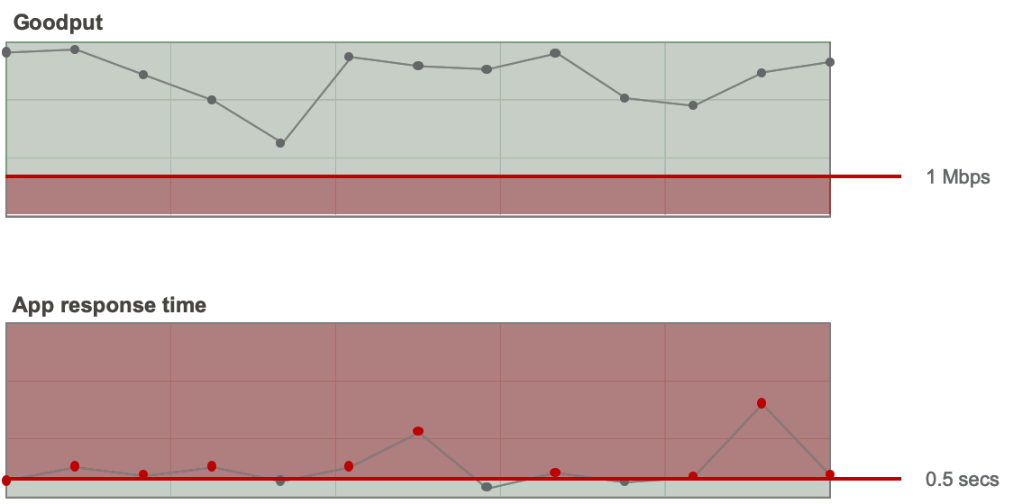

STATIC
THRESHOLDS
What Should App Thresholds be?
Thresholds for ‘Super Critical App’
Min. goodput | 1 | Mbps
Max. app response time | 0.5 | secs
Possible false positives

Slide 19
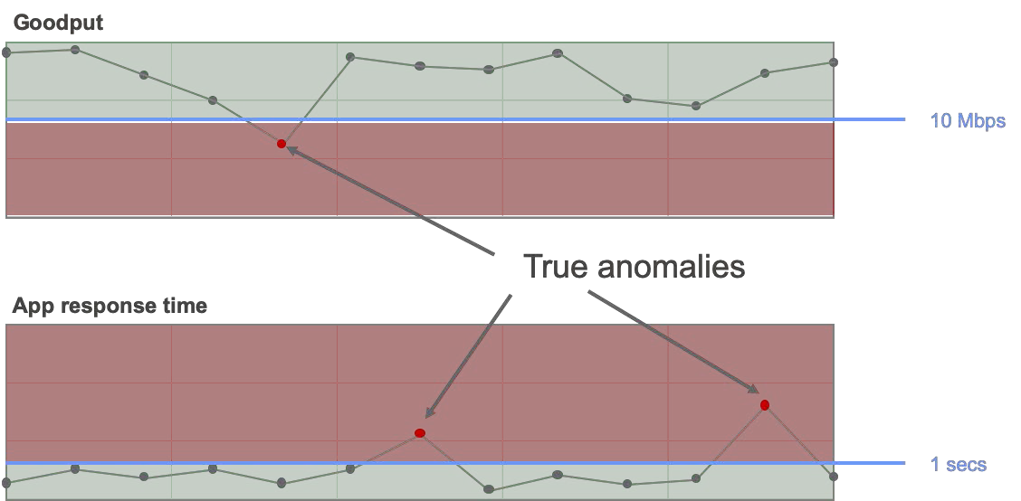

SMAR TST ATIC
THRES HT HORL DE SHOLDS
Don’t Worry About Thresholds
Smart Thresholds
No need to set any threshold
Thresholds autonomously adjust
Based on past behavioral patterns of the specific network
Takes into account previous performance, workloads etc.

Slide 20

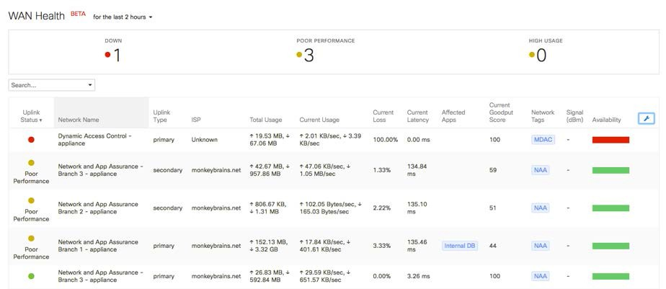

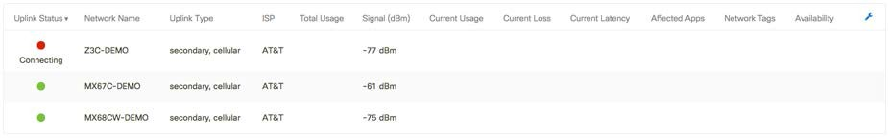
WAN Health
At-a-glance health of all MX uplinks across all sites
Quickly identify downed uplinks, including cellular across all sites
Easily monitor signal strength for cellular uplinks across all locations
Quickly isolate sites with underperforming uplinks to make the case for switching ISP or adding cellular as failover
Discover which sites are most reliant on cellular as failover
Monitor the health of all MX uplinks including cellular across all sites

Slide 21

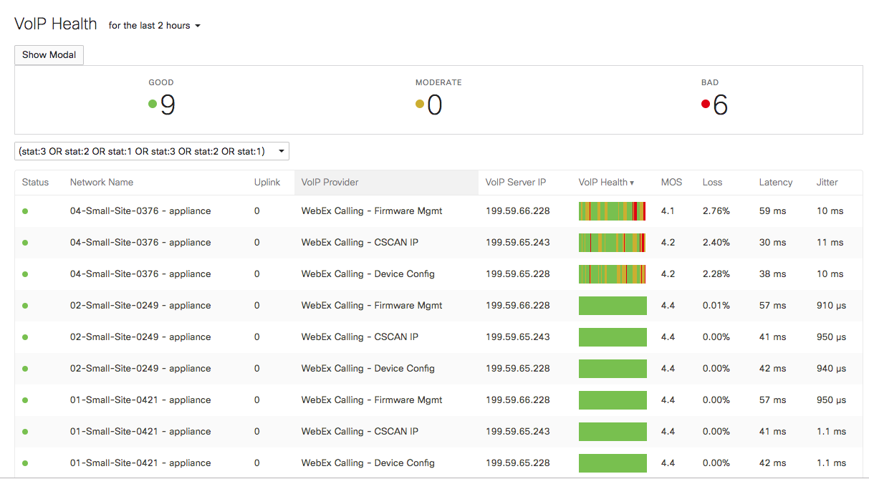

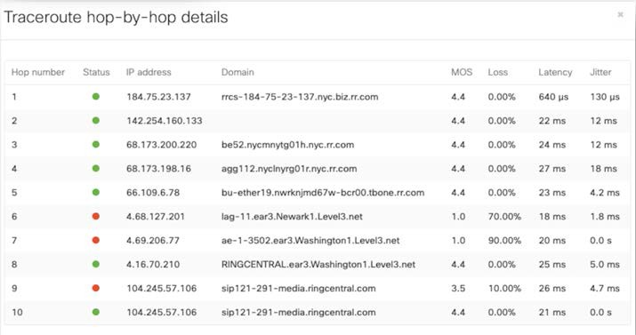
VoIP Health
Track the performance of SaaS-based VoIP services over all uplinks
Simple to set up – add VoIP servers by domain name or IP addresses
Quickly identify the cause of VoIP quality degradation through detailed hop-by-hop analysis
Active monitoring of VoIP servers allows for ‘virtual’ PoC for multiple vendors

Slide 22






Smart SaaS Quality of Experience
Planned 2021
Vision
Controlled Path
Optimal Path
Smart Path
Control the path for SaaS apps over all available links
[MPLS, broadband, fiber, cellular]
Internet
Auto VPN
Performance based path selection across all available paths
Informed by aggregated Meraki platform analysis with ML
- Pre-emptive path re-routing to counteract imminent performance issues
Increasingly optimized and intelligent path selection

Slide 23

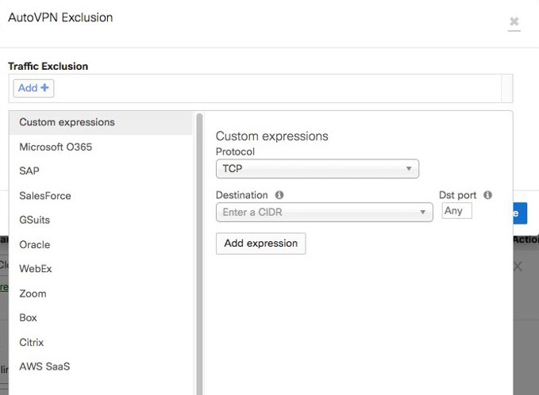

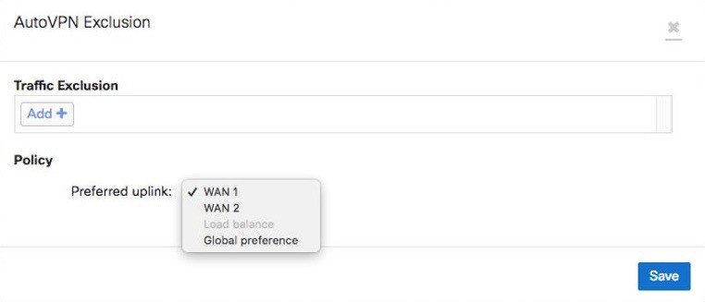
Control Path Selection for SaaS Applications
Local breakout of SaaS applications to use public Internet links instead of Auto VPN tunnels
Seamless one-click setup for top applications
Choose a proffered public Internet path
Load balance between available public Internet links
Apply a global preference

Slide 24



Tag-Based Segmentation
Vision
Tag Based
Simplified segmentation
Adaptive policy extended over and enforced by the WAN
User and device groups are tagged
Only users and devices with the necessary tags have access to corresponding resources in other locations

Slide 25
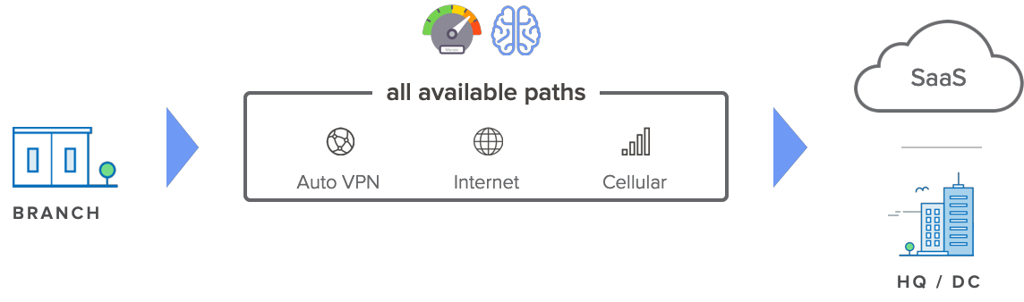
Smart SaaS QoE on all Available Paths
SECURE SD-WAN PLUS

Slide 26
Natively Secure SD-WAN

Slide 27


Informed by Cisco Talos Threat Intelligence
Over 250 full time threat researchers
Millions of telemetry agents
4 global data centers
Over 100 threat intelligence partners
Over 1,100 threat traps
1.5 million malware samples / day
600 billion email messages / day
Internet-wide scanning
16 billion web requests / day
Telemetry
Honeypots
Internal vulnerability discovery
Open source communities

Slide 28
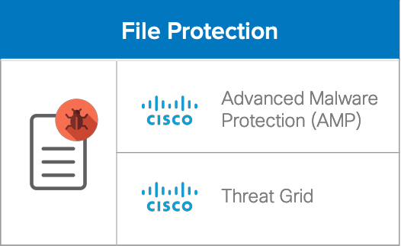
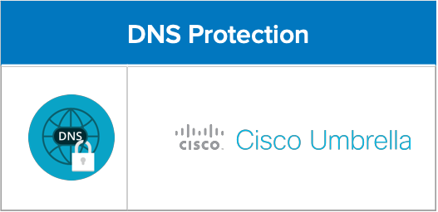
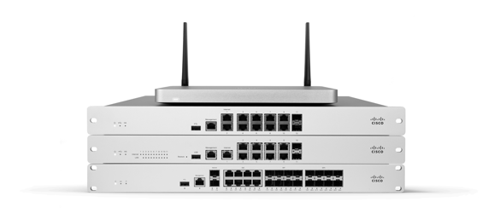
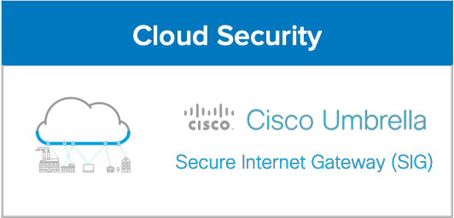
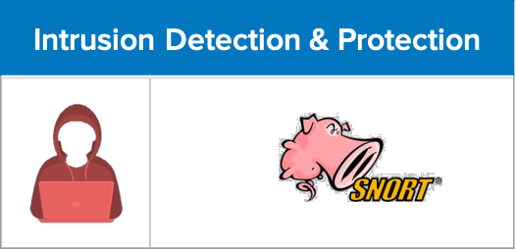


Natively Integrated Industry-Leading Security
P O W E R E D B Y
Cisco Identity Services Engine (ISE)
Industry-Leading Content Filtering

Slide 29

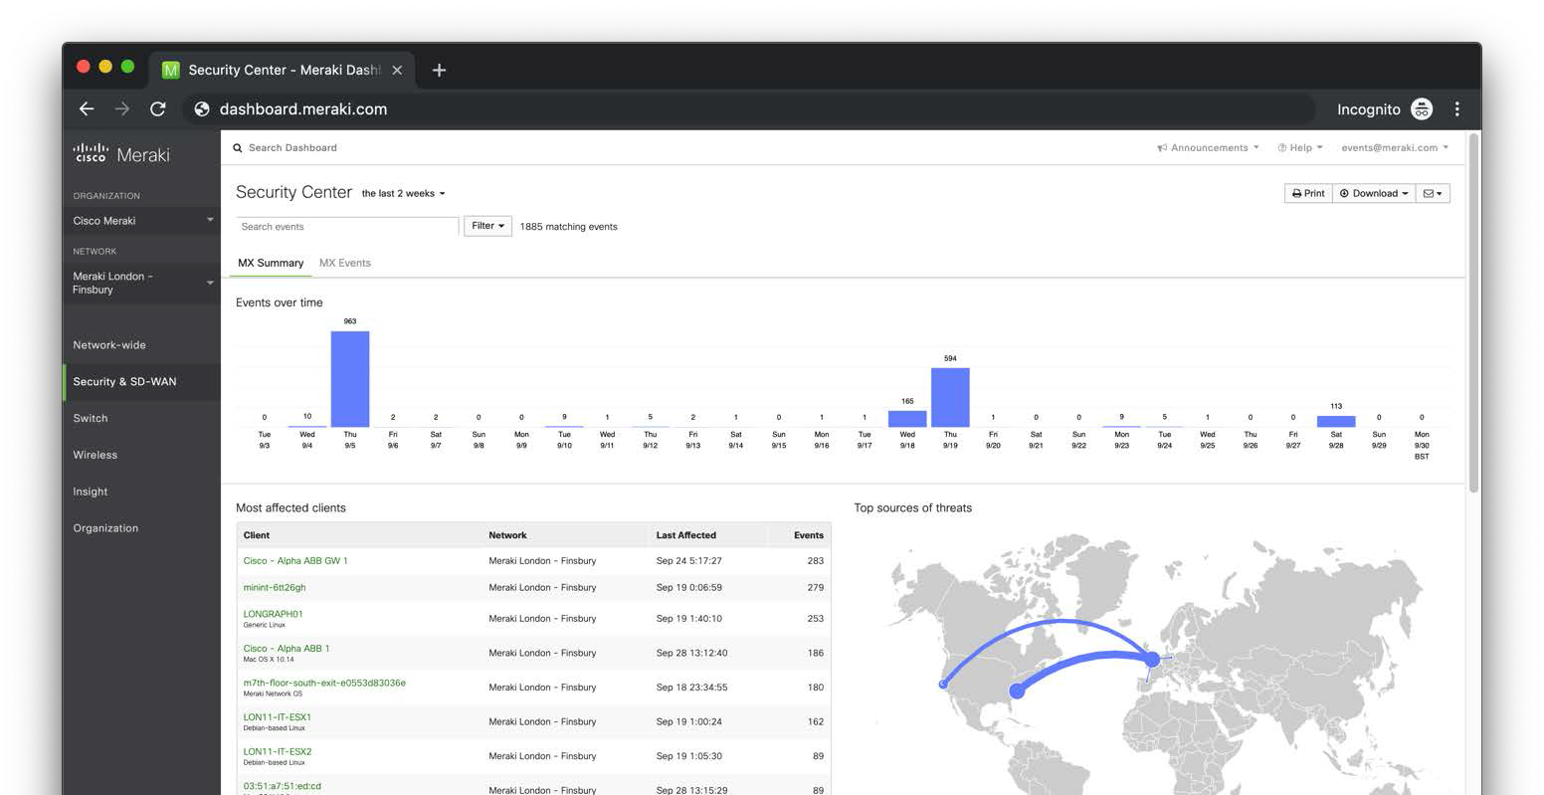
Elegant Security Monitoring

Slide 30
Hub-Centric Connectivity & Optimization

Slide 31
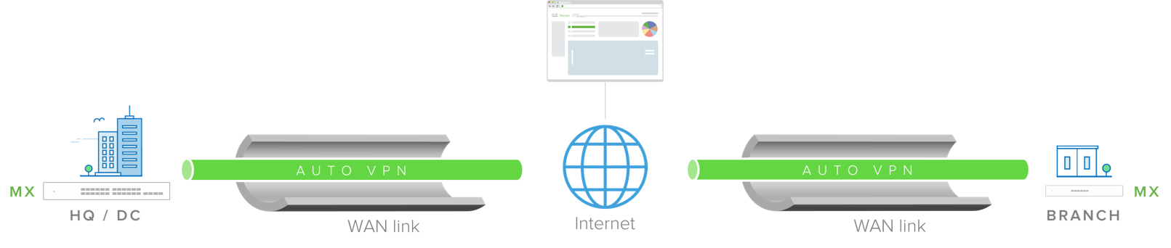
Securely Built on Site-to-Site Auto VPN
Meraki Auto VPN | The ability to configure site-to-site, Layer 3 IPsec VPN tunnels in just two clicks in the Cisco Meraki dashboard over any WAN link
Automatically configured VPN parameters | The Cisco Meraki dashboard uniquely acts as a broker between MXs in an organization, negotiating VPN routes, authentication and encryption protocols, and key exchange automatically to create hub-and-spoke or mesh VPN topologies
Redundancy built-in | MXs with two uplinks will automatically self-heal to re-negotiate VPN tunnels if a primary uplink goes down

Slide 32
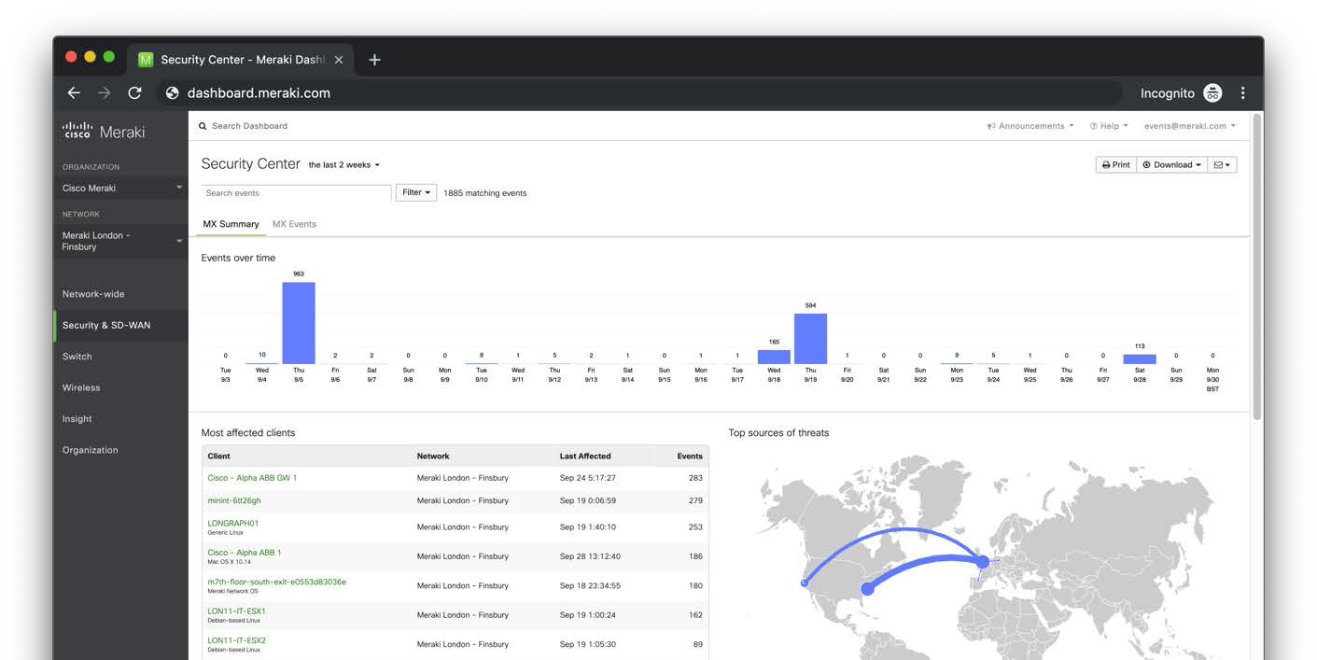
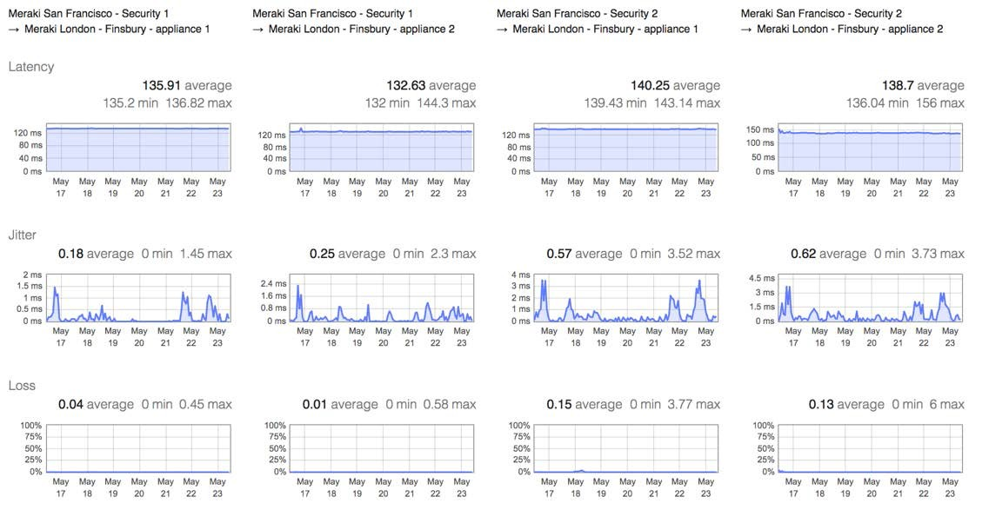
Driven by Real-Time VPN Performance Monitoring
Latency | Jitter | Loss | MOS

Slide 33
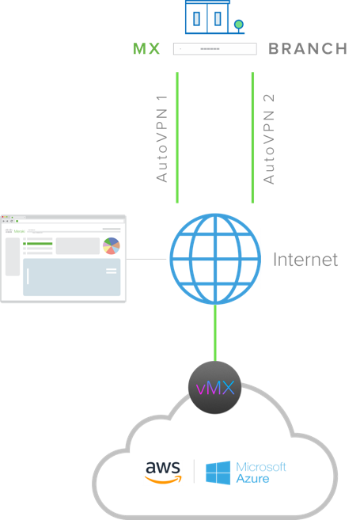
Extension to Public Cloud Services
Extend MX deployments to IT services located in AWS or Microsoft Azure with site-to-site auto VPN to a virtual MX (vMX)
Leverage SD-WAN on vMX the same way as a physical MX for optimal path selection to IT services hosted in AWS or Azure
vMX is managed just like any other physical MX in the dashboard once deployed on an AWS EC2 instance or an Azure VM
Only a license is required

Slide 34


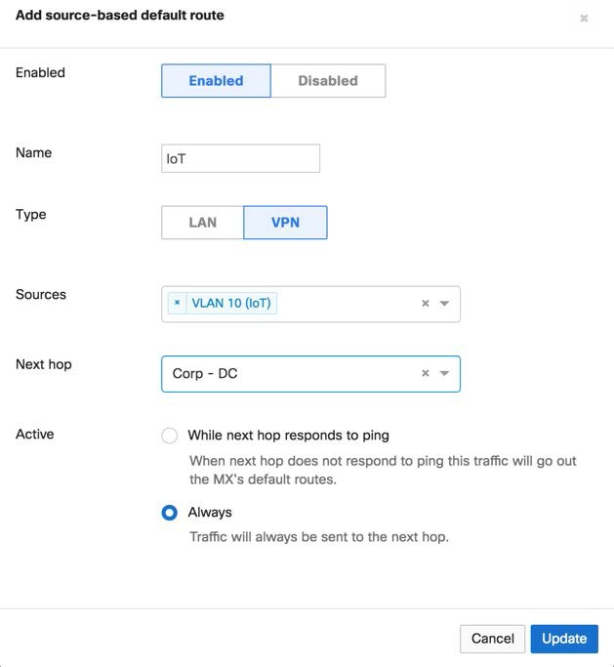
Source Based Segmentation
Coming soon
Seamlessly route segments of branch traffic to the desired destination
Example
Define segments by VLAN
Select an MX as the desired destination
Only traffic on the ‘IoT’
VLAN is routed to the ‘Corp
– DC’

Slide 35
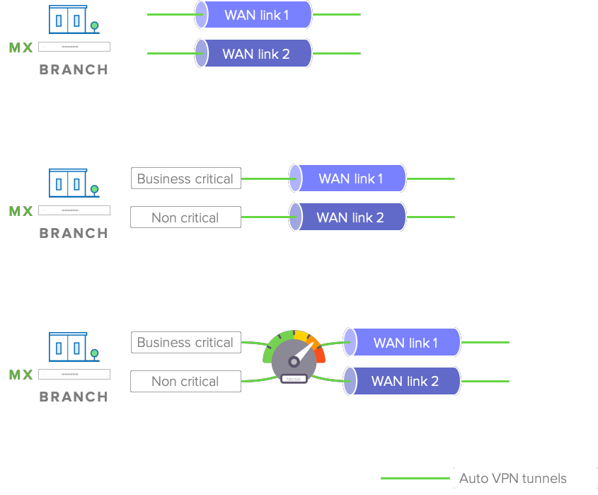
Smart WAN Paths to Suit Your Business
Dual active VPN
Load balance your VPN traffic over two WAN links
Policy-based Routing (PbR)
Select the preferred path for traffic based on protocol, port, source, and destination IP
Dynamic path selection
Select the best VPN tunnel for traffic automatically based on performance

Slide 36

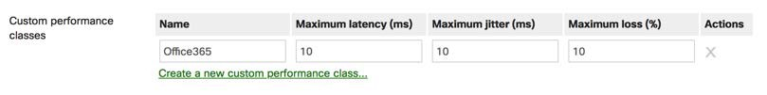
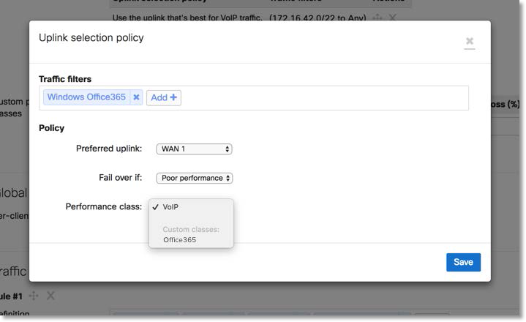

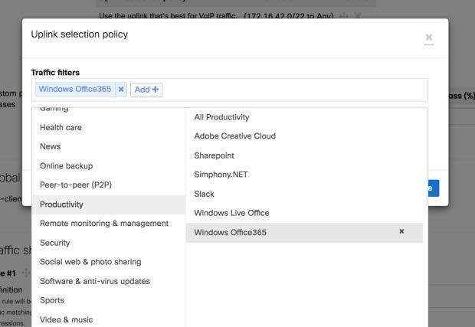
Simply Express Your Intent
1. Define acceptable performance thresholds
3. Choose preferred uplink and when fail over should occur
2. Select from built-in Layer-7 categories and applications

Slide 37
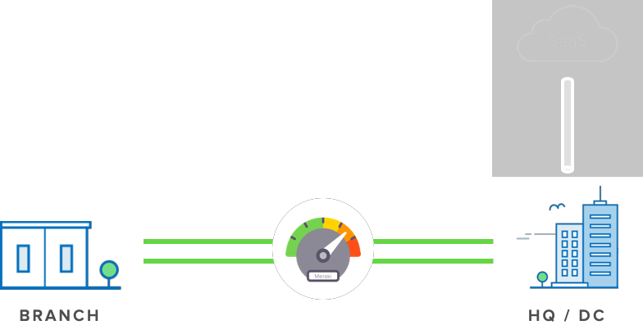
Hub-Centric Connectivity & Optimization
SECURE SD-WAN BUILT ON AUTO VPN
Dynamic path selection
MOS based VoIP routing
Policy based path selection
Manual path selection

Slide 38
MX Portfolio

Slide 39



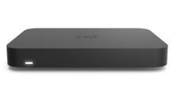




A Model for Every Location
 | SMALL BRANCH
 | MX64/W | MX67/68 | MX67C/68CW
 | ~50 users 802.11ac Wireless* & PoE FW throughput: 250 Mbps | ~50 users 802.11ac Wave 2* & PoE FW throughput: 450 Mbps | ~50 users 802.11ac Wave 2* & PoE FW throughput: 450 Mbps CAT 6 LTE
T EL EW O R K ER
Z3 Z3C
~5 users
802.11ac Wave 2 Wireless & PoE FW throughput: 100 Mbps
CAT 3 LTE (Z3C)
L A RG E B RA N C H , C A M P U S OR C ON C EN T RA T O R
 | MEDIUM BRANCH
 | MX84 | MX100
 | ~200 users FW throughput: 500 Mbps | ~500 users FW throughput: 750 Mbps
 | VIRTUAL
 | vMX100 for AWS & Azure
 | FW throughput: 750 Mbps VPN & SD-WAN
MX250
MX450
~2,000 users
FW throughput: 4 Gbps
~10,000 users
FW throughput: 6 Gbps

Slide 40

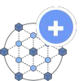

A License for Every Use Case
Enterprise
Advanced Security
Secure SD-WAN Plus
Essential SD-WAN features
All enterprise features plus:
All advanced security features plus:
Secure connectivity & basic security
Fully featured unified threat management
Advanced analytics with ML Smart SaaS quality of experience Tag-based segmentation
All I need is Auto VPN and a firewall
I connect to the internet, so I need UTM security too
My business relies on SaaS/IaaS/DC served apps

Slide 41
Wireless WAN

Slide 42




A Maturing Market
TO D AY
Failover
Backup Network Solution for WAN Connectivity
Other, 0%
MPLS VPN, 9%
EM ERG I NG
Failover and Primary
Broadband Internet, 43%
Cellular, 48%
Spin up across multiple locations in a fraction of the time MPLS
Available in areas with no broadband or fiber coverage
[ Source: IDC, 2019 ]
More primary use cases will emerge building on the confidence and successes of LTE
5G promises the throughput and assurance that was missing

Slide 43









Barriers to Leveraging Cellular
Coaxial
COAXIAL LOSS
-2dB per 10 feet
Outside
Network closet
Coverage
Good cellular signal strength
Poor cellular signal strength

Slide 44


Barriers to Leveraging Cellular
Coverage
Multiple management systems
Scale

Slide 45

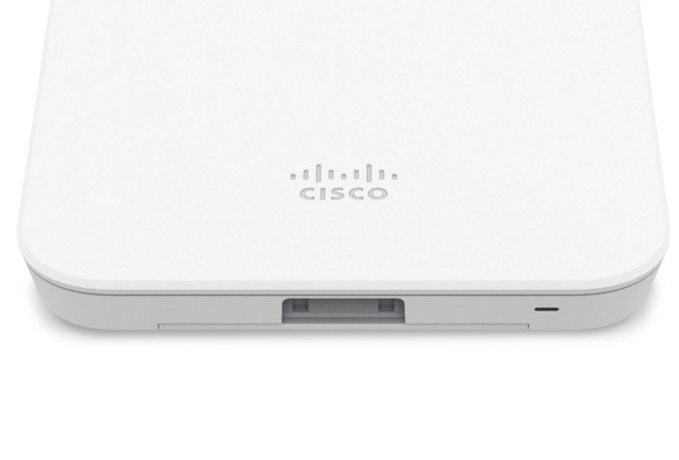



MG
Meraki Cellular Gateway
The simplest path to wireless WAN
Unlocks the potential of wireless WAN
Precision placement for optimal cellular signal strength
Pair with any router to deliver failover or primary cellular support

Slide 46

MG
Meraki Cellular Gateway
The simplest path to wireless WAN
ETHERNET LOSS
0dB per 300 feet

Slide 47
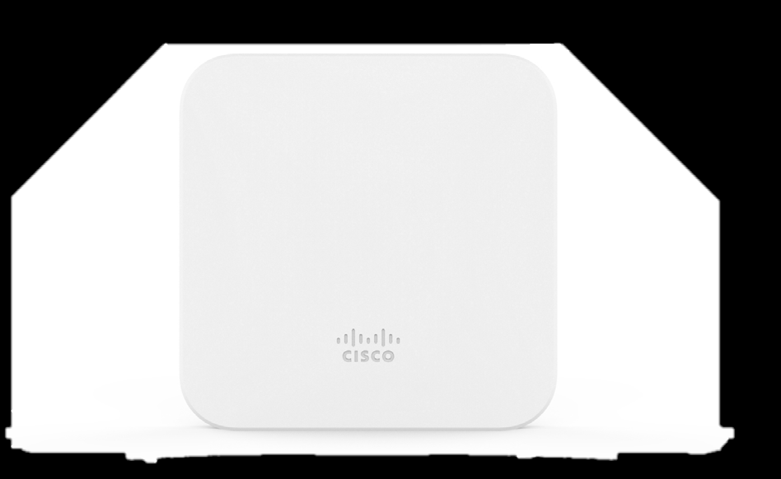
The Meraki MG21 Cellular Gateway
Feature Highlights
Integrated CAT6 modem with up to 300Mbps
Multi-surface mounting bracket (wall, ceiling, pole, and tabletop)
Integrated high performance antenna
DC / PoE power in
×2 Ethernet ports
External antennas*
Dipole included
Patch available as an accessory
Nano SIM card slot
IP67 Rated with Lifetime Warranty
*Available on MG21E model

Slide 48

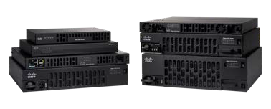
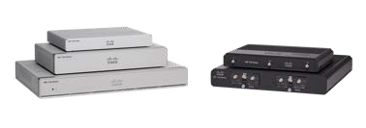
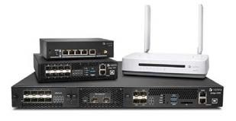

PAIR WITH ANY ROUTER / SD-WAN APPLIANCE
MX
ISR
vEdge
Other vendor routing rights reserved.
WIRELESS WAN
Use Cases
Replacing a standalone 3rd party cellular gateway
Implementing cellular links
Looking to leverage cellular for SD-WAN
© 2020 Cisco and/or its affiliates. All

Slide 49
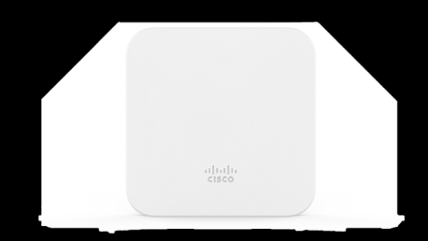


Models & Licensing
HW Hardware | Meraki MG21 Cellular Gateway - N America & Worldwide
 | Meraki MG21E Cellular Gateway External Antennas - N America & Worldwide
MG21
LIC Licensing | 1 Year
 | 3 Year
 | 5 Year
 | 7 Year
 | 10 Year
MG21E

Slide 50
Why Meraki

Slide 51

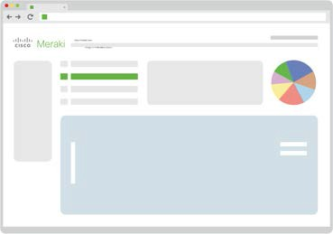



True Zero Touch Provisioning
One-time remote, web- based configuration Configuration templates simplify large multi-site deployments
No pre-staging
No onsite configuration
Unbox and plug in MX appliances at required locations

Slide 52
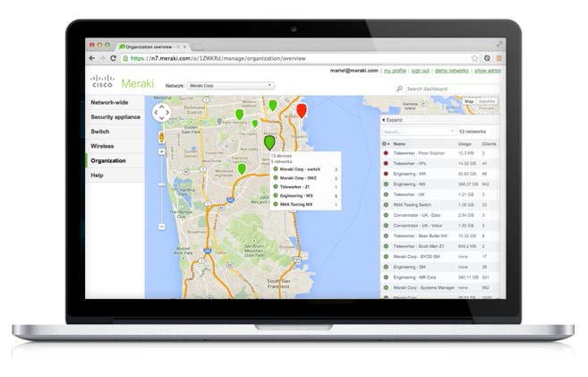


Centralized Management
MANAGEABILITY
SCALABILITY
COST SAVINGS
Turnkey installation and management Integrated, always up to date features
Scales from small branches to large networks Reduces operational costs

Slide 53
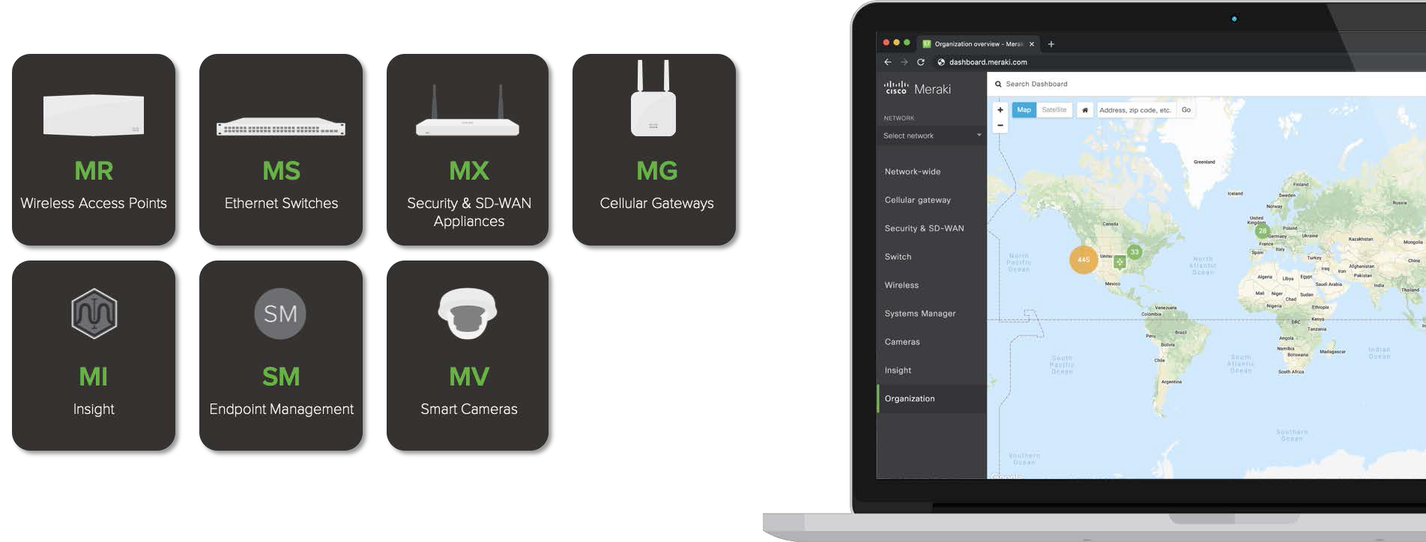
A Complete IT Portfolio from a Single Pane of Glass

Slide 54
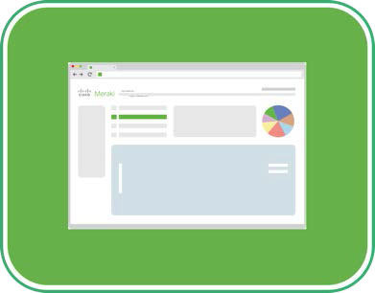








The Cisco Meraki Platform
O U T - OF - T H E - BO X
M A N A G E M E N T & A N A L Y T I C S
D IG IT A L B U S IN E S S
P O W E R E D B Y M E R A K I
{ API }

Slide 55

Thank you
Meraki

