Slide 1
Cisco SD-WAN
Connect any user to any application without compromise

Slide 2








Today Applications are Moving to Multiple Clouds
Devices & Things
WAN
SaaS
IaaS
Mobile Users
Campus & Branch Users
DC/Private Cloud
Notes:
Digital transformation, businesses moving to the cloud
Add 3 industry stats on multicloud
Possibly adjust talk track to reflect VPCs, how do I get visibility into VPCs
----
How do I connect to the cloud
How do I extend policy across the enterprise, data center and the cloud (SD-WAN overlay extension (solution)
How do I secure my data as it passes over the internet – how do I secure my data in the cloud
How do I secure access to the cloud for my user
But the multicloud world brings with it…complexity. Use cases that might seem straightforward when working in a single environment become suddenly complicated when having to span on-premises and potentially multiple public clouds.

Slide 3









Internet Connectivity Becomes Business Critical
Campus
X2-5
DC/Private Cloud
Branches X100+
Exposure to cyber threats
WAN
Inconsistent user experience
SaaS
Increasing complexity
Mobile
Users
X1000s
IaaS
More users, things and applications, everywhere
Notes:
Businesses view the Cloud as a key part of their strategy and innovation.
The larger the business, the More users, devices, things that are consuming applications from multiple different clouds.
As the pace of business increases this results in a highly complex and dynamic network.
The preferred method of connecting users to applications is shifting from dedicated MPLS connectivity to using the internet.
As a result Internet connectivity becomes business critical.

Slide 4
To help, IT is deploying SD-WAN
2018 Analyst Definition*
Branch router/CPE functionality
Operate autonomously during loss
of connection to controller
Summary of Basic
SD-WAN Capabilities
Support Hub & Spoke, Partial/Full Mesh
Centralized management:
Inventory, visibility, reporting, Management, config changes, SW upgrades via GUI
Circuit Load Balancing
Direct Internet Access
Centralized Management & Orchestration
Lower Circuit Costs
Zero-touch configuration
VPN (AES 256-bit encryption)
Direct Internet Access
Dynamic traffic steering based
on business or application policy
Support for traffic shaping and QoS
>100 well-known application profiles included + custom template capabilities
Self-serve granular configuration changes
*Gartner Critical Capabilities for WAN Edge Infrastructure, December 2018

Slide 5




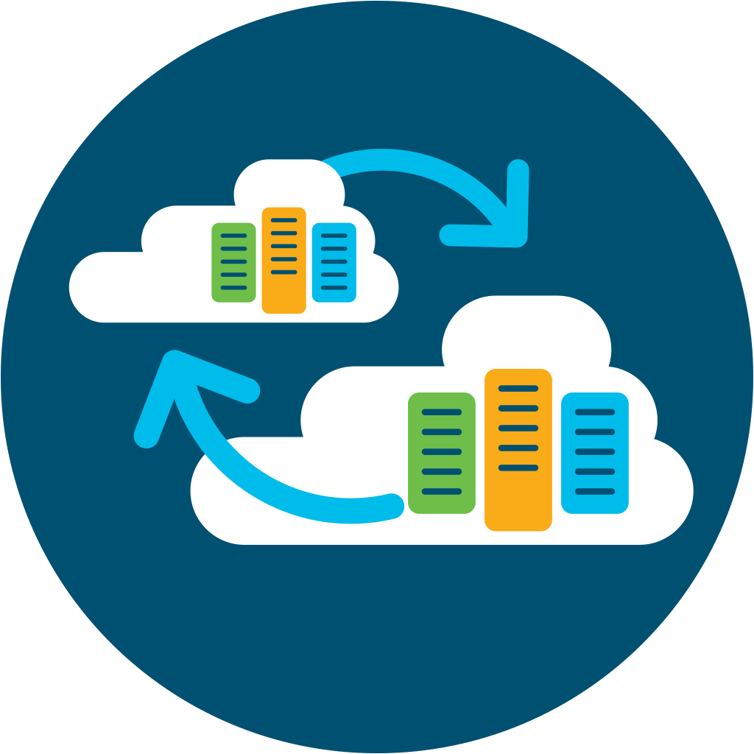
Introducing Cisco SD-WAN
Powered by Viptela
Cisco SD-WAN extended capabilities
Basic SD-WAN*
Multi-layered Security
Summary of Basic
SD-WAN Capabilities*
Circuit Load Balancing
Direct Internet Access
Centralized Management & Orchestration
Circuit Cost Savings
Security & Segmentation
Analytics &
Visibility
Circuit Load Balancing
Direct Internet Access
Centralized Management & Orchestration
Circuit Cost Savings
Application Optimization
Voice
Optimization
SaaS/IaaS Optimization
App Aware
Dynamic Routing
Enterprise Scale
Open and Programmable
Multi-Tenant/
Multi-Domain
*Gartner Critical Capabilities for WAN Edge Infrastructure, December 2018
Notes:
”Basic SD-WAN” is:
FEC
Transport Independence
Hub-Spoke, Mesh
Circuit Load Balancing
Centralized Orchestration
Branch office router/CPE functionality
Operate autonomously during loss of connection to controller
Support for: Hub & Spoke, Partial/Full Mesh
Centralized management:
- Inventory, visibility, reporting & config changes, SW upgrades
- Management, configuration via GUI
Zero-touch configuration for branch devices
VPN (AES 256-bit encryption)
Direct Internet Access
Dynamic traffic steering based on business or application policy
Support for traffic shaping and QoS
> 100 well-known application profiles included + custom template capabilities
Self-serve granular configuration changes

Slide 6


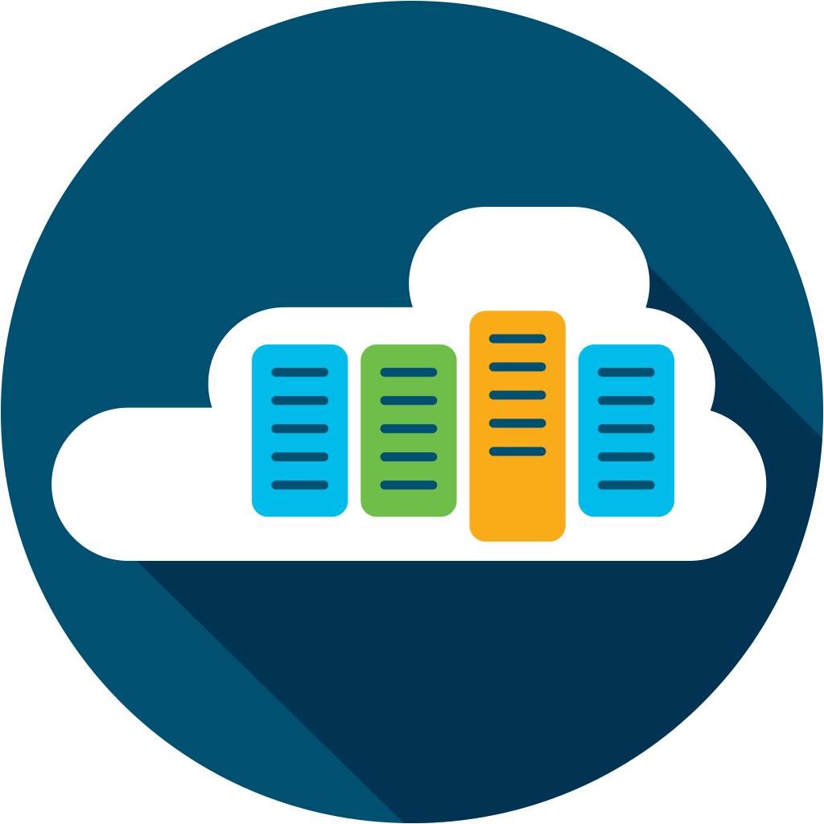
Secure Cloud Scale SD-WAN Architecture
vManage
On-premise | Cloud | Multi-tenant
Any Deployment
Automation | Network Insights | Analytics
Open | Programmable | Scalable
Any Service
Branch Security
Cloud Security
Application Quality of Experience
Voice and Collaboration
Cloud
OnRamp
Any Transport
5G/LTE
Satellite
Internet
MPLS
Any Location
Branch
Colocation
Cloud
GCP
AWS
Azure

Slide 7






Benefits of Cisco SD-WAN
Predictable app experience
Right security, right place
Enterprise grade, simplified
Support for evolving business application strategy
Cloud OnRamp for IaaS, SaaS and Colocation
Secure segmentation across entire network stack
Full edge security stack from branch to cloud and colocations
Intent-based networking with multi-domain policy
Proven deployments to over 10,000+ sites
One user interface for Security and SD-WAN across branch, cloud, and co-location

Slide 8




Business Value of Cisco SD-WAN
38%
58%
94%
Lower five-year cost of WAN operations
Faster to implement policy/ configuration changes
Less unplanned downtime
Full IDC report available on www.cisco.com/go/sdwan
$14.98M increased revenue per organization
Notes:
1st middle
58% 2nd
^{3rd 94% and 14.98}

Slide 9



























SD-WAN Market Leader across all Metrics
#1 in Market share with IDC, Dell ‘Oro and Gartner
30,000+ customers across Viptela & Meraki
  Widely deployed across Fortune 2000
  70% of Fortune 100 Companies

Slide 10
Application Experience – Use Cases

Slide 11






Why Backhauling Impacts Application Performance
SaaS
Single Path to Internet
Datacenter
Colocation provider
Cloud security provider
Data Center
Branch/Campus
Corporate
Software
Users
SD-WAN Fabric
Colocation
Provider
Cloud Security
Provider
A single path for all mission critical business applications
Notes:
Today, backhauling traffic that is internet bound impacts SaaS performance.
If you only have a single path for all of you internet bound traffic then you will see impact to application performance as all internet bound traffic competes for the same bandwidth.
That single path could be through:
Your data center
A cloud security provider (the added downside here is that if the cloud security provider goes down then your network will be down as well. The same applies to Microsoft Virtual WAN where all traffic (even non Microsoft traffic) is being sent to a single provider and in addition to the extra latency this creates it is also a single point of failure).
A colocation provider that is providing your internet access.

Slide 12

Improving Application Experience
Internet
IaaS/SaaS
Capabilities
FEC Header
FEC Header
1
2
FEC Header
Application SLA
TCP Optimization (Web)
Forward Error Correction (Voice/Video)
Pack Duplication (Voice/Video)
Integrated UC / Webex gateway
Primary or failover cellular WAN connectivity
3
FEC Header
FEC Header
P
4
TCP
Internet
(Secondary)
Optimized
TCP Connection (Cubic)
Internet
Internet
Data Center
1
2
1
4
3
Branch/Campus
2
Parity
Path 1
2
App
A
4
3
1
3
44
MPLS
4
Path 2
1
3
2
Path 3
4
2
1
MPLS
(Primary)
4G LTE
MPLS
App Aware Routing Policy
App A path must have
latency <150ms & loss <2%
Path1: 10ms, 0% loss
Path2: 200ms, 3% loss
Path3: 140ms, 1% loss

Slide 13
Now SD-WAN has UC Integration
Delivers Webex/Teams gateway and optimization
Config & Administration with vManage
Enterprise-grade features like Survivability during outages (SRST , 911 calling, conferencing
Analog & Digital Voice Support
UCM and WebE/Teams Calling
Centralized Call Control & Messaging
On Prem and Cloud calling with SIP Integration
All UC, Voice and App QoE features come with DNA Advantage License
Notes:
Notes:
Analog Support in 17.2, i.e.
Limited analog voice and fax support – i.e. low density FX0/FXS interfaces
No legacy ISDN BRI
SRST (survivability support) on PSTN/PBX. If SP connection lost then continue to get dial tone and switch calls
Full digital voice will be supported, but in 17.3
- ISDN PRI
- T1/E1
- Packet Voice DSP modules for connectivity & optimization (all modules)

Slide 14
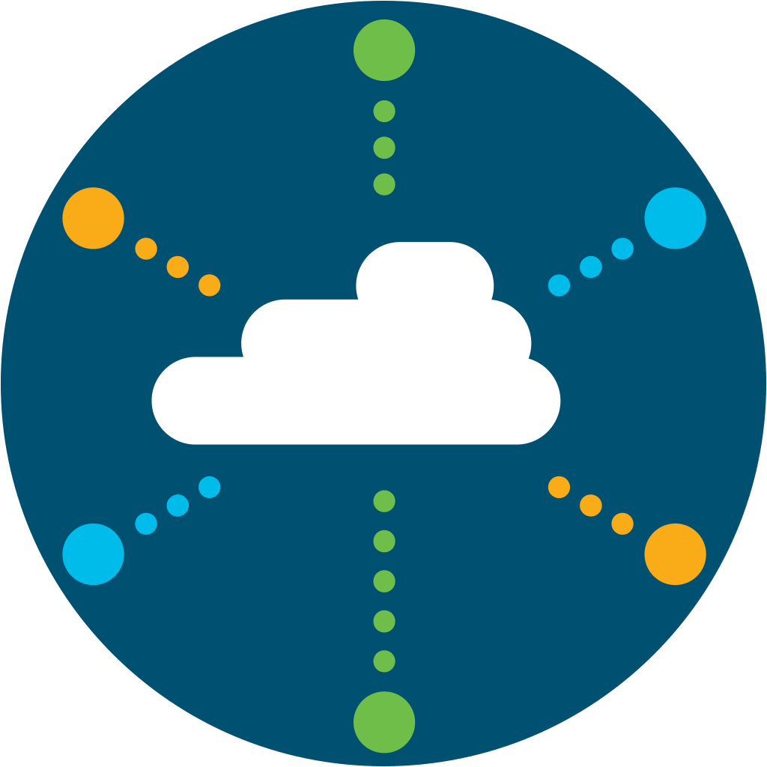

SaaS Optimization
SaaS
Optimization via Multipath
Up to 40% faster Office 365 Performance
Data Center
Branch/Campus
Corporate
Software
Users
SD-WAN Fabric
Colocation
Provider
Cisco
SD-WAN
Cloud Security
Provider
Increased reliability and utilization of best path for SaaS applications
Notes:
Today Cisco SD-WAN (Viptela) has a feature called OnRamp that can optimize 13 SaaS applications: https://sdwan-docs.cisco.com/Product_Documentation/Software_Features/Release_18.3/Network_Optimization/Using_Cloud_OnRamp_for_SaaS
Cisco SD-WAN makes it easy for IT to optimize SaaS application performance. We do 3 things:
With OnRamp we make it easy for IT to connect to SaaS applications with simplified workflows within Cisco vManage
vManage continuously measures the performance of a SaaS application through all available paths from the user to the cloud and will always select the best path that delivers the best user experience.
By monitoring all available paths Cisco SD-WAN OnRamp not only provides the best performance it also increases availability (and productivity) for users since it will find alternative paths if a failure occurs.
In the case of Office 365 Cisco has worked closely with Microsoft to add new capabilities so that Cisco SD-WAN is now able to easily identify the closest Office 365 data center to the user that will deliver the best performance.
This score gives network administrators visibility into application performance that has never before been available. Most importantly, the fabric automatically makes real-time decisions to choose the best-performing path between the end users at a remote branch and the cloud SaaS application. Enterprises have the flexibility to deploy this capability in multiple ways, according to their business needs and security requirements.
To achieve this 40% number we did the following:
We did this the tests by simulating a Data center in AWS Mumbai region and a remote branch in AWS Sydney region.
We did download/upload tests to and from one-drive (Office 365) using a 233MB file and recorded the transfer times with and without the feature enabled. We observed up to 40% improvement in file transfer times with the feature enabled. We also did tests using Skype network assessment tool published my Microsoft and also observed better round trip times with the solution enabled.

Slide 15




Extending SD-WAN to IaaS
VPC
VPC
VNet
VNet
Cloud OnRamp automation to IaaS
VPC
VPC
VNet
VNet
VPC
VPC
VNet
VNet
VPC
VPC
VNet
VNet
Transit
Hub
Transit
Hub
Cisco WAN Edges deployed in a Transit Hub, acting as virtual aggregation routers
Partial extension of SD-WAN Fabric
Automated deployment process with vManage
SD-WAN Fabric
SD-WAN Fabric
vManage
vManage
Branch
Branch
Internet connection
to IaaS cloud
Connect to IaaS cloud
via co-location

Slide 16



Multicloud Partners: SD-WAN Beyond the Branch
Microsoft
Amazon
Equinix
Google
Office 365 path selection and optimization improves the end user experience
Centralized management, automated configuration and policy changes with Azure
Easy network extension to Amazon AWS using virtual instances of on-prem devices
Native integration of SD-WAN end points into AWS Transit Gateway (TGW) Network
Ease of management with the ability to extend Cisco SD-WAN fabric into colocation
Establish direct and secure, private interconnection between branch and public clouds
Industry’s first application-centric multicloud networking fabric
Exchange service-level agreement settings, security policy, and compliance data, between SD-WAN and GCP
These Partnerships Will Help Accelerate Enterprise Cloud Strategy

Slide 17
Secure SD-WAN / SASE – Use Cases

Slide 18
How SD-WAN Exposes New Security Challenges
Internal & External Threats
Internet
IaaS/SaaS
External
Exposure to malware & phishing due to direct internet and cloud access
Data breaches
Guest access liability
Internal
Untrusted access (malicious insider)
Compliance (PCI, HIPPA, GDPR)
Lateral movements (breach propagation)
NO SECURITY
Data Center
Branch/Campus
Corporate
Software
BASIC/NO SECURITY
Users
SD-WAN Fabric
WAN Edge Device
Existing Security Stack in DMZ
Notes:
So SD-WAN with its direct Internet access capability exposes branch & remote locations plus IaaS to some security risks.
Network teams must balance security against both external and internal threats exposed by SD-WAN with user experience, cost, and complexity:
External Threats: Direct cloud connectivity presents a greater level of exposure to malware and other internet-borne threats for branch, IaaS, and remote locations. Examples: unauthorized access, data breaches, malware infections, phishing attacks.
Internal Threats: Public internet transport exposes your apps & databases to internal threats that move laterally between your branches, DCs or IaaS gaining untrusted access or subject to compliance rules.
To secure SD-WAN, three security approaches are typically considered:
<click>

Slide 19

Relevant Security Models. Driving towards SASE
SaaS/IaaS
Application
SaaS/IaaS
Application
SaaS/IaaS
Application
Cloud Security
Colocation
Branch Security
On-Prem Security
Cloud Security & SASE
@Regional Hub
Thick branch with Routing and Security (SD-Branch model)
Thin branch with security in the cloud
Security Services as VNF at Regional Colocation Hub
Notes:
SD-WAN Security can be delivered in 3 ways –on-prem security, cloud security, or security at colocation/hub.
As we spoke to many customers, it is very clear that security and SD-WAN both go hand-in-hand. Security becomes a top priority with SD-WAN deployments.
Compliance Use Case – Any branch that services customers, takes credit card payment must be PCI compliant. Even though they encrypt and send all the data over a VPN tunnel, for PCI compliance all packets need to be subjected to a stateful firewall and an IPS solution.
Guest Access Use Case – Guests walking into a Starbucks, Panera, Firestone or a hospital will bring in their BYOD devices. Companies are liable to provide a good enough content filtering solution these days to avoid any litigation. We can leverage on box URL-Filtering to block or allow based on 82 different categories.
Direct Cloud Access Use Case – Some customers have a need to route SaaS application traffic for optimal performance via DIA and the rest of the internet traffic via the HQ
Direct Internet Access use case – All internet traffic from the branch go directly to the internet from the branch. Only HQ related traffic rides over the VPN tunnel.

Slide 20

Cisco SD-WAN Security & SASE Solution
Consistent across on-prem and cloud
Enterprise Firewall
Layer 3 to 7 apps classified
Intrusion Protection System
Most widely deployed IPS engine in the world
URL-Filtering
Web reputation score using 82+ web categories
Cisco
Security
Cisco
SD-WAN
Adv. Malware Protection
With File Reputation and Sandboxing (TG)
SSL Proxy
Detect Threats in Encrypted Traffic
Umbrella Cloud Security
DNS Security/Cloud FW with Cisco Umbrella
Notes:
We now have a full security stack with consistency across both on-premise and the cloud.

Slide 21



Cisco SD-WAN Fully integrated with Umbrella
Easy to Consume
Fast to Deploy
Simple to Manage
Consistent packaging and entitlement reporting
Simplified billing with Enterprise Agreements
Flexible pre and post-paid payment terms for MSPs
Auto-registration of SD-WAN to Umbrella
Single touch auto-provisioning from Branch
Discovery and granular control of SaaS applications
Integrated troubleshooting and service assurance
Unified security policy and threat insights*
Identity aware based SD-WAN for better path selection*
A SASE architecture secured by leading real-time threat intelligence
*Roadmap – CY21
Notes:
Auto provisioning between vManage and Umbrella Dashboards

Slide 22

Fully Automated Umbrella Setup from vManage
Auto-Registration + Auto-Tunnel to Umbrella
Smart Account credentials on both Umbrella and SD-WAN
Automatic Registration of Edge Devices to Umbrella
Secure API key provisioning on SD-WAN through HTTPS
Auto-setup with IPSec tunnel to Umbrella SIG using template
UMBRELLA
HTTPS session
Edge Device
No need to manually add API Keys

Slide 23
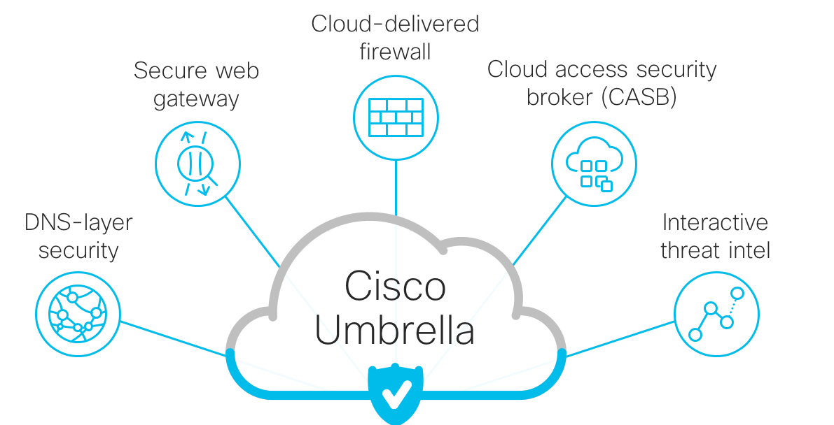

Transitioning to a Cloud-First Security Model
Cloud-delivered firewall
Secure Web Gateway
Cloud-delivered security broker (CASB)
DNS-layer security
Interactive threat intel
Cloud & Internet
Cisco SD-WAN
Cisco SD-WAN + Umbrella
Notes:
Umbrella is now a full SIG

Slide 24

Secure SD-WAN: Cisco SD-WAN + Security
Full Edge Security Stack
Internet
IaaS/SaaS
On-Prem Security
Mitigate Internal & External Threats
Cloud
Security
Mitigate External Threats at Scale
Data Center
Branch/Campus
Corporate
Software
Users
SWG, DNS protection, CASB
FW, URL filtering, IPS
Segmentation & Policy
Zero-trust authentication and Encryption
SD-WAN Fabric
Single Management Console
Notes:
Only Cisco SD-WAN offers an integrated on-prem and cloud security solution that provides a full edge security stack for all connections from branch to Internet/SaaS and to DCs/IaaS.
Cisco SD-WAN edge devices integrate connectivity and on-prem security, providing end-to-end WAN access security against internal threats. Concurrently, the edge devices integrate connectivity and cloud security, providing a secure internet gateway against external threats.
No need to compromise on security, user experience, or performance. Gain the advantages of both on-prem security and cloud security without their disadvantages:
Improve end-user experience by securing direct internet and cloud access
Ensure performance through cloud-based SSL/TLS traffic decryption
Get comprehensive visibility and control on all inbound and outbound traffic
Reduce costs and complexity by providing one box for networking, security, and cloud.
Only Cisco SD-WAN offers comprehensive Gartner defined security categories spanning both on-prem and cloud security. These categories are: Network Segmentation’, ‘Enterprise Firewall’, ‘Secure Web Gateway’, ‘DNS-Layer Security’
The specific capabilities which span multiple market categories are: ‘IPsec Encryption’, ‘IPS’, ‘App Controls’, ‘TLS/SSL Decryption’, ‘Malware Protection’, ‘URL Filtering’
<click>
For On-prem security, we provide enterprise firewall with application control and Talos-Powered IPS to defend against internal threats and URL filtering and malware protection and file sandboxing to defend against External threats.
We also provide segmentation policy based on device type, application characteristics, network topologies, and user locations and profiles to simplify the provisioning of network access.
And we ensure the privacy of traffic crossing the network by all devices being fully and securely authenticated with 2048-bit encryption keys.
<click>
As for cloud security side we:
Quickly deploy DNS-layer security to block internet destinations hosting threats or policy violations
Shift firewalling controls from hardware to software as a service to enforce IP, port, and protocol rules to give customers the option to deploy in the cloud instead of on-prem
Check for malware and policy violations in all web and SaaS traffic with decryption that scales for future traffic growth

Slide 25






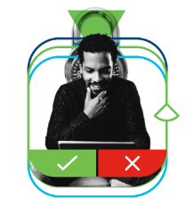

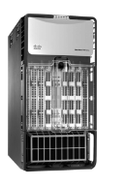


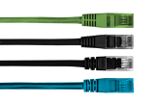
Cisco is best positioned for the SASE Transformation
Network as a Service
Network Security as a Service
Sensitive Data Awareness
Threat Detection
Connect It
Secure It
Market Convergence
Secure Access Service Edge (SASE)
SD-WAN
Firewall as a Service
(FWaaS)
Secure Web Gateway
(SWG)
Cloud Access Security Broker
(CASB)
Zero Trust Network Access
(ZTNA)
Source: Gartner

Slide 26
Enterprise Grade – Use Cases

Slide 27

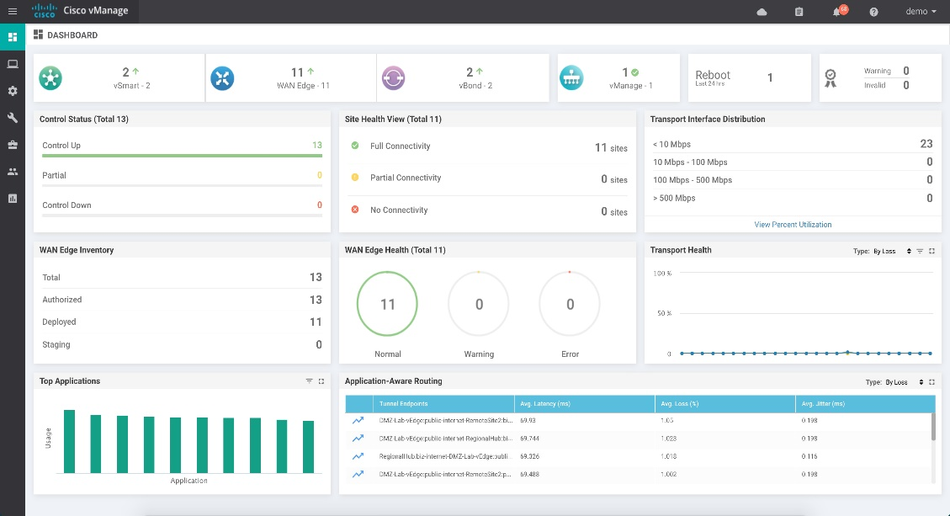
SD-WAN Management
Cisco vManage
Single Monitoring Dashboard
Configuration: OnRamp, Security, Devices, Policies, Templates
Lifecycle management
Role based access/
Multi-tenant
One management dashboard for branch, co-location, cloud and Security
Notes:
Through Cisco vManage (Viptela cloud management user interface) Cisco is able to provide One console for SD-WAN and network security to help simplify management

Slide 28
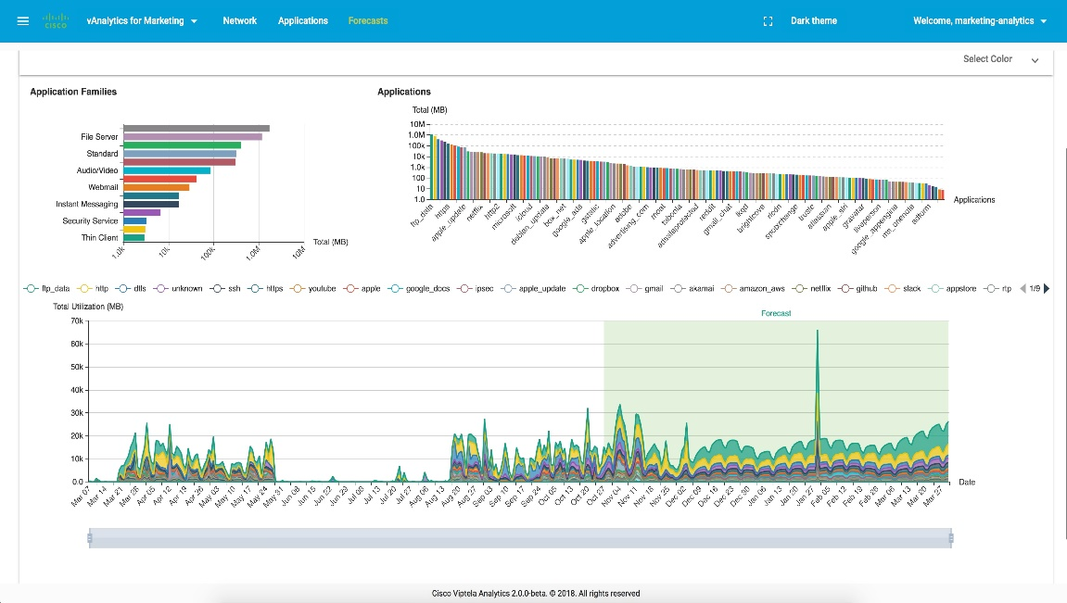

SD-WAN Analytics
Real-Time Information
Future planning and what-if scenarios
Recommendations for predictable app performance
Benchmarking
Cisco vAnalytics
Notes:
An additional feature is Cisco SD-WAN vAnalytics.
vAnalytics provides us with these benefits for the WAN network:
Provides real-time information for failure correlation, cross customer benchmarking, and App perf scores
Enables future planning based on intelligent data (App / bandwidth forecasting, branch expansion analysis, policy changes what-if)
Recommendations for App QoS categorization and policy changes for predictable App performance

Slide 29
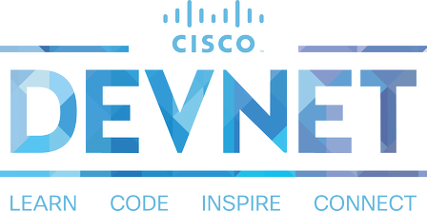
Cisco SD-WAN is Open and Programmable
Enterprises
Managed Services
OSS/BSS Integration
Multi-Tenant
Learning and
hands-on content
Sandbox
Partners
Code Exchange
Dev Center
Ecosystem Exchange
Notes:
In a world of proprietary and closed SD-WAN solutions, Cisco SD-WAN is Open and Programmable.
Viptela designed API’s into its platform from the start and with this announcement we are making those API’s available to everyone through Cisco DevNet.
Key benefits include:
With open APIs, Cisco SD-WAN provides service providers and partners the opportunity to create new and unique services including Operational/Business Support Systems.
Learn how to access the available REST APIs, create API calls, obtain device and interface information using code, pass parameters and write applications and work on innovative solutions.
As part of the SD-WAN developer resources availability and learning content, there are two additional resources available that are a great value add for developers:
DevNet Ecosystem Exchange makes it easy to find and share an application or solution built for Cisco platforms. Business leaders and developers alike can use this online portal to discover partner solutions that span all Cisco platforms and products. Currently, this one-stop-shop for developers contains over 1,300 solutions.
DevNet Code Exchange gives developers a place to access and share software to quickly build next-generation applications and workflow integrations. A curated list of sample code, adaptors, tools, and SDKs available on GitHub and written by Cisco and the DevNet community, Code Exchange spans Cisco’s entire portfolio and is organized according to Cisco platform and product areas.

Slide 30
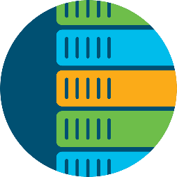
Interconnecting Multi-Domain Networks
SD-Access
Cisco DNA Center
SD-WAN
Cisco vManage
ACI
Cisco APIC
Users (Consumers)
API Integration
API Integration
Applications (Providers)
Users & Devices
Identify and onboard everything
Authenticate and authorized access
Hybrid Cloud
Application experience
Secure internet and cloud access
Data & Applications
Automate resources and workloads
Prevent data breaches
Vertical Integrated Solutions
Notes:
we already have cross domain management and functionality with Meraki, this is how we’re bringing it to Viptela-powered by SD-WAN

Slide 31

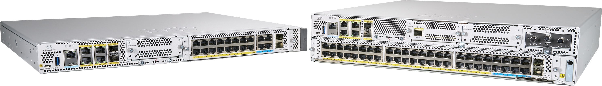


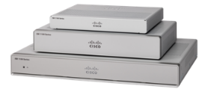
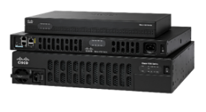
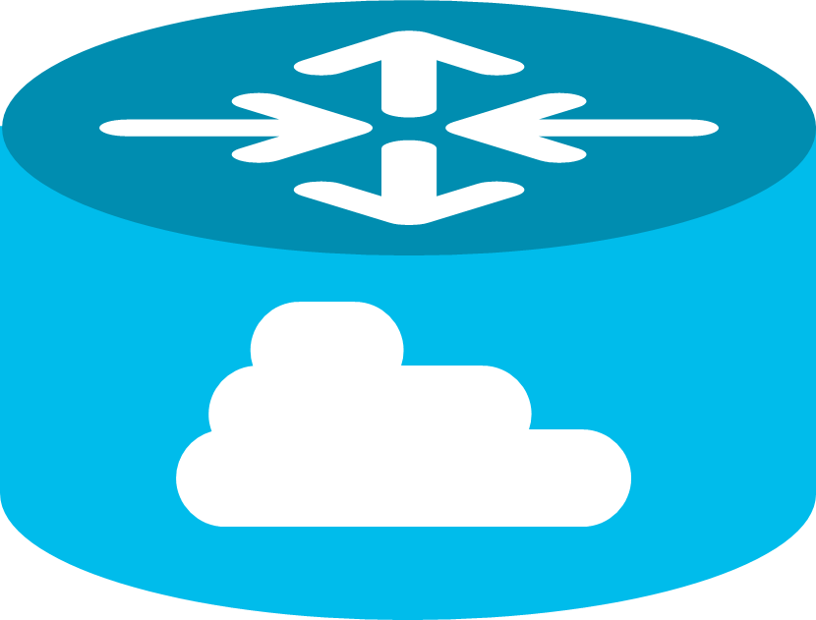

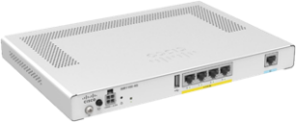



Broadest Set of SD-WAN Platforms
Branch
Aggregation
Cloud
Cloud Edge
SD-WAN +
Services
(IOS XE)
Catalyst 8300
Catalyst 8500
Catalyst 8000V
ISR 1000
ISR 4000
ASR 1000
CSR 1000V
SD-WAN
(Viptela OS)
ISR 1100-4G/6G/LTE
vEdge 2000
vEdge 2000
vEdge 5000
vEdge Cloud
Virtualization
ENCS 5000
CSP 5000
Notes:
Today, backhauling traffic that is internet bound impacts SaaS performance.
If you only have a single path for all of you internet bound traffic then you will see impact to application performance as all internet bound traffic competes for the same bandwidth.
That single path could be through:
Your data center
A cloud security provider (the added downside here is that if the cloud security provider goes down then your network will be down as well. The same applies to Microsoft Virtual WAN where all traffic (even non Microsoft traffic) is being sent to a single provider and in addition to the extra latency this creates it is also a single point of failure).
A colocation provider that is providing your internet access.

Slide 32
Cisco DNA SD-WAN Licensing
Use Case Based Packaging
Cisco DNA Essentials
Cisco DNA Advantage
Cisco DNA Premier
Simplified management and security protection for the cost-conscious customer
Advanced SD-WAN with enhanced security for feature-rich & valued branch deployment models
Advanced SD-WAN security will mitigate the most sophisticated threats to your business
End to end direct Internet
access security
Visibility and control to defeat direct Internet/cloud access threats
Automated cloud security at scale
Improved application experience
Optimized SaaS application experience
Keep consistent controls and visibility when users roam outside the WAN
Simplify operations
Multi-domain Orchestration
across domains
Deep inspection capabilities for compliance
Basic voice optimization
Enhanced voice optimization
Granular Application Detection
Common SD-WAN architectures
Network analytics and visibility
Flexible Policy by
Identity SAML or AD
Up to 50 Device Overlay

Slide 33
Cisco DNA SD-WAN Licensing
Capability Based Packaging
Cisco DNA Essentials
Cisco DNA Advantage
Cisco DNA Premier
Simplified management & security protection for the cost-conscious customer
Advanced SD-WAN with enhanced security for feature-rich & valued branch deployment models
Advanced SD-WAN security will mitigate the most sophisticated threats to your business
Enterprise firewall with Talos-
powered IPS and app controls Cisco Umbrella DNS Monitoring
Cisco AMP with SSL proxy
Basic URL filtering
Cisco Umbrella app discovery
Cisco Umbrella SIG Essentials®
(Full URL Filtering | Granular App Control | File-type Controls | AMP | Threatgrid | L3 – L4 Cloud Firewall | Roaming User Protection With AnyConnect)
Application-based SLA
Basic WAN & path optimizations
Cloud OnRamp for IaaS, SaaS, and Colo AppQoE & WAAS RTU
Single centralized management
console in the cloud or on-prem
Integrated border plus orchestration
for campus, branch & DC
NEW ‘Buy More’
DNA Premier SIG
Seats
Forward Error Correction (FEC)
Packet duplication
Integrated voice/UC gateways
Flexible topology & dynamic routing (hub/spoke, partial/full mesh)
vAnalytics
Cisco DNA Advantage
Up to 50 Device Overlay
Cisco DNA Essentials
Cisco DNA Essentials
Notes:
Each user equals about 50kbps of bandwidth traffic

Slide 34














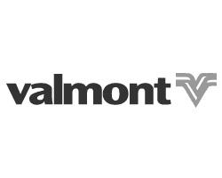



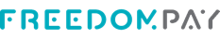




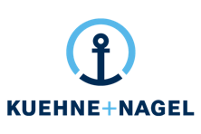








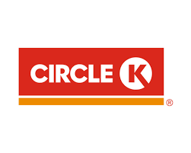





Global Customers Across All Verticals
Finserv
Healthcare/Pharma
Manufacturing
FinServ
Healthcare / Pharma
Manufacturing
Retail
Technology
Other Industries
Retail
Technology
Other Industries
Notes:
Ok to show if under NDA

Slide 35
Fast track to SD-WAN with Cisco Services
  Proven infrastructure simplifies implementation complexity
  Expert technology guidance scales innovation and accelerates results
  Cisco’s experience and best practices reduces risk
SD-WAN quick start service
cisco.com/c/en/us/products/routers/service-listing.html
Fixed price | Predefined scope for design | Implementation and validation
Notes:
Cisco Service makes it easy to get started with SD-WAN.
Cisco services can rapidly deliver simpler projects based on a fixed price ($25K list) limited-scope deployment via the SD-WAN Advise and Implement Quick Start
Accelerate your path to SD-WAN with a predefined project scope and budget including Solution Design, remote Implementation Execution and remote Knowledge Transfer.
Simplify implementation complexity with a predefined project scope, proven infrastructure that can scale when you’re ready.
Scale innovation and accelerate results using predictive steps, state-of-the-art tools, and expert technology guidance.
Reduce risk knowing that you’re building your SD-WAN infrastructure on a solid foundation based on Cisco’s deep experience and best practices gained from countless real-world deployments.
Value of Cisco Services- with proven experience, best practices, and innovative tools, we help you confidently adopt, deploy and manage SD-WAN in a multicloud environment

Slide 36

Why Cisco SD-WAN?
v
Predictable Application Experience
No matter where you applications are hosted Cisco SD-WAN delivers the best user experience, securely across any cloud.
Right Security, Right Place
Protect all users, devices and applications by deploying the right security, on-premise and cloud delivered, in the right place, quickly.
Simplicity at Enterprise Scale
Delivering Intent-based Networking with best of breed technologies across every domain with consistent policy and assurance integration
*Gartner Critical Capabilities for WAN Edge Infrastructure, December 2018

Slide 38
Case Studies

Slide 39

National Instruments
Background
      Needed to improve global network capacity and performance at a lower cost
      Increasing bandwidth and security burden on WAN impacted sales, R&D, manufacturing and contact center globally
      Demand growing 10-25% annually
      Benefits of Cisco SD-WAN
      Optimizes traffic and performance across the WAN
      Traffic distributed over lower-cost Internet connections vs MPLS
      Reduced MPLS spending by 25% while increasing bandwidth 30.75%

Slide 40

Enterprise Case Study
Fortune 500
National Food Distributor
Food distributors play a key role in the food and beverage industry, serving as the intermediary between the manufacturer and their respective retail, restaurant, and foodservice customers.
Challenge
Solution
Result
Cloud: Trying to connect all of their sites to the cloud without being vulnerable to a single point of failure
Bandwidth and scale: Need more bandwidth to deal with growth in applications such as Office 365
Security
Agility: Want to be agile, flexible, able to move wherever the market is going, which could be away from data centers and to the public cloud
vEdge, vManage, vSmart
The solution is a combination of Viptela and extending into Amazon Web Services (AWS) for development, interlock locations, and customer facing applications
Viptela solution extends the WAN to the cloud and brings in different types of transport
Viptela can extend a branch to the cloud just as the data center would extend a branch to the cloud
Security
Ease of deployment
Can give more to their customers
Can be more agile in terms of capital planning
Food distributor feels they have a partner in terms of support and ongoing growth
Source: Viptela’s Website – Transcript of AWS Reinvent Interview

Slide 41
Additional SD-WAN Customer Case Studies: Public Blogs
Circle K Finds Value In SD-WAN Speed (gas stations, retail)
Solving Complexity with SD-WAN at National Instruments (technology)
REI’s retail SD-WAN deployment (retail)
Taking SD-WAN Even Wider at Acadia Heathcare (healthcare)
First American Title And Viptela: A Story of Resilience (insurance, financial, retail)
Migrating to Healthcare Cloud Apps With Acadia and Viptela (healthcare, SaaS)
Enabling The Most Remote Offices With Viptela (77 Energy) (energy)

Slide 42
Additional SD-WAN Customer Case Studies:
Customer Videos
Reece Group delivers always connected workplace with Cisco SD-WAN (engineering, retail)
ONUG 2018: Mckesson’s Global SD-WAN Transformation (healthcare)
FutureWAN’18: SD-WAN in Retail (REI Case Study) (retail)
FutureWAN’18: Acadia Healthcare SD-WAN Case Study (healthcare, SaaS)
FutureWAN’17: First American Title Insurance Case Study (insurance, retail, financial)
FutureWAN’17: Kindred Healthcare Case Study (healthcare)
ONUG 2017: SD-WAN at Acadia Healthcare (Healthcare)

Slide 43
Featured Quotes: SDWAN
WWT
“With Cisco’s SD-WAN advanced security, we can instantly turn any customer’s entire network into a fortified wall across any cloud environment, ” Bill Thompson, Practice Manager, World Wide Technology. “This is a significant step toward adopting an Enterprise Architecture with integrated security, Software Defined WAN, and cloud services; all managed via a single policy controller.”
Bank (Anonymized)
“Cisco SD-WAN on ISR routers drive a reliable foundation to quickly integrate SD-WAN and its ability to simplify management and improve real-time access to critical cloud-based business applications” -- US Banking Institution
Portugal Telecom
“SD-WAN on Cisco’s ISR4K routers creates a robust, trusted platform on which to quickly realize security and performance benefits with a simple software upgrade.” – Rui Pereira, Altice Portugal
Datacom
“Bringing the WAN edge securely to the Internet is now possible with the new security features of Cisco SD-WAN delivered as a single consolidated solution." -Hussein Omar, Network Solutions Architect, Datacom
National Instruments
“With Cisco SD-WAN, we’ve reduced our MPLS spending by 25 percent while increasing bandwidth by 3,075 percent.” --Luis Castillo, Global Network Team Manager, National Instruments
Microsoft
“Optimal Office 365 performance is achieved by enabling local Internet breakouts for key Office 365 scenarios from users in the branch directly into Microsoft’s global network. Modern SD-WAN solutions, like Cisco’s SD-WAN, make it easier for customers to implement this setup, support multiple DIA links and dynamically choose the best one, improving the Office 365 user experience.” - Konstantin Ryvkin, Partner Architect, Microsoft
CDW
“Customers want more secure connections, usually with multiple cloud environments, so CDW sees Cisco’s new integrated security features for SD-WAN as an important differentiator.”- Will Kerr, Technical Architect, CDW
Verizon
“Verizon's Virtual Network Services offerings, leveraging Cisco’s SD-WAN products, are deployed in tens of thousands of customer locations, enabling digital transformation and helping businesses accelerate their move to the cloud while reducing IT complexity and controlling cost.” - Shawn Hakl, Senior Vice President, Verizon
Notes:
43

Slide 44
Complete Multicast Support on Cisco SD-WAN
Use Cases
Requirements for financials, healthcare, media and others
Multicast support across All SD-WAN Platforms
    Viptela OS and IOS XE SD-WAN
IGMP v2 and v3 support
ISR 1k/4k, ASR1k and vEdge
Video distribution / IP TV
Collaboration
Periodic push
(Financial/Banking)
Interactive simulation

