Slide 1

Managed Detection
and Response (MDR)
For Technical Decision Makers

Slide 2
today’s conversation
Cisco Managed Services background
Cisco Managed Detection
and Response (MDR) overview
MDR use case demo
Reporting / Service Activation
Contract and Terms

Slide 3

Title Goes Here
Cisco Brand Promise
We securely connect everything to make anything possible.
Cisco Managed Services Vision
We enable the digital transformation of our customers, with our partners,
by accelerating the adoption and maximizing the promise of Cisco technology
through a premium managed experience.

Slide 4





Cisco Managed Services
delivers excellence worldwide
2,200
175
2.3M+
53%
93%
world-class
specialists
countries served around the world
managed devices
and endpoints
of customers rank
in the Fortune 500
customer renewal
rate in 2018
NOCs SOCs CaaS Data Centers
Notes:
With over 25 plus years of innovation leadership…
Consistent, global capabilities with local presence
With Network Operation Centers across the U.S., and in China, Belgium, Argentina, India, and more
Security Operation Centers in North Carolina, US, Krakow Poland, Tokyo, Japan and Bangalore India
And Data Centers in Texas, India and Amsterdam to name a few
Our best resource is our people with 2,200 world-class specialists. Our services and solutions are delivered by highly trained, experienced Cisco experts who are focused on your business and understand our customers challenges and objectives. World-class specialists provide support, and they have direct access to Cisco developers, business units, and product development teams.
Cisco Managed Services manages over one million devices for companies in 175 countries and 38 different industries.
53% of these companies are ranked in the Fortune 500, employing over 6 million people and generating 3.3 trillion dollars in annual revenue.
With a customer renewal rate of 93% as of 2018
We understand the operational model, and how to deliver effective managed operations.

Slide 5
Cisco Managed Security Delivery Organization
North Carolina
Krakow
Tokyo
Bangalore
Operations Manager
Operations Manager
Operations Manager
Operations Manager
Team Lead
Team Lead
Team Lead
Team Lead
Investigators
Investigators
Investigators
Investigators
Threat Research
Research Analysts | Comprehensive Threat | Interface with IR, TALOS, CSIRT, and PSIRT
Monitoring and Detection
Solutions Lab | Comprehensive Tuning | Interface with Offer (SA, TME), BE, and Platform Operations
Orchestration & Automation
Playbook Automation | Scripting Service | Interface with Platform Engineering

Slide 6
Cisco MDR Overview

Slide 7




Increased cybersecurity workload and expanding attack surface
What’s driving the Managed Security Market
Continued expansion to cloud
Consolidation of endpoint and traditional managed security services
Organizations looking for response guidance/capabilities

Slide 8

Security operations challenges
Find, recruit, retain,
and afford security expertise
Keep pace with
current threats
Keep up with the growing attack surface
Respond to the overwhelming number of threats with defined playbooks
3.5 million cybersecurity positions are projected to go unfilled by 2021*
*According to Cybersecurity Ventures
Notes:
We understand that your security challenges run deeper than technology.
Companies are unable to:
Find, recruit, retain and afford security expertise
They are unable to keep pace with current threats and the growing attack surface
They are not able to respond to the overwhelming number of threats with defined playbooks.
Together, these factors contribute to gaps in security, higher operational costs, and a less efficient team.

Slide 9
Time to respond to threats is a critical factor
1 in 4
Companies risk a major breach in the next 24 months
Early detection
Low impact
TIME
206
Industry average detection time for a breach
73
Industry average time to contain
a breach
$3.9M
Average cost
of a data breach
DAYS
DAYS
Source: Ponemon 2019 Cost of a Data Breach Study
Notes:
Going deeper into how we quantify these business challenges is this annual industry breach report.
Businesses are prone to a breach more than ever.
Nearly half of the alerts an organization receives daily go uninvestigated.
Minimizing the impact of a breach is largely a function of reducing the mean time to detection.
And without a focused detection capability bringing visibility, breaches can go undetected for months, until the organization’s critical data are likely compromised… with the cost of a data breach costing an average of $3.9 million.
An organization that is successful in containing a threat in less than 30 days saves on average $1 million dollars than those that contain a threat in more than 30 days.
Since 2014, the share of breaches caused by malicious attacks surged by 21 percent, growing from 42 percent of breaches in 2014 to 51 percent of breaches in 2019. It took substantially longer to identify and contain a breach in the case of a malicious attack: a combined 314 days, for a breach lifecycle that was 12.5 percent longer than the average breach lifecycle of 279 days. This finding helps explain why breaches caused by a malicious attack were 27 percent more costly than breaches caused by human error ($4.45 million vs. $3.5 million) and 37 percent more costly than a breach caused by system glitches ($4.45 million vs $3.24 million).
Breaches at organizations with fully deployed automation decreased in cost from 2018 to 2019. Those breaches decreased in cost by 8 percent, from an average of $2.88 million in 2018 to $2.65 million in 2019.
In other words, organizations in the 2019 study were nearly one-third more likely to experience a breach within two years than they were in 2014.
However, the faster a data breach can be identified and contained, the lower the costs. Breaches with a lifecycle less than 200 days were on average $1.22 million less costly than breaches with a lifecycle of more than 200 days ($3.34 million vs. $4.56 million respectively), a difference of 37 percent.

Slide 10







Cisco Managed Detection and Response (MDR)
Expert team
of researchers, investigators, and responders
MDR Threat Intelligence
and Automation Platform
Defined investigations
and response playbooks
Integrated
security architecture
and automation
Customer
portal
Talos® Incident Response
Stealthwatch® Cloud
AMP for Endpoints
Threat Grid
Umbrella™
Notes:
Managed Detection and Response (MDR) provides Managed Security Detection and Response across cloud, network and endpoints to advance security operations.
Cisco’s MDR offer combines an elite team of researchers, investigators and responders with a purpose-built Cisco MDR threat intelligence, automation and response platform, and defined investigations and response playbooks supported by Cisco Talos threat research.
The service leverages Cisco’s world-class integrated security architecture to advance security operations capabilities by delivering industry-leading 24x7x365 threat detection and response to reduce mean time to detect and contain threats faster with relevant, meaningful and prioritized response actions.
Expert team of researchers, investigators and responders
Our expert team of researchers, investigators and responders are based in our global security operations centers. They provide 24x7 monitoring to alerts occurring within the cloud, on-prem networks and endpoints, and engage with the customer to advance their security operations capabilities by providing clarity on attacks and expert guidance on how to eliminate threats quickly and prevent a breach.
Our employees are one of our biggest assets. Cisco attracts and retains top talent and is number 6 on Fortune 100’s best companies to work for.
Our team of expert researchers provide a comprehensive approach to monitoring, detection, analysis and response by using defined investigations and response playbooks, and incident communications.
This gives you higher confidence in results using proven methodologies, unique intelligence and an experienced team.
Purpose-built Cisco MDR platform
We utilize a purpose-built Cisco MDR platform and operations model to effectively detect, analyze, investigate and respond to security alerts occurring within an organization.
We built and host a cloud-based, world-class analytics platform so you don’t have to.
Our expert analysts use advanced intelligence for continuous monitoring, detection and analysis 24x7 for known and emerging attacks
Analysis through automated enrichment from key Cisco security technologies and threat intelligence sources, our analytics platform, machine learning and AI, predicts threats, identifies attacker attributes and the potential impact and scope of an alert.
Defined Investigations and Response Playbooks
Investigation and research by our team of cyber investigators responds to alerts to further identify indicators of compromise or indicators of attack.
When malware, ransomware, bot-net, bad actors and other such bad behavior is occurring, they are able to build context in order to respond, enforce or notify in a meaningful way.
Our expert analysts utilize proven security operations case management and security orchestration and automation response (SOAR) to contain, mitigate and eradicate threats using response action playbooks and action plans aligned with your company’s security operations policy.
Our team of experts conduct investigations and research using threat information from Cisco Talos Intelligence Group, the largest non-governmental threat intelligence research team in the world, with advanced orchestration, automation and response playbooks to raise efficacy and provide prioritized response actions.
Cisco Integrated Security Architecture
MDR leverages Cisco’s world-class integrated security architecture - consisting of Stealthwatch Cloud, Advanced Malware Protection or AMP for Endpoints, Threat Grid, and Umbrella - to advance security operations capabilities.
Stealthwatch Cloud applies the latest Cisco threat intelligence and analytics to proactively protect your cloud resources, internal network, and even encrypted traffic against new threats in a SaaS delivered solution.
Advanced Malware Protection (AMP) for Endpoints continually evolves your endpoint defenses. AMP correlates Talos threat data against your environment’s telemetry data and known behavior, linking your defenses into a single, cohesive shield against emerging malware threats.
Threat Grid with advanced sandboxing, analyzes the threat new malware poses to your specific environment and helps prioritize proactive defenses.
Cisco Umbrella enforces security at the DNS and IP layers and blocks threats over any port or protocol before they reach the network or endpoints.
Customer Portal
A customer portal provides a dashboard, ticketing, case management workflow for maximum visibility into all activities.
Corrective action can be taken directly from the portal interface with the ability to block suspicious files, domains, and more.
Talos Incident Response
Coordination with Cisco Talos Incident Response for breach and forensic investigations provides next-level capabilities when an alert becomes a breach.
When an alert becomes a breach, we coordinate with our Incident Response Service for forensic investigations which provides next-level capabilities.
Our team of forensic investigators can leverage the MDR data repository and tools to respond to an emergency faster.

Slide 11






Gain visibility and apply context
across the attack surface
Network-wide visibility with
Stealthwatch Cloud
Endpoint visibility with
AMP for Endpoints
Threat Intelligence with
Threat Grid
Internet-wide visibility with
Cisco Umbrella
Detect threats on-premises and across multi-cloud environments
Map the entire attacker infrastructure
Correlate against samples of malware artifacts
Detect threats across all operating systems
Leverage predictive intelligence to uncover future threats
Prioritize malware
response
Monitor process
and system behavior
Classify devices and model normal behavior
Detect threats in encrypted traffic without decryption
Analyze the relationships between domains, IPs, networks, files
Automate submission
of suspicious files
Apply dynamic analysis and sandboxing to detect malicious files
Notes:
Gain visibility and apply context across your attack surface with Cisco’s integrated security architecture.

Slide 12
Cisco Managed Detection and Response
Cisco MDR
Threat Intelligence
Platform
SOAR
Platform
Threat intelligence
UMBRELLA
DNS
AMP
Endpoint Protection
STEALTHWATCH
CLOUD
THREAT GRID
Analytics
Network
Headquarters
Users
Branch
Roaming Users
Admin
Data Center

Slide 13
Detection and Response for Advanced Threats
Detection
Analysis
Investigation
Response
Alarm triggered
Threat verified
Investigation and research
Mitigation recommendation
Notes:
Detection
Driven by:
-MDR Core Technologies
-Correlation
-Threat Intelligence
-Statistical analysis and machine learning
Analysis
-Enrichment added to ticket
-Supplemental information gathered
-SOC Investigator determines validity of detection
-Event classified as a True Positive or False Positive
Investigation
-SOC Investigator determines the Impact and Urgency
-Identify scope and if any other sources have been seen with similar activity
-Hunt for root cause
-SOC investigator creates write-up and recommendations
Response
-Based on recommendation made by MDR SOC
-Occurs two main ways
-Immediately via the MDR SOC according to ROE
-Customer initiated approval in ServiceNow ticket

Slide 14


Integrate reliable external threat intelligence
Analyze and research global threat activity
Vast threat telemetry
Automated intel sharing
Experienced researchers
Notes:
Cisco Talos Intelligence Group is one of the largest commercial threat intelligence teams in the world, comprised of world-class researchers, analysts and engineers. These teams are supported by unrivaled telemetry and sophisticated systems to create accurate, rapid and actionable threat intelligence for Cisco customers, products and services. Talos defends Cisco customers against known and emerging threats, discovers new vulnerabilities in common software, and interdicts threats in the wild before they can further harm the internet at large. Talos maintains the official rule sets of Snort.org, ClamAV, and SpamCop, in addition to releasing many open-source research and analysis tools.
<Click>
To learn more about the capabilities of Talos, read whitepaper: https://www.talosintelligence.com/docs/Talos_WhitePaper.pdf

Slide 15
Cut the noise to get to the critical alerts fast
Increase fidelity of detection using best-in-class security analytics
Network telemetry
Anomalous Traffic
Anomalous Traffic- scored
Malicious Events
Incidents
Prioritized high fidelity incidents
Confirmed Incidents
Notes:
Expanded visibility is great but what isn’t are the large number of alerts that you might begin to see. That’s why it’s important to carefully analyze the massive data sets using multiple techniques, and also fine-tune policies based on your business logic. Because what might be considered anomalous for one organization, doesn’t really apply to another.
We apply a pipeline of analytical techniques in order to reduce the anomalies to malicious events, and further leverage internal and external threat intelligence to reduce those events to confirmed threats.
<Click>
More details:
Stealthwatch integrates with Cognitive Intelligence, a cloud based multi-stage machine learning analytics engine, that can correlate threat behaviors seen in the enterprise with those seen globally by processing massive amount of data near real time to discover anomalous and malicious network activity that is indicative of a breach.
The system analyzes user and device behavior to discover malware infections, command-and-control communications, data exfiltration, and potentially unwanted applications operating in an organization’s infrastructure. There are multiple layers of processing, where we apply a combination of techniques from Artificial Intelligence, Machine Learning and Mathematical Statistics to self-learn normal network behavior.
The engine gradually builds a notion of first “what is anomalous”, then classifies individual pieces of “malicious activity” and finally arrives at a conviction of “yes” this device or user is infected with a new form of malware. It is through a very careful analysis and correlation of multiple incidents on a global scale, that we are able to bring in small pieces of evidence for a high fidelity detection.

Slide 16
Quickly investigate hosts
Collect and
analyze telemetry
Create a baseline
of normal behavior
Alarm on anomalies
and behavioral changes
Comprehensive data set optimized to remove redundancies
Security events to detect anomalies and known bad behavior
Alarm categories for high-risk,
low-noise alerts for faster response
Threat
Analysis of multiple threat behaviors
Threshold
Anomaly
Number of concurrent flows
New flows
created
Number of
SYNs received
Packet
per second
Number of
SYNs sent
Rate of
connection resets
Bits per second
Time of day
Duration
of the flow
Flows
Exchange Servers
Notes:
Alarms in Stealthwatch are tied to specific entities within the network, so you can investigate easily. The host report provides a quick assessment of the behavior of the host: view all the alarms this host has triggered and where else it has been communicating within as well as outside the organization, and perform a flow search in order to conduct forensic analysis.
<Click>

Slide 17
Gain insights into the attacker’s infrastructure
Using multiple
statistical models
2M+ live events per second
11B+ historical events
Spike rank model
Detect domains with sudden
spikes in traffic
Predictive IP space monitoring
Analyzes how servers are hosted
to detect future malicious domains
Dozens more models
Co-occurrence model
Identifies other domains looked up in
rapid succession of a given domain
Natural language processing model
Detect domain names that spoof terms and brands
Notes:
Umbrella Investigate
- Investigate leverages a live graph database of DNS requests and other contextual data. We take this massive amount of data and apply statistical models to it in real-time. This helps us automatically discover and predict malicious domains and IPs.
- More than a reputation score that looks at the past, we analyze both historic and live data.*
- This information is also constantly analyzed by our research and response team.
- Using this combination of human intelligence and machine learning we identify malicious sites (whether it’s domains, URLs, IPs, or autonomous systems), all across the internet.
<Click>
Additional notes:
Here you see various statistical models, but let’s take a closer look at some.
A few examples models include the:
Co-occurrence model:
Identifies domains queried right before or after a given domain. This models helps to uncover domains linked to the same attack, even if they’re hosted on separate networks.
Traffic spike model:
Recognize when spikes in traffic to a domain match patterns seen with other attacks. For example, the traffic for one domain matches the request patterns seen with exploit kits, so we’ll block the domain before the full attack launches.
Predictive IP space monitoring model:
Starts with domains identified by the Spike Rank model and scores the steps attackers take to set up infrastructure (e.g. hosting provider, name server, IP, etc.) to predict if malicious. This identifies other destinations that can be proactively blocked before an attack launches.

Slide 18



MDR customer portal
Ticketing and case management
Threat and vulnerability details
Reporting
Robust ticket detail provides both insights and tracking
for every activity
Maximum visibility to details of the most relevant and related threats
Actionable reporting against actions, trending responses,
and threat details
Notes:
Customer Portal
A customer portal provides access to the supported Cisco security technologies and offers a robust dashboard, ticketing, reporting and case management interface, providing both operations and executive visibility to all activities.
Corrective action can be taken directly from the portal interface with the ability to block suspicious files, domains, and more.

Slide 19

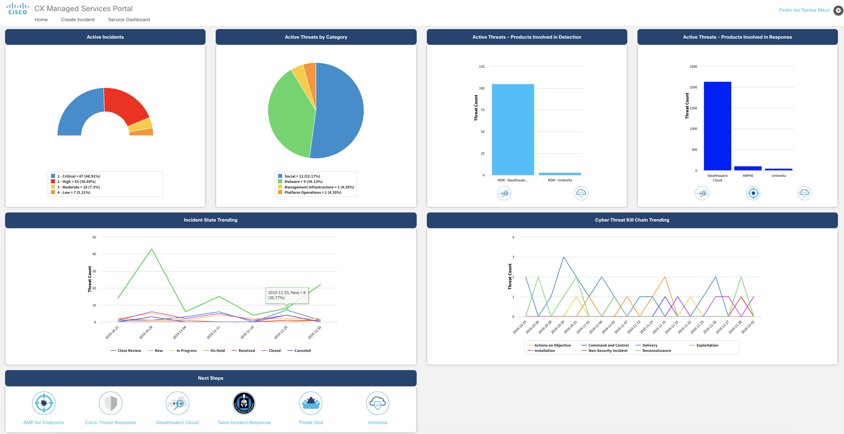
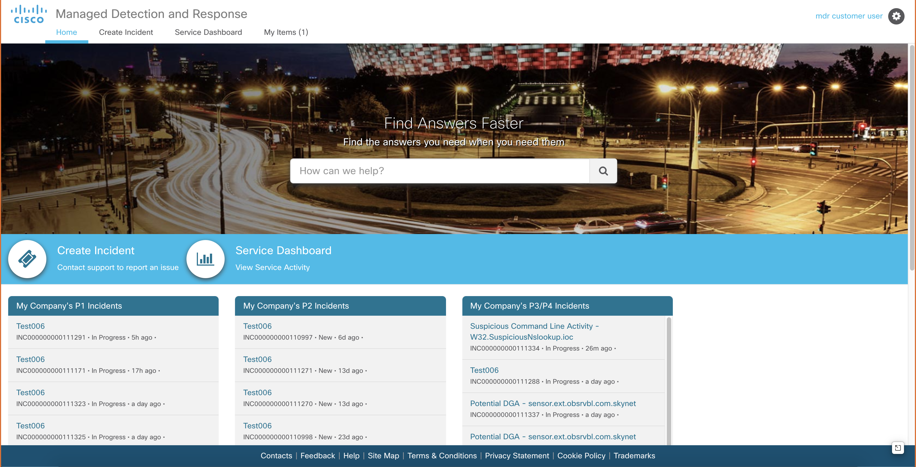
Active Incidents
Active Threats by Category
Active Threats – Products Involved in Detection
Active Threats – Products Involved in Response
Incident State Trending
Cyber Threat Kill Chain Trending
Next Steps
Notes:
The customer MDR dashboard is the single place where you can see the effectiveness of MDR to securing your business.
It presents the service metrics that allow you to recognize the detection of threats, most common threats detects, the importance of each Cisco Intelligence product (AMP4E, Umbrella, SWC and Threat Grid) in detecting and responding, what stage of the kill chain you are mitigating the threats and direct launch to the main products and intel sources.
Active Incidents: displays the distribution of the threat incidents by assigned severity, which has a direct influence over impact and urgency. By clicking in one of the severities, the portal will launch a filtered list of the incidents of that severity. We want to have a majority of minor incidents meaning the security provided by Cisco products and the detection is happening at early stages and avoiding threats to spread and cause business impact.
Active Threats by Category displays the distribution of threat incidents by threat categories as defined in ATT@CK market definition. By clicking in one of the categories, the portal will launch a filtered list of the incidents of that particular type.
This allows you to understand the most common threats that are targeting your business so you can implement security policies and evolve your defense to be more effective in protecting the business.
Active Threats – Product Involved in Detection displays the number incidents detected by each of the products used to collect telemetry (AMP4E/TG, SWC and Umbrella). By clicking in one of the products, the portal will launch a filtered list of the incidents that were detected by this product.
Active Threats – Product Involved in Response displays the number incident response that contained information from each one the products used to collect telemetry (AMP4E/TG, SWC and Umbrella). By clicking in one of the products, the portal will launch a filtered list of the incidents that have response information from this product.
The above widgets allow you to realize the value or each Cisco product in both detection of threats and accurate response. Without telemetry from these products, a number of incidents would have not been detected or would have not been investigated properly, which could reduce the effectiveness of the mitigation action.
Incident State Trending: displays the trending number of incidents by state. As the time passes, we want to keep control over the number of threats in new state to ensure the security policy and monitoring are effectively avoiding the. Majority of threats. We also want to see a consistent number of resolved events meaning the detected threats are being mitigated timely.
Cyber Threat Kill Chain Trending: displays the number of threats in each stage of the Cyber Threat Kill Chain. This indicates the far in the “lifecycle” of a threat you were able to detect and stop it. You want the majority to be in the early stages of the chain meaning you stopped them before they could actually damage systems, impact business and cause financial losses.
Access to Product Portals and Incident Response: this is where you can cross-launch the Cisco security products and relevant intel sources to facilitate ongoing research and investigations.

Slide 20
Why choose Cisco MDR
Stronger
Security Posture
Advanced
security operations capabilities
Management
and prioritization of alerts
Powerful integrated security architecture
Expert team of researchers, investigators, and responders
Cisco® MDR Threat Intelligence
and Automation Platform
Defined investigations
and response playbooks
Greater visibility
with integrated
and innovative technologies
Notes:
Gain higher confidence in threat detection and response capabilities with an expert team, unique intelligence, proven methodologies, and an integrated security architecture to stay ahead of the expanding attack surface and reduce detection and remediation time
Cisco MDR provides Managed Security Detection and Response across cloud, network and endpoints to advance security operations. Benefits include:
A stronger security posture that protects against threats with an expert team of researchers, investigators, and responders
Advanced security operations with a Cisco MDR Threat Intelligence and Automation Platform
Management and prioritization of alert volume across cloud, network and endpoints with defined investigation and response playbooks
Powerful integrated security architecture providing greater visibility
24x7x365 analysis, investigation and response to improve mean-time-to-detect and mean-time to respond to security threats

Slide 21
MDR Use Case Demo
Domain Generating Algorithm (DGA) Activity
Notes:
Managed Detection and Response

Slide 22
Lots of questions to be answered… and fast!
Do we care about this threat?
What departments and machines have been infected?
Who was patient 0?
Are there any related attacks or attack components we need to be concerned with?
How can we block this attack, and prevent potential future attacks?
1
How?
Who?
Is it bad?
Has it
affected
us?
2
3
4
5
Notes:
Now there are a lot of questions that need to be answered once an incident comes to the MDR SOC:
Question #1 – Do we care about this threat. Look at Threat Grid to understand the risk. Okay, it’s bad. Let’s trigger a response.
Question #2 – What were the endpoints that had this specific file (CTR showing AMP for Endpoints data).
Question #3 – Who was patient 0? (Device trajectory in AMP for Endpoints).
Question #4 – Are there any related attacks or attack components we need to be concerned with? (should confirm #2, check alarms in Stealthwatch).
Question #5 – How else could we identify the source of the attack? (Umbrella)
Transition
- To start with, let’s take a look at how an event flows through the MDR Threat Intelligence platform.

Slide 23



Threat Story: DGA
*.7asel7[.]top
Infected system joins the network
1011010110
1011010110
Threat spreads and infects another host
10110101101011
IP: 10.201.3.149
IP: 10.201.3.153
Pinpoint lateral communication
User receives email and clicks link
Contacts home and sends instructions to deliver phishing email to valid internal user account
Server with sensitive employee data
Notes:
1. Infected system joins the network
That system would build connection to the cloud large icon or potentially 100’s of others until it is successful in building the connection
With new instructions that host may execute a phishing attack to other users within the domain through the use of a valid user account - Then send the email to the dark blue system
And that system or systems would then begin the same activity of building connections externally for new instructions and potentially damaging malware including data exfiltration. - the second system builds connections to the clouds
The systems at the right appear to indicate the potential exfiltration of data.

Slide 24
Detection and Response for Advanced Threats
Detection
Analysis
Investigation
Response
Alarm triggered
Threat verified
Investigation and research
Mitigation recommendation
Notes:
The lifecycle of a use case is broken down into four phases – and I will cover what happens in each step from the time a threat is detected and an alarm is triggered to what takes place during the analysis, investigation and lastly the response.
The Detection Phase is driven by one of several possibilities:
Directly by the telemetry from our four security technologies.
By correlation – where we look for not just for a single event, but for a combination or a series of events
Threat intelligence or
Machine learning
Once the detection occurs, we move into the Analysis Phase.
This phase is all about information gathering.
This is where the first round of automations occur where we start to bring in enrichments and attribution information, and identify related activity.
The goal is to gather enough information to allow the Cisco Threat Investigator to answer one question, "Does this event need to be brought to the attention of the customer?“ A ticket is then created.
In the Investigation Phase, the Cisco Threat Investigator runs additional playbooks and automations to determine the impact and urgency of the event by identifying the scope and hunting for a root cause.
In this step they create their write up of the activity and start to form their response recommendations.
Then we reach the Response Phase, response can take place in one of two ways:
Immediately via the MDR SOC for critical events
Or via ServiceNow approvals from the customer
Transition:
All this activity is captured in the MDR Customer Portal where we will go next.

Slide 25
Alerts with context enable faster investigations
Contextual user and application info
Top security alarms by hosts
Drill-down into telemetry associated with security events
Malware propagation through infected hosts
Relationships between domains, IPs, malware
Notes:
To summarize, we infuse the alarms with additional contextual information so that you can easily and quickly understand who has been infected, what is the threat, where it has spread, and how you can remediate it.
<Click>

Slide 26
Notes:
This is the landing page for the MDR Customer Portal which provides one-stop for all service interactions.
This is where a customer can access the service-level dashboard; they can view all open and historical tickets, and case management workflows for maximum visibility into all activities.
Corrective action can be taken through the portal interface with the ability approve or reject a response, to action tasks like: block suspicious files, domains, and more.
Transition:
Now, let’s dive in to look at the list of open tickets…

Slide 27
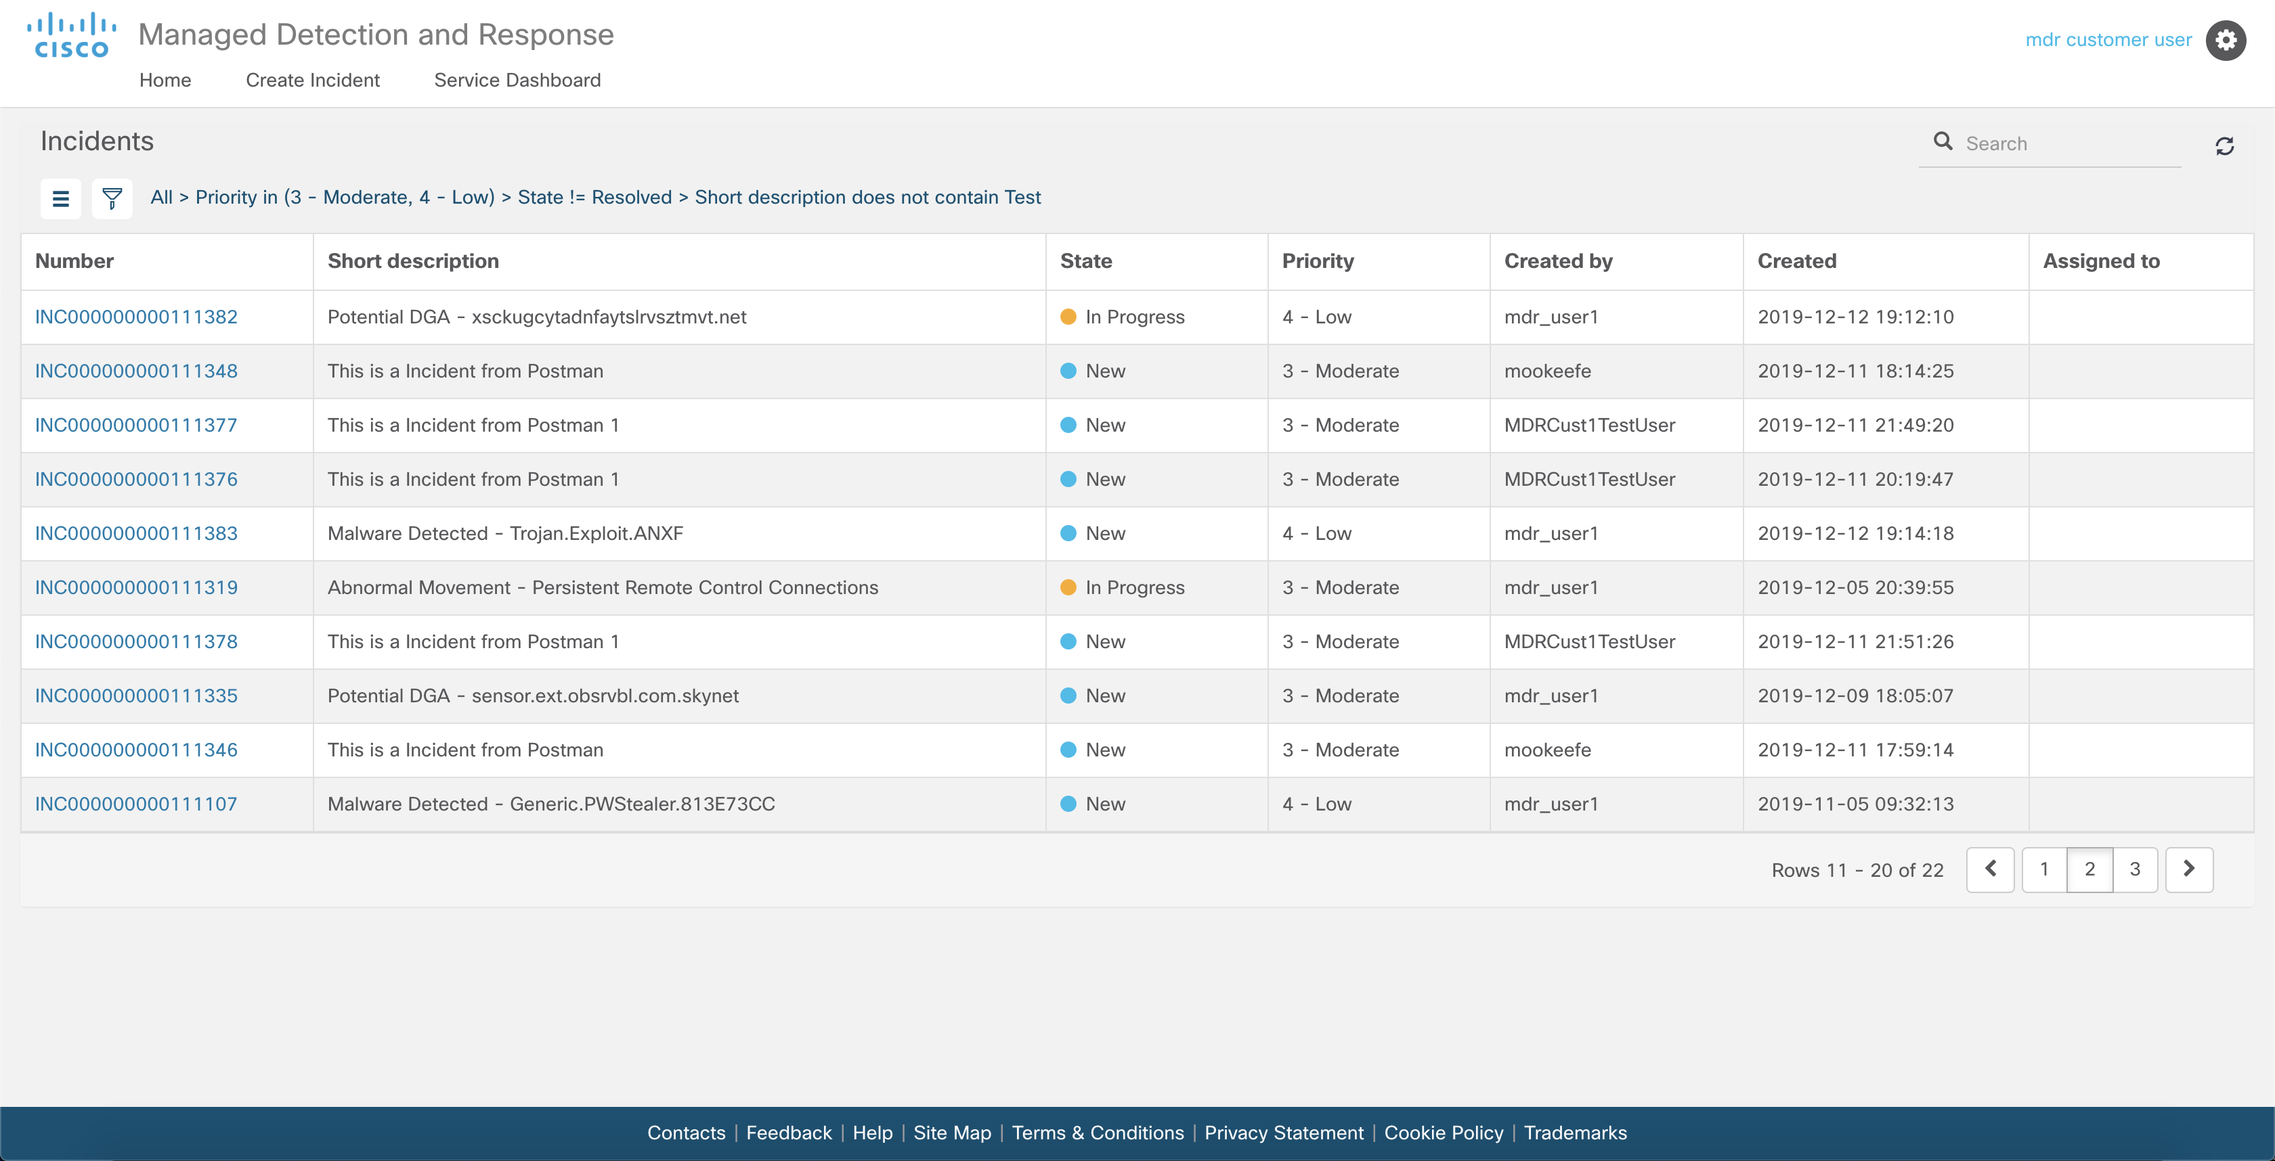
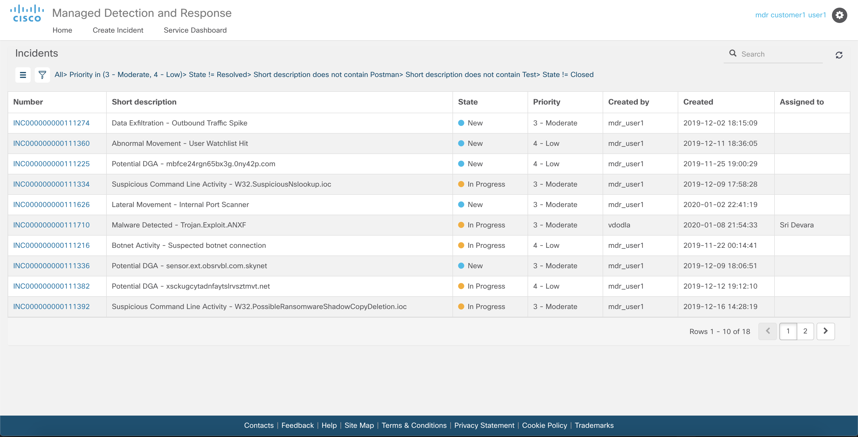
Notes:
This list of tickets is the how an occurrence of a use case will manifest itself to the customer.
For our walkthrough, we're going to take a look at the third event on the list about a Potential DGA.
DGA domains are domains randomly generated using an algorithm or formula that malware can calculate on the fly to find what domain they need to connect to for progressing their attack, such as downloading additional malware, look for c2, etc.
In this case, telemetry from Umbrella feeds into our analytics platform and has triggered an alert for activity to a potential DGA domain, or Domain Generation Algorithm domain, and a respective threat incident ticket is created.
We can see the DGA in the title of the ticket, and for us as humans, we can quickly see that this domain looks fairly odd. But for a computer, it's much more difficult for it to determine what is normal versus what is odd. To solve this, this use case makes use of Machine Learning, which in our usage means using and applying statistical models and statistical analysis to give the platform the ability to predict the likely validity of a domain.
Transition:
- From this main list of tickets, we can click on the Potential DGA ticket number to open it and get more information.

Slide 28
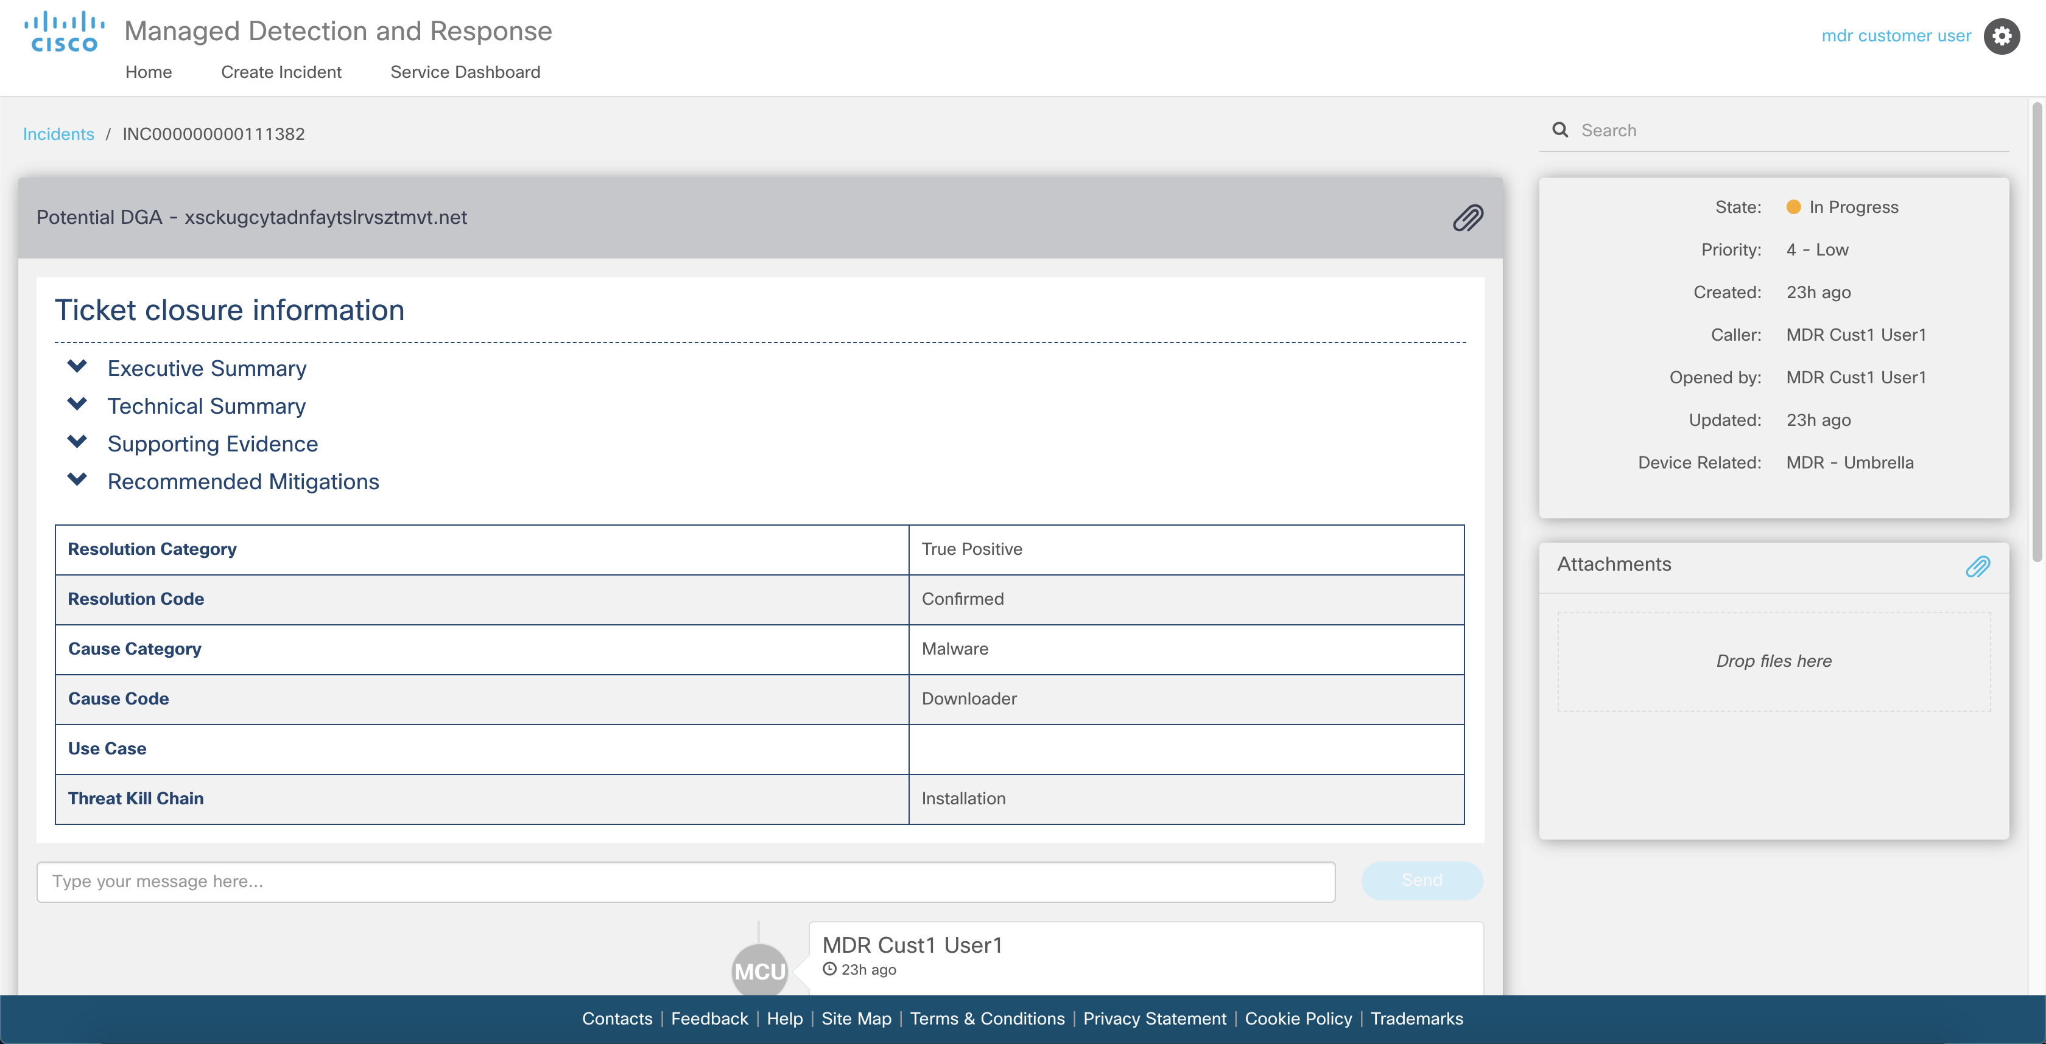
Notes:
Opening the ticket, we can immediately see a few key attributes bubbled up to us, as if we are the customer.
Even knowing little about DGA, we can read down this table to get a quick overview of the ticket: True Positive, Confirmed, Malware, Downloader. This info tells us at a glance about whether or not if I need to continue to read more about this event.
The Threat Investigator has been populating this information through the course of the investigation, and in this view, it gives us a bit of a quick peek at what's going on and identifies: what kind of a threat it is, and how far in the kill chain it has progressed.
In this case, this threat is a confirmed malware downloader that is attempting to install.
Transition:
From here, we can expand the Executive Summary section to get into the write-up created by the Investigator.

Slide 29
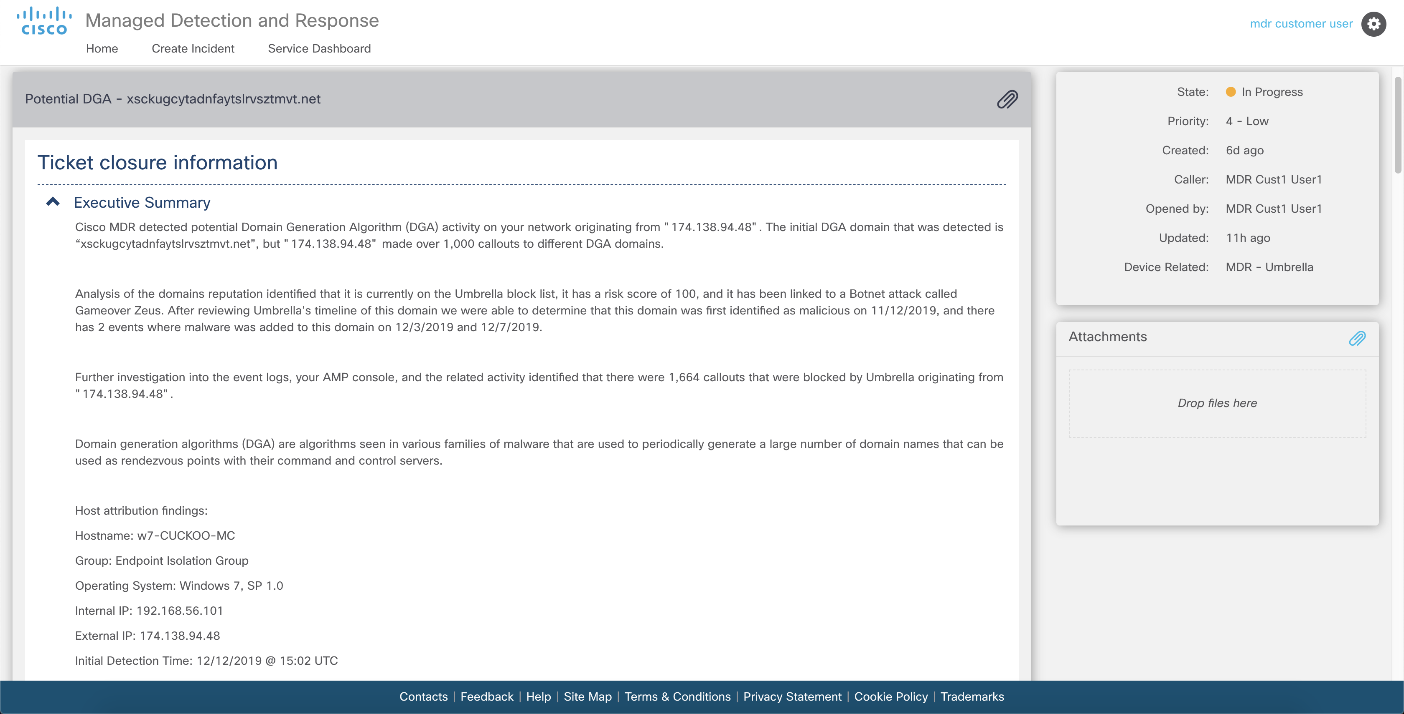
Notes:
This [Executive Summary] section represents a high-level overview of what is happening, in English sentences to quickly explain:
Why this ticket was created
Why the customer should care, and
How it impacts them
- For our DGA domain example, the Threat Investigator identifies that there was not just 1 request seen, but more than 1,000, and that the domain requested belonged to a known malware family.
Transition:
The next section, goes into more detail.

Slide 30
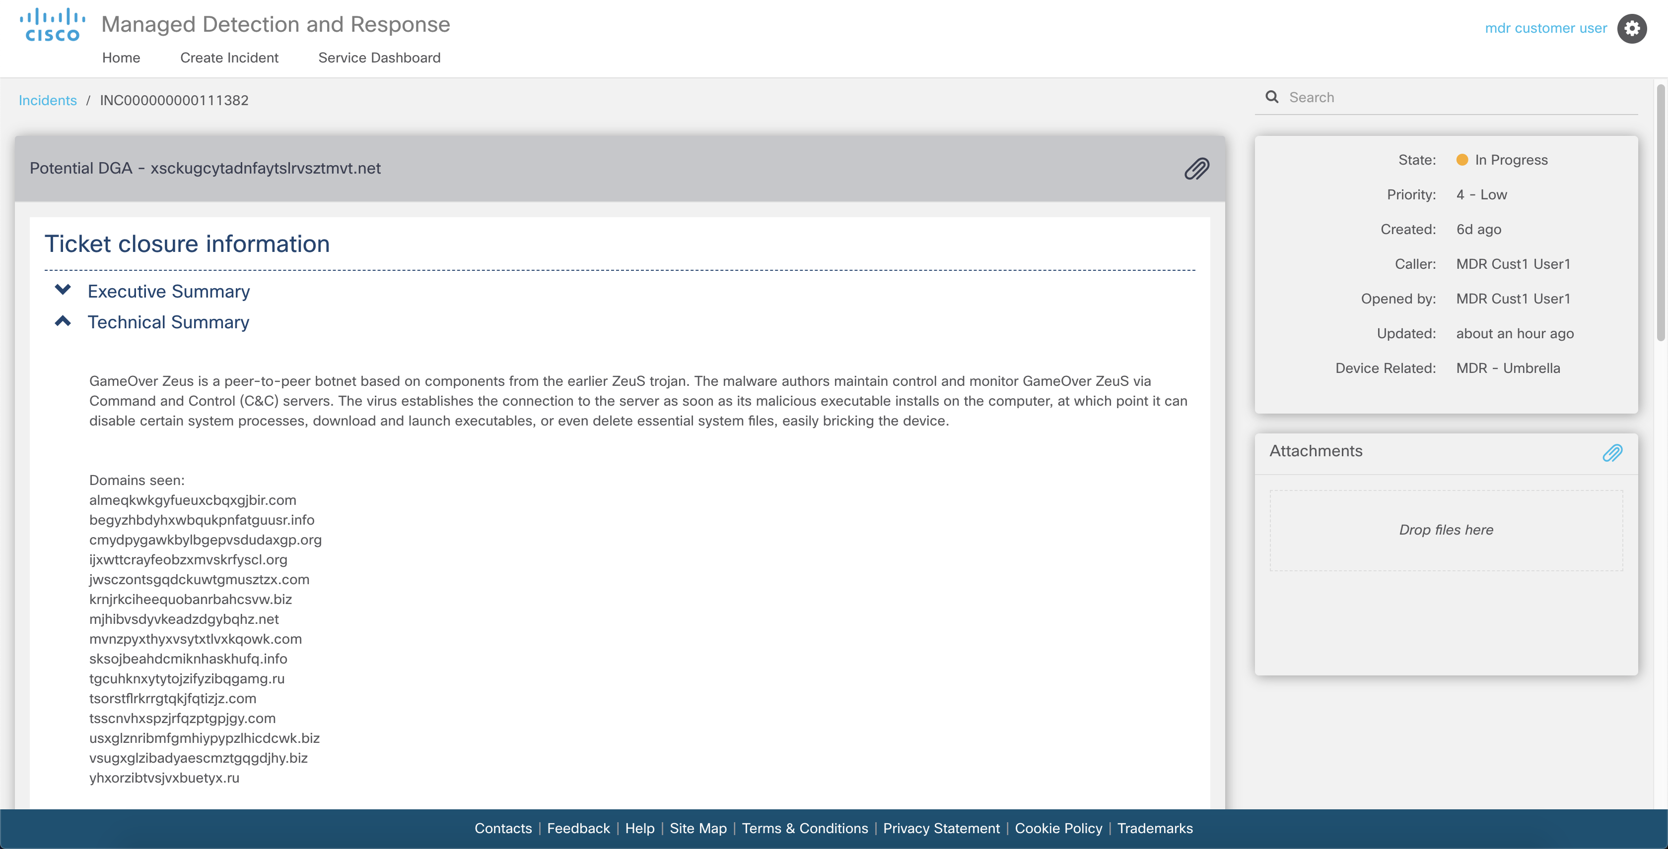
Notes:
This [Technical Summary] section starts to get into the technical information about the event.
It has more specific information about the DGA and how it operates to attack and more information about the malware family that was seen.
The Investigator will also start to pull out important bits of information from the raw data and populate that information here. In our case, the Investigator pulled out a list of domains that were seen. This provides an easy way for the customer to view important details about the event without having to wade through the raw data themselves.
Transition:
The next Supporting Evidence section dives one step deeper…

Slide 31
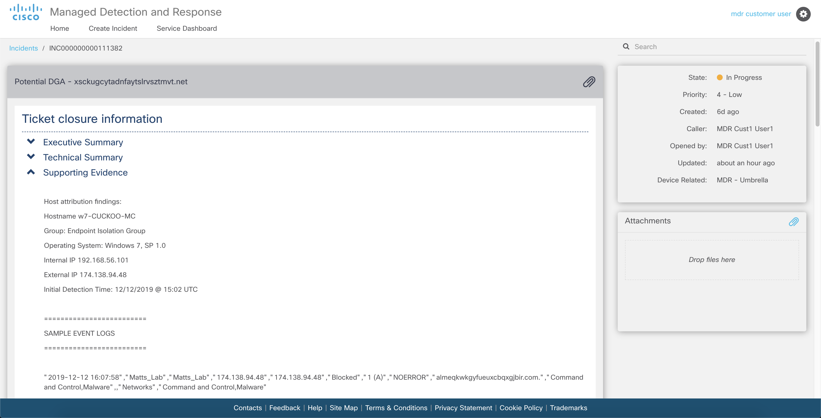
Notes:
The [Supporting Evidence] section contains the proof that supports the explanations we saw above and why we are making the recommendations that we are. This has two subsections.
The first is host attribution information. It has been our experience that there is not such thing as too much identifying information about a host that is exhibiting suspicious behavior, but it *is* possible to not have enough. So to ensure that we are able to provide as much information as possible, we have created a playbook whose sole purpose is to go and search for this information for each event. In our case, it was able to take the IP address that was in the Umbrella log, and correlate that to AMP where it was able to pull hostname, OS, and other attributes.
This section also contains the raw data itself. This allows the customer to review the same data the Investigator did if they wish.
Transition:
- This leads us to the recommended mitigations section…

Slide 32
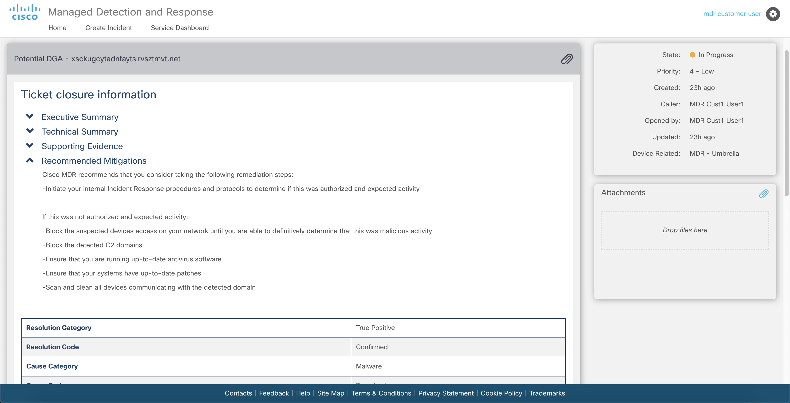
Notes:
The Recommended Mitigations section contains the Investigators recommendations. When we approach response, we view it as being able to isolate or remove a threat from the network, and to block or prevent the reoccurrence.
These recommendations are tailored not to a use case, but to each event itself.
In our case of DGA, we have domains and their associated IP addresses we recommend blocking, and taking proactive steps to prevent the threat from spreading or reoccurring.
If during the course or the investigation, the investigator tracks the activity back to something like a toolbar installed in a user's web browser, where the sub total threat is one user experiencing extra ads, the recommendations will be different than if the malware causing this activity is a more nefarious one, such as Emotet or Trickbot, the recommendations would go farther and include isolating the host.
These recommendations are also done on a per attribute basis; an attribute being each instance of a domain, or IP, or hash.
This means the approval from the customer can also take place on a per attribute basis.

Slide 33
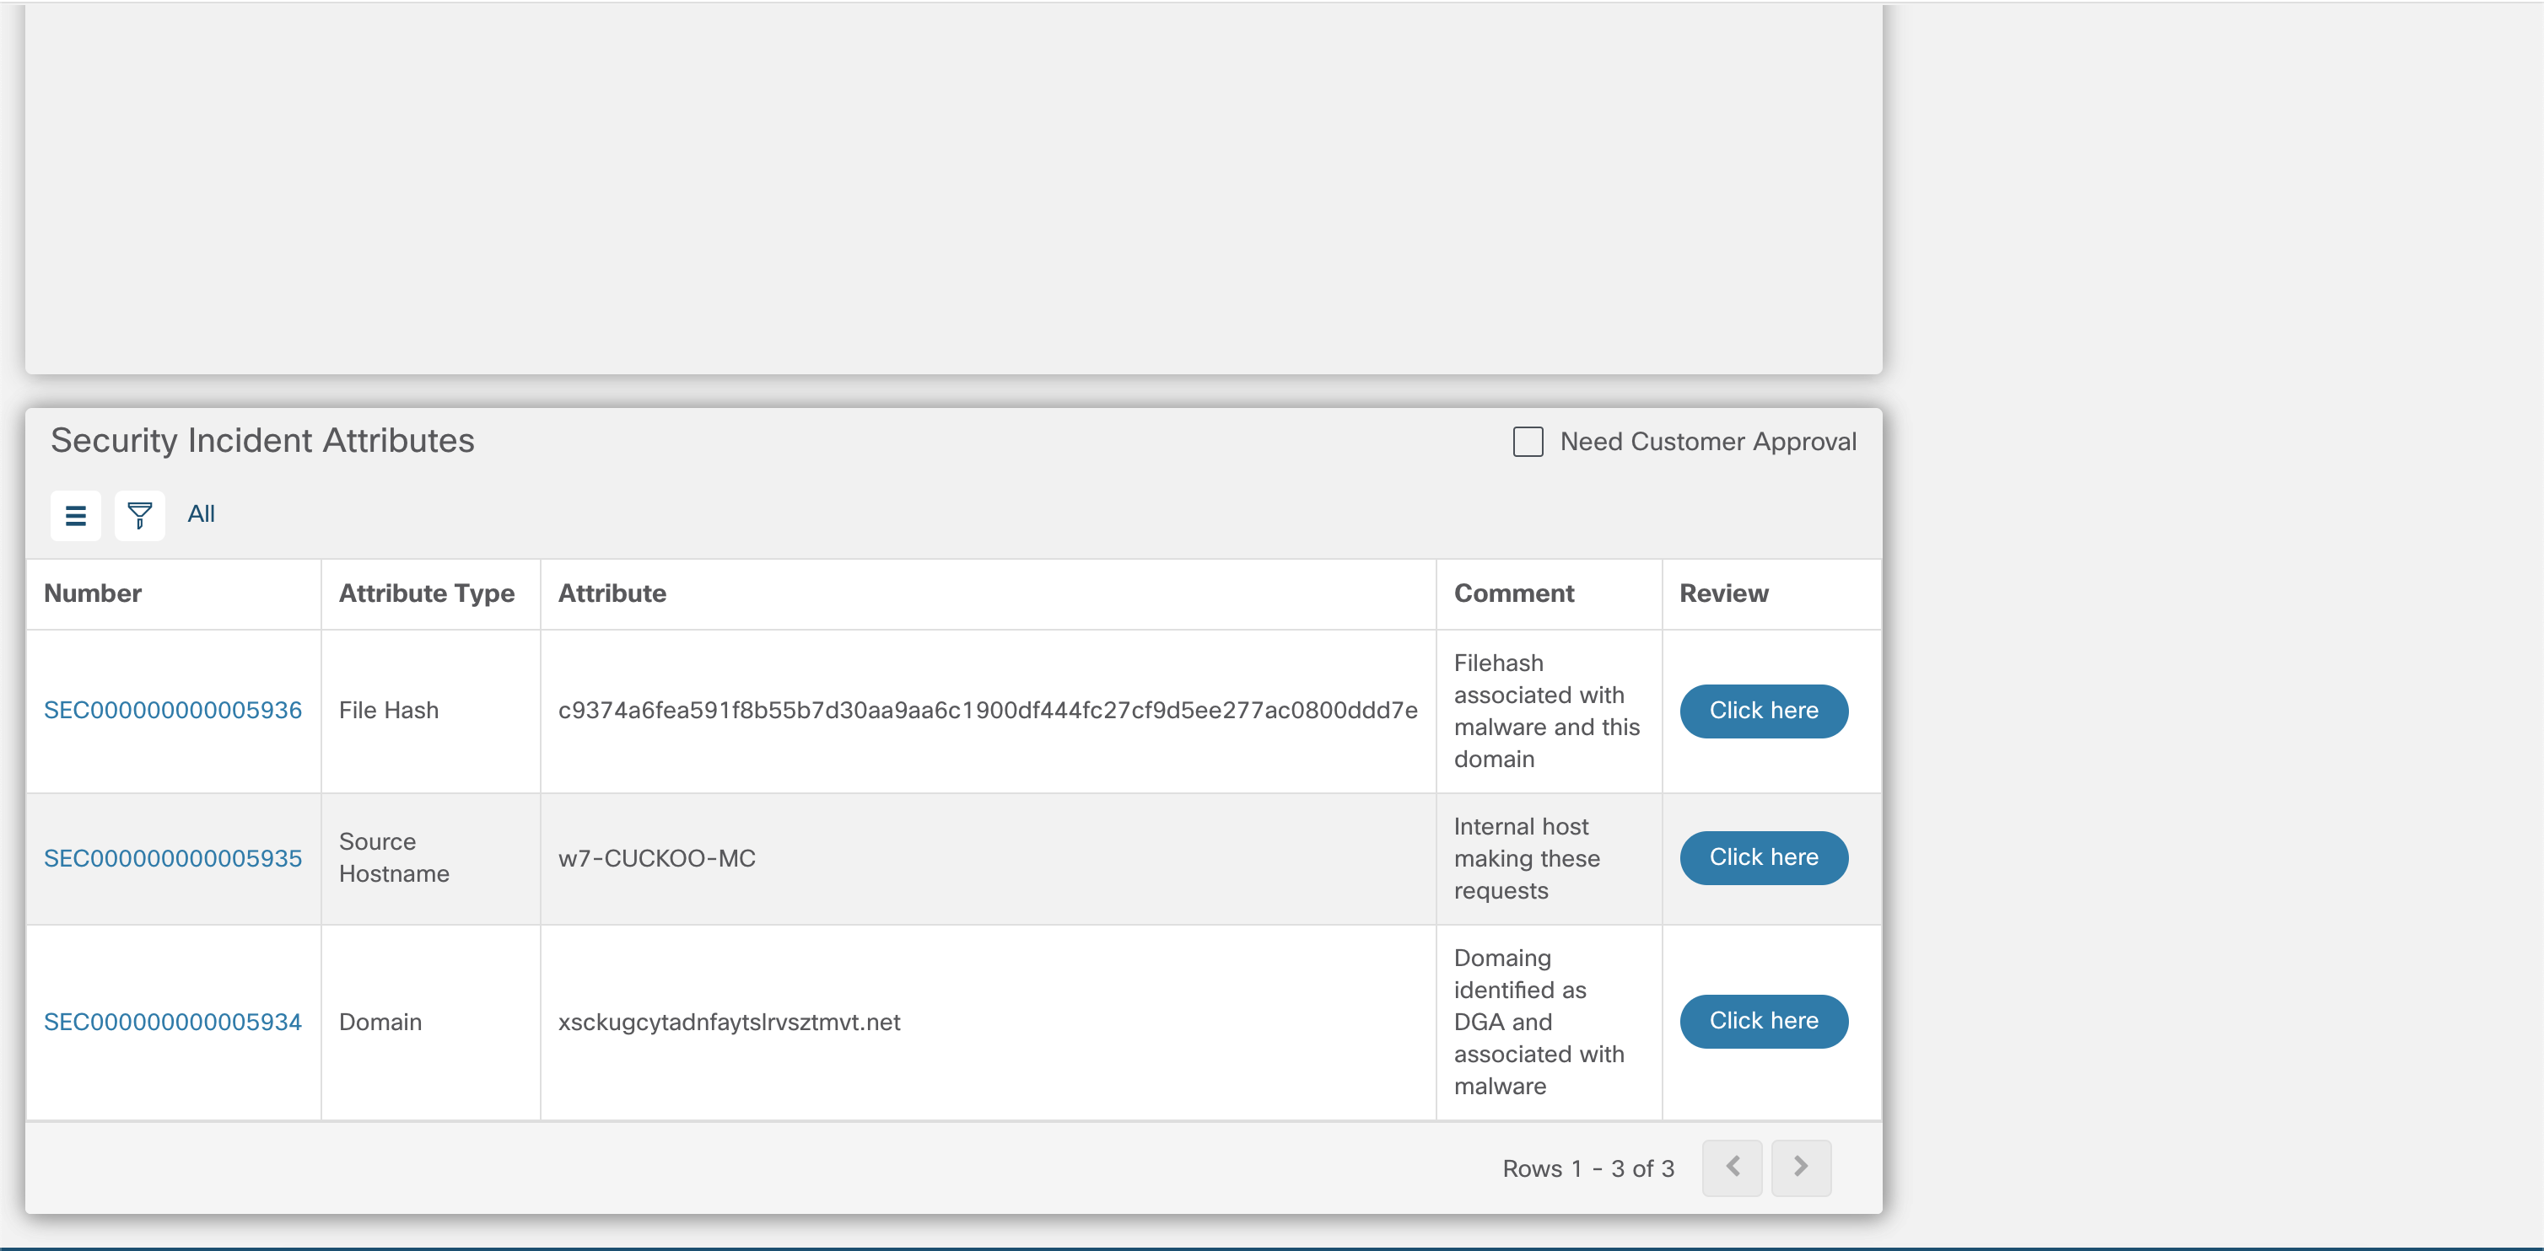
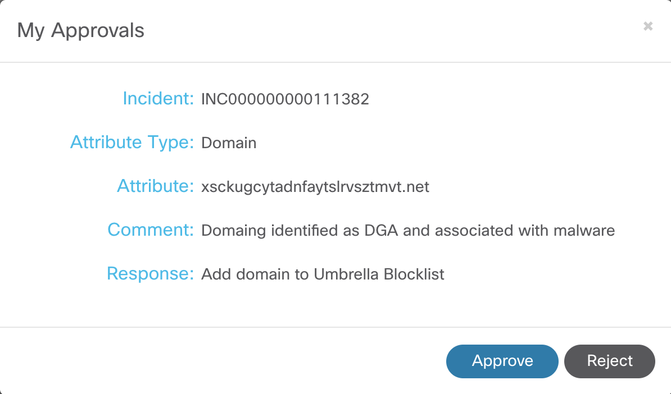
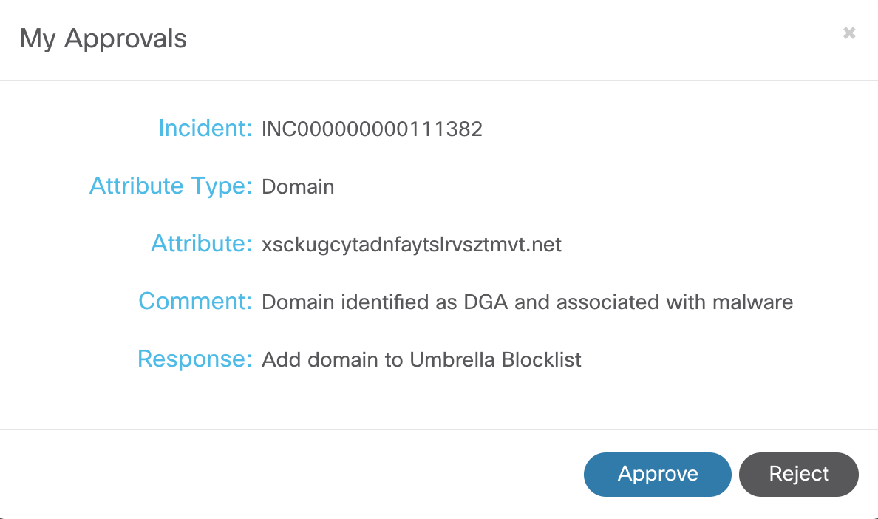
Notes:
The recommended mitigation actions also appear at the bottom of the ticket in the customer view.
Here, the customer can view the recommendation each individual attribute.
Clicking on the 'Click here' button will open the dialog box (as shown) where the customer can then approve or reject the recommended action. Doing this will feed the response and automatically implement the action if approved.
(Not all of the domains were added to the list for brevity)
Transition:
- Next, let’s take a look at MDR dashboard…

Slide 34
Active Incidents
Active Threats by Category
Active Threats – Products Involved in Detection
Active Threats – Products Involved in Response
Incident State Trending
Cyber Threat Kill Chain Trending
Next Steps
Notes:
The customer MDR dashboard is the single place where you can see the effectiveness of MDR to securing your business.
It presents the service metrics that allow you to recognize the detection of threats, most common threats detects, the importance of each Cisco Intelligence product (AMP4E, Umbrella, SWC and Threat Grid) in detecting and responding, what stage of the kill chain you are mitigating the threats and direct launch to the main products and intel sources.
Active Incidents: displays the distribution of the threat incidents by assigned severity, which has a direct influence over impact and urgency. By clicking in one of the severities, the portal will launch a filtered list of the incidents of that severity. We want to have a majority of minor incidents meaning the security provided by Cisco products and the detection is happening at early stages and avoiding threats to spread and cause business impact.
Active Threats by Category displays the distribution of threat incidents by threat categories as defined in ATT@CK market definition. By clicking in one of the categories, the portal will launch a filtered list of the incidents of that particular type.
This allows you to understand the most common threats that are targeting your business so you can implement security policies and evolve your defense to be more effective in protecting the business.
Active Threats – Product Involved in Detection displays the number incidents detected by each of the products used to collect telemetry (AMP4E/TG, SWC and Umbrella). By clicking in one of the products, the portal will launch a filtered list of the incidents that were detected by this product.
Active Threats – Product Involved in Response displays the number incident response that contained information from each one the products used to collect telemetry (AMP4E/TG, SWC and Umbrella). By clicking in one of the products, the portal will launch a filtered list of the incidents that have response information from this product.
The above widgets allow you to realize the value or each Cisco product in both detection of threats and accurate response. Without telemetry from these products, a number of incidents would have not been detected or would have not been investigated properly, which could reduce the effectiveness of the mitigation action.
Incident State Trending: displays the trending number of incidents by state. As the time passes, we want to keep control over the number of threats in new state to ensure the security policy and monitoring are effectively avoiding the. Majority of threats. We also want to see a consistent number of resolved events meaning the detected threats are being mitigated timely.
Cyber Threat Kill Chain Trending: displays the number of threats in each stage of the Cyber Threat Kill Chain. This indicates the far in the “lifecycle” of a threat you were able to detect and stop it. You want the majority to be in the early stages of the chain meaning you stopped them before they could actually damage systems, impact business and cause financial losses.
Access to Product Portals and Incident Response: this is where you can cross-launch the Cisco security products and relevant intel sources to facilitate ongoing research and investigations.

Slide 35
Reporting
Notes:
Managed Detection and Response

Slide 36
Reporting
Can be scheduled or downloaded, and include: Current/All Time/Day/Week/Month/Year/Trending
Incident Detail overview (List)
Incidents by Priority, List or Counts
MTTD (Mean-time-to-Detection)
MTTC (Mean-time-to-Containment)
Threat Kill-Chain Stages
Incidents by Configuration Item (AMP for Endpoints /Threat Grid/Umbrella /Stealthwatch Cloud)
Incidents Closed/Opened/On-Hold/Resolved
Incidents without updates seen in X days
Containment and Prevention Actions taken

Slide 37
Service Activation

Slide 38
Cisco Security Technologies License Requirements for MDR Service Activation
Stealthwatch Cloud
Network-wide visibility
AMP for Endpoints
Internet-wide visibility
Threat Grid
Threat Intelligence
Umbrella
Endpoint visibility
Private Network Monitoring
Cloud Sensor
AMP for Endpoints Advantage
(Includes Threat Grid
- New Jan. 2020)
AMP for Endpoints Essentials
(Requires Threat Grid license)
Threat Grid license
OR, included with
AMP for Endpoints Advantage
Umbrella DNS Security
Advantage or above license
OR, Umbrella Insights
with Investigate Add-on

Slide 39
Quick MDR Service Activation
Prep / Readiness
Technical
Activation
Deployment
Validate product licensing
Review configuration
and connectivity requirements
Commit Resources
Kick off activation
Configure connectivity
Complete set-up (APIs)
Provision ticketing
Complete MDR Customer Portal training
Go live
Conduct Quarterly Business Reviews
30 Days

Slide 40
Contract and Terms

Slide 41
MDR Service Description
Service Level | Target
Service Level Agreement:
Platform Availability | 100%
Portal Availability | 99%
Time to Acknowledge Success Cisco will assign a priority to a Security Incident within 30 minutes of a ticket being opened by Cisco or a Security Incident Reported by Customer for P1 for P2 and within 2 hours for a P3 and P4. | 95%
On Time Escalation Cisco will contact Customer’s designated contact by phone or MSS Chat within 30 minutes of prioritizing a P1 Security Incident (45 minutes for a P2) if a recommendation to mitigate, stop, research, etc. has already not been provided by this time. | 95%
Service Level Objective:
Containment Provide response to resolve, stop, prevent or mitigate Security Incident, if no automatic response is possible: P1: 4 hours P2: 8 hours P3: 1 business day P4: 3 business days | 99%
Key Performance Indicators:
Containment/Eradication Cisco will work to create automated responses to resolve, prevent, or mitigate known Security Incident causes and add them to the standard Response Catalogue for faster delivery to customer.
Situational Awareness Create or modify existing detection and response playbooks based on new information and threats: P1: 1 calendar day P2: 2 calendar days P3: 5 business days P4: 1 calendar month

Slide 42
MDR Service Priority Definitions
Impact
 | Widespread | Large | Localized | Individualized
Critical | P1 | P1 | P2 | P2
Major | P1 | P2 | P2 | P3
Minor | P2 | P3 | P3 | P3
Low/Notice | P4 | P4 | P4 | P4
Urgency
P1: Cisco and Customer will commit any necessary resources 24x7 to assist in resolving the Incident.
P2: Cisco and Customer will commit full-time resources during standard business hours to resolve the Incident.
P3: Cisco and Customer are willing to commit resources during standard business hours to restore service to satisfactory levels.
P4: Cisco and Customer are willing to commit resources during standard business hours to provide information or assistance.

Slide 43


Cisco Managed Detection and Response Service
Cisco® MDR
Platform
Cisco
SOAR Platform
Private cloud
Public cloud
Stealthwatch Cloud
Stealthwatch® Cloud
Umbrella™
Response Action Catalog
AMP
Cloud
Threat Grid
AMP for Endpoints
Remote users
Stealthwatch Cloud
AMP add-on
AMP
Branch
Data center
On-premises users
Cisco integrated security architecture
Cisco security operations centers
Notes:
Ingesting metadata from Stealthwatch Cloud, AMP for Endpoints and Umbrella through available APIs allows for quick deployment of the MDR service.
Telemetry is ingested into the threat intelligence and analytics platform for correlation and analysis by MDR researchers and analysts resulting in detections of critical threats reducing the mean-time-to-detect.

Slide 44
Cisco Managed Detection and Response Service
Cisco® MDR
Platform
Cisco
SOAR Platform
Private cloud
Public cloud
Stealthwatch Cloud
Stealthwatch® Cloud
Umbrella™
Response Action Catalog
AMP
Cloud
Threat Response
AMP for Endpoints
Remote users
Stealthwatch Cloud
Block domains
Block URLs
Block hashes
Isolate hosts
Add custom IOCs
Response Action Catalog
AMP add-on
AMP
Branch
Data center
On-premises users
Cisco integrated security architecture
Cisco security operations centers
Notes:
Our team then using the power of an orchestration, automation and response platform for rapid response recommendations and actions can reduce the mean-time-to-contain an attack within the environment with the available blocking capabilities of the Cisco technologies included in the MDR service.

Slide 45
Let Cisco help you
respond faster!

Slide 46
Advance your security capabilities with…
Higher confidence in detection and response capabilities with proven methodologies, unique intelligence,
and an expert team
24x7x365 analysis, investigation, and response to improve mean time to detect (MTTD) and mean time to respond (MTTR) to security threats
For more information, visit:
Cisco® Managed Services

