Slide 1
Cisco Secure Firewall
Reimagine the firewall

Slide 2
Legacy network security
A single enforcement point at the network edge
Public Internet
The firewall was the single control point for all traffic
Internal traffic was considered trustworthy and external traffic untrustworthy
Firewall
Corporate Network
Notes:
The perimeter is no longer a single place but instead multiple “enforcement point s” that need to be seamlessly harmonized across an increasingly complex environment.
However, as cloud, BYOD (bring your own device), and other emerging technologies and trends gain prominence, security devices are also becoming more diverse. Traditional “firewall” devices are being replaced by a mixture of physical and virtual appliances, some embedded into the network while others are delivered as a service, are host-based, or included with public cloud environments.
Transition: Businesses need a better way to protect their networks and harmonize their security controls across these new “enforcement point” micro-perimeters to lessen the burden on their IT teams and maximize security.
<click>

Slide 3
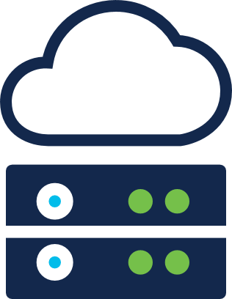
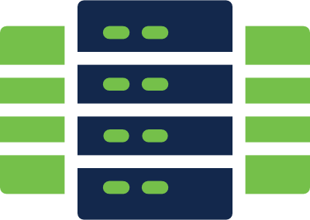
The new reality
Disparate enforcement points across a variety of interconnected networks, devices, users and data
Branch offices
Hybrid clouds
Inefficient and inconsistent security is the result
Management complexity results in inefficient processes that waste time and result in fragmented, inconsistent security.
Cloud applications
Remote employees
Mobile devices
Data centers
Firewall
Personal devices
Vendors and
contractors
Corporate Network
Notes:
These new developments require that every business re-think “firewalling”.
Instead of the traditional approach where the network is protected by a single enforcement point…
…Organizations need a more agile and flexible approach toward delivering and harmonizing security controls across increasingly heterogenous networks.
Our security portfolio provides that more flexible approach, enabling organizations to deliver consistent visibility and control to their data centers, branch offices, cloud environments, and everything in between.

Slide 4
It’s time to reimagine the firewall
Branch offices
Remote employees
001101001100111001110
001101001100111001110
Hybrid clouds
0011010011001110011100011001100000 1001 010011
0011010011001110011100011001100000 1001 010011
0011010011001110011100011001100000 1001 010011
001101001100111001110
0011010011001110011100011001100000 1001 010011
001101001100111001110
The foundation for consistent security
Share policy, logging, and threat intelligence across all firewall form factors to simplify management and enhance security posture.
Mobile devices
Cloud applications
001101001100111001110
0011010011001110011100011001100000 1001 010011
001101001100111001110
Personal devices
0011010011001110011100011001100000 1001 010011
Data centers
0011010011001110011100011001100000 1001 010011
0011010011001110011100011001100000 1001 010011
Vendors and
contractors
001101001100111001110
Firewall
001101001100111001110

Slide 5
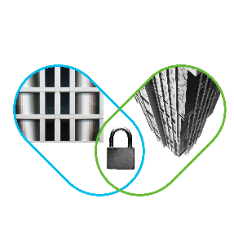
Reimagine firewalling with Cisco
Your foundation for an open and integrated security platform
World-class security controls
Consistent policy and visibility
Integrated security portfolio
Protect your network with a portfolio of firewall solutions backed by leading Cisco Talos threat intelligence.
Streamline security policy and device management across your network to accelerate key security operations.
Extend network security beyond the firewall with the broadest, most integrated portfolio in the industry.
Notes:
Modernizing your “firewalling” efforts starts with Cisco NGFW – the powerful foundation to the most comprehensive security platform on the planet.
Experience network security, evolved with:
World-class security controls
Unified policy and threat visibility
And the ability to turn your entire network into an extension of security architecture
<click>

Slide 6
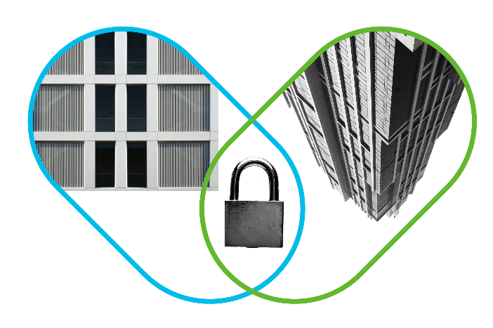
World-class security controls
With Cisco you can…
Stop more threats: Contain known and unknown threats with leading Cisco IPS and Malware defense with sandboxing.
Prioritize threats: Gain superior visibility into your environment. Automate risk rankings and impact flags to quickly identify priorities.
Detect earlier, act faster: Talos threat intelligence underpins the entire Cisco Secure platform. Every Cisco Secure product harnesses the power of Talos.
Need: detect more sophisticated threats with a complete line of firewall solutions.

Slide 7
Consistent policy and visibility
With Cisco you can…
Maintain consistent policies: Write a policy once and scale enforcement consistently across tens or thousands of security controls throughout your network.
Reduce complexity: Get unified management and automated threat correlation across tightly integrated security functions, including application firewalling, network firewall and endpoint.
Accelerate key security operations functions: Leveraging existing resources and make the team more efficient by removing manual processes. Access security patches and new features faster by completing software image upgrades in a just a few clicks.
Need: stronger security policy management practices that can effectively protect the business at scale.

Slide 8
Integrated security portfolio
With Cisco you can…
Get more from your existing network: Tightly integrate existing investments, including Cisco Application-Centric Infrastructure (ACI) and Cisco Identity Services Engine (ISE) with your firewall.
Reduce complexity: Get unified management and automated threat correlation across tightly integrated security functions, including application firewalling, Firewall, and Endpoint.
Accelerate key security operations functions Leveraging existing resources and make the team more efficient by removing manual processes. Access security patches and new features faster by completing software image upgrades in a just a few clicks.
Need: a deep set of integrations for comprehensive security that protects everything, everywhere.

Slide 9
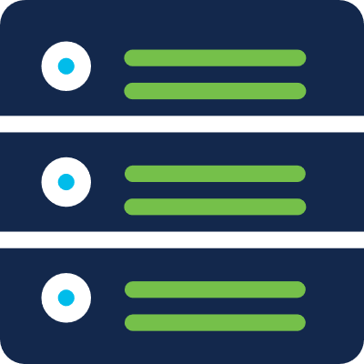
Network, virtual, cloud, & application firewalling
The future of firewalling, today
Network Firewall Cisco Secure Firewall
Meraki MX
Virtual Firewall Cisco Secure Firewall Virtual Meraki vMX
Cloud-Delivered Cisco Umbrella Firewall
Apps & Workloads Cisco Tetration

Slide 10
Cisco Secure Firewall scales with your business
9000 series
4100 series
2100 series
Find the optimal throughput and form factor for your business
1000 series
Virtual
Eliminate security gaps and integrate with multiple Cisco and partner security services across the network
Integrate with every major public cloud provider and virtual, private, and hybrid cloud environments
Attain ease of management at scale with firewall clustering
Notes:
With a Firepower NGFW you eliminate security gaps and can integrate with Cisco and partner services across your heterogenous networks.
You can enforce consistent security across public and private clouds for threat management. Firepower NGIPS is based on Cisco’s open architecture, with support for Azure, AWS, VMware, and more.
You are also able to cluster your firewalls together, enabling much easier management at scale.
And there’s a Cisco NGFW that is perfect for your business – with a wide variety of physical form factors and virtual options, you can find the optimal solution for your needs.
By purchasing a Cisco security solution today, you get a 3.5x performance boost in NGFW throughput, up to 2x more connections per second, and up to 3x performance boost for encrypted traffic compared to existing ASA and Firepower appliances.
Transition: But more importantly, you’re setting the foundation for capitalizing on this broader evolution—leading to the strongest security posture available today and tomorrow.
<click>

Slide 11
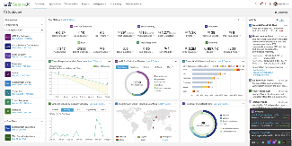
A simplified Firewall experience with Cisco SecureX
Connect Cisco's integrated security portfolio to your existing infrastructure for a consistent experience that can:
Orchestrate pre-built playbooks to simplify incident response and enable better collaboration between NetOps, ITOps and SecOps
Strengthen breach defense by unifying visibility with alerts correlated and prioritized from other integrated Cisco Secure solutions
Optimize network performance by automating VPN capacity management to facilitate continued remote worker productivity
Enable secure remote worker for workplace and workloads by extending zero-trust access controls with the firewall
Enable data center security by harmonizing policies across all micro-perimeters
Cisco Secure
Network
Endpoint
Cloud
Applications
Your infrastructure
3rd Party/ITSM
Intelligence
Identity
SIEM/SOAR
Notes:
​And Cisco Secure Firewall is also integrated into the Cisco SecureX platform and helps you automates workflows and harmonizes policies to improve the operational efficiencies of managing Cisco Secure Firewalls. It unifies threat visibility by adding network, endpoint, and cloud context for enhanced protections across physical and virtual networks. As a Cisco Secure Firewall customer, your benefits are further enhanced:​
Automated workflows leveraging Secure Firewall intrusion events to enable rapid identification, prioritization, investigation and remediation of threats.​​
Streamlined firewall provisioning, centralized management and automated health checks to increase operational efficiency, reduce errors and improve overall security.​​
Correlate and coordinate events, threat intelligence and indicators of compromise (IoCs) across your entire security landscape from built-in threat intel sources​.​​
​
With SecureX, security teams can immediately determine what to focus on with shared context across multiple integrated Cisco as well as third-party technologies. You can:​
Unify visibility: You get unified visibility across all integrated security technologies - network, endpoint, cloud and applications​
Simplify threat response: You can take action on the threat through the additional information about the incident, and integrated controls such as blocking the malicious domain, stopping a file execution, removing the endpoint off the network, etc. ​
Enable automation: The new orchestration feature simplifies these SecOps tasks and as well broader SecOps, ITOps and NetOps use cases. This feature relies on built-in and custom workflows leveraging built-in integrations. A workflow is a series of activities, such as you might find in an incident response playbook. It can be initiated by a trigger, an API call, a different workflow, or manual input. SecureX helps reduce the time spend on executing manual repetitive tasks and enables better collaboration for your team.​
​

Slide 12
Enable your business to do more with Cisco Secure Firewall
Rest assured that you have the best security available to protect your network, data, and customers
Increase efficiency and reduce the burden on your IT team
Save money with a single vendor that has the strongest security platform on the market and reduces the risk of costly breaches
Notes:
Rest assured, you have the best security to protect your network, data, and your customers.
Along with that you increase efficiency and reduce the burden on your IT team with the fullest and most comprehensive security network.
Finally, you save money by choosing us to future-proof your network as we have the strongest security platform on the market that reduces the risk of costly breaches
<click>

Slide 13
Case studies
Lewisville Independent School District
New Castle Hotels and Resorts
Rackspace
Cisco helped to safeguard students and staff by decreasing malware and cutting remediation time in half.
Cisco empowered a hospitality company to maintain business continuity during a crisis while reducing their time-to-detection and remediation from days to hours.
Cisco enables Rackspace to seamlessly manage and defend its customers' complex environments using several key technologies that work together as an integrated system.

Slide 14
Cisco Secure portfolio: simpler to buy and use
Security Choice Enterprise Agreement
Talos threat intel
Great discounts on 2+ security products with support included
Buy what you need now and add more in the future
Single coterminous agreement managed in one portal
Built-in 20% growth allowance with true forward terms
Pay annually with 0% financing
Cloud-native, built-in platform experience including XDR capabilities and beyond
Integrated and open for simplicity with true turnkey interoperability
Unified in one location for visibility that accelerates your time to detect and investigate
Maximized operational efficiency that accelerates your time to remediate
Network Security
Cloud Edge
User & Endpoint Protection
Application Security
Zero Trust

Slide 15
Reimagine your security today with Cisco Secure Firewall
Learn more at Cisco.com/go/firewall
Notes:
As the company that built the internet and your network, no one is better equipped to future-proof your network than Cisco.
The NGFW is a great standalone solution or gateway into the portfolio which solves broader problems than just threats at the network edge and access control lists.
Join the massive amount of other businesses that trust Cisco and experience the deepest threat visibility on the market with the powerful control of the Cisco NGFW. You can sign up for a free trial for the NGFW and/or the CDO. If you’d like to learn more, please let me know.
<click>

Slide 17
What is Talos?
Talos is Cisco’s threat intelligence group. They work keep our customers, and users at large, safe from malicious actors.
Threat Intelligence and Interdiction
Vulnerability Research and Discovery
Global Outreach
Detection Research
Community
Engineering and Development

Slide 18
The Firepower Portfolio – links to data sheets below (replaces individual Firepower series slides)
Firepower 1000 Series: Data Sheet here | Small business and branch office security with superior price / performance
Firepower 1150: Data Sheet here | Enterprise-grade security with exceptional price / performance
Firepower 2000 Series: Data Sheet here | Internet Edge and branch office security with leading price / performance
Firepower 4000 Series: Data Sheet here | Large enterprise and data center security with superior price / performance
Firepower 4112: Data Sheet here | Large campus and data center security with optimized performance and scalability in a small footprint
Firepower 9000 Series: Data Sheet here | Carrier-grade security with leading price / performance
NGFWv Data Sheet here | Advanced threat prevention security for public and private cloud environments
ASAv Data Sheet here | Virtual firewall and VPN for public and private cloud environments; supports your remote workforce
ASAv100 Data Sheet here | Supports private and public cloud environments
= not MVC

Slide 19
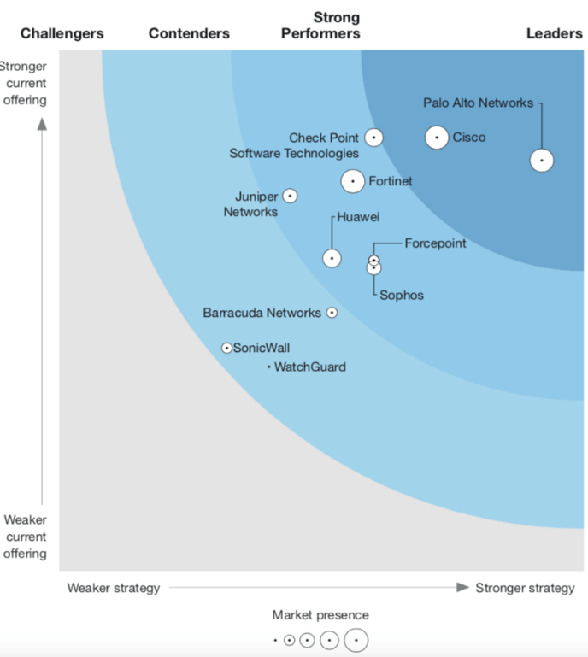
Cisco is a Leader
2020 Forrester Wave for Enterprise Firewalls
#1 in Current Offering
We earned top marks (5/5) in 20 out of the 34 criteria, for Zero Trust, cloud-delivered components, workload security, microsegmentation, and Firewall-as-a-Service
#1 in Market Presence
Forrester described Cisco as well-suited to meet the diverse requirements of large enterprise buyers (5/5 vs. 4.5/5 for PAN)
Leading with a Platform Strategy
Cisco was ranked a Leader in Strategy, with a perfect 5/5 for Product Vision
Cisco also earned the highest possible rating for threat intelligence
This demonstrates how the power of Cisco Talos continues to link and uplift the portfolio

Slide 20
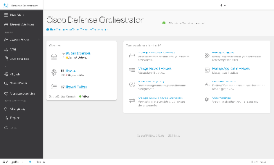
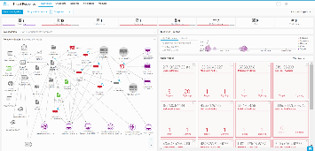
Unified Policy and Threat Visibility
Maintain consistent policies and stay ahead of threats with comprehensive visibility
Cisco Defense Orchestrator (CDO)
One consistent security policy across device types
Monitor and optimize your existing policies
Deploy new devices faster with templates
Track all changes over time across your environment
Reduce time spent on administrative tasks up to 90%
SecureX threat response
Aggregated threat intelligence and automate enrichment
Leverage pre-built /automated workflows to accelerate investigations
Share context between tools and teams
Enable corrective actions like blocking domains and isolating hosts
“Cisco Defense Orchestrator makes firewall builds, management, visibility, and auditing infinitely easier. Things that take 10 minutes in CDO take a day or more without it.”
Mike Muzinich Senior IT Network Administrator, Los Rios Community College District
“You cannot hit a target you cannot see. Threat Response really simplifies security analysis...”
Cyber Security Specialist at MSSP
Notes:
Staying on top of security is easier than ever. Cisco Defense Orchestrator (CDO) helps a network operations team easily manage policies across Cisco security products. It’s a cloud-based application that cuts through complexity. You can orchestrate and manage policies consistently from one spot to keep your organization protected against the latest threats. You can track all changes in the change log and roll back to a previous configuration at any time. You can also write a policy once and scale enforcement consistently across tens of thousands of security controls throughout your network.
As a cloud platform, clients are on-boarded within hours and within days you can be leveraging CDO to perform management across their portfolio of supported devices.
CDO dramatically reduces the time it takes managing your network. We have applied the ability to drive bulk changes across the most common of challenges such as policy management and image upgrades.
Example: We have a client that needed to upgrade the firmware on 40 ASA firewalls that she manages. Traditionally to do an upgrade across all of these firewalls it would take at least a day if not more for planning, deploy and monitor. Leveraging CDO, she was able to perform the upgrade in 30 minutes across all 40 ASAs. How much do you think 7 hours and 30 minutes is worth to that organization?
<click>
Cisco Threat Response unleashes the full power of our portfolio by automating integrations directly out of the box. It’s designed to dramatically cut the time and effort needed to detect, investigate, and remediate – thereby making your SOC operations more efficient and effective. It’s about making sure your organization has the best possible security posture and speeding up cyber investigations significantly.
<click>
Customers are seeing great benefits from both of these products.
<click>

Slide 21
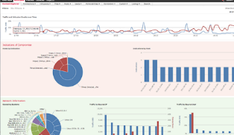
Unified Policy and Threat Visibility
Maintain consistent policies and stay ahead of threats with comprehensive visibility
Cisco Firepower Management Center (FMC)
Total visibility into your network
Advanced security automation
Intelligent threat analysis
Real-time threat management
SecureX threat response
Confirm threats and indicators of compromise automatically
Know instantly which of your systems was targeted and how
Manage and document key investigation information
Take corrective action like blocking suspicious files and domains directly from the interface
“We’re able to monitor the health of all devices in the network so we know when something’s failing and we’re able to isolate and fix those problems before they become disasters.”
Wes Dawes Senior Network Administrator, SugarCreek
“You cannot hit a target you cannot see. Threat Response really simplifies security analysis...”
Cyber Security Specialist at MSSP
Notes:
Centralize, integrate, and simplify management with Cisco Firepower Management Center (FMC).
This is your administrative nerve center for managing critical Cisco network security solutions. It provides complete and unified management over firewalls, application control, intrusion prevention, URL filtering, and advanced malware protection. Easily go from managing a firewall to controlling applications to investigating and remediating malware outbreaks.
<click>
Cisco Threat Response is the key pillar of our integrated security architecture, designed to get you more from your Cisco Security investments.
It unleashes the full power of our portfolio by automating integrations directly out of the box. It’s designed to dramatically cut the time and effort needed to detect, investigate, and remediate – thereby making your SOC operations more efficient and effective. It’s about making sure your organization has the best possible security posture.
Another great part? Cisco Threat Response is included as part of the Cisco Security product licenses... There’s nothing more to buy.
<click>
Customers are seeing great benefits from both of these products.
<click>

