Slide 1

Workplace Monitoring
Technology for a smarter, safer business

Slide 2

Understanding how people use your physical space is important for workflow, traffic monitoring, safety, and social distancing.
And it can affect your bottom line.
Customers Want to Be Safe
94%
62%
would stop shopping at a
retailer not taking health
and safety seriously.²
say stores need to have at least some health or safety measures in place to feel comfortable shopping again.¹
1. https://files.constantcontact.com/08defd39001/ca17d8e4-eba9-4f2a-9790-9a761139fd45.pdf
2. https://www.ipsos.com/en-us/news-polls/Brick-and-Mortar-Retail-for-Fear-of-Getting-Sick
© 2020 Cisco and/or its affiliates. All rights reserved. Cisco Confidential

Slide 3


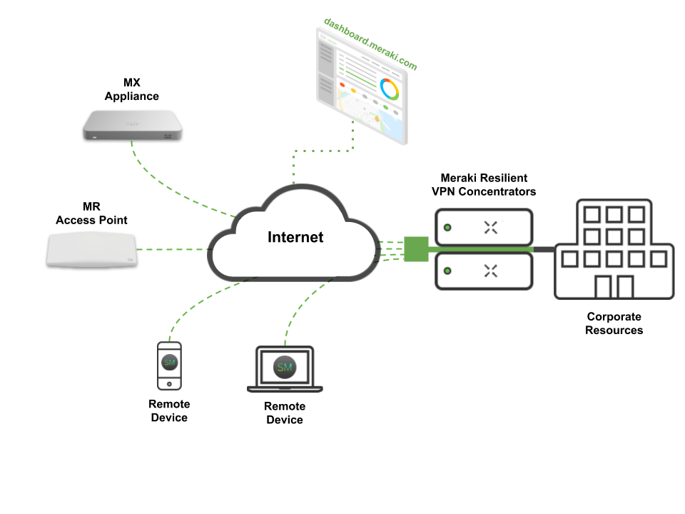
Workplace Monitoring
dashboard.meraki.com
DESIGNED
Meraki™
Smart Cameras
Meraki MX
Appliance
MR
Access Point
Remote Device
Internet
Remote Device
Protect customers and employees with object detection and motion heatmaps
Alerts with motion recap images let you take action.
Integrate smart cameras with other applications using the open APIs.
© 2020 Cisco and/or its affiliates. All rights reserved. Cisco Confidential

Slide 4
Monitor your premises to make smart decisions about safety, layout, and traffic flow.
© 2020 Cisco and/or its affiliates. All rights reserved. Cisco Confidential

Slide 5
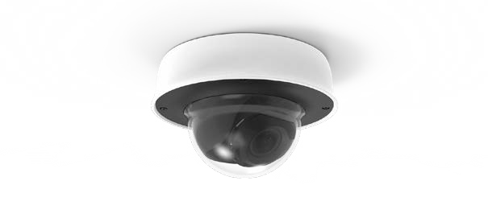
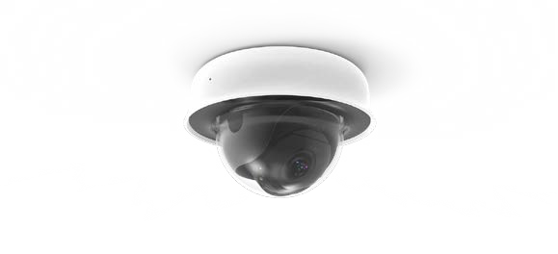
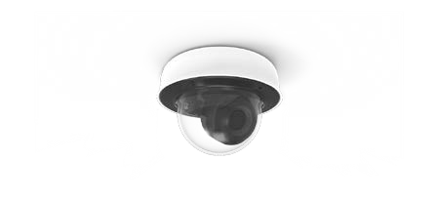
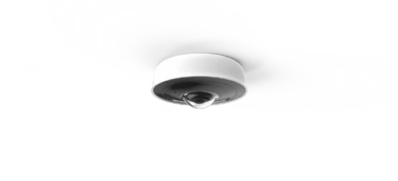
Meraki MV Smart Camera Family
Smart cameras with built-in intelligence
Smart cameras, not just security cameras
Managed in the cloud using the Meraki™ dashboard
Solid state storage on each camera, plus wireless and audio
Motion and schedule-based recording, plus cloud archive options
© 2020 Cisco and/or its affiliates. All rights reserved. Cisco Confidential
Notes:
®

Slide 6
Smart Cameras That Do More
Learn and provide more insights over time
Better understand customer behavior patterns
Provide context or trigger action in other systems
© 2020 Cisco and/or its affiliates. All rights reserved. Cisco Confidential

Slide 7



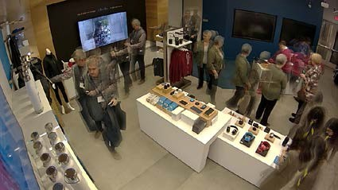
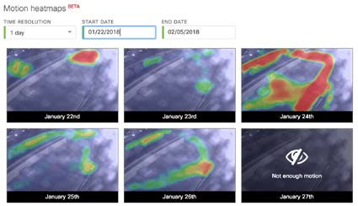
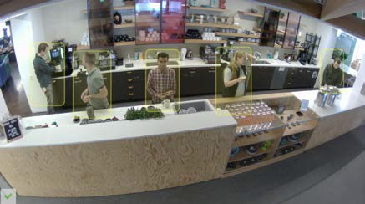
Physical Security Meets Business Intelligence
Motion Search
Motion Heatmaps
Object Detection
Isolate key motion events
Motion Recap results summarize activity in a single image
Easily export important video segments
See relative motion in an area over time
Hour-by-hour or
day-by-day view
Generated entirely from metadata
Detection and classification of objects
People counting over time
© 2020 Cisco and/or its affiliates. All rights reserved. Cisco Confidential

Slide 8
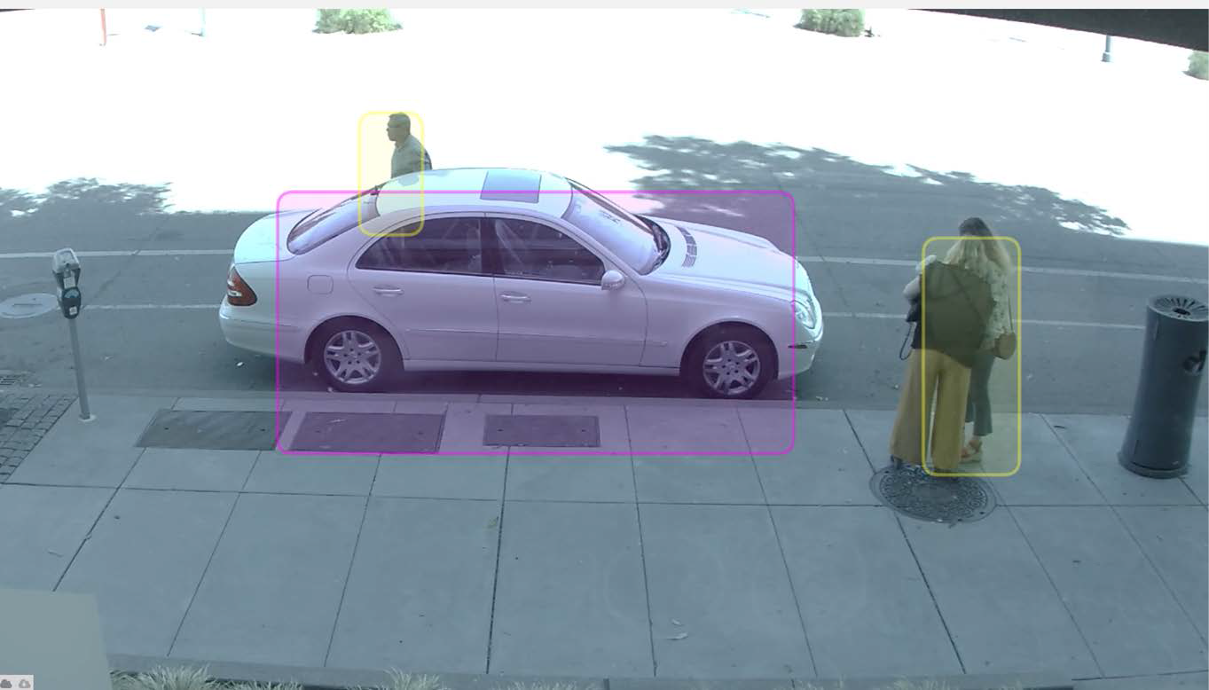
Object Detection
Anonymized person and vehicle detection
People counting to understand in-store behavior patterns
Vehicle detection and snapshot API for license plate recognition
© 2020 Cisco and/or its affiliates. All rights reserved. Cisco Confidential

Slide 9

Machine Learning
Historical Aggregate
Third-Party Applications
Request
How many were here at X time?
Input
Smarter data to solve tougher business problems
Current Snapshot
Request
Lots of
video data
How many are here now?
MV Computer Vision / Machine Learning Algorithm
Real-Time Feed
Subscribe
Subsecond feed of objects and location
© 2020 Cisco and/or its affiliates. All rights reserved. Cisco Confidential

Slide 10
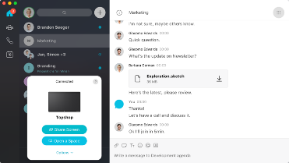
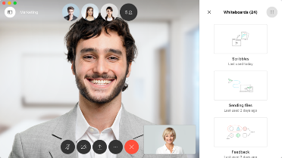
Solve Problems in Real Time
Use the API to connect a Meraki™ MV smart camera with Cisco® Webex Teams™.
Teams receives alerts with video links or snapshots for review.
If users need to take action, they can coordinate a response and stay in touch using Webex® to call or videoconference with just one click.
Seamless communication coupled with graphical, visual representations of incidents give you the power to take fast action.

Slide 11


Smart Cameras Designed with
Security in Mind
Hardware and software security, built-in
Automatic firmware upgrades
Automatic, always-on video encryption
Role-based access and audit logs
© 2020 Cisco and/or its affiliates. All rights reserved. Cisco Confidential

Slide 12
Simplify Deployments with
Wireless
Upgrade from analog security: Same coverage, greater simplicity and security with minimal downtime.
Remote or outdoor areas: Visibility into challenging locations far from the primary site.
Temporary site security: Security where you need it; run multiple cameras from a single cell signal.
© 2020 Cisco and/or its affiliates. All rights reserved. Cisco Confidential

Slide 13
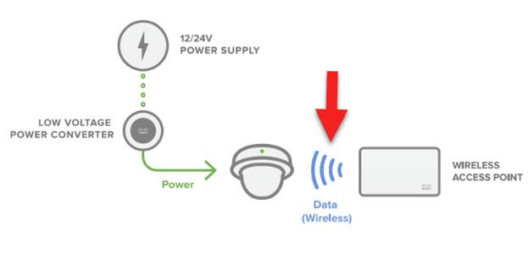
Connect to a Secure Wireless Network
Cisco® Meraki™ MR series access points include enterprise-class security to safeguard your network from attacks.
Cisco Meraki MX security appliances include firewall protection, intrusion detection, and content filtering.
© 2020 Cisco and/or its affiliates. All rights reserved. Cisco Confidential

Slide 14
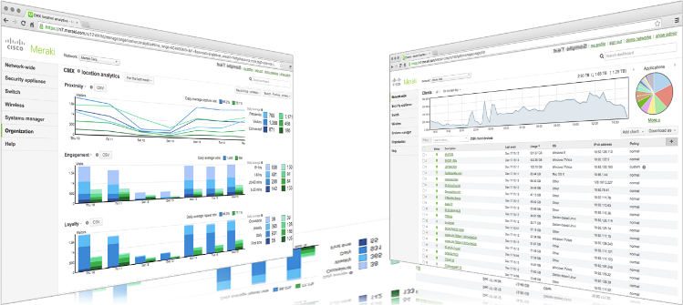
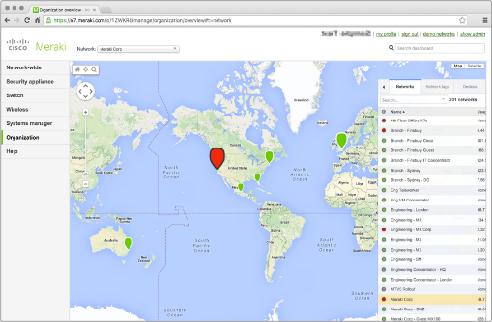



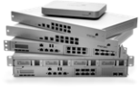

Use One Dashboard for the Network and Cameras
MR Wireless LAN
MS Ethernet Switches
MX Security Appliances
SM Enterprise Mobility Management (EMM)
Meraki™ Insight
MV Video
Surveillance
© 2020 Cisco and/or its affiliates. All rights reserved. Cisco Confidential

Slide 15
Workplace monitoring customer offers
Cisco® Meraki™ Test Drive
Get up and running in minutes
Webex® Work
Single collaboration solution in the cloud

