Slide 1

Cybercrime Protection
Protection from hackers that steal data and disrupt business

Slide 2
Cybercrime Protection
If a small business involves people, it is vulnerable to ransomware, phishing, and social engineering scams. Compromising email is big business. Small businesses need complete, layered security solutions because no one technology can prevent or eliminate cyberattacks by itself.
Small businesses need up-to-date and secure connections among networks, employees, and customers. And yet, many do not have the expertise or internal staff to do it themselves. Cisco® Partners help with affordable small business solutions that are just right for protecting and growing businesses.
Use this presentation to learn about:
The Cisco Designed Cybercrime Protection sales play
Positioning Cisco Designed Cybercrime Protection solutions
Presenting Cisco Designed complete Cybercrime Protection solutions
© 2020 Cisco and/or its affiliates. All rights reserved. Cisco Confidential
Notes:
Small business owners wear a lot of hats and field a lot of demands. Their employees are increasingly mobile and need a reliable network. Their customers expect a flawless digital experience. They are working to build the future and battling to keep it secure.

Slide 3
Positioning Cybercrime Protection Solutions
Cybersecurity is increasingly viewed as important as any other part of the organization by small business executives, but many still view cybersecurity as an expense, rather than an essential business cost. Obviously, every business needs good backup systems so they can restore their data if they’re attacked. But it’s better to stop a cyberattack before it damages anything in the first place. Protecting against cybercrime is a key IT challenge for small businesses.
Cisco® cloud-based security solutions are easy to set up. They also work better together and are easier to manage than separately sourced products. Small businesses get the peace of mind they need at a cost they can afford with Cisco Designed cloud-based security solutions.
Protect the business from cyberattacks by securing four key areas: people, devices, email, and the network.
Secure and protect confidential customer, employee, and partner data, while minimizing the ever-present threat of ransomware attacks, phishing, spoofing, and spam.
Protect users and devices with verified access, threat detection, and cloud-delivered security, so employees can work securely from any device, at any time, in any location.
Prevent, detect, and contain cybercrime with artificial intelligence and machine learning.
© 2020 Cisco and/or its affiliates. All rights reserved. Cisco Confidential

Slide 4

Cybercrime Protection
Protection from hackers that steal data and disrupt business
For: All vertical markets, particularly small and medium-sized managed service providers
Cisco products: Duo, AMP, Umbrella, Cloud Mailbox Defense, Meraki MX appliance
© 2020 Cisco and/or its affiliates. All rights reserved. Cisco Confidential

Slide 5

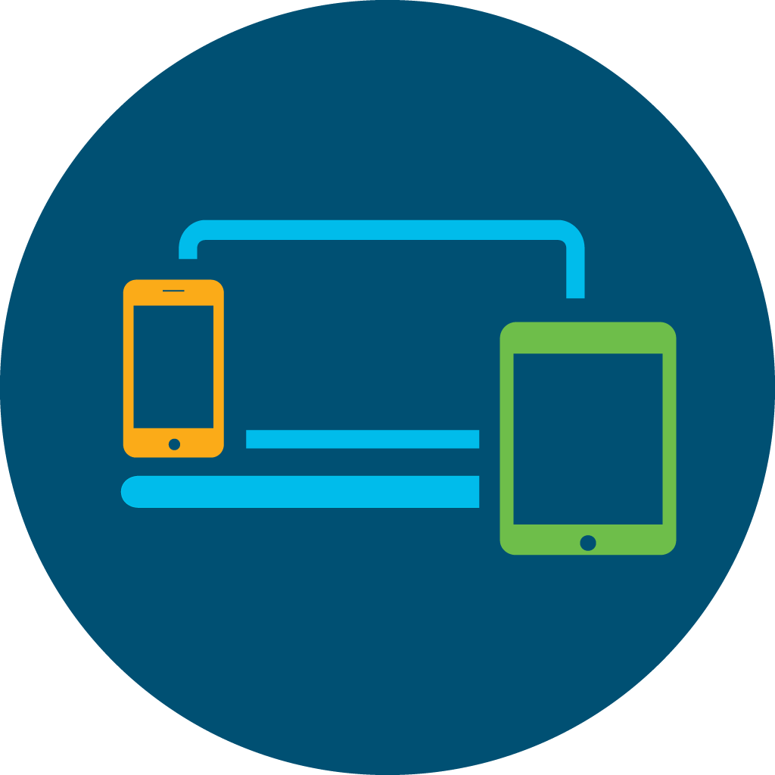
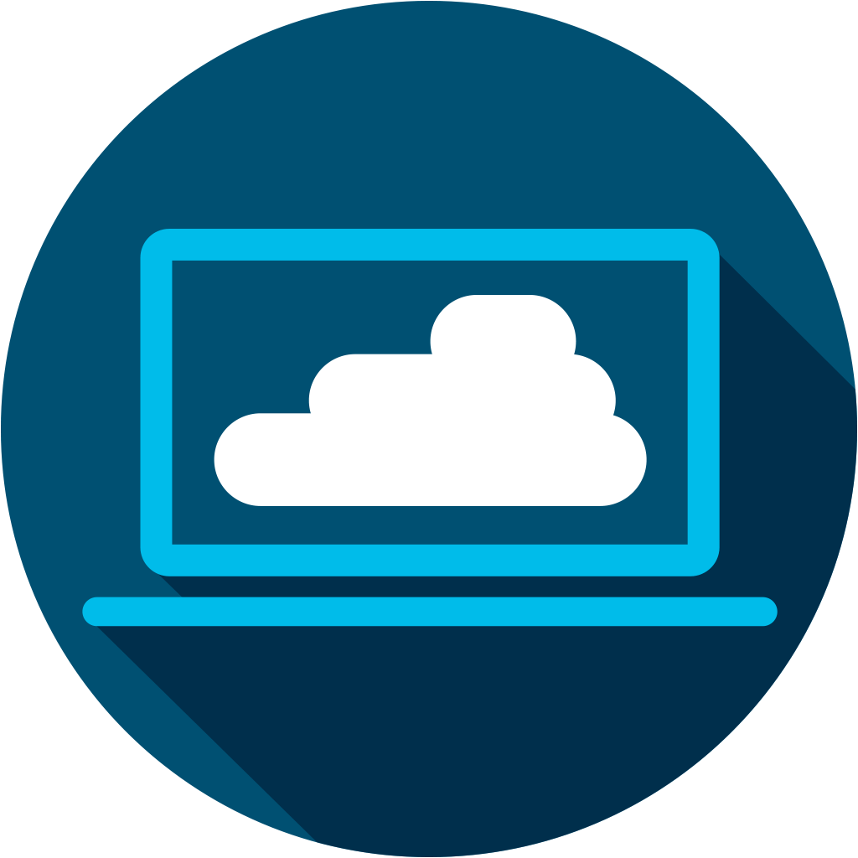

Help Secure Small Businesses
Small business owners know that security needs to be a priority because cybercrime can severely affect and disrupt the operations of any organization, of any size, in any industry, anywhere in the world. The tools they use to connect and secure their businesses workers must be affordable, reliable, and simple to use.
With Cisco® Designed cloud-based security solutions, you can help small business leaders secure four vulnerable areas:
People
Devices
Email
Network
© 2020 Cisco and/or its affiliates. All rights reserved. Cisco Confidential
Notes:
seure

Slide 6

Security Is Vital to Small Business Survival
Small businesses, regardless of size, should never compromise on security. Employees often need to share sensitive information, and when small businesses support remote employees, they have multiple sites and devices that are subject to attack. Small businesses face threats to their very existence if they fall victim to a cybersecurity breach.
76%
of small businesses worldwide have reported
a cyberattack¹
87%
Cyberattacks get more sophisticated all the time. But keeping ahead of the bad guys is exhausting, and finding the right solutions to protect people, devices, emails, and the network can get complicated.
Many businesses resort to disjointed tools from multiple vendors, leaving them with a complicated mess that’s still riddled with security holes.
of small business executives say security
is a high priority³
43%
of all cyberattacks target small businesses²
1.https://www.zdnet.com/article/76-percent-of-us-businesses-have-experienced-a-cyberattack-in-the-past-year/
2.https://enterprise.verizon.com/resources/reports/dbir/
3.https://www.cisco.com/c/en/us/products/security/ciso-benchmark-report-2020.html
© 2020 Cisco and/or its affiliates. All rights reserved. Cisco Confidential

Slide 7
Common Customer Pain Points
People
Devices
Email
Network
Can remote and
traveling employees securely access the network while they are away from the office?
Can user identities
easily be verified with two-factor authentication?
Are business applications
and user data protected
with strong access controls?
Can all devices be monitored to detect stealthy malware ?
Can risky endpoints be blocked from gaining access to business applications?
Can attacks be contained by quickly isolating infected endpoints?
Can viruses and malware from external emails be stopped before infecting the network?
Is the business protected from insider threats, account takeover and compromised email?
Can email flow policies be easily managed without disruption to email users?
Can network updates be automated to ensure 24 x 7 optimum security?
Can the network easily scale to accommodate growth and expansion?
Can the entire network be managed on or off-site through an intuitive dashboard?
© 2020 Cisco and/or its affiliates. All rights reserved. Cisco Confidential

Slide 8

Cisco Cloud-Based Cybersecurity Solutions
People
Email
Make sure that the people who access systems are who they say they are.
Every business uses email. And
everyday people click malicious links
or open harmful attachments
Cisco® Duo helps protect sensitive
data by verifying the identify
of users, devices, and
applications with secure
two-factor authentication.
Cisco Cloud Mailbox Defense is
a cloud-native email security platform for
Office 365.
People connect in multiple ways.
Mobile or remote workers may be connecting from an office, a home
laptop, or mobile device.
Devices
Network
Once malware finds a way in, it spreads across the network and encrypts files or takes down critical systems.
Cisco Umbrella® provides flexible, fast, and effective cloud-delivered security that blocks requests to sites hosting ransomware.
Meraki® MX appliances offer simple cloud management with security features such as firewalling, content filtering, intrusion detection and more.
Cisco Advanced Malware Protection (AMP) for Endpoints detects and blocks malware and viruses across employee devices.
© 2020 Cisco and/or its affiliates. All rights reserved. Cisco Confidential

Slide 9
Build a Practice
Small businesses are resilient and innovative and touch every part of the global economy. Small business leaders need experts to help them create added value from their technology. Show your customers you have the technical and business skills to create solutions that can help their businesses grow and thrive. Build your business, profitably, with Cisco® Designed solutions.
Small business should never be underestimated. Small business accounted for
44% of all IT spending before the Covid-19 pandemic.
2/3
90%
1/2
Employ 2/3 of the global workforce
of all businesses worldwide
Create ½ of the world’s GDP
Source: World Trade Organization
© 2020 Cisco and/or its affiliates. All rights reserved. Cisco Confidential

Slide 10
Partner Resources
and Offers

Slide 11


Resources for Cisco Partners
Marketing Velocity
SalesConnect
Co-brandable digital banners
Co-brandable infographics and essential guides
Email journeys
Social kits
Videos
Copy blocks
Sales play narrative
Conversation starters
Partner FAQs
Call guides
Presentations
Add URL here
https://www.cisco.com/go/ciscodesigned
© 2020 Cisco and/or its affiliates. All rights reserved. Cisco Confidential

Slide 12
Cybercrime Protection
Solutions
Partner Logo
Customer Presentation
[Speaker Name]
[Speaker Title]
[Date]

Slide 13
Cybercrime Protection
Encryption Key Infrastructure
Web Redirect
Exploit Kit Domains
Web Server
Compromised Site
or Malvertising
C2
C2
File drop
Malicious
Infrastructure
Ransomware
Payload
Web Link
Email Attachment
Email
Phishing or Spam
Blocked by Cisco® Cloud
Mailbox Defense
Blocked by Cisco Umbrella® (Cloud Security)
Blocked by Cisco AMP for Endpoints (Host Anti-Malware)
DNS
Get up and running quickly with cloud-based solutions
Protect the 3 key vectors that attackers use
Only multi-layered solution backed by Talos threat intelligence
© 2020 Cisco and/or its affiliates. All rights reserved. Cisco Confidential

Slide 14
Security Is Essential
• 76% of small businesses worldwide have reported a cyberattack.¹
• 43% of all cyberattacks target small businesses.²
• 87% of small business executives say security is a high priority.³
1. https://www.zdnet.com/article/76-percent-of-us-businesses-have-experienced-a-cyberattack-in-the-past-year/
2.https://enterprise.verizon.com/resources/reports/dbir/
3. https://www.cisco.com/c/en/us/products/security/ciso-benchmark-report-2020.html
© 2020 Cisco and/or its affiliates. All rights reserved. Cisco Confidential

Slide 15
Protect 4 key areas

Slide 16
Area #1: People
Make sure people are who they say they are
Cisco® Duo helps ensure that only authorized people are accessing your network. It helps protect your sensitive data by verifying the identity of users, devices, and applications with secure two-factor authentication.
© 2020 Cisco and/or its affiliates. All rights reserved. Cisco Confidential

Slide 17

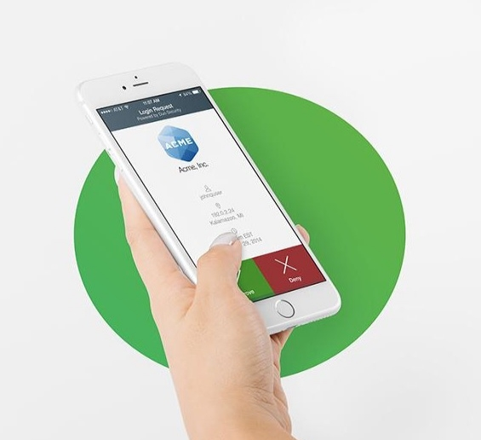
Secure Authentication
Cisco Duo
Instantly integrates with all apps
Users self-enroll in minutes
Users authenticate in seconds with no codes to enter
© 2020 Cisco and/or its affiliates. All rights reserved. Cisco Confidential
Notes:
Slide Objective (why to use the slide):
Duo has best-in-class MFA
Key Points:
Pioneers of Push technology for stronger security
Consistent workflow for all end-users is convenient and easy to use
Security focus - Out-of-band, context during authentication
Easy enrollment
Talking Points (how to use the slide):
Validating the user trust through an MFA solution
Duo Push is easy to use. Works on any smartphone. End-users simply tap a button to get access into applications
Duo provides a consistent workflow which is user friendly for authentication and easy to setup
End-users have a choice of authentication options when logging in
Show a simple login workflow with Duo Push - https://demo.duo.com/push
User can self-enroll their endpoints into Duo through different workflows to reduce the burden on IT admins
Most end-users enroll themselves in less than 5 minutes
Customer stories:
An IT admin called us from Stanford Health to share that he received a voicemail from a doctor, telling him that he liked using Duo (Duo Push for e-prescriptions) - this was the first time that a doctor ever thanked the IT admin for adding a new security solution.
Our customer Boston University was able to enroll 24000 students in less than 2 months

Slide 18
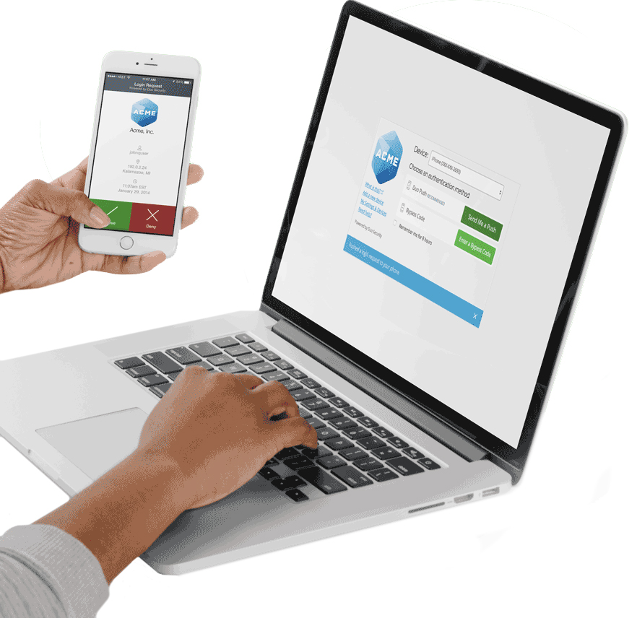
Cisco Duo
Why do you need multi-factor authentication?
80% of security breaches involve compromised passwords.¹
Verify user identities in seconds.
Protect any application on any device.
Enforce secure access to your applications and data.
© 2020 Cisco and/or its affiliates. All rights reserved. Cisco Confidential
^{1.} 2019 Data Breach Investigations Report, Verizon - via DBIR Interactive

Slide 19
Area #2: Devices
People get on your network in multiple ways from multiple locations: office, home laptop, mobile, device.
Cisco® Advance Malware Protection (AMP) for Endpoints detects and blocks malware and viruses across employee devices. If malware gets on any user’s device, it can then spread through your network. So you need advanced malware protection for all of your devices and critical servers.
© 2020 Cisco and/or its affiliates. All rights reserved. Cisco Confidential

Slide 20


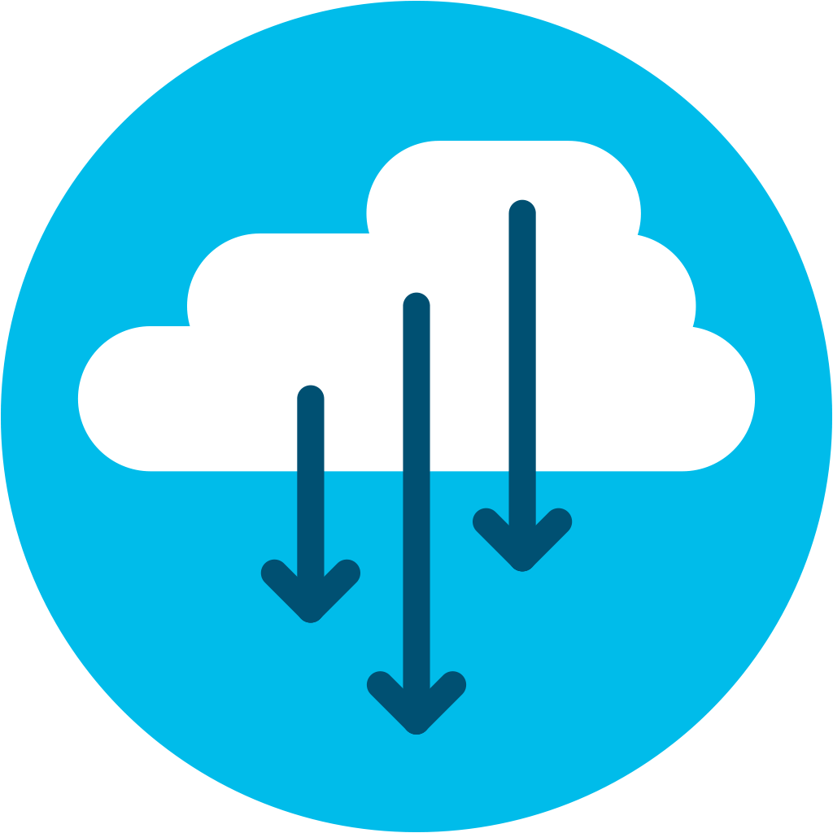


What Is Cisco AMP for Endpoints?
Next-gen endpoint firewall, Intrusion Prevention System (IPS), anti-virus and more
Cloud managed
Continuously monitors, records, analyzes all file activity
Protects Windows, Mac, Linux, and Android
© 2020 Cisco and/or its affiliates. All rights reserved. Cisco Confidential
Notes:
Very simply, AMP for Endpoints is a Next Gen Endpoints Security Solution that provides this visibility, context and control. It’s software as a service, cloud managed, deployed via a lightweight connector to protect endpoints running windows, mac, linux, and android

Slide 21
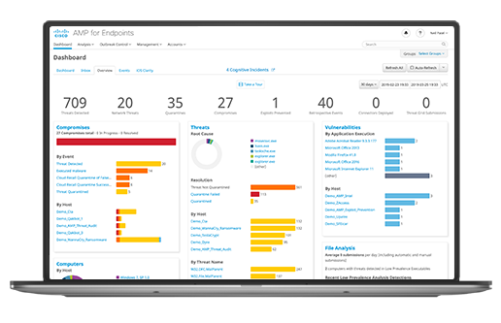
Cisco AMP for Endpoints
Why do you need endpoint security?
Laptops and mobiles are the most vulnerable endpoints for small businesses.
As malware becomes more evasive, traditional antivirus falls short in protecting your endpoints.
Endpoint security helps you to find the threat fast and see what it has affected.
Quickly stop threats from spreading and fast-track remediation.
© 2020 Cisco and/or its affiliates. All rights reserved. Cisco Confidential

Slide 22
Area #3: Email
Every day, people inadvertently click malicious links or open harmful email attachments that download ransomware.
Cisco Cloud Mailbox Defense is a cloud-native email security platform for Office 365 that you can set up in five minutes. It doesn’t change email flow or delivery while it’s busy spotting spam, phishing, or known malicious attachments.
© 2020 Cisco and/or its affiliates. All rights reserved. Cisco Confidential

Slide 23



Cisco Cloud Mailbox Defense
Cloud-native email security platform that focuses on
Visibility
Simplicity
Integration
All messages
Search / Triage
Open APIs
Deployment
Configuration
Management
Talos Intelligence
MS APIs
Cisco® Threat Response
Powered by Cisco Talos threat intelligence
© 2020 Cisco and/or its affiliates. All rights reserved. Cisco Confidential

Slide 24











Cloud Mailbox Defense
Sender reputation
Content scanning
URL reputation
File reputation
and analysis
Spam protection
Cloud
Mailbox
Defense
Malware
Phishing / BEC
Internal Threats
Account Takeover
© 2020 Cisco and/or its affiliates. All rights reserved. Cisco Confidential
Notes:
The next big thing is context. What we mean by that is having all your teams work available on hand in the meeting and having the ability to ‘meet’ before the meeting.
Before the meeting work can start - Webex Teams provides the space for the team to discuss things, share content - start working.
And when you get the the time of the meeting things have already started and all that discussion and work is available right there in the meeting.
You can simply share content from any device in the meeting - directly from the space, another, or from your desktop or mobile device - it really is that simple, wireless and fast! (unlike: having to go find content, find a lead to connect to the video system if in a room, or even email to all participants)
And it doesn’t stop there. The moment the meeting finishes, the work doesn’t - the team is still connected and can carry on, keep productive, check in on items discussed, provide updates and status reports - and all this is all available in the next meeting…
An added benefit of joining a meeting through Webex Teams is that during the meeting everyone is an equal participant and so can mange the meeting - mute noisy participants, record… without having to disrupt the flow of the meeting so keeping the productivity going
Slide Transition
Now let’s let’s look at the meeting experience through the lens of creativity…

Slide 25
Area #4: The Network
If malware gets in, it spreads across your network, and encrypts your files or takes down critical systems.
Cisco Umbrella® provides flexible, fast, and effective cloud-delivered security that blocks requests to sites hosting ransomware.
Cisco Meraki® MX appliances offer simple cloud management with security features such as firewalling, content filtering, intrusion detection, and more.
© 2020 Cisco and/or its affiliates. All rights reserved. Cisco Confidential

Slide 26
Cisco Umbrella
Cloud-delivered firewall
Secure web
Gateway (SWG)
Cloud access security broker (CASB)
Interactive
threat intel
DNS-layer security
Cisco®
Umbrella
© 2020 Cisco and/or its affiliates. All rights reserved. Cisco Confidential
SD-WAN
ON/OFF NETWORK DEVICES
Notes:
Umbrella integrates multiple security services — DNS-layer security, firewall, secure web gateway, cloud access security broker, and more — to centrally manage protection for all of your remote and branch locations
Having this functionality in a single platform is important because it helps to reduce the time, money, and resources previously required for deployment, configuration and integration tasks.
Equally important, is the flexibility to deploy what is needed by locations and users:
For some, that means DNS-layer security is the perfect fit
While for others, deeper inspection with the web gateway or cloud-delivered firewall is needed
Let’s first look at the broad set of visibility, protection and control that Umbrella can provide and then we will look at some of the key capabilities within each of the security services (or components) more closely.

Slide 27
Cisco Umbrella
Secure onramp to the internet, everywhere
Visibility
Protection
Control
On and off corporate network
All Internet and Web traffic
All apps
All devices
SSL decryption
DNS-layer security
Web inspection
File inspection
Sandboxing
Threat intel access
URL block/allow lists
Port & protocol rules
Content filtering
App blocking
Granular app controls
Powered by Cisco® Talos threat intelligence
© 2020 Cisco and/or its affiliates. All rights reserved. Cisco Confidential

Slide 28

CISCO
Global Threat Research and Intelligence
1%
120 TB
of Data Received Daily
threats that
matter
MILLIONS
of Telemetry Agents
Automated
Analysis
Specialized Tools
BILLIONS
of Malware, Email, DNS, Web, IPS, and Flow Metadata
250+
Full Time Threat
Intel Researchers
OVER 100
Threat Intelligence Partners
© 2020 Cisco and/or its affiliates. All rights reserved. Cisco Confidential
Notes:
In order to reduce the threats you face, you need the best threat intelligence. Cisco Talos is the largest threat detection network in the world, monitoring 35% of global email traffic, including 600 billion email messages and 1.5 million malware samples daily.
Talos is a recognized leader in threat detection as validated by NSS Labs. With over 250 highly skilled malware reverse engineers, threat analysts, and zero-day vulnerability research engineers, Talos catches threats that traditional security infrastructure and analysis systems can’t.
Talos has unique insight into email-based threats due to SenderBase reputation filtering. Our diverse customer base allows us to address and identify threats with unparalleled speed and agility. Each day we inspect billions of emails; drawing on layered detection technologies we’re going to talk about today. Talos blocks 200 billion malicious emails a day, or 2.3 million blocks per second.
With Talos, you’re able to see more anomalies, network intrusions and threats because Cisco delivers a 24/7 view into global traffic activity and keeps you up-to-date with the latest intelligence every 3-5 minutes. No other company can offer this comprehensive intelligence.
Live map of threats today: Malware = http://beta.senderbase.org/ebc_malware/. Email Spam = http://beta.senderbase.org/ebc_spam/.
Let's have a look at how Talos protects us…
-They start by gathering and analyzing telemetry from all the vectors on the left the bad guys seek to exploit.
-This allows us to develop a more complete picture of threats looking at billions of emails every day, a million malware samples, and so on. We connect elements from one area to another to correlate threats.
-Talos then uses automated analysis like artificial intelligence and machine learning to eliminate the majority of noise and threats.
-They then bring in a second layer of specialized tools…leaving only the 1% of advanced threats that matter for Talos researchers to address.
-The last part of the funnel is Talos researchers We have over 250 threat researchers around the world with expertise in hardware, malware analysis, vulnerability research, and more.
-All of this happens before any security alert gets to that SOC analyst. When something goes red, she knows it's for a reason.

Slide 29




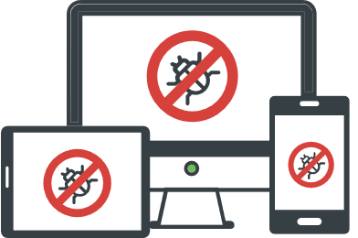

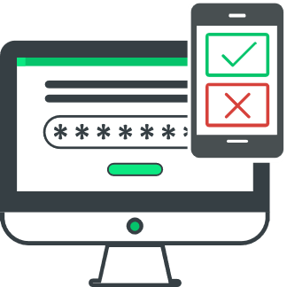
Harness the Power of Talos Threat Intelligence
Talos tracks threats across end points, networks, cloud environments, web, and email providing a comprehensive understanding of cyber threats and solid, actionable intelligence.
Talos security intelligence is the industry’s most powerful cyber threat protection.
19.7B threats blocked per day
600B emails inspected per day
1.5M malware samples per day
When you own a Cisco® security product, you’re automatically harnessing the power of Talos threat intelligence, which Cisco integrates into every solution.
© 2020 Cisco and/or its affiliates. All rights reserved. Cisco Confidential

Slide 30

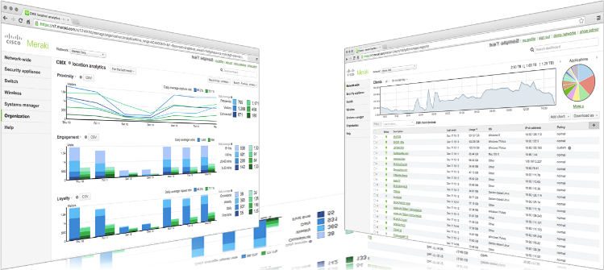
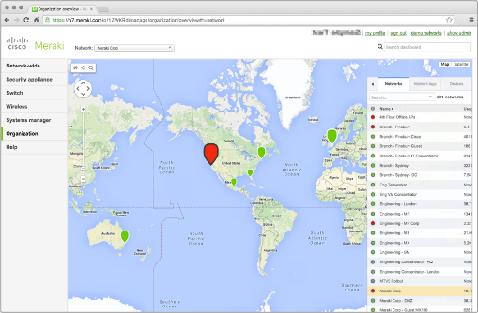
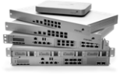




MR Wireless LAN
MS Ethernet Switches
MX Security Appliances
SM EMM
Cisco® Meraki Insight
MV Video
Surveillance

Slide 31
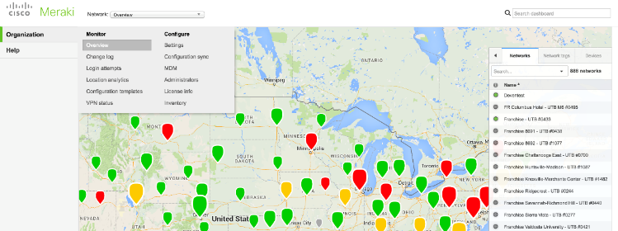
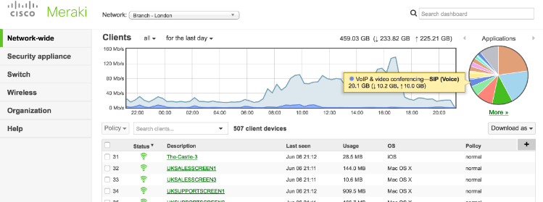
Simplifying IT with Cloud Management
A complete cloud-managed IT solution
Easy to deploy, manage, and support using the cloud
See all your employees, devices, and locations from one dashboard
Strong security with built-in unified threat management (UTM), device, network, and user security
© 2020 Cisco and/or its affiliates. All rights reserved. Cisco Confidential

Slide 32
Cybercrime Protection
“How do I protect my users from malware?”
AMP For Endpoints
“How can I stop malware when most of it comes through email?”
Cloud Mailbox Defense
“How can I stop my users from downloading malicious content wherever they are?”
Cisco Umbrella®
“How can I protect against stolen credentials?”
DUO Security
© 2020 Cisco and/or its affiliates. All rights reserved. Cisco Confidential

Slide 33
Customer Offers

Slide 34
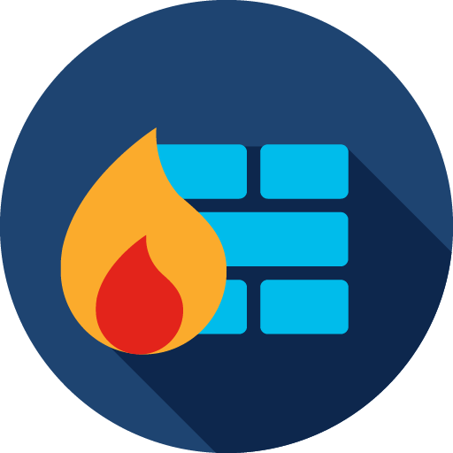



Cybercrime Protection Customer Offers
© 2020 Cisco and/or its affiliates. All rights reserved. Cisco Confidential

