Slide 1

Always-on Business
Keep IT simple and minimize capital expenditures

Slide 2
Always-On Business
There’s a high probability that your small business customers and prospects are already using applications that run in the cloud. Most small businesses are looking for simple approaches to IT while looking to avoid spending large amounts of cash on technology. Cloud-based technology offers a far more simple, secure, reliable and budget-friendly option.
Putting networking, security, and collaboration in the cloud is a great option for small business. And yet, many do not have the expertise or internal staff to do it themselves. Cisco® Partners help with affordable cloud-based solutions that are just right for small businesses.
Use this presentation to learn about:
The Cisco Designed Always-On Business Sales Play
Positioning Cisco Designed Always-On Business Solutions
Presenting Cisco Designed Always-On Business Solutions
© 2020 Cisco and/or its affiliates. All rights reserved. Cisco Confidential
Notes:
Small business owners wear a lot of hats and field a lot of demands. Their employees are increasingly mobile and need a reliable network. Their customers expect a flawless digital experience. They are working to build the future and battling to keep it secure.

Slide 3
Positioning Always-On Business Solutions
Small business need to be flexible, secure, and agile, all while managing costs and resiliency. Most small businesses are looking for simple approaches to IT while looking to avoid large cash outlays on technology. Cloud-based technology offers a far more simple, secure, reliable and budget-friendly option. Cloud-based solutions also are inherently more resilient than on-site IT and they’re easier to deploy and manage. The recurring cost model helps optimize cash flow and keep the business running.
Cisco cloud-based solutions are easy to set up and manage. Small businesses get the peace of mind they need at a cost they can afford with Cisco® Designed cloud-based “always-on” business solutions.
Improve cash flow, productivity and resiliency with cloud technology that is available all day, every day, 365 days a year.
Manage networks from the cloud with application visibility, real-time web-based diagnostics, monitoring, and reporting.
Protect the business against both known and emerging threats with cloud-based security.
Streamline remote teamwork with secure, easy-to-use video conferencing, messaging, and whiteboarding tools.
Verify users and devices so employees can work securely from any device, at any time, in any location.
© 2020 Cisco and/or its affiliates. All rights reserved. Cisco Confidential

Slide 4

Always-On Business
For small businesses who want to keep their IT simple and minimize capital expenditures.
For: Hospitality, retail, restaurants, sports & entertainment, manufacturing, transportation; small offices such as professional services: legal, finance, and real estate
Cisco products: Meraki® MR, MS, MX, MI, Cloud Mailbox Defense, Duo; Webex® Work, Umbrella®
© 2020 Cisco and/or its affiliates. All rights reserved. Cisco Confidential

Slide 5




Always-On Business Using Cloud Delivered IT
DESIGNED
Webex® Cloud
Cisco® Duo
Cisco AnyConnect®
Webex Teams™
Meraki® MX
Meraki MR/MS
Webex Work
Webex Calling
Cisco Umbrella®
Webex Meetings
Cisco AMP for Endpoints
dashboard.meraki.com
Shared global threat intelligence
Laptop
Home/
Remote Office
Office/branch
Mobile
Enable a remote workforce
with cloud-based tools
Gain flexibility, agility, and security
by using cloud-based solutions
Get access to enterprise-grade technologies
© 2020 Cisco and/or its affiliates. All rights reserved. Cisco Confidential

Slide 6





Help Small Businesses Collaborate Securely – Always On
Small business owners need to focus on growing their business; they don’t want to manage rigid solutions that can’t adapt. Cisco® solutions easily scale up and down to meet business demands, and the tools they use must be affordable, reliable, and simple to use. With Cisco Designed always-on cloud-based solutions, you can help small business leaders:
Protect vital information
Authorize
network access
Collaborate
securely
Secure
cloud email
Gain network
visibility
Improve
cash flow
© 2020 Cisco and/or its affiliates. All rights reserved. Cisco Confidential

Slide 7

The State of Cloud IT
Small business owners have a lot to do. The last thing they want to do is spend time dealing with IT problems, so it’s easy to see why so many of these small businesses are embracing cloud. With the cloud, small businesses can manage everything whether they’re in an office, on the move with a mobile device, or sitting at home with a laptop.
#1
Cloud-based solutions are the number one business priority for small business leaders.¹
4X
Cloud-based applications have become essential for most small business organizations. But these same organizations may be running their essential applications on out-of-date networking equipment that is unable to scale and is vulnerable to attacks.
And, as companies adopt new IT strategies to support remote workers, small business leaders are looking for guidance and help deploying more simple, reliable and secure solutions.
Companies that use cloud-based technology are up to 4 times more productive.³
84%
of small businesses feel cloud services are essential.²
1. https://techaisle.com/blog/394-2020-top-10-smb-and-midmarket-business-issues-challenges-priorities
2. https://sbecouncil.org/2020/06/17/small-businesses-pivot-to-thecloud-technology-platforms-and-cloud-services-critical-during-covid-19-according-to-survey
3. https://www.newgenapps.com/blog/how-small-businesses-use-cloud-computing-for-efficiency-and-profit/
© 2020 Cisco and/or its affiliates. All rights reserved. Cisco Confidential

Slide 8


Common Customer Pain Points
People/Devices
Collaboration
Email
Network
Can user identities
easily be verified with two-factor authentication?
Can all devices be monitored to detect stealthy malware ?
Can risky endpoints be blocked from gaining access to business applications?
Can attacks be contained by quickly isolating infected endpoints?
Can employees easily participate in team meetings while working from home?
Are remote employees using video to help them build and maintain customer relationships?
Can employees access team workspaces to share files securely and collaborate with each other?
Can viruses and malware from external emails be stopped before infecting the network?
Is the business protected from insider threats, account takeover and compromised email?
Can email flow policies be easily managed without disruption to email users?
Can network updates be automated to ensure 24 x 7 optimum security?
Can the entire network be managed on or off-site through an intuitive dashboard?
Is the network designed to grow over time?
Is there real-time web- based diagnostics, monitoring and reporting?
© 2020 Cisco and/or its affiliates. All rights reserved. Cisco Confidential

Slide 9
Cisco Cloud-Based Always-On Solutions
Cloud-based networking management can be ideal for businesses with growing or fluctuating demands and provide a level of agility that gives them an advantage over competitors.
Cloud solutions are more resilient than on-site IT and they’re easier to deploy.
With more people working from home, access to cloud-based business tools can simplify remote work. Cloud-based collaboration tools keep everyone secure and productive.
The “always-on” nature of cloud means that it’s always up to date. Small businesses get access to the latest application innovations and security, so they don’t have to spend time patching and fixing their own solutions on premises. Their employees can work from any device, at any time, from any location and access cloud-based security solutions.
Meraki products, with a focus on the Meraki Dashboard, enable customers to reduce operating costs and rapidly implement IT initiatives
Webex Meetings and Teams gives everyone the
ability to easily communicate and collaborate using the same, secure interface.
Cloud Mailbox Defense is a cloud-native email security platform for
Office 365.
Umbrella provides flexible, fast, and effective cloud-delivered security that blocks requests to sites hosting malware.
Duo helps ensure only authorized people are accessing the network.
Cisco®
Meraki®
Webex® Meetings
and Webex Teams™
Cloud Mailbox Defense
Cisco
Umbrella®
Cisco Duo
© 2020 Cisco and/or its affiliates. All rights reserved. Cisco Confidential

Slide 10
Build a Practice
Small businesses are resilient and innovative and touch every part of the global economy. Small business leaders need experts to help them create added value from their technology. Show your customers you have the technical and business skills to create solutions that can help their businesses grow and thrive. Build your business, profitably, with Cisco Designed solutions.
Small business should never be underestimated. Small business accounted for
44% of all IT spending before the Covid-19 pandemic.
2/3
90%
1/2
Employ 2/3 of the global workforce
of all businesses worldwide
Create ½ of the world’s GDP
Source: World Trade Organization
© 2020 Cisco and/or its affiliates. All rights reserved. Cisco Confidential

Slide 11
Partner Resources
and Offers

Slide 12


Resources for Cisco Partners
Marketing Velocity
SalesConnect
Co-brandable digital banners
Co-brandable infographics and essential guides
Email journeys
Social kits
Videos
Copy blocks
Sales play narrative
Conversation starters
Partner FAQs
Call guides
Presentations
Add URL here
https://www.cisco.com/go/ciscodesigned
© 2020 Cisco and/or its affiliates. All rights reserved. Cisco Confidential

Slide 13
Always-On Business
Solutions
Partner Logo
Customer Presentation
[Speaker Name]
[Speaker Title]
[Date]

Slide 14
Always-On Business Using Cloud Delivered IT
DESIGNED
Webex® Cloud
Cisco® Duo
Cisco AnyConnect®
Webex Teams™
Meraki® MX
Meraki MR/MS
Webex Work
Webex Calling
Cisco Umbrella®
Webex Meetings
Cisco AMP for Endpoints
dashboard.meraki.com
Shared global threat intelligence
Laptop
Home/
Remote Office
Office/branch
Mobile
Enable a remote workforce
with cloud-based tools
Gain flexibility, agility, and security
by using cloud-based solutions
Get access to enterprise-grade technologies
© 2020 Cisco and/or its affiliates. All rights reserved. Cisco Confidential

Slide 15

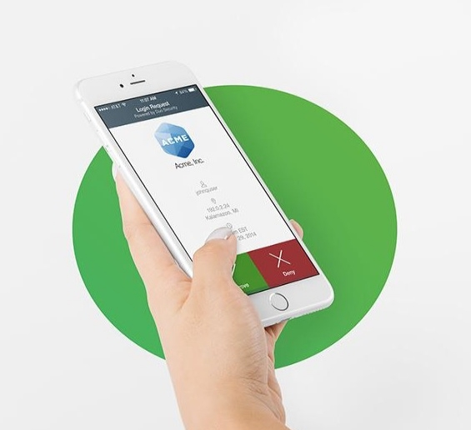
Secure Authentication
Cisco Duo
Instantly integrates with all apps
Users self-enroll in minutes
Users authenticate in seconds with no codes to enter
© 2020 Cisco and/or its affiliates. All rights reserved. Cisco Confidential
Notes:
Slide Objective (why to use the slide):
Duo has best-in-class MFA
Key Points:
Pioneers of Push technology for stronger security
Consistent workflow for all end-users is convenient and easy to use
Security focus - Out-of-band, context during authentication
Easy enrollment
Talking Points (how to use the slide):
Validating the user trust through an MFA solution
Duo Push is easy to use. Works on any smartphone. End-users simply tap a button to get access into applications
Duo provides a consistent workflow which is user friendly for authentication and easy to setup
End-users have a choice of authentication options when logging in
Show a simple login workflow with Duo Push - https://demo.duo.com/push
User can self-enroll their endpoints into Duo through different workflows to reduce the burden on IT admins
Most end-users enroll themselves in less than 5 minutes
Customer stories:
An IT admin called us from Stanford Health to share that he received a voicemail from a doctor, telling him that he liked using Duo (Duo Push for e-prescriptions) - this was the first time that a doctor ever thanked the IT admin for adding a new security solution.
Our customer Boston University was able to enroll 24000 students in less than 2 months

Slide 16

Cisco Duo
Why do you need multi-factor authentication?
80% of security breaches involve compromised passwords.¹
Verify user identities in seconds.
Protect any application on any device.
Enforce secure access to your applications and data.
© 2020 Cisco and/or its affiliates. All rights reserved. Cisco Confidential
^{1.} 2019 Data Breach Investigations Report, Verizon - via DBIR Interactive

Slide 17



Improve
Device Trust with Cisco Duo
Complete Visibility
Gain complete visibility into all laptops and mobile devices using Cisco® Duo’s native device visibility.
Assess Security Posture
Easily identify device security posture, and if they are managed or not based on enrollment in Mobile Device Management (MDMs)/Enterprise Mobility Management (EMMs).
Continuous Inspection
Continuously monitor if devices are infected with malware by using solutions such as AMP to prevent
them from reaching sensitive apps.
© 2020 Cisco and/or its affiliates. All rights reserved. Cisco Confidential

Slide 18

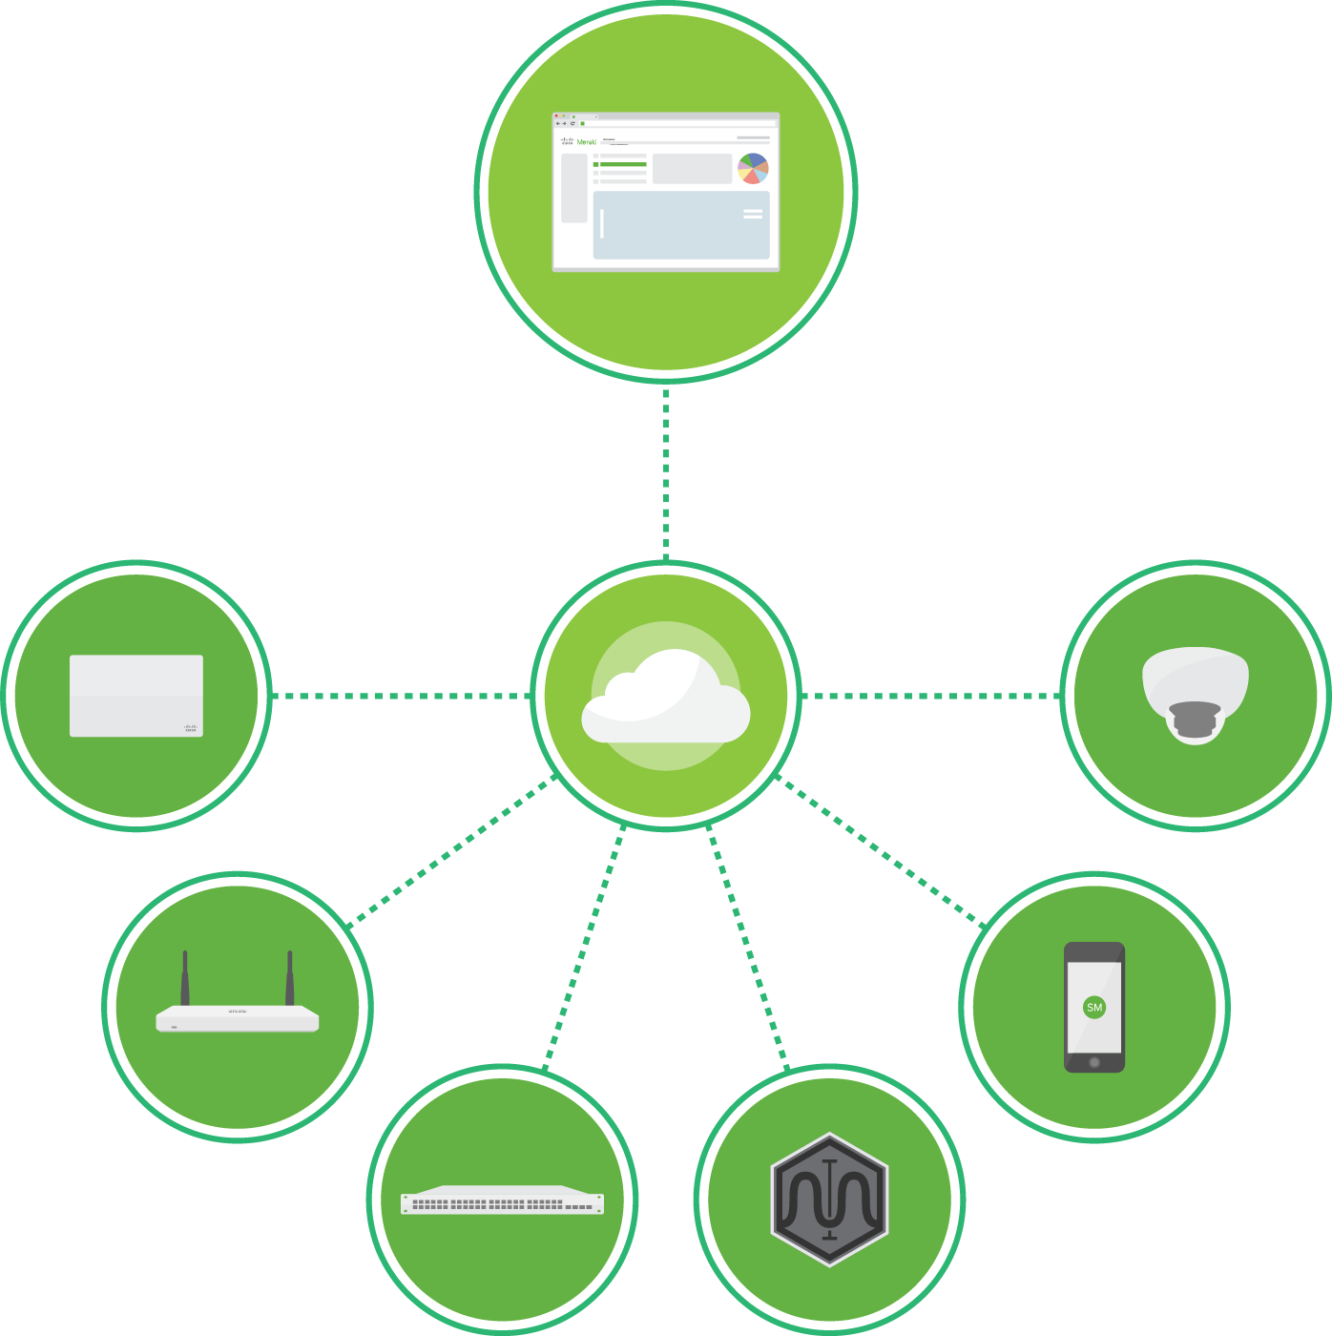
Simplifying IT with Cloud Management
A complete cloud-managed IT solution
Wireless, switching, security, SD-WAN, application performance management, unified endpoint management (UEM), and security cameras
Integrated hardware, software, and cloud services
TECHNOLOGY THAT SIMPLY WORKS
© 2020 Cisco and/or its affiliates. All rights reserved. Cisco Confidential
Notes:
Meraki was started in 2006, by a team of MIT research engineers. They were deploying free Wi-Fi for MIT and the surrounding town. However, they found that management, troubleshooting, and configuration was taking up a significant portion of their time, hindering from doing what they loved: the research. They devised a way to manage the network remotely from the cloud. They moved out to Silicon Valley and got funded by Google and Sequoia venture capital in 2007. The company started picking up steam, as organizations with lean IT teams found immense value in the simplicity of cloud management. Meraki caught the attention of Cisco in 2012, and was acquired, which allowed Meraki to have the best of both worlds: powerful Cisco technology integrated across a networking stack. Since the acquisition Meraki has expanded the cloud managed model to an entire networking stack beyond wireless – switching, SD-WAN, security/routing, endpoint management, and cameras.

Slide 19
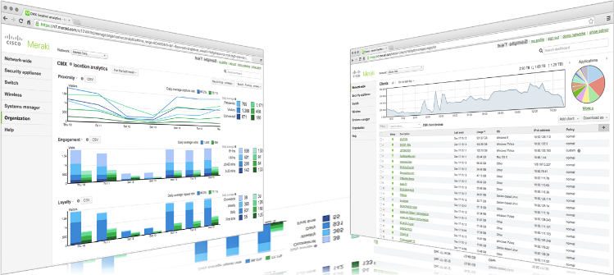
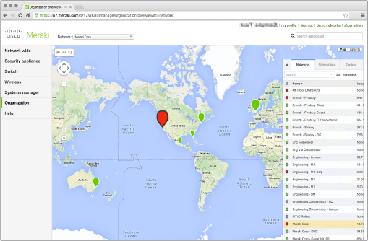
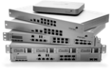




Simplifying IT with Cloud Management
MR Wireless LAN
MS Ethernet Switches
MX Security Appliances
SM EMM
Meraki® Insight
MV Video
Surveillance

Slide 20
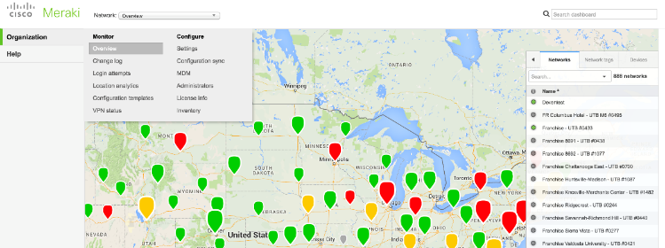
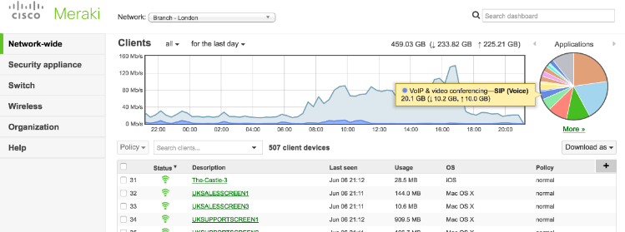
Simplifying IT with Cloud Management
A complete cloud-managed IT solution
Easy to deploy, manage, and support using the cloud
See all your employees, devices, and locations from one dashboard
Strong security with built-in unified threat management (UTM), device, network, and user security
© 2020 Cisco and/or its affiliates. All rights reserved. Cisco Confidential

Slide 21



Save Where It Really Matters with Meraki Simplicity
largely dependent on vendor negotiations
Gartner estimates that 80% of IT costs occur after the initial purchase.
Total Cost Savings of over
$178,000 over 3 years*
Time Savings of over 25 weeks’ worth man-hours*
For more, visit meraki.com/TCO
* Based on average Meraki customer
© 2020 Cisco and/or its affiliates. All rights reserved. Cisco Confidential
Notes:
Operating expenditures (OPEX) take up a vast majority of the overall cost of most network infrastructure. Having a solution that has a seamless user experience and management simplicity helps provide a large ROI over the course of time.
Direct cost savings
No purchase of WLAN controllers or centralized AP management
Included Enterprise Support
Included visibility & troubleshooting tools
Access to all existing and future cloud-based wireless features
Time savings
Intuitive, centralized, single-pane-of-glass dashboard
Plug-and-play deployment
Network configuration templates
Automated firmware and feature updates - HUGE time savings
Integrated analytics and reporting
Integrated packet capture and event logs - HUGE savings on troubleshooting
Real-time network access by Meraki Technical Support
No CLI (Meraki has a GUI-based web dashboard)

Slide 22
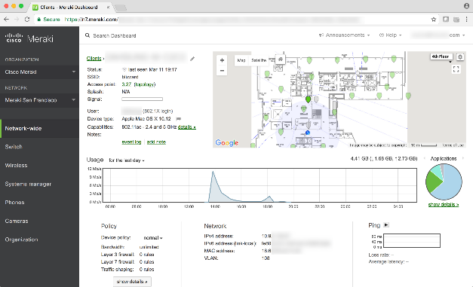
Meraki Dashboard
420k+
Unique customers
5.7M+
Meraki® devices
online
30M+
API requests per day
© 2020 Cisco and/or its affiliates. All rights reserved. Cisco Confidential
Notes:
Backed by a wealth of networking data and insights, Meraki helps you get things done, so you can do more.

Slide 23



Cisco Cloud Mailbox Defense
Cloud-native email security platform that focuses on
Visibility
Simplicity
Integration
All messages
Search / Triage
Open APIs
Deployment
Configuration
Management
Talos Intelligence
MS APIs
Cisco® Threat Response
Powered by Cisco Talos threat intelligence
© 2020 Cisco and/or its affiliates. All rights reserved. Cisco Confidential

Slide 24











Cloud Mailbox Defense
Sender reputation
Content scanning
URL reputation
File reputation
and analysis
Spam protection
Cloud
Mailbox
Defense
Malware
Phishing / BEC
Internal Threats
Account Takeover
© 2020 Cisco and/or its affiliates. All rights reserved. Cisco Confidential
Notes:
The next big thing is context. What we mean by that is having all your teams work available on hand in the meeting and having the ability to ‘meet’ before the meeting.
Before the meeting work can start - Webex Teams provides the space for the team to discuss things, share content - start working.
And when you get the the time of the meeting things have already started and all that discussion and work is available right there in the meeting.
You can simply share content from any device in the meeting - directly from the space, another, or from your desktop or mobile device - it really is that simple, wireless and fast! (unlike: having to go find content, find a lead to connect to the video system if in a room, or even email to all participants)
And it doesn’t stop there. The moment the meeting finishes, the work doesn’t - the team is still connected and can carry on, keep productive, check in on items discussed, provide updates and status reports - and all this is all available in the next meeting…
An added benefit of joining a meeting through Webex Teams is that during the meeting everyone is an equal participant and so can mange the meeting - mute noisy participants, record… without having to disrupt the flow of the meeting so keeping the productivity going
Slide Transition
Now let’s let’s look at the meeting experience through the lens of creativity…

Slide 25
Cisco Umbrella
Cloud-delivered firewall
Secure web
Gateway (SWG)
Cloud access security broker (CASB)
Interactive
threat intel
DNS-layer security
Cisco®
Umbrella
© 2020 Cisco and/or its affiliates. All rights reserved. Cisco Confidential
SD-WAN
ON/OFF NETWORK DEVICES
Notes:
Umbrella integrates multiple security services — DNS-layer security, firewall, secure web gateway, cloud access security broker, and more — to centrally manage protection for all of your remote and branch locations
Having this functionality in a single platform is important because it helps to reduce the time, money, and resources previously required for deployment, configuration and integration tasks.
Equally important, is the flexibility to deploy what is needed by locations and users:
For some, that means DNS-layer security is the perfect fit
While for others, deeper inspection with the web gateway or cloud-delivered firewall is needed
Let’s first look at the broad set of visibility, protection and control that Umbrella can provide and then we will look at some of the key capabilities within each of the security services (or components) more closely.

Slide 26
Cisco Umbrella
Secure onramp to the internet, everywhere
Visibility
Protection
Control
On and off corporate network
All Internet and Web traffic
All apps
All devices
SSL decryption
DNS-layer security
Web inspection
File inspection
Sandboxing
Threat intel access
URL block/allow lists
Port & protocol rules
Content filtering
App blocking
Granular app controls
Powered by Cisco® Talos threat intelligence
© 2020 Cisco and/or its affiliates. All rights reserved. Cisco Confidential

Slide 27



© 2020 Cisco and/or its affiliates. All rights reserved. Cisco Confidential
One core experience
Simple and fast however you work, wherever you work
Video-first
Mobile-optimized
App-
and device- optimized
One button to push
Empower
a more intuitive
way to work
Notes:
One core experience providing continuity across all collaboration modes – hardware devices, software applications, meetings, team collaboration…and even calling.
This enables us to humanize how people and teams connect with one core experience, that intelligently adapts to users workstyle to provide more intuitive interactions.
And this drives value for all users especially as work gets done in more places and across distributed teams inside and outside your organization.
In April 2018 we extended core experience across all cloud meeting apps (Webex Meetings and Teams) and devices – delivering a share meeting that adapts to the way you work – with simple one- button to push, multistream video, shared participant lists and unified controls – however you work.
Services that are app and device optimized allows users to connect, pair and share from the video device of their choice to deliver the most engaging experience whether they join from Webex Meetings or WebEx teams so everyone can focus on the meeting and the work, not the technology to produce their best work with no compromises.

Slide 28




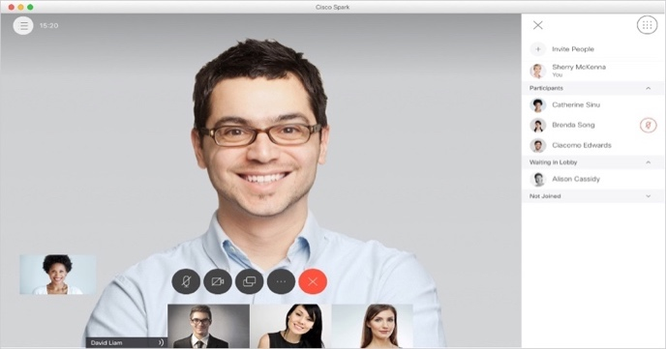
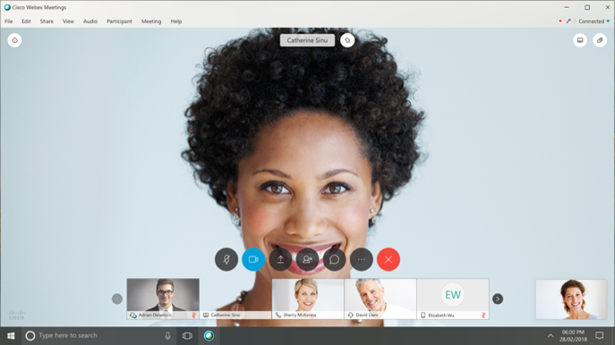
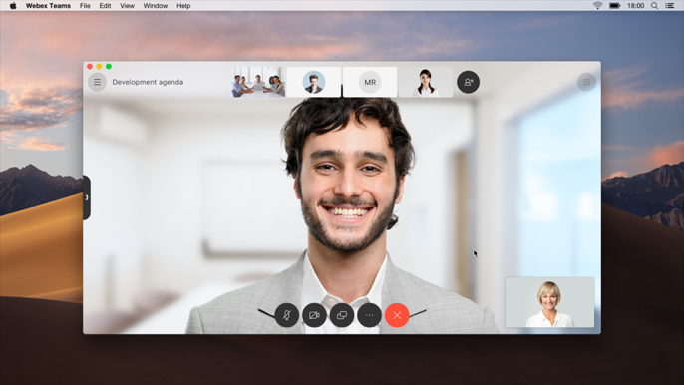
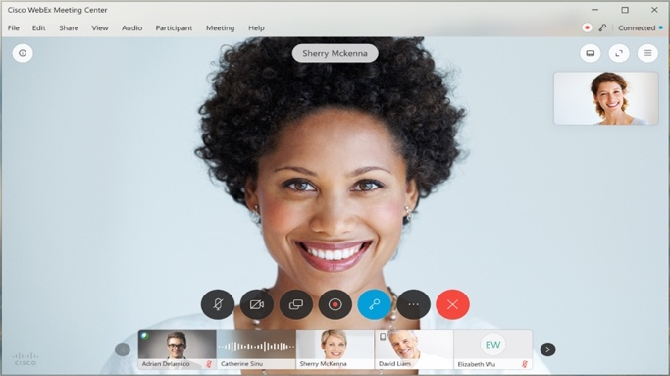
One modern platform
Common capabilities: PSTN, roster, meeting controls*
Webex® Meetings
Webex Devices
Webex Teams™
© 2020 Cisco and/or its affiliates. All rights reserved. Cisco Confidential
Notes:
We bring this together on one modern platform – Cisco Webex
Alignment of Webex Meetings and Webex Teams along with our Webex Devices
This provides a lot of efficiencies b/c we have a converged backbone which Jonathan will touch on more later
Also gives us a lot of common capabilities across all of these experiences
User experience
PSTN audio
Common roster lists
Meeting controls
We don’t want users to skip a beat as they move throughout their day

Slide 29

Cisco Webex
Most widely adopted and trusted meetings service on the market
130+ million meeting attendees per month
18+ billion meeting minutes per month
100+ million meetings hosted per month
© 2020 Cisco and/or its affiliates. All rights reserved. Cisco Confidential
Notes:
Cisco Webex provides a powerful feature set you need to keep your teams engaged and productive
This is why it is the market leading meetings solution

Slide 30




Always-On Business
Offers
© 2020 Cisco and/or its affiliates. All rights reserved. Cisco Confidential
Notes:
tes

Slide 31
Always-On Business
Offers
Meraki Test Drive
Cisco Threat Defense Solution
© 2020 Cisco and/or its affiliates. All rights reserved. Cisco Confidential
Notes:
tes

