Slide 1
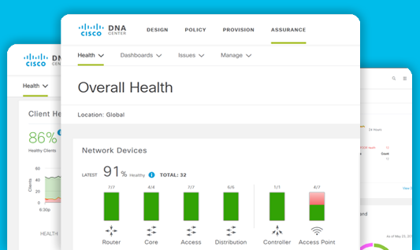
Activate your Cisco DNA Center
Take advantage of a better way to control your network

Slide 2
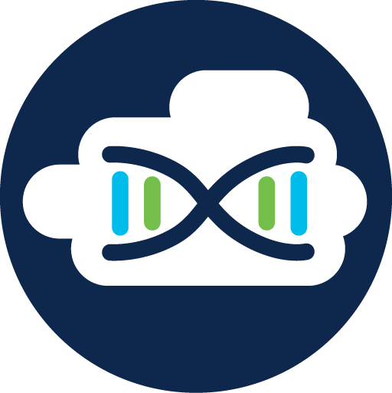
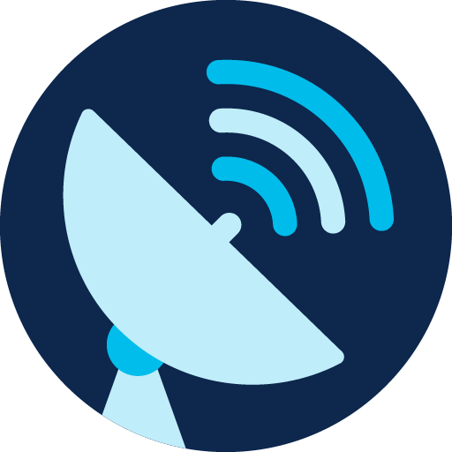
Cisco DNA Center
The best tool for network management and control is already in your possession.
A management platform for all of your network.
An SDN controller for automation of your virtual devices and services.
An assurance engine to guarantee the best network experience for users.

Slide 3
You have a Cisco DNA Center license because you invested in: Cisco Catalyst 9000 Series Switches

Slide 4
Cisco DNA Center offers a single dashboard for every core function in your network
Simplify network management
Lower operational costs
Deploy networks in minutes, not days
Eliminate error-prone manual tasks
Improve operational processes with third-party integration
Proactively monitor, troubleshoot, and optimize
Notes:
Short and relevant: Stay focused on what your audience cares about. Think about what you want them to know, feel and do. Then, say what you need to say and no more.
Bold and human: Be confident in your ideas and in the words you use to express them. Use clear, natural language to connect with your audience and make your message stick.
Show what’s possible and make it real: We call this Dreaming and Doing. When we do it right it's powerful, inspiring, convincing and persuasive.
To learn more, download the brand language guidelines: https://cisco.jiveon.com/docs/DOC-660269

Slide 5
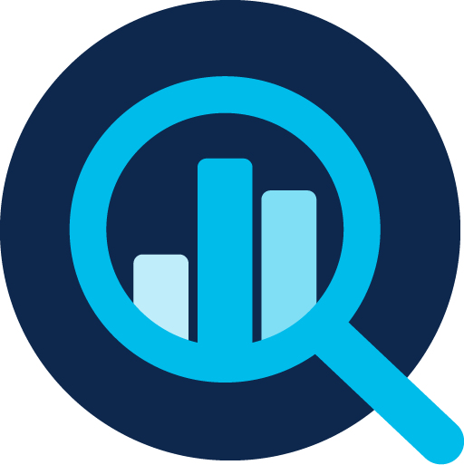
Benefits by the numbers
Up to
67%
savings in network provisioning time
Up to
80%
improved issue resolution
Up to
61%
reduction in operating expense
Up to
reduction in impact of security breaches
48%
Based on an internal TCO analysis
Notes:
Short and relevant: Stay focused on what your audience cares about. Think about what you want them to know, feel and do. Then, say what you need to say and no more.
Bold and human: Be confident in your ideas and in the words you use to express them. Use clear, natural language to connect with your audience and make your message stick.
Show what’s possible and make it real: We call this Dreaming and Doing. When we do it right it's powerful, inspiring, convincing and persuasive.
To learn more, download the brand language guidelines: https://cisco.jiveon.com/docs/DOC-660269

Slide 6
Your operational advantages

Slide 7
Multiple tools with multiple interfaces add complexity, increasing the probability of errors in configuration and management.
Changing between interfaces during network operations is time consuming and makes simple tasks longer to complete.
Automatic troubleshooting with guided remediation is complex. Third-party tools can tell you if a problem is due to the network or an application, but they can’t offer guided remediation.
The challenges of multiple network management tools

Slide 8
Network management
Automation
Visualization
Analytics and assurance
Security
IoT connectivity
Integration with your business-critical tools
What used to require multiple third-party software tools can now be done through Cisco DNA Center:
34% of network managers use 11 or more tools for network monitoring and troubleshooting.
Source: EMA Research, Digital Enterprises Require a Next-Generation Wireless Platform, 2018.

Slide 9
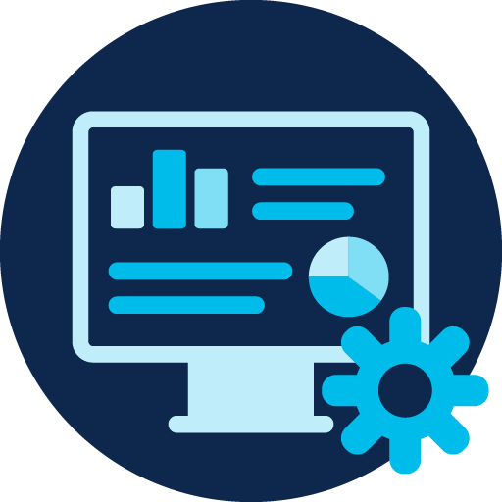
Reasons to activate your Cisco DNA Center
Provides a detailed view of every network device and client performance. Provides granular troubleshooting in seconds.
Offers network history view so operator can see the cause of an issue, instead of trying to re-create in a lab.
Perform a common, and critical, troubleshooting task in one click that normally requires 6 to 10 minutes.
Updates the preferred performance curve in real time, as network conditions change. The result is 75% fewer issues to troubleshoot.

Slide 10
Reasons to activate your Cisco DNA Center
Speeds and simplifies deployment of new software images and patches. Pre-and post-checks help prevent issues with upgrade.
Enables deployment of new devices in minutes, and without onsite support visits.
Saves time in setting up network virtual services.
Detects malware, attacks, and other threats.

Slide 11
Cisco DNA Center
Run your network with maximum performance, reliability, security, and open interfaces.
“I’ve been impressed with Cisco DNA Center. It’s reliable, easy to use, and has truly simplified our work.”
Daniele De Francesco, Network and Security Engineer, Lutech Group

Slide 12
How to activate your Cisco DNA Center license Attend an Ask the Expert session or schedule an Accelerator consultation http://go.tklgo.cisco.com/acc-atx

