Slide 1
Cisco Business Wireless
Insert Presenter Name here
Organization
Date

Slide 2
Agenda
1
Why do small businesses matter?
2
Cisco Business
3
Why Cisco Business Wireless?
4
What is Cisco Business Wireless?
5
Summary

Slide 3

Small Business is Big Business
50%
66%
75%
30%
Creates 1/2 of world’s GDP
Employ 2/3 of work force
Eager to embrace new technology
Yet find adoption of technology a challenge
Source: World Bank, Accenture

Slide 4

Pricing Information – Multipacks
$630B
2020
2018
Compound annual growth rate 5.6%
12 billion mobile devices
Integration of
on-prem and cloud
26% have multiple locations
$630 billion
Revenue growth as the most cited drivers
1/3 use social media
as info source for
new technology
Leverage eComm
and MSPs
Emergence of analytics
60% will have a
mobile workforce
Source: IDC, Analysys Mason, Forrester

Slide 5

Small Business – What We’ve Learned
Priorities
Business growth and market share
Managing operational budgets efficiently
Customer experience and business reputation
Attracting and retaining talent
Business growth
Uptime and reliability
Security threats
Network demands and capabilities
Price/TCO
Scale
Priorities
Triggers
Triggers
Digital transformation
Aligning IT to new opportunities and customer needs
Involved in IT purchase decisions
Take recommendation from social media/online resources
Advise and support small businesses with new technology
Monitor the performance of networking infrastructure
Maintain the infrastructure
Ticket and case closure
DIY small business owner
MSPs/VARs
IT manager

Slide 6
Agenda
1
Why do small businesses matter?
2
Cisco Business
3
Why Cisco Business Wireless?
4
What is Cisco Business Wireless?
5
Summary

Slide 7

1
Cisco’s New Global ”Storefront” Brand for Our Digital Experience
Small Business Branding
Portfolio Brand
2
Current state
New Brand
Cisco Small Business
Cisco Business
Product Line / Model Naming [rolled out over 2020-2021]
Cisco Business
Cisco Business Switch (CBS)
Cisco Business Wireless (CBW)
Cisco Business Router (CBR)
Cisco Business Dashboard (CBD)
Security (TBD)
3

Slide 8
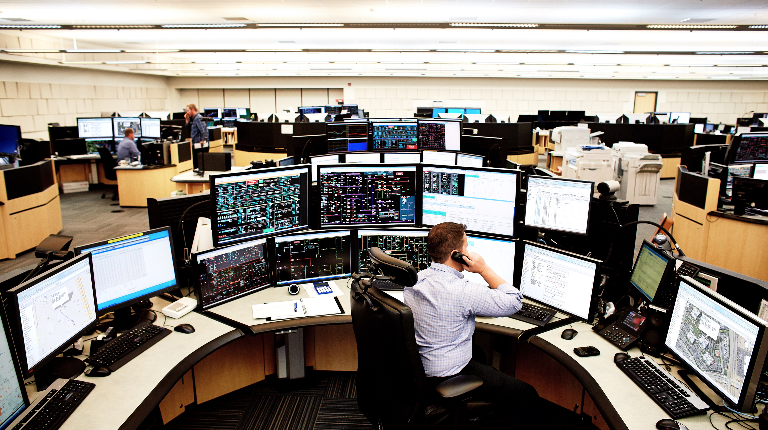

Business is a Journey
Stages of Business Journey*
Small Business Portfolio
Quality Over Price
Operation efficiency and cost optimization
Enhancement of current IT
Vendor evaluation
Established
Meraki
Catalyst
Aironet
ISR
Value For Money
Focus on business growth
Scalability
Proven technology
Evaluation/pilot of new technology
Expansion
Price Conscious
Basic IT infrastructure
No complication and prefer easy installation
Conservative buyer to avoid disruption
Start-up
*Source: Gartner

Slide 9

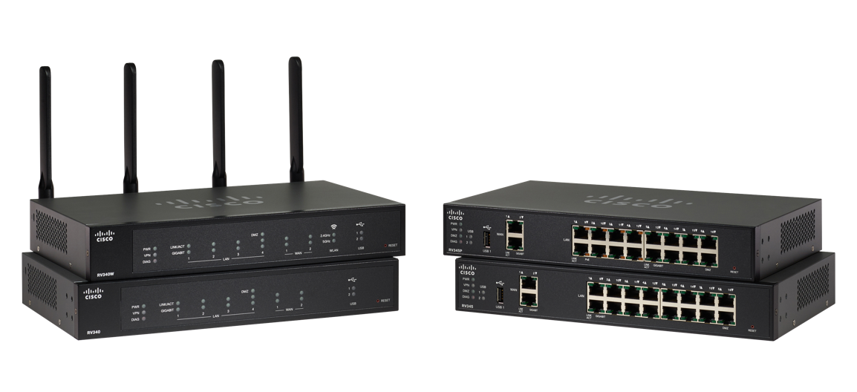
Building on Our Strong Foundation
Support It
World class customer experience organization
Tech Support delivered in 9 different languages
Secure It
Leading company for threat research
Dedicated team to focused on Product Security
Test It
Solution level testing
Security Baselines
Human factor testing
Build It
Same standards as Enterprise equipment
World class dev team
Design It
Making investments in user experience
Design Thinking
UX design

Slide 10
Agenda
1
Why do small businesses matter?
2
Cisco Business
3
Why Cisco Business Wireless?
4
What is Cisco Business Wireless?
5
Summary

Slide 11




Why Cisco Business Wireless
Simple
Flexible
Secure
  Set up in minutes and expand wireless coverage with mesh extenders. Simplified management and operations with Mobile app or web dashboard so you can spend more time tending your business
  Innovative product portfolio meets the evolving business challenges, improves agility for greater business outcomes
  Advanced security protocols provides a solid security foundation, ensuring privacy and business continuity

Slide 12

Why Grow with Cisco Business
Note to presenter:
This slide is intended for small business owners
The life of a
small business owner today…
Complex
Networks
Limited IT
Support
Security & privacy
Reliability
Balancing performance and cost
Cisco Business makes your life easier
Set up in minutes. Simplified management and operations
Support from experts + limited lifetime warranty
Integration with Cisco Umbrella
Proven solution with flexible deployments
Enterprise grade solution at small business prices

Slide 13
Why Grow with Cisco Business
Note to presenter:
This slide is intended for partners
The life of a
partner today…
Complex networks
Client
Support
Security & Privacy
Reliability
Competitive Pricing
Cisco Business makes your
life easier
Set up in minutes. Simplified management and operations
Partner Enablement Training
Proven Solution, with flexible deployments
Enterprise grade solution at small business prices
Integration with Cisco Umbrella

Slide 14
Agenda
1
Why do small businesses matter?
2
Cisco Business
3
Why Cisco Business Wireless?
4
What is Cisco Business Wireless?
5
Summary

Slide 15
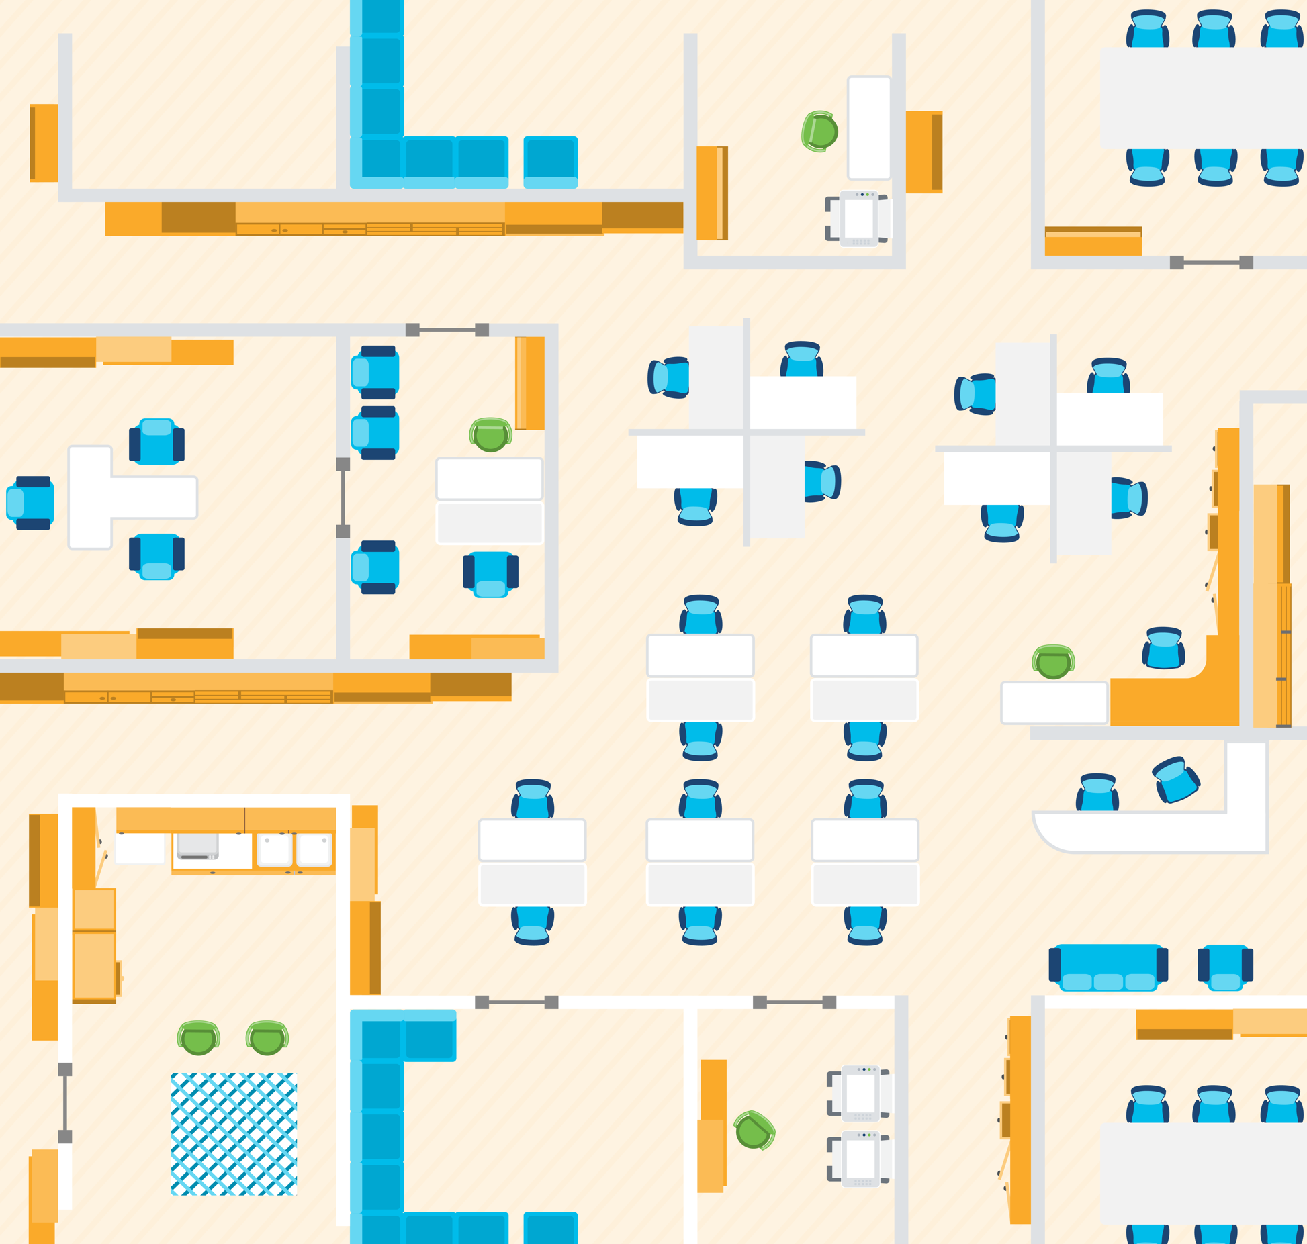
Cisco Business Wireless Access Points
Predictable performance and compact form for
small- to mid-size businesses
Enterprise-class 802.11ac Wave 2 with multiuser multi-Input multi-Output (MU-MIMO) functionality
Gigabit Ethernet ports with PoE support
Cisco Business Wireless Mesh Extenders
Extend coverage of Cisco Business Wireless access points
Multiple form factors with option to connect to wired devices

Slide 16

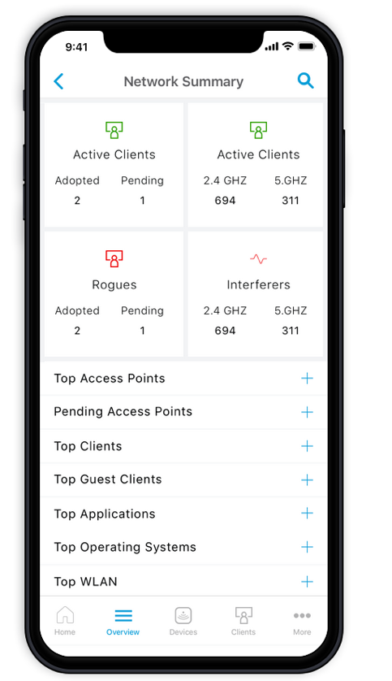
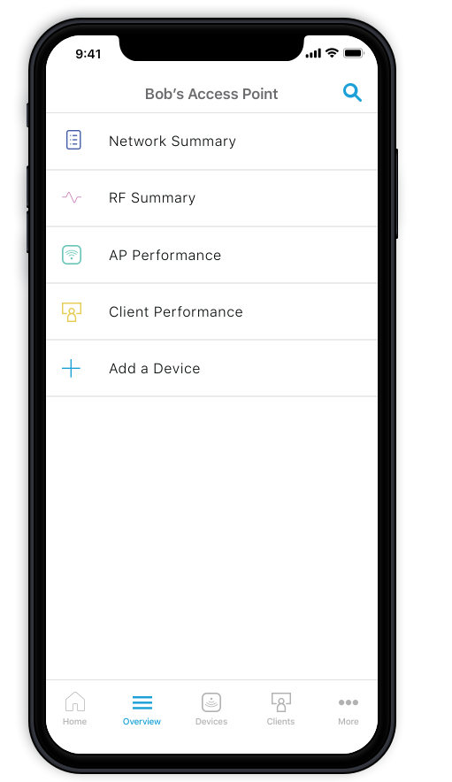
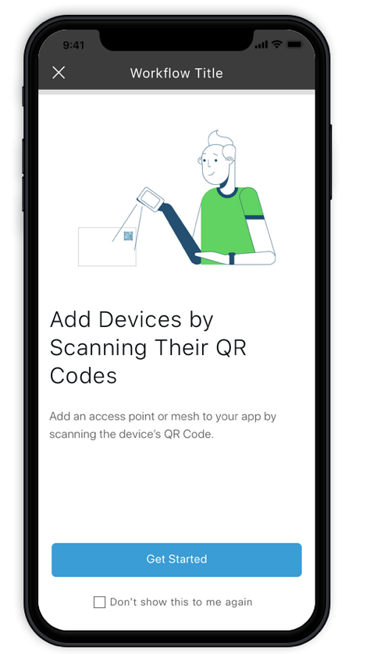
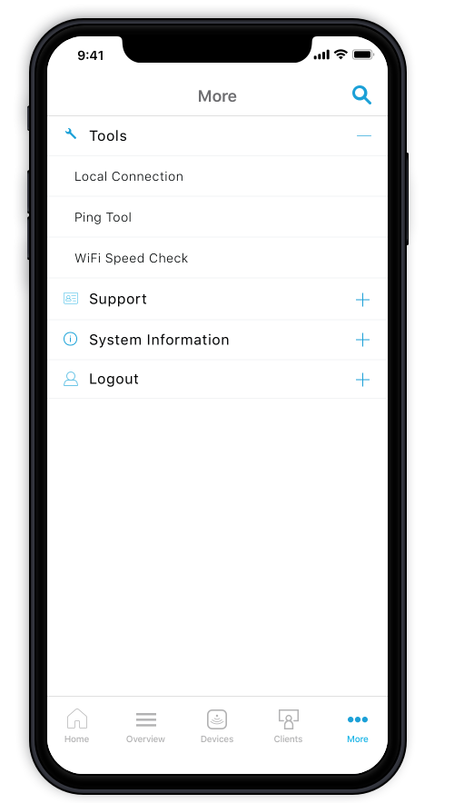
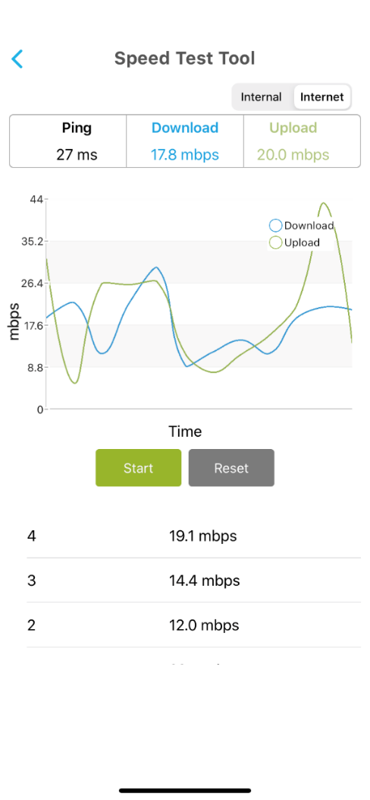
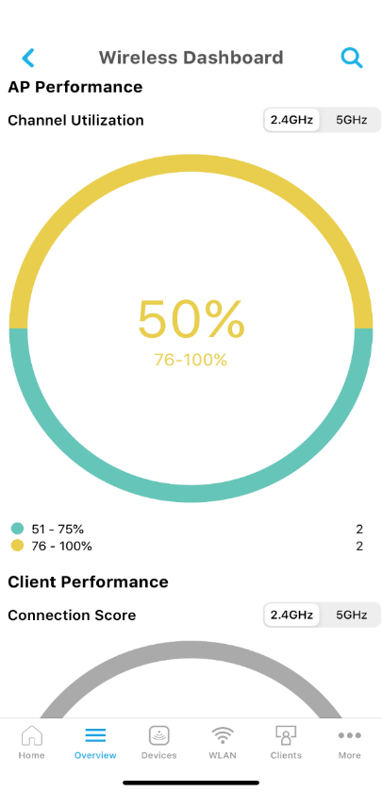
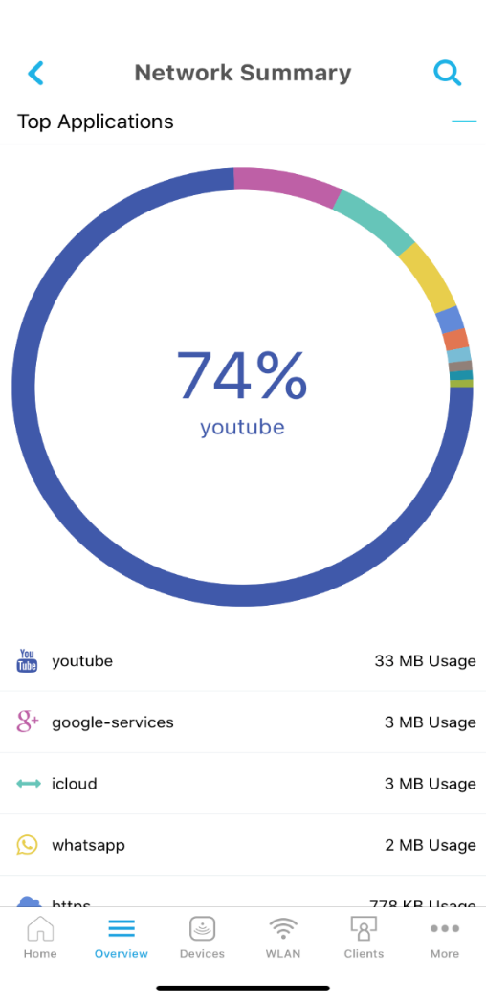
Simple - Cisco Business Mobile App
Set up in minutes
Monitoring at your fingertips
Top Applications
Network insights
Performance
Notes:
Set up in minutes
Scan a QR code to get your Cisco Business Wireless access points and mesh extenders up and running in minutes.
Simplified management
Display current network configuration and make changes at your fingertips. Back up all your settings into your mobile device for added reliability.
Easy Share
Instantly share guest network access from your smartphone. Prioritize which devices get faster speed for optimal user experience.
Network insight
Peace of mind with real-time snapshot of your network usage, traffic patterns, and alerts.
Performance
Monitor your network performance with throughput reading and speed test

Slide 17
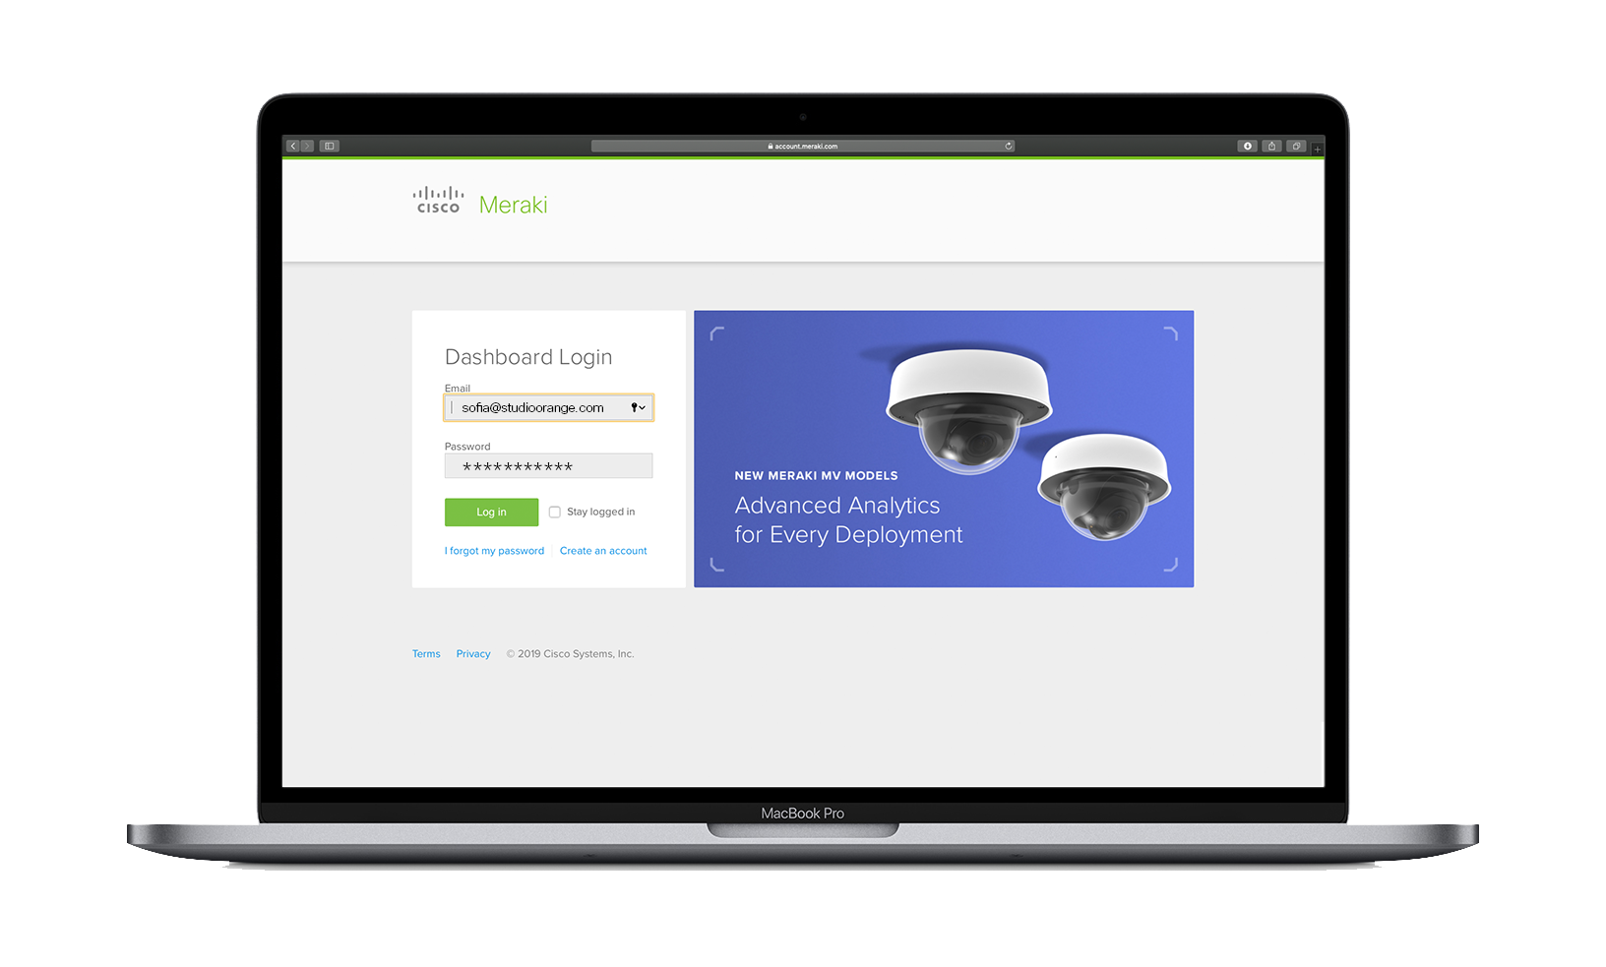
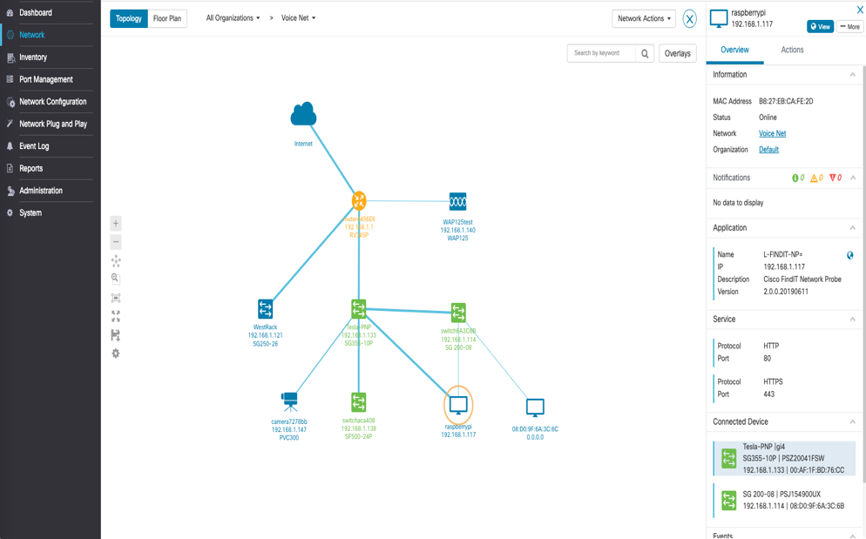
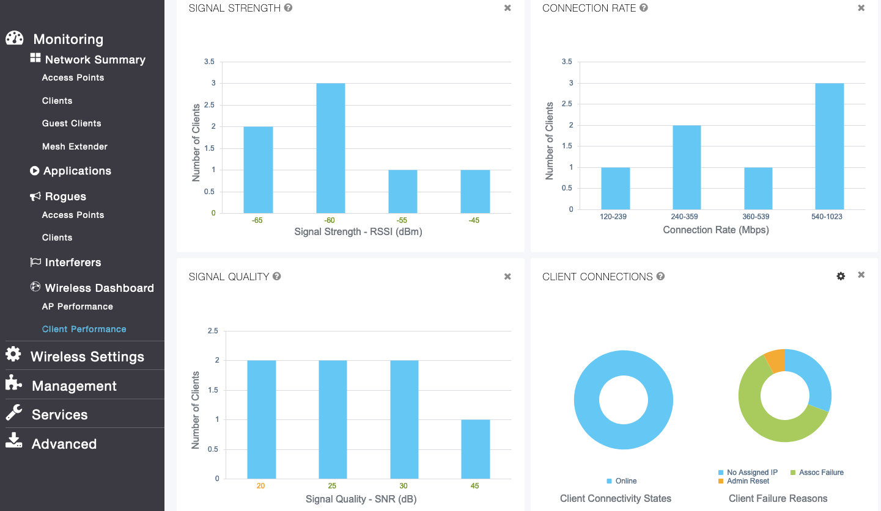


Simple - On-box UI & FindIT Dashboard
Discovery
Monitoring
Provisioning
Reporting
Management
Third Party Integration
Notes:
Unified interface for all Cisco Business portfolio
Eliminate complexity with easy set up in minutes.
Cisco Business mobile app and dashboard simplify network management and operations, thereby freeing up your valuable time and resources for business growth and profitability.
Auto discovery, plug and play with your existing voice, wireless, data, and video products solutions.

Slide 18
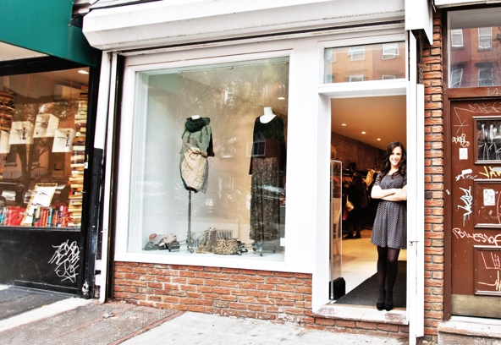




Flexible – Diverse Use Cases
Retail
Small Office
Education
Hospitality
MSPs
Single to multiple locations
Set and forget
Security
Mix and match APs and mesh extenders
Network segmentation
Security
Policy-based guest access and prioritization
Mix and match APs and mesh extenders
Security
Segmentation
Mix and match APs and mesh extenders
Security
Policy-based guest access and prioritization
Primary network connectivity
IT services
Security

Slide 19

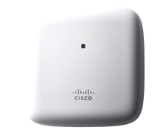
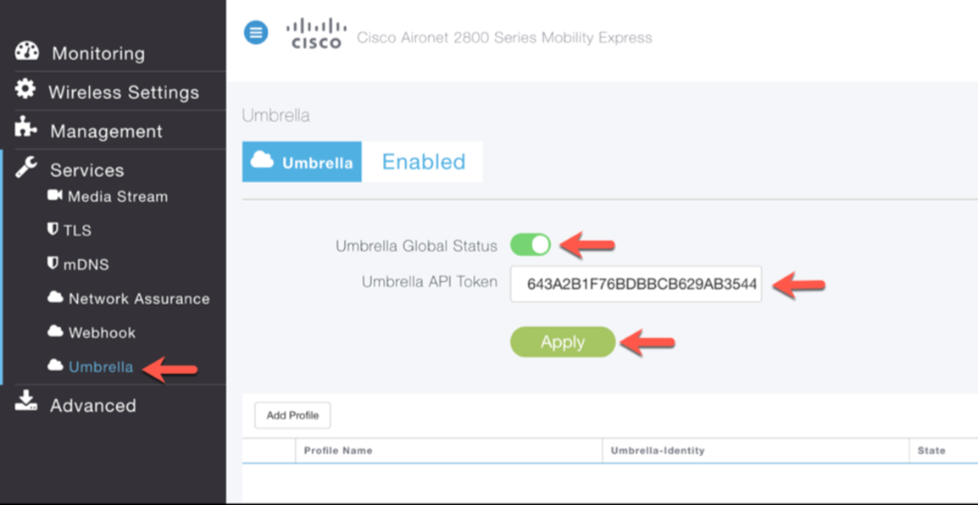

Secure – Cisco Umbrella
    Use DNS to block malware, phishing and other threats
    Powered by Cisco Talos threat intelligence
    Blocks before it hits the router/firewall
    Faster Internet access
    Provision globally in minutes
Umbrella
Umbrella

Slide 20
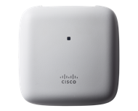
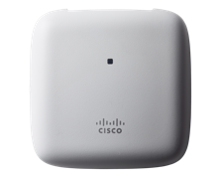
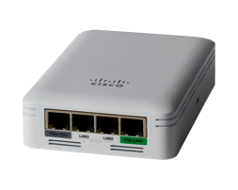
Cisco Business Wireless Access Points
 | CBW140AC Access Point | CBW240AC Access Point | CBW145AC Access Point
Best For | SoHo / SB | SB / SMB | SB / SMB / Back Office
Mounting | Ceiling & T-bar / Wall Mounting Kit included | Ceiling & T-bar / Wall Mounting Kit included | Wall / Wall Plate Mounting Kit included
Maximum data rate | 867Mbps | 1733Mbps | 867Mbps
Antennas Spatial streams | 2X2:2SS – 80 MHz | 4X4:4SS – 80 MHz | 2X2:2SS – 80 MHz
Max Tx Output Power (5GHz) | 20 dBm | 23 dBm | 20 dBm
Number of Wired Ports | 1 GbE | 2 GbE | 4 GbE (1 PoE PSE) Includes pass-thru port
Security | WPA/WPA2, WPA3 , WPA2-Enterprise, RADIUS Server | WPA/WPA2, WPA3 , WPA2-Enterprise, RADIUS Server | WPA/WPA2, WPA3 , WPA2-Enterprise, RADIUS Server
Cisco Suggested Price ($USD) | $165 | $235 | $205
Also sold as Multipacks (Qty of 3 & 5) | ✔ | ✔ | -

Slide 21
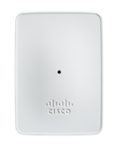
Cisco Business Wireless Mesh Extenders
 | CBW141ACM Mesh Extender | CBW142ACM Mesh Extender | CBW143ACM Mesh Extender
Best For | SoHo / SB / SMB | SoHo / SB / SMB | SoHo / SB / SMB
Mounting/Placement | Desktop | Direct to Power Outlet | Wall
Maximum data rate | 867Mbps | 867Mbps | 867Mbps
Antennas Spatial streams | 2X2:2SS – 80 MHz | 2X2:2SS – 80 MHz | 2X2:2SS – 80 MHz
Max Tx Output Power (5GHz) | 20 dBm | 20 dBm | 20 dBm
Number of Wired LAN Ports | 4 GbE (1 PoE PSE) | None | 1 GbE downlink
Security | WPA/WPA2, WPA3 , WPA2-Enterprise, RADIUS Server | WPA/WPA2, WPA3, WPA2-Enterprise, RADIUS Server | WPA/WPA2, WPA3, WPA2-Enterprise, RADIUS Server
Cisco Suggested Price ($USD) | $235 | $135 | $165

Slide 22

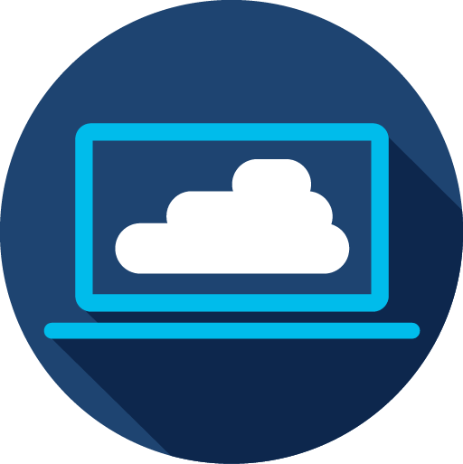
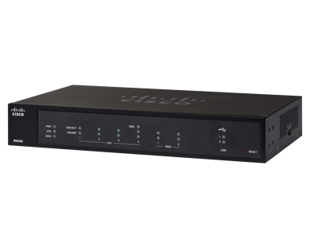

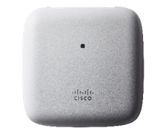

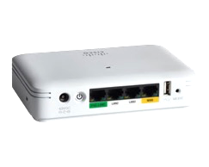
Cisco Business – Building Block for a Small Business Network
Cisco
SG350-28PD
Cisco
RV340
Cisco
SG350-52P
Cisco
CBW143ACM
Cisco
CBW141ACM
Cisco
CBW140AC
Mesh
Creates a reliable
small business
local area network
Easily integrates with
data, voice, video, and
wireless products
Easy to use, with a consistent interface across all Cisco
Small Business products

Slide 23
Agenda
1
Why do small businesses matter?
2
Cisco Business
3
Why Cisco Business Wireless?
4
What is Cisco Business Wireless?
5
Summary

Slide 24

Peace of Mind with Cisco Business
Complementary 24/7 access to
our Small Business TAC
available in10 languages
Limited lifetime warranty with advanced hardware replacement service option
keeps your business running smoothly.
Notes:
Global 24-hour access to experts in the Cisco® TAC and Small Business Support Center (SBSC)
Advance hardware replacement
Flexible contract term
Software upgrades
Self-help support through online communities,
resources, and tools
10 languages support: Portuguese, Spanish (EU), French, German, Russian, Polish, Japanese, Chinese, English, Spanish (LATAM)

Slide 25
“
We've been very successful at deploying Cisco Business solutions for small businesses at our client sites - to provide the stability, security, and uptime that we're looking for as well as the simplicity associated with remote manageability.
Cisco Business solutions are flexible and have the price/performance ratio that we look for to take our clients’ business to the next level
—WAYNE CHOW
DIRECTOR OF TECHNOLOGY SOLUTION
NUCLEUS

Slide 26
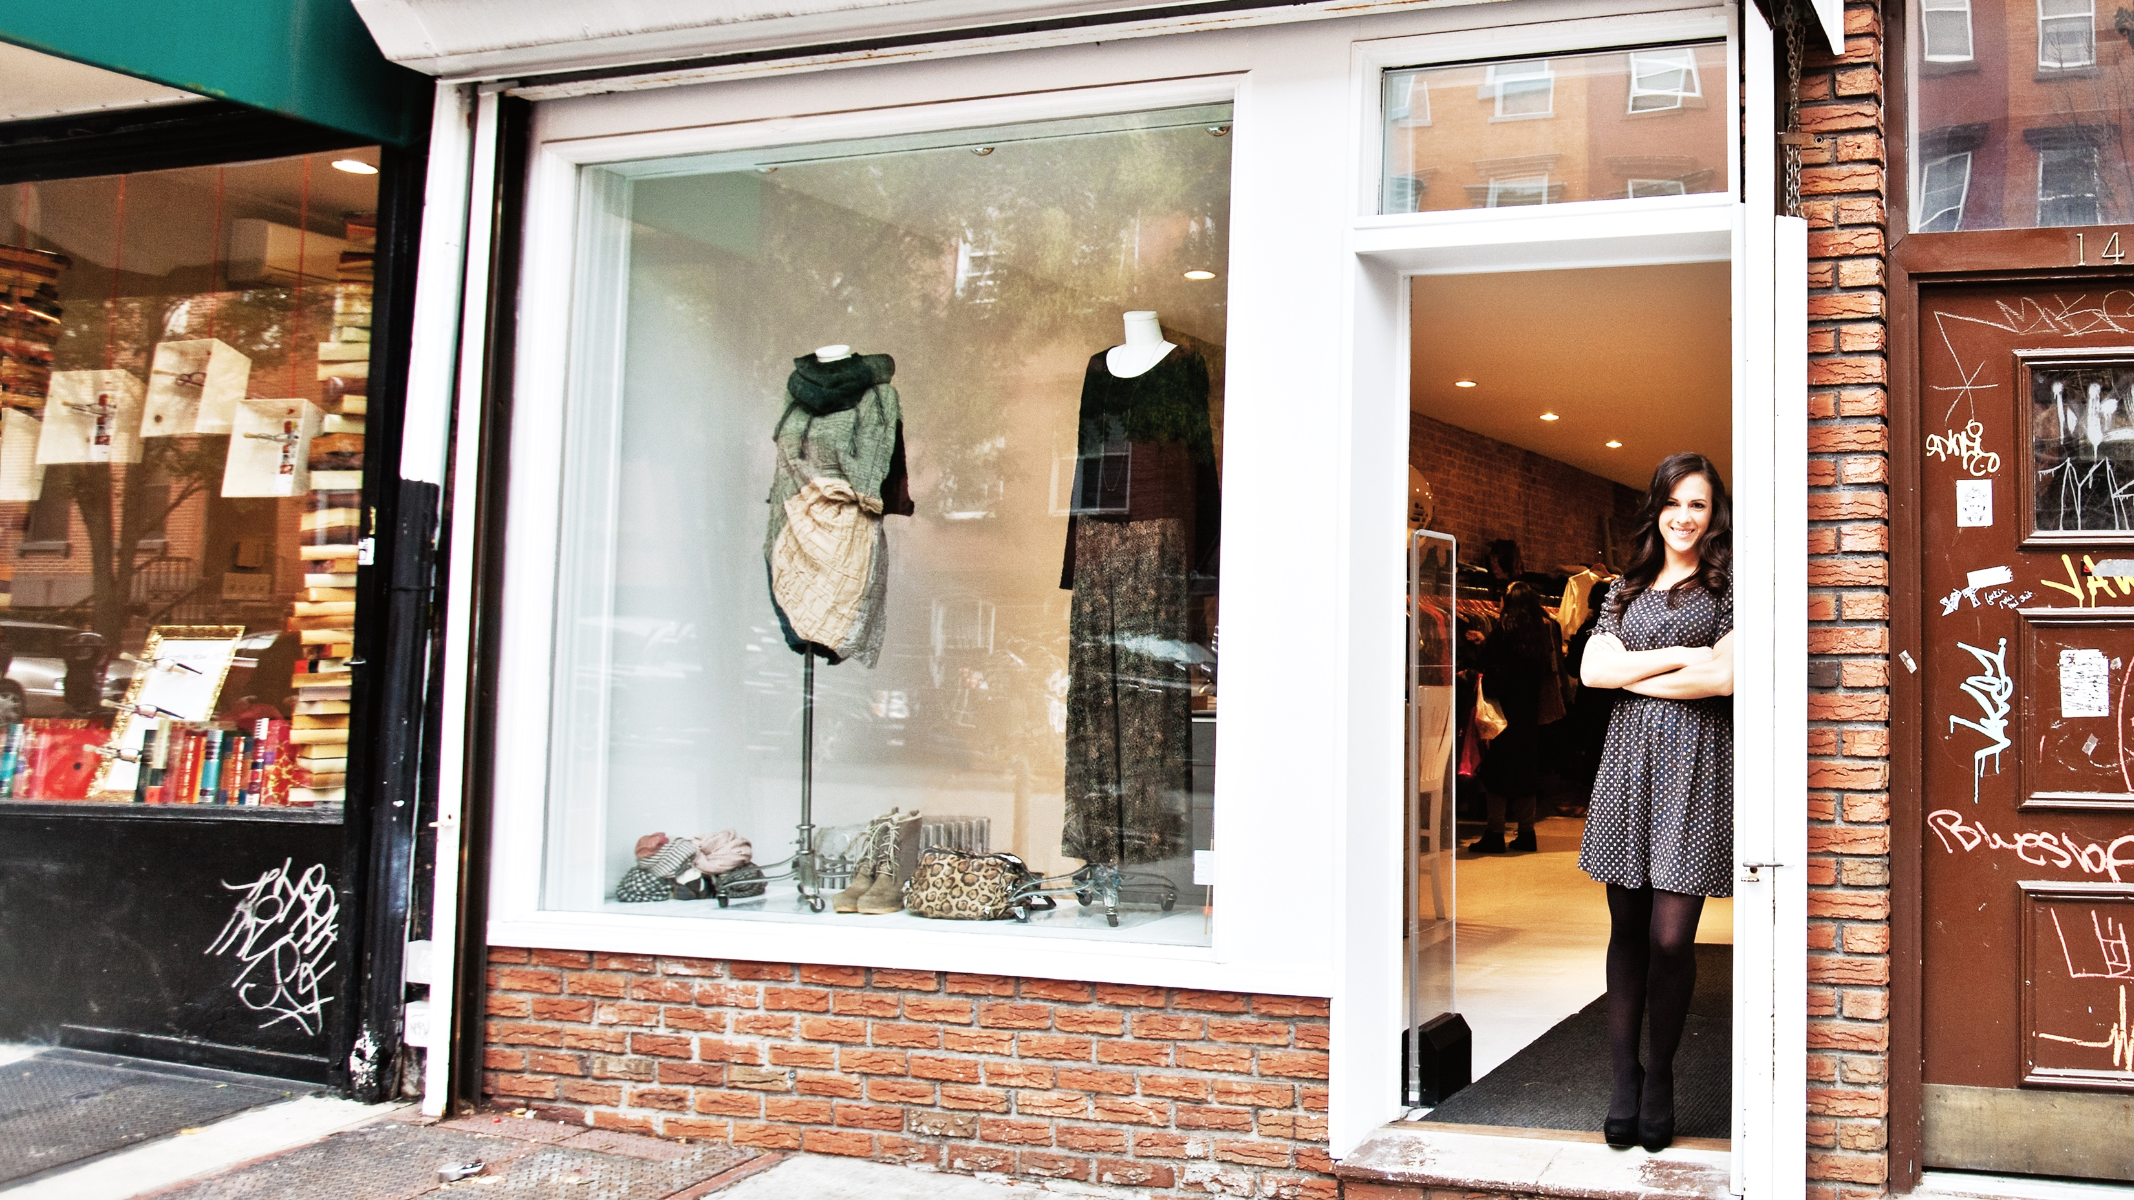




Cisco Business Wireless: Network of Possibilities
Simple-to-deploy, flexible, and secure to help small businesses connect and collaborate like never before
Wireless access points
Mesh extenders
Set-up in minutes
Mobile App and Dashboard
Diverse use cases
Pervasive security
Lifetime warranty
Enterprise-grade solution

Slide 27
Questions?

Slide 29
Additional slides for Disti/Partner or technical audience

Slide 30

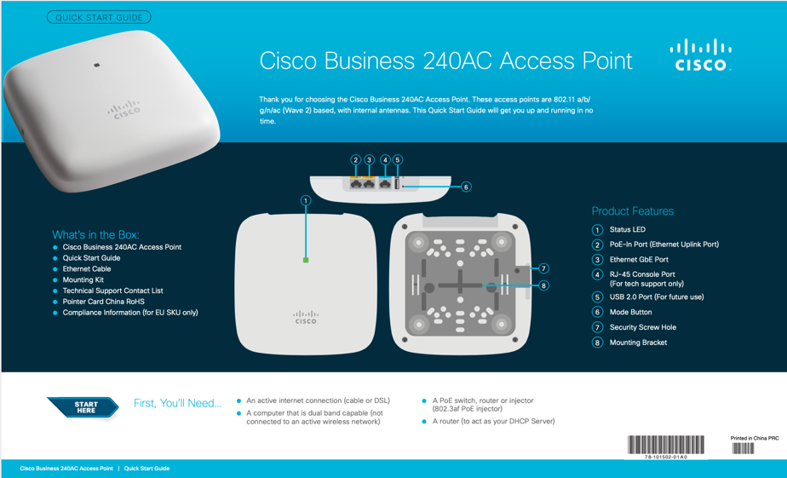
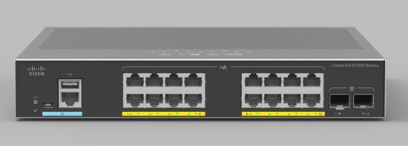
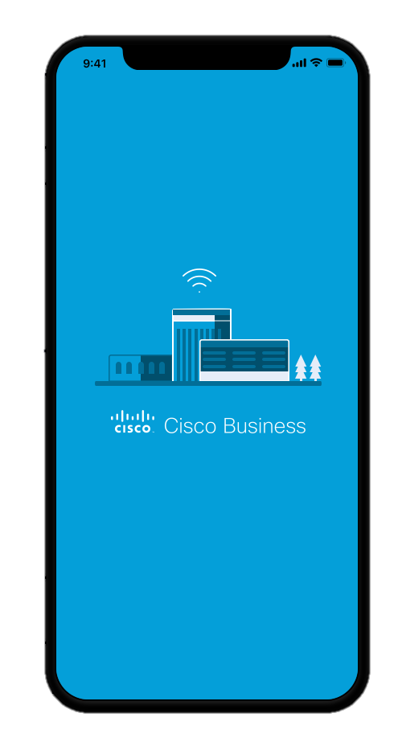
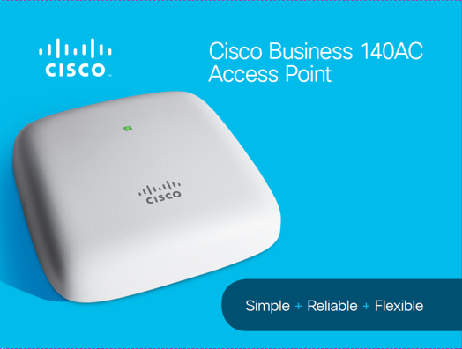

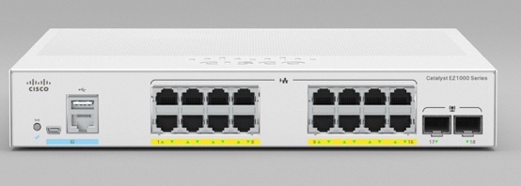
New Visual Identity
Documentation
Product
Packaging

Slide 31
Build Tough for Small Business
Operating Environment
Temperature: 32° to 104°F (0° to 40°C)
Humidity: 10% to 90% (noncondensing)
Max. altitude: 9843 ft (3000 m) @ 40°C
CBW140AC
8 Layer PCB
Thermal Solution & RF Reflector
Enclosure w/single LED, with Mounting & Security provisions

Slide 32

Simultaneous Delivery to Multiple Devices
Multiuser MIMO (MU-MIMO)
Devices get on and off the network quicker, allowing more devices to be served

Slide 33

Wider channels allow more traffic to pass
Multi-user MIMO uses the channel to maximum capacity
Traffic Handling
20 to 40 MHz
80 to 160 MHz

Slide 34
Improved Device Battery Life
0 MB
890 MB
2.1 GB
3.26 GB
4.68 GB
4.68 GB
802.11ac
25%
20%
15%
10%
5%
Data
802.11n
25%
20%
15%
10%
5%
0 MB
432 MB
1.08 GB
1.64 GB
2.13 GB
2.76 GB
Speed of 802.11ac results in less transmit/receive = Improved battery life

Slide 35

Best Practices for Cisco Business Wireless
Best Practices for 802.11ac Wave 2 Deployments
Utilize 5.0 GHz WLAN to leverage greater # of channels & cleaner spectrum
Create separate SSIDs for Business and Guest Access on individual VLANs, also Rate Limit Guests
Deploy with Cisco Small Business PoE switches
Maximum Scalability
Max APs | 50
Max Clients per AP | 200
Total Clients | 1000
Max # of Mesh Extenders | 25
Max # of Mesh Hops | 8
Max # of SSIDs | 16
Max # of VLANs | 16
Management VLAN | Yes
Max Coverage per AP | up to 3000 ft² 279 m²
Installation Recommendations
Coverage | Access Point per 2,500 square feet
Placement | Every 50 feet
Coverage Overlap | 10 -20% cell overlap to optimize roaming
Network Cabling | Category 5E or better recommended
Signal Strength (RSSI) | Network Type(s) | Use Case Example
-65 | Data, Voice, Multicast Video, High Density | School
-67 | Data, Voice, Unicast Video | Office
-70 | Data, Unicast Video | Cafe
-72 | Data | Warehouse

Slide 36
Cisco Business – Building Block for a Small Business Network
Retail Example
Cisco
SG350-28PD
Cisco
RV340
Mesh
Cisco
SG350-52P
Cisco
CBW140
Creates a reliable
small business
local area network
Easily integrates with
data, voice, video, and
wireless products
Easy to use, with a consistent interface across all Cisco
Small Business products

Slide 37
Cisco Business Wireless Bundle
Coming Soon!!
 | CBW140 Cisco Business Mesh Starter Kit
Best For | DIY’er with a Small to Medium office
Access Point | Cisco Business 140AC Wireless Access Point
Mesh Extenders | Cisco Business 142AC Mesh Extenders
Form Factor/Mounting | Ceiling (AP), AC outlet (extenders)
Combined 11ac Performance | 2600mbps
Management | Mobile App & WebUI

Slide 38
Pricing Information – Access Points & Mesh Extenders
List Price - United States Only
Model | Product Description | List Price ($ USD) | CSP ($ USD)
CBW140AC | Cisco Business CBW140AC 2x2 Wave 2 Ceiling Mount Access Point | $260 | $165
CBW240AC | Cisco Business CBW240AC 4x4 Wave 2 Ceiling Mount Access Point | $375 | $235
CBW145AC | Cisco Business CBW145AC 2x2 Wave 2 Wall Plate Access Point | $330 | $205
CBW141ACM | Cisco Business CBW141ACM 2x2 Wave 2 Desktop Mesh Extender | $375 | $235
CBW142ACM | Cisco Business CBW142ACM 2x2 Wave 2 Wall Outlet Mesh Extender | $210 | $135
CBW143ACM | Cisco Business CBW143ACM 2x2 Wave 2 Wall Mount Mesh Extender | $255 | $165
CB-PWRINJ | Cisco Business 802.3af Gigabit PoE Injector | $85 | $64

Slide 39
Pricing Information – Multipacks
List Price - United States Only
Model | Product Description | List Price ($ USD) | CSP ($ USD)
3-CBW140AC | 3 Pack - Cisco Business CBW140AC 2x2 Wave 2 Ceiling Mount Access Point | $775 | $495
5-CBW140AC | 5 Pack - Cisco Business CBW140AC 2x2 Wave 2 Ceiling Mount Access Point | $1275 | $815
3-CBW240AC | 3 Pack - Cisco Business CBW240AC 4x4 Wave 2 Ceiling Mount Access Point | $1115 | $705
5-CBW240AC | 3 Pack - Cisco Business CBW240AC 4x4 Wave 2 Ceiling Mount Access Point | $1840 | $1175

Slide 40
Pricing Information – Access Points & Mesh Extenders
List Price – Excluding US
Model | Product Description | List Price ($ USD) | CSP ($ USD)
CBW140AC | Cisco Business CBW140AC 2x2 Wave 2 Ceiling Mount Access Point | $246 | $139
CBW240AC | Cisco Business CBW240AC 4x4 Wave 2 Ceiling Mount Access Point | $354 | $189
CBW145AC | Cisco Business CBW145AC 2x2 Wave 2 Wall Plate Access Point | $309 | $159
CBW141ACM | Cisco Business CBW141ACM 2x2 Wave 2 Desktop Mesh Extender | $355 | $179
CBW142ACM | Cisco Business CBW142ACM 2x2 Wave 2 Wall Outlet Mesh Extender | $200 | $109
CBW143ACM | Cisco Business CBW143ACM 2x2 Wave 2 Wall Mount Mesh Extender | $241 | $119
CB-PWRINJ | Cisco Business 802.3af Gigabit PoE Injector | $74 | $56

Slide 41
Pricing Information – Multipacks
List Price – Excluding US
Model | Product Description | List Price ($ USD) | CSP ($ USD)
3-CBW140AC | 3 Pack - Cisco Business CBW140AC 2x2 Wave 2 Ceiling Mount Access Point | $730 | $399
5-CBW140AC | 5 Pack - Cisco Business CBW140AC 2x2 Wave 2 Ceiling Mount Access Point | $1205 | $669
3-CBW240AC | 3 Pack - Cisco Business CBW240AC 4x4 Wave 2 Ceiling Mount Access Point | $1055 | $559
5-CBW240AC | 3 Pack - Cisco Business CBW240AC 4x4 Wave 2 Ceiling Mount Access Point | $1735 | $899

