Slide 1

Cisco Collaboration Devices
August 2019

Slide 2

Cisco: The more intuitive way to work
Humanize how people and
teams connect
Adaptive and intelligent for distributed teams
Connected
for better and faster decisions
Choice and flexibility for business growth
Notes:
Cisco’s suite of communication solutions is designed to simplify and improve how teams get work done today. By humanizing how people and teams connect, adapting to how virtual teams operate, and enabling faster and better decisions with connected experiences, Cisco is delivering a more intuitive way to work. All supported by a flexible platform that grows with your business without compromising security or performance

Slide 3








Collaboration across your business
Executive
VP of Marketing
Information worker
Financial analyst
Deskless worker
Factory supervisor
Ecosystem
Mobile worker
Account manager
Contact center
Customer care agent
Customers
Partners
Suppliers
Notes:
To provide collaboration capabilities that positively affect productivity and innovation, you need to consider your different types of users – because one size does not fit all. Users across your business functions have unique needs and we want the collaboration capabilities to support how they work, not the other way around.
To collaborate successfully, you need the ability to work across and beyond your organization. With customers, partners, and other employees. Each with diverse needs and using different devices. From mobile phones to desk phones, or soft clients to immersive, full-room video conferencing systems.
Collaboration solutions that enable a common experience across roles, organizational boundaries, and devices remove restrictions and complexity. So you can focus on your work and the collaborative opportunities it presents, rather than the tools themselves.
You need a broad set of collaborative capabilities that connect people with diverse roles, in different locations, using a variety of devices. So everyone can be most effective at what they’re doing.

Slide 4

Make interactions more effective
  Lifelike,
  video-first
  experiences
  Strengthen engagement and inspire teams
  Enhance intelligence and usability of
  any space
Notes:
More intelligence and usability to any space, every interaction.
Your employees collaborate most effectively when they have the tools they believe they need. They already have many choices in their personal life, and more and more, they want to bring those collaborative options into their work life.
Give them a choice of collaboration devices and the freedom to pick the ones they want. They’ll be more engaged. More productive. And more innovative.
Transition to next slide:
Let’s see how a choice of collaboration endpoints can enable success throughout your organization.

Slide 5
Produce your best work anytime with no compromises
  Every room
  Every desk
  Every pocket
  Every app
Notes:
To support and empower the modern workforce, our mission is to put “no-compromise” collaboration into every room, on every desk, in every pocket, and into every application. [[CLICK]]
Our collaboration device offerings exemplify both affordability and ease of use with a consistent user experience across the endpoint portfolio.
We are already doing this today with the deployment options of on-premises, cloud, and hybrid collaboration tools. Moving forward, we will leverage the cloud even more to help us move faster in delivering new innovations. We are starting from a position of strength; we’ve got the industry leading SaaS business with Webex Meetings today and now with Cisco Webex Teams, we’re further innovating across a broader “fabric” platform in the cloud the right way. So whether you need business-quality voice and video in the cloud or meeting rooms that connect people from any devices, you’ll get the best solution leveraging the investment you’ve already made.

Slide 6

Setting the bar
#1
Market share
Enterprise video and telephony
Gartner Magic Quadrant Meeting Solutions: Leader
September 2018
Gartner Magic Quadrant Unified Communications: Leader
May 2018
IDC MarketScape for Enterprise Video Conferencing Equipment: Leader
July 2018
23 Red Dot
design awards
Red Dot Best of
the Best for Cisco Webex Board and Webex Room Kit Mini
Aragon Research Globe Web and Video Conferencing: Leader
January 2019
Notes:
Cisco continues to set the bar for next-generation video conferencing and collaboration. And respected industry analysts concur.
In addition to our number-one market share in enterprise video and technology, Cisco continues to be recognized for our execution and vision for video and UC collaboration including:
Gartner Magic Quadrant: Leader in Meeting Solutions as well as Leader in the Meeting Solution Critical Capabilities (Sept 2017)
Gartner Magic Quadrant: Leader in Unified Communications (July 2017)
IDC MarketScape: Leader in Worldwide Enterprise Video Conferencing Equipment – 2016
Aragon Globe for Web and Video Conferencing, November 2017
And, a first among our peers – 14 Red Dot Design awards since 2014, which speaks to our focus on experience and delightful design for our video endpoint portfolio. The awards included an International Seal for Outstanding Design, plus Best of the Best 2014 award for the Cisco Webex Board
Award Details:
Market Leadership Proof Points: Cisco CMIR report, CYQ1 ‘15
Largest installed base in the industry: 85M IP phones, 2M+ TelePresence endpoints, 22M+ Jabber seats
Gartner Magic Quadrant, August 2015
“Cisco remains an established leader in the group video systems market, with a comprehensive set of video endpoints, infrastructure, and enabling services. It has continued to simplify its endpoint portfolio down to a clear and differentiated set of devices, with form factors now available for virtually any meeting space.” Strengths include:
Cisco continues to demonstrate market traction with enterprise deployments exceeding 5000 room systems, including single and multiscreen devices.
Collaboration Meeting Rooms (CMR) leverages Cisco's considerable market presence in Web and multiparty conferencing and expands interoperability options at scale.
Cisco offers a comprehensive endpoint portfolio with clear, device-specific value propositions and consistent industrial design and user experiences.
Gartner Magic Quadrant, December 2016
“Cisco's UC solution is an attractive prospect for midsize, large and multinational corporations requiring strong voice, video or conferencing capabilities. Cisco offers a globally scalable full UC suite, with a quality user experience across all leading mobile devices, plus strong telephony and market-leading conferencing capabilities.”
Forrester Wave, Q3 2014
IDC MarketScape Leader, 2014
Cisco is ranked as a Leader in this IDC MarketScape. It features a comprehensive portfolio of video offerings ranging from browser-based support, software clients, and desktop solutions to multipurpose rooms and immersive rooms. Cisco's architectural approach allows customers to extend existing environments and scale the reach of video with consistent user experiences. Solutions are designed to enable video to be as easy as voice and accessible on any pane of glass. All Cisco collaboration applications are available for deployment in a virtualized environment.
Red Dot Design awards for:
DX70
DX80
MX200 and MX300 G2
MX700 and MX800
SX10
SX80 + SpeakerTrack 60
Touch 10 control unit
IX5000 – Best of the Best Award
Webex Board – Best of the Best Award
Room Kit
Room Kit Plus
Quad Camera
Codec Plus
Room 55

Slide 7


Experiences only Cisco can deliver
Simple to use
Innovative
Seamlessly
connected
Make collaboration simple
for everyone
Easy installation and deployment
Consistent user experience
User customization and personalization
Intelligent options optimize your interactions
Smart meetings
Smart presentation
Smart rooms
Continuous workflow with cloud
Extend investment value end-to-end
Optimized experiences
Maximized screen views
Seamless interoperability
End-to-end security
Notes:
Most of the organizations that recognized Cisco cited similar reasons. And those were our portfolio differentiators. These are the factors that give users experiences that only Cisco can deliver.
That means delightful user experiences that are simple, innovative, and seamlessly connected.
Simple to use. We make collaboration simple and easy for everyone.
Easy installation and deployment in minutes for anyone and everyone
Consistent, intuitive interface on any device creates familiar interaction from browser to the boardroom
User self-serve and personalization options allow people to work their way – layout, contacts, greetings
Innovative features and intelligent options. Now you can optimize every interaction. Work smarter with:
Intelligent Proximity – easy, flexible, content sharing on any device, personal mobile device integration for telephony features with desktop endpoints
Intelligent Imaging – automate the best view with autoframing (facial detection with gentle zoom), speaker tracking, and automated stand-up and whiteboard modes
Intelligent Audio – powerful stereo/theater quality sound on room systems, plus options for what you see is what you hear (DX80)
Seamlessly connected. Extend the value of your investment end-to-end.
Optimized experience between endpoints and infrastructure – this is the idea of Better Together, with powerful, high-value combination of endpoints and infrastructure
Maximized screen views with multistreaming
Seamless interoperability
End-to-end security
Flexible deployment models – on-premises, cloud connected or hybrid models
Seamless meeting escalation
Extend personalization and user control locally
Extend telephony features to video with unified call control for UC and video
Advanced collaboration options
Now let’s look a little closer at some of the features and capabilities that create these experiences.

Slide 8
More intelligence, more usability
Smart meetings:
Smart meetings
Smart presentations
Smart rooms
1
Auto wake-up
and consistent UI
Intelligent proximity and BYOD
One button to join scheduled calls
Intelligent
views
2
3
4
Notes:
Cisco video devices brings more intelligence and usability to all your meetings. New features such as auto-wake up, Intelligent Proximity, white boarding, people count, and more enable …
Smarter Meetings: Brings intelligent views to smaller rooms with best views/speaker tracking capabilities through new embedded, discreet camera design; great audio capabilities with integrated speakers and microphones; automatic wake-up; extends Cisco Webex Teams experience
Smarter Presentations: Supports dual screens; dual content sources for local meetings; 4K resolution; wired or wireless connection for content sharing
Smarter Room Integrations: Provides valuable analytics for better resource planning and usability; seamlessly integrates with flat panel display (Room Kits); in-room controls
Flexibility: Built for both on-premises and cloud registration for investment protection

Slide 9

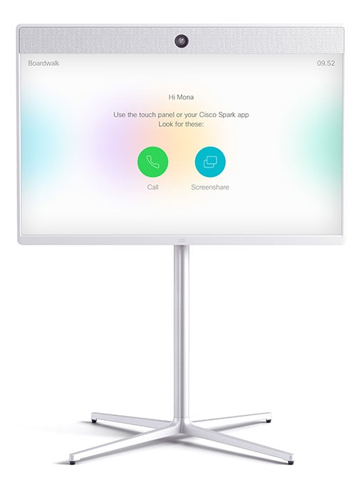
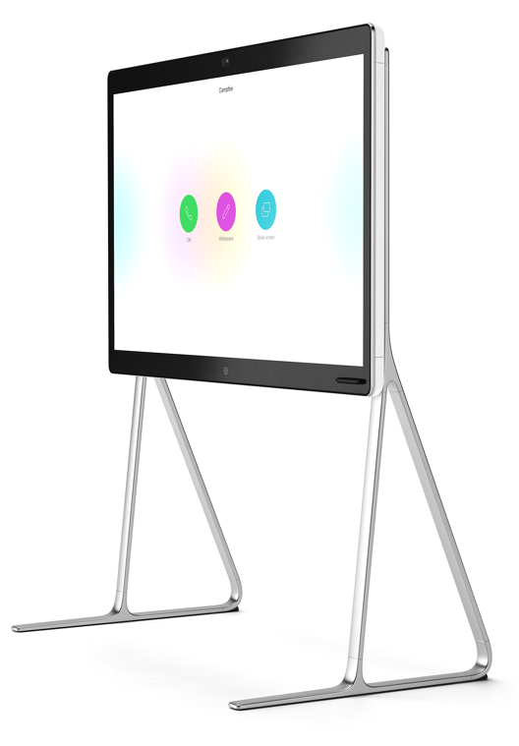

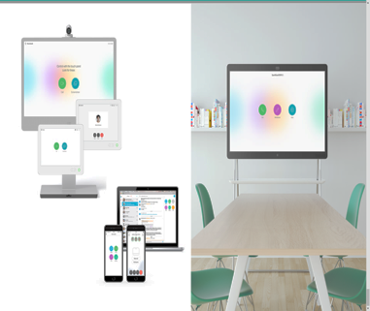
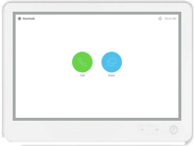
Auto wake-up and consistent user experience
Video centric
Co-create
Tap the screen to call or screenshare
Mobility
Notes:
Auto wake-up experience: The system wakes up when you enter the room (presence detected by ultrasound), says hello and suggests an activity
Consistent user experience: Whether you’re using Cisco Webex Board, Room Series device, DX80 on the desktop, or the Cisco Webex Teams app on your mobile device, the experience should be consistent, memorable and intuitive.
One button to push on the big, green button gives you the easiest meeting start possible for scheduled meetings.

Slide 10


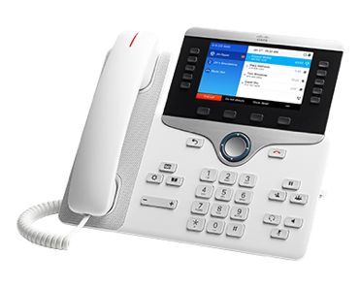

Intelligent proximity: Pair your mobile devices for richer experiences
For mobile voice
For video devices
Move audio during active call
Import contacts and call history
Enjoy ease of use and higher fidelity
View, share wirelessly, and capture content
Control your video device
Move video calls from mobile to video device
Easier, more personalized meeting experience
Notes:
Intelligent Proximity is a suite of features that activate when you bring your smartphone, tablet, or laptop close enough to select Cisco voice and video collaboration devices. It exists in two forms:
Intelligent Proximity for Mobile Voice, which allows users to move the audio from a smartphone call to higher-quality Cisco devices, and import contacts and call history from your personal mobile device to your desktop endpoint.
Intelligent Proximity for Content, which allows users to view shared content on their mobile devices and even to share content wirelessly from select devices.
Integration across mobile devices makes for richer overall collaboration experiences. Let’s see how it works in this short video.
[[Watch Video: “Promote Richer Collaboration”]]
Intelligent Proximity for Mobile Voice
Available now on select models of IP Phone 8800 Series endpoints and on the Cisco Webex DX Series.
Users of Apple iOS and Android smartphones and tablets can wirelessly connect to Cisco IP Phones 8845, 8851, 8861, 8865, and Cisco DX650, DX70, and DX80 endpoints through Bluetooth.
Easily import contacts and call history, and quickly access them on these 8800 Series and DX Series endpoints, simplifying the call management process.
Move the audio path from a call in progress on a mobile device to the specified Cisco devices to enjoy the superior audio quality Cisco devices.
Intelligent Proximity for Content Sharing
Cisco Webex Room Series, Cisco MX Series, SX, and IX Series.
Automatically pair your device with Cisco room-based video collaboration devices when they come within range.
Once mobile phones and tablets are paired, two functions are available. First, you can control the video system remotely from your mobile device. Second, you can view content being shared on the video systems on your mobile device. You can also save snapshots of shared content.
Once Mac or PC laptops are paired with the video system, users can share content from their laptop screen wirelessly with the room system. This is useful both for local meetings, where content is presented only to people in the same room, and during video calls, when you can present both locally and to remote participants.
Cisco Touch 10 is recommended for optimal user experience. Touch 10 ships with the Room Series, MX Series and SX80, and is an option for SX10 and SX20.

Slide 11
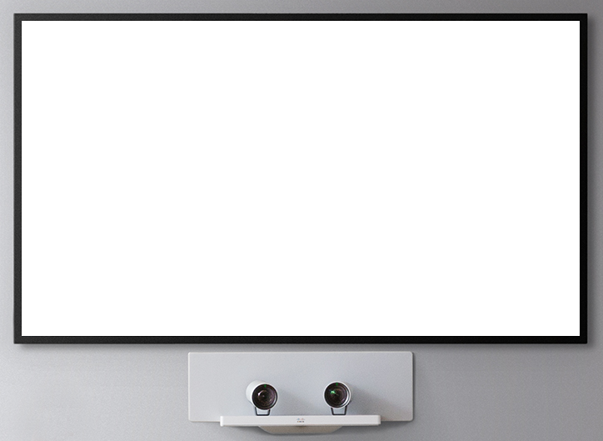
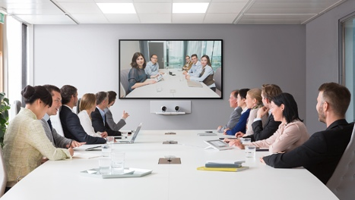
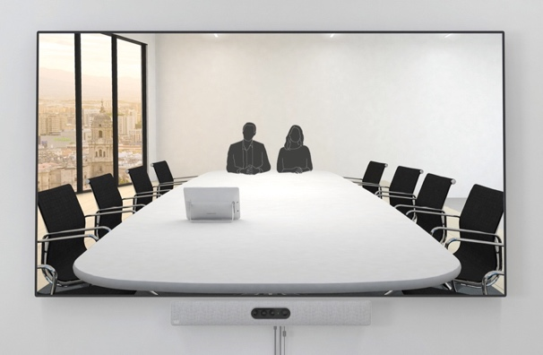
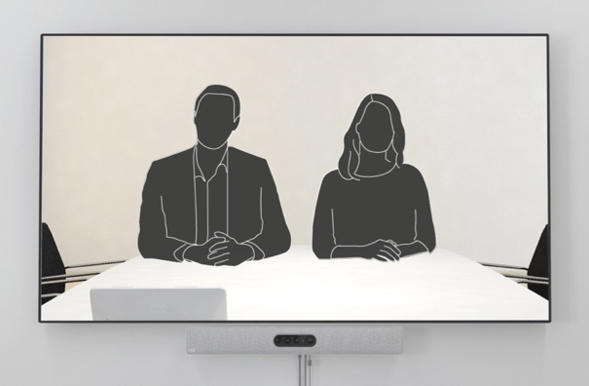
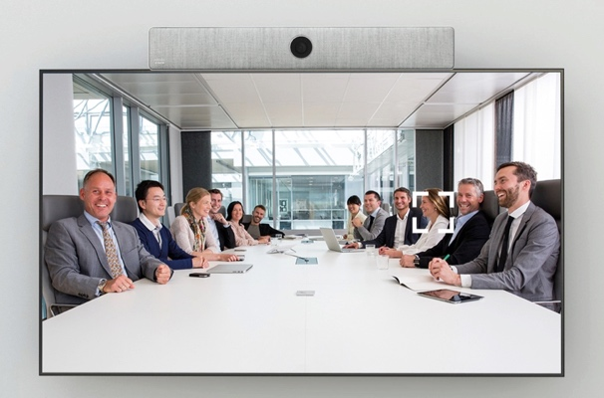



Intelligent views: For clearer communications
Best overview
Speaker tracking
Auto-detects people in room
Selects best framing
Detects person speaking
Selects best framing for speaker
Best overview and speaker tracking for every room – Cisco Webex Room Series
Watch video
Intelligent,
intuitive behavior
Fast, direct switching for optimal experience
Dynamically and perfectly frames participants - whether there’s 2 or 16 people in the room
Notes:
Intelligent imaging gives everyone a front-row seat and gives users a more intuitive experience with automated framing of speakers for the best views. Now, on the Cisco Webex Room Series, digital camera(s) provide more discreet digital tracking and puts users more at ease compared to PTZ cameras of older generation video devices.
Speaker tracking tracks the active speaker
Best overview dynamically and automatically frames participants in the room and sends the ideal image to the far end.
Features
Fast, direct, and intelligent switching between active speakers provides an optimal, continuous meeting experience.
Multispeaker views prevent unnecessary switching when the next active speaker is already in the current shot.
Automatic framing of all participants provides a dynamic overview of the full room.
Cisco offers intelligent views capability on a range of products, so that all users of meeting rooms, large and small, can benefit and experience clearer communications.

Slide 12

Smart
presentation
Wireless and wired sharing
4K
content
Local or
in conference
White boarding across portfolio
Notes:
Smarter Presentation
Cisco video devices offers a rich and easy content sharing experience:
Wired or wireless connection for content sharing
4K content
Supports dual screens
Dual content sources supported for local meetings
White boarding experience enabled across portfolio (details next slide)

Slide 13
White boarding across portfolio
Notes:
Cisco has democratized the white board experience to let everyone on your team – wherever they are – contribute ... before, during and even after the meeting
On the Cisco Webex Board and Webex DX80, you can whiteboard and annotate directly on the screen.
On the Room Series (Room Kit, Room Kit Plus, Room Kit Pro, Room 55, Room 55 Dual and Room 70 G2), you’ll be able to see the whiteboard as content when shared from a Webex Board, DX Series, or the Cisco Webex Teams app. And if you want to white board back, you can do so on the Webex Teams app.
On the MX and SX Series, you’ll get a notification on the screen that a white board has been shared. You can then view it and whiteboard back on the Webex Teams app.
On an mobile device or PC, the Webex Teams app is like your mobile white board. You can initiate a whiteboard, share it in the meeting, and save it to a Webex Teams space.

Slide 14
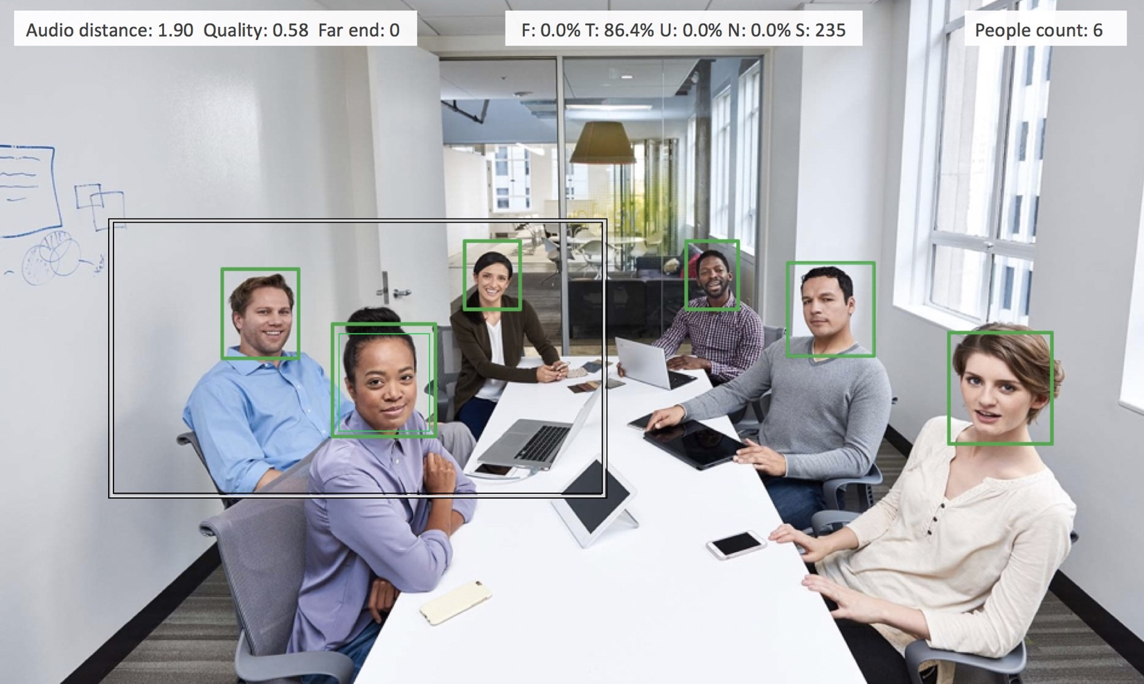
OPTION 2
Smart rooms
Macros framework
for customized experience
People count for
resource planning
Easy integration with standard displays
In-room and
3rd party control
Notes:
Smarter Room Integrations
People count: knowing how many people are in a meeting provides valuable analytics for better resource planning and usability
Display integration: seamlessly integrates with flat panel display (Room Kits);
In-room controls: control room peripherals (curtains, A/C, lights) directly from the Touch 10 control unit
Macros framework: customize your meeting experience through the power of your video device by writing applets (e.g., auto answer when certain people call, or send certain people directly to voicemail; auto start a stand meeting at a particular time; limited only by your imagination and business needs)

Slide 15
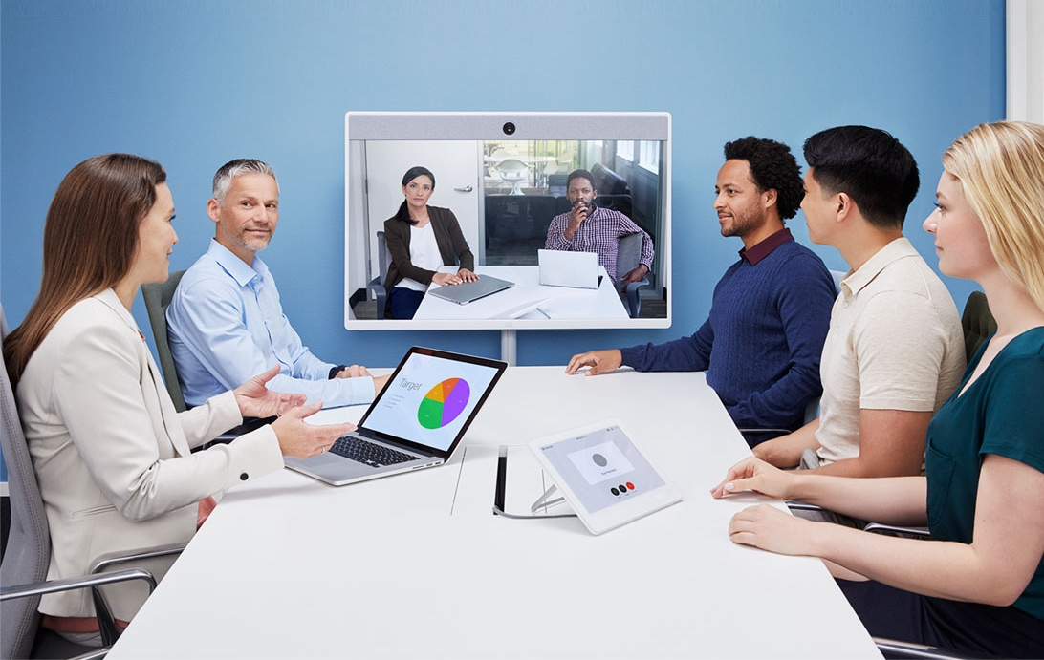
Cisco Webex Meetings
Extend the video experience
  Simple to schedule
  Join from any mobile, desk or room device
  Share content from personal devices
  Globally available and secure
Notes:
Cisco Webex Meetings is the market leader in video conferencing.
Adding Cisco devices to the overall meeting experience extends the video capabilities of Webex Meetings to more people in more places - maximizing your investments in both Webex Meetings and your video devices

Slide 16
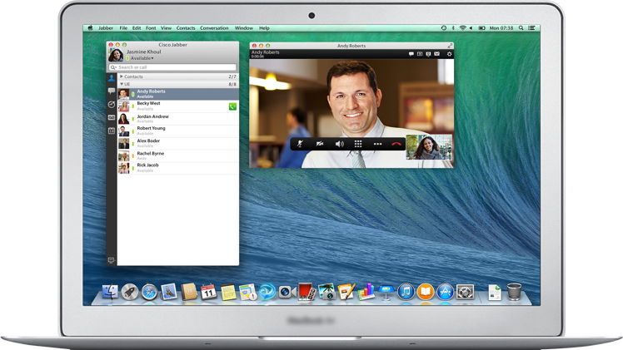
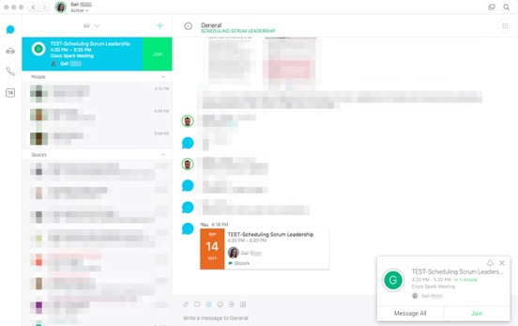
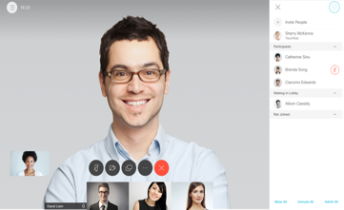
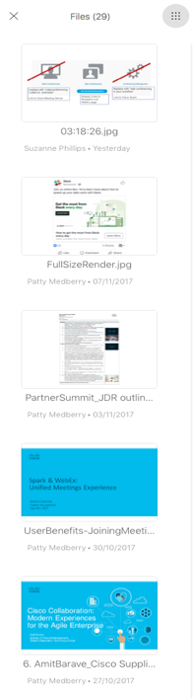
Cisco Webex Teams
Meeting within your workflow
Meet where you work
Join button brought to you (Cisco Webex Teams and Webex Meetings)
Join any on-premises or 3rd party SIP meeting
Instantly switch between meetings
Make meetings more productive
Surround meetings with messaging & content
Before meeting discussions and working
Continue the momentum after the meeting
John Smith 14:01
Could you share the presentation
Notes:
Cisco Webex Teams brings people and work together in a single, reimagined workspace in and beyond the meeting.
provides a workspace where all your collaboration tools are brought together in a single reimagined place on any device, anywhere.
allows you to connect with people (inside and outside your organization) and places all your tools right in the center of your workflow - it breaks down the siloes that exist for some across their collaboration experience.
At the time of your meeting, a Join button is presented to you and with one click, you’re in the meeting. This applies whether you’re joining from Cisco Webex Teams or Webex Meetings -- and it really helps you manage your day more effectively and also helps ensue that meetings start on time … because everyone can join instantly with one simple click, removing all those excuses of being late.
Also in your Cisco Webex calendar* you will see any other meetings you have. If the join details are in your calendar, you can also see those details within your Webex Teams calendar.
* Cisco Webex Hybrid Services required (Calendar Service)
Specifically for any Cisco Webex Teams meeting, you will also see some really cool value-add information that will help you make decisions on which meetings to prioritize and when to join them:
See invitee status / participants - every invitee will see who has accepted/declined the meeting and who’s in the meeting live before you even join. (unlike: having to switching back and forth between your calendar and the meeting application)
Instantly switch between meetings - if you need to work between meetings we have made that really simple. Leave the meeting with one click and join the other one with another click (unlike: having leave a meeting, go to your calendar and find the other meeting, access the meeting and wait to join it)
Easily inform attendees if you’re are late - In Webex Teams, you can message people in the meeting through the space and keep them posted (unlike: sending an email that no one will read because they are in the meeting)
The next big thing is context. What we mean by that is having all your teamwork available on hand in the meeting and having the ability to ‘meet’ before the meeting.
Before the meeting, work happens and Webex Teams provides the space for the team to discuss things, share content - start working.
Once the meeting starts, work as already begun and all that discussion and work is available right there in the meeting space.
You can simply share content from any device in the meeting - directly from the space, another device, or from your desktop or mobile device - it really is that simple, wireless and fast! (unlike: having to go find content, find a lead to connect to the video system if in a room, or even email to all participants)
And it doesn’t stop there. The moment the meeting finishes, the work doesn’t - the team is still connected and can carry on, keep productive, check in on items discussed, provide updates and status reports - and all this is all available in the next meeting…
An added benefit of joining a meeting through Webex Teams is that during the meeting everyone is an equal participant and so can mange the meeting - mute noisy participants, record… without having to disrupt the flow of the meeting so keeping the productivity going

Slide 17
Value of cloud collaboration
Personalized experience
Automatically recognizes you and says hello
Integrate with the Cisco Webex Teams app
Initiate a call or activity such as file sharing or white boarding from a Webex Teams space on your personal device
Rich collaboration:
Anyone can join
Take the meeting with you on your Webex Teams app
Move the meeting between your personal mobile device and the Cisco room or desktop device
Secure and managed
End-to-end encryption; easily provisioned and managed, with alerts and metrics
Notes:
The majority of our devices can register to Cisco Webex in the cloud, which provides a next-gen experience.
It’s a personalized experience. Video systems will wake up and greet you with Hello <name>.
It extends the surface of a Webex Teams space. For example, you can place a call in the Webex Teams space and move it to the Room Kit or other Cisco desk or room collaboration devices.
Similarly, if you have to leave a meeting room, you can take the meeting with you on your mobile device.
IT also benefits, receiving an alert if something is wrong with the system.
And of course there is the end-to-end encryption of the Webex platform for enhanced security.

Slide 18

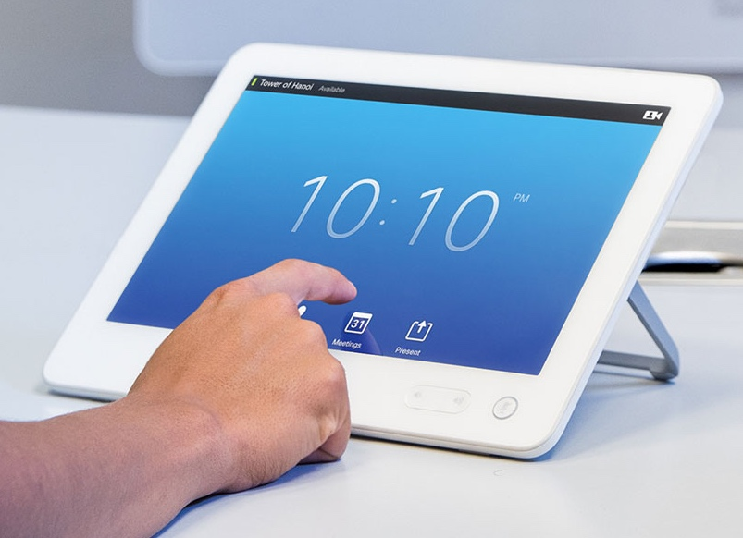

Simple to set up and use. Anywhere, by anyone.
Easily video-enable any location
Install in minutes with as few
as 2 cables
Simplest set-up and deployment on the market
Consistent user interface
Connect across mobile, desktop, or room devices, inside or outside the network
Work like you’re in the office - anywhere
One click to connect - no VPN required
BYOD in or out of the office
Notes:
And now we come back to simplicity. It’s a top priority for all of our collaboration solutions. So we’ve made it easy to video-enable any location and make it conveniently accessible to users – even remote sites and conference rooms.
Simple deployment and configuration.
Eliminate installation complexity and cabling nightmares. No hassle for IT, because any user can install an integrated video system in minutes. For example:
For example, the SX10 is out of the box and installed in minutes with just two cables: Power over Ethernet cable and an HDMI connection to the display of your choice.
Integrated camera, codec, and microphone make it simple for any user to set up and be on a call in minutes.
Going wireless simplifies things even further. Many of our devices, such as the DX80 and IP Phones 8800 Series, are wireless with support for connectivity, control, and content sharing.
Simple, consistent user experience.
Information workers, salespeople, and busy executives need to connect to office environments simply, consistently, and securely. Across all systems and devices. Our integrated devices provide consistent, business-class experiences inside or outside the corporate network.
Simple reach and access.
Video collaboration becomes intelligent collaboration when you can efficiently and securely connect in one step to the collaboration tools you need – from the device you’re using at the time. With Cisco Collaboration edge architecture and Expressway, people working from home or on the road have secure, one-click access to collaboration tools and resources just as if they were in the office. No cumbersome VPN required.
Securely extend the reach of your organization by integrating with your existing UC environment to offer directory and easy video-enabled call features.
Easily escalate IM to video conference in one click to quickly address business opportunities.
Build stronger relationships with customers and partners by enabling employees to work at customer or partner sites with access to all of your collaboration applications and tools as if they are in your office. This also helps scale resources across geographies. It enables mobile and virtual employees to work where they need to at the time in order to be more productive.
For example: The US Patent and Trademark Office was able to operate at 70% of normal productivity during devastating Superstorm Sandy despite a U.S. federal government shutdown. All thanks to their telework program and Cisco Collaboration technology, which includes video solutions.

Slide 19


Support for all deployment models
Cloud
Hybrid
Premises
OpEx outsourced IT
CapEx customer control/regulation
Notes:
Help put context around helping the customer choose between premises and cloud.
Cloud is the right option for many customers, however in some cases CMR premises provides a more appropriate solution – and we can see the main three considerations in making that choice in this chart.
Offer:
Cloud Pros Cloud Cons
Simple to get started Significant Bandwidth when scaling usage
Easy to use Limited Control for “white glove/exec level meetings”
Subscription Internet quality
Premises Pros Premsies Cons
Low cost per user CapEx model
Quality/BW guaranteed by network Complex initial set up
IT level control Requires data center and servers

Slide 20

Purchasing Cisco collaboration
Cisco collaboration flex plan
Meetings, messaging, and
calling service subscription
Cisco devices
Devices and software

Slide 21

Cisco collaboration flex plan:
Separate purchasing from deployment
Meetings
Calling
Cisco Webex Meetings
Cisco Webex Calling
Hosted (HCS)
Cisco Meeting Server
Cisco Unified Communications Manager with Jabber
Team collaboration
Cisco Webex Teams

Slide 22
Use cases
Bringing together teams of every size, from wherever they are
Notes:
Now let’s take a look at the variety of use cases for our collaboration endpoints – that helps bring together teams of every size, from wherever they are.

Slide 23


Any room: Designed for teams for co-creation
All-in-one solution:
digital whiteboard, wireless presentation, video conferencing
Continuous teamwork before, during and
after meetings
Intelligent, intuitive and effortless to use
and engage everyone
Notes:
The Cisco Webex Board is a presentation screen, digital whiteboard and video conferencing device all in a single device - for content creation and sharing, connecting physical meeting rooms to virtual teams through Cisco Webex Teams
To engage employees in a conference room and get really creative the Webex Board gives you the bigger picture
As with in-app white boarding, the really unique thing about this is that any content done on any Cisco Webex-registered device or the Webex Board is shared across the Cisco Webex platform and any participant can join in or simple see what is being shared in the meeting in the Cisco Webex Teams space live (and after the event).
Also the content is persistent so can be picked up again at a later date to continue…
The Webex Board offers new ways to create and collaborate.
That’s what we mean by ‘leveraging the power of the Cisco Webex Platform’.
Also what sets the Webex Board apart?
It recognizes you – as soon as you walk into the room, it will pair with your mobile device running the Webex Teams app and give you access to everything you have in Cisco Webex Teams.
It makes it easy to engage everyone – the ability to draw and annotate (soon) at the same time from any device from anywhere.
And cloud persistence – no one else has this ability. Users can easily save docs to a Webex Teams space for a continuous workflow – which helps keep users in synch.
No more snapping pictures of whiteboards and sticky notes and emailing them out – it all happens in Cisco Webex Teams.

Slide 24
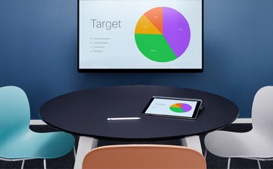
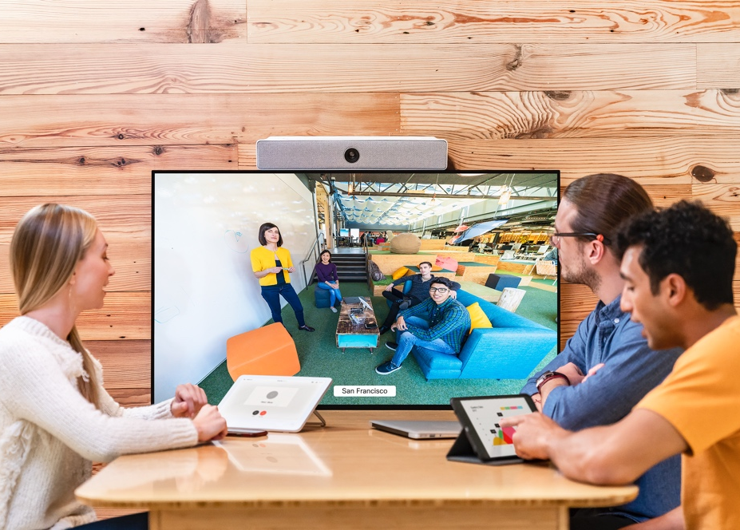
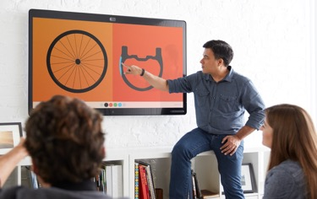
A huddle space for every interaction
Share
Connect
Co-create
Share wirelessly in local meetings
Connect with your teams by audio or video, and share wirelessly
Multi-way digital whiteboarding, connect with your teams and share wirelessly
Notes:
Cisco Webex offers a unified meeting experience across meeting spaces of all sizes, through a complete range of solutions that deliver a consistent user experience with reliable performance and intuitive controls.
What are the jobs that need to be done in your organization?
Will your team be collaborating locally and all they need is the ability to easily share content on an HD display? Cisco Webex Share may be the best choice.
Will your teams be presenting information and discussing activities where seeing remote people is most critical?
Connect people with the Cisco Webex Room Series: Room Kit, Room Kit Plus, Room 55, Room 70 – in any room.
Will your teams be creating together – white boarding, annotating, sharing content – both locally and sometimes with remote team members? The Cisco Webex Board may be the best choice.
Our portfolio of devices offers a complete range of solutions so customers can have a unified experience across all meeting rooms.
All three of these products can support wireless content sharing. Cisco Webex Board leverages Cisco Webex Proximity (cloud-based) to do this. Cisco Webex Room Series leverages Intelligent Proximity (on premises) and Cisco Webex Proximity (cloud-based).
Pricing and room size accommodation:
Cisco Webex Share –
GPL: $895 (no subscription needed)
MSRP: $475 (no subscription needed)
Room Kit – up to 7 people
GPL: $11,900
MSRP: $3990 + $99/month subscription
Room Kit Plus – up to 14 people
GPL: $17,900
MSRP: $7990 + $99 subscription
Room 55 – 5 people
GPL: $23,900
MSRP: $7490 + $199 subscription
Room 70 – 12 people
GPL: $79,900 (dual screen); $54,900 (single screen)
MSRP: $7,490 + $199/month (single and dual)
Cisco Webex Board 55 – 5 people
GPL TBD:
MSRP: $4900 +$199/month subscription
Cisco Webex Board 70 – 12 people
GPL TBD:
MSRP: $9900 + $199/month subscription

Slide 25

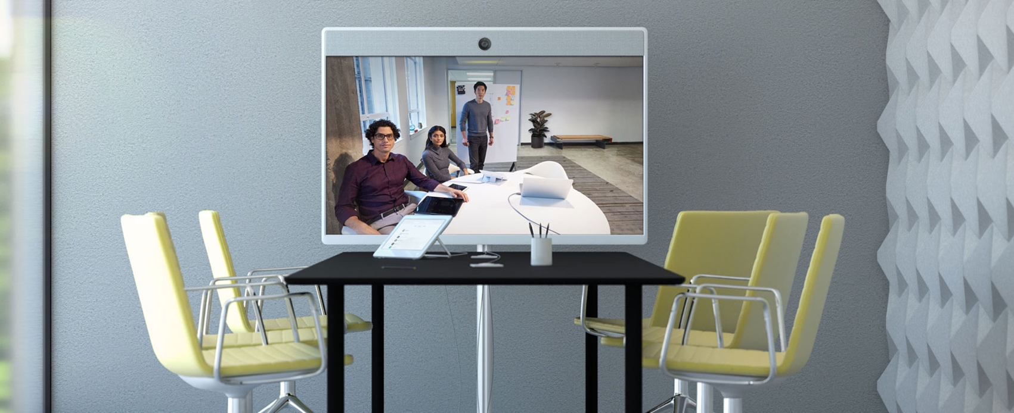
Small-to-medium rooms:
Easy collaboration for every space
Cost-effectively extend video to more rooms
Effortless to use
and deploy
Exceptional quality
and design
Notes:
Video is only effective if the community that needs to collaborate can easily access it. So we’ve created products that can easily and cost-effectively go into the majority of your meeting rooms and spaces – the small-to-medium rooms that most of us congregate in. The solutions that go into these rooms need to be affordable enough and easy enough to deploy and scale – so everyone can access video when they need it.
For teams of 3 to 6 people, we offer both integrated systems and component-based technologies that easily assemble in 10 minutes or less. While we’ve made these products more affordable, we’ve continued to innovate and bring you even more functionality. Great video and sound combined with Intelligent Proximity for flexible content sharing. And, of course, aesthetically pleasing models, as validated by the Red Dot award.

Slide 26
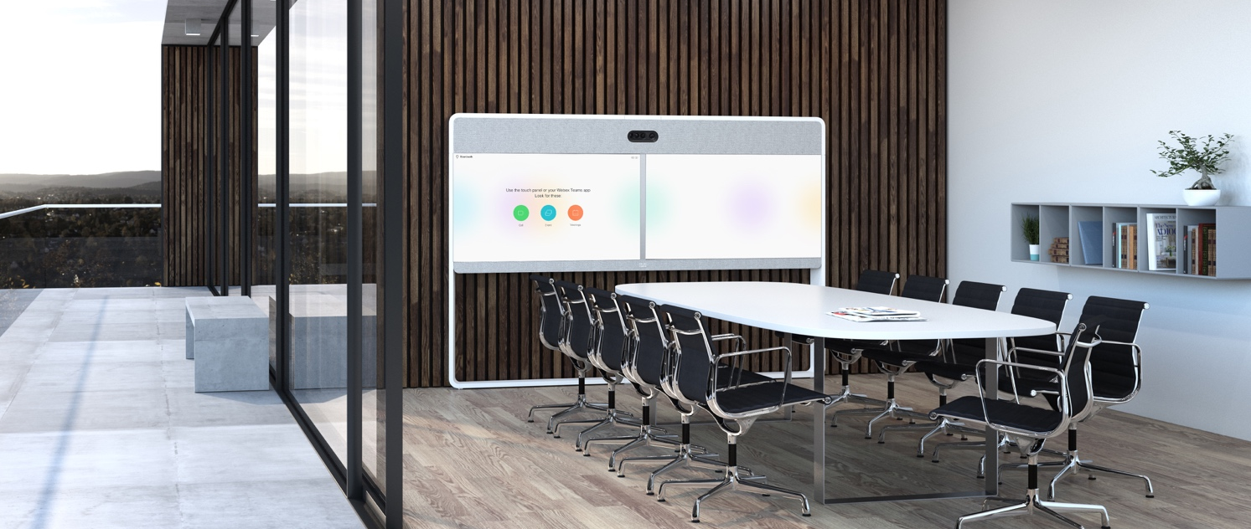

Large rooms: Empowering team collaboration
Advanced collaboration
for medium to large rooms
Flexible, powerful configurations
Exceptional video
and audio
Notes:
Consider today’s video conferencing landscape. Video is used frequently in the high-end executive suites that can afford the high cost of exclusive systems, and it’s used in desktop applications such as Skype for Business. The challenge is the middle ground, equipping medium and larger-sized meeting rooms with video that offers the highest-quality video and collaboration features that executives enjoy, only at a lower price point. So your teams can easily collaborate, see one another in high resolution, hear each other clearly, and at the same time share presentations or notes or graphics.
What would make the team meeting optimal? A video conferencing solution that could be set up quickly and easily in your medium and large meeting rooms and enable your larger workforce to enjoy video and content sharing regardless of location. One that could be installed within a few hours that you could mount on the wall or install on the floor. And what if you could choose either one or two high-fidelity cameras – with the second zooming up close on the speakers so remote participants can feel the impact of the speaker while also seeing the entire room?
Whether you’re looking for an integrated system or a complex, custom deployment, we have the solutions and components to help create the right video environment for your large rooms. Active speaker tracking and Intelligent Proximity are available with all of our large-room systems for the best possible viewing and content sharing experience.

Slide 27
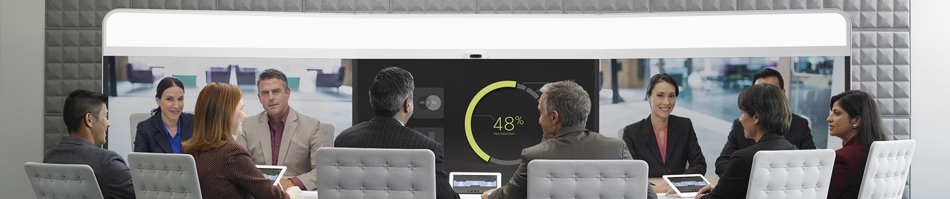
Immersive: Extraordinary collaboration
Rich multimedia
capabilities
Designed for
the ultimate experience
Powerful, efficient deployment beyond
the boardroom
Notes:
We designed the Cisco IX5000 to remove all those barriers holding our customers back from further adoption. Our flagship collaboration product provides the most vivid, immersive experience available, with rich-media features and design elements that bring remote participants together as if they were just across the table. Its sleek design and industry-first technologies make it easier and less costly to deploy than previous systems, and provide a greater user experience. Significant savings lower your total cost of ownership and make it possible to deploy the IX5000 beyond the boardroom.
With significantly lower deployment costs, you can deploy the IX5000 far beyond the boardroom to project teams across a number of functions:
Program management office – acceleration, product development, launches, office coordination, global launches
Mergers and acquisitions
Legal negotiations
Brand management
Global product launches
Even to connect innovation centers for sharing new developments
The multiple content streams enrich the collaboration experience, making meetings more efficient and productive. Three discreetly placed 4K ultra-HD camera clusters deliver true 1080p60 images; discreet camera positioning provides full-screen real estate.
And 18 custom high-fidelity speakers, a powerful subwoofer, and advanced SpeakerTrack technology give you the extraordinary theater-quality sound you get at one of today’s most state-of-the-art theaters.
Intelligent Proximity supported

Slide 28


Desktop: Video collaboration for everyone
Affordable, scalable HD video and audio for desktops
Ideal for knowledge workers to executives
Flexible deployment options with easy configuration
Notes:
Now it’s easy to empower every desk in your company with video. We have a variety of affordable and scalable endpoints for everyone from knowledge workers to executives with options for compact and large screens. Easy to use in any environment from open work spaces to home offices with features such as built-in wireless and intelligent audio (for non-private work environments).

Slide 29


Voice collaboration for your entire workforce
Desktop, mobile workers, conference rooms
Reliable, full-featured unified communications
Enhanced acoustics
for superior audio
Notes:
For customers seeking mission-critical reliability with support for full-featured voice and unified communications for workers at a desk or shared workspace, or who are actively mobile within a campus, or collaborate in physical conference rooms, our latest-generation Cisco IP Phone portfolios with the 8800 and 7800 Series have a range of models to meet your user and budgetary needs. Select models in the 8800 Series integrate telephony features with your personal mobile devices (supported by Cisco Intelligent Proximity).
Cisco also offers support for in-campus actively mobile workers with WLAN network access with the 8800 Series. These WLAN handsets are designed for mobile workers the nature of their work, IT or regulatory policies, do not find consumer mobile devices or operating systems a suitable option for their voice communications. Examples of use cases would be doctors and nurses in healthcare, customer service personnel in retail, operations managers and engineers in manufacturing facilities, shift workers in oil and chemical facilities (such as an oil rig), construction sites, etc. These are employees who are physically active in their roles and need voice communications endpoints that are portable and rugged (i.e., still work if they are dropped, sealed against the environment).
Two offerings in the IP Phone portfolio support audio conferencing. One model in the 7800 Series supports small conference/huddle rooms (up to 6 people, 172 sq. ft/16 sq. meters coverage area) and registers to Cisco Webex for cloud deployment. The other, in the 8800 Series, supports coverage area for large conference rooms (up to 1140 sq. ft/106 sq. meters) and up to approximately 42 people.
Both series support comprehensive unified communications capabilities. Examples include:
Extension mobility, where employees can log into their Cisco phone on another phone of like kind and have access to software programmed features, such as speed dials.
Single number reach – a feature where you can give out one number to your contacts and establish priorities (sequential or concurrent) for the multiple endpoints assigned to you (desk phone, mobile phone, fax machine, etc).
Multiuser login for shared workspace environments (shift workers at help desks, nurse stations), where the display is customized for them when they are on shift by logging into the phone with a PIN code.
Both portfolios include hardware enhancements to meet new industry standards to deliver superior audio performance*, are easier to use with higher-resolution displays, and include a new more intuitive software design that provides more information at-a-glance to increase user productivity.
*European Telecommunications Standards Institute (ETSI) compliant for both speaker and microphone addressing echo cancellation and vibration isolation for superior audio quality.

Slide 30

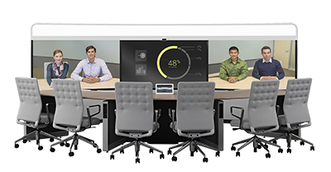
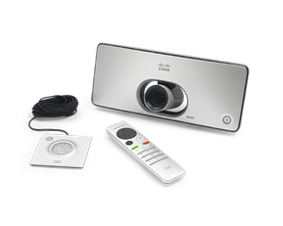
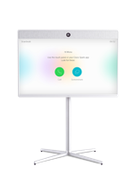
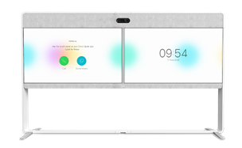
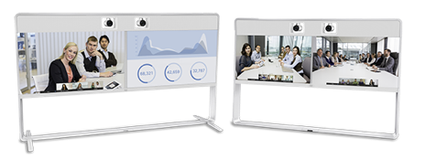

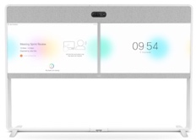
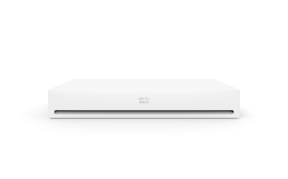

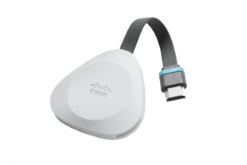
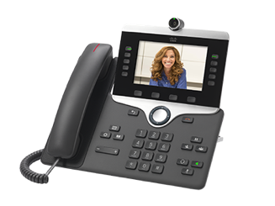
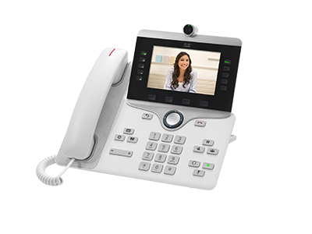
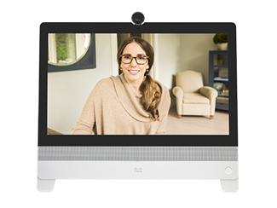

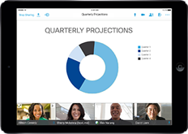
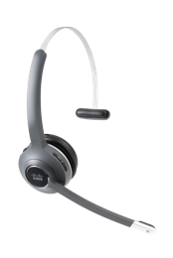
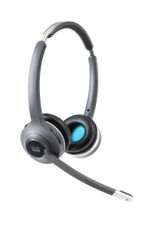
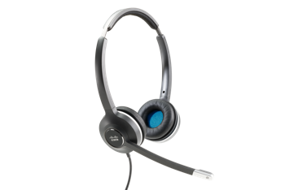
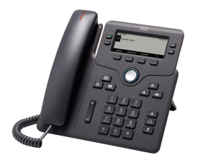
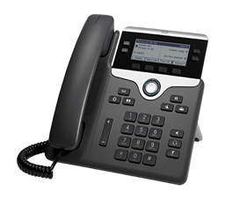

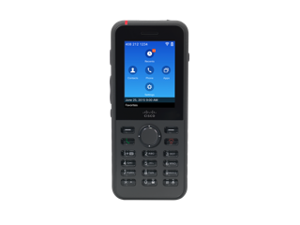
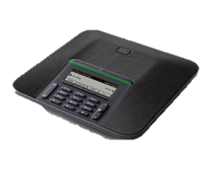

Cisco collaboration device portfolio
Choose how you wish to collaborate
Collaboration room
Integrator solutions
Webex Board 55, 70 and 85S
Room Kit Mini,
Room Kit,
Room Kit Plus
SX10 and SX20 Quick Sets
Room Kit Pro for custom/industry applications
Room 55 and Room 55 Dual
Room 70 G2
Single and dual
MX700 and MX800
IX5000 Series
In-room sharing
Collaboration desktop video
Soft clients
Webex Share*
Webex Meetings
Webex Teams
8845 and 8865
DX80
Jabber
Headsets
Voice devices
500 Series
6800, 7800, and 8800 Series
IP Wireless Phone
IP Conferencing
Notes:
Our portfolio of collaboration devices includes everything from voice to collaboration room devices for the small business to the very large enterprise. Cisco offers you the most complete range of solutions in the industry, so you can build the voice and video collaboration network that meets your needs.
The majority of the portfolio has been redesigned to make collaboration more affordable, accessible, and easy to use. Many of them of received the Red Dot award for excellence in design. The Cisco Webex Board and IX5000 received the Best of the Best award in 2017 and 2015, respectively.
Here a few highlights:
Our room-based devices have been completely refreshed with a new award-winning industrial design; richer functionality; easier installation, deployment, and use; and a great, consistent experience across the board.
Now with the addition of Cisco Webex Board, we’re expanding the collaboration rooms with new ways to create and collaborate and engage teams. With Cisco Webex Board, you can wirelessly present, white board, and video or audio conference – everything you need for team collaboration, all at the touch of a finger.
More intelligent audio, video, and usability, with new ways to bring your own personal devices, such as a smartphone or tablet, into a phone or video meeting to further enhance your collaboration experience.
The new Webex Share device allows easy, one-click wireless screen sharing from the Webex Teams software client to any external display with an HDMI port.
Collaboration desktop video devices offer users a range of options from entry level HD video up to the lifelike DX video collaboration devices.
Our IP Phone portfolio delivers superior voice communications, with select endpoints supporting HD video and a range of options that offer you a choice regardless of the size of your business, your feature needs, or your budget. Our complete portfolio also supports specialty use cases, such as in-campus wireless with WLAN handsets and an audio conferencing endpoint for conference rooms small to large conference rooms. The focus of our IP Phone portfolio is simple: Deliver the highest-quality audio communications with affordable, scalable options for desktop video that are easy to use and administer so you can collaborate effectively and achieve your desired business results.
The Cisco® Headset 500 Series delivers surprisingly vibrant sound for open workspaces. Now users can stay focused in noisy environments with rich sound, exceptional comfort, and proven reliability. The headsets offers a lightweight form factor designed for workers who spend a lot of time collaborating in contact centers and open workspaces. With the USB headset adapter, the 500 Series delivers an enhanced experience, including automatic software upgrades, in-call presence indicator, and audio customizations that allow you to adjust how you hear the far end and how they hear you.
Transition to next slide:
Let’s take a closer look at the portfolio. We’ll start with our latest addition to the portfolio – the Cisco Webex Board

Slide 31

Replace with higher res photo if available.
Provide option 2, using this photo: https://claromarketing.box.com/s/emy4ypnp7223mf2c2qj9swk2ioy1n5tc
Introducing Cisco Webex Board
Notes:
Let’s see that team collaboration in action. This short video shows you the exciting possibilities of engaging everyone across physical and virtual meeting spaces.

Slide 32
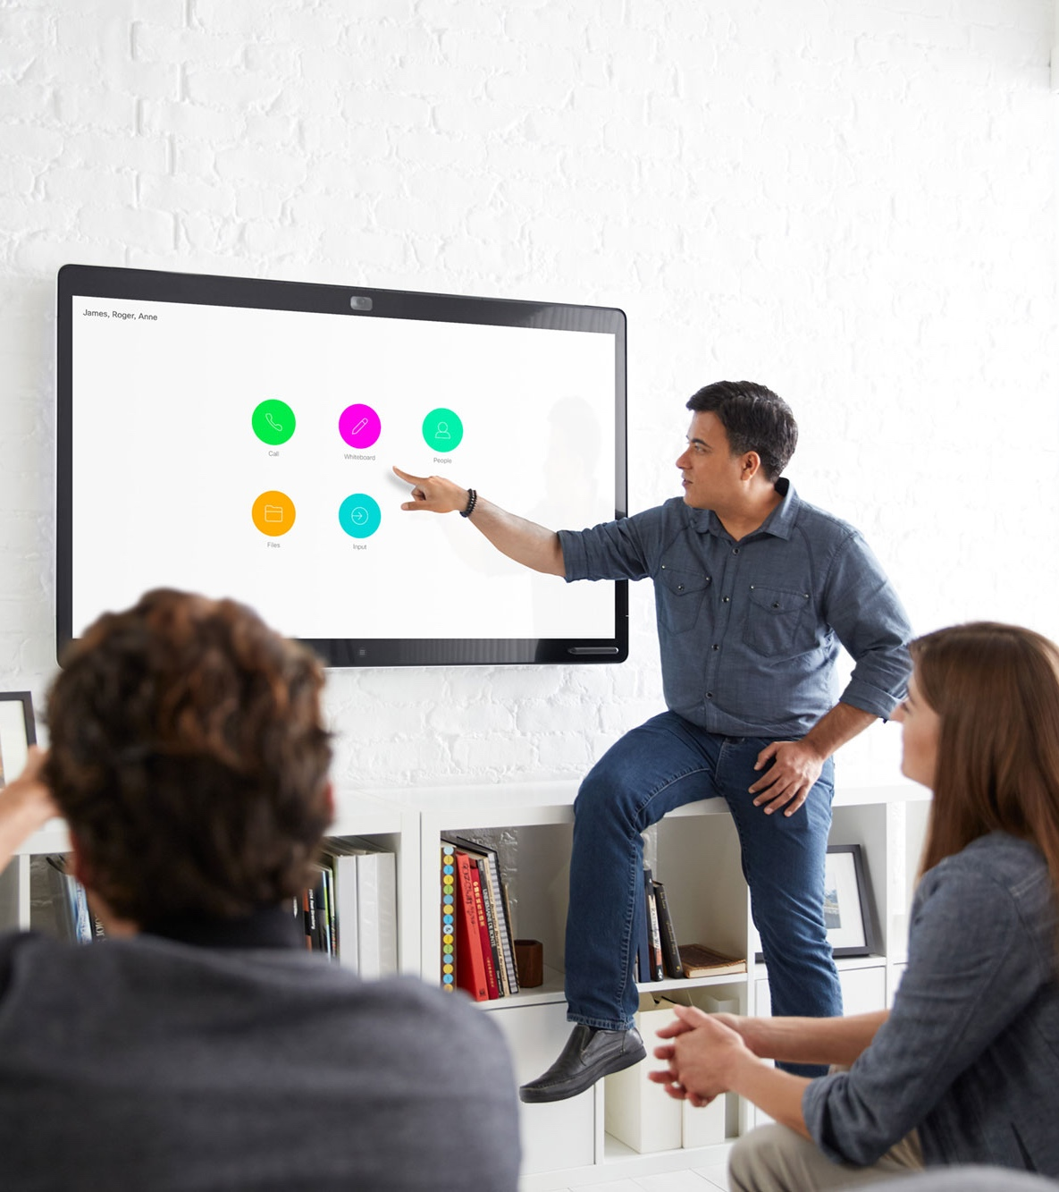

Cisco Webex Board
Recognizes you Wireless pairing and access to everything in Cisco Webex Teams app.
Engage everyone Wirelessly present, whiteboard and video or audio conference. Draw and annotate at the same time from any device from anywhere. Broad portfolio covering huddle spaces to large training and meeting spaces where co-creation is the main focus.
Cloud persistence Save docs to Cisco Webex Teams for a continuous workflow and to keep everyone in sync.
Cisco Webex Board
55, 70 and 85S
Cisco Webex Board 55
Notes:
The new Cisco Webex Board offers new ways to create and collaborate.
With the Webex Board, you can wirelessly present, white board, and video or audio conference – everything you need for team collaboration, all at the touch of a finger. And you can use the Cisco Webex Teams app to connect to your virtual teams outside the physical room, through the devices of your choice.
Enjoy an easy-to-use, touch-based, high-quality collaboration experience on Webex Board, which integrates the most common tools needed for team collaboration in physical meeting rooms into a single, elegant device.
Everything created on the Webex Board can be stored in the cloud and associated with a virtual room. Using the Webex Teams app, team members can pick up wherever they left off in the physical room, and continue working wherever they want.
System Highlights:
Automatic Wake-up
Recognizes who you are and suggests activities to choose from. The Webex Board automatically wakes up when you enter the room, detects your Webex Teams app-supported device, and suggests an activity to choose from, such as call, white board or wirelessly share your presentation. The app also gives you basic control of the Webex Board through your mobile device.
Intelligent Microphones
A 12-microphone array automatically amplifies and modulates speaker voices so meeting participants sound great, even those at the far end of the room. Built-in microphones keep tables clear of wires.
Take Your Whiteboards with You
Automatically saves whiteboards to appropriate Webex Teams space
View & interact from any Webex Teams app or on Webex Board
4K screen (55” and 70”)
Beautiful, crisp content
4K Camera with Intelligent Views
Intelligent camera delivers a natural viewing experience. Our powerful 4K camera captures a high-resolution, wide-angle image of virtually the entire room. Dynamic framing gives you the best possible view of people in the room.
Industrial Design
Easy to install and setup
Thin , elegant, inviting
Uses the Cisco Webex in the Cloud
Provisioned by Cisco Webex in the cloud , always runs the latest available software, Communicates with the Cisco Webex service using RESTful APIs with H.264 for video and Opus for audio
Secure collaboration end to end
Secure with End-to-end encryption using AES128, AES256, SHA1, SHA256, and RSA.
Real-time media is encrypted using the Secure Real-Time Transport Protocol (SRTP).
Transition – Cisco also offers a full range of room-based video collaboration solutions.

Slide 33
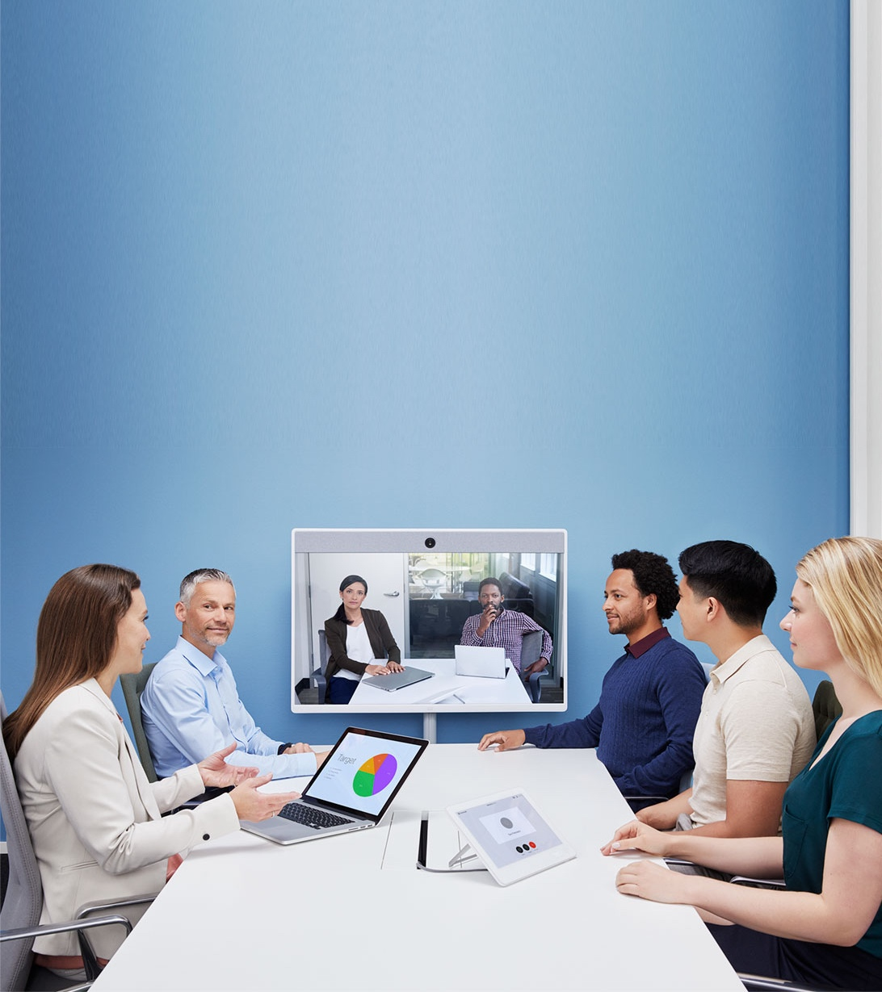
Collaboration integrated room devices
Cisco Webex Room Series: Room 55, Room 55 Dual, Room 70 G2 (single and dual)
MX Series: MX700, MX800
Elegant all-in-one devices Craftsmanship and design-focused to give your rooms a pleasing aesthetic in an all-in-one, elegant device. Choose from single- and dual-screen systems.
Value and simplicity Cost effective and easy to install and manage, so you can turn any small-to-large space into a video collaboration room in minutes with just a few cables. Same UI across all devices for ease of use and adoption.
Performance and flexibility Carefully engineered for the most realistic audio and video experience possible. AI/ML features further enhance the collaboration experience.
Cisco Webex Room 55
Notes:
Turn your lounge, huddle spaces, and small-to-large meeting rooms into a video collaboration center with our integrated Room Series and MX Series systems. You can also build solutions by adding our Room Kit/Kit Plus, and SX10 and SX20 Quick Sets to any standard display. The products are rich in functionality and experience but are priced and designed to be easily scalable to all of your conference rooms – whether registered on the premises or to Cisco Webex in the cloud.
Cisco Webex Room Kit and Room Kit Plus are powerful collaboration devices that integrate with flat panel displays to bring more intelligence and usability to your small, medium and large meeting rooms. These integrator solutions continue Cisco’s impressive video/audio experience with new capabilities that enable even smarter meetings, smarter presentations and smarter room/device integrations. The Room Kit includes camera, codec, speakers and microphones integrated in a single device, ideal for rooms of up to 7 people. The Room Kit Plus – with a separate quad-camera bar – can accommodate larger and deeper rooms of up to 14 people. The products are more intelligent and feature-rich, yet more affordable, flexible and accessible so that they can be easily scalable to all of your conference rooms – whether registered on the premises or to Cisco Webex in the cloud.
Cisco Webex Room 55 and Room 70 are powerful collaboration devices that bring more intelligence and usability to your small, medium and large meeting rooms. These fully integrated room systems continue Cisco’s impressive video/audio experience with new capabilities and artificial intelligence that enable even smarter meetings, smarter presentations and smarter room/device integrations. The Room 55 features a 55” 4K screen and an embedded 5K UltraHD camera, designed for small/medium rooms that seat 5- 7 people. The Room 55 Dual replaces the popular MX700 wit the Room Kit Plus as its technology platform. The Room 70 G2 is available in single or dual 70” 4K screens and an embedded quad-camera bar to accommodate larger and deeper rooms of up to 12 people. Room 70 G2 replaces the first generation product with the new and more powerful Room Kit Pro as its technology platform. All of the products offer sophisticated camera technologies that bring speaker-tracking and best overview capabilities to all meeting rooms.
Cisco MX700 and MX800 represent our performance line of room-based system that offers high-definition video and high-fidelity sound into a beautiful design. These powerful new systems can turn any medium-to-large meeting room into a video collaboration hub. The MX700’s dual 55” screens offer a people-and-content or people-and-people experience. The MX800 Dual offers two large 70” screens and the MX800 Single or dual system offers 70” screen (s). All three systems support H.265 and can support up to a total of three screens. Active speaker tracking with dual-camera systems gives everyone a front-row seat.
Cisco SX10 and SX20 Quick Sets are integrator solutions. The SX10 is a codec-in-camera unit that easily turns any flat panel into a video collaboration solution in less than 10 minutes – with just two cables. It’s designed to outfit any small room or huddle space with business-quality video, priced to scale at about the cost of a PC. The SX20 Quick Set allows a bit more flexibility and power with three camera options to accommodate larger room sizes. Both sets just require a standard screen to turn any meeting room into a video collaboration room.
All of these products support Intelligent Proximity for easy content viewing and sharing.
Transition to next slide:
For an even more customized system, we offer the Cisco Webex Room Kit Pro, a powerful solution for custom integrations.

Slide 34

Collaboration integrator solutions
Cisco Webex Room Kits:
Room Kit Mini, Room Kit,
Room Kit Plus
SX Quick Sets: SX10, SX20
Build your own Integrate with 1 or two screens to create your own meeting rooms from huddle spaces to large meeting rooms.
Value and simplicity Cost effective and easy to install and manage, so you can build your own video-collaboration room in minutes at scale. Same UI across all devices for ease of use and adoption.
Power and flexibility Customize your video environments with rich features for all your video scenarios. AI/ML features further enhance the collaboration experience.
Cisco Webex Room Kit
Notes:
Turn your lounge, huddle spaces, and small-to-large meeting rooms into a video collaboration center with our integrated Room Series and MX Series systems. You can also build solutions by adding our Room Kit/Kit Plus, and SX10 and SX20 Quick Sets to any standard display. The products are rich in functionality and experience but are priced and designed to be easily scalable to all of your conference rooms – whether registered on the premises or to Cisco Webex in the cloud.
Cisco Webex Room Kit and Room Kit Plus are powerful collaboration devices that integrate with flat panel displays to bring more intelligence and usability to your small, medium and large meeting rooms. These integrator solutions continue Cisco’s impressive video/audio experience with new capabilities that enable even smarter meetings, smarter presentations and smarter room/device integrations. The Room Kit includes camera, codec, speakers and microphones integrated in a single device, ideal for rooms of up to 7 people. The Room Kit Plus – with a separate quad-camera bar – can accommodate larger and deeper rooms of up to 14 people. The products are more intelligent and feature-rich, yet more affordable, flexible and accessible so that they can be easily scalable to all of your conference rooms – whether registered on the premises or to Cisco Webex in the cloud.
Cisco Webex Room 55 and Room 70 are powerful collaboration devices that bring more intelligence and usability to your small, medium and large meeting rooms. These fully integrated room systems continue Cisco’s impressive video/audio experience with new capabilities and artificial intelligence that enable even smarter meetings, smarter presentations and smarter room/device integrations. The Room 55 features a 55” 4K screen and an embedded 5K UltraHD camera, designed for small/medium rooms that seat 5- 7 people. The Room 55 Dual replaces the popular MX700 wit the Room Kit Plus as its technology platform. The Room 70 G2 is available in single or dual 70” 4K screens and an embedded quad-camera bar to accommodate larger and deeper rooms of up to 12 people. Room 70 G2 replaces the first generation product with the new and more powerful Room Kit Pro as its technology platform. All of the products offer sophisticated camera technologies that bring speaker-tracking and best overview capabilities to all meeting rooms.
Cisco MX700 and MX800 represent our performance line of room-based system that offers high-definition video and high-fidelity sound into a beautiful design. These powerful new systems can turn any medium-to-large meeting room into a video collaboration hub. The MX700’s dual 55” screens offer a people-and-content or people-and-people experience. The MX800 Dual offers two large 70” screens and the MX800 Single or dual system offers 70” screen (s). All three systems support H.265 and can support up to a total of three screens. Active speaker tracking with dual-camera systems gives everyone a front-row seat.
Cisco SX10 and SX20 Quick Sets are integrator solutions. The SX10 is a codec-in-camera unit that easily turns any flat panel into a video collaboration solution in less than 10 minutes – with just two cables. It’s designed to outfit any small room or huddle space with business-quality video, priced to scale at about the cost of a PC. The SX20 Quick Set allows a bit more flexibility and power with three camera options to accommodate larger room sizes. Both sets just require a standard screen to turn any meeting room into a video collaboration room.
All of these products support Intelligent Proximity for easy content viewing and sharing.
Transition to next slide:
For an even more customized system, we offer the Cisco Webex Room Kit Pro, a powerful solution for custom integrations.

Slide 35
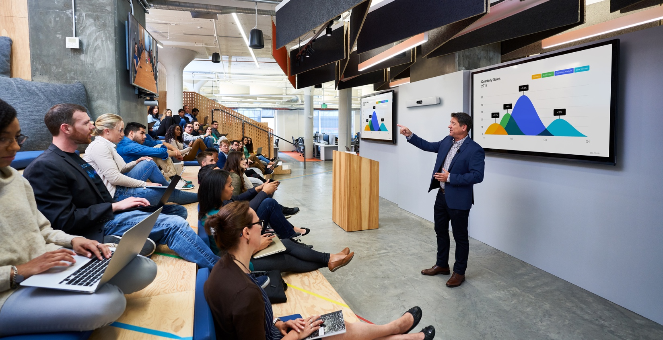
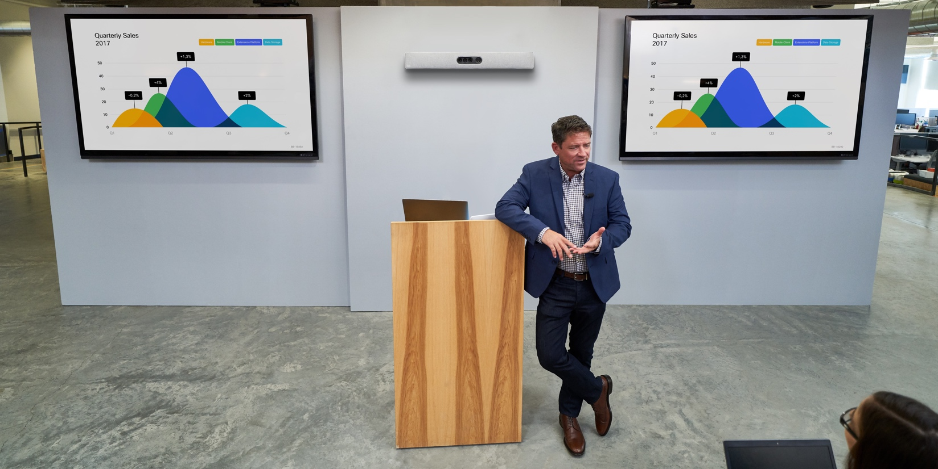
Powerful integrator solution
Powerful audio and video engine Integrator codec and packages incorporate HD video collaboration applications into large meeting rooms and purpose-built or customized rooms. AI/ML features further enhance the collaboration experience. 50% more inputs and outputs for additional screens and cameras. Consistent user experience across portfolio.
Industry-leading imaging technology Powerful cameras deliver fast, direct active-speaker switching for an uninterrupted experience. Supports complex scenarios such as presenter tracking and briefing/training room set-ups.
Cisco Webex Room Kit Pro Integrator Packages
with Precision 60 or Quad Camera, and the Touch 10 control unit
Notes:
Cisco Webex Room Kit Pro integrator packages let you or a systems integrator create a custom, room-based video conferencing system based on two powerful cameras – the Precision 60 and Quad Camera.
The Room Kit Pro codec acts as the video collaboration engine that you can use to build custom video studios, boardrooms, auditoriums, education, and telemedicine applications, with 1080p HD video and high-fidelity audio.
The SX80 is a powerful video and audio engine for integrators that delivers the industry’s first support for H.265 and bandwidth efficiency. It’s powerful enough to create video collaboration solutions for the largest and most complex scenarios. SX80 is available as part of three integrator packages that combine with Precision 60 Camera, SpeakerTrack 60, or Cisco Quad Camera for ease of integration.
Pair a Cisco camera and the Room Kit Pro codec with the screens of your choice.

Slide 36
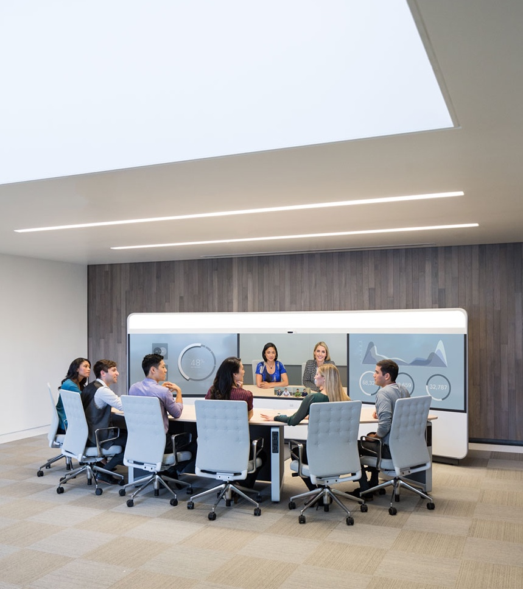
Immersive experience
Ultimate immersive experience Natural, comfortable, intuitive - as close as you can get to being there
Absolute quality Life-size HD video and flexible content sharing, spatial audio, and touch interface for excellent user experience
Advanced collaboration Flexible, intelligent content collaboration
Cisco IX5000 Series:
IX5000, IX5200
Cisco IX5000
Notes:
Our flagship IX5000 Series immersive systems give you the ultimate in face-to-face collaborative interaction. From the visual impression of sitting across the same table to spatial sound that moves with the speaker, you’ll almost believe that everyone in your meeting is actually in the same room.
IX5000 is our state-of-the-art triple-screen system combining high-fidelity audio/video and rich collaboration functions for the most vivid, immersive collaboration experience possible. As the first single-codec, H.265 triple-screen product, the IX5000 is both powerful and efficient. It’s the only product to support five simultaneous streams of data – three video and two data (H.264 only) – so that you share two content sources during a call (just one on a multipoint call). Rich multimedia capabilities provide an impressive collaboration experience with flexibility to place content on any of the three 70-inch screens. Reduced componentry and installation time; lower power and bandwidth; and no required room remediation* mean much lower TCO and thus greater value for deployment beyond the boardroom, including executive/customer meetings and globally dispersed project team collaboration.
2015 Red Dot Awarded: Best of the Best
New Features
Superior Power and Experience
A single, powerful codec and an intelligent software platform deliver unmatched high-fidelity audio, video, and overall superior rich media collaboration experience.
The codec is the first to handle five simultaneous streams of data – three video and two content – so that you can be on a point-to-point IX call and share or compare two content sources (only 1 content source possible on multipoint call at FCS).
Industry-first support for H.265 on a triple-screen product delivers true 1080p60 video on all three screens at half the bandwidth.
Rich multimedia presentation capabilities give users the most vivid collaboration experience with flexibility to place and share content on any of the three 70-inch screen(s); dual content presentation allows for comparative collaboration.
Shared content is shown on all Touch 10 devices – ships with one, but supports up to six devices.
Whiteboard mode allows the integrated camera to “un-skew” the image for remote participants, enabling flexible placement of white boards in the room.
Stand-up mode allows participants to stand up and move about the room (manual feature at FCS).
Intelligent Proximity support for up to 18 devices (supported IX 8.1 release, target FCS Sept. 2015).
Integrated presentation cables support both content and audio, which uses system speakers for high-fidelity sound.
Greater Value for Deployment Beyond the Boardroom
No required room remediation, half the power and installation time, and 50% bandwidth utilization on H.265 -- this represents up to a 30% lower total cost of ownership over a three-year period. That means you can get the IX5000 into more rooms, faster and more cost-effectively.
Enhances local meetings with rich multimedia capabilities and multiple shared content sources (up to three); increases use case for immersive collaboration to support both remote and local meetings.
Compelling and uncompromised user experience increases utilization.
Design for Elegance and Functionality
IX5000 features a new, sleek industrial design that’s inviting, comfortable, and easy to use – extending the award-winning design philosophy of our existing portfolio.
Powerful camera with 4K sensors captures the entire room in ultra high-definition with no camera movement; discreet camera placement allows full-screen usage for content.
Elegantly integrated presentation connectors are ready to plug into content sources whether you’re using a PC or Mac (i.e., no dongle needed).
Newly designed raised microphone bar allows optimal audio pick-up and alleviates sound blockage from devices such as laptops.
Integrated lighting delivers the best possible video image while eliminating the need for light reflector and room remediation.
19 speakers delivering full high-fidelity audio (formerly 6 speakers delivering voice-range audio).
8” system depth means it can fit into any room.
Transition to next slide:
For a wider range of telepresence needs, we also offer room-based multipurpose systems for standard conference rooms.
*For an optimal video experience, please follow the IX5000 Series Room Recommendations guide to ensure that ideal lighting and acoustic conditions are met.

Slide 37

In-room Sharing
Cisco Webex
Share
Simple wireless content sharing to any screen using Webex Teams or Webex Meetings
Automatic pairing and one click to share a specific application or your whole screen
Consistent Cisco experience with integrated wake-up and enterprise calendar preview
Notes:
Easy Wireless Screen Sharing
Many teams struggle to use external displays in small meeting spaces and huddle rooms.
Available in Fall 2018, Cisco Webex Share solves the problem with simple wireless content sharing to any HD display. No need for cables or dongles.
Webex Share plugs into the HDMI port of an external display. Your device is automatically paired to Webex Share when nearby. With one click, you can share content from your screen to the external display, without cables or dongles or any adjustments to video settings.
Getting started is quick and easy with step-by-step instructions. The Cisco Webex platform provides a consistent user experience for teams and makes collaboration seamless.

Slide 38

Elevate collaboration with
desktop HD video and voice
Notes:
Our IP Phone portfolio enhances collaboration for every employee across the organization.

Slide 39
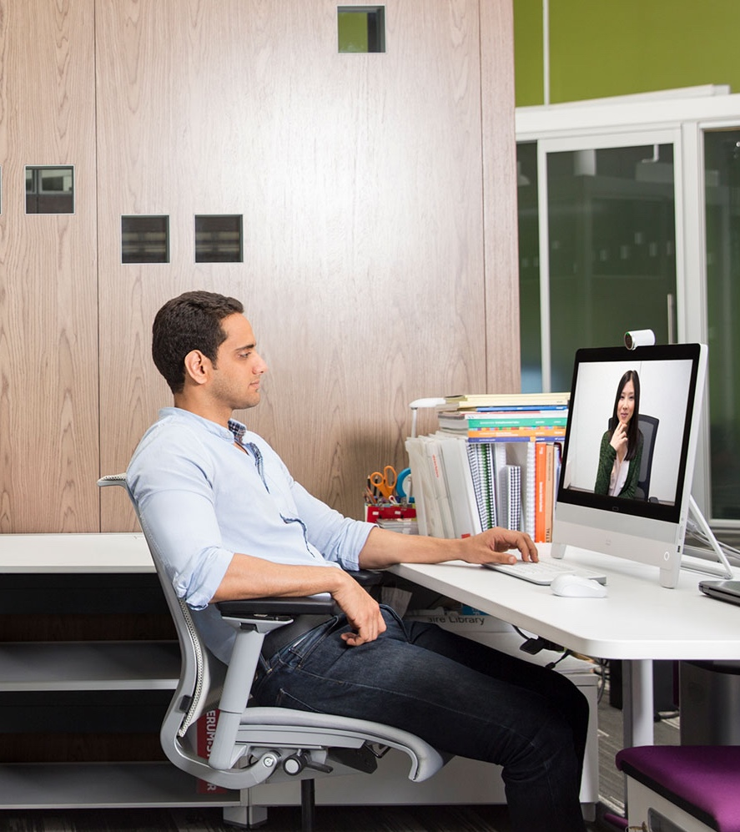
Collaboration desk devices
Cisco Webex DX80
Business-quality video and audio Professional video collaboration for everyone Business ready – reliable, secure, and available Delightful to use, easy to deploy, scalable for all Whiteboard with ease
Seamless workflows for next-generation work spaces Unified desktop collaboration in one device Touch-based user interaction Shared spaces, open spaces, wireless environments
Notes:
As you would expect from any of our video collaboration devices, we have invested in the video and audio communication functions to ensure best-in-class, professional-grade video collaboration. This means HD video and extensive UC features with dial-tone reliability, security, and availability.
The Webex DX80 offers delightful and unified desktop collaboration at a price that is affordable for everyone. Featuring an intuitive touchscreen that is fully touch-based—like your smartphone—to make everything easier. You can also seamlessly transition between PC or Mac view on the DX80 display to voice or video communications. You can also use the DX80 display as your monitor when you are not in video meetings. If you'd like, you can plug in a USB wideband audio handset, or use a Bluetooth headset with a dongle or a USB headset for added privacy.
Users can seamlessly share content from a PC or Mac while in a video call. Maintain eye contact and focus both on content and people during meetings.
Only Cisco offers the innovative intelligent audio.
Intelligent Audio for the DX80
Eliminates background noise for non-private work areas so you only hear what you see.
These systems have been designed to deploy simply and effectively, enabling the end user to be up and running from box to call in a matter a few minutes.
Transition to next slide:
Now let’s look at our IP Desk Phone portfolio.

Slide 40
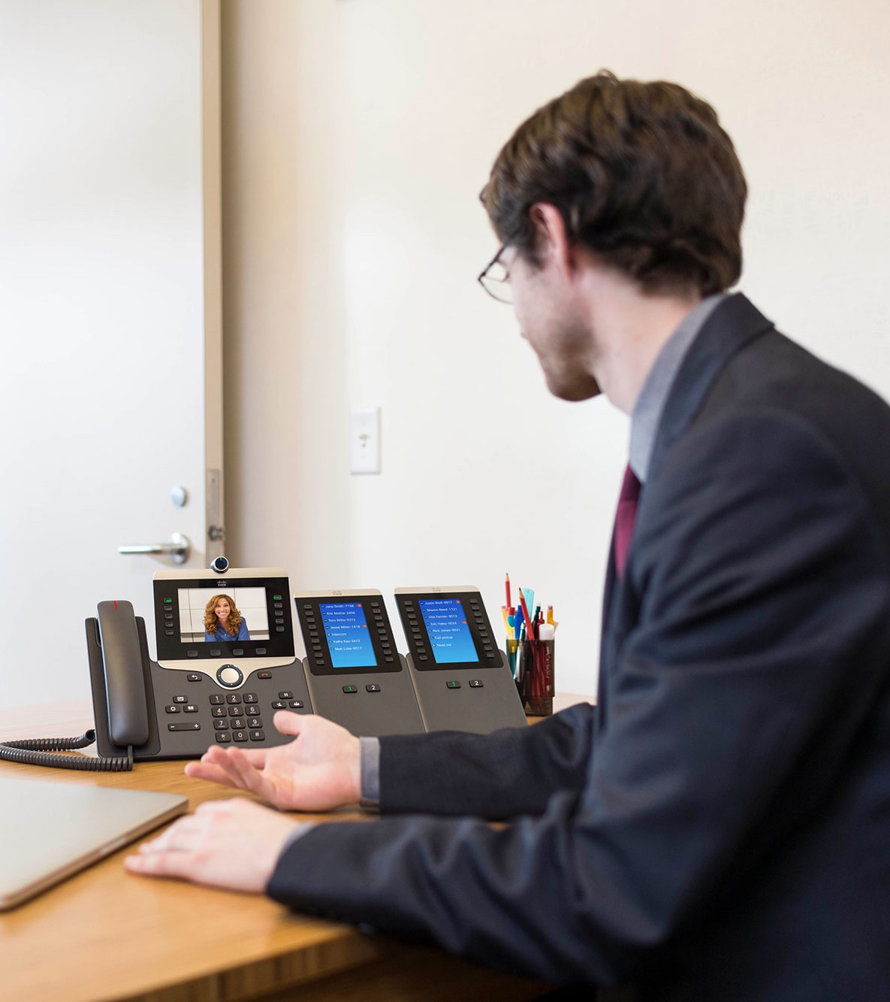
Entry to video for all your users
Entry to desktop HD video Easy-to-use 720p HD on select models
Personal mobile device integration Integrate telephony features between mobile and desktop
Extensible and scalable Key modules and enhanced line mode (ELM) extend investment with one-button to call
Cisco IP Phone
8800 Series
Cisco IP Phone 8865 and 8845*
* IP Phone 8865 Model Supports Key Expansion Modules
Notes:
The 8800 Series delivers people-centric collaboration capabilities to users who have moderate to highly active voice communications needs.
The 8865 and 8845 models introduce very affordable entry to HD video (720p) communications on their 5-inch displays. This is in addition to their support of comprehensive unified communications (voice) experiences. The experience is simple – video calling is as easy as making a phone call. No user intervention required. Their affordability enables you to make video communications standard and pervasive throughout your organization.
The 8865 and 8845 (plus two other voice-only versions) offer telephony feature integration with your personal mobile devices.
The models use Bluetooth and Cisco Intelligent Proximity for Mobile Voice and support smartphones and tablets. Advantage is superior audio acoustics offered by the 8800 Series over acoustics of consumer devices. An example would be receiving a call on your smartphone and then having a colleague join you when at your desk to listen to the call over speakerphone. The same active call could be moved back to the mobile phone if you then had to step away from your desk, adding convenience and increasing personal productivity.
The 8845 and 8865 models support extensibility of your investment in several ways. Both models support a software feature, called enhanced line mode, which enables these endpoints to support up to 10 line/feature keys without need for a hardware-based expansion module (KEM). They’re a user option and IT can configure this on a per individual user basis. The 8865 model also supports Key Extension Modules (KEMs), which add further scalability and return on investment beyond the five lines that come standard with most of the 8800 Series endpoints. They can support up to a maximum (using 3 KEM’s) of 113 total line/feature key appearances.
Both solutions are sought by administrative staff, managers and executives, and customer care staff who seek the convenience and benefits of “one button push to call” and status monitoring (colleagues or staff who are not available, cannot be disturbed, etc.).
For more detailed info on the 8800 Series: www.cisco.com/go/ipphones/8800

Slide 41

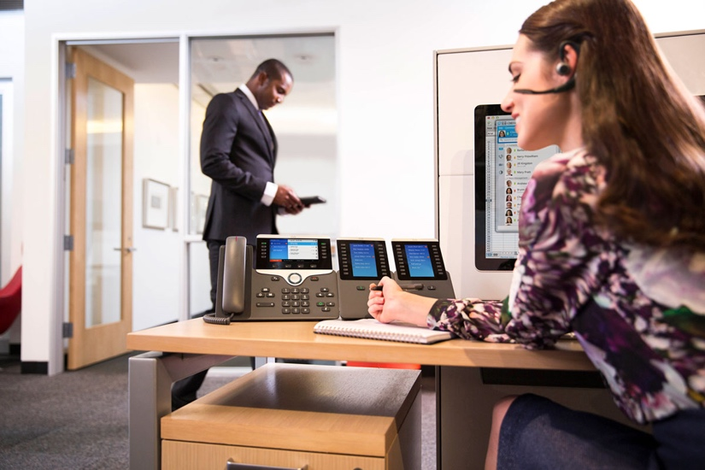
Easy-to-use voice communications
Cisco IP Phone
7800 and 8800 Series
Superior audio performance Wideband audio
Comprehensive telephony Fully-featured voice communications
Common user experience Software architecture common across endpoints
7800 Series
Affordable Basic Voice
8800 Series
Advanced Voice
Notes:
IP Phone 7800 Series is our most affordable IP Phone portfolio.
The series introduces five phones with a new ergonomic design to support the daily needs of light to highly active voice communications users.
Range for deskphone models from single-line phone up to 16-line phone. Also supports a Cisco Webex cloud-registered audio conferencing endpoint for small conference/huddle rooms up to 6 people (172 sq. ft/16 sq. meters) and private office desks. Most models deliver high-quality audio (i.e., wideband) as standard. Lowest end model supports wideband with an optionally purchased handset.
Comes with a full suite of voice communications features.
Support can come from on-premises, cloud, or hybrid-cloud infrastructures.
Earth-friendly design (IEEE Class 1 for all desktop models; Class 2 for conferencing endpoint) and Cisco EnergyWise technology for lower power consumption in off hours to reduce OPEX costs.
The Cisco IP Phone 8800 Series introduces 7 models for more advanced and specialty voice communications.
Four voice-only desktop models that are multi-line, supporting between 5-10 line/feature keys each (dependent on choice of session mode or enhanced line mode by the user). Two of these models support Cisco Intelligent Proximity for telephony feature integration with your mobile device and two models support expanded scalability and added investment protection with support of Key Expansion Modules (KEMs). Depending on phone model, the total number of line keys supported is either 77 or 113.
An audio conference room phone, the 8831, provides audio conferencing for rooms up to 1140 square feet (139 square meters). It can also be used in executive offices for hands-free, 360-degree audio conferencing.
Two Voice over Wireless LAN handsets support the need for rugged, portable, full suite of voice communications for in-campus workers who are physically active within their work roles (i.e., doctors, nurses, customer service personnel in retail, operations, engineering, production staff within manufacturing, maids in hospitality).
The series supports full-featured voice communications, including:
Extension mobility (log into your phone, via a unique assigned PIN code, from another phone to maximize productivity)
Multiuser login (sharing a phone in multiuser environments - such as for shift workers like nurse stations, help desks, etc.) but it’s customized for you when you’re on shift
Single number reach – give out one number to all your contacts and prioritize which of your devices are contacted based on day of week, time of day, etc.
Regardless of which portfolio you choose (or if you deploy both within your organization), the software design for each series is common - ensuring an easy-to-use calling experience that is consistent across not only phones but soft-clients and video room systems.
Customers can get detailed information on each model in the series at: www.cisco.com/go/ipphones/7800
For more detailed info on the 8800 Series: www.cisco.com/go/ipphones/8800

Slide 42



Flexible deployment options
Cisco IP Phones with multiplatform firmware
Reliable Cisco performance Same audio quality, intuitive user experience, and ease of administration
Choice in call control platforms With approved Cisco UCaaS providers
Wide range of options From affordable basic voice to advanced video capabilities
6800 Series
7800 Series
8800 Series
Notes:
The Cisco IP Phone 7800 Series and 8800 Series are available with multiplatform firmware, enabling support for third-party call control through Cisco-approved UCaaS providers, including Broadsoft, Centile, Metaswitch, and Asterisk.
Now, you can have the same audio quality, rich features, and ease of use from the Cisco IP Phone 7800 and 8800 Series, even if you use another platform for unified communications.
The Cisco IP Phone 6800 Series adds additional options, and offers affordable, basic voice telephony on third-party calling platforms.

Slide 43

Vibrant audio for better productivity
Cisco Headset 500 Series
A premium range of wired and wireless headsets optimized for use with Cisco IP Phones and soft clients. Deep integrations with Cisco hardware and software provide a magical user experience and ease of administration for IT teams.
Designed for workers in open work spaces for improved productivity. Featuring rich audio, powerful noise isolation, intuitive controls, and exceptional comfort for extended wear.
Notes:
The Cisco® Headset 500 Series offers vibrant, rich audio in a surprisingly comfortable, long-wearing form factor. The 500 Series currently offers six models: four wired models (single and dual ear piece) with a variety of connector options, as well as two wireless models (single and dual ear piece) with DECT connectivity.
Designed for use in open workspaces, call centers, and other noisy environments, the 500 Series allows users to stay focused and offers rich sound, exceptional comfort, and proven reliability. Sophisticated noise-reduction technology in the earpieces and microphone keep the focus on your collaboration experience instead of on background noise.
With the USB headset adapter, the 500 Series delivers an even more magical experience, made possible through deep integrations with Cisco phones, video devices, and soft clients. Users benefit from automatic touchless software upgrades, an in-call presence indicator, and audio customizations that allow you to adjust how you hear the far end and how they hear you.

Slide 44
From pocket to the boardroom
Browser/ mobile
Home
office
Work
office
Small group spaces
Larger spaces
Any group space
Boardrooms
Notes:
By pursuing an architectural approach to delivering unified communications, we are able to deliver and support a portfolio of endpoints that ranges from the boardroom to the browser. No other vendor has the breadth and depth of what we can provide today. We provide a top-quality, consistent experience across any device, whether you’re using our immersive systems or your mobile device.

